Slide 1
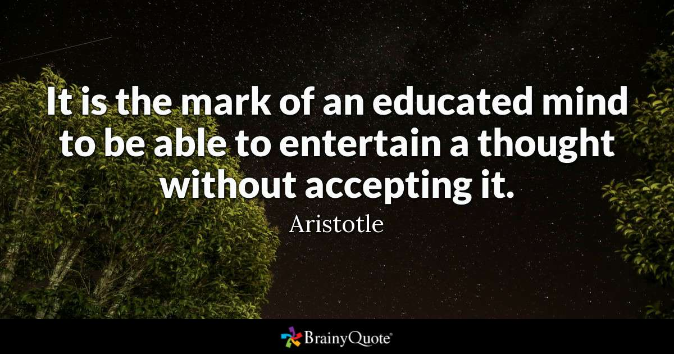

Slide 2
Audience Analysis

Slide 3
Agenda
Identifying your audience
Ways to Analyze your Audience
Choosing channels to reach your audience
Using Audience Analysis to Adapt your Message

Slide 4
Identifying your audiences
Gatekeeper: has the power to stop your message instead of sending it on to other audiences
Primary audience: decides whether to accept your recommendations or acts on the basis of your message
Secondary audience: may be asked to comment on your message or to implement your ideas after they’ve been approved
Auxiliary audience: may encounter your message but will not have to interact with it. This audience includes the “read-only” people
Watchdog audience: can’t stop the message and will not act directly on it, but has political, social, or economic power. It pays close attention to the transaction between you and the primary audience and may base future actions on its evaluation of your message

Slide 5
Identifying your audience:
Examples
Dawn is an assistant account executive in an ad agency. Her boss asks her to write a proposal for a marketing plan for a new product the agency’s client is introducing.
Primary audience is the executive committee of the client company, who will decide whether to adopt the plan.
Secondary audience includes the marketing staff of the client company, who will be asked for comments on the plan, as well as the artists, writers, and media buyers who will carry out details of the plan if it is adopted.
Gatekeeper is her boss, who must approve the plan before it is submitted to the client .
Her office colleagues who read her plan are her auxiliary audience.

Slide 6
Identifying your audience:
Examples
Joe works in the information technology department of a large financial institution. He must write a memo explaining a major software change.
His boss is the gatekeeper
The software users in various departments are the primary audience.
The secondary audience includes the tech people who will be helping the primary audience install and adjust to the new software.
The auxiliary audience includes department program assistants who forward the memo to appropriate people in each department.
A watchdog audience is the board of directors.

Slide 7
Ways to Analyze your Audience
COMMON SENSE and EMPATHY
Analyzing:
  Individuals
  members of groups
  organizational culture and discourse community

Slide 8

Ways to Analyze your Audience as Individuals
Analyzing individuals
Myers-Briggs Type Indicator
Used by 80% of Fortune 100 companies
Introvert-Extravert: measures how individuals focus attention and get energy
  Introverts get their energy from within.
  Extraverts are energized by interacting with other people.
Notes:
http://www.forbes.com/sites/elenabajic/2015/09/28/how-the-mbti-can-help-you-build-a-stronger-company/#6de1576631fb

Slide 9

Ways to Analyze your Audience
Sensing-Intuitive: measures the way an individual prefers to take in information
  Sensing types gather information through their senses; examining what is real and tangible
  Intuitive gather information by looking at the big picture, focusing on the relationships and connections between facts
Notes:
MBTI Test: http://www.humanmetrics.com/cgi-win/jtypes2.asp
16 Personalities: https://www.16personalities.com/

Slide 10

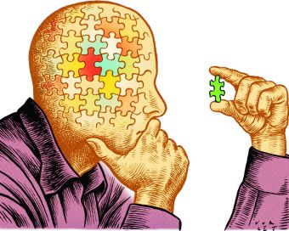
Ways to Analyze your Audience
Thinking-Feeling: measures the way an individual makes decisions
  Thinking types use objective logic to reach de­cisions.
  Feeling make decisions based on the impact to people, considering what is important to them and to others involved
Notes:
MBTI Test: http://www.humanmetrics.com/cgi-win/jtypes2.asp
16 Personalities: https://www.16personalities.com/

Slide 11
Ways to Analyze your Audience
Perceiving-Judging: measures how individuals orient themselves to the external world
  Perception (understanding) prefer to live in a flexible, spontaneous way, enjoying possibilities
  Judging types like to live in a planned, orderly way, seeking closure. (ending, finishing)
Notes:
MBTI Test: http://www.humanmetrics.com/cgi-win/jtypes2.asp
16 Personalities: https://www.16personalities.com/

Slide 12
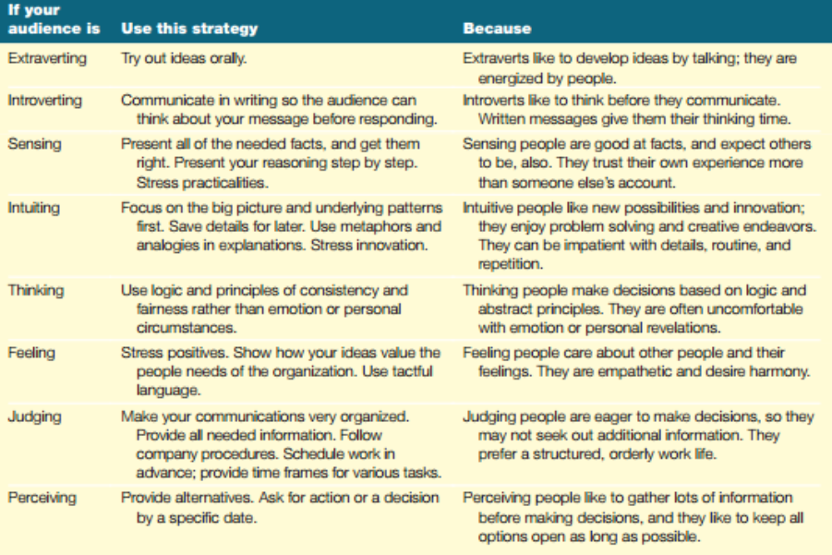
Ways to Analyze your Audience

Slide 13
Ways to Analyze your Audience:
Groups
Focus on what they have in common
  “taxpayers who must be notified that they owe more income tax”
  “customers who use our accounting services”
  “employees with small children”
Sometimes you may generalize, use a database, or do research
Geographic, Demographic, Behavioral characteristics
Psychographic characteristics

Slide 14
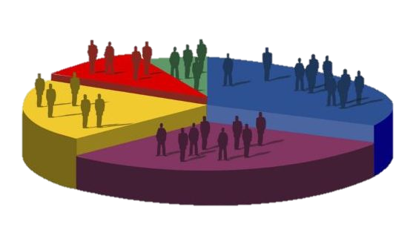
Ways to Analyze your Audience:
Groups
Demographics
  Measurable features that can be counted objectively
  Age, sex, race, religion, income, occupation, education level, family structure
  sometimes important, sometimes not
Notes:
Where your degree is from is not as important as how much you know about accounting, or whatever subject you are communicating
Age accommodations for baby boomers: talk and get to the point, font size on labels
ADT “companion services” instead of medical alert
“belay” bars instead of “grab” bars
- Kimberly clark and Dependsd

Slide 15
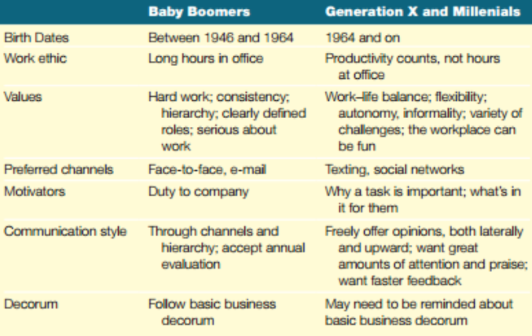

Slide 16
Ways to Analyze your Audience:
Groups
Psychographic characteristics
  qualitative rather than quantitative: values, beliefs, goals, and lifestyles
  Know what they consider important, so you can choose information and benefits to craft persuasive messages

Slide 17
Ways to Analyze your Audience:
Organizational Culture and Discourse Community
An organization's culture is its values, attitudes, and philosophies.
  revealed (expressed) verbally in the organization's myths, stories, and heroes and nonverbally in the alloca­tion of space, money, and power
  revealed nonverbally through means such as dress codes, behavior standards, or the allocation of space, money, and power
A discourse (communication) community is a group of peo­ple who share assumptions about what channels, formats, and styles to use for communication, what topics to discuss and how to discuss them, and what constitutes evidence.

Slide 18
Ways to Analyze your Audience:
Organizational Culture and Discourse Community
Culture analysis questions
Is the organization tall or flat?
How do people get ahead? Seniority, education, being well-liked, saving money, or serving customers?
Does the organization value diversity or homogeneity? Independence and creativity or being a team player and following orders?
What stories do people tell? Who are the organization’s heroes and villains?
How important are friendship and sociability? To what extent do workers agree on goals, and how intently do they pursue them?
How formal are behavior, language, and dress?
What does the work space look like?
What are the organization’s goals? Making money? Serving customers and clients? Advancing knowledge? Contributing to the community?

Slide 19
Ways to Analyze your Audience:
Organizational Culture and Discourse Community
Discourse Community analysis questions
What channels, formats, and styles are preferred for communication?
What do people talk about? What topics are not discussed?
What kind of and how much evidence is needed to be convincing?

Slide 20

Competitive
  Cutthroat
  Keeper test
Transparency
  Salary
  Performance reviews
  Sunshining
Netflix culture: https://jobs.netflix.com/culture
Reed Hastings: https://www.youtube.com/watch?v=2fuOs6nJSjY
Forbes: https://www.forbes.com/sites/stephaniedenning/2018/10/26/the-netflix-pressure-cooker-a-culture-that-drives-performance/#20ddb36d151a

Slide 21
Choosing channels to reach your audience
communication channel is the means by which you convey your message
Varies by:
  Speed
  Accuracy of transmission
  Cost
  Number of messages carried
  Number of people reached
  Efficiency
Depending on the audience, purpose, and situation, one method can be better than another
Level of formality
Confidentiality
Necessity of permanent record
Receiver’s preference and technical expertise
Ability to promote goodwill

Slide 22
Choosing Channels to Reach your Audience
Written
Oral
  Present extensive or complex financial data.
  Present many specific details of a law, policy, or procedure.
  Minimize undesirable emotions.
  Track details and agreements
  Use emotion to help persuade the audience.
  Focus the audience's attention on specific points.
  Answer questions, resolve conflicts, and build consensus.
  Modify a proposal that may not be acceptable in its original form.
  Get immediate action or response.
Notes:
Key and Peele Text Confusion: https://www.youtube.com/watch?v=naleynXS7yo&t=104s

Slide 23
Choosing Channels to Reach your Audience
In both, you should:
  Adapt the message to the specific audience.
  Show the audience how they would benefit from the idea, policy, service, or product.
  Overcome any objections the audience may have.
  Use you-attitude and positive emphasis.
  Use visuals to clarify or emphasize material.
  Specify exactly what the audience should do.

Slide 24
Channel Selection activity
As part of a task force to investigate cell phone marketing, you need to establish a central location where each team member can see general information about the task as well as add comments for others to see. Task force members are located throughout the country.
You’re sitting on the couch in the evening watching TV when you suddenly remember that you were supposed to send Jeremy some information about a shared project. Should you text him right away before you forget?
As an event planner, you have been engaged to research sites for a celebrity golf tournament. What is the best channel for conveying your findings to your boss or planning committee?

Slide 25
You want to persuade your manager to change your work schedule.
As a sales manager, you want to know which of your sales reps in the field are available immediately for a quick teleconference meeting.
You need to know whether Amanda in Reprographics can produce a rush job for you in two days.
Your firm must respond to a notice from the Internal Revenue Service announcing that the company owes a penalty because it underreported its income in the previous fiscal year.

Slide 26
Using Audience Analysis to Adapt your Message
1. What Will the Reader's Initial Reaction Be to the Message?
2. How Much Information Does the Reader Need?
3. What Obstacles Must You Overcome?
4. What Positive Aspects Can You Emphasize?
5. What Expectations Does the Reader Have about the Appropriate Language, Structure, and Form for Messages?
6. How Will the Reader Use the Document?
Notes:
Readers will read and act on messages they see as important to their own careers; they may ignore messages that seem unimportant to them.
Situation 1: PR crisis
Situation 2: Turkish air promotion
Situation 3: Installing IoT and sensors in inventory and trucks

Slide 27
A
1. What Will the Reader's Initial Reaction Be to the Message?
Will the reader see this message as highly important?
  WIIFM
If the reader may see your message as unimportant, you need to
  i. In a subject line or first paragraph, show your reader that this message is important and relevant.
  ii. Make the action as easy as possible.
  iii. Suggest a realistic deadline for action.
  iv. Keep the message as short as possible.
Notes:
Readers will read and act on messages they see as important to their own careers; they may ignore messages that seem unimportant to them.

Slide 28
B
1. What Will the Reader's Initial Reaction Be to the Message?
How will the fact that the message is from you affect the reader's reaction to the words you use?
When you must write to a reader who has negative feelings about your organization, your position, or you personally, you need to:
  i. Make a special effort to avoid phrases that could seem condescending, arrogant, rude, hostile, or uncaring.
  ii. Use positive emphasis to counteract the natural tendency to sound defensive.
  iii. Develop logic and reader benefits fully.
Notes:
The reader's experience with you, your organization, and the subject you're writing about shapes the way the reader responds to this new message. Some­one who thinks well of you and your organization will be prepared to receive your message favorably; someone who thinks poorly of you and the organiza­tion will be quick to find fault with what you say and the way you say it.

Slide 29
Using Audience Analysis to Adapt your Message
1. What Will the Reader's Initial Reaction Be to the Message?
2. How Much Information Does the Reader Need?
3. What Obstacles Must You Overcome?
4. What Positive Aspects Can You Emphasize?
5. What Expectations Does the Reader Have about the Appropriate Language, Structure, and Form for Messages?
6. How Will the Reader Use the Document?
Notes:
Readers will read and act on messages they see as important to their own careers; they may ignore messages that seem unimportant to them.

Slide 30
2. How Much Information Does the Reader Need?
A
How much does the reader already know about this subject?
When some of your information is new to the reader, you need to:
  i. Be clear. Define terms, explain concepts, and use examples.
  ii. Link new information to old information that the reader already knows.
  Use paragraphs and headings to break up new information into related parts
  iv. Test a draft of your document with a reader to see whether the audience can understand and use what you've written.
Notes:
It's easy to overestimate the knowledge an audience has. People outside your own immediate unit may not really know what it is you do. Even people who once worked in your unit may have forgotten specific details now that their daily work is in management. People outside your organization won't know how your organization does things.

Slide 31
2. How Much Information Does the Reader Need?
B
Is the reader's knowledge based on reading? Personal Experience?
If you're trying to change a reader's understanding of a policy or organiza­tion, you need to:
Acknowledge the reader's initial understanding early in the message.
Use examples as well as theory or statistics to show the difference between short-term and long-term effects, or to show that the reader's experience is not universal.
Allow the reader to save face (handle the situation) by suggesting that changed circumstances call for new attitudes or action.
Notes:
It's easy to overestimate the knowledge an audience has. People outside your own immediate unit may not really know what it is you do. Even people who once worked in your unit may have forgotten specific details now that their daily work is in management. People outside your organization won't know how your organization does things.

Slide 32
C
2. How Much Information Does the Reader Need?
What aspects of the subject does the reader need to be aware of to appreciate your points?
When the reader must think of background or old information to appreciate your points, you can:
Preface information with "As you know" or "As you may remember" to avoid suggesting that you think the reader does not know what you're saying.
Put old or obvious information in a subordinate clause.
If the background information or reminder is long, put it in a separate section with an appropriate heading or in an attachment to your letter or memo.
Notes:
It's easy to overestimate the knowledge an audience has. People outside your own immediate unit may not really know what it is you do. Even people who once worked in your unit may have forgotten specific details now that their daily work is in management. People outside your organization won't know how your organization does things.

Slide 33
Using Audience Analysis to Adapt your Message
1. What Will the Reader's Initial Reaction Be to the Message?
2. How Much Information Does the Reader Need?
3. What Obstacles Must You Overcome?
4. What Positive Aspects Can You Emphasize?
5. What Expectations Does the Reader Have about the Appropriate Language, Structure, and Form for Messages?
6. How Will the Reader Use the Document?
Notes:
Readers will read and act on messages they see as important to their own careers; they may ignore messages that seem unimportant to them.

Slide 34
3. What Obstacles Must You Overcome?
A
Is your reader opposed to what you have to say?
When you must write to readers who oppose what you have to say, you need to:
  Start your message with any areas of agreement or common ground that you share with your reader.
  Make a special effort to be clear and unambiguous. Points that might be clear to a neutral reader can be misread by someone with a chip on his or her shoulder.
  Make a special effort to avoid statements that will anger the reader.
  Limit your statement or request to the smallest possible area. If parts of your message could be delivered later, postpone them.
  Show that your solution is the best solution currently available, even though it isn't perfect.
Notes:
Readers who have already made up their minds are highly resistant to change.

Slide 35
3. What Obstacles Must You Overcome?
B
Will it be easy for the reader to do as you ask?
When your request is time-consuming, complicated, or physically or psy­chologically difficult, you need to:
Make the action as easy as possible. Provide a form that can be filled out quickly; provide a stamped, self-addressed envelope if you are writing to someone in another organization.
Break down actions into a list, so the reader can check off each step as it is completed.
Show that what you ask is consistent (relevant, steady) with some aspect of what the reader believes.
Show how the reader (not just you or your organization) will benefit when the action is completed.
Notes:
Readers who have already made up their minds are highly resistant to change.

Slide 36
Using Audience Analysis to Adapt your Message
1. What Will the Reader's Initial Reaction Be to the Message?
2. How Much Information Does the Reader Need?
3. What Obstacles Must You Overcome?
4. What Positive Aspects Can You Emphasize?
5. What Expectations Does the Reader Have about the Appropriate Language, Structure, and Form for Messages?
6. How Will the Reader Use the Document?
Notes:
Readers will read and act on messages they see as important to their own careers; they may ignore messages that seem unimportant to them.

Slide 37
4. What Positive Aspects Can You Emphasize?
A
From the readers point of view, what are the benefits of what you have to say?
Put good news in the first paragraph.
Use reader benefits that go beyond the basic good news of the first paragraph.
Notes:
Benefits help persuade the reader that your ideas are good ones. Make the most of the good points inherent(natural) in the message you want to convey.

Slide 38
4. What Positive Aspects Can You Emphasize?
B
What experiences, interests, goals, and values do you share with the reader?
When the message will be read by only one reader, or by readers who all share the same experiences, interests, goals, and values, you can:
Consider using a vivid (clear, lively) anecdote to remind the reader of what you share. The details of the anecdote should be interesting or new; otherwise, you may seem to be lecturing the reader.
Make a special effort to make your writing style friendly and informal.
Use a salutation and close that remind readers of their membership in this formal or informal group.
Notes:
Benefits help persuade the reader that your ideas are good ones. Make the most of the good points inherent(natural) in the message you want to convey.

Slide 39
Using Audience Analysis to Adapt your Message
1. What Will the Reader's Initial Reaction Be to the Message?
2. How Much Information Does the Reader Need?
3. What Obstacles Must You Overcome?
4. What Positive Aspects Can You Emphasize?
5. What Expectations Does the Reader Have about the Appropriate Language, Structure, and Form for Messages?
6. How Will the Reader Use the Document?
Notes:
Readers will read and act on messages they see as important to their own careers; they may ignore messages that seem unimportant to them.

Slide 40
5. What Expectations Does the Reader Have about the Appropriate Language, Structure, and Form for Messages?
A
What style of writing does the reader prefer?
    As you write,
  Use what you know about your reader to choose a more or less distant, more or less friendly style.
  Use the reader's first name in the salutation only if you use that name when you talk to him or her in person or on the phone.
Notes:
Good writers adapt their style to suit the reader's preferences. A reader who sees contractions as too informal needs a different style from one who sees tra­ditional business writing as too stuffy

Slide 41
5. What Expectations Does the Reader Have about the Appropriate Language, Structure, and Form for Messages?
B
Are there “hot buttons” or "red flag" words that may create an immediate negative response?
When you need agreement or approval, you should
“Triggers”
  Avoid terms that carry emotional charges for many readers: for example, criminal, un-American, feminist, fundamentalist, liberal.
  Use your previous experience with an individual reader to replace any terms that have particular meanings for him or her.
Notes:
Good writers adapt their style to suit the reader's preferences. A reader who sees contractions as too informal needs a different style from one who sees tra­ditional business writing as too stuffy

Slide 42
5. What Expectations Does the Reader Have about the Appropriate Language, Structure, and Form for Messages?
C
How much detail does the reader want?
When you write to readers you do not know well, you can
Provide all the detail the reader needs to understand and act on your message.
Group chunks (parts) of information under headings so that the reader can go directly to the parts of the message that he or she finds most interesting and relevant.
Imitate the level of detail in similar documents to the same audience. If they have succeeded, you're probably safe in using the same level of detail that they do.
D
Does the reader prefer a direct or indirect structure?
Notes:
c. A message that does not give the reader the amount of or kind of detail he or she wants may fail. When you know your readers, ask them how much detail they want.
d. Individual personality or cultural background may lead a reader to prefer a particular kind of structure. You'll be more effective if you use the structure and organization your reader prefers.

Slide 43
5. What Expectations Does the Reader Have about the Appropriate Language, Structure, and Form for Messages?
E
Does the reader have expectations about formal elements such as length, visuals, or footnotes?
If you can't meet those expectations, you need to
  Revise your document carefully. Be sure that a shorter-than-usual document covers the essential points; be sure that a longer-than-usual document is free from wordiness and repetition.
  Check with the reader to see whether the standards are flexible.
  Pretest the message on a subset of your audience to see if the format enhances or interferes with comprehension and action
Notes:
A document that meets the reader's expectations about length, number of visuals, and footnote format is more likely to succeed.

Slide 44
Using Audience Analysis to Adapt your Message
1. What Will the Reader's Initial Reaction Be to the Message?
2. How Much Information Does the Reader Need?
3. What Obstacles Must You Overcome?
4. What Positive Aspects Can You Emphasize?
5. What Expectations Does the Reader Have about the Appropriate Language, Structure, and Form for Messages?
6. How Will the Reader Use the Document?
Notes:
Readers will read and act on messages they see as important to their own careers; they may ignore messages that seem unimportant to them.

Slide 45
6. How Will the Reader Use the Document?
A
Under what physical conditions will the reader use the document?
When the reader will use your document outside an office
  Use lots of white space.
  Make the document small enough to hold in one hand.
  Number items so the reader can find his or her place after an interruption.
  Consider using plastic to protect the document.
Notes:
Reading a document in a quiet office calls for no special care. But suppose the reader will be reading your message on the train commuting home or on a lad¬der as he or she attempts to follow instructions. Then the physical preparation of the document can make it easier or harder to use.

Slide 46
6. How Will the Reader Use the Document?
B
Will the reader use the document……
- as a general reference?
- as a specific guide?
- as the basis for a lawsuit(case, problem )?
Notes:
Understanding how your audience will use the document will enable you to choose the best pattern of organization and the best level of detail.

Slide 47
6. How Will the Reader Use the Document?
B
Will the reader use the document……
as a general reference
  Use a subject line to aid in filing and retrieval (correcting, working on it). If the document is online, consider using several key words to make it easy to find the document in a database search program.
  Use headings within the document so that readers can skim (look at it quickly) it.
  Give the office as well as the person to contact so that the reader can get in touch with the appropriate person some time from now.
  Spell out details that may be obvious now but might be forgotten in six months or a year.

Slide 48
6. How Will the Reader Use the Document?
B
Will the reader use the document……
as a detailed guide or contain instructions,
  Check to be sure that all the steps are in chronological order.
  Number steps or provide check-off boxes so that readers can easily see which steps they've completed.
  Group steps into five to seven sub-processes if there are many individual steps.
  Put any warnings at the beginning of the document; then repeat them just before the specific step to which they apply.

Slide 49
Activity: Objections
Your organization is thinking of outsourcing one of its primary products to a manufacturer in another country where the product can be made more cost efficiently.
What fears or objections might people have?
What benefits might your organization receive?
Who would be easiest to convince? Who would be hardest?

Slide 50

Turkish Airlines Example
Earned an award for Best Airline in 2019
Want to offer a promotion to passengers who flew in Europe in 2019
Imagine you work in the Marketing department and you are responsible for creating the communcation about this
Consider your Purpose, Audience, and Medium / Channel
How would you adapt your potential message according to your answers to the 6 questins mentioned before (What do you expect the readers initial reaction to be, how much information do they need, etc.)

Slide 51
PR Crises
H&M
Doritos: http://freakonomics.com/podcast/indra-nooyi/
Hawaii Emergency Management Agency: https://www.cbsnews.com/news/hawaii-missile-alert-emergency-management-system-false-ballistic-missile-warning-2018-1-13/
Burger King: https://www.youtube.com/watch?v=zRwMIcPDMQ4
  https://www.youtube.com/watch?v=Fe35WtvyBVc
Lion Air:

Slide 52

United Airlines Example
https://www.youtube.com/watch?v=VrDWY6C1178
Initial Statement
Flight 3411 from Chicago to Louisville was overbooked. After our team looked for volunteers, one customer refused to leave the aircraft voluntarily and law enforcement was asked to come to the gate…we apologize for the overbook situation. Further details on the removed customer should be directed to authorities.

Slide 53


Internal email leaked, saying employees were right to follow procedures, and that the customer was “disruptive and belligerent”

Slide 54
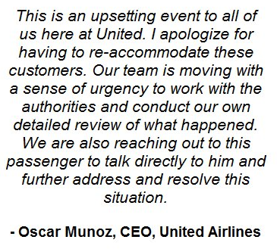
Company loses $1bn in valuation (4% loss in stock price) by the next afternoon

