Slide 1
IRE … Turkish Foreign Policy
Assist. Prof. Saffet Akkaya
Course hours: ???
saffetakkaya@cag.edu.tr
Week 10: Turkish Foreign Policy During World War II (1939-1945)

Slide 2
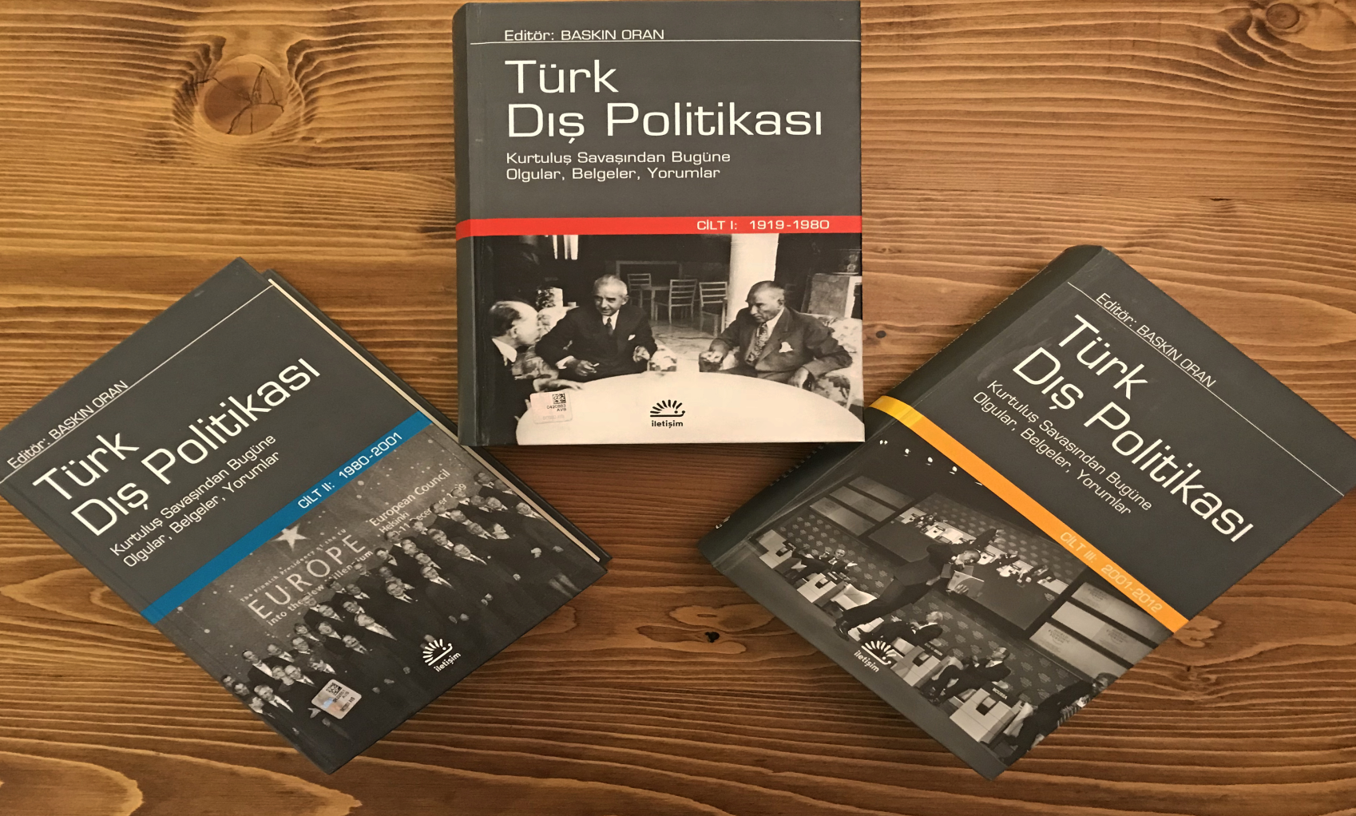
Main Source for the Course Türk Dış Politikası Vol 1, 2, 3 Ed. Baskın Oran
Türk Dış Politikası Vol 1: Pages 415-468

Slide 3
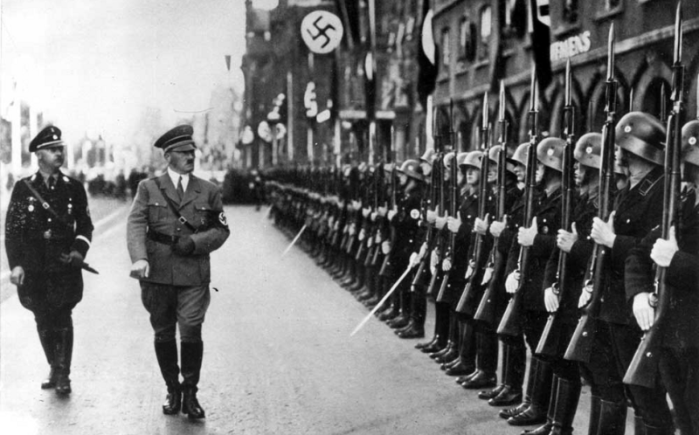
World War II

Slide 4
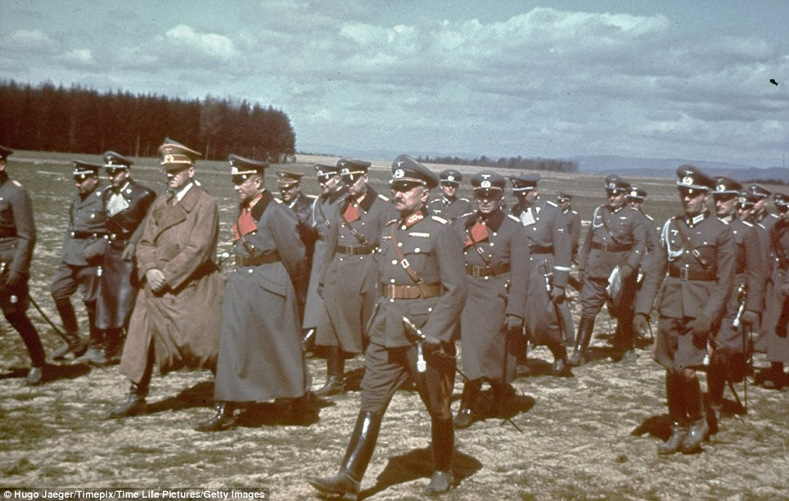
World War II

Slide 5
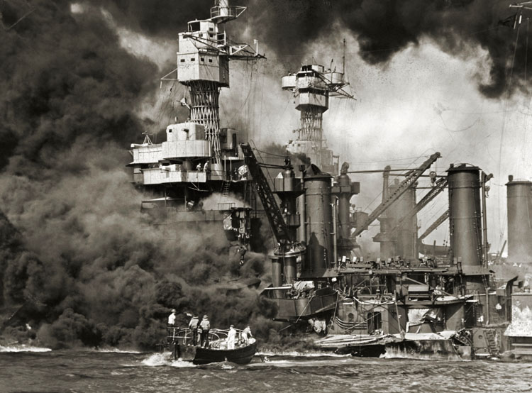
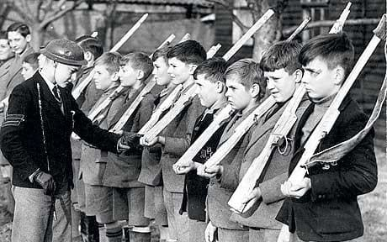
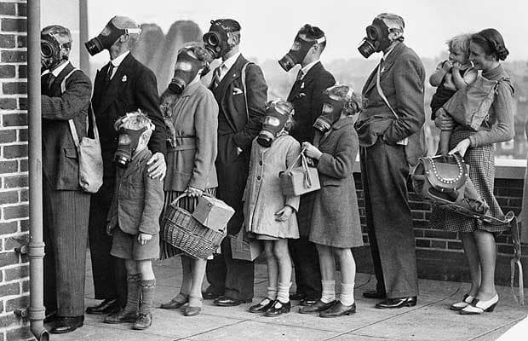
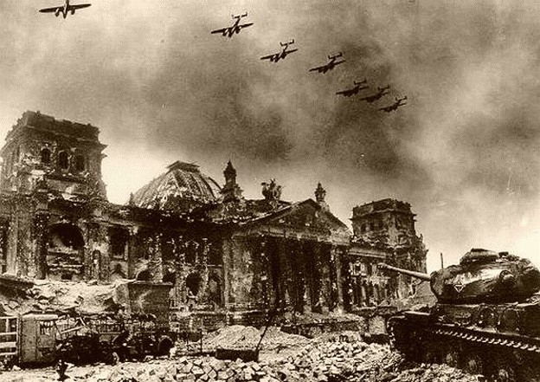
World War II

Slide 6
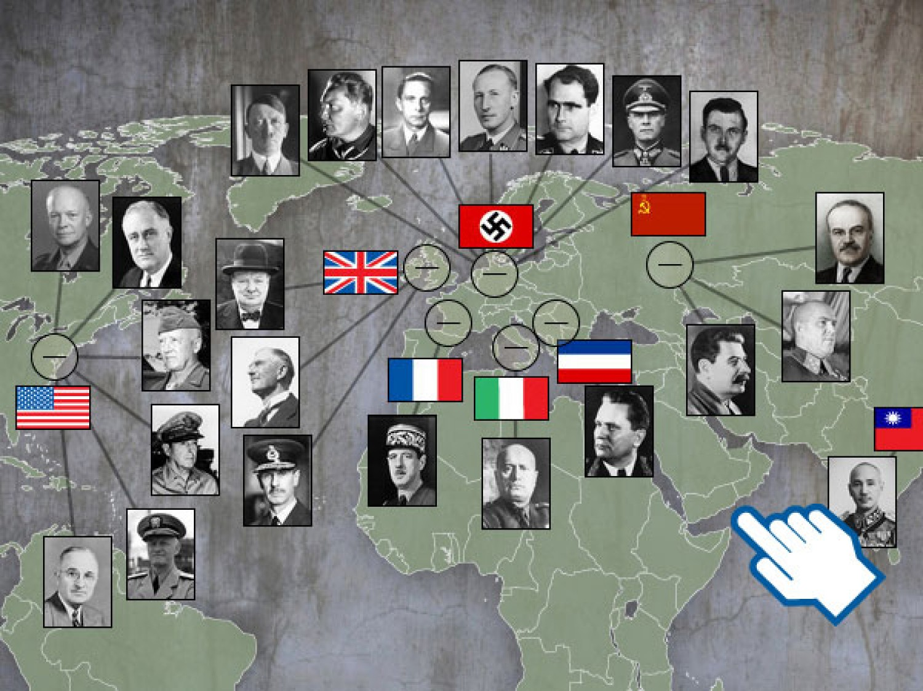
World War II (Important Figures)

Slide 7
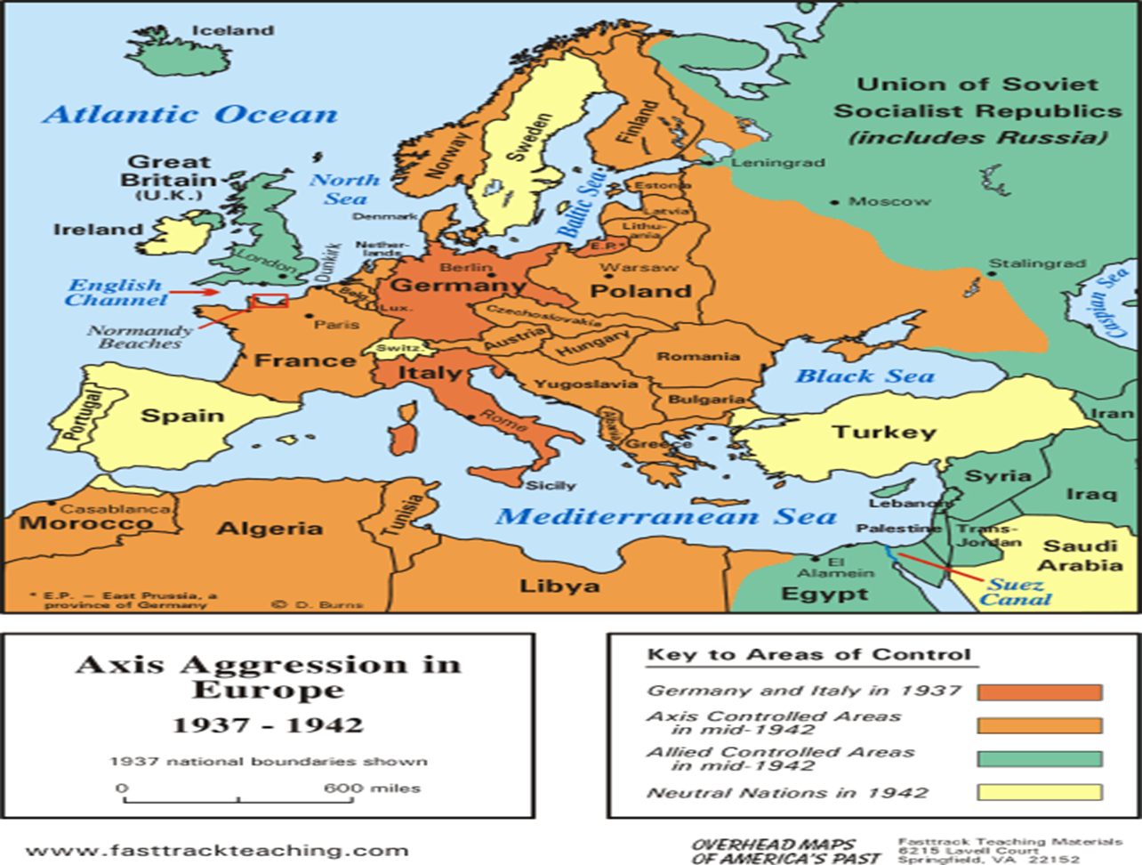
Map of Europe in 1942

Slide 8
The Warring States' Competition for Türkiye
The Soviet demands regarding the Montreux Convention and Foreign Minister Saraçoğlu's mission were embodied in Turkish-Soviet talks throughout October 1939.
Turkey wanted to obtain the USSR's approval before signing the Triple Alliance with Britain and France.
Italy's increasingly threatening stance and its occupation of Albania pushed Türkiye towards a common understanding with its northern neighbor. However, when Stalin and Molotov repeatedly proposed amendments to the Montreux Convention, the planned three-day but 23-day talks ended without conclusion.

Slide 9
The Warring States' Competition for Türkiye
Triple Alliance: When an agreement with the Soviets failed to be reached, the alliance agreement, the text of which was already prepared, was signed with Britain and France.
Germany's pressure on Türkiye regarding its imports of chrome, a key mineral in the armaments industry (60,000 tons annually), was countered by the Turkish government's patient and intelligent policies.

Slide 10
The Warring States' Competition for Türkiye
Between 1941 and 1943, Hitler's Germany also exerted pressure on Türkiye.
When a partnership between Germany and the USSR ceased to be a possibility, both countries began preparing against each other.
To secure their southern border in an operation against Russia, the Germans first invaded Bulgaria, Romania, Yugoslavia, and Greece.
Turkey was alarmed by the invasion of the Balkans and conveyed this concern to the German government.
The German government, in turn, assured in a letter that German troops would stay away from the Turkish border and would not approach closer than 100 kilometers.
German troops halted 60 kilometers from the Turkish border. President İnönü then sent a letter to Hitler.

Slide 11
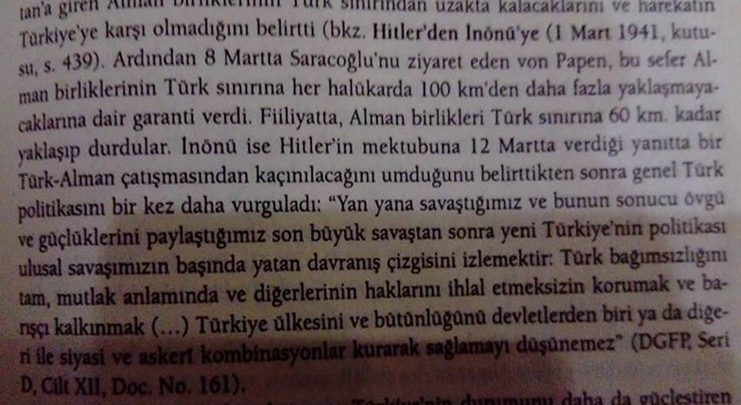
Letter of President Inönü to Hitler

Slide 12
The Warring States' Competition for Türkiye
After Germany completed its occupation of the Balkans, it offered Türkiye an offer to join the war alongside it and offered revisionist gains.
However, when Turkey rejected these offers, Germany signed a non-aggression pact with Turkey to secure its southern border before attacking the USSR.
When Germany crossed the USSR border on June 22, 1941, and began its invasion, Turkey pursued a policy of balance with all the warring parties and signed non-aggression pacts with all of them.
It now feels more secure. At the very least, the possibility of Türkiye being invaded and divided by a Russo-German alliance, like Poland, has been eliminated.

Slide 13
1943-45 War Years and the Repression of the USSR
When Germany was stopped near Stalingrad, the USSR's view of Türkiye began to change negatively.
Meanwhile, Britain and the US desired Türkiye's entry into the war.
Churchill and Roosevelt met in Casablanca, Morocco, in January 1943 to discuss the details of the operation against Germany.
Two decisions were made: to continue the war until Germany surrendered and to force Türkiye into the war.

Slide 14
1943-45 War Years and the Repression of the USSR
To this end, they sent a message to İnönü, requesting a meeting.
And on January 30, 1943, the İnönü-Churchill meeting took place in Adana. Türkiye's entry into the war was desired.
Turkey, however, expressed its primary concern: the pressure from the USSR, fearing that the Soviets would invade Europe and the Balkans after the war, just as Germany had.
In August 1943, Churchill and Roosevelt met again in Quebec, Canada, to discuss both the English Channel landings and Türkiye's entry into the war.

Slide 15
1943-45 War Years and the Repression of the USSR
In October 1943, the US, USSR, and UK foreign ministers met in Moscow.
Following these meetings, the British Foreign Minister Eden and the Turkish Foreign Minister Numan Menemencioğlu were invited to Cairo and reiterated their request to enter the war.
Menemencioğlu's response demonstrates a prudent policy.
In December of that year, Roosevelt, Churchill, and İnönü met again in Cairo to discuss the situation, and Turkey agreed in principle to enter the war.
However, they employed delaying tactics, claiming that the Turkish army was short of supplies and weapons and that preparation would take time.

Slide 16
End of War
With the Normandy landings of the US and Britain, Germany's defeat became inevitable.
Meanwhile, Turkey attempted to improve relations with the USSR, the victor of the war.
In February 1945, the three victorious heads of state met in Yalta, Crimea, to discuss the post-war situation.
At the conference, the USSR demanded a change in the status of Montreux Convention, continuing its pressure on Turkey.
In March 1945, Türkiye declared war on Germany and Japan to become a founding member of the UN.

Slide 17
End of War
The most significant events that would affect Türkiye's situation that same year were the three demands the USSR made of Turkey:
The cession of Kars and Ardahan on its eastern border to Russia,
The granting of a base to Russia in the Straits,
The reconsideration of Montreux.
As can be seen from these demands, a new era has begun for Türkiye in the bipolar world order.

Slide 18
The Effects of the War on Turkey's Domestic Politics
As a medium-sized state in a strategic position, Turkey deeply felt all the dangers of World War II.
During this period, Turkey implemented a policy of balance and contradiction, prioritizing its national interests in line with the principle of peace at home and peace in the world. Its greatest asset was its second President, İsmet İnönü, a master of prudence and balance.
While Turkey implemented a masterful foreign policy and saved its people from loss of life, it would undergo a major shift in domestic and foreign policy after the war.
As the CHP government was replaced by the DP, the US would step in and begin to exert its influence over Türkiye as the USSR turned its back.

Slide 19
The Effects of the War on Turkey's Domestic Politics
If we were a developed industrial nation, as a neutral country, we could have achieved a production boom just like the United States and sold industrial goods to neighboring countries. The US economy grew significantly during the war years.
However, Turkey, essentially an agricultural country, was severely affected by the adverse conditions of the war. The conscription of over a million men and the six-year feeding of these men further weakened an already weak economy.
Agricultural production in 1944 fell to 40% of that in 1939. Industrial production, which had doubled with the implementation of the statist economy in the early 1930s, also declined significantly during the war.
Duyunu umumiye (public debt), or foreign debt payments, accounted for approximately two-thirds of exports.

Slide 20
The Effects of the War on Turkey's Domestic Politics
Another effect of the war was the impoverishment of small farmers and tradesmen, while the emergence of a bourgeois class that prospered through the black market under wartime conditions.
The new type of politician of the 1950s would be comprised of these war-rich landlords.
In 1946, with the advent of the multi-party era, the masses, frustrated by statist policies and the negative impact of the war, would bring a new political approach to power: the Democratic Party.

Slide 21
The Effects of the War on Turkey's Domestic Politics
The state-nation consensus, which had been sought to be established through the statist policies of the 1930s, was disrupted during the war years, and the people became impoverished.
However, to maintain this consensus, the Republic launched two important initiatives during the war years.
One was the Village Institutes Law, enacted in 1940, and the other was the Farmers' Land Acquisition Law, enacted in 1945.
However, when the new government, supported by landlords and merchants who had become particularly wealthy during the war, came to power in 1950, the land law was prevented from being implemented due to the landlords' obstruction, as the village institutes were a communist education system. The village institutes were closed in 1954.

Slide 22
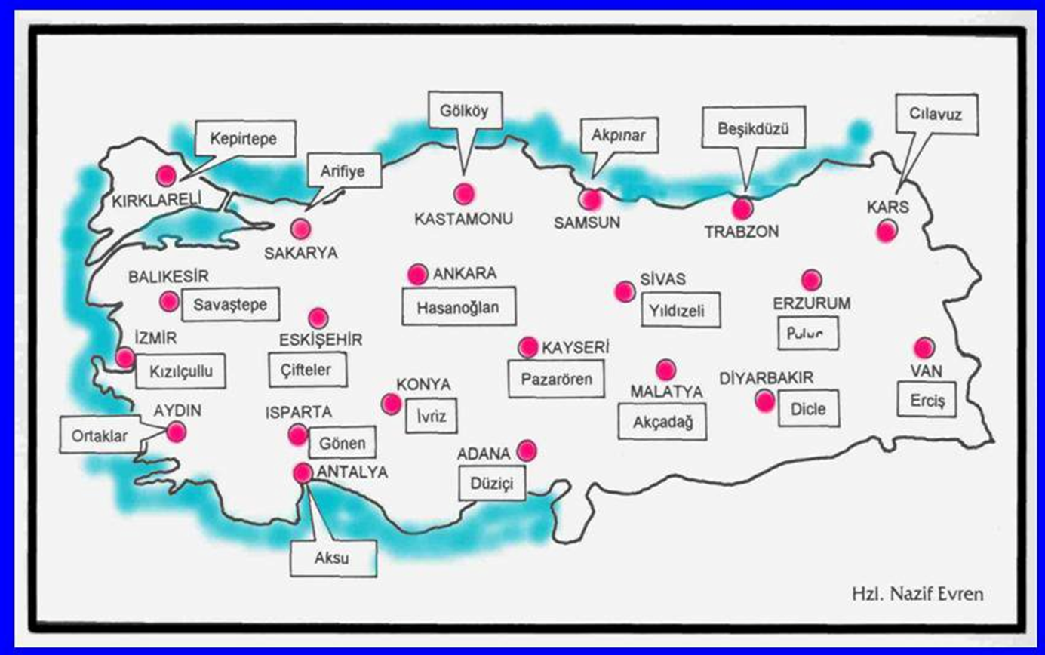
Village Institutes

Slide 23
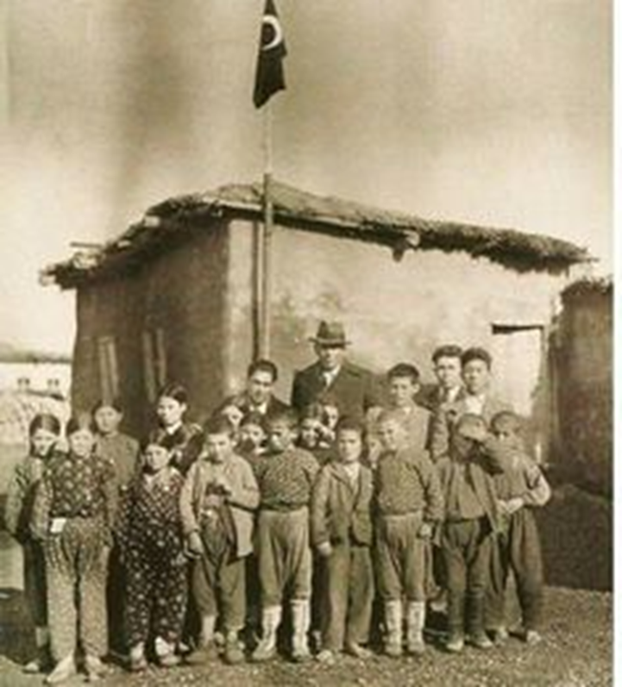
Village Institutes (İsmail Hakkı Tonguç)

Slide 24
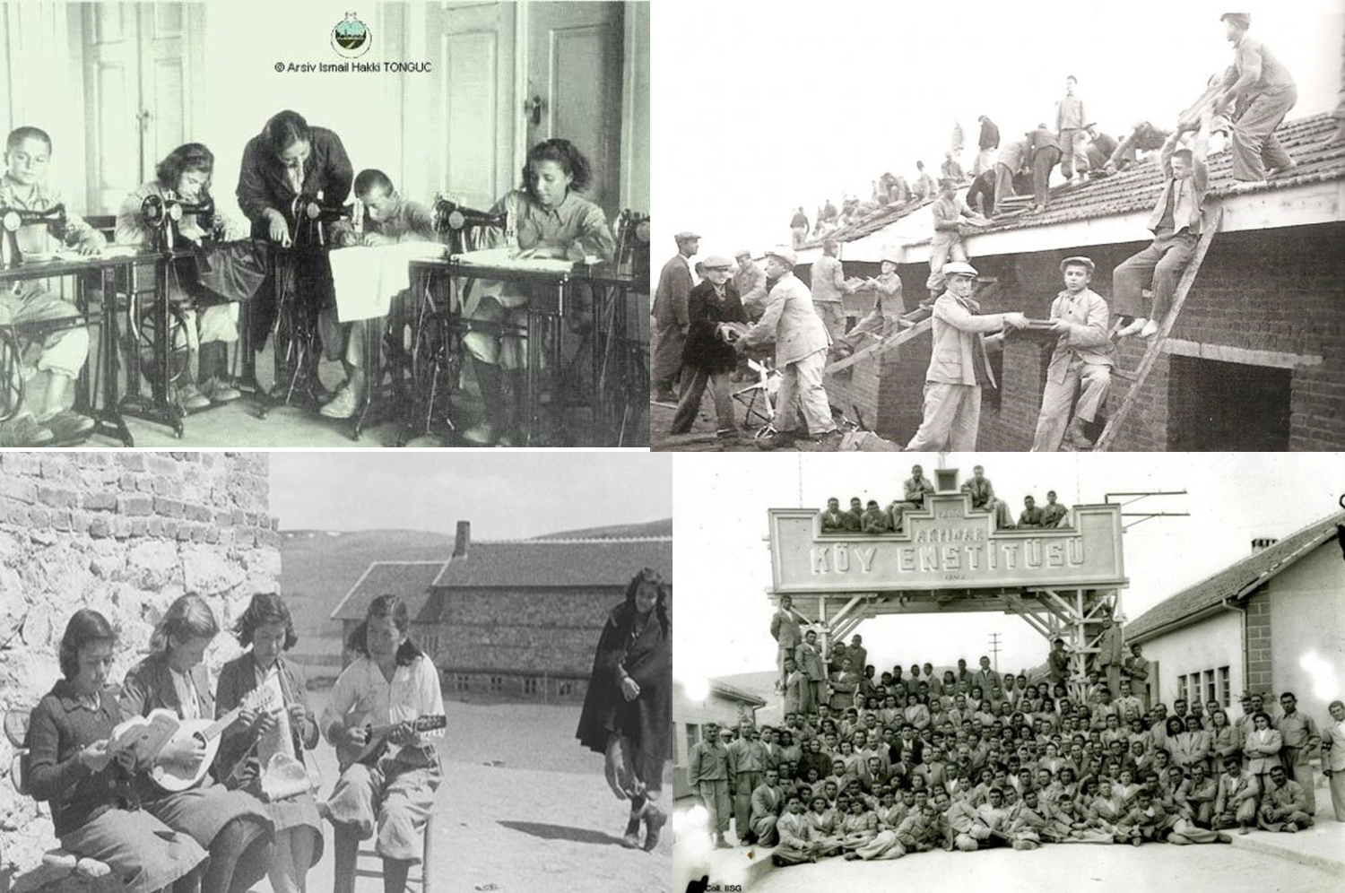
Village Institutes

Slide 25
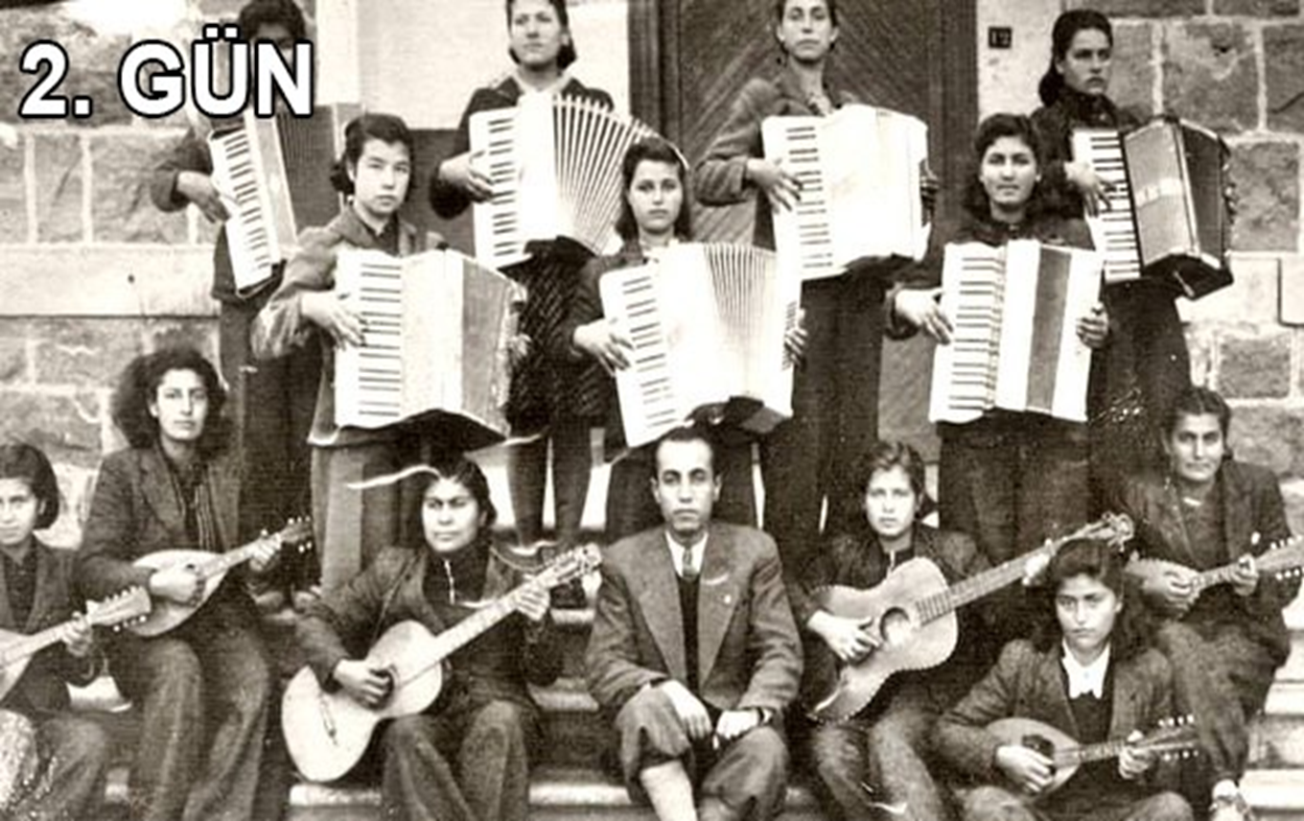
Village Institutes

Slide 26
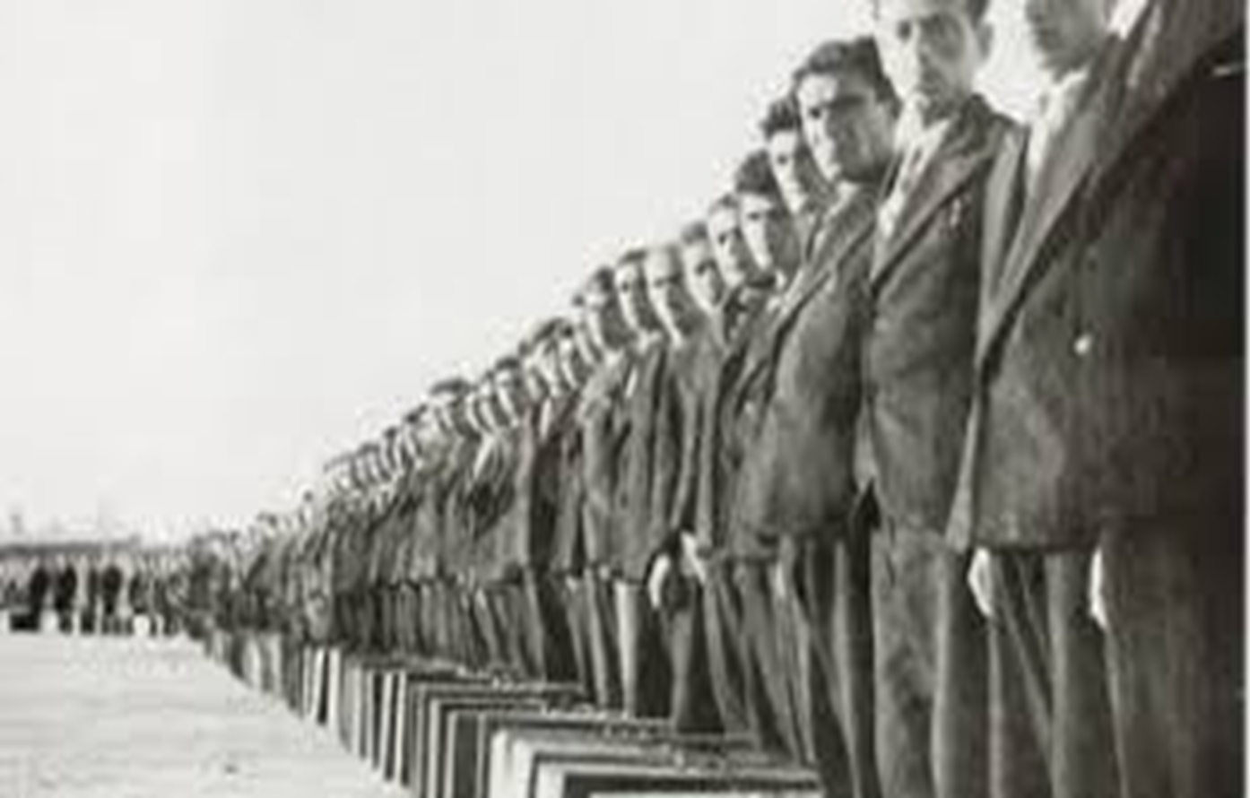
Village Institutes

Slide 27
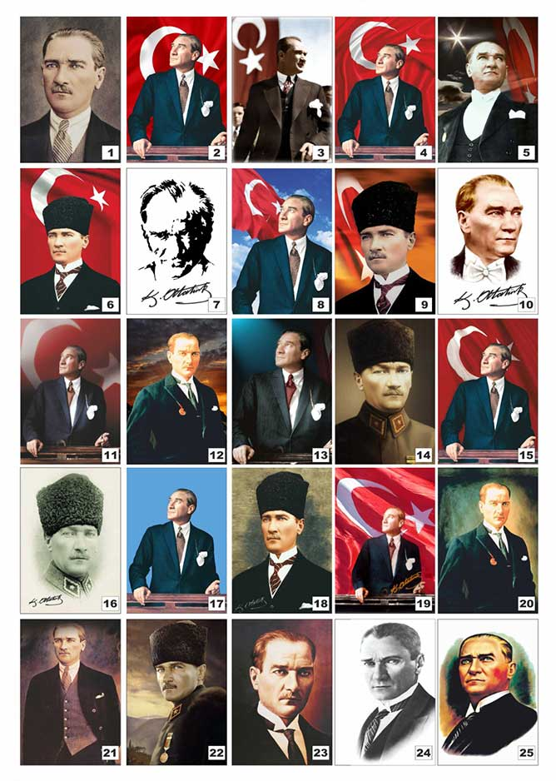
Questions?

