Slide 1
SUPERLATIVE ADJECTIVES

Slide 2
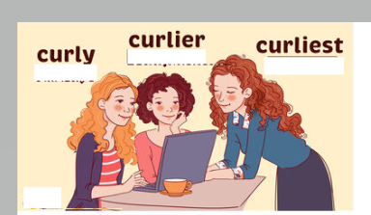
When do we use superlative adjectives?

Slide 3
Use superlative adjectives to talk about extremes. We usually use "the" before superlatives.

Slide 4
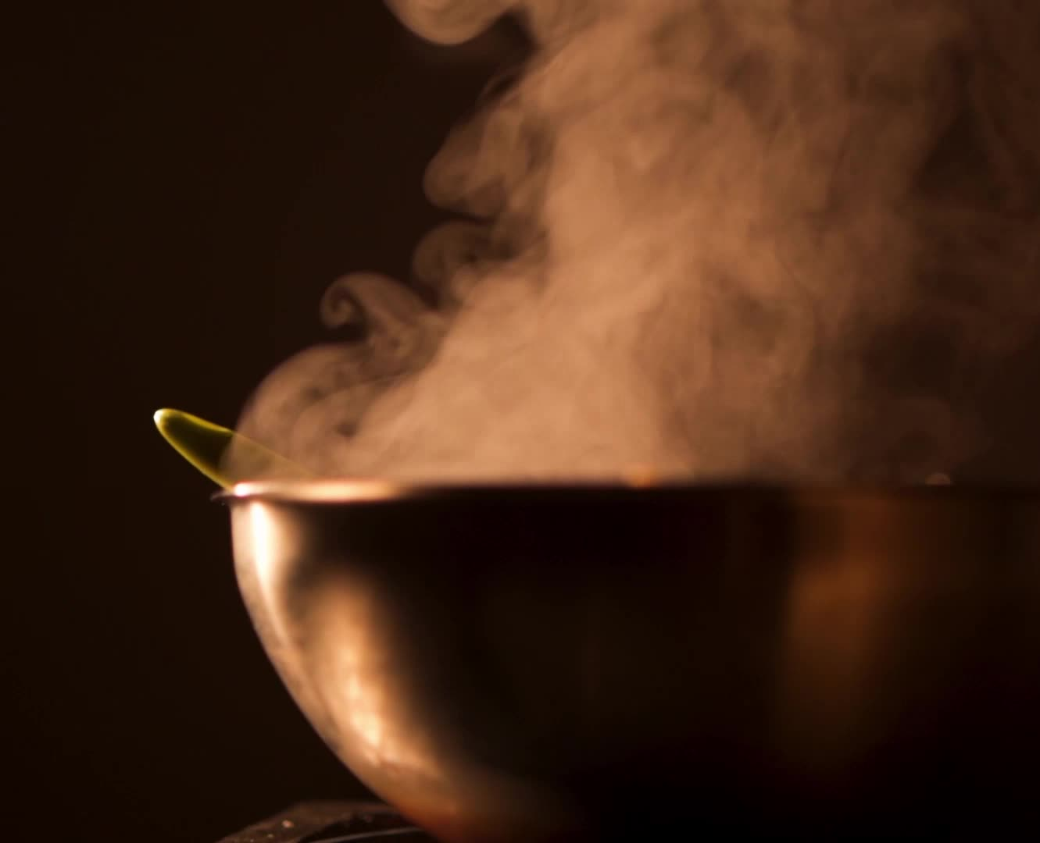
Dabiz Muńoz is the best chef in the World.

Slide 5
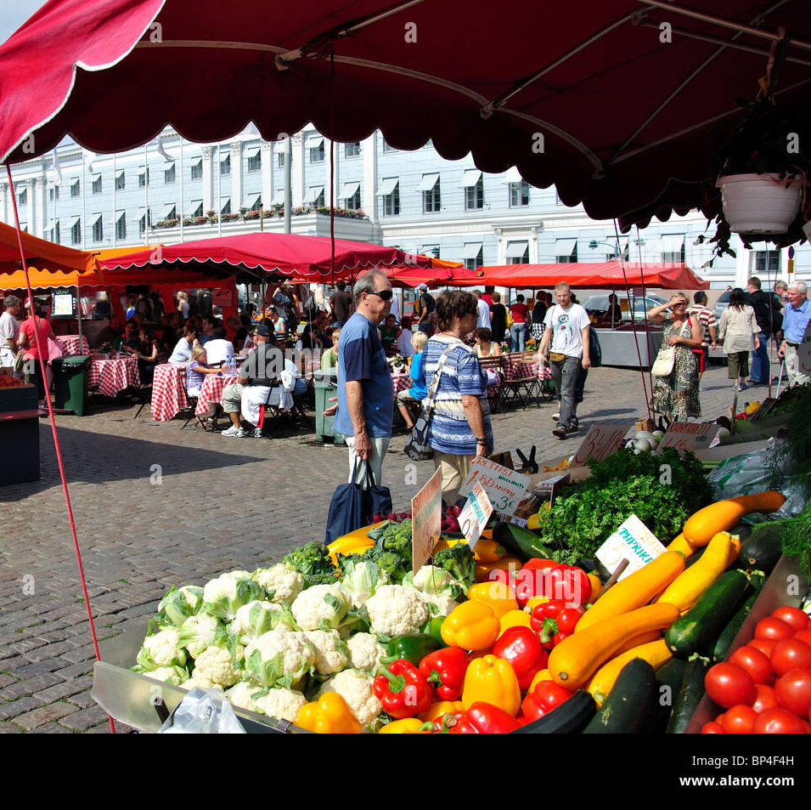
Some Examples:
Outdoor markets are the most interesting places to shop.
Jupiter is the biggest planet in our solar system.
My house is the largest one in our neighborhood.
It was the happiest day of my life.

Slide 6
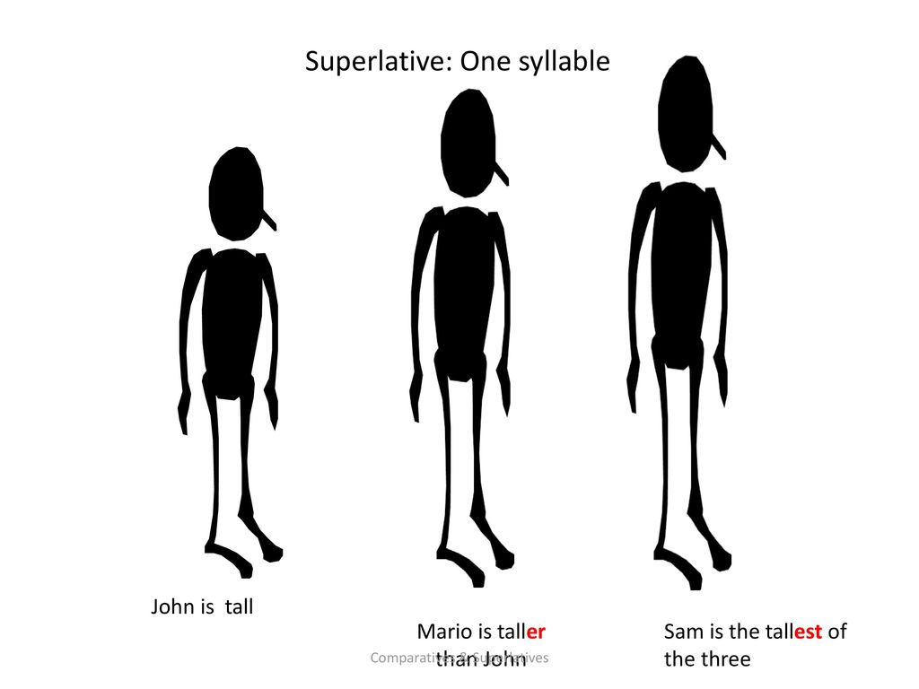
Mario is taller than John, Sam is taller than Mario. Sam is the tallest of three.

Slide 7
General rules for superlatives adjectives:
For adjectives with one syllable, add –est (the + adjective+ -est)
For example:
cheap- the cheapest
light- the lightest
old- the oldest

Slide 8
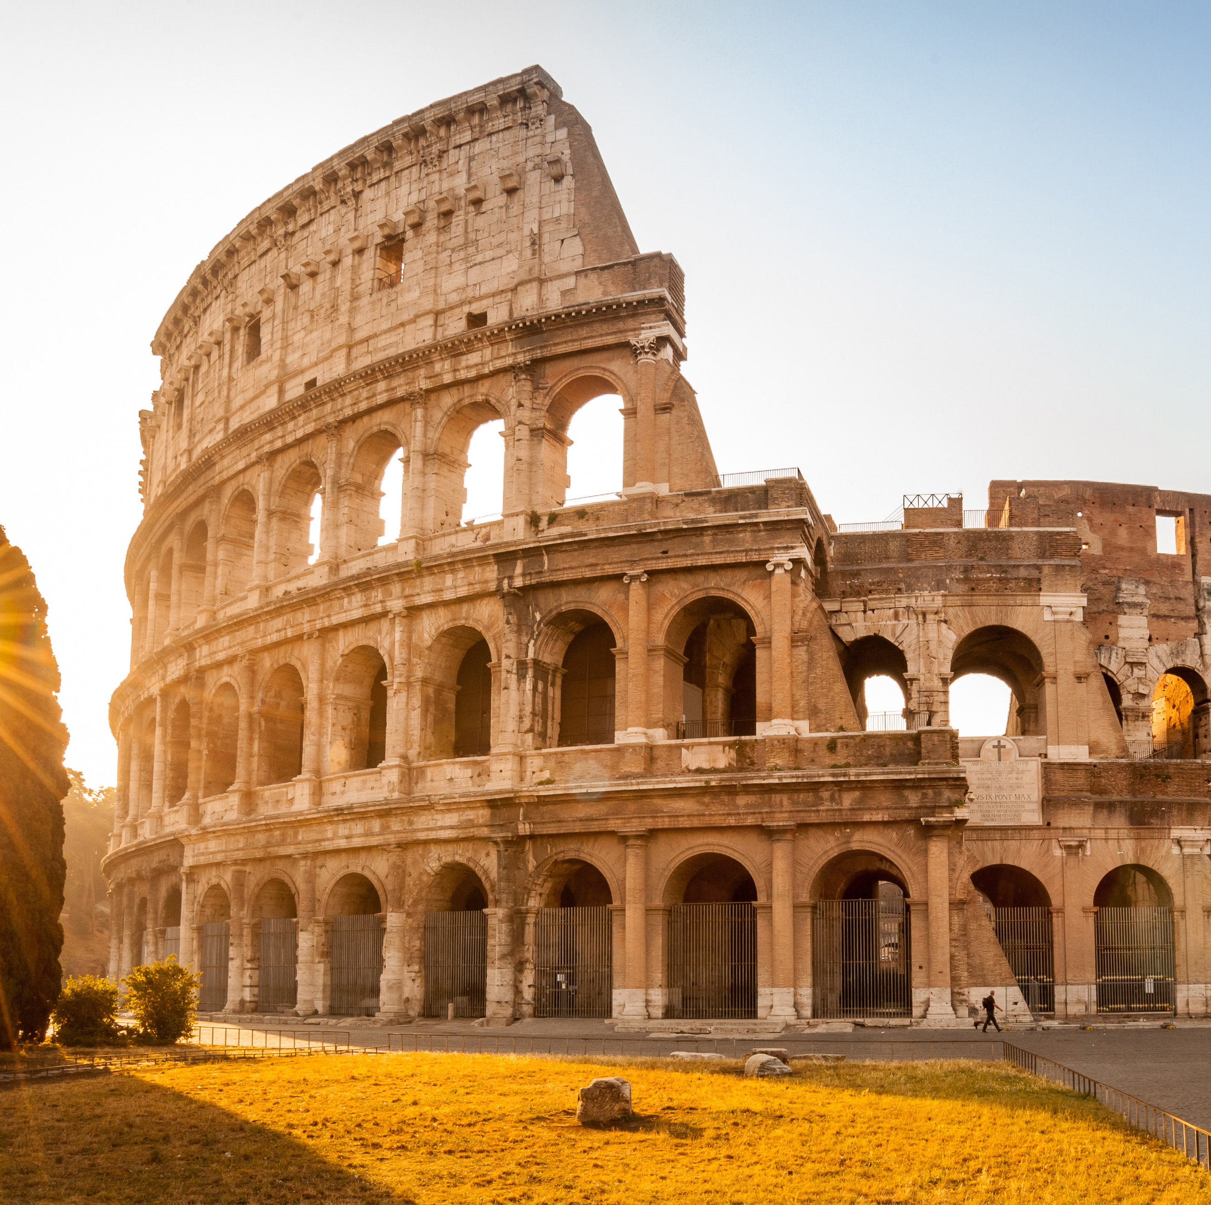
Paris is a very beautiful city, but in my opinion, Rome is the most beautiful city in the world.

Slide 9
General rules for superlatives adjectives:
difficult – the most difficult
beatiful –
the most beatiful
important- the most important
For adjectives with two or more syllable, add the most ( the most + adjective)
For example:

Slide 10
I am happy when I’m on vacation, but I’m the happiest when travel to a new place.

Slide 11
General rules for superlatives adjectives:
For adjectives end in a consonant + -y , change –y to i then est ( the + adj. –y + iest)
For example:
easy- the easiest
dry – the driest
pretty- prettiest

Slide 12
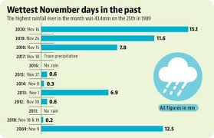
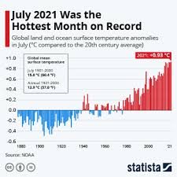
November is the wettest month of the year. July is the hottest.

Slide 13
For adjectives end in one vowel (a,e,i,o,u) and one consonant (g,n,t, etc.), double consonant and add –est
For example:
hot- the hottest
fat- fattest
big- the biggest

Slide 14
My house is the largest one in our neighborhood.

Slide 15
For adjectives end in –e, add –st
For example:
large – the largest
nice – the nicest

Slide 16
Common Exceptions!!
They are irregular adjectives:
good the best
bad the worst

Slide 17
We don’t use the with words like my, your, etc.
She’s my best friend. √
She’s my the best friend. (WRONG)

Slide 18
More examples

Slide 19
This is the most interesting book I have ever read.
I can't find my most comfortable jeans.
Which is the largest city in the World?
He was one of the kindest person I’ve ever met.
We all threw our rocks at the same time. My rock flew the highest.
She is the worst liar I have ever known.
Who is the friendliest person in our class?

