Slide 1
MAN-633 Araştırma Yöntemleri ve Çok Değişkenli istatistikler
Çağ Üniversitesi
Sosyal Bilimler Enstitüsü
İşletme Yönetimi Doktora Prog.
2019-2020 Bahar dönemi
Pazartesi 18:30-21:30
Doç.Dr.Eda Yaşa özeltürkay
edayasa@cag.edu.tr
edayasa@gmail.com

Slide 2
Araştırma Yöntemleri Dersi
İçerik:
Bilimsel yöntem ve bilim felsefesi
Bilimsel araştırma süreci ve araştırma sorunsalı belirleme
Sunum ve rapor hazırlama teknikleri (APA & Paraphrasing)
Araştırmanın kavramsal çerçevesi: kuram, model, hipotez,değişken ve işlemselleştirme
Araştırma evreni ve örnekleme
İşletimsel tanımlama ve ölçme
Veri toplama teknikleri
Veri işlemeye hazırlık,temel istatistiki ölçüler ve analiz türleri
Bilimsel araştırmada veri: birincil ve ikincil veriler
SPSS programı ve veri girişi
Nitel araştırma yöntem ve teknikleri
Nicel analizler: Farklılık testleri
Nicel analizler: ilişki testleri
Güvenilirlik ve geçerlilik testleri örnekler
Sunumlar

Slide 3
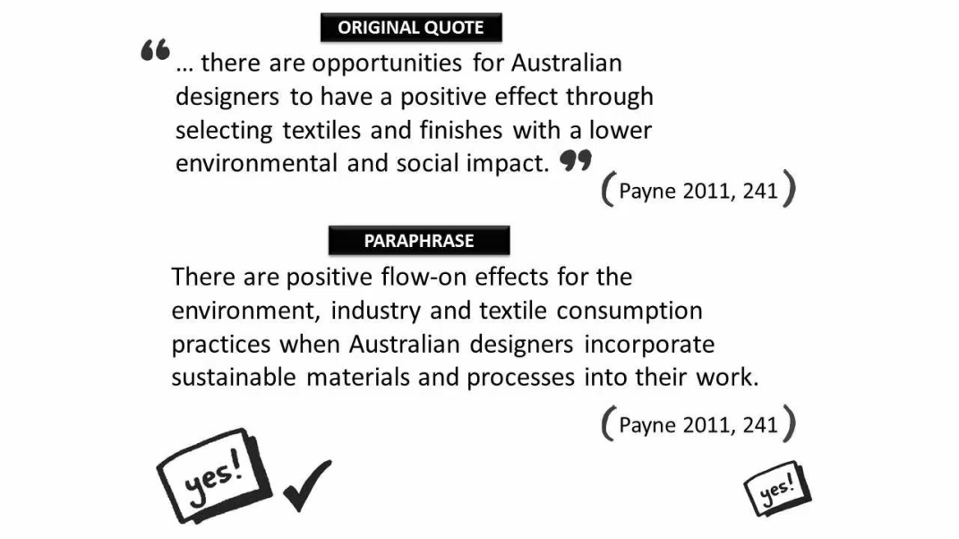
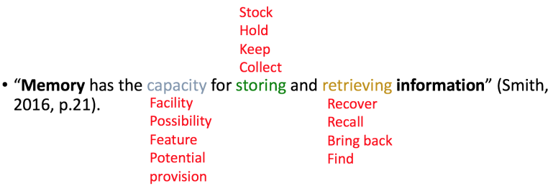
Reference& plagiarism
Neville, Colin. The Complete Guide to Referencing and Avoiding Plagiarism.2nd ed. Maidenhead: Open UP, 2007. Open University Press Educational and Professional Book Publishers. McGraw Hill Education Europe, 01 Feb. 2010. Web. 02 Oct. 2012

Slide 4
Bilimsel Araştırma Süreci ve
Araştırma Sorunsalı Belirleme

Slide 5
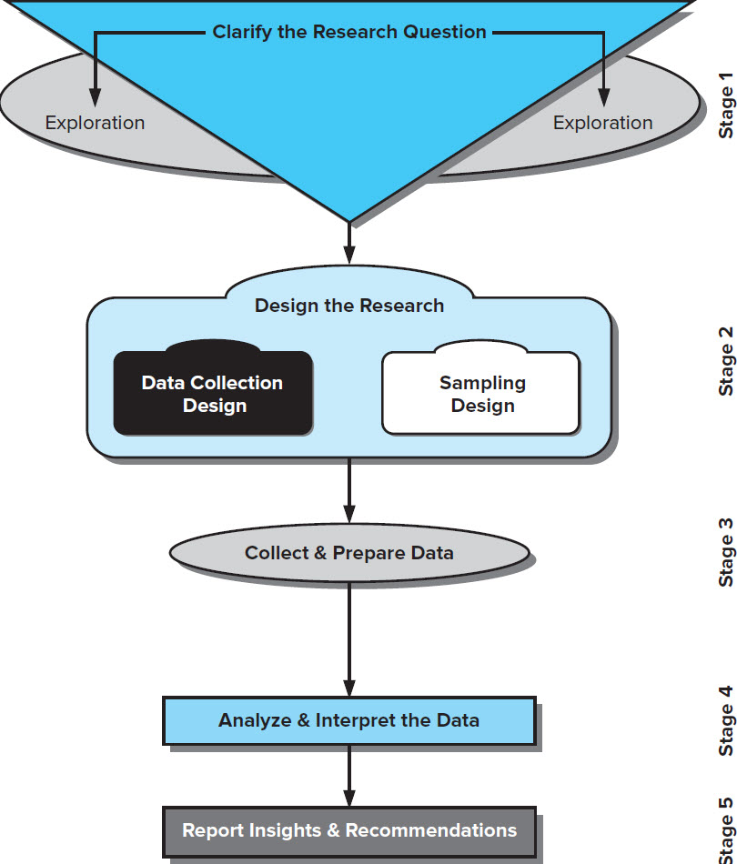
Research Process
Stage 1: Clarify the Research Question
Stage 2: Design the Research
Stage 3: Collect & Prepare the Data
Stage 4: Analyze & Interpret the Data
Stage 5: Report Insights & Recommendations
Notes:
Exhibit 2-2 reveals the model for the research process that is followed in this text. Each stage is developed in subsequent chapters.

Slide 6
Bilimsel araştırma aşamaları(süreci)
Bilimsel Araştırma Süreci
Araştırma sorunsalı belirleme
Kavramsallaştırma:kuram-model-değişken-hipotez
Araştırma tasarımı ve yöntemi belirleme
Araştırma evren ve örneklemi belirleme
Verilerin analizi ve yorumlanması
Veri toplama araçlarının belirlenmesi ve veri toplama
Araştırma bulgularını raporlama ve yayımlama

Slide 7
Stage 2: Design the Research (1 of 2)
Notes:
Stage 2 of Exhibit 2-2 encompasses the design of the research project. There are three components to this stage: research design, sampling design, and intrument development & pilot testing.
Research design is the blueprint for fulfilling objectives and providing the insight to answer the management dilemma. There are many methods, techniques, procedures, and protocols possible.
Chapters 6-9 identify various research designs
Another step in planning the research project is sampling design—to identify the target population and determine whether a sample or census is desired. A census is a count of all elements in a population. A sample is a group of cases, participants, events, or records that constitute a portion of the target population. The researcher must determine whether to choose a probability or nonprobability sample.
Types of samples, sample frames, how samples are drawn, and the determination of sample size are discussed in Chapters 5.
A pilot test is conducted to test weaknesses in the research design and the measurement instrument and protocols and to provide proxy data for selection of a probability sample.
Chapter 13 focuses on instrument development and pilot testing is discussed.

Slide 8
  Research design is the blueprint for fulfilling objectives and providing the insight to answer the management dilemma. There are many methods, techniques, procedures, and protocols possible.
    Chapter 6 identifies various research designs and
    Chapters 7-14 discuss specific methodologies.
  Another step in planning the research project is to identify the target population and determine whether a sample or census is desired. A census is a count of all elements in a population.
  A sample is a group of cases, participants, events, or records that constitute a portion of the target population. The researcher must determine whether to choose a probability or nonprobability sample.
    Types of samples, sample frames, how samples are drawn, and the determination of sample size are discussed in Chapters 15.
  A pilot test is conducted to test weaknesses in the research methodology and the data collection instrument and to provide proxy data for selection of a probability sample.
    Chapter 14 focuses on instrument development and pilot testing is discussed.

Slide 9

Stage 3: Data Collection, Preparation, Examination (2 of 2)
Collect the data
Deal with data errors/omissions
Reduce data to manageable size
Develop summaries
Notes:
PHOTO CREDIT
© Terry Vine/Blend Images LLC.

Slide 10

Data Characteristics
Abstractness (soyutluk)
Verifiability (doğrulanabilme)
Elusiveness (anlaşılmazlık)
Closeness
Data are collective units of information (e.g., production defects, purchases or returns, a person’s attitudes, behaviors, motivations, attributes, photos, recorded comments, etc.) from a subject or case (people, events, machines, personnel records, etc.) measured by a data collector (person or a sensing device or machine, digital or mechanical) following consistent procedures.
  Data are raw and unprocessed.
  Data are processed by our senses. When sensory experiences consistently produce the same result, our data are said to be trustworthy.
Notes:
Stage 3 deals with data collection and preparation.
Data are collective units of information (e.g., production defects, purchases or returns, a person’s attitudes, behaviors, motivations, attributes, photos, recorded comments, etc.) from a subject or case (people, events, machines, personnel records, etc.) measured by a data collector (person or a sensing device or machine, digital or mechanical) following consistent procedures.
Data are raw and unprocessed.
Data are processed by our senses. When sensory experiences consistently produce the same result, our data are said to be trustworthy.
PHOTO CREDIT
©BJI / Blue Jean Images/Getty Images.

Slide 11

Data Types
  Secondary data are originally collected to address a problem other than the one which require the manager’s attention at the moment.
  Primary data are data the research collects to address the specific problem at hand.
Notes:
Capturing data is elusive.
Data is characterized as of two main types.
Secondary data are originally collected to address a problem other than the one which require the manager’s attention at the moment.
Primary data are data the research collects to address the specific problem at hand.
Ask which students are seeing…
Expense reports are collected to reimburse people who have used personal resources to pay for a company expense (primary data), but if they are used in research to understand the cost of providing distribution to certain countries or geographic areas, they are seen as secondary data.
PHOTO CREDIT
murat sarica/Getty Images.

Slide 12
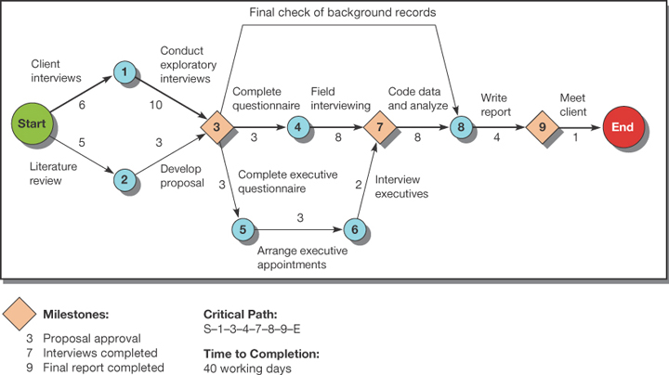
Research Project Time Frame (1 of 2)
Jump to long description
Notes:
Exhibit 2-3
Research is a time-based project. Project management tools, like CPM and Gantt, are useful.

Slide 13
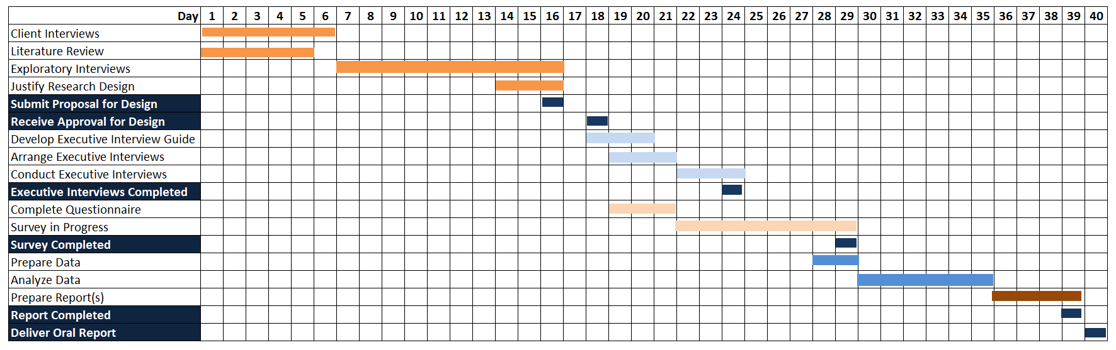
Research Project Time Frame (2 of 2)
Jump to long description
Notes:
Exhibit 2-4
Gantt chart of a research project.

Slide 14
Research Process Pitfalls to Avoid
Ill-defined Management Problem
Unresearchable questions: Not all management questions are researchable and not all research questions are answerable.
Manager’s Hidden Agendas: Sometimes a research study is intended to win approval for a pet idea or to protect a decision maker. In these cases, it may be more difficult to get support for the most appropriate research design.
Researcher Inexperience: can lead to an inappropriate research questions, poor research design, inadequate data collection protocols, in appropriate analytical techniques, and the insupportable conclusions and recommendations. Novice researchers should be supervised
Notes:
Researchers must remain objective. The slide presents common problems in the research process, especially in Stage 1 of Exhibit 2-2.
Unresearchable questions: Not all management questions are researchable and not all research questions are answerable.
An ill-defined problem is one that addresses complex issues and cannot be expressed easily or completely.
Manager’s Hidden Agendas: Sometimes a research study is intended to win approval for a pet idea or to protect a decision maker. In these cases, it may be more difficult to get support for the most appropriate research design.
Researcher Inexperience: can lead to an inappropriate research questions, poor research design, inadequate data collection protocols, in appropriate analytical techniques, and the insupportable conclusions and recommendations. Novice researchers should be supervised.

Slide 15
Research Process Problems to Avoid
Overembracing Data Analytics
Favored-Technique Syndrome
Researcher Inexperience
Notes:
Researchers must remain objective. The slide presents common problems in Stage 2 of the Research Process (Exhibit 2-2), the research design.
The favored-technique syndrome occurs when researchers are method-bound. They recast any management questions so that it is amenable to their favorite method.
Over-embracing Data Analytics means that managers may feel that they do not want to collect more data until they have thoroughly evaluated all existing data. While data mining can be a good starting point, it will rarely address all questions related to a specific management dilemma.
Researcher inexperience can lead to inappropriate designs for both data collection and sampling, and poor data collection protocols.
We discuss other problems to avoid in other stages in their respective chapters.

Slide 16
1. Araştırma sorunsalı belirleme
Adımlar | Açıklama
a. Sorunsal belirleme | Araştırılmak istenen alanda herhangi bir problemin ifadesidir. Problemin ne olduğu,neden böyle bir araştırmaya ihtiyaç duyulduğunun izahıdır. Başarıya etki eden faktörler nelerdir? İnsanlar neden taklit ürün satın alırlar? Neden şirketler git gide birbirine benzemektedirler? Çalışan örgütsel bağlılığı nasıl arttırılır? İnsanlar neden depresyona girerler? Her bilimsel araştırmada bir araştırma sorunsalı-problemi mevcuttur. Sorunu belirlemek zaman alıcıdır. Araştırmacı oncelikle literatürdeki boşluklara bakarak bir sorun belirleyebilir.

Slide 17
Araştırma konu ve sorunsalı belirleme kaynakları
Önceki bilimsel çalışmalar; tezler, makaleler, bildiriler, raporlar...

Slide 18
Eleştirel bir mantıkla çalışmaları incelerken;
Makalenin araştırma problemi (varlık gerekçesi) açıkça ifade edilmiş mi?
Araştırmanın amacı açıkça ifade edilmiş mi?
Araştırma ele aldığı konuya ilişkin kaynaklara sahip mi?
Kaynak incelemesi yeterince kapsamlı mı?
Kuramsal bir çerçeve oluşturulmuş mu?
Araştırma yöntemi ifade edilip açıklanmış mı?
Araştırmanın soru ve hipotezleri ilgili yazınla ilişkilendirilerek mi geliştirilmiş?
Araştırmanın evreni, örneklemi iyi tanımlanmış ve «niçin»leri açıklanmış mı?
Veri çözümleme yöntemi incelenmiş ve açık mı?
Elde edilen bulgular amaç ve hipotezlerle uyumlu mu, tartışılmış mı?
Bulgulara ek ne tür gelecek çalışmaları önerilmiş,
Sonuç ile araştırma amacı makul bir şekilde örtüşmüş mü?
Yazar, çalışmanın sınırlılık-kısıtlar dan bahsetmiş mi?
Kaynakça yeterli mi?

Slide 19
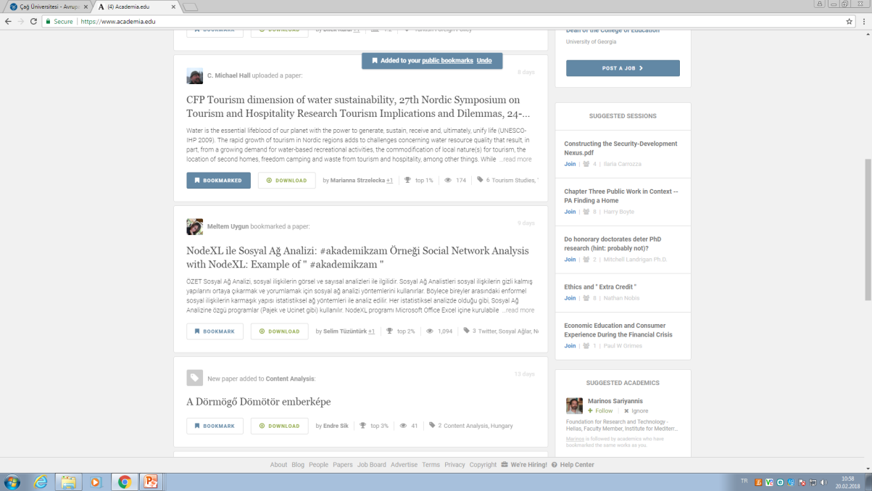
Bookmarking-İşaretleme
Özellikle internet kaynaklarını incelerken iyi bir çalışmaya rastlarsanız, daha sonr direk ulaşmak için onu favorilerinize ekleyebilirsiniz!

Slide 20
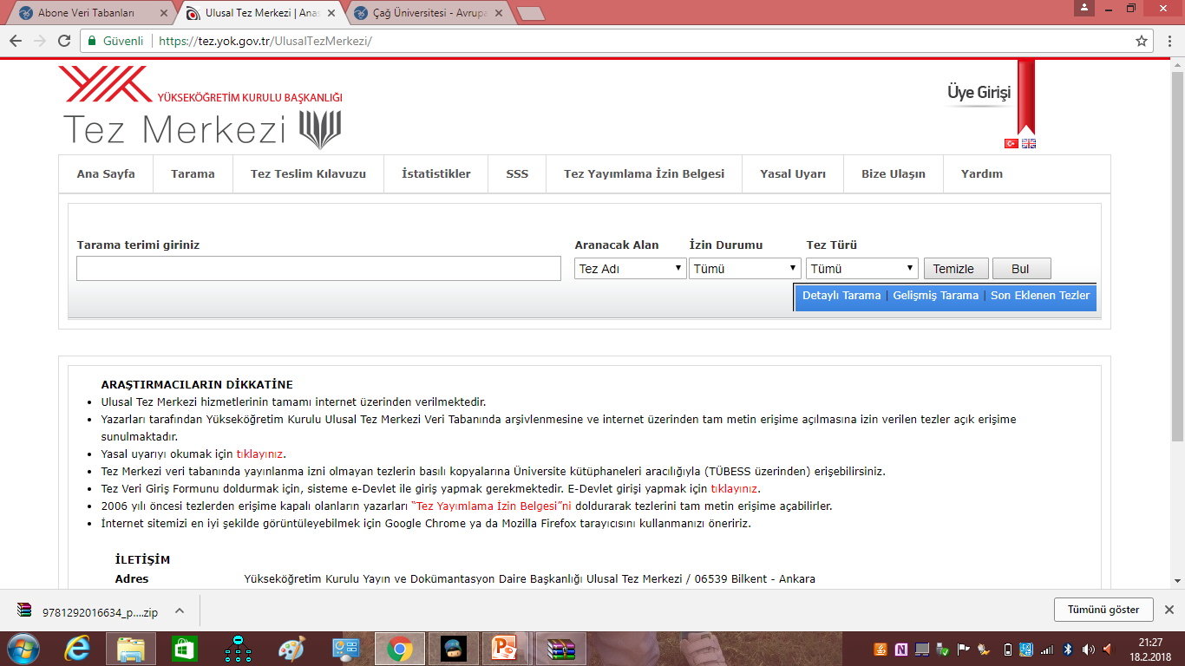
Türkiye: https://tez.yok.gov.tr/UlusalTezMerkezi/

Slide 21
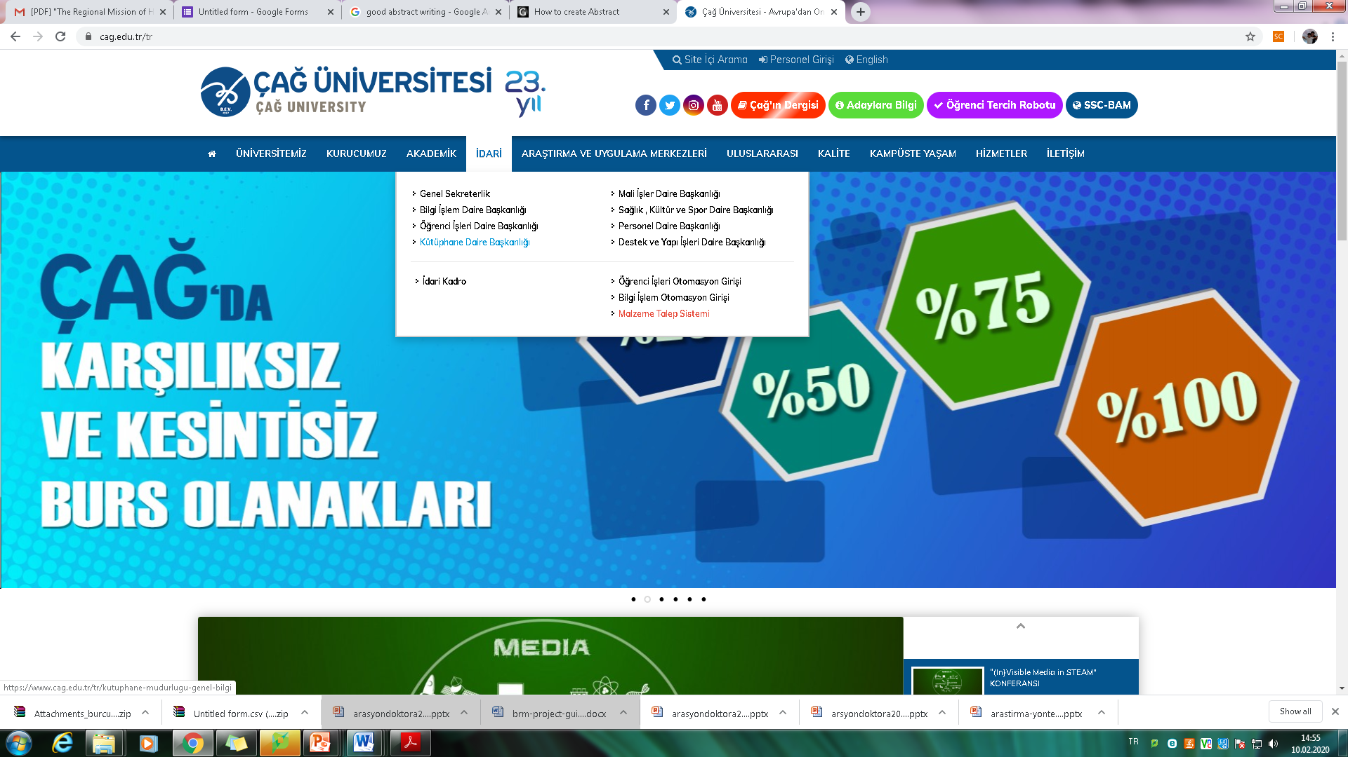

Slide 22
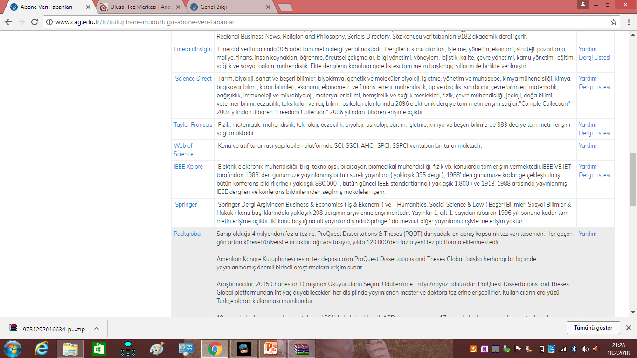

Slide 23
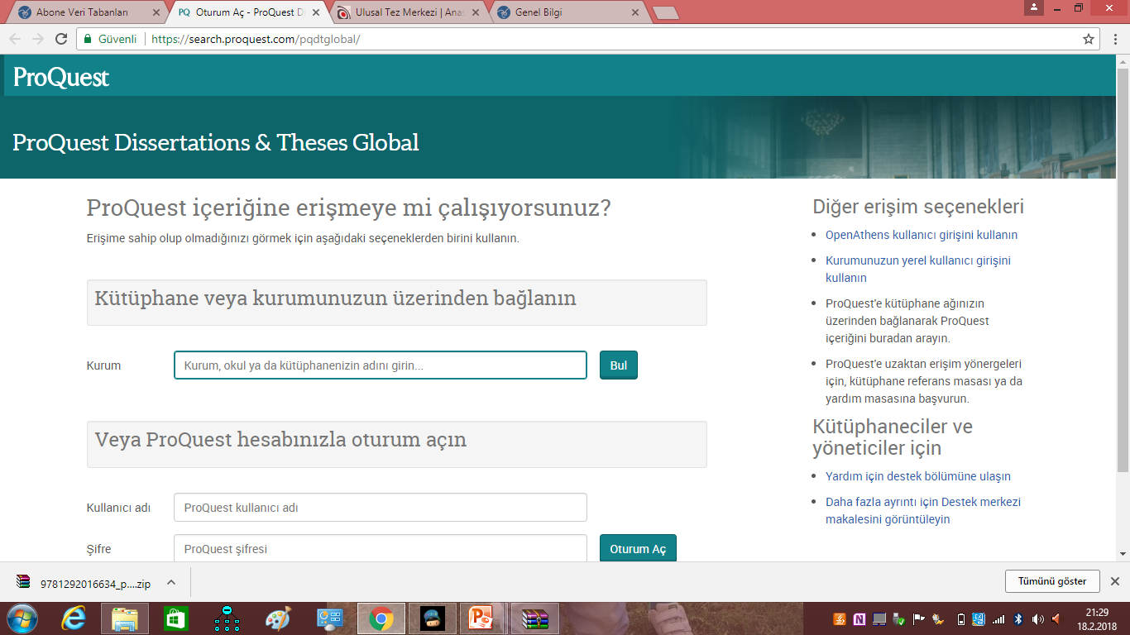

Slide 24
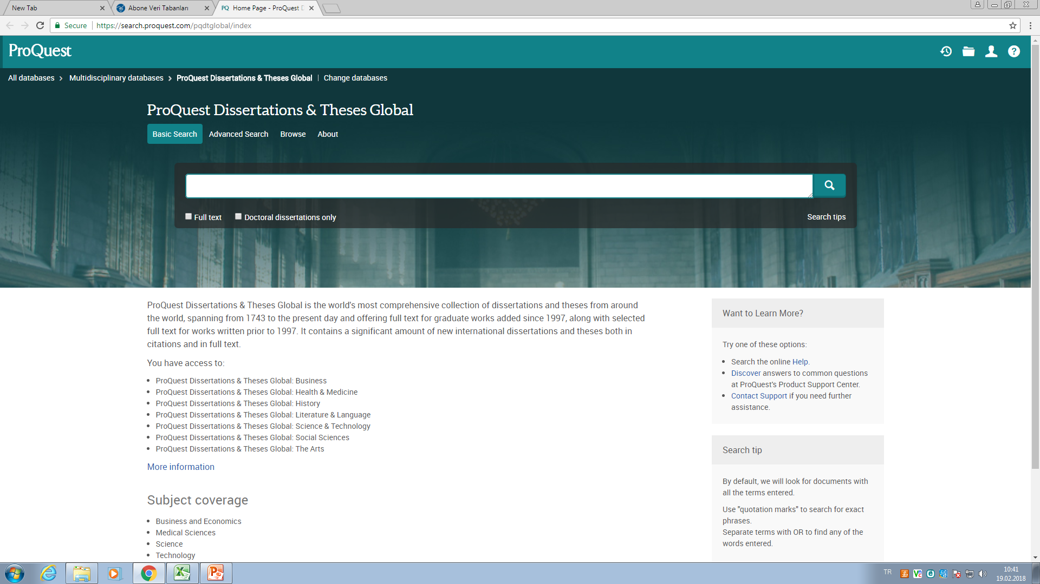
Yurtdışı: https://search.proquest.com/pqdtglobal/index

Slide 25
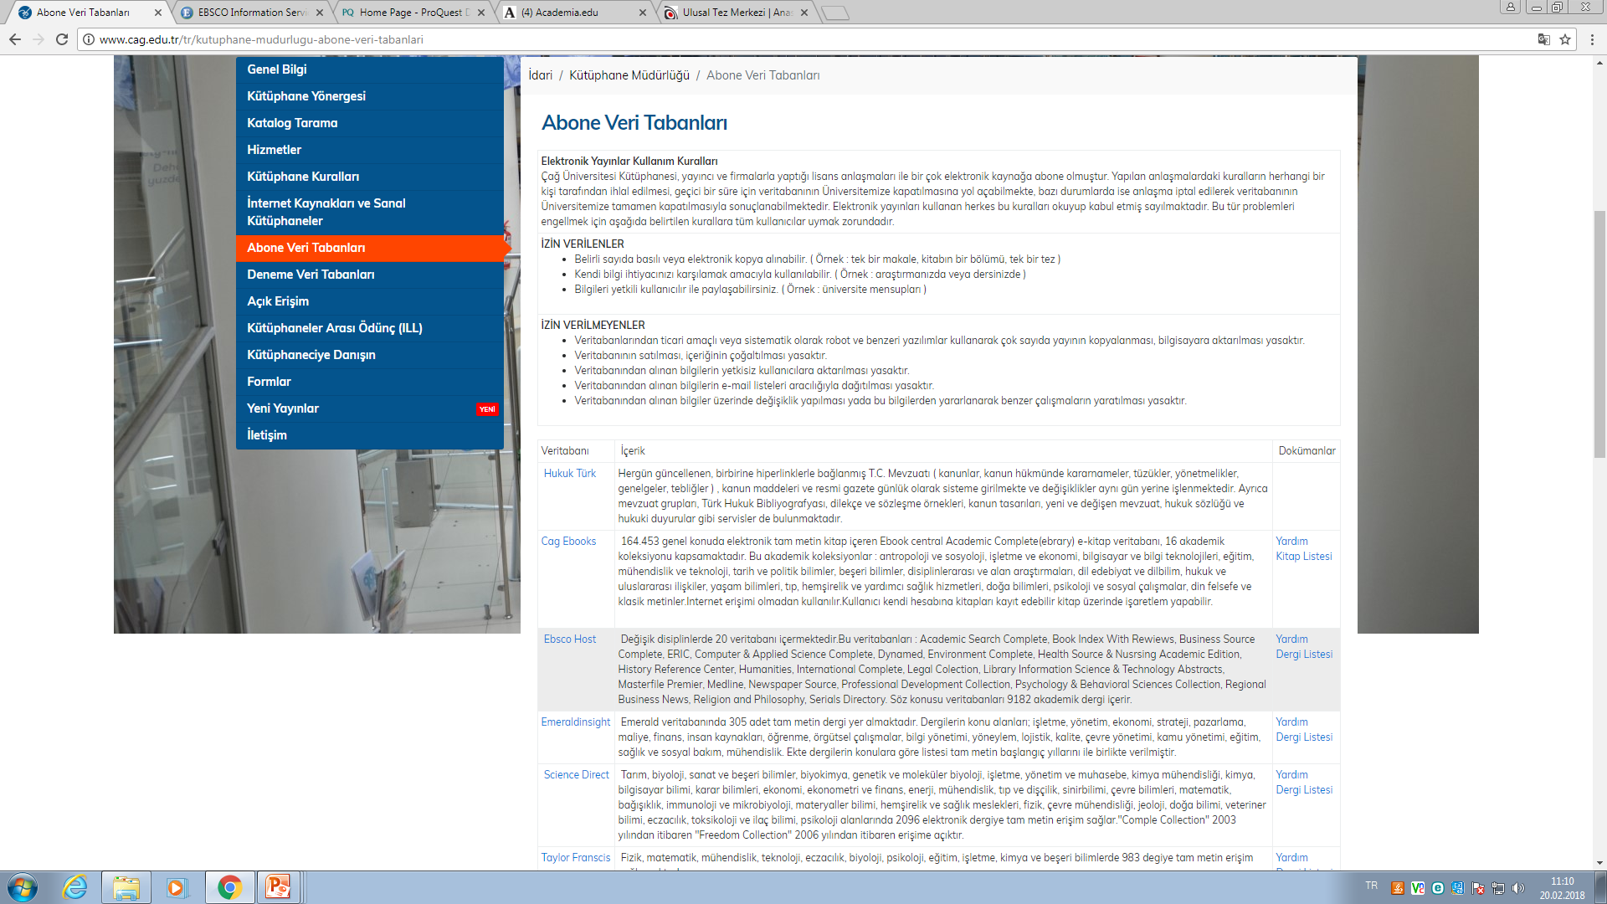

Slide 26
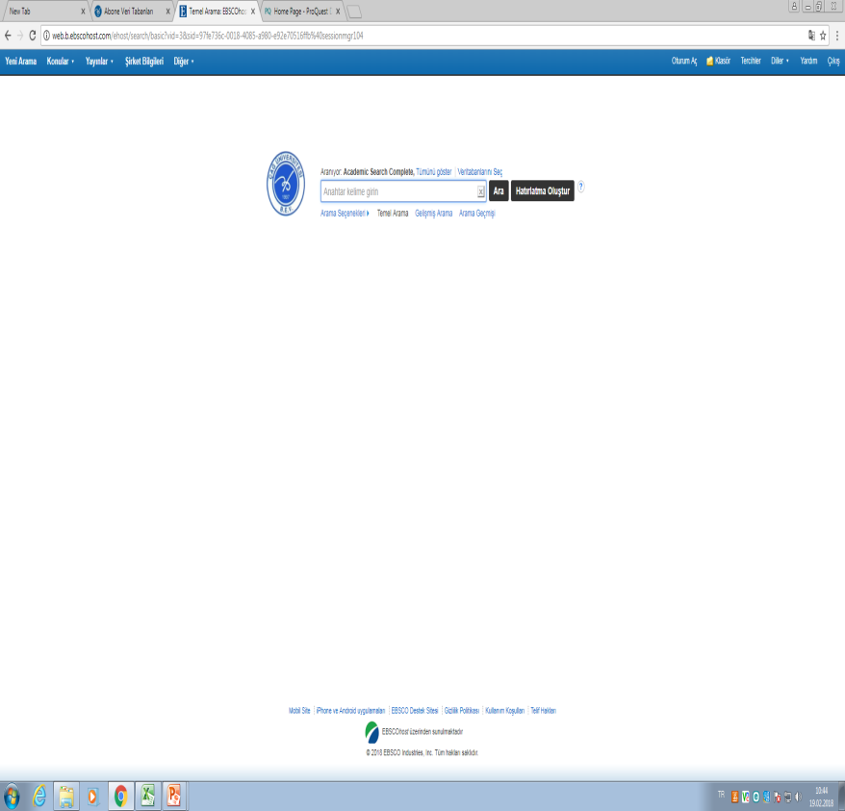
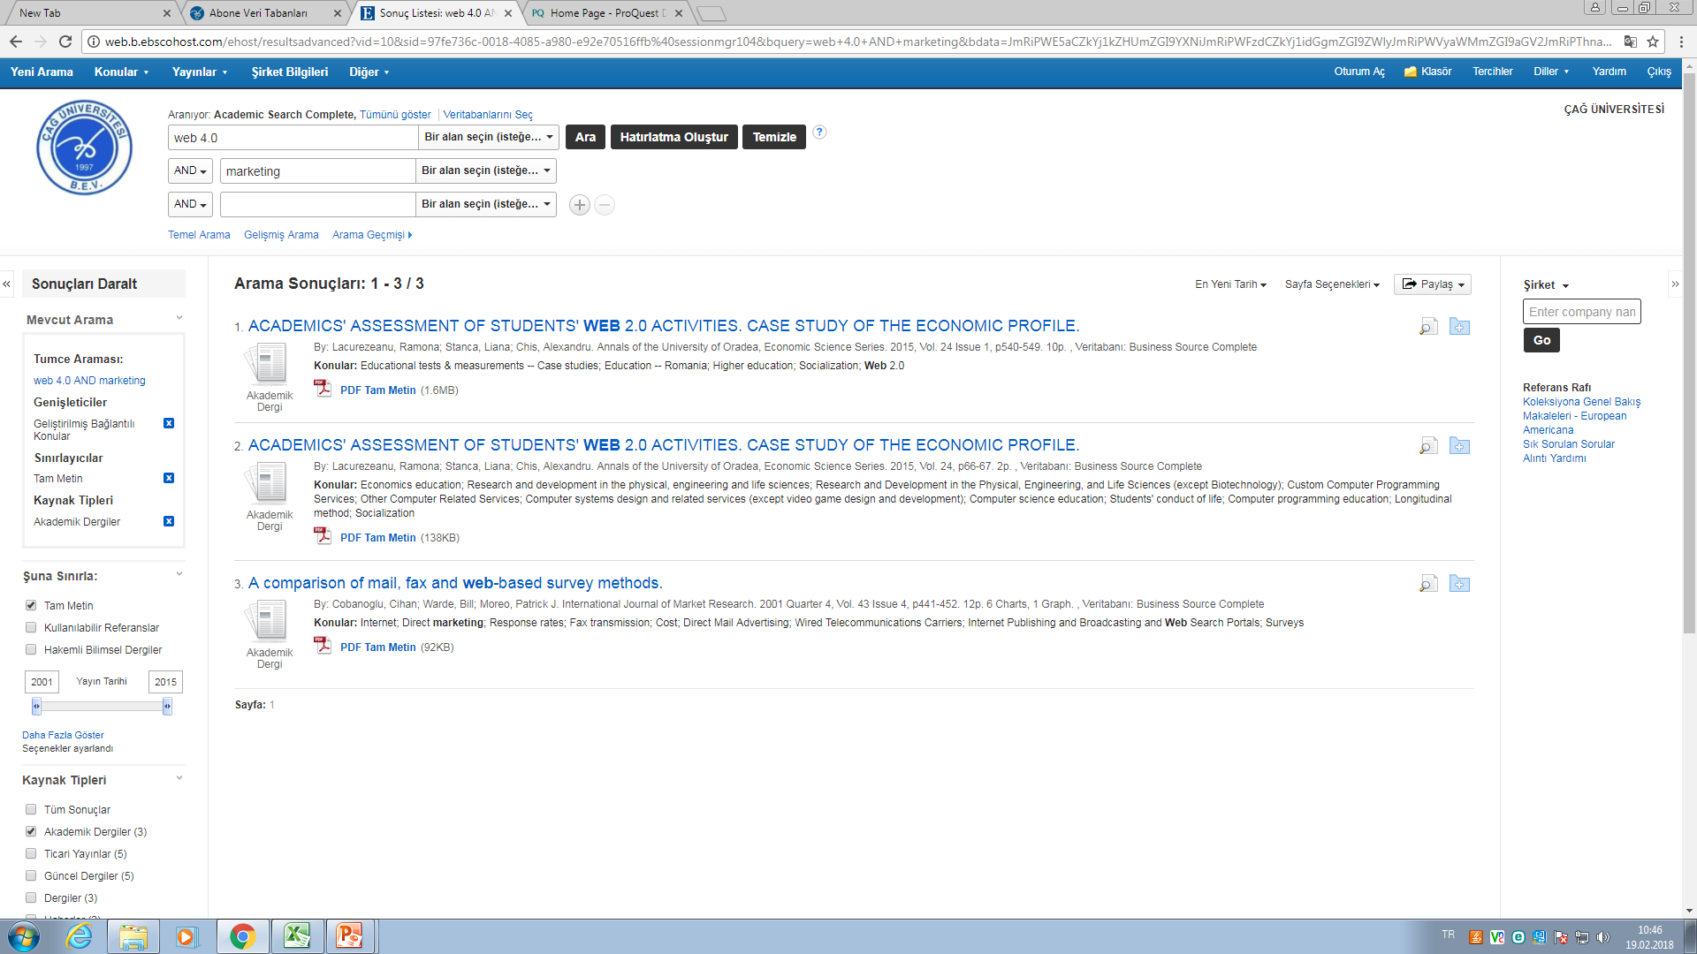
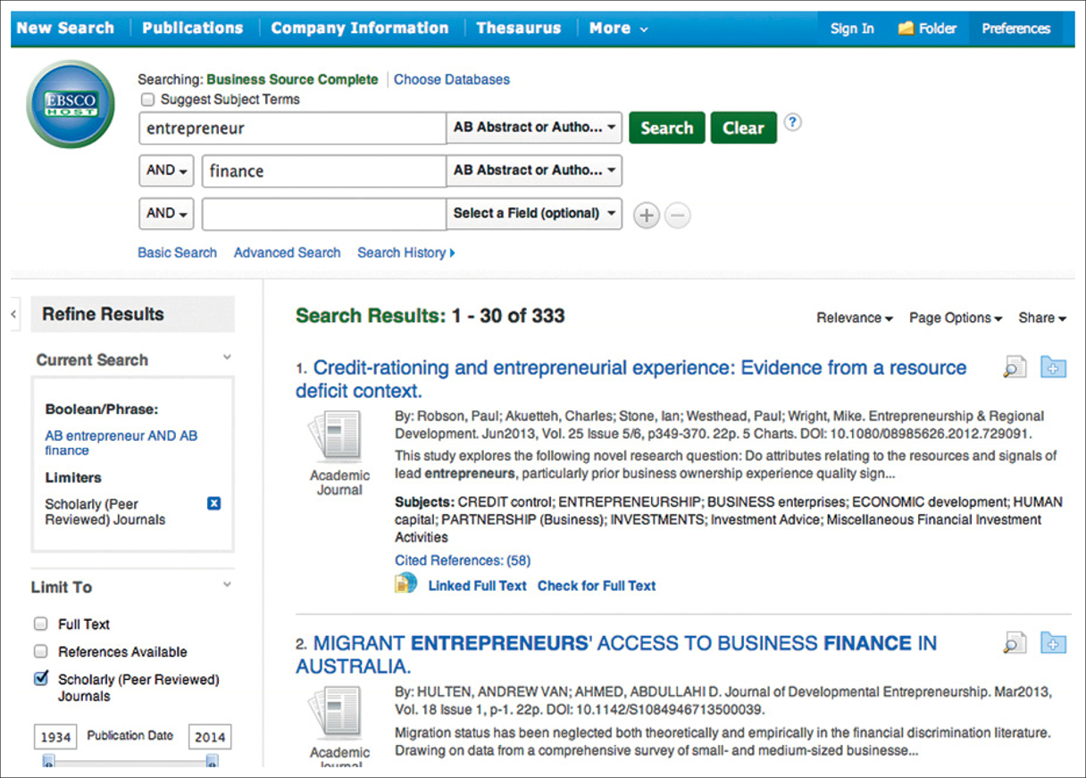

Slide 27
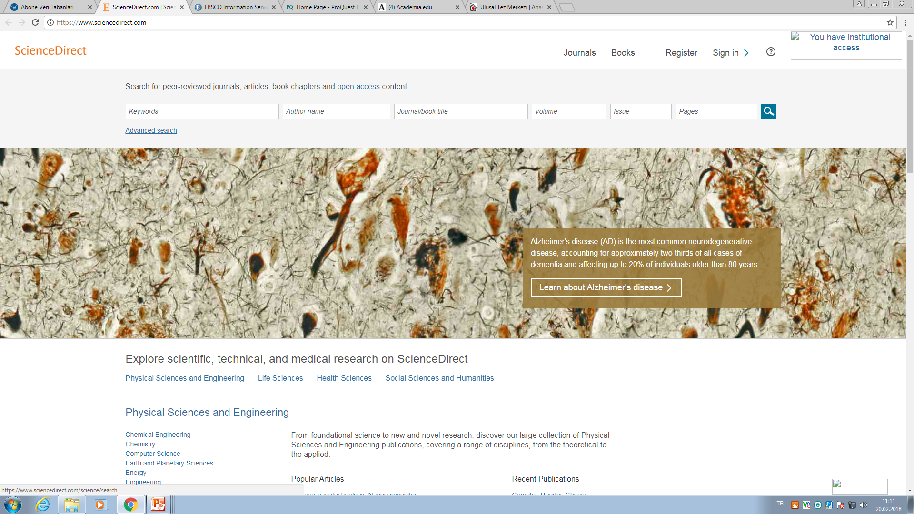
https://www.sciencedirect.com/

Slide 28
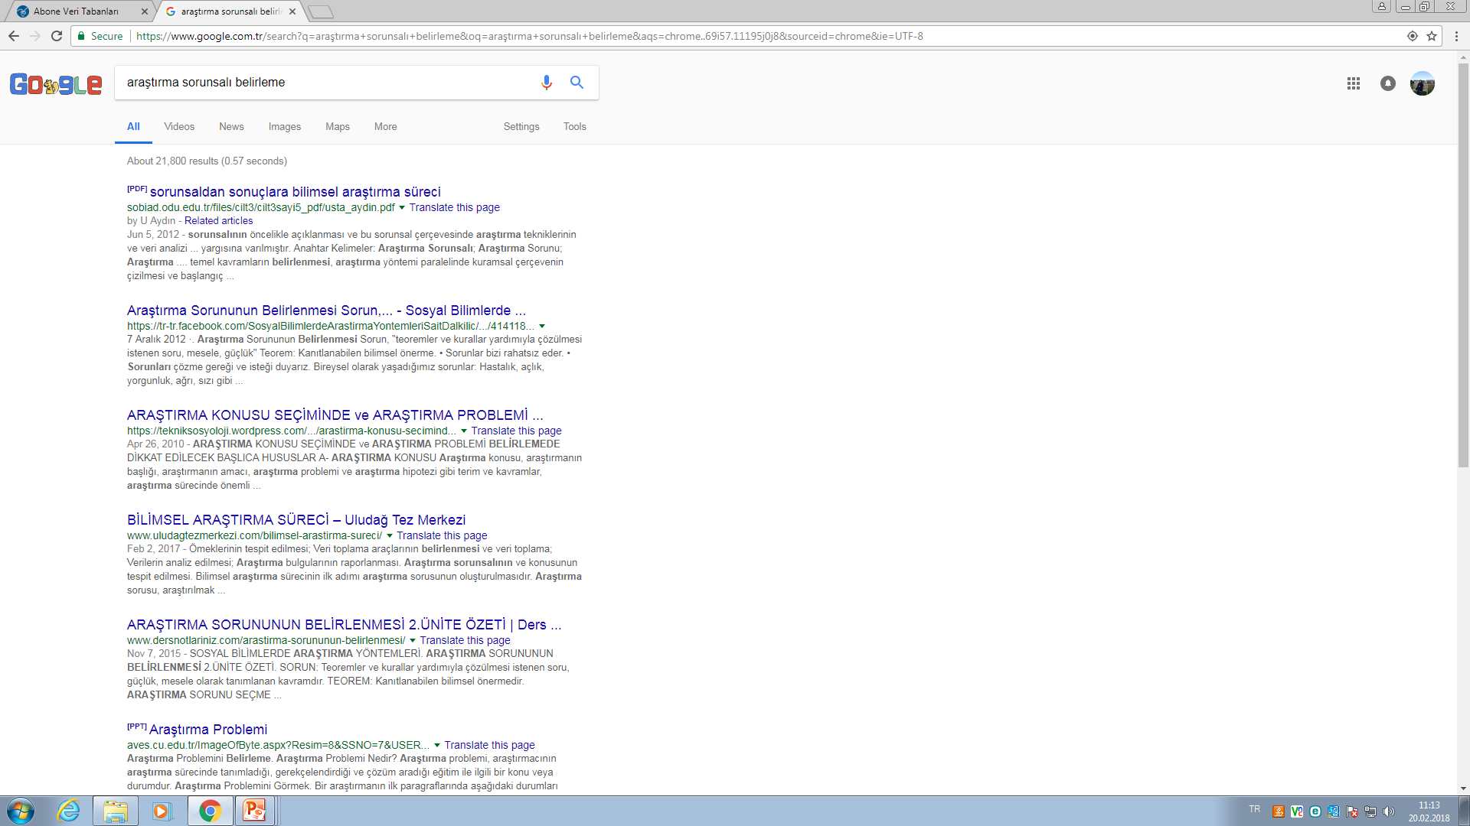
Google arama...

Slide 29
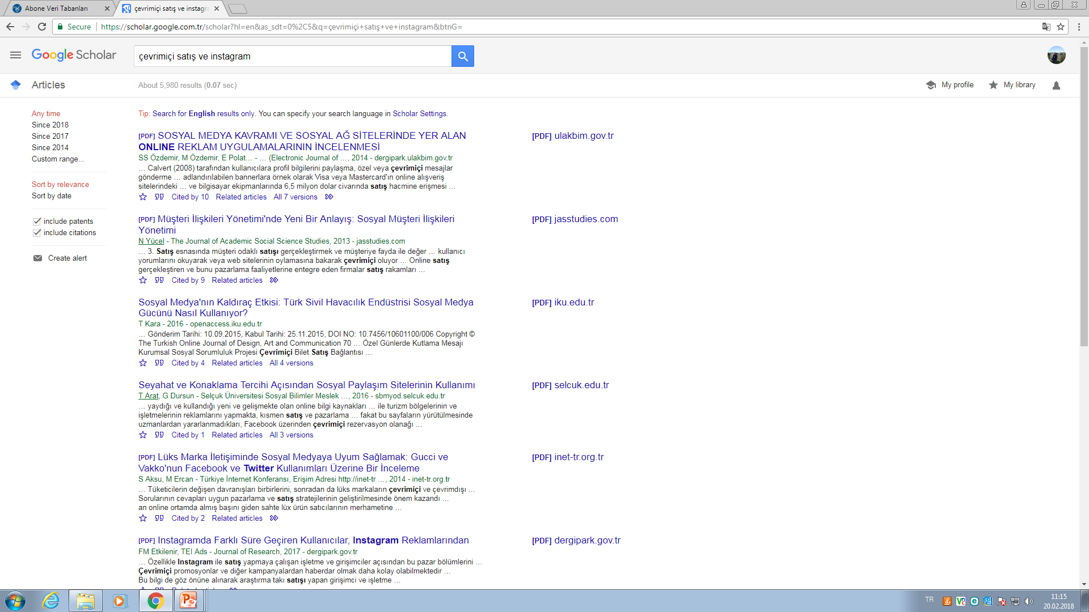
Google akademik…

Slide 30
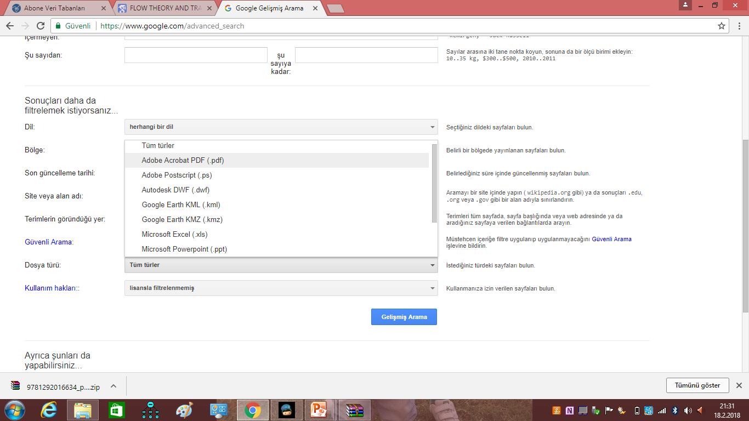

Slide 31
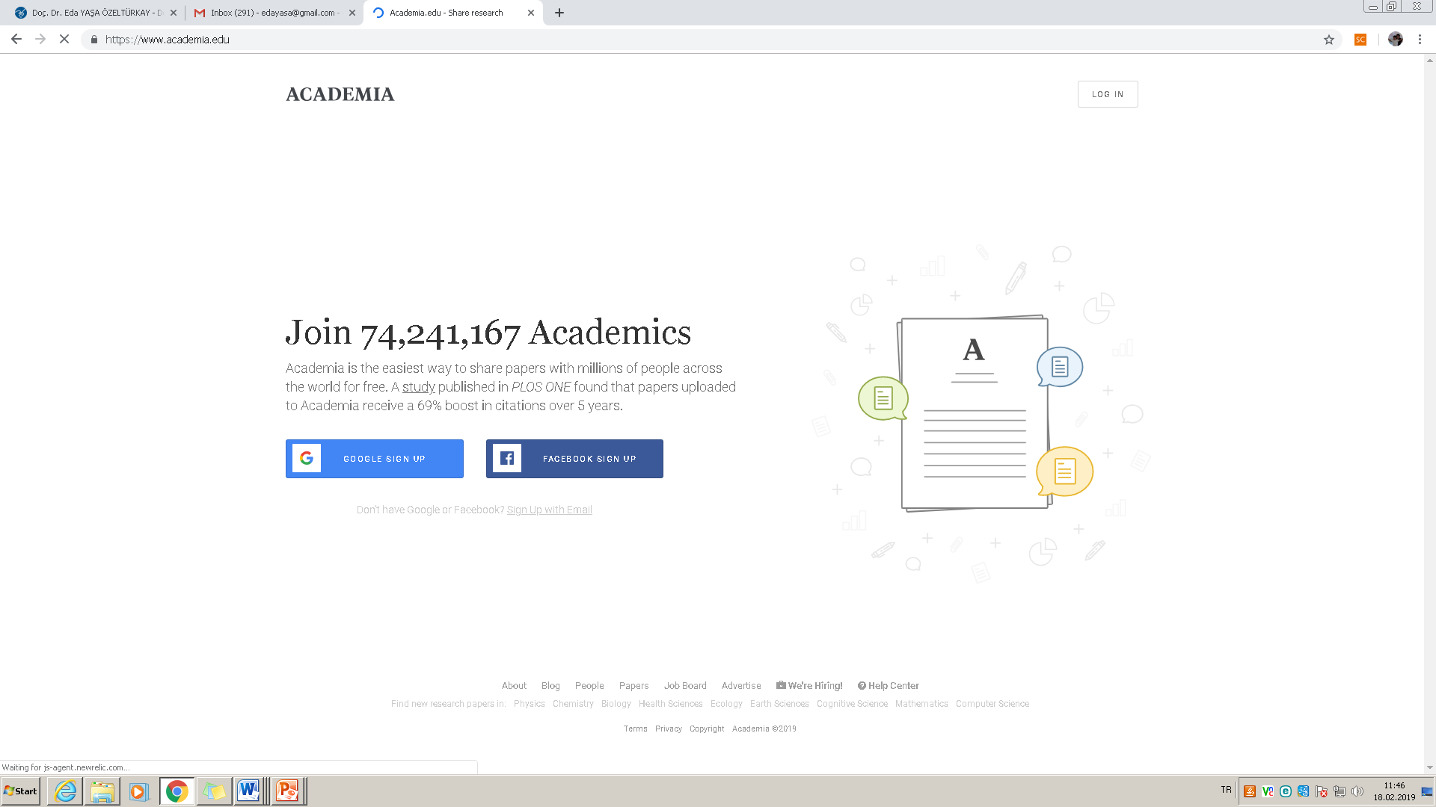

Slide 32
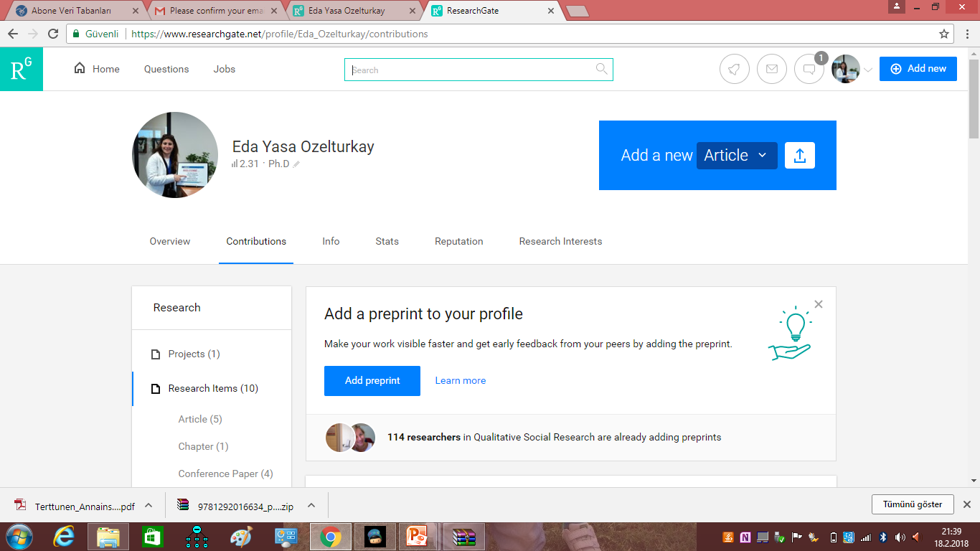

Slide 33
Okudukça not alalım...

Slide 34
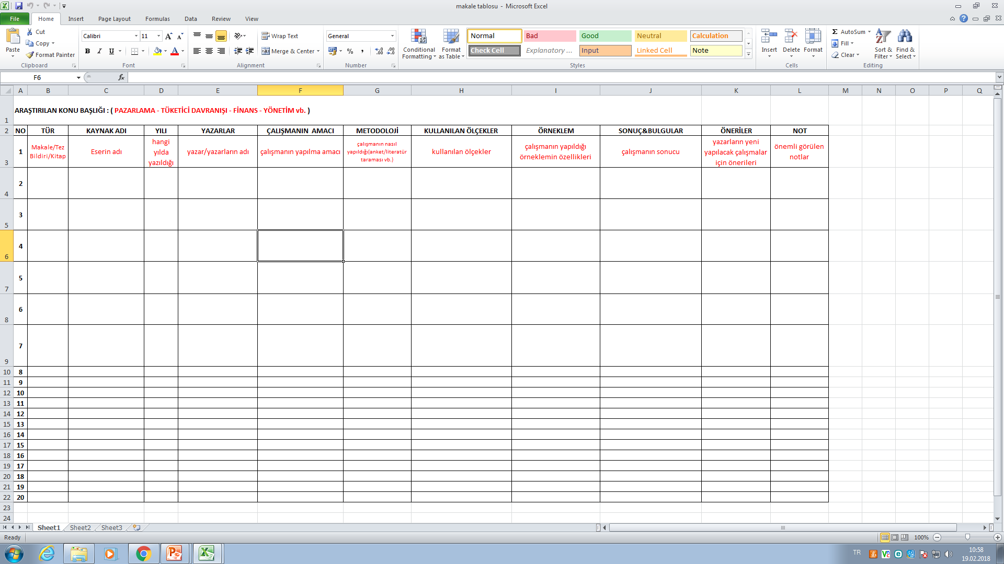

Slide 35
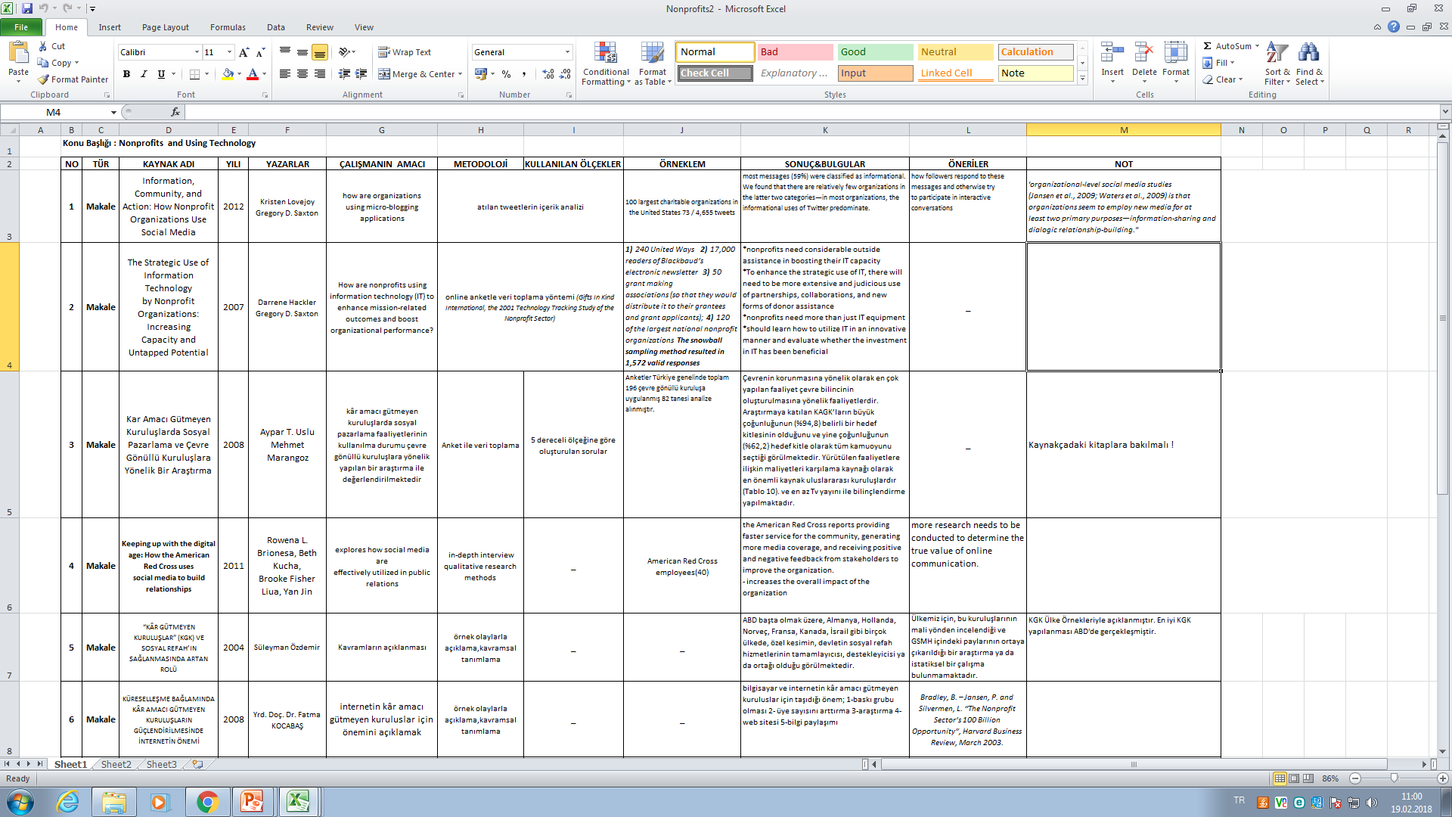

Slide 36
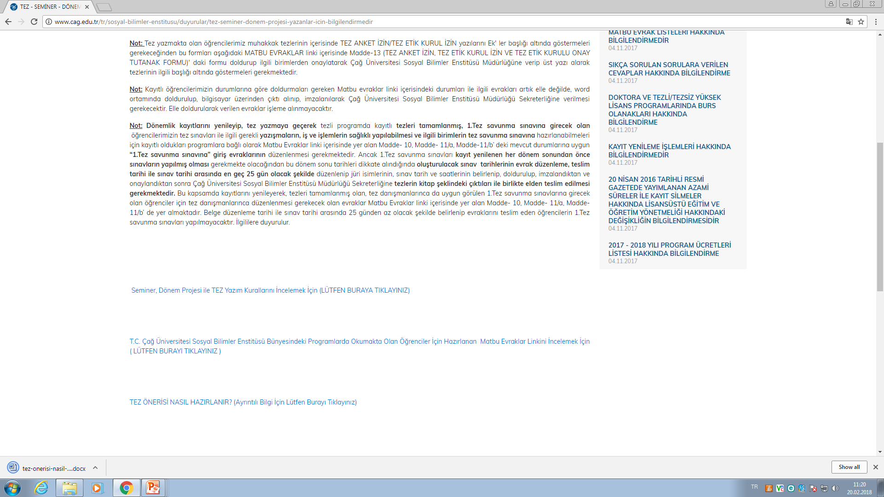

Slide 37
İdeal bir araştırma sorunsalı ve konusunun özellikleri
özellikler | Açıklama
Araştırılabilir ve çözümlenebilir olması | Değişkenlere ilişkin veri toplanabilir olmalı
İlgili yazın ve uygulamaya katkı sağlamalıdır | Araştırma sonucu faydalı olmalıdır
Özgün ve yenilikçi olmalı | Çok çalışılmamış olmalı
Etik kurallara uygun olmalı | Gizlilik, yasal kurallar, ve etik anlayışlara uygun olmalı
Değerlendiricilerin beklentilerini karşılamalı
Araştırmacının yetenek ve imkanlarıyla uyumlu olmalı
Çok geniş ve çok dar olmamalı: kapsam ve sınırları makul olmalı Zaman ve maliyet açısından gerçekleştirilebilir olmalı
Araştırmacının merak ve ilgisine uygun olmalıdır.

Slide 38
Araştırma konusu & sorunsalı belirleme aşamaları
Meraklı olduğunuz ve ilgi duyduğunuz bir konuyu belirleyin
Yazın taramasını titiz bir şekilde yapın
Tecrübeliaraştırmacılardan yararlanın
Araştırma sorunsalını daraltarak bileşenleri ile birlikte hareket edin

Slide 39
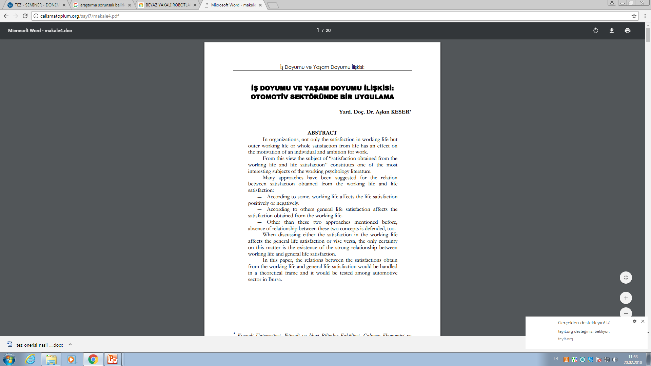
Araştırma konusunun daraltılması
Çok geniş araştırma konuları araştırılması zor ve zaman alıcıdır.
Sektör açısından (imalat,otomotiv, hizmet vb.)

Slide 40
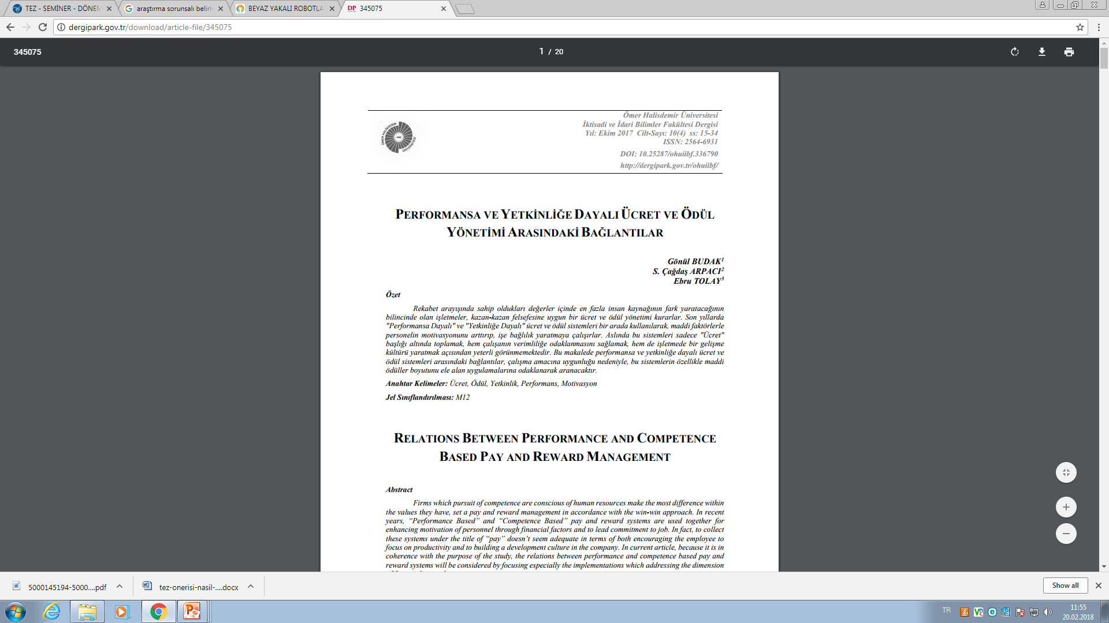
Konunun kapsamı açısından (performansa dayalı ücret, pazara ilk giriş fiyatı vb.)

Slide 41
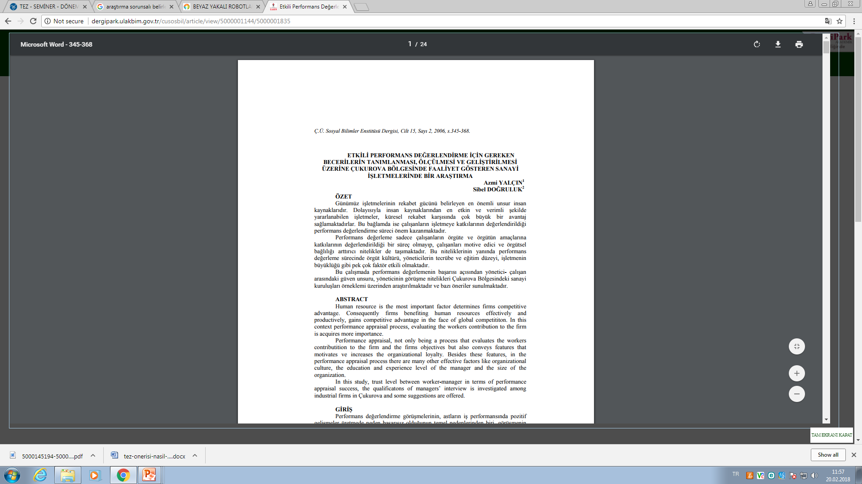
Coğrafi alan açısından (Ankara-İstanbul,Çukurova, Akdeniz bölgesi vb.)

Slide 42
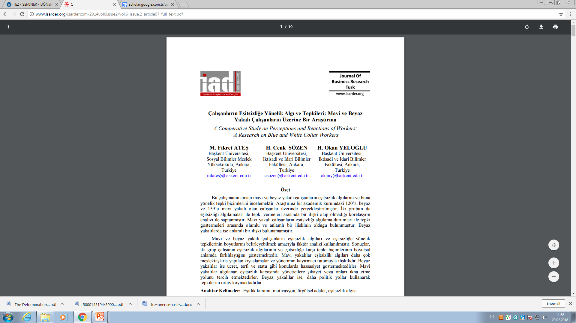
Çalışan grupları (beyaz yakalı, beyaz yakalı robotlar, mavi yakalı, yöneticiler,vb.)

Slide 43
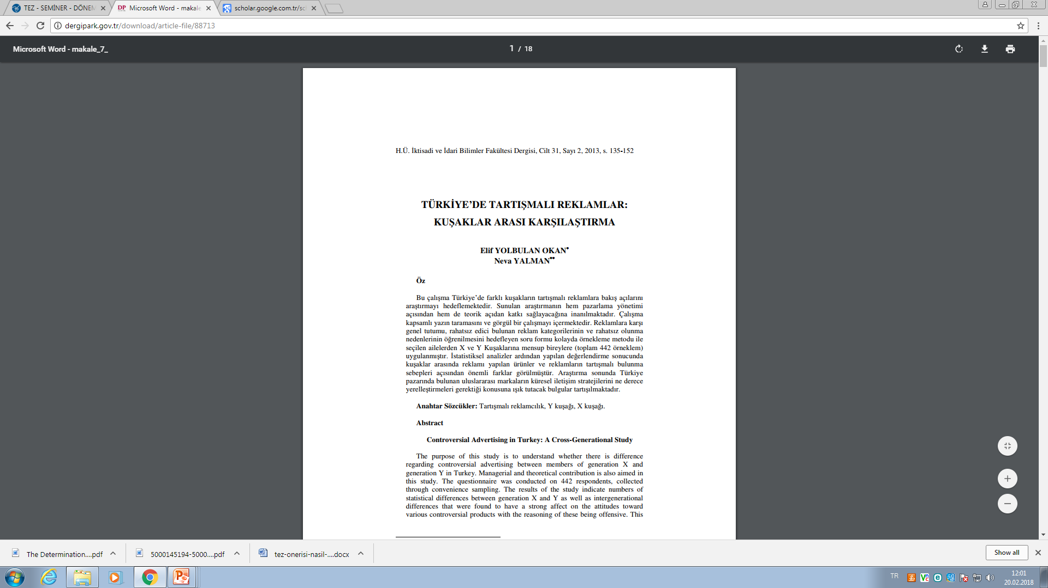

Slide 44
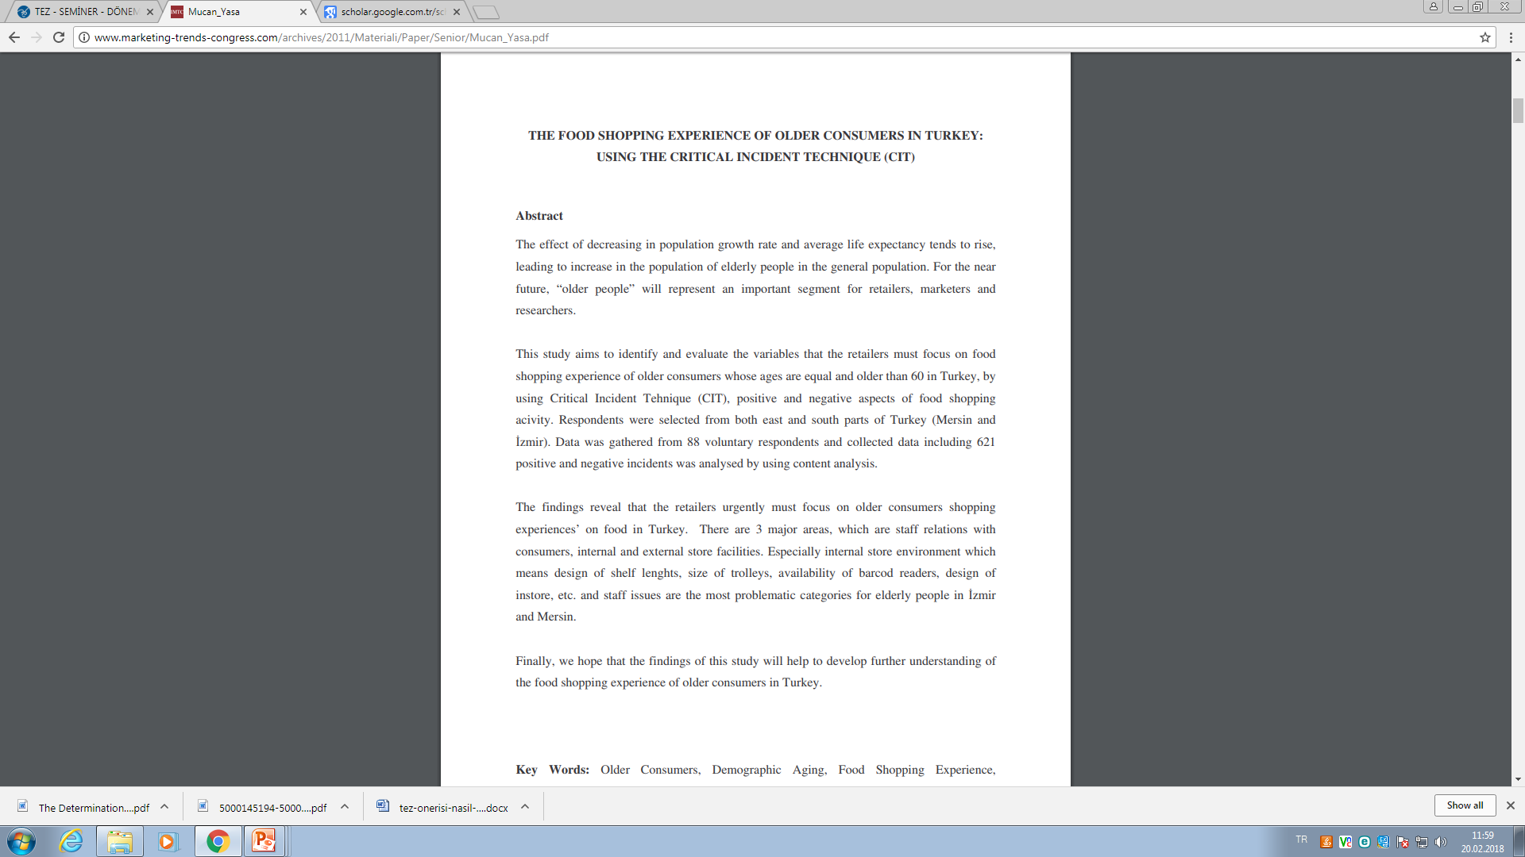
Yaş grupları açısından (X,Y,Z, çocuk ,genç yaşlı vb.)

Slide 45
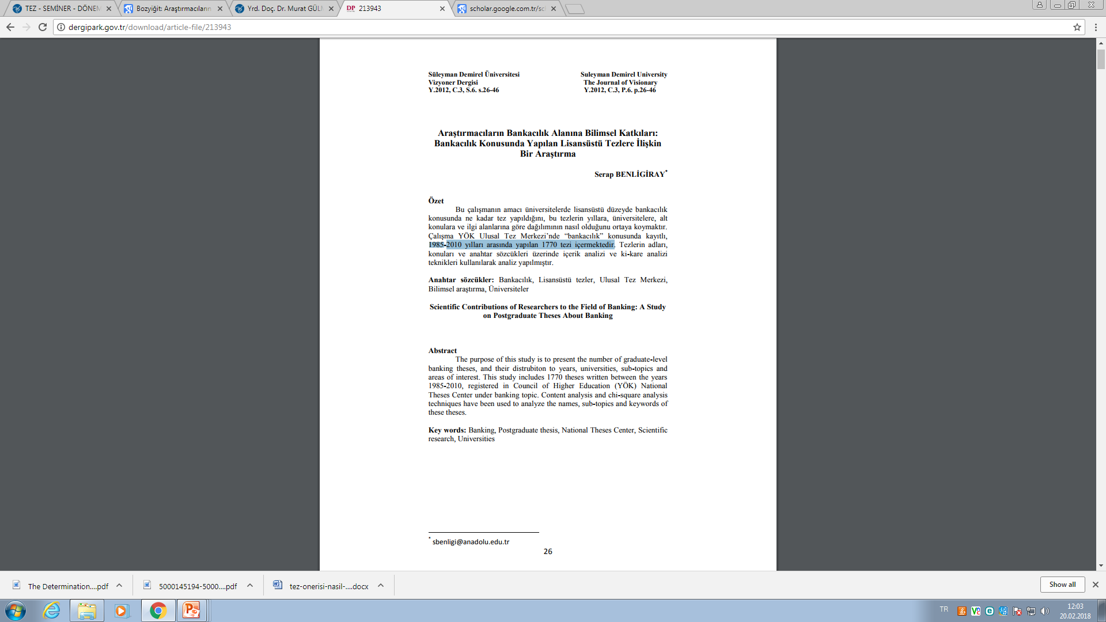
Zaman açısından (2010-2018 yılları arasında)

Slide 46
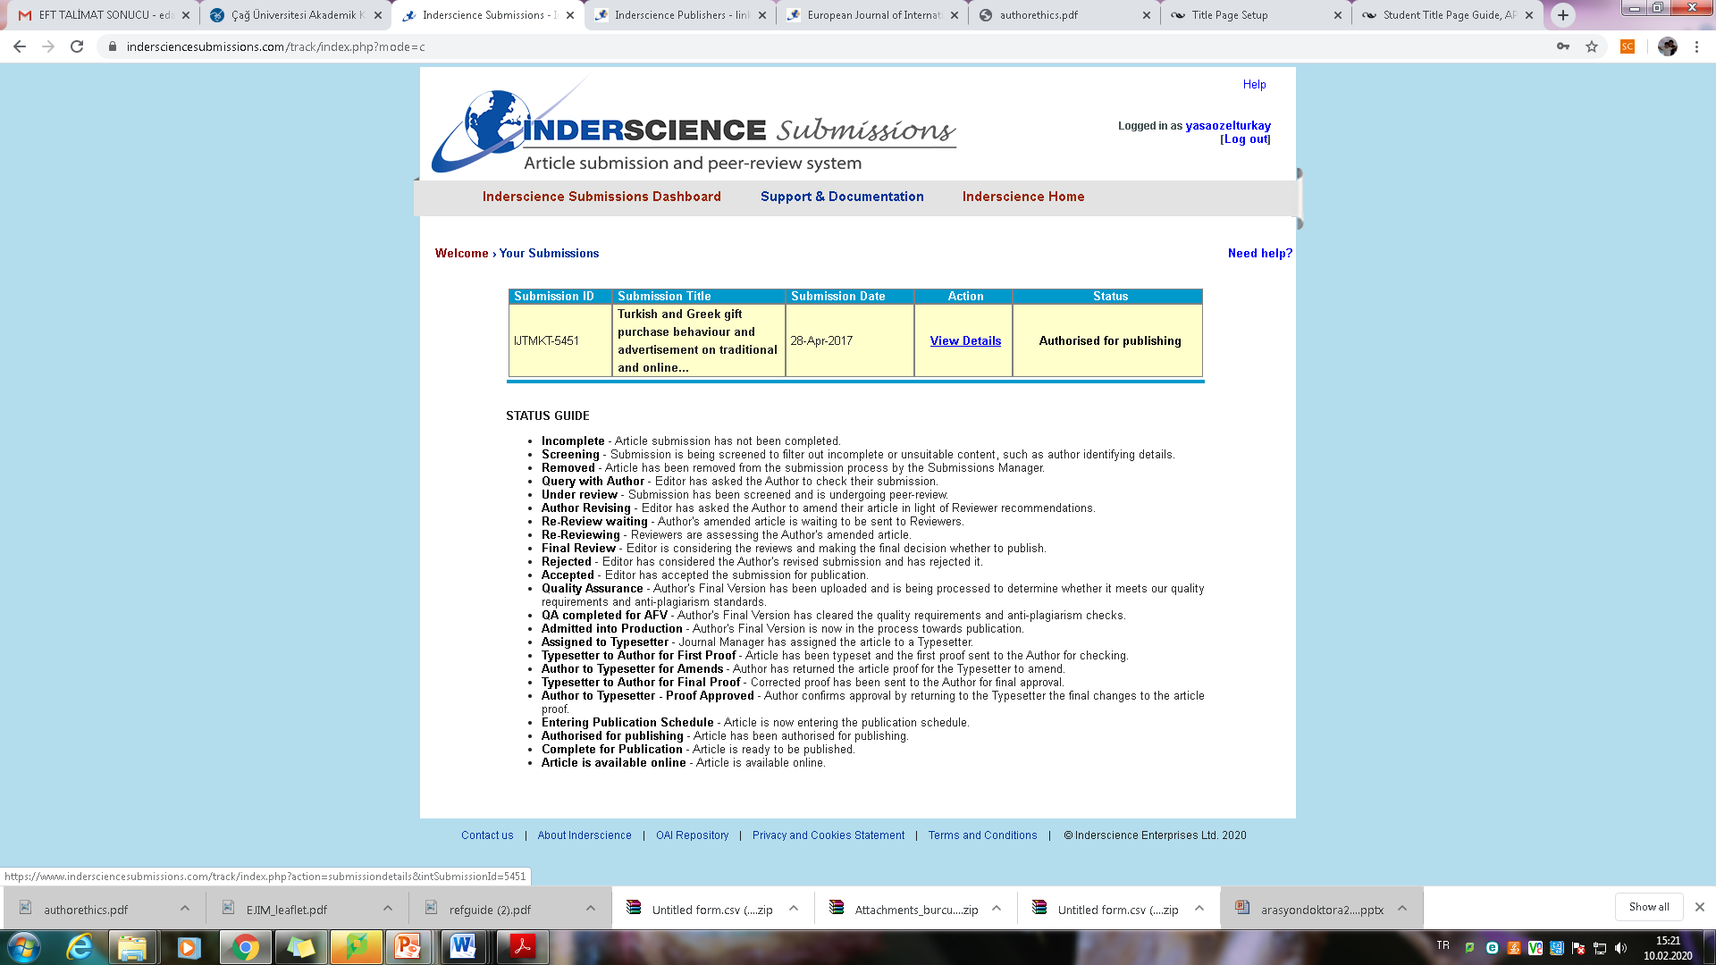

Slide 47
Çalışma hazırlarken...
https://www.emeraldgrouppublishing.com/authors/writing/calls.htm
https://www.inderscience.com/mobile/inauthors/index.php?pid=71#conf

Slide 48
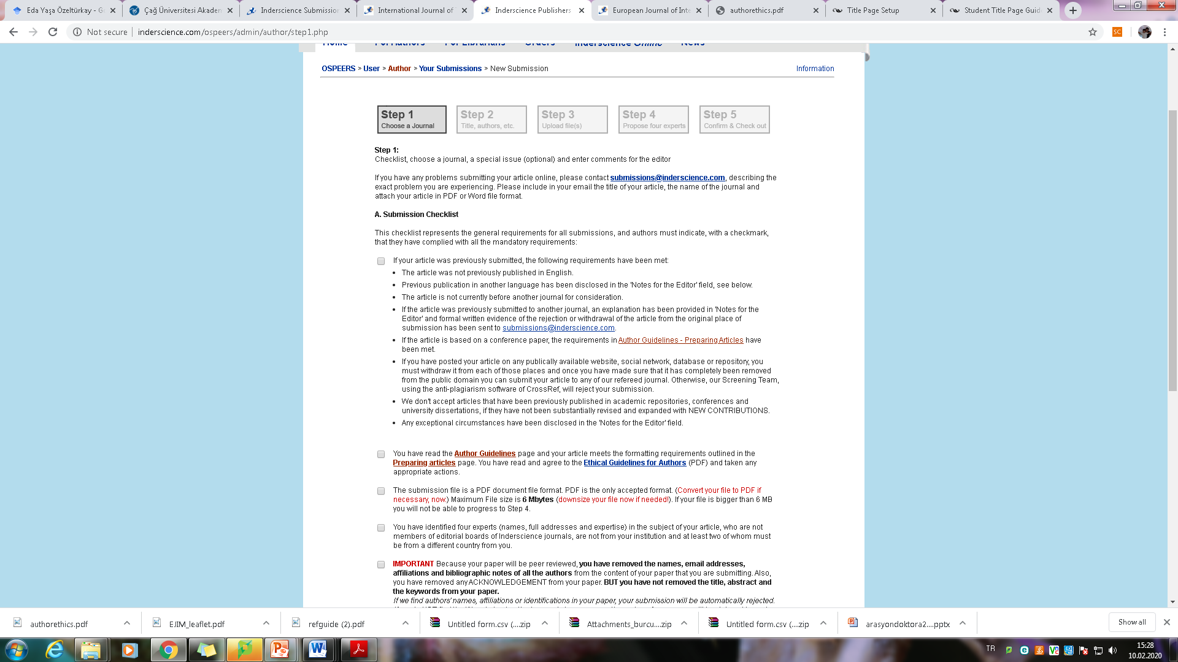

Slide 49
Araştırma sorunsalının bileşenleri
Bileşen | Açıklama
Giriş cümlesi | Konuya genel bir giriş ve okuyucuyu konuya alıştırma
Sorunsal ve boşluk | Konuyla ilgili boşluk ve problem nedir?
Amaç | Araştırmacının amacı ne? Neye odaklanılacak?
Önem ve katkı | Bu konuyu çalışmak neden önemli? Yenilik ve katkı ne olacak

Slide 50
İyi bir özet
Araştırmanın amacı, yöntemi, ana bulgularını ve orjinalliğini içerir.
To produce a structured abstract for the journal and Emerald database, please complete the following fields about your paper.
Özette olmazsa olmaz dört başlık:
Amaç,tasarım/yöntembilim/yaklaşım, Bulgular ve orjinalliği/ değer iken
Çalışmanıza dayalı olarak, araştırma sınırlılıkları, uygulamaya dönük öneriler ve sosyal etkiler de yer alabilir.
Açık ve net olmalı, 250 kelimeyi aşmamalı
Gerçek makalede ne var ise özette onlar yer almalı, içeriği yansıtmalıdır.
Emerald yayınevi için özet yazımı:
Please divide the abstract up into these headings:
Purpose What are the reason(s) for writing the paper or the aims of the research?
Design/methodology/approach How are the objectives achieved? Include the main method(s) used for the research. What is the approach to the topic and what is the theoretical or subject scope of the paper?
Findings What was found in the course of the work? This will refer to analysis, discussion, or results.
Research limitations/implications (if applicable) If research is reported on in the paper this section must be completed and should include suggestions for future research and any identified limitations in the research process.
Practical implications (if applicable) What outcomes and implications for practice, applications and consequences are identified? How will 2 the research impact upon the business or enterprise? What changes to practice should be made as a result of this research? What is the commercial or economic impact? Not all papers will have practical implications.
Social implications (if applicable) What will be the impact on society of this research? How will it influence public attitudes? How will it influence (corporate) social responsibility or environmental issues? How could it inform public or industry policy? How might it affect quality of life? Not all papers will have social implications.
Originality/value What is new in the paper? State the value of the paper and to whom

Slide 51
Good abstract https://www.aje.com/arc/make-great-first-impression-6-tips-writing-strong-abstract/
#1. Write the paper first
#2. Provide introductory background information that leads into a statement of your aim-the first section of your abstract is very valuable real estate. These 1-3 sentences must inform the reader about why you have undertaken this research.
#3. Briefly describe your methodology
#4. Clearly describe the most important findings of your study.

Slide 52
#5. State the conclusion concisely and avoid overstatements.
The last 1-2 sentences of your abstract should be devoted to the overall take-home message of your study: your conclusions. A good way to begin this section is with phrases such as “Our study revealed that…” or “Overall, we conclude that…”.
Then, state your main finding as concisely as possible. If you have other interesting secondary findings, these can be mentioned as well. Finally, consider including a sentence that states the theoretical or practical implications of your work and/or describes how your work has advanced the field.
This will help readers to more clearly understand the importance of your findings. As mentioned earlier, many readers who are unable to access the full text of your manuscript will read only your abstract, and without access to your data, they will have to take your conclusions at face value. For this reason, it is very important not to overstate your conclusions in your abstract so as not to mislead your readers

Slide 53
#6. Things to avoid in an abstract
The abstract is meant to be a summary of your research; as such, it usually carries a strict word count limit. Combining all of the most important aspects of your work into a paragraph of 250 words or less can be a challenging task. However, knowing what to avoid when writing the abstract can make the job a little easier.
#####For example, the abstract should not contain:
Lengthy background information (readers peruse your abstract to learn about your current work, not the previous work of other researchers)
Citations
Details about routine laboratory procedures
Details about the statistical methods or software used (unless this is the focus of your study)
Undefined abbreviations or acronyms (most journals will provide a list of common abbreviations/acronyms that do not need to be defined; some journals do not allow the use of abbreviations/acronyms in the abstract)
Results or interpretations that are not discussed in the text

Slide 54
How to write a good abstract
https://www.ncbi.nlm.nih.gov/pmc/articles/PMC3136
027/

Slide 55
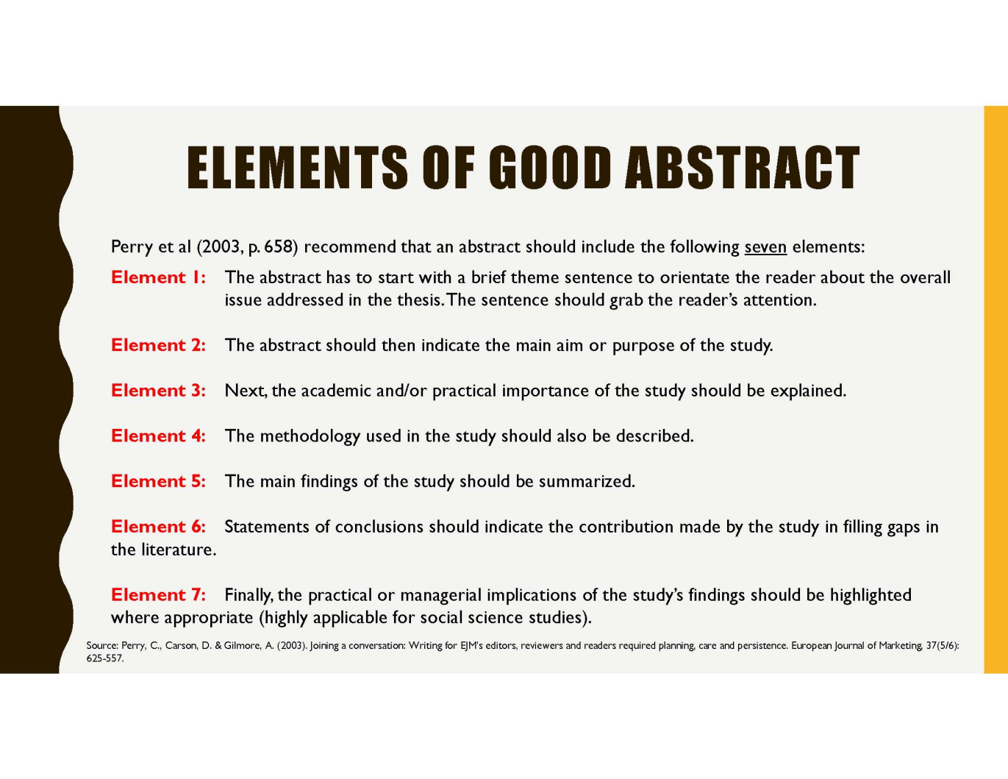
http://fbme.utm.my/postgraduate/2017/11/08/369/

Slide 56
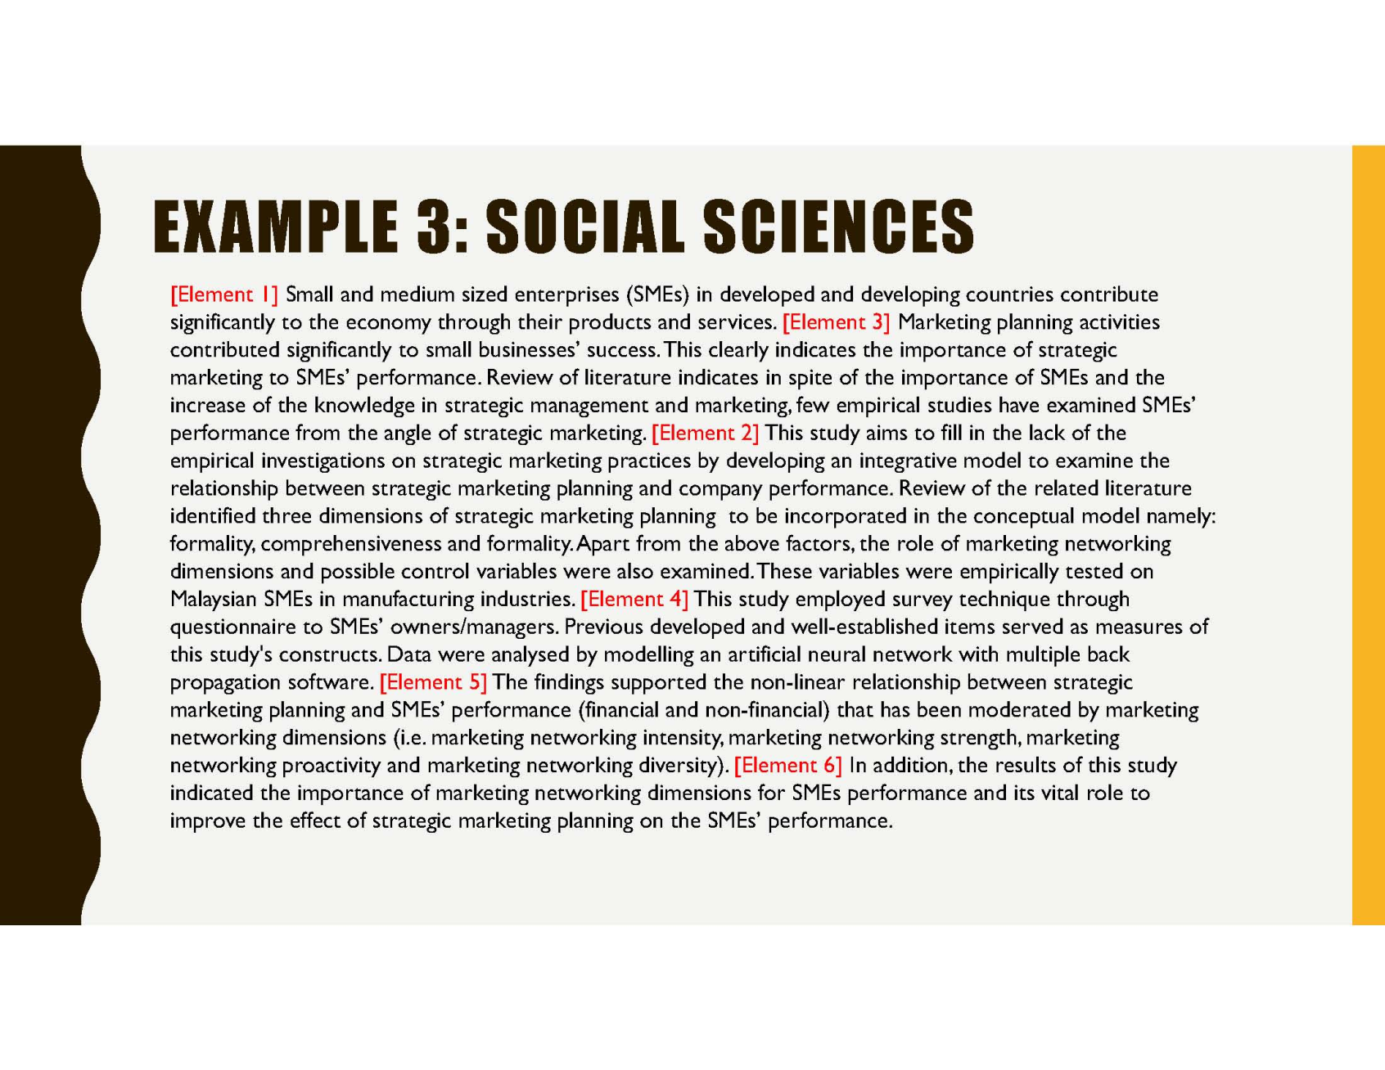

Slide 57
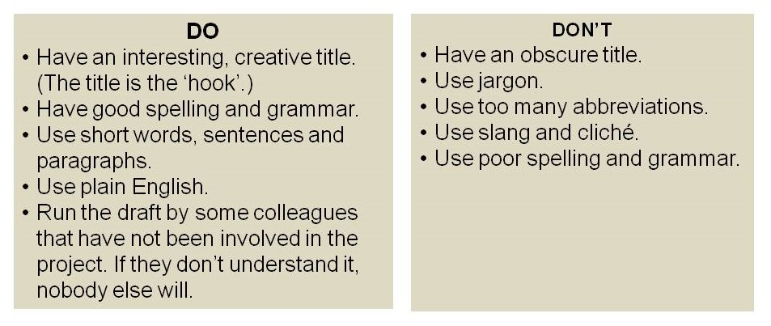
Good abstract...

Slide 58
İyi bir başlık için...
Açık ve anlaşılır olarak çalışmanın ana amacını içermeli
Kısaltma kullanmaktan kaçının
Olumlu bir etki yaratacak ve okuyucunun ilgisini çekecek kelimeler kullanın.
Alanına özgü güncel terminolojiyi kullanın.

Slide 59
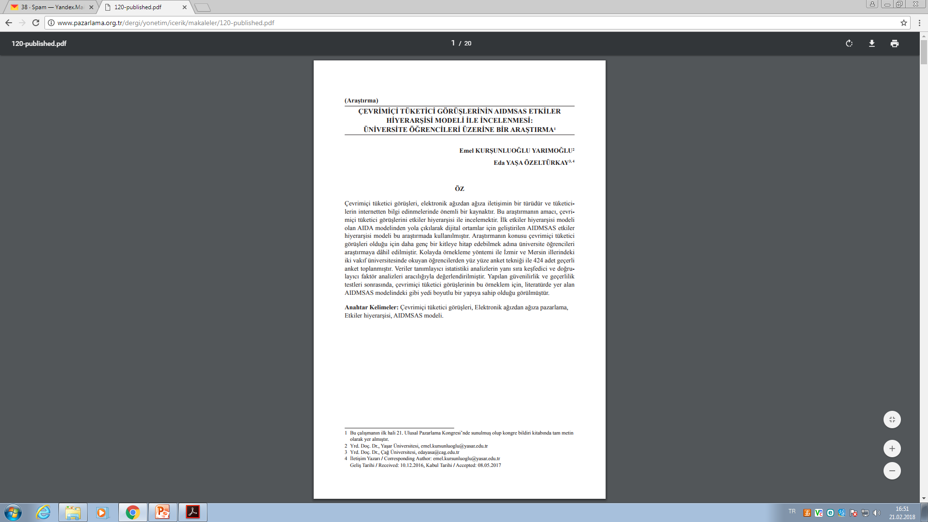

Slide 60
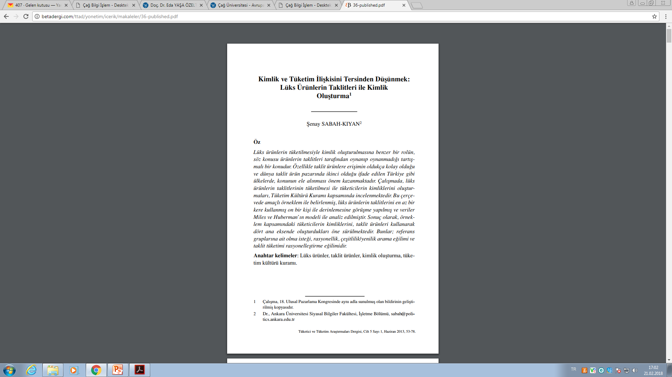

Slide 61
APA 6.0
https://apastyle.apa.org/

Slide 62
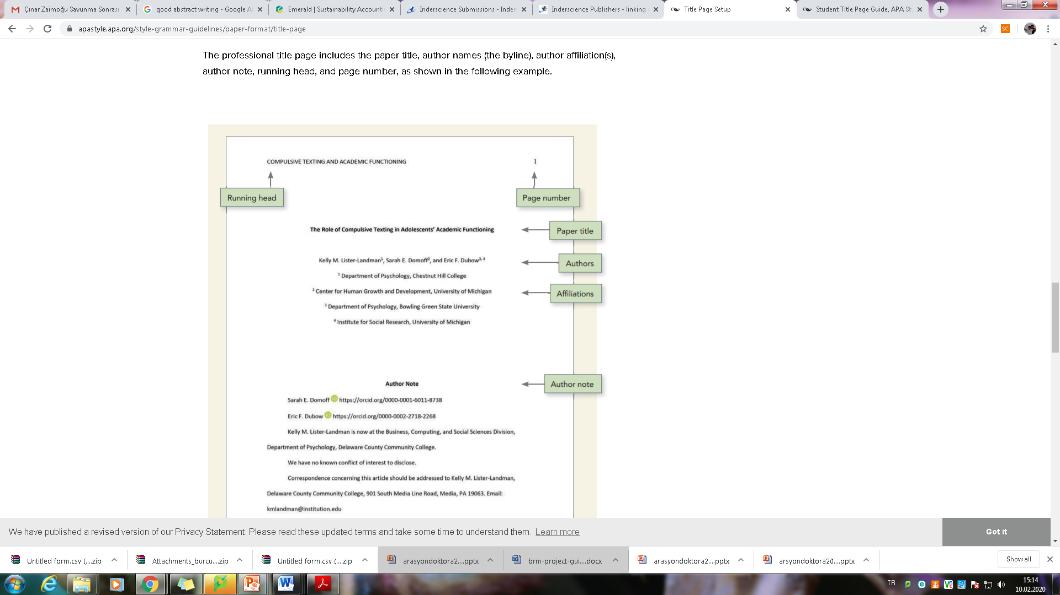

Slide 63
Sıralayalım....
Anahtar kelimeler belirleyin,
Aramaları süzün,daraltın,
Hızlı okuma yapın,
Ama iyi okuyun....
Yazmaya başlayın...

