Slide 1
Revision for midterm
Dr. Beyza Şahin Yıldırım

Slide 2
Combine following sentence with Relative clauses
Students do well on tests if they are prepared beforehand. Some students are anxious.
A research paper on environmental problems received an award. I wrote the paper.
My driveway is in front of my house. I park four cars there.
The Industrial Revolution changed the way people make things. It began in England.
Recently, a large airplane had a serious accident. It was carrying too many passengers.
British Petroleum received criticism because of the oil spill in the Gulf. It is known as BP.
The dress was long, black, and beautiful. Mary wore it.
On my vacation, I met a boy. My father disliked him.
Jacob is a student in my biology class. His father is the ambassador from Kenya. The class
meets twice a week.

Slide 3
I’ll never forget the time when ______________________________________________
I gave up my seat on the bus to a woman whose ________________________________
The person whom __________________________________________ suddenly fainted.
Everyone criticized my opinion, which _______________________________________
Often, people who ____________________________________ end up being successful.
Many people find Maryland, where ___________________________________, exciting.

Slide 4
Identfy Non-defining & Defining
The Renaissance, which was a period of great cultural and artistic revival in Europe, began in Italy in the 14th century.
The algorithm that powers the company's recommendation system uses advanced machine learning techniques.
Mount Everest, which is the highest peak in the world, attracts thousands of climbers every year despite its dangers.
The vaccine which was developed in record time has shown promising results in clinical trials.
The Louvre Museum in Paris, where the Mona Lisa is displayed, attracts millions of visitors annually.
The theory of relativity that Einstein proposed revolutionized our understanding of space and time.
The Great Barrier Reef, which is the world's largest coral reef system, is facing threats from climate change.
The novel whose protagonist is a time-traveling historian has won several literary awards.

Slide 5
Translate the following into Turkish
The war could have been ended.
German used to be taught in this school ten years ago.
He had better be taught maths.
He might have beeen wounded in the accident.
This difficulty can be avoided in several ways.
The boat can't have left already, it is not due to go until ten.
I needn't have married Jane, I could only have married someone else.
He had to get punished.
This method can be said to be the best of all.
She had to go straight home from school.

Slide 6
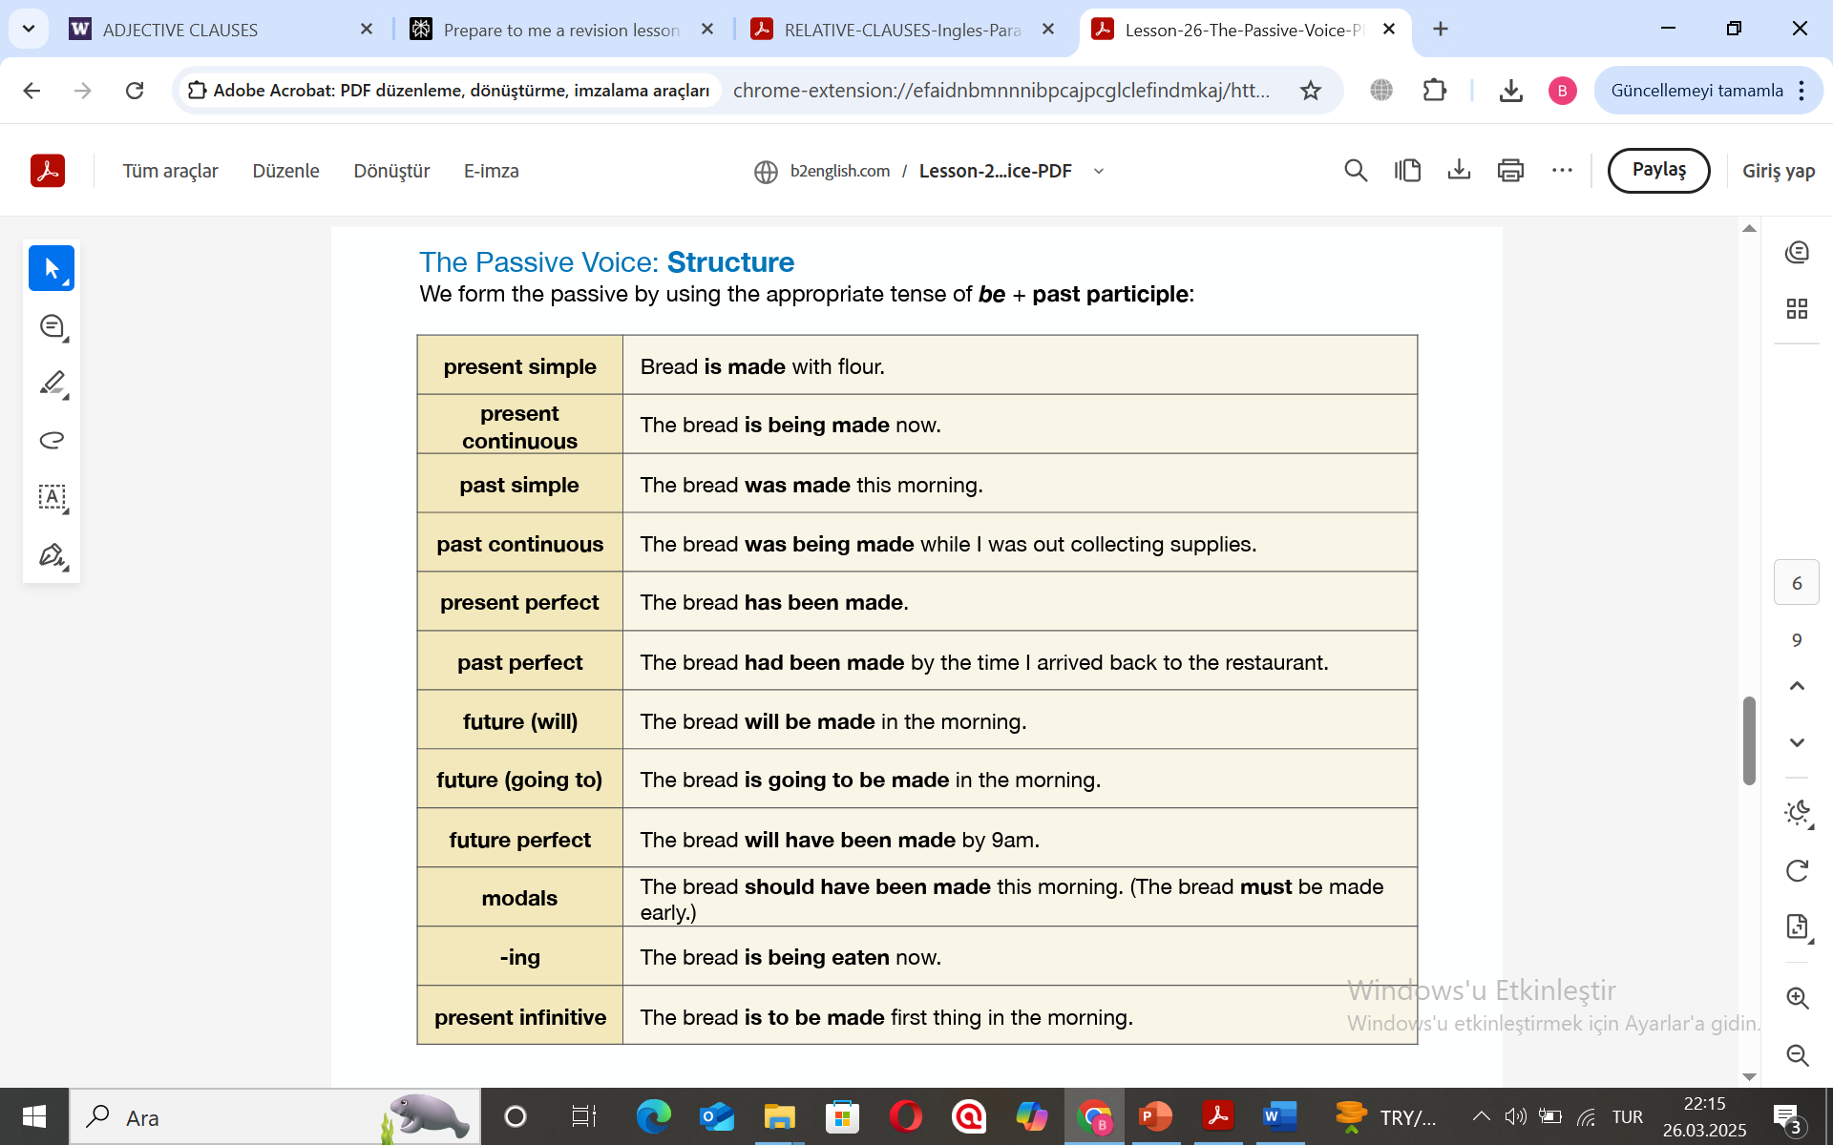
Passive Voice

Slide 7
1. Teachers require the students to watch an educational video on the new subject. The students ______________________ an educational video on the new subject.
2. My bank manager is signing the document as we speak. The document _______________ as we speak.
3. Many people will be celebrating the football team’s victory in the streets tonight! The football team’s victory ___________________ in the streets tonight.
4. People have been giving out emergency medical supplies to the villagers. Emergency medical supplies ____________________ to the villagers.
5. In India, people believe that cows are holy. In India, _______________ that cows are holy. 6. Someone has stolen my bicycle from outside the supermarket. My bicycle _________________ from outside the supermarket.

Slide 8
Determine if these sentences are in the active or passive voice. If a sentence is in the active voice, identify its subject and verb. If a sentence is in the passive voice, rewrite it so that it is in the active voice. (If a passive sentence has no “doer,” make one up!)
1. The coffee was still boiling after it was served.
2. The students worked on their papers all night.
3. The wind was making the tree sway.
4. Kana has been holding her hand up to answer the question.
5. The three dogs were being walked.
6. The earth continually spins on its axis.
7. The students were released from class.
8. Nathaniel gave his speech flawlessly.
9. Without interruption, the scarf was knit by Margot.
10. We were driven to the beach by Caleb in his minivan.
11. The class was taught by Heather in the evenings.
12. Café Moka closed early, so Danielle brewed her own pot of coffee.
13. The professor and her aid passed out the exam, and it was taken by the students.
14. Griff explained the importance of proofreading one’s sentences.
15. The exercise sheet was finished by you! See next

Slide 9
1. Answer: Passive voice. Revision: The coffee still boiled after Angela served it.
2. Answer: Active voice. Subject: the students. Verb: worked.
3. Answer: Passive voice. Revision: The wind made the tree sway.
4. Answer: Passive voice. Revision: Kana held her hand up to answer the question.
5. Answer: Passive voice. Revision: Joe walked his three dogs.
6. Answer: Active voice. Subject: the earth. Verb: spins.
7. Answer: Passive voice. Revision: The teacher released the students from class
8. Answer: Active voice. Subject: Nathaniel. Verb: gave.
9. Answer: Passive voice. Revision: Without interruption, Margot knit the scarf.
10. Answer: Passive voice. Revision: Caleb drove us to the beach in his minivan.
11. Answer: Passive voice. Revision: Heather taught the class in the evenings.
12. Answer: Active voice. Subjects: Café Moka, Danielle. Verbs: closed, brewed.
13. Answer: Active voice, Passive voice. Subjects: the professor and her aid. Verb: passed. Revision: The professor and her aid passed out the exam, and the students took it.
14. Answer: Active voice. Subject: Griff. Verb: explained.
15. Answer: Passive voice. Revision: You finished the exercise sheet!

