Slide 1

Chapter 5
Consumer Markets and Buyer Behavior
MAN 331 Contemporary Issues in Marketing
Notes:
If this PowerPoint presentation contains mathematical equations, you may need to check that your computer has the following installed:
1) Math Type Plugin
2) Math Player (free versions available)
3) NVDA Reader (free versions available)

Slide 2
Learning Objectives
5.1 Define the consumer market and construct a simple model of consumer buyer behavior.
5.2 Name the four major factors that influence consumer buyer behavior.
5.3 List and define the major types of buying decision behavior and the stages in the buyer decision process.
5.4 Describe the adoption and diffusion process for new products.

Slide 3
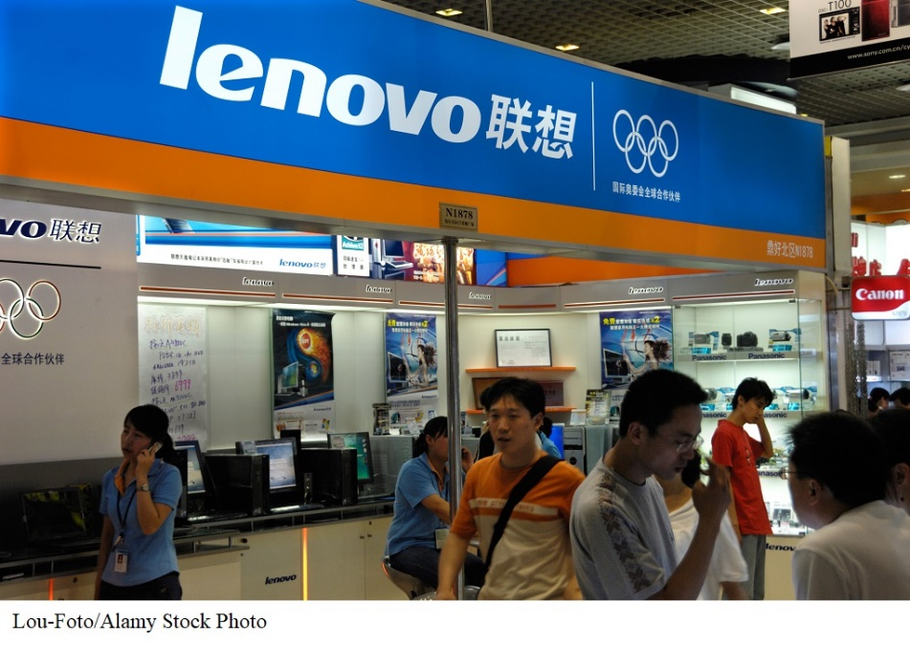
Lenovo: Understanding Customers and Building Profitable Relationships
“The global success of Lenovo is rooted in its deep and sound understanding of customers and its ability to build profitable relationships. The business model is thus built on customer satisfaction, innovation, and operational efficiency.”
Notes:
By listening and communicating constantly with their customers and taking into consideration their input when it comes to product development and improvement, Lenovo has been successful in building emotional relationships with its customers.

Slide 4
Learning Objective 1
Define the consumer market and construct a simple model of consumer buyer behavior.

Slide 5
Consumer Markets and Buyer Behavior
Consumer buyer behavior is the buying behavior of final consumers—individuals and households that buy goods and services for personal consumption.
Consumer markets are made up of all the individuals and households that buy or acquire goods and services for personal consumption.
Notes:
Discussion Question
What have you recently purchased that cost over $100? Write down all the reasons you purchased this particular item.
Because students are all consumers—it is interesting to start the class with a discussion of products they have recently purchased. When you ask them why they purchased a particular item or product, you can bring them through many topics in this chapter including the characteristics that affect consumer behavior (cultural, social, personal, and psychological). You can also try to determine the process they went through including how and where they searched for information and how they evaluated their alternatives. Finally, ask them how they feel about their purchase (postpurchase behavior). This discussion will lead nicely to the next slide about the model of buyer behavior.
Consumers make many buying decisions every day, and the buying decision is the focal point of the marketer’s effort. Most large companies research consumer buying decisions in great detail to answer questions about what consumers buy, where they buy, how and how much they buy, when they buy, and why they buy. Marketers can study actual consumer purchases to find out what they buy, where, and how much. But learning about the whys of consumer buying behavior is not so easy—the answers are often locked deep within the consumer’s mind. Often, consumers themselves don’t know exactly what influences their purchases.

Slide 6
Learning Objective 2
Name the four major factors that influence consumer buyer behavior.

Slide 7
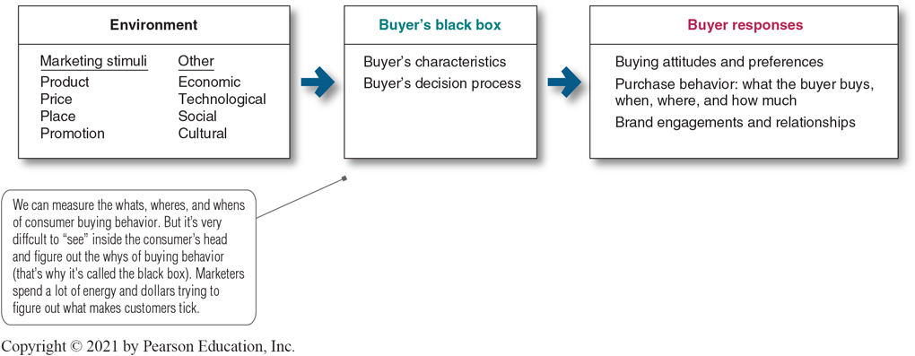
Model of Consumer Behavior
Figure 5.1 The Model of Buyer Behavior
The central question for marketers is this: How do consumers respond to various marketing efforts the company might use? The starting point is the stimulus-response model of buyer behavior
This figure shows that marketing and other stimuli enter the consumer’s black box and produce certain responses.
Notes:
The central question for marketers is this: How do consumers respond to various marketing efforts the company might use? The starting point is the stimulus-response model of buyer behavior shown in Figure 5.1. This figure shows that marketing and other stimuli enter the consumer’s “black box” and produce certain responses. Marketers must figure out what is in the buyer’s black box.
Long Description:
The details depicted in the flowchart are as follows:
The environment
Marketing stimuli
Product
Price
Place
Promotion
Other
Economic
Technological
Social
Cultural
Buyer’s black box
Buyer’s characteristics
Buyer’s decision process
Buyer responses
Buying attitudes and preferences
Purchase behavior: what the buyer buys, when, where, and how much
Brand engagements and relationships
Note: We can measure the whats, wheres, and whens of consumer buying behavior. But it’s very difficult to "see" inside the consumer’s head and figure out the whys of buying behavior (that’s why it’s called the black box). Marketers spend a lot of energy and dollars trying to figure out what makes customers tick.

Slide 8
Model of Consumer Behavior
Marketers want to understand how the stimuli are changed into responses inside the consumer’s black box, which has two parts.
First, the buyer’s characteristics influence how he or she perceives and reacts to the stimuli. These characteristics include a variety of cultural, social, personal, and psychological factors.
Second, the buyer’s decision process itself affects his or her behavior. This decision process—from need recognition, information search, and alternative evaluation to the purchase decision and post purchase behavior—begins long before the actual purchase decision and continues long after. We look first at buyer characteristics as they affect buyer behavior and then discuss the buyer decision process.

Slide 9
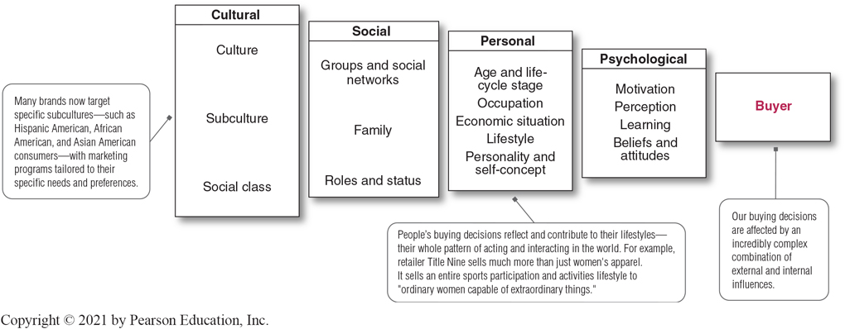
Characteristics Affecting Consumer Behavior (1 of 15)
Figure 5.2 Factors Influencing Consumer Behavior
Notes:
Consumer purchases are influenced strongly by cultural, social, personal, and psychological characteristics, as shown in Figure 5.2. For the most part, marketers cannot control such factors, but they must take them into account.
Discussion Question
What factors influenced your decision to buy the specific smart phone you have?
Long Description:
The details of the figure are as follows:
Cultural
Culture
Subculture: Many brands now target specific subcultures—such as Hispanic American, African American, and Asian American consumers—with marketing programs tailored to their specific needs and preferences.
Social class
Social
Groups and social networks
Family
Roles and status
Personal
Age and life-cycle stage
Occupation
Economic situation
Lifestyle
Personality and self-concept
Note: People’s buying decisions reflect and contribute to their lifestyles—their whole pattern of acting and interacting in the world. For example, retailer Title Nine sells much more than just women’s apparel. It sells an entire sports participation and activities lifestyle to "ordinary women capable of extraordinary things."
Psychological
Motivation
Perception
Learning
Beliefs and attitudes
Buyer: Our buying decisions are affected by an incredibly complex combination of external and internal influences.

Slide 10
Characteristics Affecting Consumer Behavior (2 of 15)
1. Cultural Factors
Cultural factors have an important influence on consumer behavior. Marketers need to understand the role played by the buyer’s culture, subculture, and social class
A. Culture is the set of basic values, perceptions, wants, and behaviors learned by a member of society from family and other important institutions.
Marketers are always trying to spot cultural shifts to discover new products that might be wanted. For example, the cultural shift toward greater concern about health and fitness has created a huge industry for health-and-fitness services, exercise equipment and clothing, organic foods, and a variety of diets.
Notes:
Cultural factors exert a broad and deep influence on consumer behavior. Marketers need to understand the role played by the buyer’s culture, subculture, and social class.
Marketers are always trying to spot cultural shifts so as to discover new products that might be wanted. For example, the cultural shift toward greater concern about health and fitness has created a huge industry for health-and-fitness services, exercise equipment and clothing, organic foods, and a variety of diets.

Slide 11
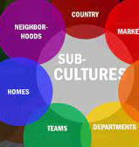
Characteristics Affecting Consumer Behavior (3 of 15)
1. Cultural Factors
B. Subcultures are groups of people within a culture with shared value systems based on common life experiences and situations.
Many subcultures make up important market segments, and marketers often design products and marketing programs tailored to their needs. Examples of three such important subculture groups are Hispanic American, African American, and Asian American consumers.
Targeting Hispanic consumers: Nestle’s DiGiorno brand worked with Twitter’s U.S. Hispanics team and the NFL to create a football campaign with Spanish tweets.
Notes:
Subcultures include nationalities, religions, racial groups, and geographic regions.
Discussion Question
What subculture do you belong to? How does this influence you as a consumer?
Although Hispanic consumers share many characteristics and behaviors with the mainstream buying public, there are also distinct differences. They tend to be deeply family oriented and make shopping a family affair. Older, first-generation Hispanic consumers tend to be very brand loyal and to favor brands and sellers who show special interest in them. Younger Hispanics, however, have shown increasing price sensitivity in recent years and a willingness to switch to store brands.
Within the Hispanic market, there exist many distinct subsegments based on nationality, age, income, and other factors. A company’s product or message may be more relevant to one nationality over another, such as Mexicans, Costa Ricans, Argentineans, or Cubans. Companies must also vary their pitches across different Hispanic economic segments.
The U.S. African American population is growing in affluence and sophistication. In recent years, many companies have developed special products, appeals, and marketing programs for African American consumers.
Asian American consumers are the most affluent U.S. demographic segment. They now number more than 18 million, with annual buying power expected to approach $1 billion by 2017. Asian Americans are the second-fastest-growing subsegment after Hispanic Americans. And like Hispanic Americans, they are a diverse group that speaks many different languages. As a group, Asian consumers shop frequently and are the most brand conscious of all the ethnic groups. They can be fiercely brand loyal. As a result, many firms now target the Asian American market.
Cross-cultural marketing is the practice of including ethnic themes and cross-cultural perspectives within mainstream marketing. Cross-cultural marketing appeals to consumer similarities across subcultures rather than differences. Many marketers are finding that insights gleaned from ethnic consumers can influence their broader markets.
Long Description:
The tweet is followed by an image of a 10-seconds video clip that depicts two helmets labeled DiGiorno versus Delivery. The background shows a football ground with a DiGiorno original rising crust pizza box. The tweet has 26 retweets, 318 likes, and 11 replies.

Slide 12
Characteristics Affecting Consumer Behavior (4 of 15)
1. Cultural Factors
C. Social classes are society’s relatively permanent and ordered divisions whose members share similar values, interests, and behaviors.
Measured as a combination of occupation, income, education, wealth, and other variables
Social scientists have identified seven American social classes: upper-upper class, lower-upper class, upper-middle class, middle class, working class, upper-lower class, and lower-lower class.
Marketers are interested in social class because people within a given social class tend to exhibit similar buying behavior. Social classes show distinct product and brand preferences in areas such as clothing, home furnishings, travel and leisure activity, financial services, and automobiles.
Notes:
In some social systems, members of different classes are reared for certain roles and cannot change their social positions.
In the United States, however, the lines between social classes are not fixed and rigid; people can move to a higher social class or drop into a lower one.

Slide 13
Characteristics Affecting Consumer Behavior (5 of 15)
2. Social Factors
A consumer’s behavior also is influenced by social factors, such as the consumer’s groups and social networks, family, and social roles and status.
A. Groups and Social Networks
Reference groups
Opinion leaders
Word-of-mouth influence
Influencer marketing
Online social networks
Notes:
Discussion Question
How can marketers use social networks?
This slide should provide a lively discussion for students because they all are users of social networks. Ask students for examples they have seen or experienced. Then be sure to ask if they think the marketing efforts were effective for the marketer and why? The text gives many examples.
Marketers are working to harness the power of online social networks to promote their products and build closer customer relationships.
Word-of-mouth influence can have a powerful impact on consumer buying behavior. The personal words and recommendations of trusted friends, associates, and other consumers tend to be more credible than those coming from commercial sources, such as advertisements or salespeople.
Marketers of brands subjected to strong group influence must figure out how to reach opinion leaders—people within a reference group who, because of special skills, knowledge, personality, or other characteristics, exert social influence on others.

Slide 14
Reference Groups:
Serve as direct (face-to-face interactions) or indirect points of comparison or reference in forming a person’s attitudes or behavior.
Marketers try to identify the reference groups of their target markets. Reference groups expose a person to new behaviors and lifestyles, influence the person’s attitudes and self-concept, and create pressures to conform that may affect the person’s product and brand choices
Opinion Leader:
Person within a reference group who, because of special skills, knowledge, personality, or other characteristics, exert social influence on others. Many marketers identify opinion leaders for their brands and direct marketing efforts toward them.
Word of mouth Influence:
Have a powerful impact on consumer buying behavior. The personal words and recommendations of trusted friends, family, associates, and other consumers tend to be more credible than those coming from commercial sources, such as advertisements or salespeople.
Most word-of-mouth influence happens naturally: Consumers start chatting about a brand they use or feel strongly about one way or the other. Often, however, rather than leaving it to chance, marketers can help to create positive conversations about their brands.

Slide 15
Influencer Marketing:
Involves enlisting established influencers or creating new influencers to spread the word about a company’s brands.
Brands love influencer marketing because it builds on existing relationships between influencers and their followers.
For starters, marketers must partner with influencers who fit naturally with their brands. And rather than just chasing large numbers of followers with one-time posts by big-name influencers, brands must build long-term relationships with influencers who resonate authentically with customers. Ideally, a brand can find influencers that have all three attributes—a fit with the brand, big numbers, and authentic brand-related connections with followers.
Online Social Networks:
Online communities where people socialize or exchange information and opinions. Social networking communities range from blogs and message boards to social media sites (Facebook, Twitter, YouTube, Instagram, LinkedIn) and even communal shopping sites (Amazon.com and Etsy).
Marketers are working to benefit from the power of these social networks to promote their products and build closer customer relationships. They hope to use digital, mobile, and social media to become an interactive part of consumers’ conversations and lives.

Slide 16
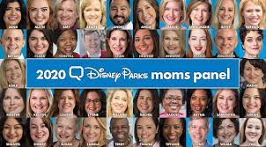
Influencer marketing
Disney has long recognized the power of moms in social media and the importance they play in planning family vacations.
Eight years ago, the company assembled a group called Disney Social Media Moms, roughly 1,300 carefully selected mom bloggers (and some dads), travel bloggers, and active Disney-focused social media posters. Disney looks for influential moms who fit the brand’s family-friendly focus, use social media heavily, and are active in their communities offline as well as online.

Slide 17
Influencer marketing
Adidas partners with super-model, socialite, and reality TV personality Kylie Jenner, the youngest of the Jenner–Kardashian clan.
At just 21 years old, Jenner has amassed more than 250 million highly engaged social media followers—132 million on Instagram alone. Jenner is Instagram’s most lucrative influencer, commanding a cool $1 million per post. She keeps fans hooked with daily personal posts as well as posts for her own Kylie Cosmetics. But when it comes to promoting other companies’ brands, Jenner is very choosy.
A few months ago, the former Puma girl began posting images of herself wearing adidas sneakers. Shortly thereafter, adidas announced that Jenner’s posts were no co-incidence. She was the brand’s latest ambassador and the face of two new adidas lines: Falcon sneakers and the Coeeze collection of cropped hoodies, sweat suits, tees, and tights.
Whether in the park with her daughter Stormi or on the go in her Rolls Royce Ghost, Jenner’s looks and style in adidas apparel have inspired her fans and matched the brand’s positioning beautifully. The Kylie Jenner–adidas partnership illustrates another influencer marketing guideline: Influencers should actually use the products they’re being paid to represent.

Slide 18
Characteristics Affecting Consumer Behavior (6 of 15)
2. Social Factors
B. Family : Family is the most important membership reference group and consumer buying organization in society. Marketers are interested in the roles and influence of the husband, wife, and children on the purchase of different products and services.
Buying roles change with evolving consumer lifestyles. For example, in the United States, the wife traditionally has been considered the main purchasing agent for the family in the areas of food, household products, and clothing. But with more than 70 percent of all mothers now working outside the home and the willingness of husbands to do more of the family’s purchasing, all this has changed in recent years. Recent surveys show that one-third of men do the majority of the house cleaning and 43 percent of men preform food preparation and cleanup activities. At the same time, women today purchase more than 50 percent of traditionally male products, including cars, electronics, and home improvement products.
C. Role and status can be defined by a person’s position in a group. family, clubs, organizations, online communities. The person’s position in each group can be defined in terms of both role and status
Notes:
Discussion Question
What brands do you purchase because it is what your parents used? Why do you think this occurs?
Family members can strongly influence buyer behavior. The family is the most important consumer buying organization in society, and it has been researched extensively. Marketers are interested in the roles and influence of the husband, wife, and children on the purchase of different products and services.
People usually choose products appropriate to their roles and status. Consider the various roles a working mother plays. In her company, she may play the role of a brand manager; in her family, she plays the role of wife and mother; at her favorite sporting events, she plays the role of avid fan. As a brand manager, she will buy the kind of clothing that reflects her role and status in her company. At the game, she may wear clothing supporting her favorite team.

Slide 19
Characteristics Affecting Consumer Behavior (7 of 15)
3. Personal Factors
A.Occupation affects the goods and services bought by consumers.
B. Age and Life Stage affect tastes in food, clothes, furniture, ad recreation. Life-stage changes usually result from demographics and life-changing events—marriage, having children, purchasing a home, divorce, children going to college, changes in personal income, moving out of the house, and retirement. Marketers often define their target markets in terms of life-cycle stage and develop appropriate products and marketing plans for each stage.
C. Economic situations include trends in spending, personal income, savings, interest rates AND will affect consumer store and product choices.
Notes:
Discussion Question
Ask the students how their occupations and economic situations affect the goods and services they buy.
Marketers try to identify the occupational groups that have an above-average interest in their products and services. A company can even specialize in making products needed by a given occupational group.
A person’s economic situation will affect his or her store and product choices. In today’s more frugal times, most companies have taken steps to redesign, reposition, and reprice their products and services. For example, upscale discounter Target has put more emphasis on the “Pay less” side of its “Expect more. Pay less.” Positioning promise.

Slide 20
Characteristics Affecting Consumer Behavior (8 of 15)
3. Personal Factors
D.Lifestyle is a person’s pattern of living as expressed in his or her psychographics.
Activities (work, hobbies, shopping, sports, social events), interests (food, fashion, family, recreation), and opinions (about themselves, social issues, business, products).
Lifestyle captures something more than the person’s social class or personality. It profiles a person’s whole pattern of acting and interacting in the world. When used carefully, the lifestyle concept can help marketers understand changing consumer values and how they affect buyer behavior. Consumers don’t just buy products; they buy the values and lifestyles those products represent.
E. Personality refers to the unique psychological characteristics that distinguish a person or group. Example: self-confidence, dominance, sociability, aggresiveness
The idea is that brands also have personalities, and consum-ers are likely to choose brands with personalities that match their own.
Notes:
Discussion Question
What categories of products seem to be targeted to consumer’s lifestyles?
Students will realize that many products including cars, food, cosmetics, and shampoo appeal to consumer lifestyles.
When used carefully, the lifestyle concept can help marketers understand changing consumer values and how they affect buyer behavior. Consumers don’t just buy products; they buy the values and lifestyles those products represent.
Psychographics measure a consumer’s AIOs (activities, interests, opinions) to capture information about a person’s pattern of acting and interacting in the environment.
Marketers look for lifestyle segments with needs that can be served through special products or marketing approaches. Such segments might be defined by anything from family characteristics or outdoor interests to pet ownership.
It is interesting to talk about brand personalities and ask students the personality of several brands.
A brand personality is the specific mix of human traits that may be attributed to a particular brand.
This slide shows five brand personality traits
1. Sincerity (down-to-earth, honest, wholesome, and cheerful)
2. Excitement (daring, spirited, imaginative, and up-to-date)
3. Competence (reliable, intelligent, and successful)
4. Sophistication (upper class and charming)
5. Ruggedness (outdoorsy and tough)
Each person’s distinct personality influences his or her buying behavior. Personality refers to the unique psychological characteristics that distinguish a person or group. Personality can be useful in analyzing consumer behavior for certain product or brand choices.
The idea is that brands also have personalities, and consumers are likely to choose brands with personalities that match their own.

Slide 21
Characteristics Affecting Consumer Behavior (9 of 15)
Psychological Factors
Motivation
Perception
Learning
Beliefs and attitudes
Notes:
The following slides will discuss these psychological factors in detail.
Motive (drive) is a need that is sufficiently pressing to direct the person to seek satisfaction of the need.
Perception is the process by which people select, organize, and interpret information to form a meaningful picture of the world.
Learning is changes in an individual’s behavior arising from experience.
Beliefs and Attitudes are difficult to change.

Slide 22
Characteristics Affecting Consumer Behavior (10 of 15)
Psychological Factors
A motive (or drive) is a need that is sufficiently pressing to direct the person to seek satisfaction of the need.
Motivation research refers to qualitative research designed to probe consumers’ hidden, subconscious motivations.
Notes:
Consumers often don’t know or can’t describe why they act as they do. Thus, motivation researchers use a variety of probing techniques to uncover underlying emotions and attitudes toward brands and buying situations.
Many companies employ teams of psychologists, anthropologists, and other social scientists to carry out motivation research. One ad agency routinely conducts one-on-one, therapy-like interviews to delve into the inner workings of consumers.
Another company asks consumers to describe their favorite brands as animals or cars (say, a Mercedes versus a Chevy) to assess the prestige associated with various brands. Still others rely on hypnosis, dream therapy, or soft lights and mood music to plumb the murky depths of consumer psyches.
Such projective techniques seem pretty goofy, and some marketers dismiss such motivation research as mumbo jumbo. But many marketers use such touchy-feely approaches, now sometimes called interpretive consumer research, to dig deeper into consumer psyches and develop better marketing strategies.

Slide 23
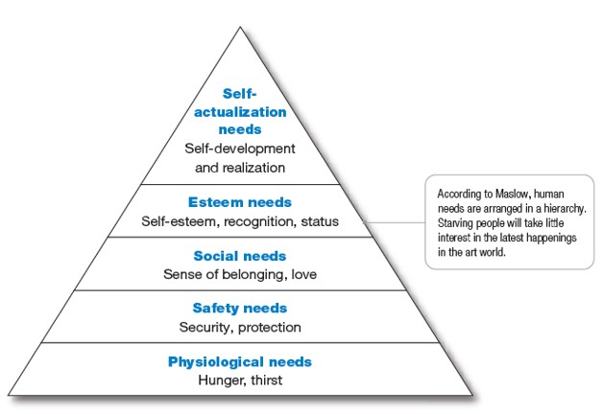
Characteristics Affecting Consumer Behavior (11 of 15)
Figure 5.3 Maslow’s Hierarchy of Needs
Notes:
Abraham Maslow sought to explain why people are driven by particular needs at particular times. Why does one person spend a lot of time and energy on personal safety and another on gaining the esteem of others? Maslow’s answer is that human needs are arranged in a hierarchy, as shown in Figure 5.3, from the most pressing at the bottom to the least pressing at the top.
A person tries to satisfy the most important need first. When that need is satisfied, it will stop being a motivator, and the person will then try to satisfy the next most important need.
Long Description:
The details of the figure from the base upward are as follows:
Physiological needs: hunger, thirst
Safety needs: security, protection
Social needs: sense of belonging, love
Esteem needs: self-esteem, recognition, status
Self-actualization needs: self-development and realization
Note: According to Maslow, human needs are arranged in a hierarchy. Starving people will take little interest in the latest happenings is the art world.

Slide 24
Characteristics Affecting Consumer Behavior (15 of 15)
Psychological Factors
A belief is a descriptive thought that a person has about something based on: knowledge, opinion and faith.
Marketers are interested in the beliefs that people formulate about specific products and services because these beliefs make up product and brand images that affect buying behavior. If some of the beliefs are wrong and prevent purchase, the marketer will want to launch a campaign to correct them.
An attitude describes a person’s relatively consistent evaluations, feelings, and tendencies toward an object or idea.
Notes:
Discussion Question
Ask the students how a belief they hold influenced one of their purchase decisions.
Through doing and learning, people acquire beliefs and attitudes. These, in turn, influence their buying behavior.
Marketers are interested in the beliefs that people formulate about specific products and services because these beliefs make up product and brand images that affect buying behavior. If some of the beliefs are wrong and prevent purchase, the marketer will want to launch a campaign to correct them.

Slide 25
Learning Objective 3
List and define the stages in the buyer decision process.

Slide 26
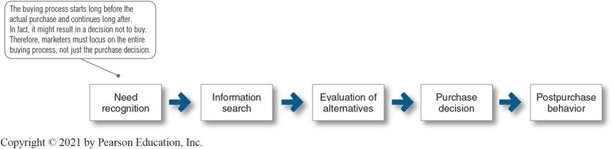
Figure 5.5 The Buyer Decision Process
Consumers pass through all five stages with every purchase in
a considered way. But buyers may pass quickly or slowly through the buying decision process. And in more routine purchases, consumers often skip or reverse some of the stages. Much depends on the nature of the buyer, the product, and the buying situation. A person buying a regular brand of toothpaste would recognize the need and go right to the purchase decision, skipping information search and evaluation.
Notes:
The buying process starts long before the actual purchase and continues long after. In fact, it might result in a decision not to buy. Therefore, marketers must focus on the entire buying process, not just the purchase decision.
Figure 5.5 suggests that consumers pass through all five stages with every purchase in a considered way. But buyers may pass quickly or slowly through the buying decision process. And in more routine purchases, consumers often skip or reverse some of the stages. Much depends on the nature of the buyer, the product, and the buying situation.
Long Description:
The details of the flowchart are as follows:
Need recognition
Information search
Evaluation of alternatives
Purchase decision
Postpurchase behavior
Note: The buying process starts long before the actual purchase and continues long after. In fact, it might result in a decision not to buy. Therefore, marketers must focus on the entire buying process, not just the purchase decision.

Slide 27
The Buyer Decision Process (1 of 6)
Need Recognition
Need recognition is the first stage of the buyer decision process, in which the consumer recognizes a problem or need triggered by:
Internal stimuli: when one of the person’s normal needs—for example, hunger or thirst—rises to a level high enough to become a drive.
External stimuli: For example, an advertisement or a chat with a friend might get you thinking about buying a new car. At this stage, the marketer should research consumers to find out what kinds of needs or problems arise, what brought them about, and how they led the consumer to this particular product.
Notes:
Need recognition may occur because of an advertisement or a discussion with a friend and get you thinking about buying a new car. This is the stage where the marketer should research consumers to find out what kinds of needs or problems arise, what brought them about, and how they led the consumer to this particular product.

Slide 28
The Buyer Decision Process (2 of 6)
Information Search
Information search is the stage of the buyer decision process in which the consumer is motivated to search for more information.
Sources of information:
  Personal sources: family, friends, neighbors, acquaintances (most effective source) Today, consumers share product opinions, images, and experiences freely across social media
  Commercial sources:advertising, sales-people, dealer and manufacturer web and mobile sites, packaging, displays
  Public sources: mass media, consumer rating organizations, social media, online searches and peer reviews
  Experiential sources: examining and using the product
Notes:
An interested consumer may or may not search for more information. If the consumer’s drive is strong and a satisfying product is near at hand, he or she is likely to buy it then. If not, the consumer may store the need in memory or undertake an information search related to the need.
For example, once you’ve decided you need a new car, at the least, you will probably pay more attention to car ads, cars owned by friends, and car conversations. Or you may actively search the web, talk with friends, and gather information in other ways.
Traditionally, consumers have received the most information about a product from commercial sources—those controlled by the marketer. The most effective sources, however, tend to be personal. Commercial sources normally inform the buyer, but personal sources legitimize or evaluate products for the buyer.

Slide 29
The Buyer Decision Process (3 of 6)
Evaluation of Alternatives
Alternative evaluation is the stage of the buyer decision process in which the consumer uses information to evaluate alternative brands in the choice set.
Notes:
Once consumers arrive at a set of final brand choices, marketers need to know how consumers process information to choose among alternative brands.
How consumers go about evaluating purchase alternatives depends on the individual consumer and the specific buying situation. The evaluation may involve careful calculations and logical thinking or little or no evaluating, buying on impulse, and relying on intuition.

Slide 30
The Buyer Decision Process (4 of 6)
Purchase Decision
Purchase decision is the buyer’s decision about which brand to purchase.
The purchase intention may not be the purchase decision due to:
Attitudes of others: If someone important to you thinks that you should buy the lowest-priced car, then the chances of you buying a more expensive car are reduced
Unexpected situational factors: For example, the economy might take a turn for the worse, a close competitor might drop its price, or a friend might report being disappointed in your preferred car. Thus, preferences and even purchase intentions do not always result in an actual purchase choice.
Notes:
Once the evaluation is complete, the consumer’s purchase decision will generally be to buy the most preferred brand.
Preferences and even purchase intentions do not always result in an actual purchase.

Slide 31
The Buyer Decision Process (5 of 6)
Postpurchase Behavior
Postpurchase behavior is the stage of the buyer decision process in which consumers take further action after purchase, based on their satisfaction or dissatisfaction.
What determines whether the buyer is satisfied or dissatisfied with a purchase?
The answer lies in the relationship between the consumer’s expectations and the product’s perceived performance.
If the product falls short of expectations, the consumer is disappointed; if it meets expectations, the consumer is satisfied; if it exceeds expectations, the consumer is delighted
Notes:
The marketer’s job does not end when the product is bought. After purchasing the product, the consumer will either be satisfied or dissatisfied and will engage in postpurchase behavior of interest to the marketer.
What determines whether the buyer is satisfied or dissatisfied with a purchase? The answer lies in the relationship between the consumer’s expectations and the product’s perceived performance.

