Slide 1
IRE … Turkish Foreign Policy
Assist. Prof. Saffet Akkaya
Course hours: ???
saffetakkaya@cag.edu.tr
Week 14: Turkish Foreign Policy in Post- Cold War Term (1990-2025)

Slide 2
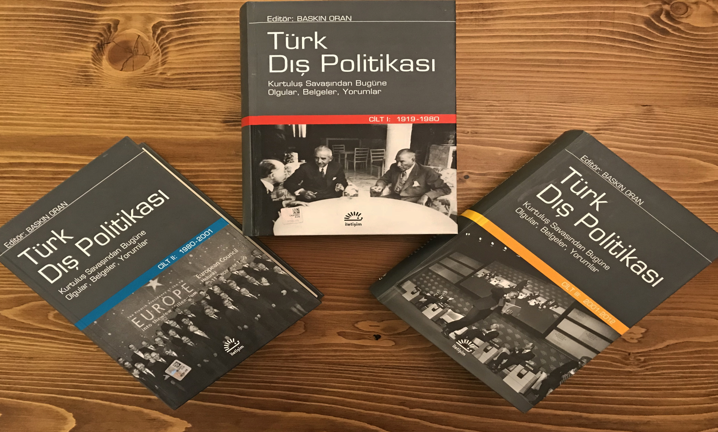
Main Source for the Course Türk Dış Politikası Vol 1, 2, 3 Ed. Baskın Oran
Türk Dış Politikası Vol 2: Pages 201-587

Slide 3
Globalization
Globalization has occurred in three waves since the 1500s.
The first wave was mercantilism, that is, exploration, the collection and transportation of virgin raw materials, and the enrichment of the West.
The second wave was colonialism and imperialism, which began in the 1850s.
The third wave is modern globalization, which began in the 1980s and accelerated with the defeat of the USSR and the triumph of capitalism.

Slide 4
The New Economic Order of the 1990s
The new economic order that evolved with globalization began to operate outside the control of states and under the control of large multinational corporations and money funds.
Money and capital were no longer fixed and could flow from one country to another at will.
As nation-state control mechanisms over the economy became virtually paralyzed, states began to form economic-political groupings.
They began to establish alliances such as NAFTA (North America Free Trade Area), the EU (European Union), and ASEAN (Association of Southeast Asean Nations).
The economies of small and isolated states began to fall, albeit distantly, under the control of these economic giants.

Slide 5
Turkish Foreign Policy in the 1990s
Ultimately, from 1990 onward, the infrastructure (economy) of individual and state life, as well as its superstructure (human and minority rights), began to dominate the agenda of Europe and the West.
While the West and the US, riding the winds of globalization in the 1980s, were filling their sails, the USSR was grappling with problems arising from within its own structure and from abroad.
To briefly summarize these: increased space and military spending, a cumbersome economic structure, aging leaders who favored the status quo, the withdrawal of USSR troops from Eastern Europe, the USSR's withdrawal from Afghanistan in 1988, the demobilization of 500,000 soldiers, nationalist movements in other Soviet republics, nationalist movements and conflicts in the Caucasus, efforts to unify East and West Germany, and ultimately, the OSCE's Third Basket's virtual surrender of the vast USSR empire, ultimately leading to the collapse of a 74-year-old state.

Slide 6
Internal Environment and Dynamics in Turkey
Starting in the 1980s, the Turkish economy underwent a structural transformation.
The fundamental pillars of this were the reduction of domestic demand, the promotion of exports, the liberalization of the economy, excessive foreign borrowing, and the creation of an economic model working hand in hand with the IMF.
The construction of highways and the privatization of state-owned enterprises (SOEs) also took place during this period.
However, this model of capitalism was an unregulated program, effectively called "wild capitalism."
This program was a bitter pill for low-income groups and the civil servant-worker-retired population.

Slide 7
The Collapse of the USSR and Its Consequences
The collapse of the USSR had several consequences. These can be categorized under six headings.
System-wise: The system of stability collapsed, and the West was left alone. Difficult years began for Soviet leaders. This triggered political Islam.
World peace-wise: The risky but secure bipolar system was gone, and a period of chaos began. An era of instability and insecurity began.
Ideology-wise: Communist ideology collapsed, but a new ideology could not be developed to counter the system of exploitation created by capitalism. The reaction in the Islamic world manifested itself primarily in the form of turmoil, terrorism, and regional wars.

Slide 8
Turkey's Foreign Policy in the 1990s
From a regional perspective: Eastern Europe has virtually collapsed, and the pains of transition from a weak communist structure to a weak capitalist one are still ongoing. Those who profited most have been Mafia barons.
From a Russian perspective: Gorbachev hadn't anticipated such a collapse. When communism, the state, and the rule of law collapsed, opportunistic thieves dominated the economy, and the mafia rose. Liberalization became synonymous with theft. When Yeltsin left, Putin took his place. Putin embraced Russian nationalism to save the state. He pursued a hawkish policy toward minorities and neighboring countries, and unleashed internal forces he could not control.
From a Turkish perspective: With the removal of a threat like the USSR, Turkey felt relieved, but its geostrategic importance in the eyes of the West has diminished. In its foreign policy to regain this, it will abandon the status quo, lose relative autonomy, and face new risks.

Slide 9
Turkey's Foreign Policy in the 1990s
Regional developments:
a. Balkans: A civil war broke out with the dissolution of Yugoslavia. New states emerged. The communist structure collapsed.
b. Middle East: With the USSR's withdrawal from the region, the US and EU exerted significant influence in the region. The 1990 invasion of Iraq, the rise of Israel, the rise of Iran, the rise of Kurdish nationalism, and separatist terrorism.
c. Caucasus and Central Asia: The transfer of energy lines to the west, the independence of the new Turkic republics, Turkey's increasing influence, and the energy-security rivalry with the Russian Federation in the Caucasus were the dominant dynamics of the region in the 1990s.

Slide 10
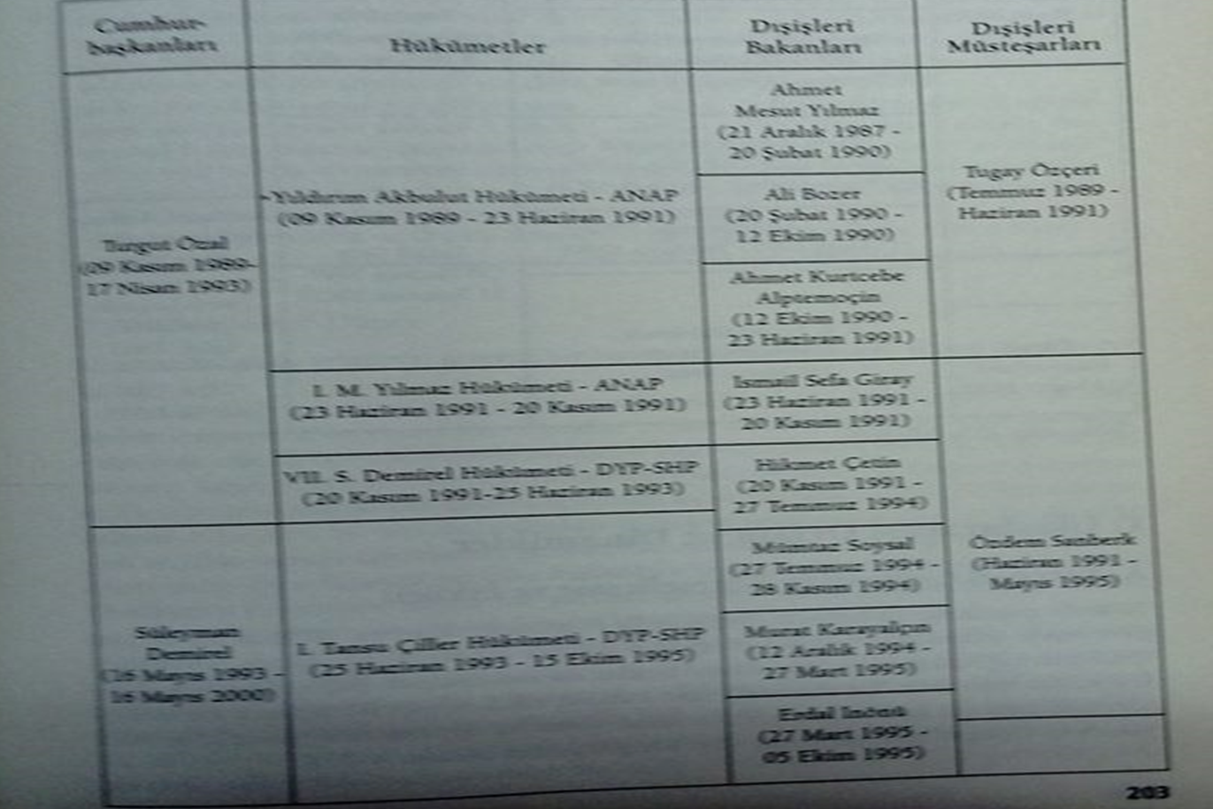
Turkey's Foreign Policy in the 1990s

Slide 11
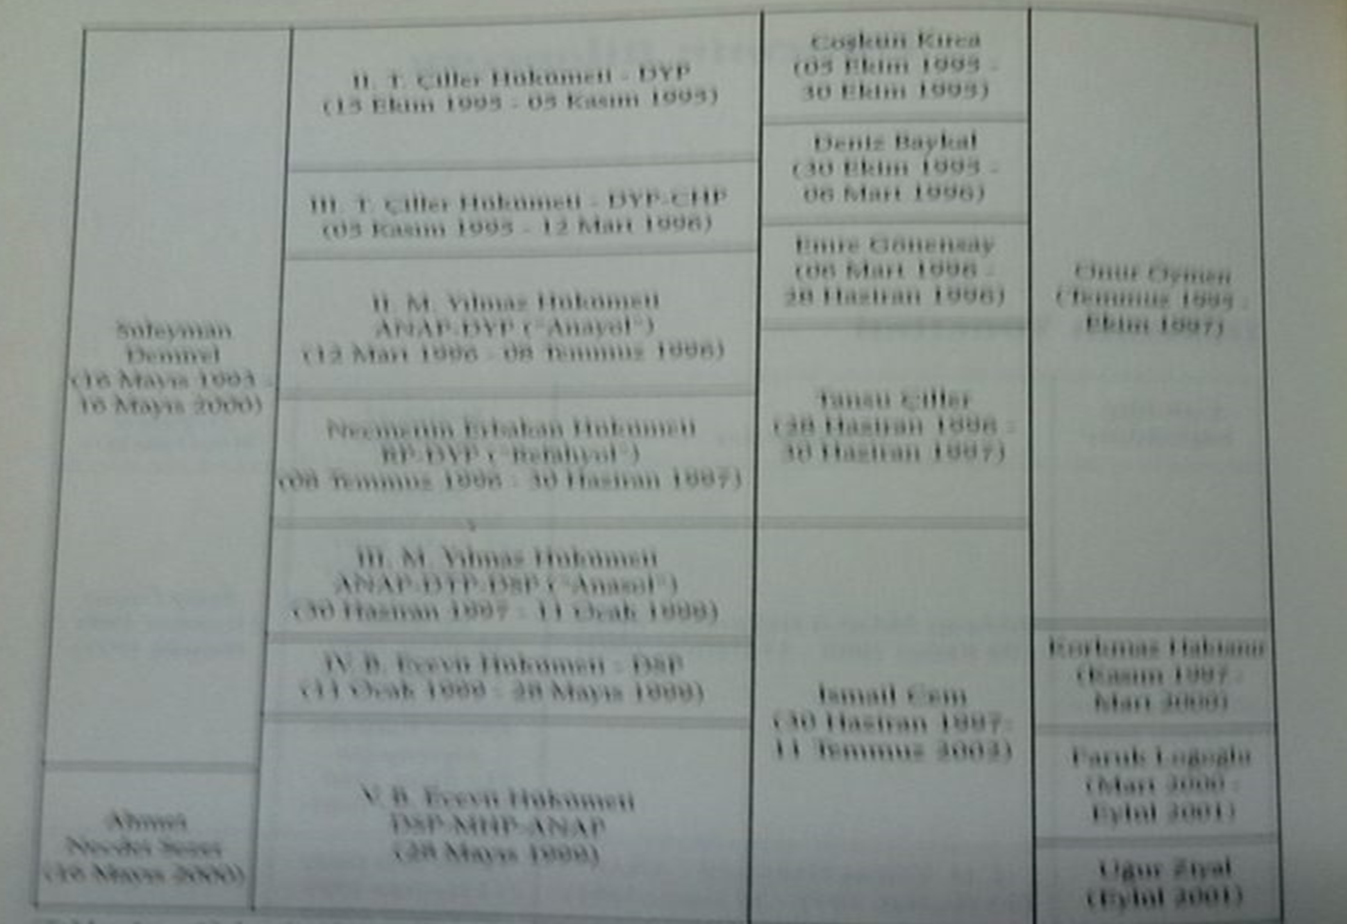
Turkey's Foreign Policy in the 1990s

Slide 12
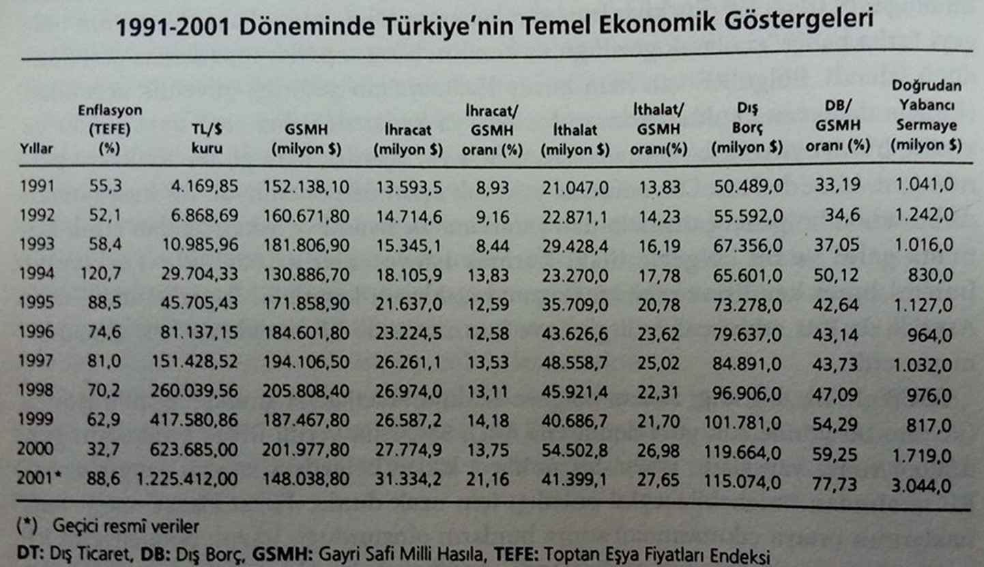
Turkey's Foreign Policy in the 1990s

Slide 13
Turkey's Foreign Policy in the 1990s
As can be seen from the table, an unstable economic-domestic political spiral has unfolded since the 1990s.
Politics and the economy operated in an atmosphere of chaos.
The economic policies and unstable political decisions implemented in the 1980s have resulted in significant consequences.

Slide 14
Turkey's Foreign Policy in the 1990s
We can make the following general assessment of this highly dynamic and risky period in Turkish foreign policy.
First, Turkey entered the post-USSR era with three disadvantages inherited from the previous decade.
First, an increasingly foreign-dependent economic structure due to globalization.
Second, the human rights and Kurdish-Armenian issues left by the September 12 military coup.
Third, Özal's pursuit of a pragmatist and pro-US foreign policy, rather than a status quo-based, balanced one.
Furthermore, Türkiye's geostrategic importance, which had diminished with the dissolution of the USSR, increased in the eyes of the US and NATO during this period.

Slide 15
Turkey's Foreign Policy in the 1990s
The chaos in domestic politics also had a harsh impact on foreign policy institutions.
For example, in the context of the Directorate of Religious Affairs, while there were 28 ministerial changes in the 70-year period between 1920 and 1990, there were 11 in the 7 years between 1990 and 1997.
This is troubling for a field like foreign policy, which requires expertise and stability.
This period also marked the signing of a customs union agreement with the EU and expansion negotiations with NATO.

Slide 16
Turkey's Foreign Policy in the 1990s
During this period, Turkey was forced to adopt the West's capitalist economic infrastructure and its democratic and human rights superstructure.
When Turkey resisted, it became economically dependent on foreign countries and politically isolated due to human rights violations.

Slide 17
Turkey's Foreign Policy in the 1990s
Despite all these risks, Turkey has not made any major mistakes in its foreign policy.
There are two reasons for this:
First, Türkiye has pursued a foreign policy closely aligned with the US, the hegemonic power, during this period.
In other words, Turkish foreign policy in the Balkans, the Caucasus, and the Middle East has always been aligned with the US.
However, as an effective Central Bank of the Republic of Turkey (CBA), Türkiye should have pursued more effective and autonomous policies in its immediate region.

Slide 18
Turkey's Foreign Policy in the 1990s
Secondly, the reasons why Türkiye has not failed to resolve the Cyprus-Aegean issues, which have been a persistent problem for Turkey, can be attributed to the following three reasons:
The transfer of these issues to the EU by Greece.
The EU has set a timetable for future discussions on these issues.
The EU has left the resolution of these issues to the expectation of attrition and Türkiye being cornered economically.

Slide 19
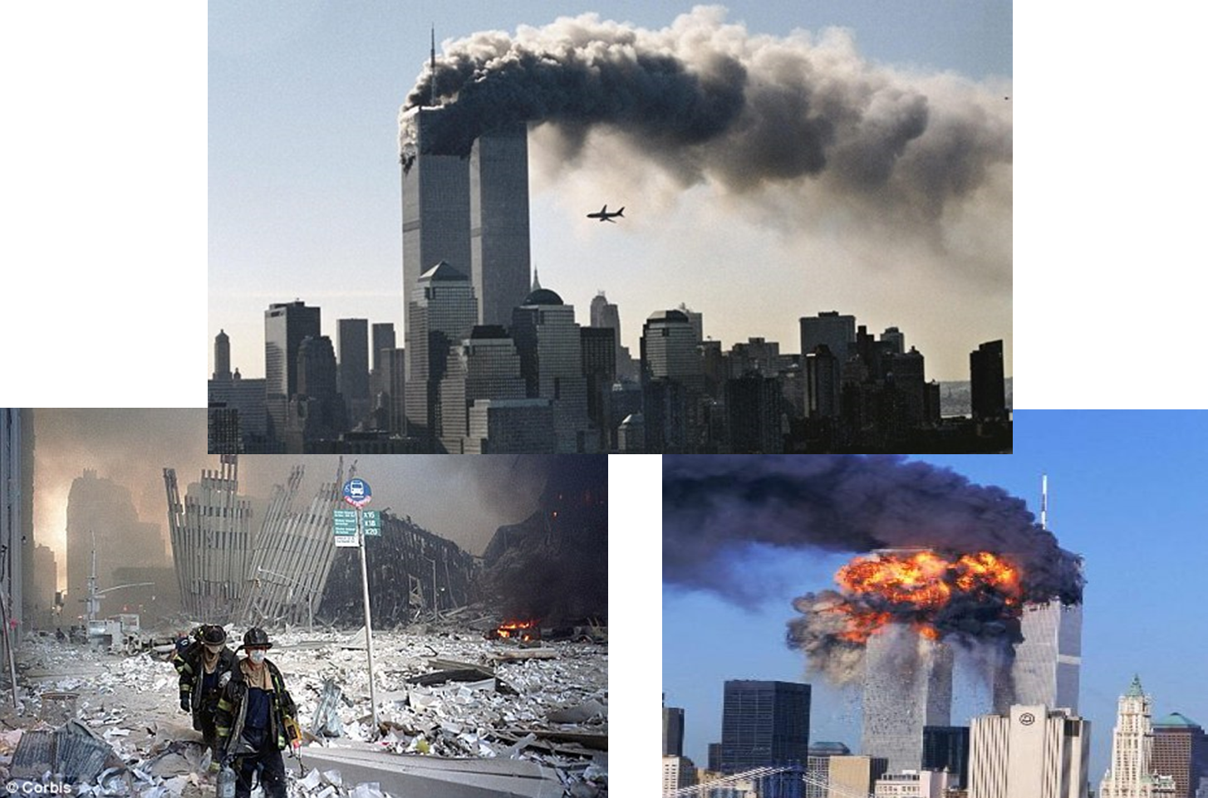
September 11, 2001

Slide 20
September 11 Events
A backlash against globalization
The pro-Israeli policies of the dominant powers
The democratic weakness of Middle Eastern states
The desperation of the peoples of the Middle East
The replacement of Soviet ideology with fundamentalist religious ideologies
The Arab Spring

Slide 21
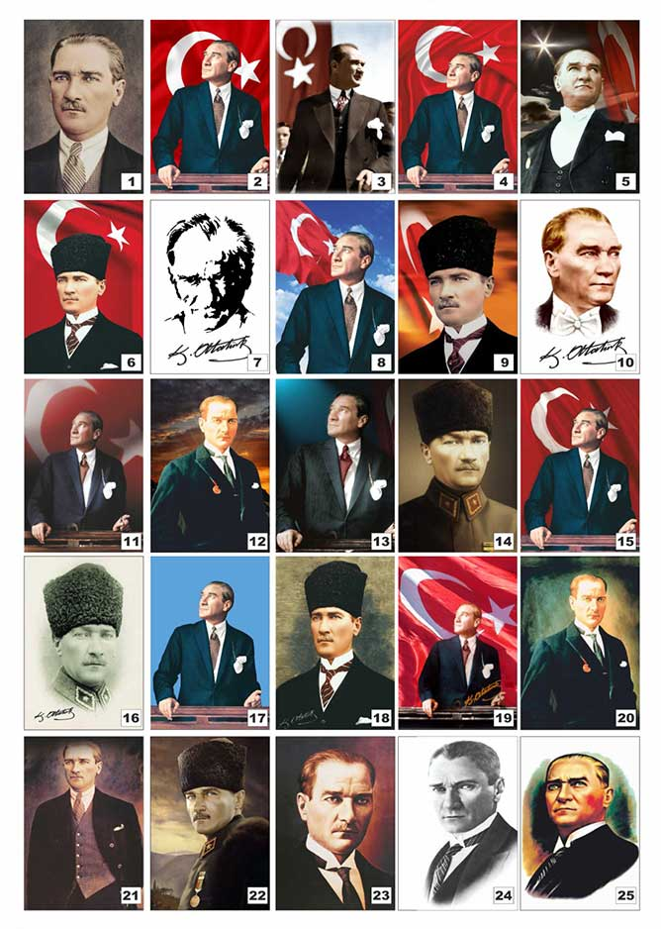
Questions?

