Slide 1
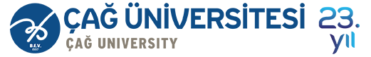

Course Title
Investment Analysis
Course Coordinator
Assist.Prof.Dr. Gökhan Sökmen
Research Assistant
Gözde Elbir

Slide 2
Learning Objectives
After studying this chapter;
You will be able to understand the relationship between investment decisions and capital budgeting.
You will be able to define net working capital.
You will be able to explain statement of cash flows.
You will be able to calculate a firm’s cash flow.

Slide 3
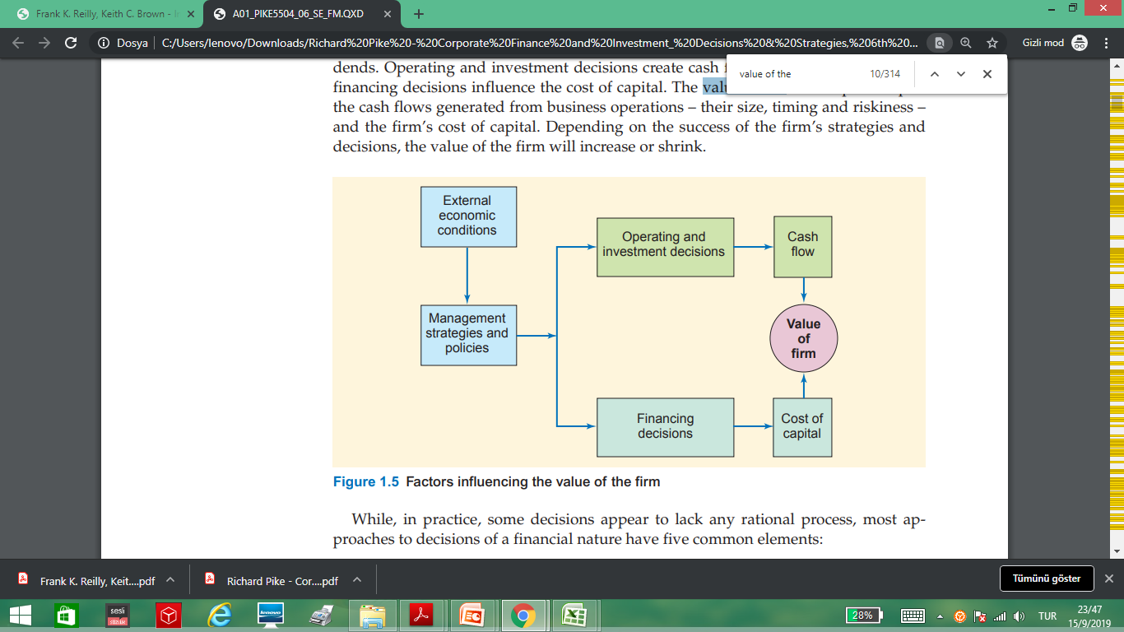
Investment Decisions and Capital Budgeting
Managers must evaluate a number of factors in making investment decisions. Also, every decision has future consequences that will affect the value of the firm.

Slide 4
Investment Decisions and Capital Budgeting
A firm must continually evaluate possible investments, capital budgeting is an ongoing process. However, before a firm begins thinking about capital budgeting, it must first determine its corporate strategy — its broad set of objectives for future investment.
Capital budgeting is the process of identifying and selecting investments in long-lived assets, or assets expected to produce benefits over more than one year.

Slide 5
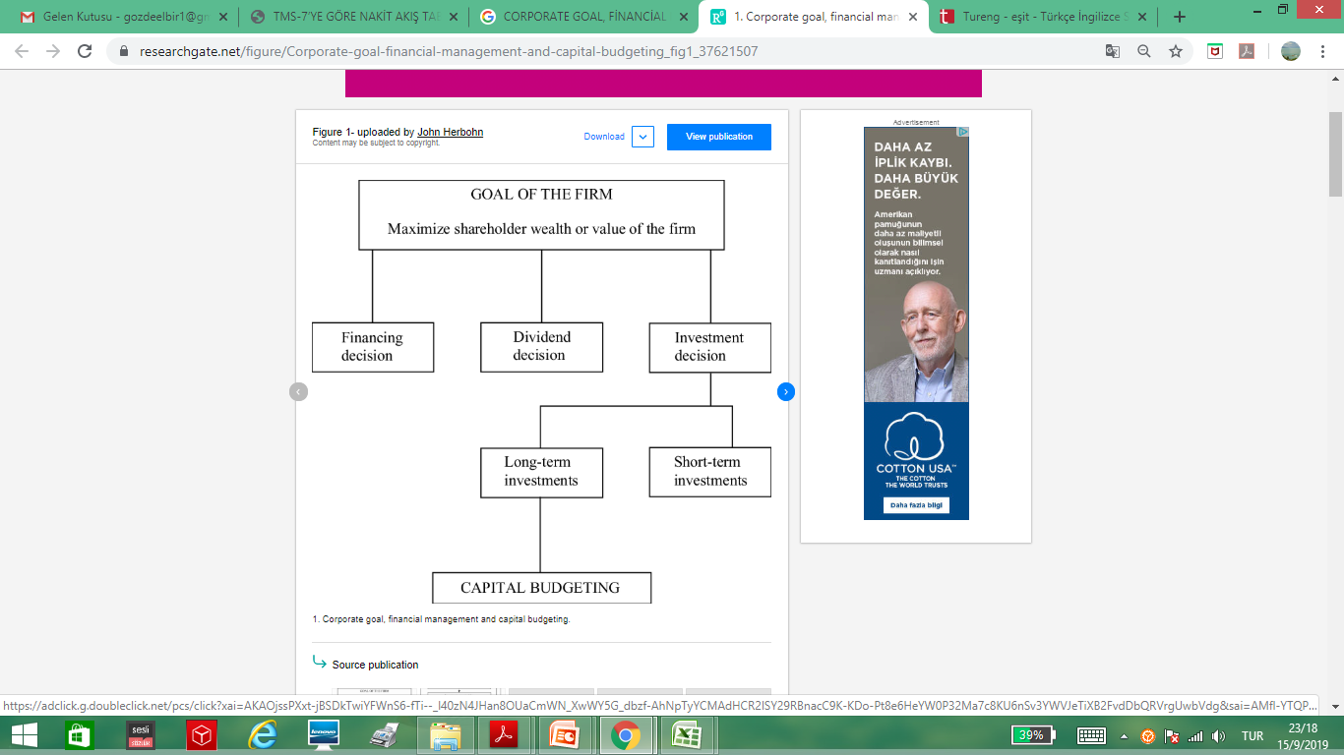
Investment Decisions and Capital Budgeting

Slide 6
Investment Decisions and Capital Budgeting
A firm invests only to increase the value of their ownership interest. A firm will have cash flows in the future from its past investment decisions. When it invests in new assets, it expects the future cash flows to be greater than without this new investment.

Slide 7
Statement of Financial Position
The statement of financial position is a snapshot of the firm’s assets and liabilities at a given point in time
Assets are listed in order of liquidity
  Ease of conversion to cash
  Without significant loss of value
Statement of Financial Position Identity
  Assets = Liabilities + Stockholders’ Equity

Slide 8
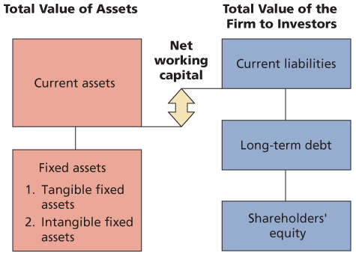
Statement of Financial Position

Slide 9
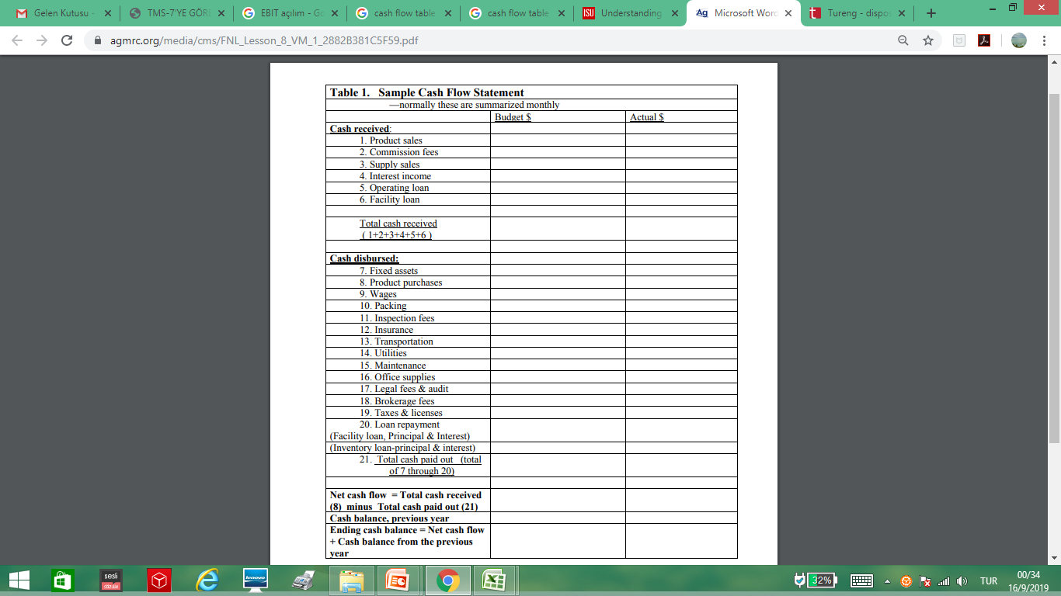
Cash Flow Summary Table

Slide 10
Net Working Capital
Net Working Capital
  Current Assets – Current Liabilities
  Positive when the cash that will be received over the next 12 months exceeds the cash that will be paid out
  Usually positive in a healthy firm

Slide 11
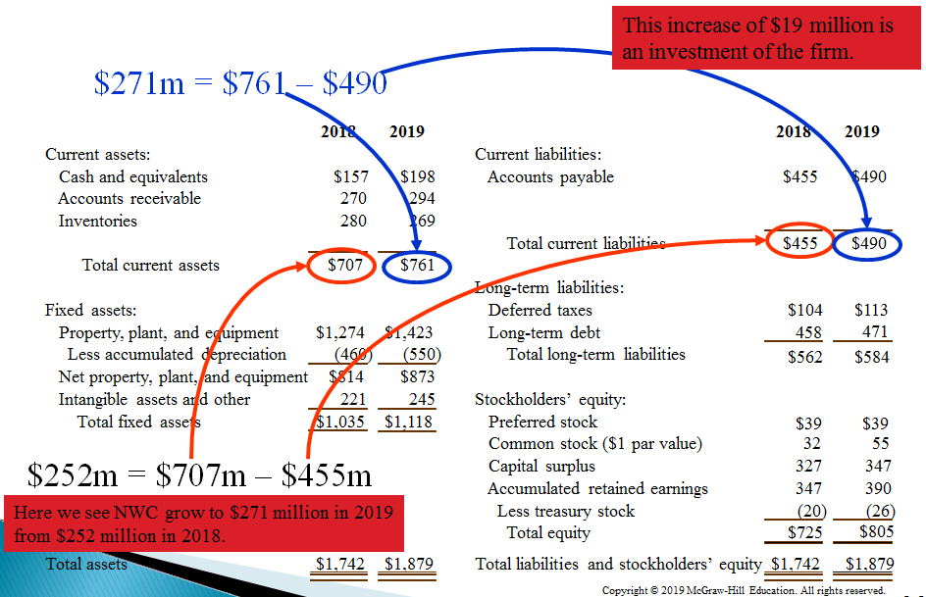
Example: The Balance Sheet of the U.S. Composite Corporation

Slide 12
Statement of Cash Flows
Net Income typically does NOT equal the amount of Cash the firm has earned.
– Non-Cash Expenses
• Depreciation and Amortization
– Uses of Cash not on the Income Statement
• Investment in Property, Plant, and Equipment

Slide 13
Statement of Cash Flows
Cash flow is one of the most important pieces of information that a financial manager can derive from financial statements
We will look at how cash is generated from utilizing assets and how it is paid to those that finance the purchase of the assets

Slide 14
Statement of Cash Flows
Statement of Cash Flows
Operating Activities
Financing Activities
Investment Activities

Slide 15
Statement of Cash Flows
Operating Activities: Adjusts net income by all non-cash items related to operating activities and changes in net working capital
•Accounts Receivable – deduct the increases
• Accounts Payable – add the increases
• Inventories – deduct the increases

Slide 16
Statement of Cash Flows
Investing Activities
– Capital Expenditures
– Buying or Selling Marketable Securities
Financing Activities
– Payment of Dividends
• Retained Earnings = Net Income–Dividends
– Changes in Borrowings

Slide 17
Cash Flow From Assets
Cash Flow From Assets = Cash Flow to Bondholders + Cash Flow to Shareholders
Cash Flow From Assets = Operating Cash Flow – Net Capital Spending – Changes in NWC

Slide 18
Example1: Canadian Enterprises Statement of Financial Position

Slide 19
Example1: Canadian Enterprises

Slide 20
Example1: Canadian Enterprises
Operating Cash Flow = EBIT + Depreciation – Taxes
= 694 + 65 – 250 = 509

Slide 21
Example1: Canadian Enterprises
Net Capital Spending = Ending net fixed assets–beginning net fixed assets+depreciation
= 1,709 – 1,644 + 65 =130

Slide 22
Example1: Canadian Enterprises
Changes in NWC = Ending NWC – Beginning NWC
= (Ending Current Assets – Ending Current Liabilities) – (Beginning Current Assets – Beginning Current Liabilities)
= (1,403 – 389) – (1,112 – 428) = 330

Slide 23
Example1: Canadian Enterprises
Cash Flow From Assets
= 509 – 130 – 330 = $49
Operating Cash Flow = 509
Changes in NWC = 330
Net Capital Spending = 130

Slide 24
Example1: Canadian Enterprises
CF to Creditors = interest paid – net new borrowing =
= Interest paid – (Ending long term debt – Beginning long term debt)
= 70 – (454 – 408) = $24

Slide 25
Example1: Canadian Enterprises
CF to Stockholders = Dividends paid – net new equity raised
= 65 – (640 – 600) = $25
CFFA = 24 + 25 = $49
Notice – the cash flow identity holds.

Slide 26
Investment Cash Flows
Asset Acquisition:
1. Cost of the asset
2. Set-up expenditures, including shipping and installation
3. Any tax credit
Cash flow from acquiring assets = Cost + Set-up expenditures − Tax credit

Slide 27
Example
Suppose the firm buys equipment that costs $100,000 and it costs $10,000 to install it. If the firm is eligible for a 10% tax credit on this equipment (that is, 10% of the total cost of buying and installing the equipment), the change in the firm’s cash flow from acquiring the asset of $99,000 is:
Cash flow from acquiring assets
= $100,000 + $10,000 − 0.10($100,000 + $10,000)
= $100,000 + $10,000 − $11,000 = $99,000
The cash outflow is $99,000 when this asset is acquired: $110,000 out to buy and install the equipment and $11,000 in from the reduction in taxes.

Slide 28
Investment Cash Flows
Asset Disposition:
1. What you receive or pay in disposing of the asset
2. Any tax consequences resulting from the disposal
Cash flow from disposing assets = Proceeds or payment from disposing assets − Taxes from disposing assets

Slide 29
Operating Cash Flows
Change in Revenues
Change in Expenses
Change in Taxes
Change in Working Capital

Slide 30
Change in Working Capital
Let’s use the symbol “∆” to indicate “change in”: ∆OCF = change in operating cash flow
∆R = change in revenues
∆E = change in expenses
∆D = change in depreciation
∆NWC = change in net working capital
τ = tax rate
∆OCF = (∆R − ∆E − ∆D)(1 − τ)+ ∆D − ∆NWC
We can also write this as:
∆OCF = (∆R − ∆E)(1 − τ) + ∆Dτ − ∆NWC

Slide 31
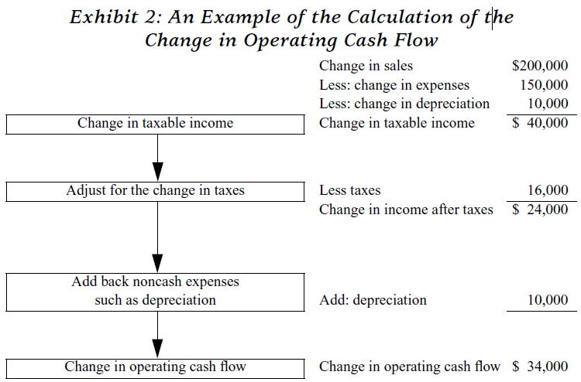
An Example of the Calculation of the Change in Operating Cash Flow

Slide 32
An Example of the Calculation of the Change in Operating Cash Flow
Or, using the rearrangement as in equation (2):
∆OCF = (∆R − ∆E) (1 − τ) + ∆Dτ
= ($200,000 − $150,000) (1 − 0.40) + $10,000 (0.40) = $24,000

Slide 33
An Example
Suppose you are evaluating modern equipment that you expect will reduce expenses by $100,000 during the first year. The old machine cost $200,000 and was depreciated using straightline over 10 years, with five years remaining. The new machine cost $300,000 and will be depreciated using straight-line over ten years. If the firm’s tax rate is 30%, what is the expected operating cash flow in the first year?

Slide 34
An Example
Let’s identify the components:
∆R = $0 (The new machine does not affect revenues)
∆E = −$100,000 (The new machine reduces expenses that will reduce taxes and increase cash flows)
∆D = +$10,000 (The new machine increases the depreciation expense from $20,000 to $30,000)
τ = 30%
The operating cash flow from the first year is therefore:
∆OCF = (∆R − ∆E − ∆D) (1 − τ) + ∆D
= ($100,000 − 10,000) (1 − 0.30) + $10,000
= $63,000 + $10,000 = $73,000

Slide 35
NET CASH FLOWS
As we have seen, an investment’s cash flows consist of two types of cash flows:
(1) cash flows related to acquiring and disposing the assets represented in the investment,
(2) cash flows related to operations.
To evaluate any investment project, we must consider both cash flows. The sum of the cash flows from asset acquisition and disposition and from operations is referred to as net cash flows (NCF).
The net cash flows are therefore the incremental cash flows related to an investment. The net cash flow is calculated for each period of the project’s life.

Slide 36
NET CASH FLOWS
In each period, we add the cash flow from asset acquisition and disposition and the cash flow from operations. For a given period,
Net Cash Flow = Investment cash flow + Change in operating cash flow (∆OCF)
The analysis of the cash flows of investment projects can become quite complex. But by working through any problem systematically, line-by-line, you will be able to sort out the information and focus on those items that determine cash flows.

Slide 37
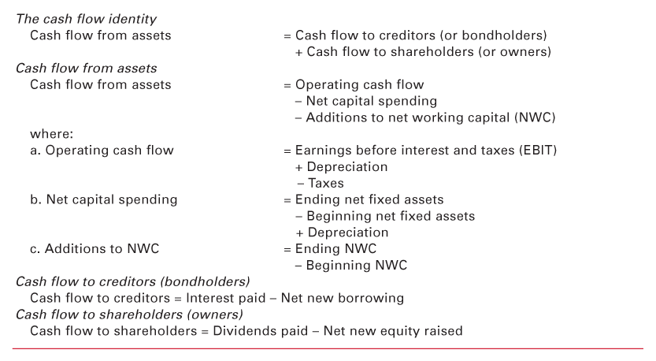
Cash Flow Summary

Slide 38
Example: Calculating Cash Flows
Current Accounts
  2011: CA = 1500; CL = 1300
  2012: CA = 2000; CL = 1700
Fixed Assets and Depreciation
  2011: NFA = 3000; 2012: NFA = 4000
  Depreciation expense = 300
LT Liabilities and Equity
  2011: LTD = 2200; Common Equity = 500; RE = 500
  2012: LTD = 2800; Common Equity = 750; RE = 750
Statement of Comprehensive Income Information
  EBIT = 2700; Interest Expense = 200; Taxes = 1000; Dividends = 1250

Slide 39
Example: Calculating Cash Flows
OCF = 2700 + 300 – 1000 = 2000
NCS = 4000 – 3000 + 300 = 1300
Changes in NWC = (2000 – 1700) – (1500 – 1300) = 100
CF From Assets = 2000 – 1300 – 100 = 600
CF to Bondholders = 200 – (2800 – 2200) = -400
CF to Shareholders = 1250 – (750 – 500) = 1000
CF From Assets = -400 + 1000 = 600
Notice – the cash flow identity holds.

Slide 40
Example
During the year, the company had gross sales of $865,000. the firm’s cost of goods sold and selling expenses were $455,000 and $210,000, respectively. The company also had notes payable of $680,000. these notes carried an interest rate of 4 percent. Depreciation was $105,000. the tax rate was 21 percent.
What was the company’s net income?
What was the company’s operating cash flow?

Slide 41
Example
 | Input area:
 | Sales | $ 865.000
 | Cost of goods sold | $ 455.000
 | Selling expenses | $ 210.000
 | Notes payable | $ 680.000
 | Interest rate | 4%
 | Depreciation expense | $ 105.000
 | Tax rate | 21%
 | Output area:
 | Income Statement
 | Sales | $ 865.000
 | Cost of goods sold | 455.000
 | Selling expenses | 210.000
 | Depreciation expense | 105.000
 | EBIT | $ 95.000
 | Interest expense | 27.200
 | EBT | $ 67.800
 | Taxes (21%) | 14.238
 | Net income | $ 53.562
 | EBIT | $ 95.000
 | Depreciation | 105.000
 | Taxes | (14.238)
 | Operating cash flow | $ 185.762

