Slide 1
E-commerce 2023: business. technology. society.
Seventeenth Edition
Chapter 1
The Revolution Is Just Beginning
Copyright © 2024, 2022, 2020 Pearson Education, Inc. All Rights Reserved
Notes:
If this PowerPoint presentation contains mathematical equations, you may need to check that your computer has the following installed:
1) MathType Plugin
2) Math Player (free versions available)
3) NVDA Reader (free versions available)

Slide 2
Learning Objectives
1.1 Understand why it is important to study e-commerce.
1.2 Define e-commerce, understand how e-commerce differs from e-business, identify the primary technological building blocks underlying e-commerce, and recognize major current themes in e-commerce.
1.3 Identify and describe the unique features of e-commerce technology and discuss their business significance.
1.4 Describe the major types of e-commerce.
1.5 Understand the evolution of e-commerce from its early years to today.
1.6 Describe the major themes underlying the study of e-commerce.

Slide 3
TikTok: Creators and the Creator Economy
Class Discussion
Why is TikTok so popular?
Do you use TikTok? If so, in what manner—do you just view content or also post content?
Do you consider yourself a creator? Have you ever received payments for content you have created?
What are some of the negative consequences associated with being a creator?

Slide 4
The First Five Minutes: Why You Should Study E-commerce
First quarter-century or so of e-commerce
Still just the beginning
Rapid growth and change
Technologies evolve at exponential rates
Disruptive business change
New opportunities
Why study e-commerce
Understand opportunities and risks
Analyze e-commerce ideas, models, issues

Slide 5
What Is E-commerce?
Use of Internet to transact business
Includes Web, mobile browsers and apps
More formally:
Digitally enabled commercial transactions between and among organizations and individuals

Slide 6
The Difference Between E-commerce and E-business
E-business
Digital enabling of transactions and processes within a firm, involving information systems under firm’s control
Does not include commercial transactions involving an exchange of value across organizational boundaries

Slide 7
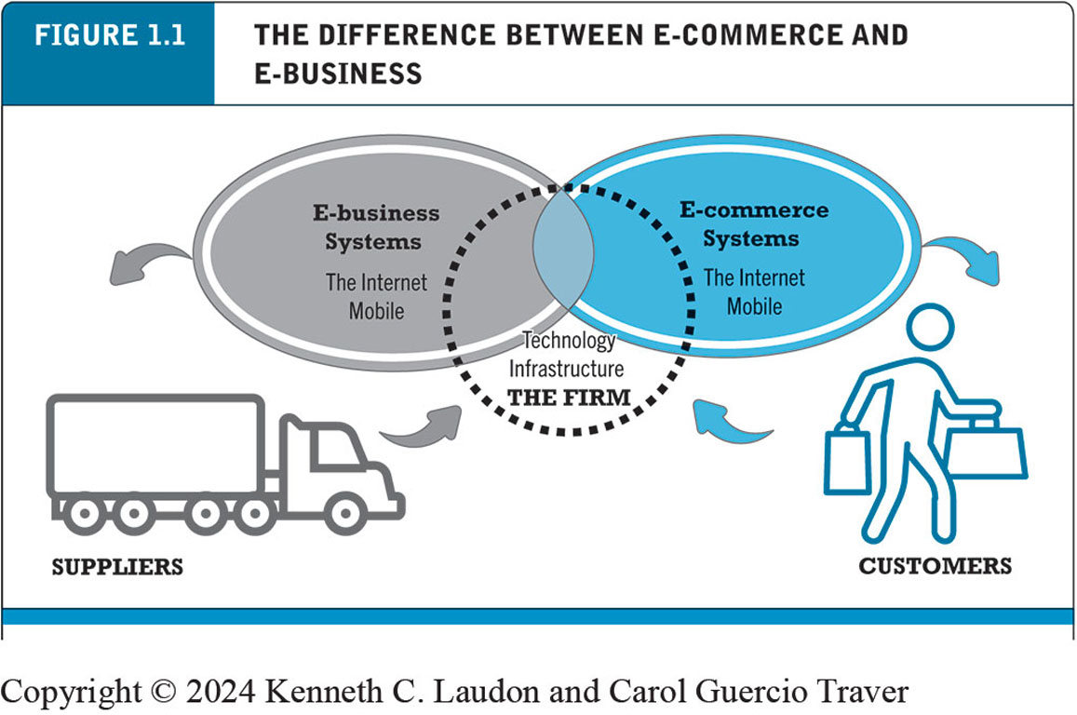
Figure 1.1 The Difference Between E-commerce and E-business
Notes:
Figure 1.1, Page 9.
E-commerce primarily involves transactions that cross firm boundaries. E-business primarily involves the application of digital technologies to business processes within the firm.
Alt Text
Long description: An illustration in the form of a Venn diagram depicts two ovals intersecting each other, one labeled e-business systems and the other labeled e-commerce systems. Both types of systems include the Internet and mobile. Both ovals overlap a central circle labeled the technology infrastructure, the firm. An arrow points from e-business systems to suppliers, while another arrow points from suppliers to the firm, indicating an interconnection between them. Similarly, an arrow points from e-commerce systems to customers, while another arrow points from customers to the firm, indicating an interconnection between them.

Slide 8
Technological Building Blocks Underlying E-commerce
The Internet
Worldwide network of computer networks built on common standards
The World Wide Web
Provides access to trillions of web pages created in HTML
“Surface” Web versus “deep” Web
Mobile platform
Smartphones, tablets, ultra-lightweight laptops
Mobile apps

Slide 9
Insight on Technology: Will Apps Make the Web Irrelevant?
Class Discussion
What are the advantages and disadvantages of apps, compared with websites, for mobile users?
What are the benefits of apps for content owners and creators?
What are progressive web apps and how do they differ from native apps?
Will apps eventually make the Web irrelevant? Why or why not?

Slide 10
Major Trends in E-commerce (1 of 3)
Business trends include:
Retail e-commerce and m-commerce settle back to normal growth rates (around 10%) after Covid-19 pandemic
Mobile app ecosystem: almost 250 million U.S. adults use smartphone apps
Social e-commerce estimated to generate around $55 billion in 2022
B2B e-commerce revenues expected to reach about $8.5 trillion in 2022

Slide 11
Major Trends in E-commerce (2 of 3)
Technology trends include:
Mobile platform
Cloud computing
Internet of Things
Big data
Artificial intelligence technologies
Blockchain
Web3
Metaverse

Slide 12
Major Trends in E-commerce (3 of 3)
Societal trends include:
User-generated content
Commercial and governmental invasion of privacy
Concerns about increasing market dominance of Amazon, Google, Meta (Big Tech)
Online security issues

Slide 13
Unique Features of E-commerce Technology (1 of 2)
Ubiquity
Global reach
Universal standards
Information richness

Slide 14
Unique Features of E-commerce Technology (2 of 2)
Interactivity
Information density
Personalization/customization
Social technology

Slide 15
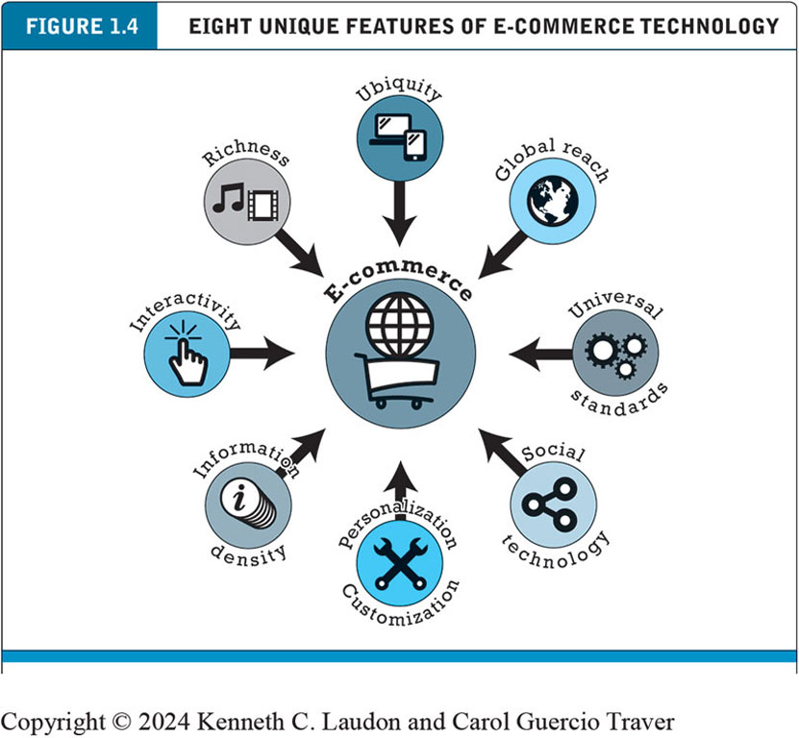
Figure 1.4 Eight Unique Features of E-commerce Technology
Notes:
Figure 1.4, Page 16.
E-commerce technologies provide a number of unique features that have impacted the conduct of business.
Alt Text
Long description: The features are ubiquity, global reach, universal standards, social technology, personalization and customization, information density, interactivity, and richness.

Slide 16
Types of E-commerce
Business-to-consumer (B2C)
Business-to-business (B2B)
Consumer-to-consumer (C2C)
Mobile e-commerce (M-commerce)
Social e-commerce
Local e-commerce

Slide 17
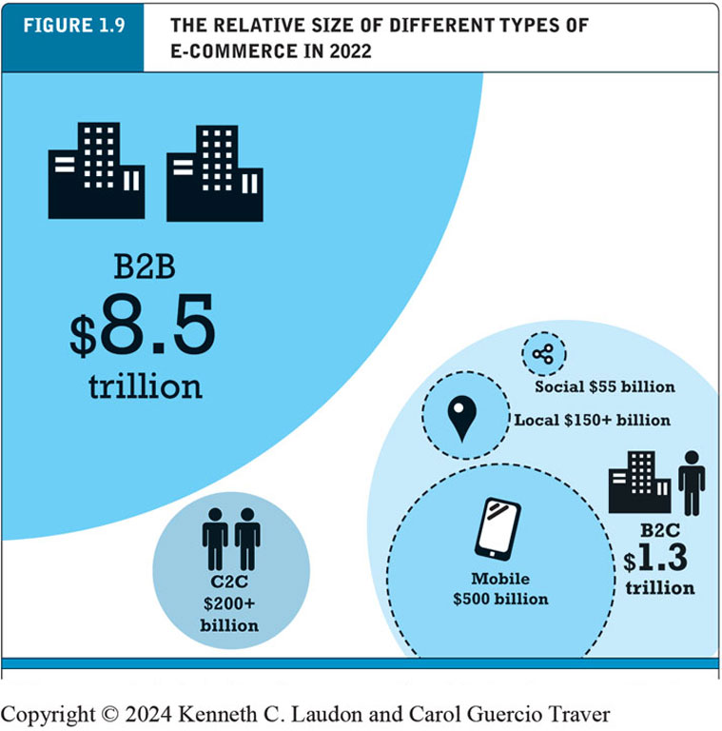
Figure 1.9 The Relative Size of Different Types of E-commerce
Notes:
Figure 1.9, Page 26.
B2B e-commerce dwarfs all other forms of e-commerce; mobile, social, and local e-commerce, although growing rapidly, are still relatively small in comparison to “traditional” e-commerce.
Alt Text
Long description: The data in the illustration is as follows: B 2 B e-commerce revenue, 8.5 trillion dollars; B 2 C e-commerce revenue, 1.3 trillion dollars. Within B 2 C e-commerce revenue, mobile e-commerce revenue is 500 billion dollars, social e-commerce revenue is 55 billion dollars, and local e-commerce revenue is more than 150 billion dollars. C 2 C e-commerce revenue is more than 200 billion dollars.

Slide 18
E-commerce: A Brief History (1 of 4)
Precursors
Baxter Healthcare modem-based system (1970s)
Order entry systems (1980s)
Electronic Data Interchange (E D I) standards (1980s)
French Minitel (1981)

Slide 19
E-commerce: A Brief History (2 of 4)
1995–2000: Invention
Sale of simple retail goods
Limited bandwidth and media
Euphoric visions of:
Friction-free commerce
First-mover advantages
Dot-com crash of 2000
Notes:
Additional concepts: disintermediation, monopoly profits, switching costs, network effects, disruption of traditional channels.

Slide 20
E-commerce: A Brief History (3 of 4)
2001–2006: Consolidation
Emphasis on business-driven approach
Traditional large firms expand presence
Start-up financing shrinks
More complex products and services sold
Growth of search engine advertising
Business web presences expand

Slide 21
E-commerce: A Brief History (4 of 4)
2007–Present: Reinvention
Rapid growth of:
Web 2.0, including online social networks
Mobile platform
Local commerce
On-demand service economy
Entertainment content develops as source of revenues
Transformation of marketing

Slide 22
Figure 1.10 Periods in the Development of E-commerce
Notes:
Figure 1.10, page 28.
Alt Text
Long description: The three phases are Invention, Consolidation and Reinvention. During the period of Invention, from 19 95 to 2000, the curve for content revenue remains at 0, and retail and service revenue rise slightly from 0 in 19 98 to 25 billion dollars in 2000. The economic crash occurred in the U S in 2000. During the period of Consolidation from 2001 to 2007, the curve for retail and services revenues increases from 25 billion dollars in 2001 to 140 billion in 2007. The smartphone was invented in 2007. During the period of Reinvention, during which social, mobile, and local e-commerce emerged, from 2008 to 20 18, the curve for retail revenue rises to 530 billion dollars in 20 18. Services revenue rises to 400 billion dollars in 20 18. Content revenue grows to 50 billion dollars by 20 18. All values are estimated.

Slide 23
Insight on Business: Y Combinator’s Startup Boot Camp
Class Discussion
Why do you think investors today are still interested in investing in startups?
What are the benefits of investing in a company that is a graduate of a Y Combinator boot camp?
Is an incubator the best solution for startups to find funding? Why or why not?

Slide 24
Assessing E-commerce (1 of 2)
Stunning technological success
Early years a mixed business success
Few early dot-coms have survived
Online sales growing rapidly
Many early visions not fulfilled
Price dispersion
Information asymmetry
New intermediaries

Slide 25
Assessing E-commerce (2 of 2)
Other surprises
Fast-follower advantages
Start-up costs
Impact of mobile platform
Emergence of on-demand e-commerce

Slide 26
Understanding E-commerce: Organizing Themes
Technology
Development and mastery of digital computing and communications technology
Business
New technologies present businesses with new ways of organizing production and transacting business
Society
Intellectual property, individual privacy, public welfare policy

Slide 27
Insight on Society: Facebook and the Age of Privacy
Class Discussion
Why are social networks interested in collecting user information?
What types of privacy invasion are described in the case? Which is the most privacy-invading, and why?
Was the Federal Trade Commission’s $5 billion fine and its placement of restrictions on Facebook’s business operations sufficient in light of Facebook’s history with respect to privacy violations?
How do you protect your privacy online?

Slide 28
Careers in E-commerce
Position: Category Specialist in the E-commerce Retail Program
Qualification/Skills
Preparing for the Interview
Possible Interview Questions

Slide 29
Copyright
This work is protected by United States copyright laws and is provided solely for the use of instructors in teaching their courses and assessing student learning. Dissemination or sale of any part of this work (including on the World Wide Web) will destroy the integrity of the work and is not permitted. The work and materials from it should never be made available to students except by instructors using the accompanying text in their classes. All recipients of this work are expected to abide by these restrictions and to honor the intended pedagogical purposes and the needs of other instructors who rely on these materials.

