Slide 1
Present Perfect & Simple Past

Slide 2
Let’s remember ☺
Present Perfect
Simple Past
We use present perfect to talk about the past experiences in our life, BUT we don’t say when exactly. (we don’t know when)
We speak about the experience.
It is not important when the thing happened.
The person has such an experience.
For example: I have seen the Eiffel Tower this year.
We use simple past to say when something happened.
We know when the event happened. (e.g last year, yesterday, ago, in 2013.)
For example: I saw the Eiffel Tower in 2012.

Slide 3
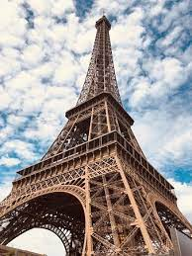
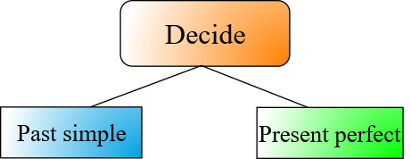
I have seen the Eiffel Tower this year. ͢ Present perfect I saw the Eiffel Tower in 2012. ͢ Simple past

Slide 4
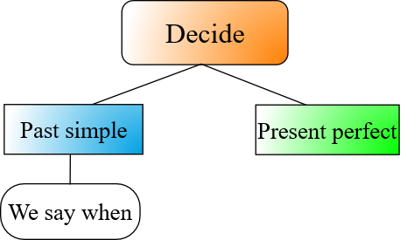
Some examples:
I started learning English in 2014.
Clara spent much for travel last summer.
They didn’t eat any chocolate yesterday.
He helped me to do my work 2 weeks ago.
Did you have a good time at the party last night?

Slide 5
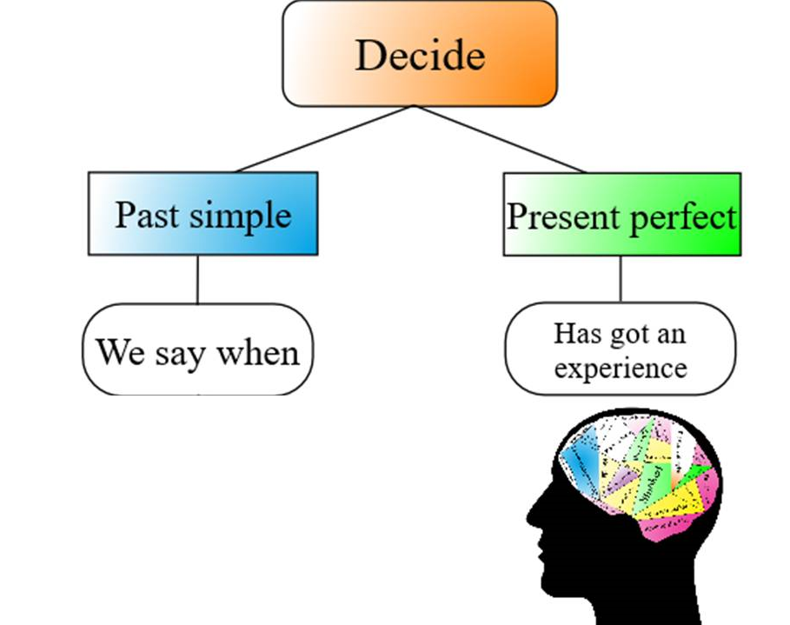
Some examples:
Have you ever touch a snake?
Have you sent many messages so far today?
I have read many books up to my age.
Brown Family has visited so many countries this year.
Mary has run two marathons this month.
I have never met a famous person.

Slide 6
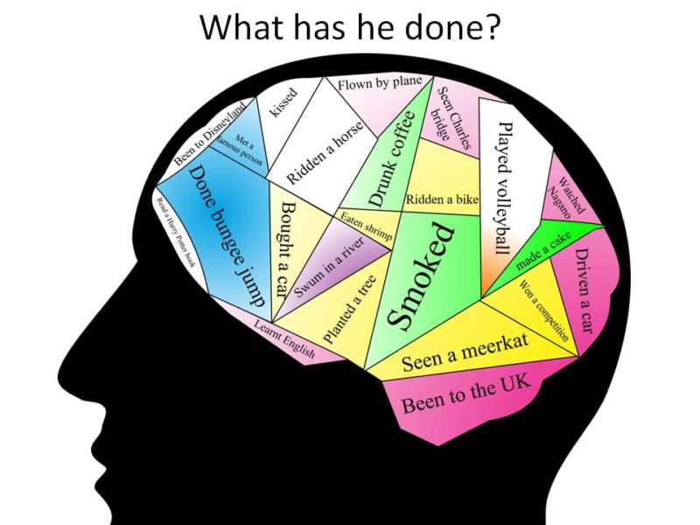
Let’s write…
He has seen Charles bridge.
He has played voleyball.
He has won a competition.
He has learnt English.
He has planted a tree.
He has been to the UK.
He has done bungee jumping.

Slide 7
I have tried Chinese food.
We visited the theatre in 2015.
I was at school yesterday.

Slide 10
Detail…
We often start a conversation by asking about or describing an event using the present perfect and then change to the past simple to ask about or describe the details of the event.
For example:
Jane: Have you ever been to pajama party?
Mary: Yes, I have☺.
Jane: Really? What colour pajama did you wear?
Jane: Purple.

Slide 11
Let’s do an online quiz
https://www.youtube.com/watch?v=BN2GNnMLjBs

Slide 12
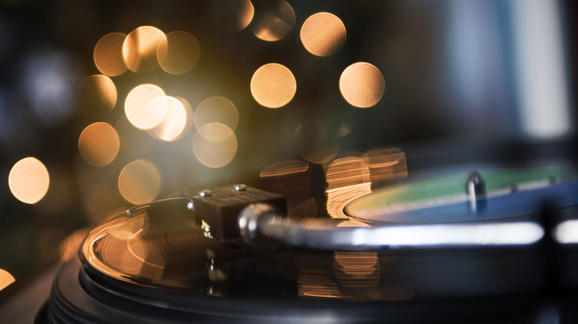
Thanks for Listening…

