Slide 1
Research Ethics
MAT 304- Data Analysis & Reporting

Slide 2
RESEARCH ETHICS
Working with human participants in your research always raises ethical issues about how you treat them.
People should be treated with respect, which has many implications for how exactly how you deal with them before, during and after the research.

Slide 3
Even if you are not using human participants in your research, there is still the question of honesty in the way you collect, analyse and interpret data.

Slide 4
There are two aspects of ethical issues in research:
1- The individual values of the researcher relating to honesty and frankness and personal integrity.
2- The researcher’s treatment of other people involved in the research, relating to informed consent, confidentiality, anonymity and courtesy.

Slide 5
Organizations And Ethics Committees
The role of ethics committees is to oversee the research carried out in their organizations in relation to ethical issues. Applying for ethics approval inevitably involves filling in forms.

Slide 6
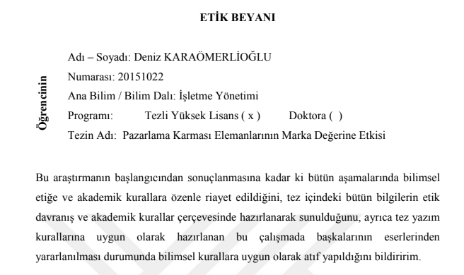

Slide 7
HONESTY IN YOUR WORK
Plagiarism
Citation
Data and Interpretations

Slide 8
Plagiarism
Presenting the work and ideas of other people and passing them off as your own, without acknowledging the original source of the ideas used, four common forms of plagiarism which are commonly found in universities

Slide 9
Plagiarism
Directly copying someone else’s work into your report, thesis etc. and letting it be assumed that it is your own.
Using the thoughts, ideas and works of others without acknowledging their source, even if you paraphrased into your own words, is unethical.

Slide 10
Stealing material from another source and passing it off as your own.
For example: buying a paper from a research service, essay bank or term-paper mill (either specially written for the individual or pre-written); copying a whole paper from a source text without proper acknowledgement.
2. Submitting another student’s work with or without that student’s knowledge
For example: by copying a computer disk

Slide 11
3. Copying sections of material from one or more source texts, supplying proper documentation (including the full reference) but leaving out quotation marks, thus giving the impression that the material has been paraphrased rather than directly quoted.
4 . Paraphrasing material from one or more source texts without supplying appropriate documentation

Slide 12
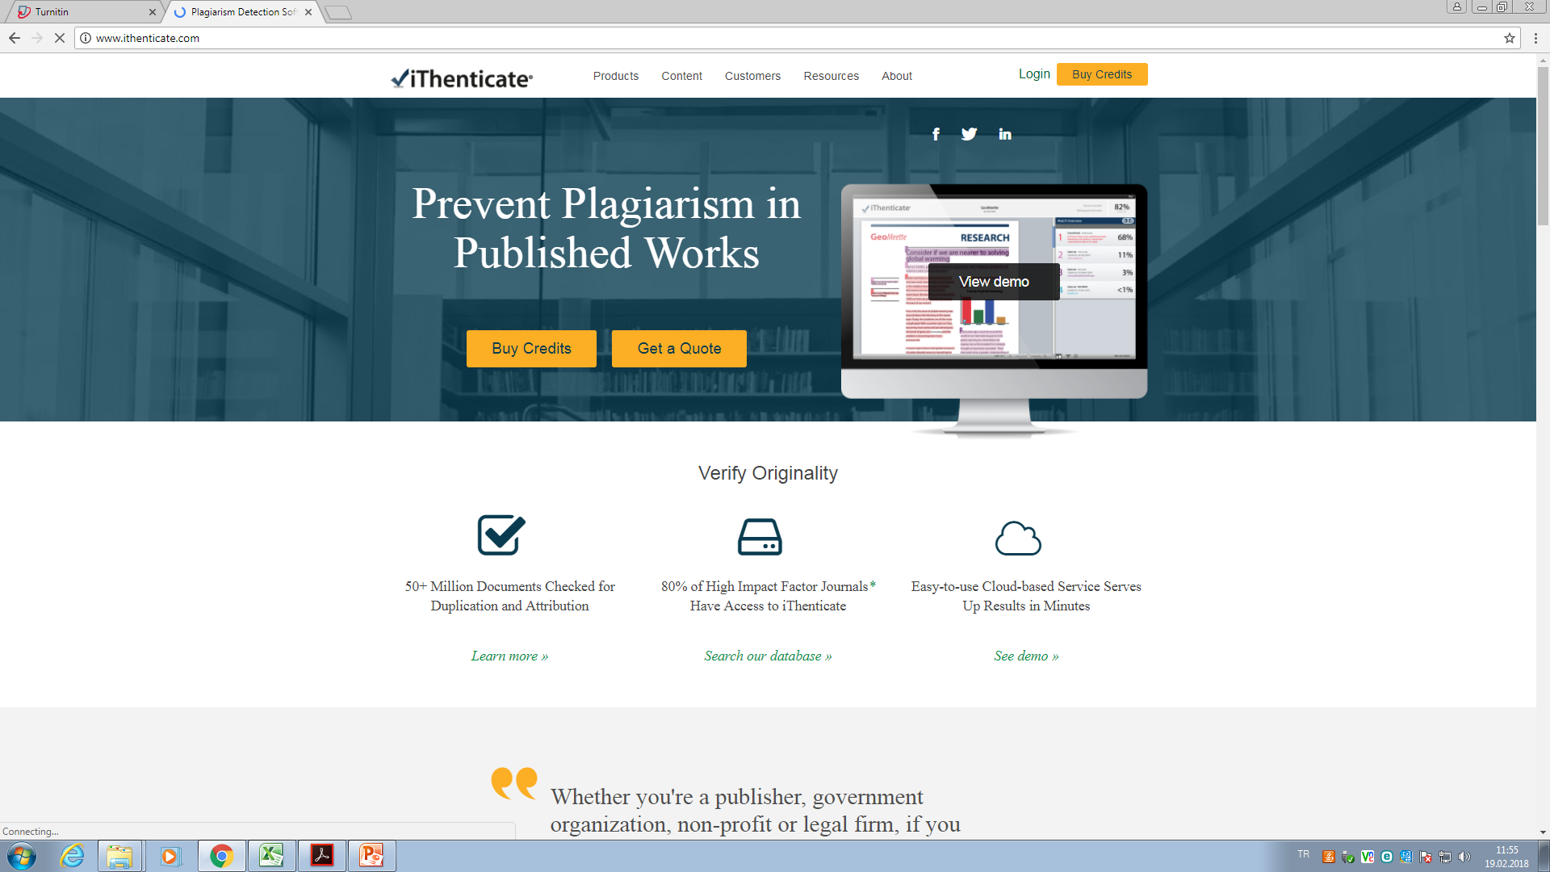

Slide 13
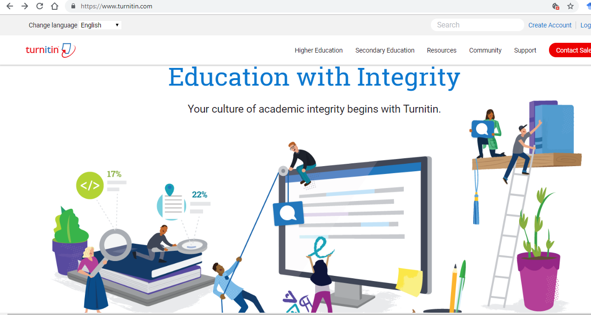

Slide 14
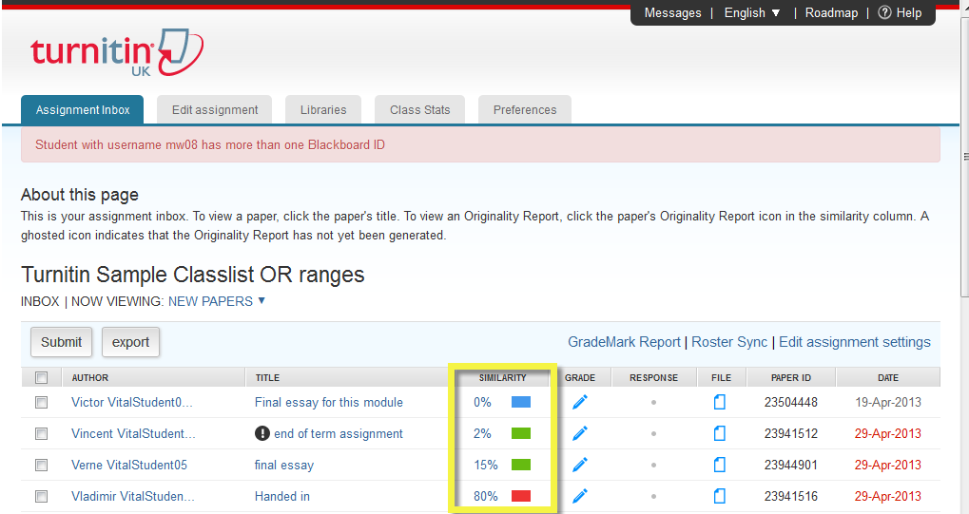

Slide 15
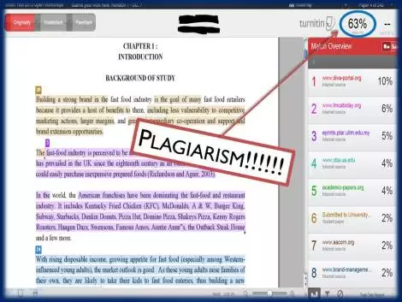

Slide 16
CITATION
You can avoid accusations of plagiarism by acknowledging the sources of these features and their originators within your own text. This is called citation.
Although there are several well established citation methods, they all consist of brief annotations or numbers placed within the text that identify the cited material,
and a list of references at the end of the text that give the full publication details of the source material.

Slide 17
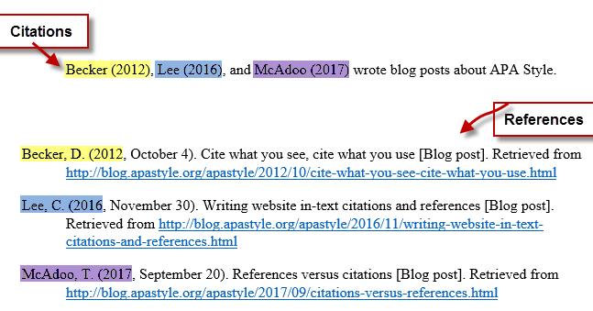

Slide 18
DATA AND INTERPRETATIONS
If you can see any reason for a possibility of bias in any aspect of the research, it should be acknowledged and explained.
If the study involves personal judgements and assessments, the basis for these should be given.
The sources of financial support for the research activities should be mentioned, and pressure and sponsorship from sources which might influence the impartiality of the research outcomes should be avoided.

