Slide 1
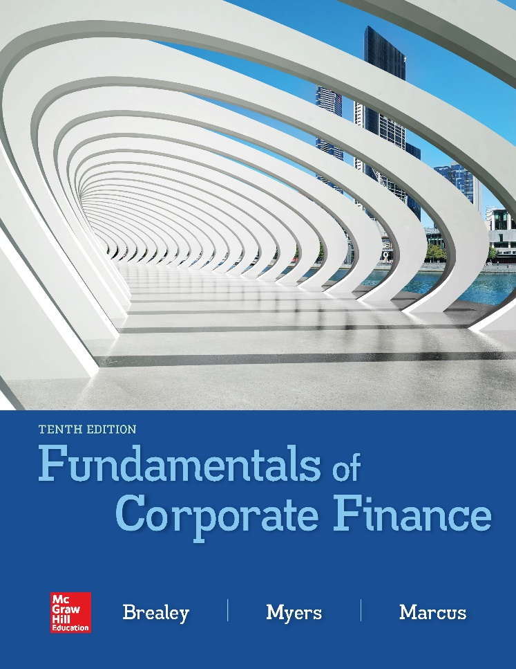

Slide 2
Topics Covered
13.1 Geothermal’s Cost of Capital
13.2 The Weighted-Average Cost of Capital (WACC)
13.3 Interpreting the WACC
13.4 Measuring Capital Structure
13.5 Estimating Expected Returns
13.6 Valuing Entire Businesses
Notes:
2

Slide 3
Cost of Capital (1 of 5)
Cost of Capital
The return the firm’s investors could expect to earn if they invested in securities with comparable degrees of risk
Capital Structure
The mix of long-term debt and equity financing
Notes:
3

Slide 4
Cost of Capital (2 of 5)
Example
Geothermal Inc. has the following structure. Given that Geothermal pays 8% for debt and 14% for equity, what is the company cost of capital?
Market value of debt | $194 | 30%
Market value of equity | 453 | 70
Market value of assets | $647 | 100%
Notes:
4

Slide 5
Cost of Capital (3 of 5)
Example (continued)
Given that Geothermal Inc. pays 8% for debt and 14% for equity, what is the company cost of capital?
Portfolio return = (.3 × 8%) + (.7 × 14%) = 12.2%
Notes:
6

Slide 6
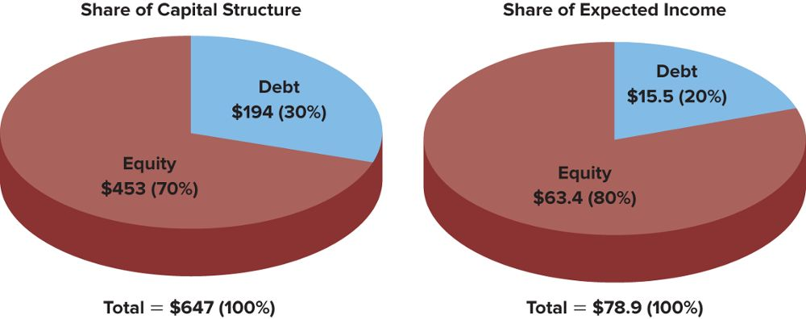
Cost of Capital (4 of 5)
Example
Geothermal’s debtholders account for 30% of the company’s capital structure, but they get a smaller share of income because their 8% return is guaranteed by the company. Geothermal’s stockholders bear more risk and receive, on average, greater return. Of course, if you buy all the debt and all the equity, you get all the income.
Notes:
6

Slide 7
Cost of Capital (5 of 5)
Example
Given that Geothermal Inc. pays 8% for debt and 14% for equity, what is the company cost of capital?
Portfolio return = (.3 × 8%) + (.7 × 14%) = 12.2%
Interest is tax deductible. Given a 21% tax rate, debt only costs us 6.32% (i.e. 8 % × .79).
WACC = (.3 × 6.32%) + (.7 × 14%) = 11.7%
Notes:
6

Slide 8
WACC (1 of 9)
Weighted Average Cost of Capital (WACC)
The expected rate of return on a portfolio of all the firm’s securities, adjusted for tax savings due to interest payments
Company cost of capital = Weighted average of debt and equity returns
Notes:
7

Slide 9
WACC (2 of 9)
$$r_{assets}=\frac{total income}{value of investments}$$
$$r_{assets}=\frac{\left(D×r_{debt}\right)+(E×r_{equity})}{V}$$
$$r_{assets}=\left(\frac{D}{V}×r_{debt}\right)+\left(\frac{E}{V}×r_{equity}\right)$$
Notes:
10

Slide 10
WACC (3 of 9)
Taxes are an important consideration in the company cost of capital because interest payments are deducted from income before tax is calculated
After-tax cost of debt = pretax cost × (1 - tax rate)
= r_{debt} × (1 - T_{c})
Notes:
12

Slide 11
WACC (4 of 9)
IMPORTANT
E, D, and V are all market values of equity, debt, and total firm value
$$r_{assets}=r_{debt}\left(\frac{D}{V}\right)+r_{equity}\left(\frac{E}{V}\right)$$
V = D + E
D = market value of debt
E = market value of equity = # shares × price per share
r_{debt} = YTM on bonds
r_{equity} = CAPM = r_{f} + β(r_{m} - r_{f})

Slide 12
WACC (5 of 9)
Weighted Average Cost of Capital = WACC
$$WACC= \left[\frac{D}{V}×(1−T_{c})r_{debt}\right]+\left[\frac{E}{V}×r_{equity}\right]$$
Notes:
13

Slide 13
WACC (6 of 9)
Three Steps to Calculating Cost of Capital
Calculate the value of each security as a proportion of the firm’s market value
Determine the required rate of return on each security
Calculate a weighted average of the after-tax return on the debt and the return on the equity
Notes:
11

Slide 14
WACC (7 of 9)
Weighted Average Cost of Capital with Preferred Stock
$$WACC= \left[\frac{D}{V}×(1−T_{c})r_{debt}\right]+\left[\frac{P}{V}×r_{preferred}\right]+\left[\frac{E}{V}×r_{equity}\right]$$
Notes:
13

Slide 15
WACC (8 of 9)
Example
Executive Fruit has issued debt, preferred stock and common stock. The market value of these securities are $4 million, $2 million, and $6 million, respectively. The required returns are 6%, 12%, and 18%, respectively.
Q: Determine the WACC for Executive Fruit, Inc.
Notes:
14

Slide 16
WACC (9 of 9)
Example (continued)
Step 1
Firm Value = 4 + 2 + 6 = $12 million
Step 2
Required returns are given
Step 3
Notes:
17

Slide 17
WACC for Selected Firms

Slide 18
Interpreting WACC (1 of 2)
The WACC is an appropriate discount rate only for a project that is a carbon copy of the firm's existing business
There are two costs of debt financing
The explicit cost of debt is the rate of interest bondholders demand
The implicit cost is the required increase in return from equity

Slide 19
Interpreting WACC (2 of 2)
Issues in Using WACC
Debt has two costs
Return on debt
Increased cost of equity demanded due to the increase in risk
Betas may change with capital structure
$$β_{assets}=\left[\frac{D}{V}×β_{debt}\right]+\left[\frac{E}{V}×β_{equity}\right]$$
Corporate taxes complicate the analysis and may change our decision
Notes:
18

Slide 20
Measuring Capital Structure (1 of 5)
In estimating WACC, do not use the book value of securities
In estimating WACC, use the market value of the securities
Book values often do not represent the true market value of a firm’s securities
Notes:
19

Slide 21
Measuring Capital Structure (2 of 5)
Market Value of Bonds - PV of all coupons and par value discounted at the current YTM
Market Value of Equity - Market price per share multiplied by the number of outstanding shares
Notes:
20

Slide 22
Measuring Capital Structure (3 of 5)
Big Oil Book Value Balance Sheet (mil)
Bank debt | $ 200 | 25.0%
LT bonds | $ 200 | 25.0%
Common stock | $ 100 | 12.5%
Retained earnings | $ 300 | 37.5%
Total | $ 800 | 100.0%
Notes:
21

Slide 23
Measuring Capital Structure (4 of 5)
Big Oil Book Value Balance Sheet (mil)
Bank debt | $ 200 | 25.0%
LT bonds | $ 200 | 25.0%
Common stock | $ 100 | 12.5%
Retained earnings | $ 300 | 37.5%
Total | $ 800 | 100.0%
If the long term bonds pay an 8% coupon and mature in 12 years, what is their market value assuming a 9% YTM?
Notes:
21

Slide 24
Measuring Capital Structure (5 of 5)
Big Oil Market Value Balance Sheet (mil)
Bank debt (mil) | $ 200.0 | 12.6%
LT bonds | $ 185.7 | 11.7%
Total debt | $ 385.7 | 24.3%
Common stock | $ 1,200.0 | 75.7%
Total | $ 1,585.7 | 100.0%
Notes:
21

Slide 25
Required Rates of Return (1 of 4)
Bonds
r_{d} = YTM
Common Stock
r_{e} = CAPM
= r_{f} + β(r_{m} - r_{f})
Notes:
23

Slide 26
Required Rates of Return (2 of 4)
Example
Big Oil has a beta of .85. The risk free rate is 6% and the market risk premium is 7%.
Q: Determine the WACC for Big Oil.
Notes:
14

Slide 27
Required Rates of Return (3 of 4)
Dividend Discount Model Cost of Equity
Perpetuity Growth Model =
Solve for r_{e} :
Notes:
25

Slide 28
Required Rates of Return (4 of 4)
Expected Return on Preferred Stock
Price of preferred stock =
Solve for r_{preferred} :
Notes:
27

Slide 29
FCF and PV
Free Cash Flows (FCF) should be the theoretical basis for all PV calculations
FCF is a more accurate measurement of PV than either Div or EPS
The market price does not always reflect the PV of FCF
When valuing a business for purchase, always use FCF

Slide 30
Capital Budgeting (1 of 3)
Valuing a Business
The value of a business or project is usually computed as the discounted value of FCF out to a valuation horizon (H)
The valuation horizon is sometimes called the terminal value and is calculated like a perpetuity

Slide 31
Capital Budgeting (2 of 3)
Valuing a Business or Project
PV (free cash flows)
PV (horizon value)

Slide 32
Capital Budgeting (3 of 3)
Example – Deconstruction Company

