Slide 1

INTRODUCTION TO INTERPRETING STUDIES

Slide 2
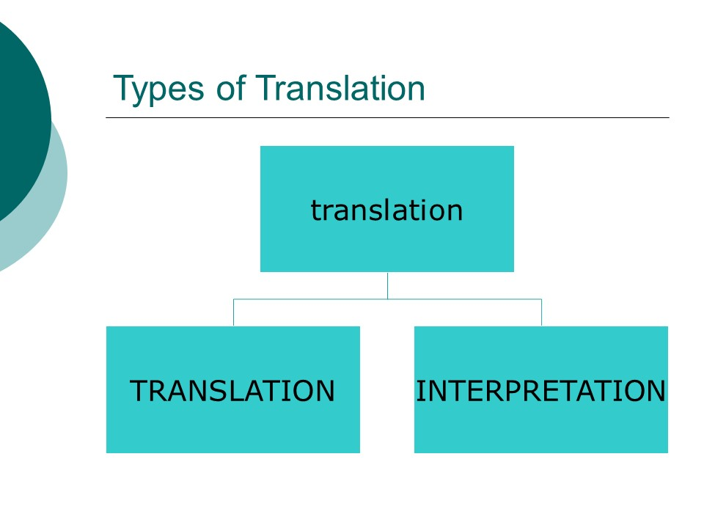

Slide 3
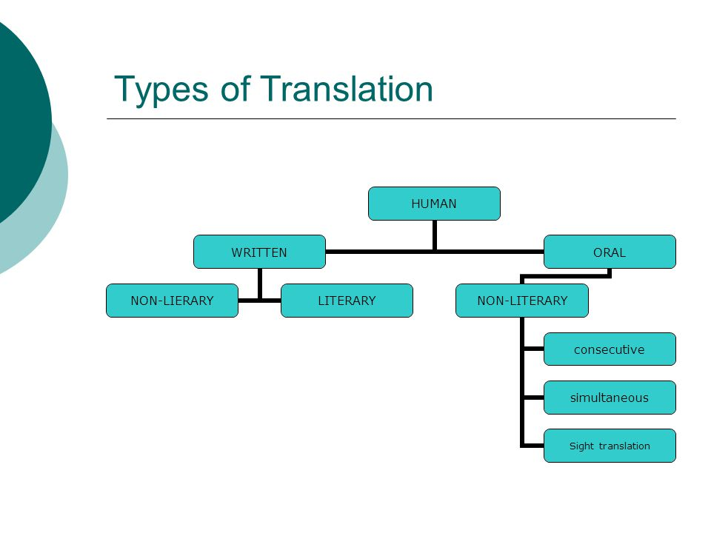

Slide 4
https://www.youtube.com/watch?v=MGmffejFm4s&ab_channel=DayTranslationsInc

Slide 5
ORAL TRANSLATION
CONSECUTIVE INTERPRETING (ARDIL ÇEVİRİ)
It is the most commonly used mode of interpreting.
Consecutive involves a relay in which the speaker says a couple of sentences and then pauses for the interpreter to interpret and then
The other party responds and pauses and the interpreter interprets what they say.
Simply said, the parties involved in the conversation take turns talking.
Consecutive is less confusing than simultaneous and is the most common mode of interpreting in healthcare because it resembles the way in which people usually talk to each other

Slide 6
During Consecutive Interpreting the speaker stops every 1–5 minutes (usually at the end of every “paragraph” or complete thought) and
the interpreter then steps in to render what was said into the target language.
A key skill involved in consecutive interpreting is note-taking, since few people can memorize a full paragraph in one hearing without loss of detail
writing down words in the source language makes the interpreter’s job harder when he has to translate the speech into the target language.
THEREFORE
Many professional interpreters develop their own “ideogramic” symbology, which allows them to take down not the words, but the thoughts of the speaker in a sort of language-independent form
Then the interpreter’s output is more idiomatic and less source-language bound.

Slide 7
EXAMPLES
https://www.youtube.com/watch?v=3oWAg-lppFY&t=20s&ab_channel=T%C3%BClinNacaro%C4%9Flu
https://www.youtube.com/watch?v=ut_dObnwWzQ&ab_channel=HaberlerveHaberler
https://www.youtube.com/watch?v=T3gPrF8PhWY&ab_channel=estarabim

Slide 8
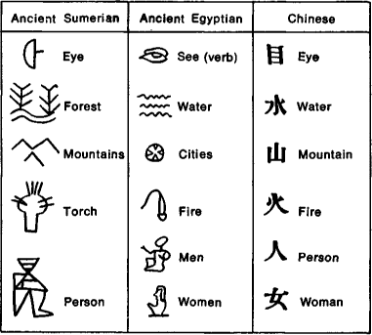

Slide 9
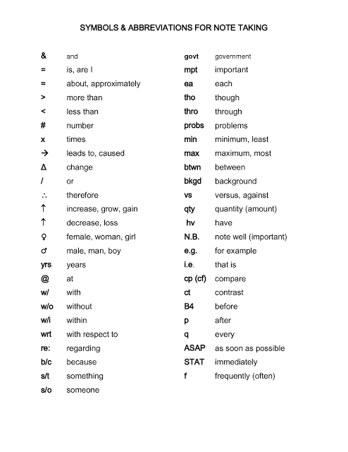

Slide 10
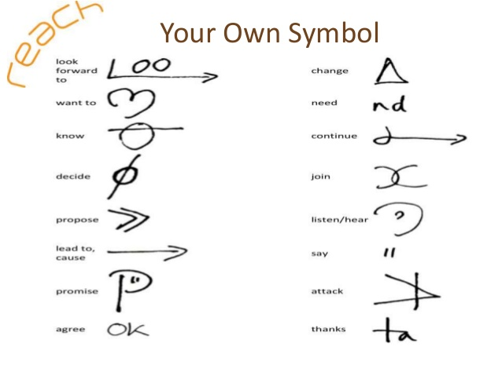

Slide 11
SIMULATANEOUS INTERPRETING (EŞ ZAMANLI ÇEVİRİ)
Typically, while performing Simultaneous Interpreting, the interpreter sits in a booth wearing a pair of headphones and speaks into a microphone.
“simultaneous” is a misnomer ???????
the interpreter cannot start interpreting until he or she understands the general meaning of the sentence.
Depends on language structure/ the speaker is speaking staying only a few words behind
S/he must translate the sentence into the target language while simultaneously listening to and comprehending the next sentence
One of the key skills of the simultaneous interpreter is decisiveness

Slide 12
EXAMPLES
https://www.youtube.com/watch?v=UrypVnooPoc&ab_channel=ErayKarakuzu
https://www.youtube.com/watch?v=I_bmBezzblo&ab_channel=Ostim%C4%B0vogsanTerc%C3%BCmeB%C3%BCrosu
https://www.youtube.com/watch?v=e-nc3zTLTkc&ab_channel=M.Emin%C3%96%C4%9E%C3%9CK
https://www.youtube.com/watch?v=aFLoVnhB0iw&ab_channel=TurkiyeKonferansTercumanlariDernegi

Slide 13
WHISPER INTERPRETING (FISILTI ÇEVİRİSİ)
Whispering Interpreting is where the interpreter sits next to the person needing to understand the foreign language and whispers what’s being said in their ear
No special equipment is required and the interpreting is near real-time
If the person being interpreted to wishes to speak their Whispering Interpreter will speak on their behalf.
The aim to provide personal language support to an individual within a group without impacting the group as a whole
Whispering interpreters work best on a one-to-one basis

Slide 14
ESCORT INTERPRETATING (Eşlik çevirisi veya refakat çevirisi)
Escort interpreters utilize a combination of the simultaneous and consecutive modes of interpretation to relay the speaker’s message.
Escort interpretation does not require electronic equipment and is spoken directly to an individual listener.
This mode is used primarily when one or two individuals in a group speak a different language from the rest, or during informal conversations.
In addition, tourists and foreign delegates often engage escort interpreters for various types of excursions

Slide 15
SIGHT TRANSLATION (YAZILI METİNDEN SÖZLÜ ÇEVİRİ)
Somewhere between translation and intrepretation
the oral translation of a written text
Due to its dual nature the notion of sight translation has generated a number of terms such as sight interpreting, underlining the oral target-text presentation
One must read the document at a steady pace without lengthy pauses making it sound natural as if the interpreter is just reading it out loud in the target language
In contrast to other modes of interpreting, what characterizes sight translation is that the input is visual rather than oral
the verbal rendering of the written source text in the target language

Slide 16
EXAMPLE
https://www.youtube.com/watch?v=wTyxDeEoLMc&ab_channel=MillenniumTranslationGroup

Slide 17
The basic difference between sight translation and interpreting relates to the process of reading and listening
since the sight translator translates the text he reads whereas the interpreter performs the same task on the text he hears.
This means the sight translator has the text in front of him until he finishes translating, but the interpreter’s actual auditory exposure to the oral text lasts until just after the source segments are uttered by the speaker

Slide 18
It is generally considered as a useful exercise practiced in the early stages of the interpreter training program to improve students‟ oral language skills and techniques and hence prepare them for consecutive and simultaneous interpreting
However, The possible settings of use are courts, hospitals, schools and business negotiations where documents are available
ST is an important skill for professional translators and interpreters. It is an efficient strategy in the translation industry
ST helps student interpreters achieve rapid source text analysis and quick conversion of message from one cultural setting to another,
avoid the literal word-for-word translation approach,
improve the skills of note-reading and public speaking, and
enhance the flexibility of expression

Slide 19
It facilitates the acquisition of a global strategy for text production,
increases students’ ability of analytical reading, and
helps students divorce themselves from the surface structure of the original text

Slide 20
Sight Translation Skills
ST involves analytical reading instead of analytical listening.
The interpreter deals with written texts instead of oral presentations, characterized by
high information density, long sentences, and no auditory cues (pauses, rising and falling intonation patterns, and facial expressions) but punctuations.
successful ST performance depends on analytical reading and on such related sub-skills as text analysis, speed reading, identification of main ideas and their links, and concentration
the interpreter has to coordinate between reading ahead, reformulation and monitoring

Slide 21
The use of non-verbal elements (pause distribution, fillers, intonation, etc.) is also an important skill
the load of short-term memory in ST is lighter than that in consecutive or simultaneous interpreting, partly because the information is continuously present in the manuscript
When the source text sentences to be sight translated are long and complex, and the source and target language are syntactically different, the interpreter has to rely more on short-term memory
“Reading + Short-term Memory + Production + Coordination”

Slide 22
the linguistic and cultural differences between the source and target language require the interpreter to use language-specific and culture-specific strategies to overcome the constraints
Additionally, similar to simultaneous, the interpreter must keep reading ahead and avoid backtracking in oral production because of the time constraints involved in oral output
the simultaneity of reading ahead, production, and monitoring in ST requires efficient cognitive resource management. Whenever necessary, the interpreter uses problem-oriented strategies to ease overload of memory and processing capacities, and improve the pace of delivery
For example, summarization, compression or condensing and omission are necessary for interpreters to deal with message redundancy and increase their speed of delivery
a good ST performance should be free of pauses, restarts, and hesitations, and sound as if the interpreter is reading a document in the target language

Slide 23
quick semantic access to the target equivalent
good mentality under time pressure
speed production
anxiety control

Slide 24
Main Characteristics of ST
Reception conditions:
Production conditions:
written source-text presentation
absence of author
punctuation
permanent access to the text
attention-sharing between visual input and oral output
non-sequential reception (reader can go back)
interpreter-paced (not paced by speaker)
oral target-text presentation (short, long, recorded)
considerable time delay between source language production and translation
coordination of Reading and Production Efforts
monitoring production while reading
prior access to information
interpreter-paced (not paced by speaker)
time-saving (in comparison to written translation)
no help of colleagues

Slide 25
Possible problems
The text to be sight translated may be handwritten
The text to be sight translated may involve ungrammatical sentence structures and poor punctuation
The text to be sight translated may be incoherent, or poorly organized
The text to be sight translated may involve graphs, tables, pictures or diagrams

Slide 26
COMMUNITY INTERPRETING (TOPLUM ÇEVİRMENLİĞİ)
Community interpreting
Community interpreting is usually referred to as a special type of oral translation facilitating access to public services
mediating between service users and service providers who do not share the same language.
public service interpreting (UK),
cultural interpreting (Canada),
liaison interpreting (Australia),
contact interpreting (Scandinavia), dialogue interpreting,,
ad hoc, triangle, face-to-face, and bidirectional or bilateral interpreting

Slide 27
Community interpreting is sometimes distinguished from other types of interpreting by the contexts in which it is employed
It is understood as a kind of interpreting that takes place in neighbourhoods and community agencies and is performed by unpaid volunteers, often perceived as non-professional interpreters
The settings where communication takes place include hospitals and doctors´ offices, attorneys´ offices, social welfare and housing agencies, employment agencies, or police stations

Slide 28
Another characteristic feature of community interpreting is the degree of formality/informality in the interpreting activities.
Instead of interpreting a speech to a large audience, a community interpreter works in a more interactive atmosphere, often with a dialogic structure
Therefore, it is sometimes labelled as dialogue interpreting.

Slide 29
Compared to other types of interpreting, the (unprofessional) community interpreter also serves as a guide, advisor or social mediator.
His often spontaneous face-to-face interaction / helping hand.

Slide 30
Community interpreting is also distinguished from other types of interpreting by the fact that no equipment is used for communication.
Depending on the circumstance, it can take the form of either consecutive or simultaneous interpreting,
but on principle in the presence of all people involved, although sometimes over the telephone.
Intrepreting through telephone or videoconferencing: remote interepreting

Slide 31
community interpreting is making use of interpreting skills, linguistic skills, research and technical skills, and interpersonal skills.
The interpreting skills include: active listening, good memory retention, note-taking, and mental ability to transpose and verbalize messages into the target language.
The linguistic skills are represented by: the depth of knowledge in and the understanding of the interpreter’s working languages and the required range of language registers; and the knowledge of subject areas and related terminology.
The research and technical skills include: the ability to efficiently acquire the additional linguistic and specialized knowledge necessary to interpret in specialized cases, the experience in the use of research tools, and the ability to develop suitable strategies for the efficient use of the information sources available.
The interpersonal skills include: strong communication skills, polite, respectful and tactful conduct, positive relationship to people, and good judgment.

Slide 32
1. Accuracy and Fidelity
2. Confidentiality
3. Impartiality
4. Respect for Persons
5. Maintaining Role Boundaries
6. Accountability
7. Professionalism
8. Continued Competence

Slide 33
SIGN LANGUAGE INTERPRETING (İŞARET DİLİ ÇEVİRMENLİĞİ)
Sign language interpreters are professionals.
Their job is to accurately translate a spoken language, such as English, into a signed or manual language, such as American Sign Language, the native language of the deaf.
The interpreter listens to the spoken message and interprets it into the sign language used by the deaf person.
The translation can also go in the other direction. An interpreter may watch the signed language of a deaf person and translate the message into the spoken language of a hearing listener

Slide 34
Are there any other types of interpreters?
Hard-of-hearing or deaf people who do not use sign language may use the services or an oral interpreter.
Oral interpreters reproduce what a speaker has said by mouthing the message without audible speech. Their job is to produce a message that is easy for a deaf listener to lipread.
Other specialties include tactile signing, which is interpreting for persons who are blind as well as deaf by conveying signs into a person’s hands

Slide 35
There are two types of interpretation: simultaneous and consecutive.
Simultaneous interpretation requires interpreters to listen and sign, or watch and speak, at the same time.
The interpreter begins to convey a sentence in the target language while listening or watching the message being delivered in the source language.
This type of interpreting happens most commonly in business meetings, college classes or conferences.

Slide 36
In contrast, consecutive interpretation begins only after the speaker has spoken or signed a sentence or paragraph.
Interpreters may need to take notes to assist in the process of creating a coherent accurate translation.
This form of interpretation is used most often for witness testimony in legal settings or in a one-on-one meeting such as with a doctor, social worker or counsellor

