Slide 1
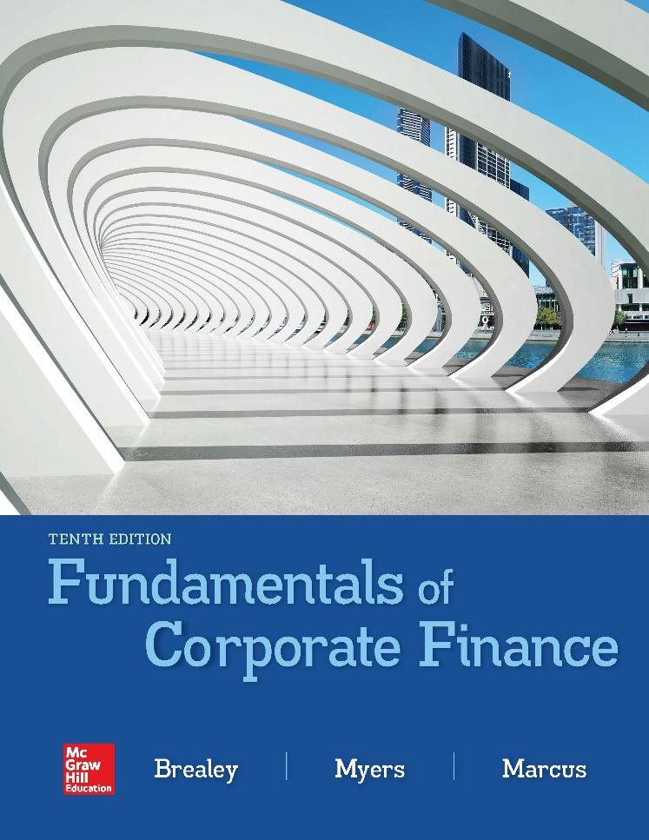

Slide 2
Topics Covered
11.1 Rates of Return: A Review
11.2 A Century of Capital Market History
11.3 Measuring Risk
11.4 Risk and Diversification
11.5 Thinking About Risk
Notes:
2

Slide 3
Rates of Return (1 of 4)
Notes:
5

Slide 4
Rates of Return (2 of 4)
Notes:
6

Slide 5
Rates of Return (3 of 4)
Notes:
8

Slide 6
Rates of Return (4 of 4)
Nominal vs. Real
Notes:
11

Slide 7
Market Indexes
Market Index
  Measure of the investment performance of the overall market
Dow Jones Industrial Average (The Dow)
  Index of the investment performance of a portfolio of 30 “blue-chip” stocks
Standard & Poor’s Composite Index (S&P 500)
  Index of the investment performance of a portfolio of 500 large stocks
Notes:
12

Slide 8
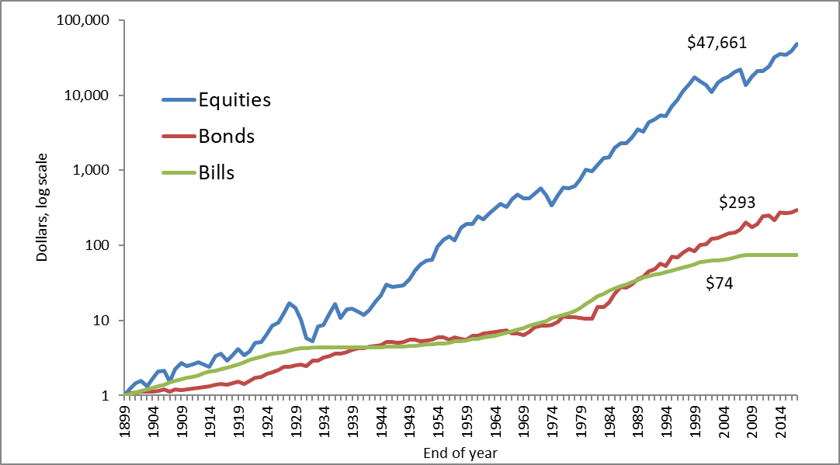
The Value of a $1 Investment in 1900
2017
Notes:
13

Slide 9
Rates of Return (5 of 6)
Notes:
15

Slide 10
Rates of Return (6 of 6)
Common Stocks (1900-2017)

Slide 11
Expected Return
Expected market return | = | interest rate on Treasury bills | + | normal risk premium
(1981) 21.7% | = | 14 | + | 7.7
(2018) 9.4% | = | 1.7 | + | 7.7
Notes:
15

Slide 12
Expected Returns
 | 1900-1928 | 1929-1957 | 1958-1987 | 1987-2017
Stocks | 12.0% | 9.8% | 11.8% | 12.5%
Treasury bills | 4.9% | 1.0% | 6.0% | 3.1%

Slide 13
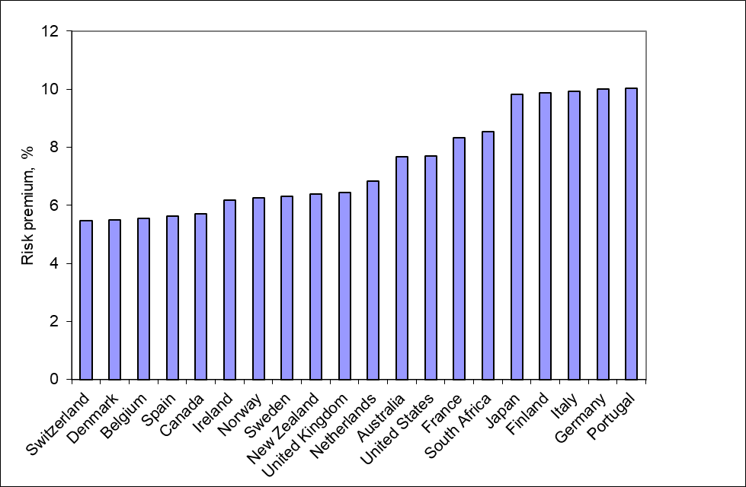
Country Risk Premiums (%)
Country risk premiums (1900-2017)

Slide 14
Measuring Risk (1 of 4)
Variance
  Average value of squared deviations from mean
  A measure of volatility
Standard Deviation
  Square root of variance
  Another measure of volatility
Notes:
16

Slide 15
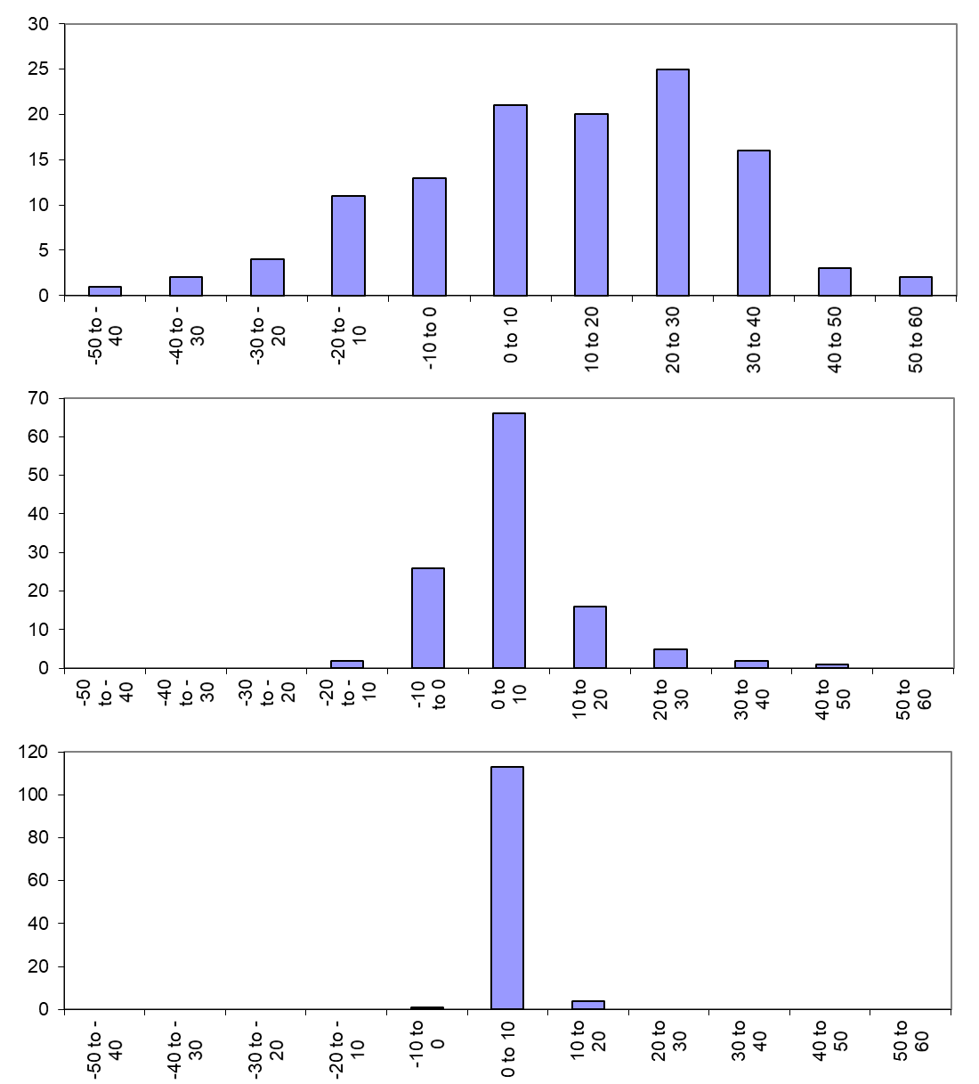
Measuring Risk (2 of 4)
Number of Years
Returns %

Slide 16
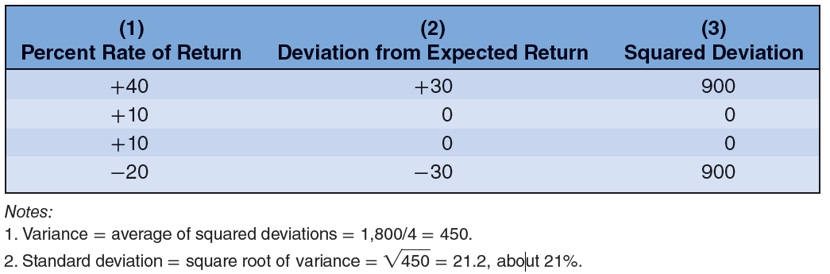
Measuring Risk (3 of 4)
Coin-toss game; calculating variance and standard deviation
Expected return = (.25 × .40) + (.5 × .10) + (.25 × -.20)
= .10 of 10%
Notes:
17

Slide 17
Measuring Risk (4 of 4)

Slide 18
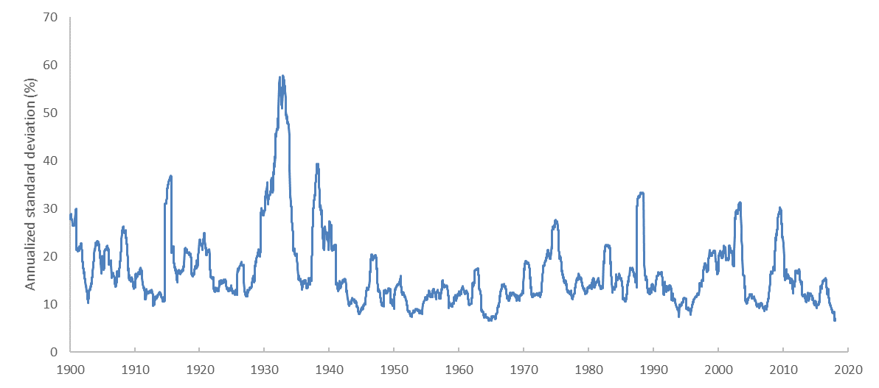
Stock Market Volatility 1900-2017

Slide 19
Risk and Diversification (1 of 9)

Slide 20
Risk and Diversification (2 of 9)
Portfolio rate of return | = | fraction of portfolio in first asset |  | × | rate of return on first asset
 |  | + | fraction of portfolio in second asset | × | rate of return on second asset
Notes:
19

Slide 21
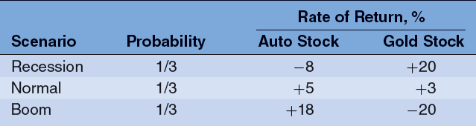
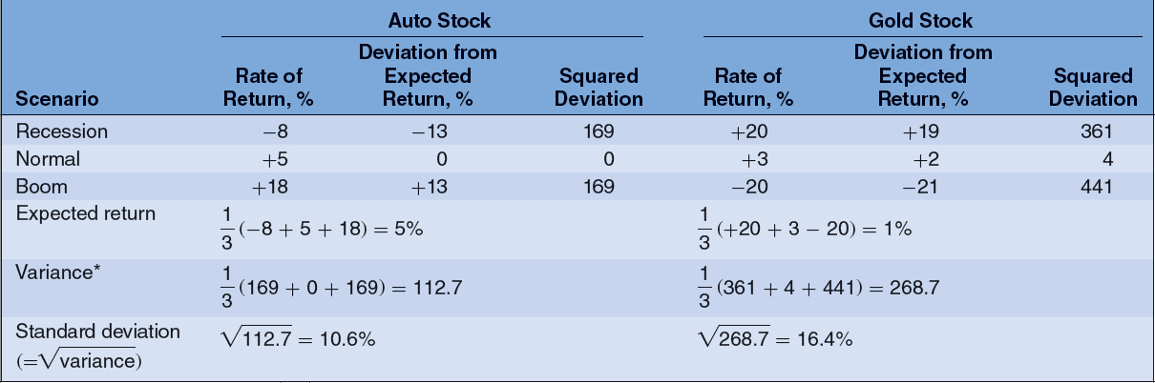
Risk and Diversification (3 of 9)
Two Asset Example: Gold and Auto stocks

Slide 22
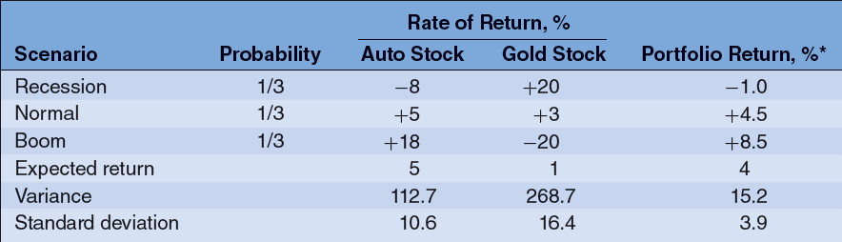
Risk and Diversification (4 of 9)
Two Asset Example (continued)
Assume 25% in Gold and 75% in Auto

Slide 23
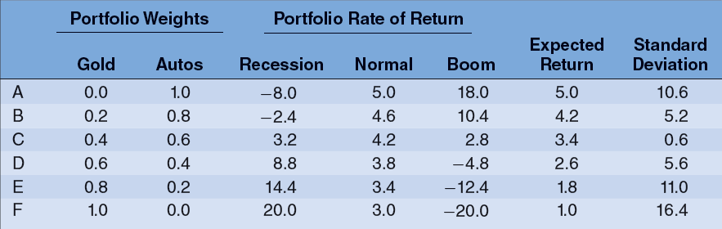
Risk and Diversification (5 of 9)
Two Asset Example (continued)
Sensitivity analysis

Slide 24
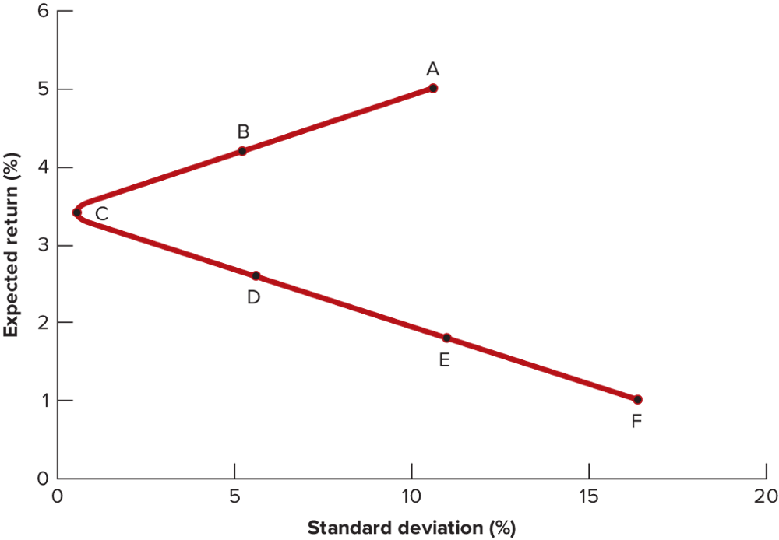
Risk and Diversification (6 of 9)
Two Asset Example (continued)
Sensitivity analysis graph

Slide 25
Risk and Diversification (7 of 9)
Diversification
  Strategy designed to reduce risk by spreading the portfolio across many investments
Specific Risk
  Risk factors affecting only that firm, also called “diversifiable risk”
Market Risk
  Economy-wide sources of risk that affect the overall stock market, also called “systematic risk”
Notes:
18

Slide 26
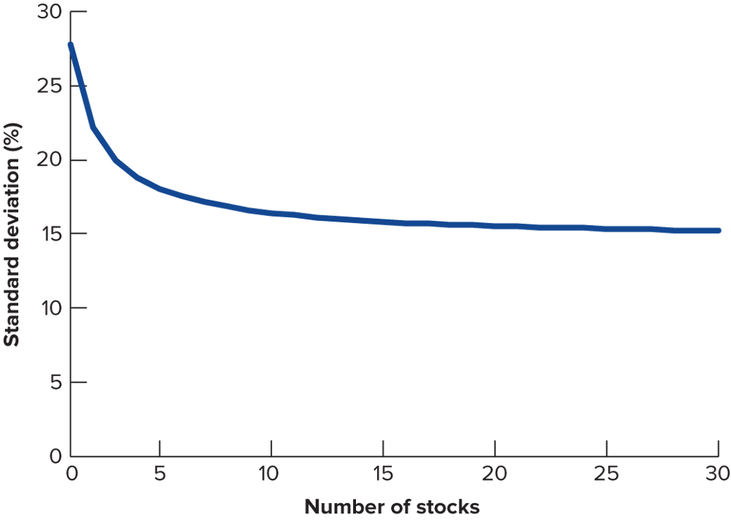
Risk and Diversification (8 of 9)
Notes:
20

Slide 27
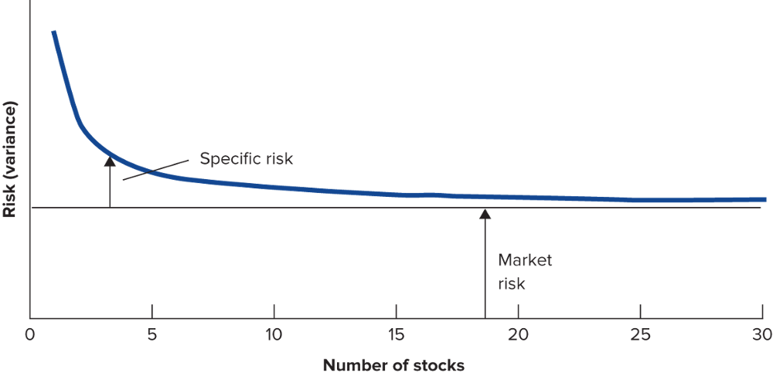
Risk and Diversification (9 of 9)
Notes:
21

Slide 28
Thinking about Risk
Message 1
  Some risks look big and dangerous but really are diversifiable
Message 2
  Market risks are macro risks
Message 3
  Risk can be measured

