Slide 1
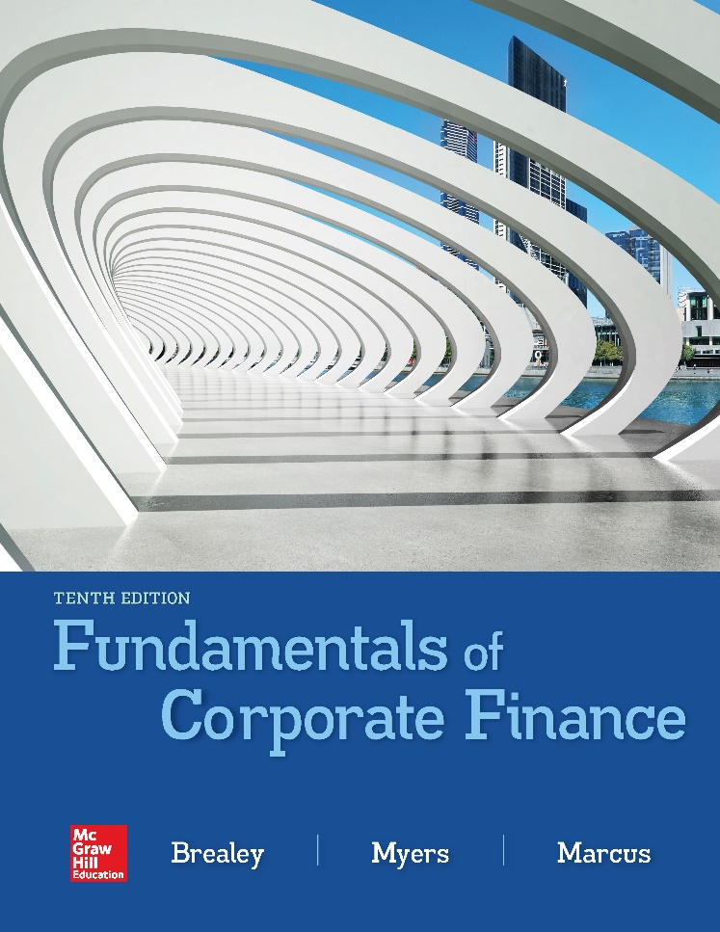

Slide 2
Topics Covered
1.1 Investment and Financing Decisions
1.2 What is a Corporation?
1.3 Who Is the Financial Manager?
1.4 Goals of the Corporation
1.5 Agency Problems, Executive Compensation, and Corporate Governance
1.6 The Ethics of Maximizing Value
1.7 Careers in Finance
1.8 Preview of Coming Attractions
1.9 Snippets of Financial History
Notes:
3
2
2
2
2
2

Slide 3
Investment and Financing Decisions (1 of 6)
Capital Budgeting Decision
  Decision to invest in tangible or intangible assets
…also called
  Investment Decision
  Capital Expenditure (CAPEX) decision
Notes:
6
5
5
5
5
5

Slide 4
Investment and Financing Decisions (2 of 6)
  “Capital Budgeting”
TANGIBLE ASSETS
Southwest Airlines
Purchase new planes
INTANGIBLE ASSETS
GlaxoSmithKline
R&D expenditures
Notes:
6
5
5
5
5
5

Slide 5
Investment and Financing Decisions (3 of 6)
Financing Decision
  Decision on the sources and amounts of financing
Capital Structure
  The mix of long-term debt and equity financing
Notes:
6
5
5
5
5
5

Slide 6
Investment and Financing Decisions (4 of 6)
ASSETS
FIRM
Investment Decision
“Capital Budgeting”
Debt
Equity
Financing Decision
Notes:
6
5
5
5
5
5

Slide 7
Investment and Financing Decisions (5 of 6)
Real Assets
  Assets used to produce goods and services
Financial Assets
  Financial claims to the income generated by the firm’s real assets
Notes:
6
5
5
5
5
5

Slide 8
Investment and Financing Decisions (6 of 6)
Are the following capital budgeting or financing decisions?
  Intel decides to spend $7 billion to develop a new microprocessor
  BMW borrows 350 million euros (€350 million) from Deutsche Bank
  Royal Dutch Shell constructs a pipeline to bring natural gas onshore from a production platform in Australia
  Avon spends €200 million to launch a new range of cosmetics in European markets
  Pfizer issues new shares to buy a small biotech company
Notes:
6
5
5
5
5
5

Slide 9
What Is a Corporation? (1 of 4)
Corporation
  A business organized as a separate legal entity owned by stockholders
Types of Corporations
  Public Companies
  Private Corporations
  Limited Liability Corporations (LLC)
Notes:
4
3
3
3
3
3

Slide 10
What Is a Corporation? (2 of 4)
Types of Business Organizations
  Sole Proprietorships
  Partnerships
  Corporations
  Limited Liability Options
    Limited Liability Partnerships
    Limited Liability Corporations
    Professional Corporations
Limited Liability
  The owners of a corporation are not personally liable for its obligations
Notes:
4
3
3
3
3
3

Slide 11
What Is a Corporation? (3 of 4)
 | Sole Proprietorship | Partnership | Corporation
Who owns the business? | The manager | Partners | Stockholders
Are managers and owners separate? | No | No | Usually
What is the owner’s liability? | Unlimited | Unlimited | Limited
Are the owner and business taxed separately? | No | No | Yes
Notes:
5
4
4
4
4
4

Slide 12
What Is a Corporation? (4 of 4)
Sole Proprietorships
Unlimited Liability
Personal tax on profits
Partnerships
Limited Liability
Corporate tax on profits + personal tax on dividends
Corporations

Slide 13
Who Is the Financial Manager? (1 of 3)
Chief Financial Officer
Treasurer
Controller
Notes:
19

Slide 14
Who Is the Financial Manager? (2 of 3)
Chief Financial Officer (CFO)
  Responsible for financial policy and corporate planning
Treasurer
  Responsible for cash management, raising of capital and banking relationships
Controller
  Responsible for preparation of financial statements, accounting and taxes
Notes:
4
3
3
3
3
3

Slide 15
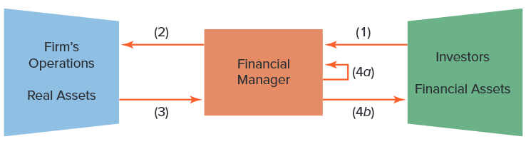
Who Is the Financial Manager? (3 of 3)
(1) Cash raised from investors
(2) Cash invested in firm
(3) Cash generated by operations
(4a) Cash reinvested
(4b) Cash returned to investors
Notes:
11
10
6
6
6
6

Slide 16
Goals of the Corporation (1 of 2)
Shareholders desire wealth maximization
Profit maximization
  Maximize profits? Which year’s profits?
  Earning manipulation
Opportunity cost of capital
  The minimum acceptable rate of return on capital investment is set by the investment opportunities available to shareholders in financial markets
Notes:
17

Slide 17
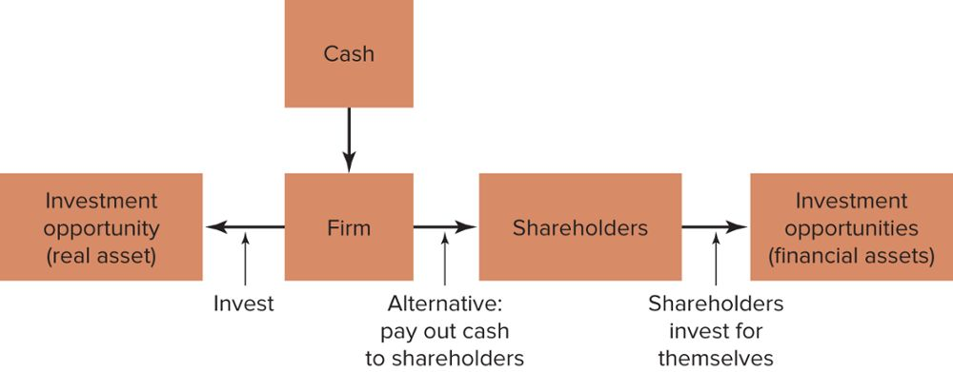
Goals of the Corporation (2 of 2)
The Investment Trade-Off
Notes:
17

Slide 18
Agency Problem (1 of 5)
Do managers maximize shareholder wealth or manager wealth?
Mangers have many constituencies called “stakeholders”
Stakeholder
  Anyone with a financial interest in the corporation
Notes:
17

Slide 19
Agency Problem (2 of 5)
Agency problem
  Managers are agents for stockholders and are tempted to act in their own interests rather than maximizing value
Agency cost
  Value lost from agency problems or from the cost of mitigating agency problems
Notes:
17

Slide 20
Agency Problem (3 of 5)
Ownership vs. Management
Difference in Information
Stock prices vs. returns
Dilution of ownership
Dividend policy
Financing decisions
Different Objectives
Managers vs. stockholders
Top managers vs. lower managers
Stockholders vs. banks and lenders

Slide 21
Agency Problem (4 of 5)
Corporate governance
  The laws, regulations, institutions, and corporate practices that protect shareholders and other investors
Notes:
18

Slide 22
Agency Problem (5 of 5)
Elements of good corporate governance
  Legal requirements
  Board of directors
  Activist shareholders
  Takeovers
  Information for investors
Notes:
18

Slide 23
Ethics of Maximizing Value
“It is not from the benevolence of the butcher, the brewer, or the baker, that we expect our dinner, but from their regard to their own interest. We address ourselves, not to their humanity but to their self-love, and never talk to them of our own necessities but of their advantages.” –Adam Smith, 1776
Does value maximization justify unethical behavior?
  Volkswagen
  Charles Ponzi
  Bernard Madoff
Is it ethical?
  Short selling
  Corporate raiders
  Tax avoidance
Notes:
18

Slide 24
Preview of Coming Attractions
How do I calculate the value of a stream of future cash flows?
How do I measure risk?
Where does financing come from?
How do I ensure that the firm’s financial decisions add up to a sensible whole?
What about some of those other responsibilities of the financial manager that you mentioned earlier?
Notes:
18

Slide 25
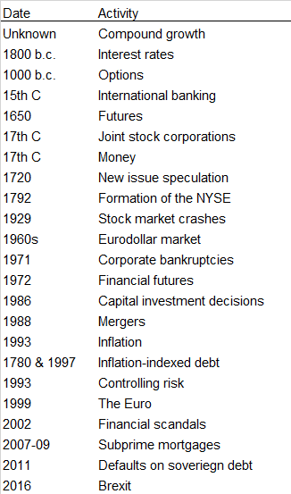
Snippets of Financial History

