Slide 1
Chapter Two
Determinants of Interest Rates
©McGraw Hill LLC. All rights reserved. No reproduction or distribution without the prior written consent of McGraw-Hill.

Slide 2
Interest Rate Fundamentals
Nominal interest rates are the interest rates actually observed in financial markets
  Directly affect the value (price) of most securities traded in the money and capital markets
  Changes in interest rates influence the performance and decision making for individual investors, businesses, and governmental units

Slide 3
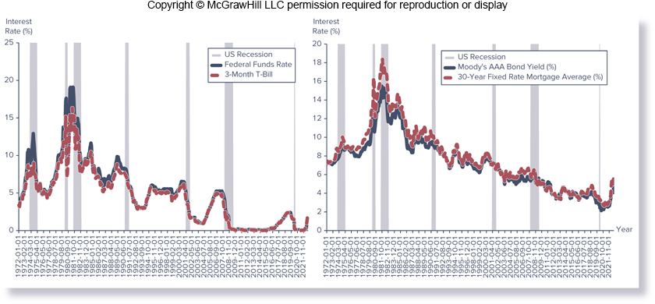
Key U.S. Interest Rates, 1972-2022
Notes:
Figure 2–1 illustrates the movement in several key U.S. interest rates over the past 50 years: the federal funds rate used for interbank borrowing, the three-month T-bill rate, the AAA-rated corporate bond rate, and the home mortgage rate.

Slide 4
Loanable Funds Theory
Changes in interest rates impact security values
  FIs spend much time and effort trying to identify factors that determine the level of interest rates at any moment in time, as well as what causes interest rate movements over time
Loanable funds theory views equilibrium interest rates in financial markets as a result of the supply of and demand for loanable funds
  Categorizes financial market participants – consumers, businesses, governments, and foreign participants – as net suppliers or demanders of funds

Slide 5
Supply of Loanable Funds
“Supply of loanable funds” describes funds provided to the financial markets by net suppliers of funds
  Generally, the quantity of loanable funds supplied increases as interest rates rise
    Household sector (consumer sector) is one of the largest suppliers of loanable funds in the U.S. ($84.66t in 2019)
    Business sector often has excess cash that it can invest for short periods of time ($28.06t for nonfinancial and $98.47t for financial business in 2019)
    Governments may supply loanable funds ($5.66t in 2019)
    Foreign investors view U.S. markets as alternatives to their domestic financial markets ($27.20t in 2019)

Slide 6
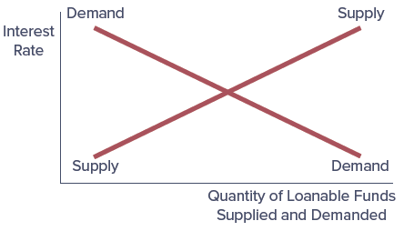
Supply of and Demand for Loanable Funds

Slide 7
Demand for Loanable Funds
“Demand for loanable funds” describes the total net demand for funds by fund users
  In general, the quantity of loanable funds demanded is higher as interest rates fall
    Household demand reflects financing purchases of homes, durable goods, and nondurable goods ($16.05t in 2019)
    Businesses demand funds to finance investments in long-term assets and for short-term working capital needs ($66.46t for nonfinancial and $111.87t for financial in 2019)
    Governments also borrow heavily ($28.86t in 2019)
    Foreign participants, mostly from the business sector, borrow in U.S. financial markets ($20.81t in 2019)

Slide 8
Factors That Cause the Supply and Demand Curves for Loanable Funds to Shift
Factors that cause the supply curve of loanable funds to shift, at any given interest rate:
  As wealth of fund suppliers increases (decreases), the supply of loanable funds increases (decreases)
  As risk of the financial security increases (decreases), the supply of loanable funds decreases (increases)
  As near-term spending needs increase (decrease), the supply of loanable funds increases (decreases)
  When monetary policy objectives allow the economy to expand (restrict expansion), the supply of loanable funds increases (decreases)
  As economic conditions improve in a domestic (foreign) country, the supply of funds increases (decreases)
Notes:
A shift in the supply or demand curve occurs when the quantity of a financial security supplied or demanded changes at every given interest rate in response to a change in another factor besides the interest rate.
It is important to note, related to point 5 on this slide, that when economic conditions improve in a foreign country relative to the domestic country, the supply of funds will decrease in the domestic country. Likewise, when conditions improve in a domestic country relative to a foreign country, the supply of funds increase in the domestic country.

Slide 9
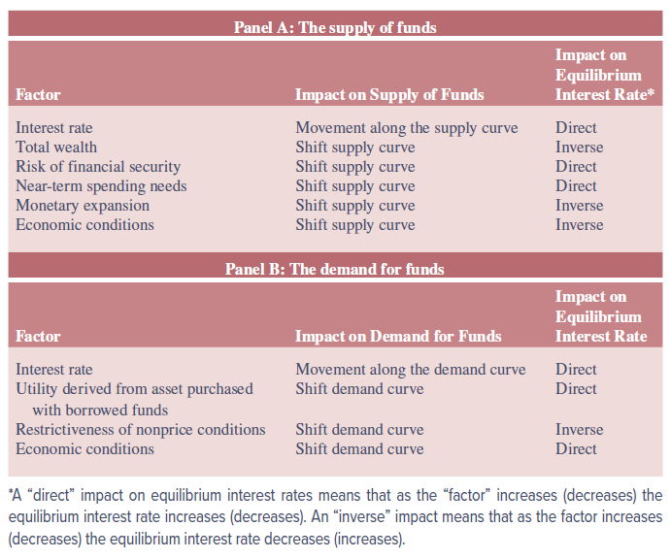
Factors That Affect the Supply of and Demand for Loanable Funds for a Financial Security

Slide 10
Factors That Cause the Supply and Demand Curves for Loanable Funds to Shift (Continued)
Factors that cause the demand curve for loanable funds to shift include the following:
  As the utility derived from an asset purchased with borrowed funds increases (decreases), the demand for loanable funds increases (decreases)
  As the restrictiveness of nonprice conditions on borrowed funds decreases (increases), the demand for loanable funds increases (decreases)
    Nonprice conditions may include fees, collateral, or requirements or restrictions on the use of funds (i.e., restrictive covenants)
  When domestic economic conditions result in a period of growth (stagnation), the demand for funds increases (decreases)

Slide 11
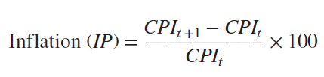
Determinants of Interest Rates for Individual Securities: Inflation
Inflation is the continual increase in the price level of a basket of goods and services
  The higher the level of actual or expected inflation, the higher will be the level of interest rates
  In the U.S., inflation is measured using indexes
    Consumer price index (CPI)
    Producer price index (PPI)
Annual inflation rate using the CPI index between years t and t+1 would be equal to:
Notes:
Specific factors affect differences in interest rates across the range of real-world financial markets . Those factors include inflation, the “real” risk-free rate, default risk, liquidity risk, special provisions regarding the use of funds raised by a security’s issuance, and the term to maturity of the security.

Slide 12

Determinants of Interest Rates for Individual Securities: Real Risk-Free Rate
A real risk-free rate is the interest rate that would exist on a risk-free security if no inflation were expected over the holding period of a security
  The higher society’s preference to consume today, the higher the real risk-free rate (RFR)
Relationship among the real risk-free rate (RFR), the expected rate of inflation [E(IP)], and the nominal interest rate (i) is referred to as the Fisher effect
  The Fisher effect is often written as the following:

Slide 13

Determinants of Interest Rates for Individual Securities: Default Risk
Default risk is the risk that a security issuer will fail to make its promised interest and principal payments to the buyer of a security
  The higher the default risk, the higher the interest rate that will be demanded by the buyer of the security to compensate him or her for this default (or credit) risk exposure
Difference between a quoted interest rate on a security (security j) and a Treasury security with similar maturity, liquidity, tax, and other features (such as callability or convertibility) is called a default or credit risk premium (DRPj)

Slide 14
Determinants of Interest Rates for Individual Securities: Liquidity Risk
Liquidity risk is the risk that a security can be sold at a predictable price with low transaction costs on short notice
  A highly liquid asset is one that can be sold at a predictable price with low transaction costs, and thus can be converted into its full market value at short notice
  If a security is illiquid, investors add a liquidity risk premium (LRP) to the interest rate on the security that reflects its relative liquidity
    LRP might also be thought of as an “illiquidity” premium
  LRP may also exist if investors dislike long-term securities because their prices (present values) are more sensitive to interest rate changes than short-term securities

Slide 15
Determinants of Interest Rates for Individual Securities: Special Provisions or Covenants
Special provisions or covenants that may be written into the contract underlying a security also affect the interest rates on different securities
  Some of these provisions include the security’s taxability, convertibility, and callability
    For investors, interest payments on municipal securities are free of federal, state, and local taxes
    A convertible (special) feature of a security offers the holder the opportunity to exchange one security for another type of the issuer’s securities at a preset price
  In general, special provisions that provide benefits to the security holder (e.g., tax-free status and convertibility) are associated with lower interest rates

Slide 16

Determinants of Interest Rates for Individual Securities: Term to Maturity
The term structure of interest rates is a comparison of market yields on securities, assuming all characteristics except maturity are the same
  Change in required interest rates as the maturity of a security changes is called the maturity premium (MP)
    The MP can be positive, negative, or zero
The following general equation can be used to determine the factors that functionally impact the fair interest rate (ij*) on an individual (jth) financial security:
Notes:
IP = Inflation premium
RFR = Real risk-free rate
DRPj = Default risk premium on the jth security
LRPj = Liquidity risk premium on the jth security
SCPj = Special feature premium on the jth security
MPj = Maturity premium on the jth security

Slide 17
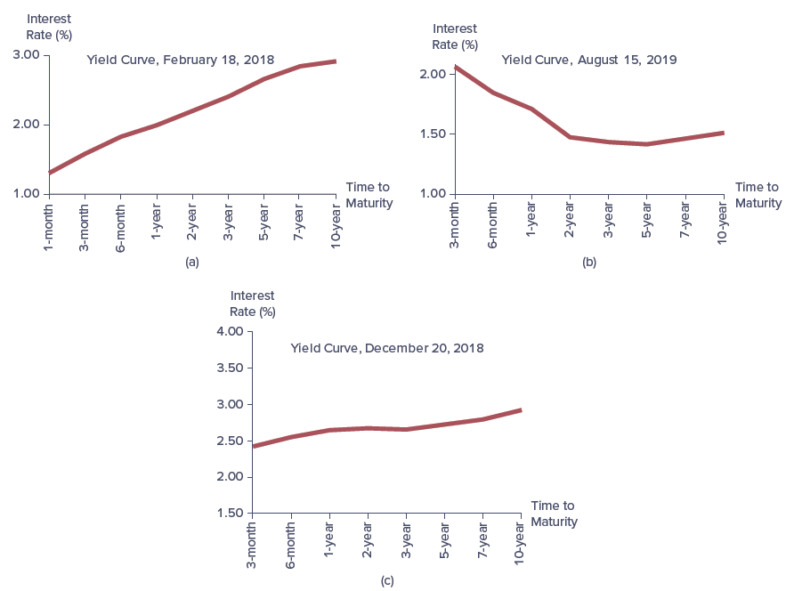
Common Shapes for Yield Curves on Treasury Securities

Slide 18
Term Structure of Interest Rates
Relationship between a security’s interest rate and its remaining term to maturity (i.e., the term structure of interest rates) can take a number of different shapes
Explanations for the shape of the yield curve fall predominately into three theories:
  Unbiased expectations theory
  Liquidity premium theory
  Market segmentation theory

Slide 19
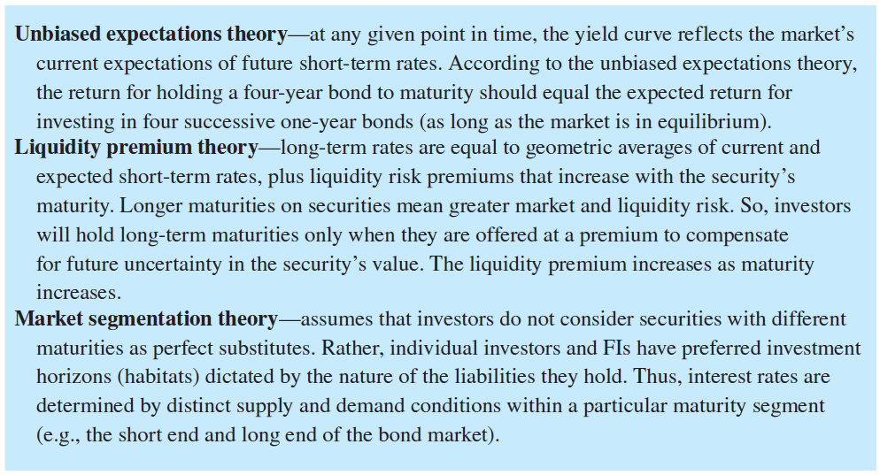
Explanations for the Shape of the Term Structure of Interest Rates

Slide 20
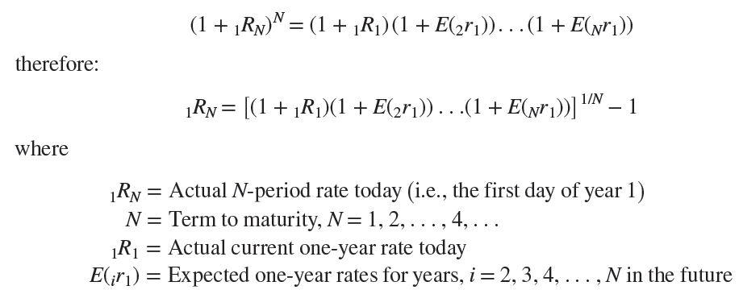
Unbiased Expectations Theory
At a given point in time, the yield curve reflects the market’s current expectations of future short-term rates
Notes:
The intuition behind the unbiased expectations theory is that if investors have a four-year investment horizon, they could either buy a current, four-year bond and earn the current or spot yield on a four-year bond (₁R₄, if held to maturity) each year, or invest in four successive one-year bonds—of which they know only the current one-year spot rate (₁R₁) but form expectations of the unknown future one-year rates [E(₂r₁), E(₃r₁), and E(₄r₁)].
In equilibrium, the return to holding a four-year bond to maturity should equal the expected return to investing in four successive one-year bonds. If this equality does not hold, an arbitrage opportunity exists.

Slide 21
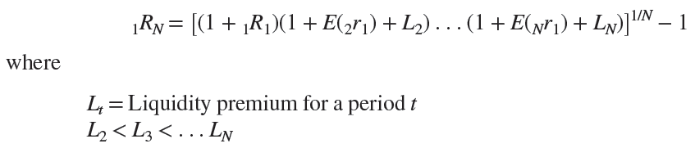
Liquidity Premium Theory
A weakness of the unbiased expectations theory is that it assumes that investors are risk neutral
Liquidity premium theory is an extension of the unbiased expectations theory
  Based on the idea that investors will hold long-term maturities only if they are offered at a premium to compensate for future uncertainty in a security’s value, which increases with an asset’s maturity
2-21

Slide 22
Market Segmentation Theory
2-22
Market segmentation theory argues that individual investors and FIs have specific maturity preferences, and to get them to hold securities with maturities other than their most preferred requires a higher interest rate (maturity premium)
  Does not consider securities with different maturities as perfect substitutes
  Individual investors and FIs have preferred investment horizons (habitats) dictated by the nature of the liabilities they hold (i.e., investors have complete risk aversion for securities outside their maturity preferences)
Notes:
A weakness of both the unbiased expectations and liquidity premium theories is that they assume that investors have no preference when it comes to different maturities and the risks associated with them.

Slide 23
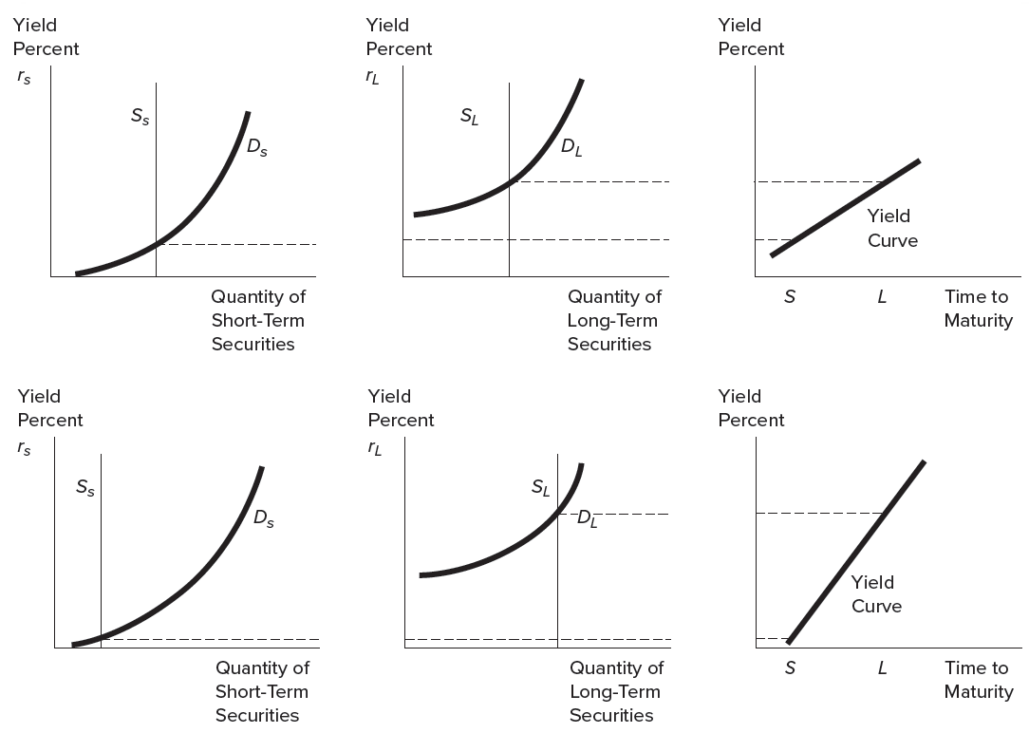
Market Segmentation and Determination of the Slope of the Yield Curve
2-23

Slide 24
Time Value of Money
Time value of money is the basic notion that a dollar received today is worth more than a dollar received at some future date
Two forms of time value of money calculations are commonly used in finance for security valuation purposes:
  Value of a lump sum
    A lump sum payment is a single cash payment received at the beginning or end of some investment horizon
  Value of annuity payments
    Annuity payments are a series of equal cash flows received at fixed intervals over the entire investment horizon
Notes:
We now explore how interest rates affect the value of financial securities by reviewing time value of money concepts.

Slide 25


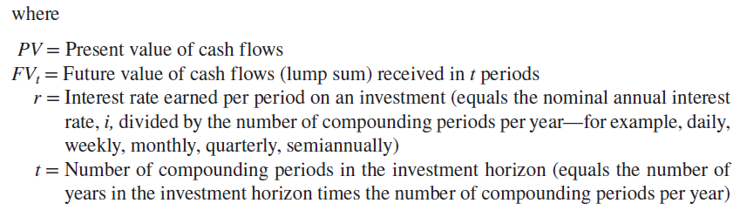
Lump Sum Valuation
Present Value of a Lump Sum
Future Value of a Lump Sump
Notes:
The present value function converts cash flows received over a future investment horizon into an equivalent (present) value as if they were received at the beginning of the current investment horizon. Note present values of the security investment decrease as interest rates increase.

Slide 26
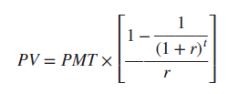


Annuity Valuation
Present Value of an Annuity
Future Value of an Annuity

