Slide 1
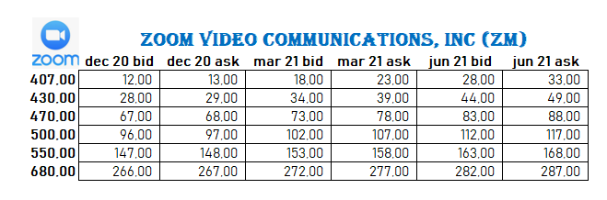
PUT PRICES
Put Prices
Q9: Today is 30 nov 2020. Spot price of 1 ZM is 406,00 USD.
You long one put contract for 407,00. Maturity : December 20 (1 option contract is 100 shares).
What is your payoff and profit as of Dec 20? Dec’20 Price of ZM is 390,00 USD. Draw the graph.

Slide 2
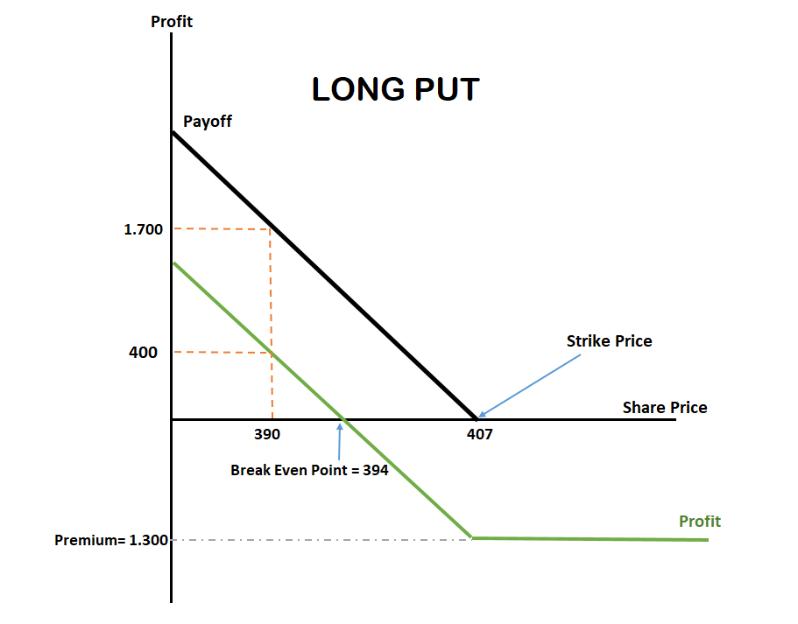
Answer q9:
Ask Cost (407) : 13,00 USD
1 option contract: 100 share
Total Cost (Premium) = 100 x 13,00 = 1.300 $
Break Even = 407-13 = 394
*** Payoff occurs below 407,00
@Dec 20 : 390,00 USD
Payoff = 407 -390 = 17 $ (per share)
Total payoff = 17 x 100 = 1.700 $
Profit = Payoff – Cost
Profit = 1.700 – 1.300 = 400 $

Slide 3
PUT PRICES
Q10: Today is 30 nov 2020. Spot price of 1 ZM is 406,00 USD.
You long one-thousand put contract for 430,00. Maturity : December 20 (1 option contract is 100 shares). What is your payoff and profit as of Dec 20? Dec’20 Price of ZM is 400,00 USD. Draw the graph.

Slide 4
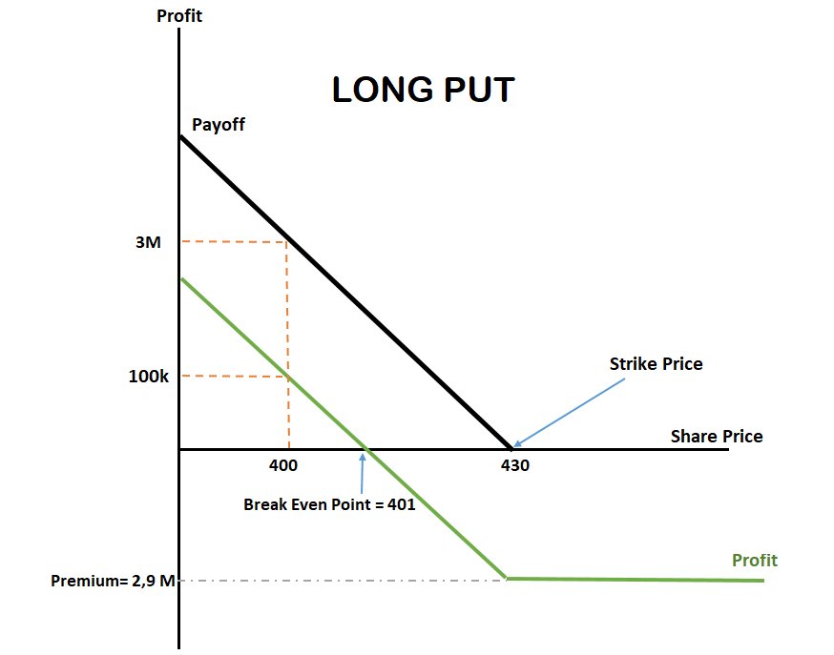
Answer q10:
Ask cost (430) : 29,00 USD
1.000 option contract : 1.000 x 100=
100.000 shares
Total Cost= 29 x 100.000 = 2.900.000$
Break Even = 430-29 = 401 $
*** Payoff occurs below 430,00
@Dec 20: 400,00 USD
Payoff: 430-400 = 30 USD
Total Payoff = 30 x 100.000 =
3.000.000 $
Profit = Payoff – Cost
= 3.000.000 $ - 2.900.000 $ = 100.000 $

Slide 5
PUT PRICES
Q11: Today is 30 nov 2020. Spot price of 1 ZM is 406,00 USD. You long ten-thousand put contracts for 680,00. Maturity : June 21 (1 option contract is 100 shares).
What is your payoff and profit as of Jun 21? Jun’21 Price of ZM is 660,00 USD. Draw the Graph.

Slide 6
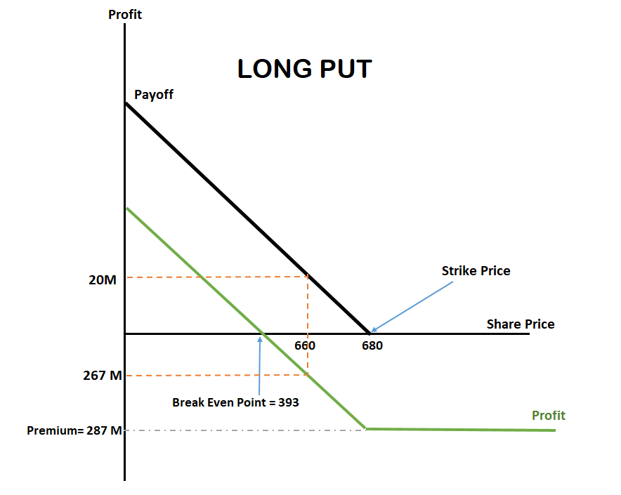
Answer q11:
Ask Cost (680) = 287,00 USD
10.000 option contract
10.000 x 100 = 1.000.000 shares
Total Cost (Premium): 287 x 1.000.000 = 287.000.000 $
Breakeven = 680-287 = 393 $
*** payoff occurs below 680
@Jun’21: 660,00 USD
Payoff = 680-660 = 20$
Total Payoff = 20 x 1.000.000 = 20.000.000 $
Profit = Payoff – Cost
= 20.000.000 – 287.000.000
= - 267.000.000 $ (LOSS)

Slide 7
PUT PRICES
Q12: Today is 30 nov 2020. Spot price of 1 ZM is 406,00 USD.
You long three put contracts for 500,00. Maturity : March 21 (1 option contract is 100 shares). What is your payoff and profit as of Mar 21? Mar’21 Price of ZM is 515,00 USD. Draw the Graph.

Slide 8
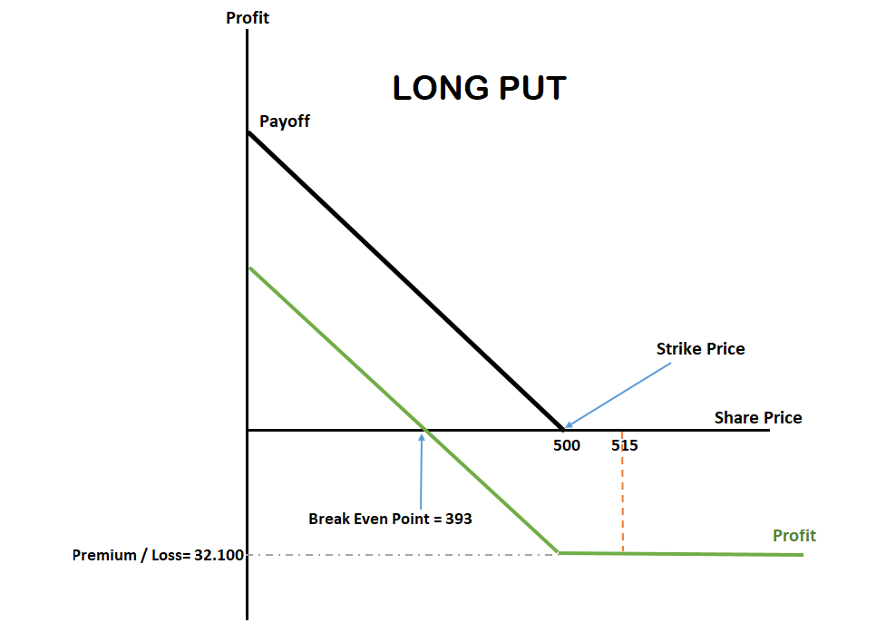
Answer q12:
Ask Cost (500) : 107,00 USD
3 option contract : 3x100 = 300 shares
Total Cost : 107 x 300 = 32.100 $
Break even = 500-107 = 393 $
*** Payoff occurs below 500
Is the price below 500?
No, the price is 515.
So no payoff. Payoff = 0
Profit = Payoff – Cost
Profit = 0 – 32.100 =
- 32.100 $ (LOSS)

