Slide 1
CHAPTER-5
Finding a topic and
doing critical literature review
&
How to access to the databases

Slide 2
Learning outcomes
By the end of this chapter you should:
• understand the importance and purpose of the critical literature review
to your research project;
• be able to adopt a critical perspective in your reading;
• know what you need to include when writing your critical review;
• be able to identify key words and to undertake a literature search using
a range of methods;
• be able to evaluate the relevance, value and sufficiency of the literature
found;
• be able to reference the literature found accurately;
• understand what is meant by plagiarism;
• be able to apply the knowledge, skills and understanding gained to your
own research project.

Slide 3
For most research projects, your literature search will be an early activity. Despite this early start, it is usually necessary to continue searching throughout your project’s life. The process can be likened to an upward spiral, culminating in the final draft of a written critical literature review.

Slide 4
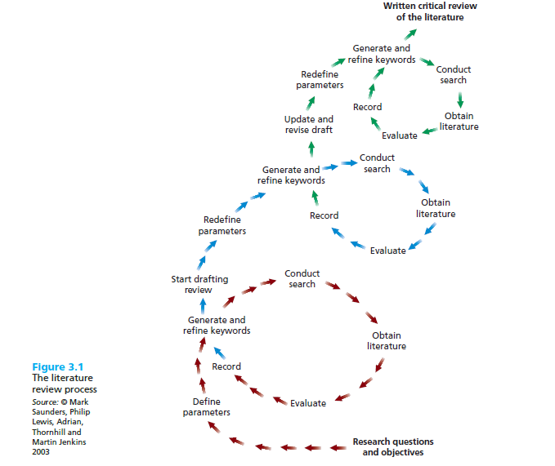
Saunders et al, 2009

Slide 5
The critical review
For some research projects you will use the literature to help you to identify theories and ideas that you will test using data. This is known as a deductive approach in which you develop a theoretical or conceptual framework, which you subsequently test using data.
For other research projects you will be planning to explore your data and to develop theories from them that you will subsequently relate to the literature. This is known as an inductive approach and, although your research still has a clearly defined purpose with research question(s) and objectives, you do not start with any predetermined theories or conceptual frameworks.

Slide 6
Literature sources available
The literature sources available to help you to develop a good understanding of, and insight into, previous research can be divided into three categories: primary (published and unpublished), secondary, and tertiary.
In reality these categories often overlap: for example, primary literature sources, including conference proceedings, can appear in journals, and some books contain indexes to primary and secondary literature.

Slide 7
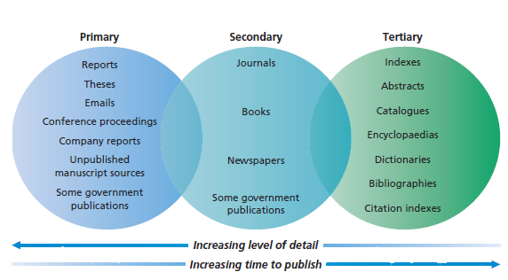
Literature sources available
Saunders et al, 2009

Slide 8
Before literature search
When planning your literature search you need to:
– have clearly defined research question(s) and objectives;
– define the parameters of your search;
– generate key words and search terms;
– discuss your ideas as widely as possible.

Slide 9

Generating Key words
The identification of key words or ‘search’ terms is the most important part of planning your search for relevant literature.
Key words are the basic terms that describe your research question(s) and objectives.
Key words can be identified using one or a number of different techniques in combination.

Slide 10
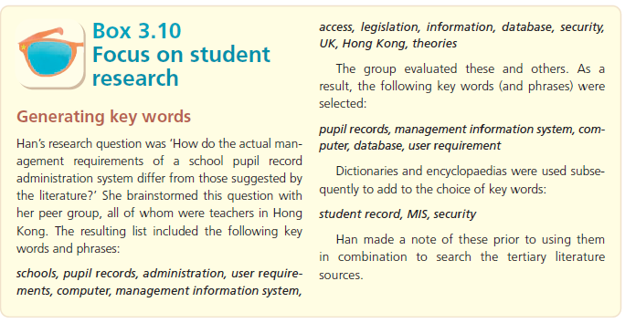

Slide 11
Where you look will depend on the subject you have chosen. Some sources cover most subjects, others are specialized in a narrow range, and will hence provide more detail. Here is a list of places you can search.

Slide 12

Libraries
Library catalogue. Most libraries now have an electronic catalogue accessed through their computer terminals, often accessible online from elsewhere too via the Intra- and/or Internet.
Journals and newspapers. These are often catalogued and stored separately to the books and may be available online. As they appear regularly, they tend to be very up to date.
Electronic databases. These are computer-based lists of publications, on CD-ROM or on the university Intranet or the Internet.

Slide 13
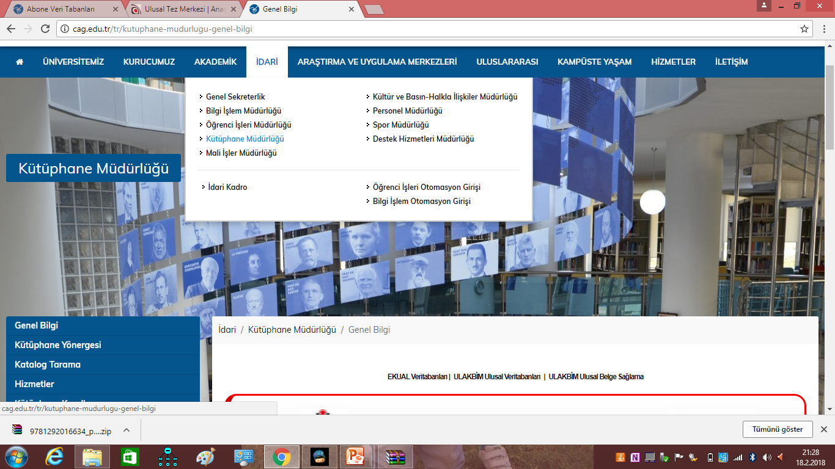

Slide 14
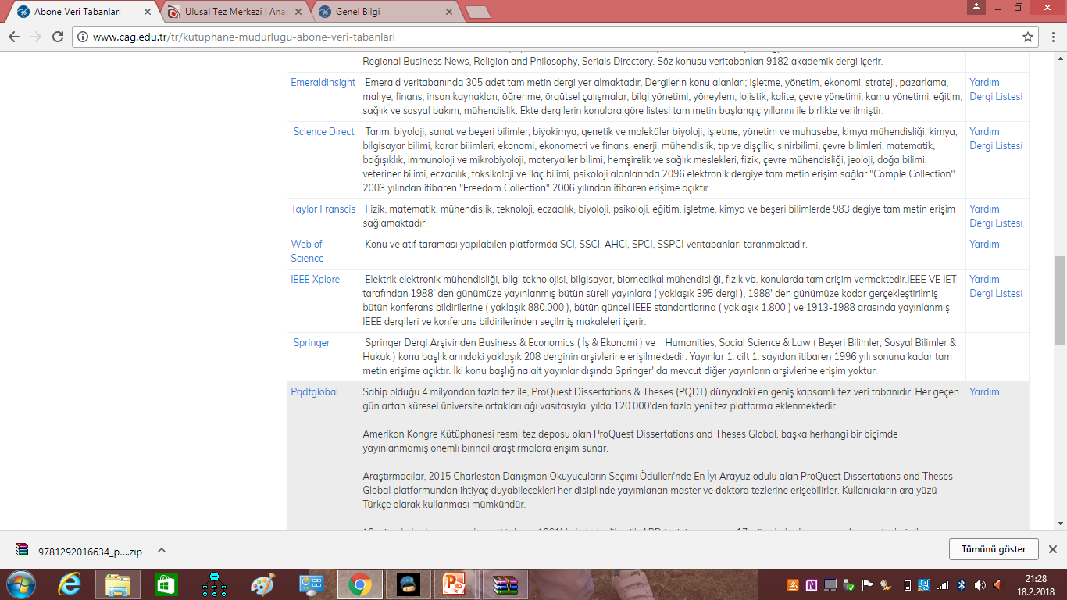

Slide 15
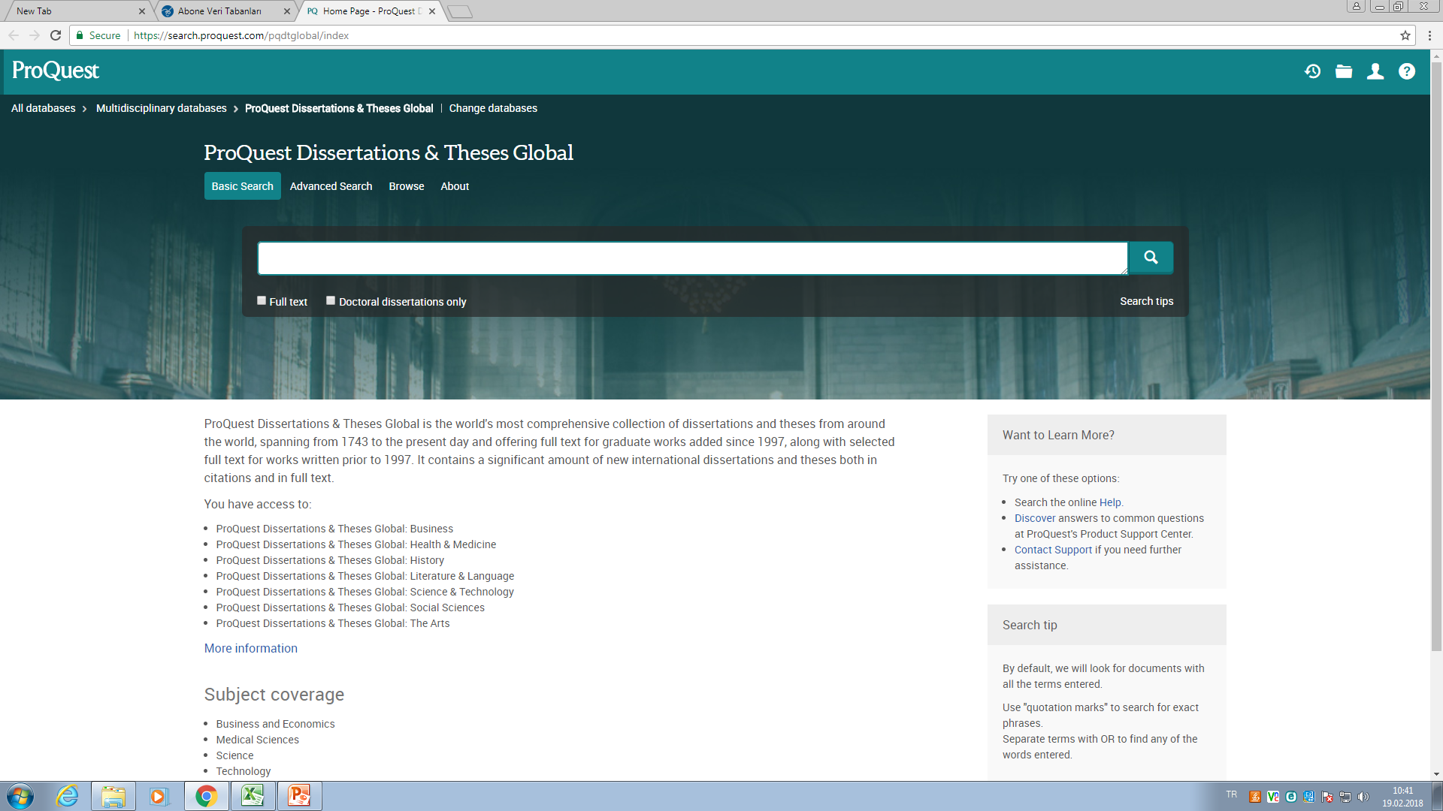

Slide 16
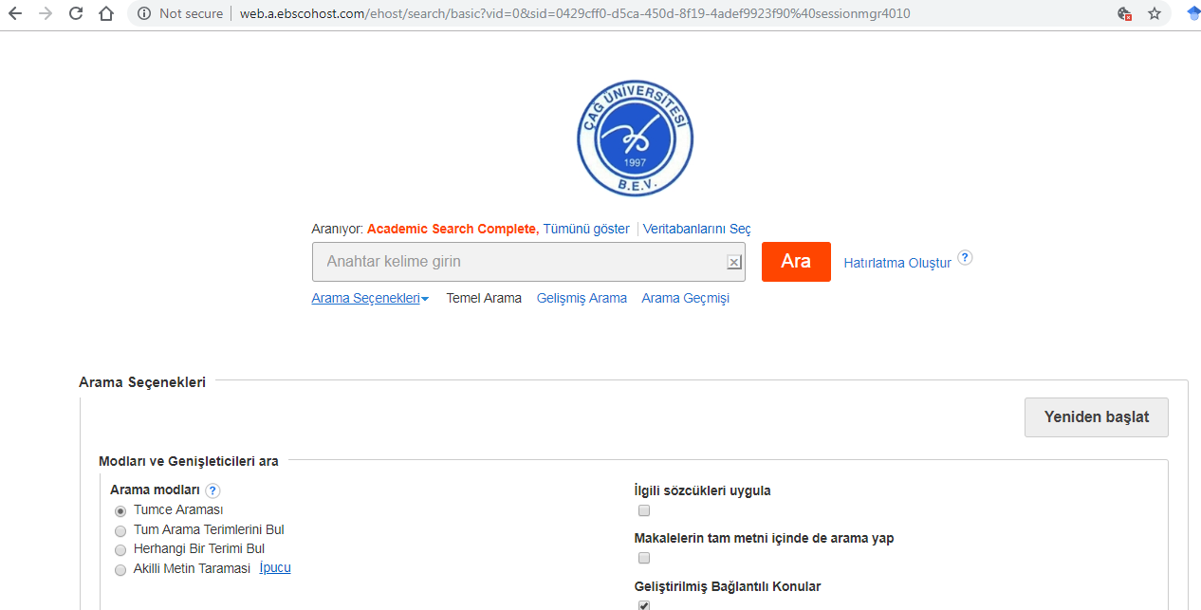

Slide 17
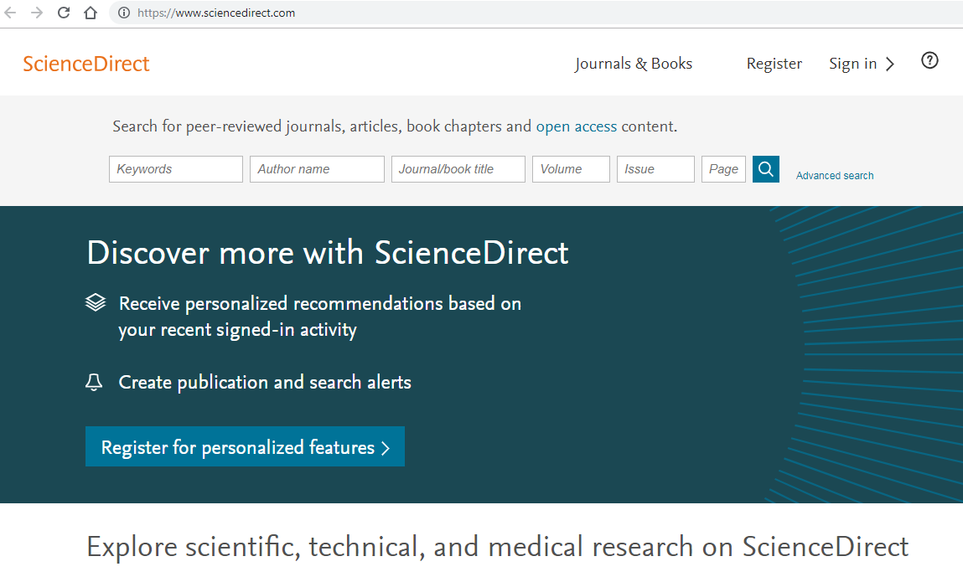

Slide 18

PEOPLE
Try the members of your own university staff at first, many of whom will be involved in research. Your library will contain guides to professionals and experts. In some cases, local knowledge will be needed – search out the relevant local experts.

Slide 19

THE INTERNET
Published Internet guides can help you to make the best of this resource.
Some are specifically aimed at students and list useful search engines, sites and databases.
Any Internet guide becomes quickly outdated.
Specialized search engines such as Google Scholar will filter out much of the dross by listing academic and technical papers from proven sources.

Slide 20
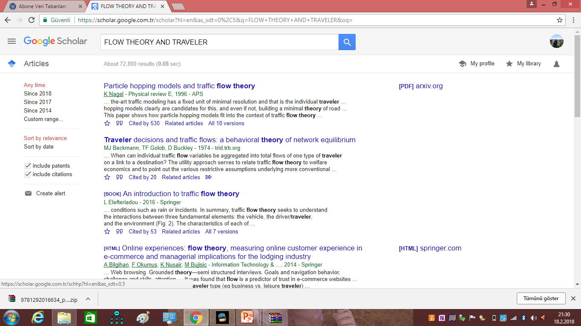

Slide 21
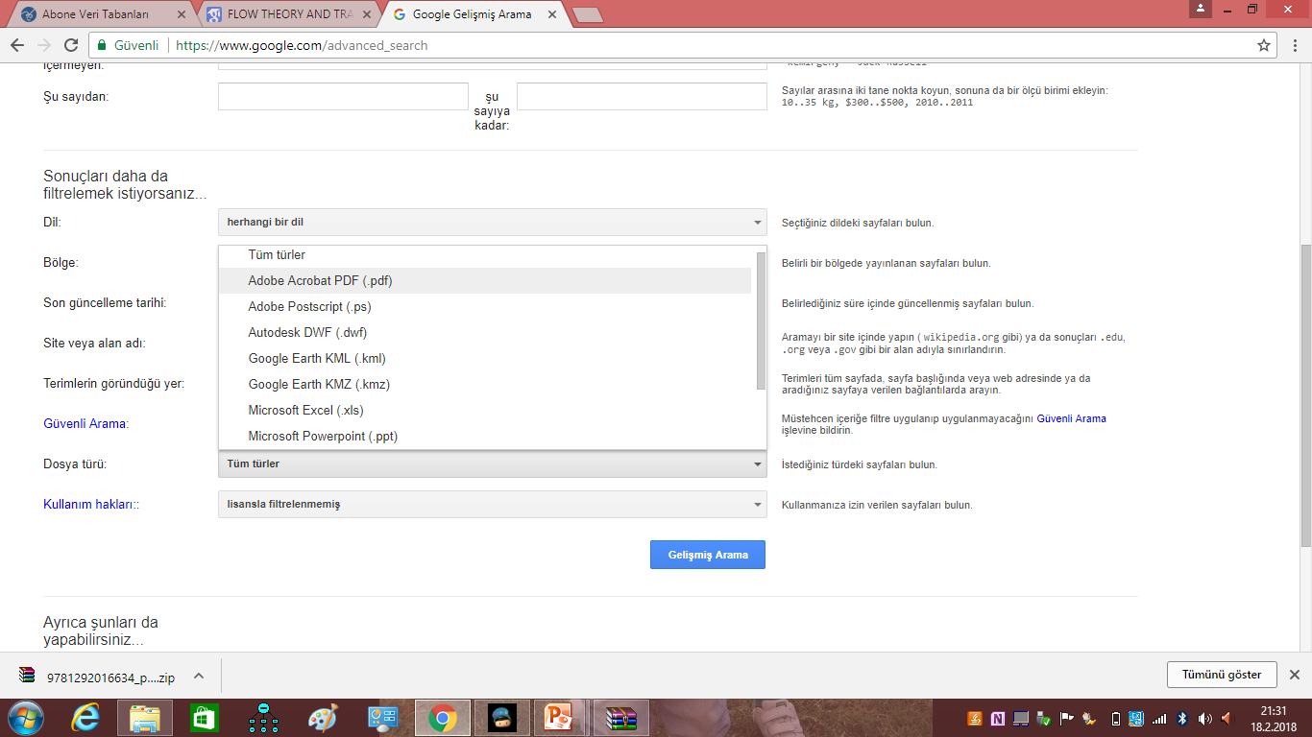

Slide 22
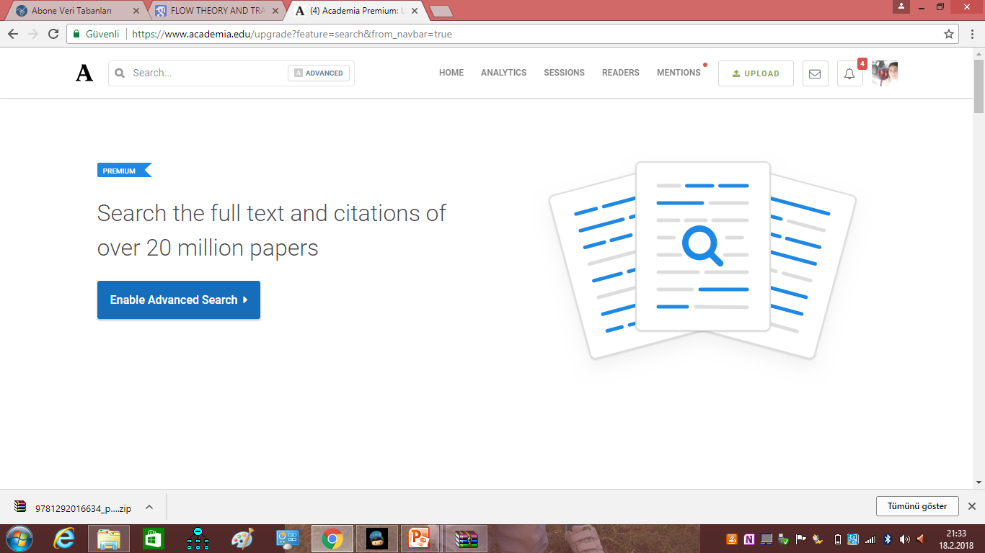

Slide 23
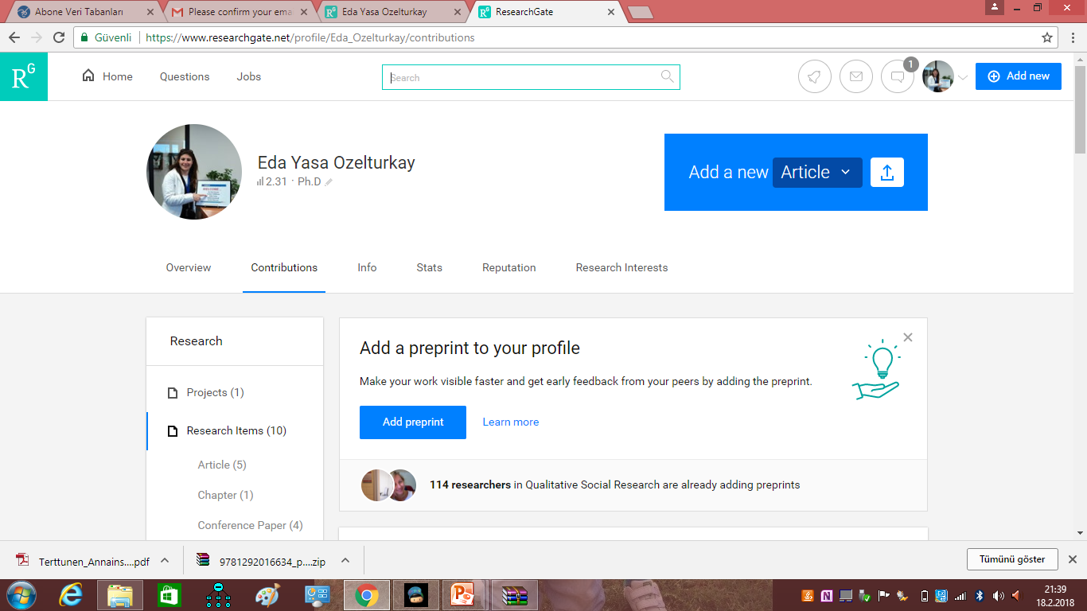

Slide 24

DOING A LITERATURE REVIEW
The literature review will need to be carried out in four major directions. Here they are, arranged from the general to the particular, their relative importance depending on the nature of your subject:

Slide 25
Research theory and philosophy – to establish the intellectual context(s) of research related to your subject.
History of developments in your subject – to trace the background to present thinking.
Latest research and developments in your subject – to inform about the current issues being investigated and the latest thinking and practice, to discuss the conflicting arguments, and to detect a gap in knowledge.
Research methods – to explore practical techniques that have been used, particularly those that might be relevant to your project.

Slide 26
FORMULATING A SUCCESSFUL RESEARCH PROPOSAL
Academic research proposals are usually composed of the following
elements:
the title;
aims of the research;
the background to the research
a definition of the research problem;
outline of methods of data collection and analysis;
timetable of the project and description of any resources required;
list of references.

Slide 27

The Title
This may be your first attempt at the title. It may change as your work progresses. At this stage it should closely mirror the content of your proposal.
Aims of the research
This goes right to the heart of the project. One main aim, and perhaps two or three subsidiary aims resulting from it are sufficient

Slide 28

Research problem
The research problem provides the focus of the research project. It must be very clearly defined to explain the nature of the problem and why it is significant.
Background
This explains to the reader the background from which the research problem emerges. It should explain the major factors which surround your problem, and of any significant literature which relates to it.

Slide 29
Method
Two aims may be met by dividing your method section into two parts:
1- research design
2-data collection.
In the part on research design you will explain where you intend to carry out the research. However, if your research topic is more generic you will wish to explain, for example, which sector(s) of the economy you have chosen to research and why you chose these sectors.
You will also need to explain the identity of your research population (e.g. Managers or trade union officials) and why you chose this population. The research design section gives an overall view of the method chosen and the reason for that choice ethical guidelines.

Slide 30

Timescale
This will help you and your reader to decide on the viability of your research proposal. It will be helpful if you divide your research plan into stages. This will give you a clear idea as to what is possible in the given timescale. Experience has shown that however well the researcher’s time is organised the whole process seems to take longer than anticipated

Slide 31
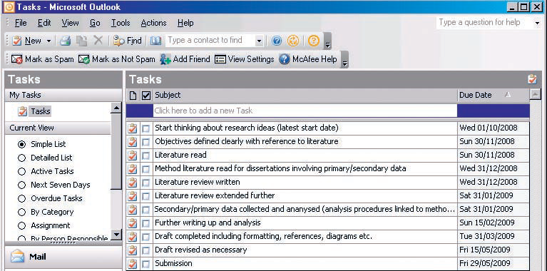
Example of time scale

Slide 32
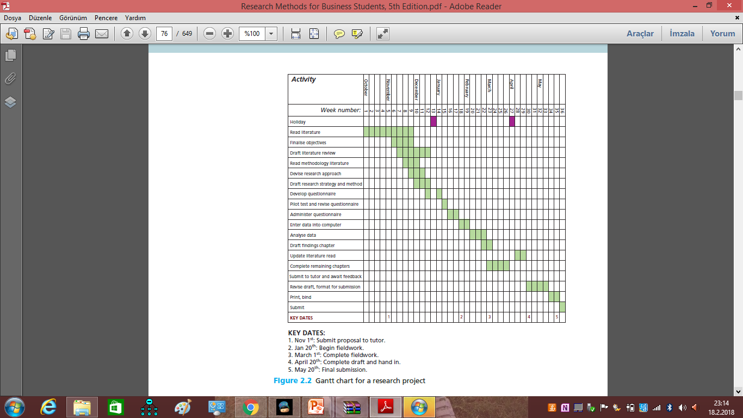

Slide 33

List of References
The location of the cited work of others must be meticulously recorded in this list. Not only does this ensure that you cannot be accused of plagiarism but also demonstrates that you are aware of the latest thinking in the subject.

