Slide 1
CAG UNIVERSITY 2019 – 2020 FALL SEMESTER MAN 429 HEALTH CARE MANAGEMENT CHAPTER 7 QUALITY IMPROVEMENT BASICS

Slide 2
DEFINING QUALITY IN HEALTH CARE
Health care quality may be defined in various ways, with differing implications for health care providers, patients, third-party payers, policy makers, and other stakeholders.
High quality health services should be effective, achieving desired health outcomes for individuals.
Health care services should achieve desired health outcomes for populations, while matching the societal preferences of policy makers and third-party payers for efficiency.
Health care providers should adhere to professional standards and base treatments on their efficacy, as determined by the best scientific evidence available.
Quality is the result of a system with interdependent parts that must work together to achieve outcomes such as those noted above.

Slide 3
DEFINING QUALITY IN HEALTH CARE
Avedis Donabedian (1966) defined quality in terms of structures, processes, and outcomes.
The structural elements of quality involve the material and human resources of an organization and the facility itself. The quality of personnel is documented in their numbers ( nurse staffing), skill level (e.g., certified nursing assistant), and various certifications (e.g., board-certified physician), while the quality of facilities lies in accreditation (in hospitals through The Joint Commision) and/or certification (e.g., Magnet Hospital certification).
Process involves the actual delivery of care as well as its management (e.g., the quality of basic care including cleanliness, feeding, hydration, delivery of treatments, and keeping patients safe from falss and errors).
Outcomes are the resulting health status of the patients (e.g., mortality, morbidity, length of stay, and functionalstatus) and organizations (turnover of staff, cost outcomes).

Slide 4
DEFINING QUALITY IN HEALTH CARE
Donabedian (1986) defined quality as having at least four components:
The technical management of health and illness;
The management of the interpersonal between the providers of care and their clients;
The amenities of care; and
The ethical principles that govern the conduct of affairs in general and the health care enterprise in particular.
Effectiveness is defined as providing services based on scientific knowledge to all who could benefit and refraining from providing services to those not likely to benefit (avoiding underuse and overuse).
Efficiency is defined as avoiding waste, in particular waste of equipment, supplies, ideas, and energy.

Slide 5
LEADERS OF THE QUALITY MOVEMENT
Plan-do-check-Act (PDCA) cycle model for improving production processes.
Pareto principle from economics, focusing attention and resources on those important quality problems that are attributable to a small number of factors ( e.g., the 80/20 rule, that 80% of quality problems result from 20% of the possible factors).
Pareto principle focuses on identifying the «vital few» from the «trivial many» and also helps focusing on what really matters.
For ex., 20% of a hospital’s patients are responsible for 80% of its revenue.

Slide 6
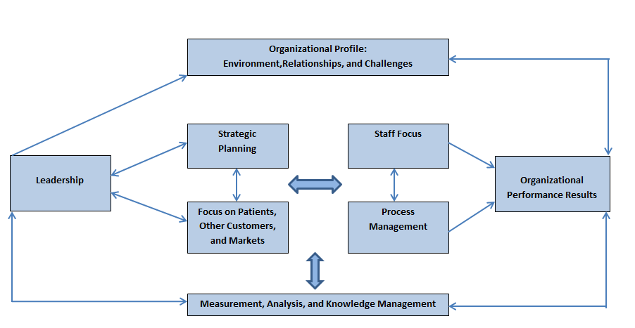
Baldrige Health Care Criteria for Performance Excellence Framework: A SystemsPerspective

Slide 7
APPROACHES TO QUALITY IMPROVEMENT
-Focus(Find, Organize, Clarify, Understand, and Select):
Find means identifying a process problem, preferably a «high-pain» one, to address.
Organize means to put tpgether a team of people who work on the proces. These people would then be trained on process improvement skills and tools.
Clarify results in the team moving on clarify the process problem through some type of process mapping (flowcharting).
Understanding the process problem comes next. It involves measurement and data collection of key metric to document the dimensions of the process problem and to provide a benchmark for goal setting.
Select means to identify a set of process improvements and then select from them for implementation.

Slide 8
APPROACHES TO QUALITY IMPROVEMENT
-PDCA( Plan, Do, Check, and Act)
Plan means to take the process improvement from the S phase of FOCUS and create a plan for its implementation.
Do, not surprisingly, means to actually implement the process improvement.
Check means to study whether the process is improving, using the measures identified and measured in the U phase of FOCUS.
Act means to determine whether the process improvement was successful.

Slide 9
APPROACHES TO QUALITY IMPROVEMENT
Six Sigma is an extension of Joseph Juran’s approach to quality improvement and was developed by Motorola and popularized by Jack Welch at General Electric.
It has been defined as a « data-driven quality methodology that seeks to eliminate variation from a process ».
Six Sigma employs a structured process called DMAIC (Define, Measure, Analyze, Improve, and Control):
Define includes delimiting the scope of work, determining due dates, and mapping the future state of the process, including improvements.
Measure encompasses both the creation of measures or metrics and their application to determine how well a process is performing.
Analyze further breaks down the understanding of the process and often includes flowcharting the process.
Improve specifies the steps that will be taken to meet the goals outlined during the define step.
Control is about ensuring that the improvements are permanent rather than temporary.

Slide 10
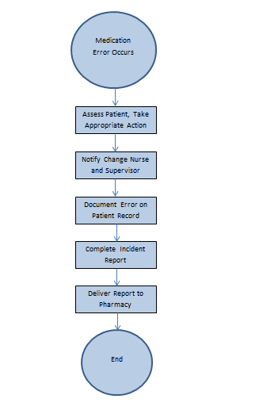
QUALITY IMPROVEMENT TOOLS
Flowcharting (also referred to as Process Mapping) is the main way that processes are mapped.
The figure on the right side shows the Medication Error Reporting Flowchart.

Slide 11
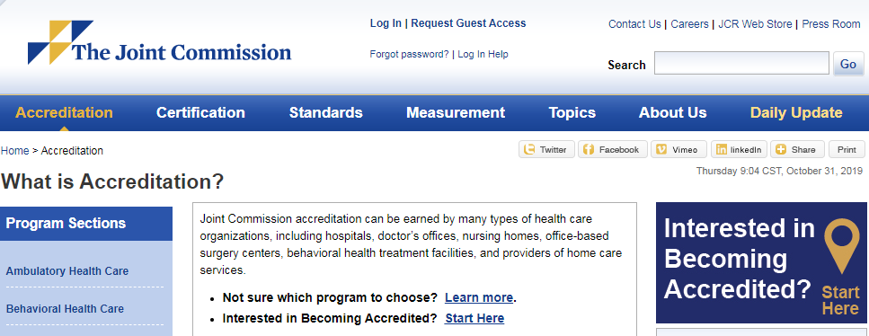
OPPORTUNITIES FOR RESEARCH IN HEALTH CARE QUALITY

Slide 12
OPPORTUNITIES FOR RESEARCH IN HEALTH CARE QUALITY
The Joint Commision Gold Seal

