Slide 1

PRESENT PERFECT TENSE

Slide 2

HAVE YOU FOLLOWED THE RULES FOR PREVENTING YOURSELF FROM CORONA VIRUS THIS YEAR?

Slide 3

The people who say YES☺ ….Yes, I have.
The people who say NO☹ …. No, I haven’t.

Slide 4
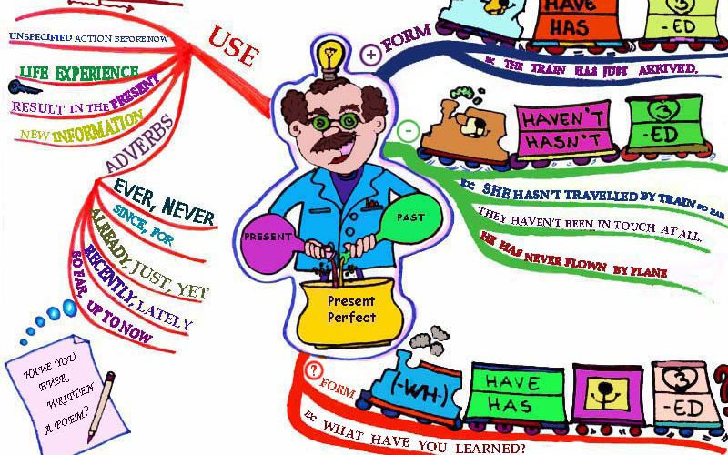
When do we use Present Perfect Tense ?

Slide 5
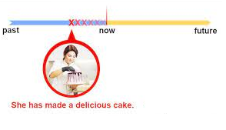
Present Perfect Tense Time line…

Slide 6

Use present perfect tense to talk about past actions in a time period which starts in the past and continues now.
For example:
today
this year, this week,
your lifetime.

Slide 7
Let’s see some examples☺
I have been mother for almost ten years.
She has gone to Great Britain for holiday this year.
They have watched that TV Show this week.
We haven’t read that book before.
I haven’t finished my master thesis.
She hasn’t done her homework.
Have you finished your dinner?,
Has she seen the film?

Slide 8
Present Perfect Form
For regular verbs;
For irregular verbs;
They have spent much money for this dress.
This country has had five big storms this winter.
Pamela hasn’t got a letter from her father this week.
You haven’t bought a gift for her birthday.
Have students written their names on the paper?
Has she found your glasses?
I have walked to work fast.
The florist has arranged flowers for the wedding.
House painters haven’t painted our new house yet.
She hasn’t looked exercises in the exam over and over.
Have they worked for years in this company?
Has John tried my chocolate cake today?

Slide 9


For regular verbs
For irregular verbs
The past participle (V3) is the same as the past form.
e.g:
I have walked to work fast today.
The past participle (V3) is usually different.
e.g:
They have spent much money for this dress.

Slide 10
 | + | _
I / you / we / they | I have eaten Chinese food in my lifetime. They have played in Paralympic Olympic games. | I haven’t eaten Chinese food in my lifetime. They haven’t played in Paralympic Olympic games.
he / she / it | She has seen her favorite film many times. He has visited his grandmother before going abroad. | She hasn’t seen her favorite film many times. He hasn’t visited his grandmother before going abroad.

Slide 11
 | Yes / No questions | Short answers
I / you / we / they | Have you prepared a lot of food for the party? | Yes , I have. No, I haven’t.
he / she / it | Has he drunk too much coffee today? | Yes, he has. No, he hasn’t.

Slide 12
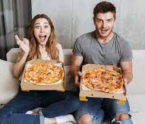
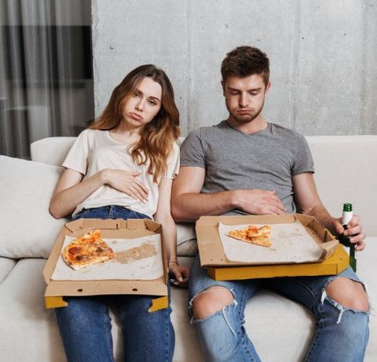
Before ☺
After ☹

Slide 13
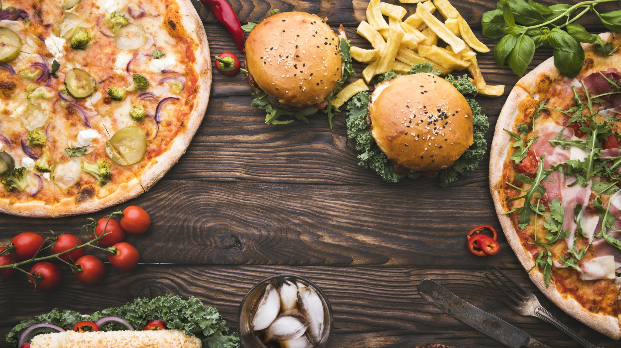
Have you ever eaten too much food in your life time?

Slide 14

Use present perfect tense to talk about experiences.
When we ask a question about experiences, we often use the word ever.
Have you ever bought a special gift for anyone?
Yes, I have.
No, I haven’t.
Have you ever been to abroad?
Yes, I have.
No, I haven’t.

Slide 15

We use never with the present perfect to say there is no experience.
Some examples:
I have never seen this film.
You have never read that writer’s book.
We have never tried really spicy food.
She has never learned to play an instrument.
He has never slept outside.

Slide 16

The past participle of go is gone. But we often use the past participle of be (been) instead of gone.
I have been to Paris. (I am not there now.)
Mary has gone to the gym. (she’s still there now.)
Dan has to been to an important conference.
( Is Dan still there now?)
They have gone to the museum.
( Are they still there now?)

Slide 17

Let’s listen some music…
https://www.youtube.com/watch?v=UX2mKfxe1AE

Slide 18

Thanks for listening..

