Slide 1

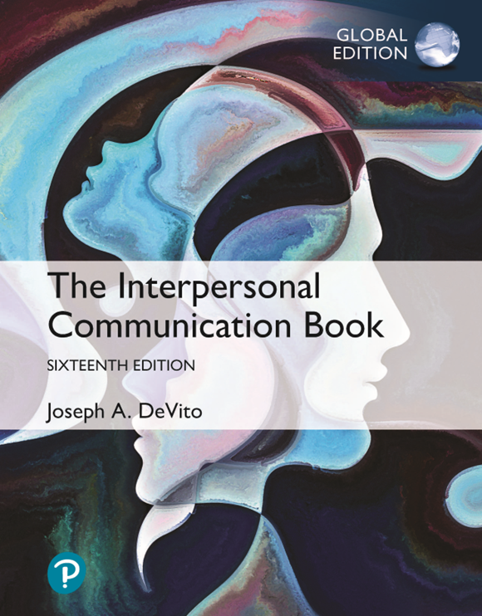
CAG UNIVERSITY
PSYCHOLOGY DEPARTMENT
INTERPERSONAL COMMUNICATION
PSY 211
Chapter 6
LISTENING
31st October 2025

Slide 2

Listening
Listening is an active process.
* It not just hearing sounds.
* It means paying attention, understanding what is said, remembering it, and responding thoughtfully.
* Good listening requires both your mind and emotions.

Slide 3
Five Stages of Listening

Slide 4
Five stages of Listening – Continue
Stage | Explanation | Example
Receiving | Hearing and focusing on the message. Avoid distractions (phones, noise). | Looking at the speaker and not interrupting.
Understanding | Learning what the speaker means — not only the words but their intent and feelings. | Noticing tone of voice or emotional meaning.
Remembering | Storing information for later use. Summarize key points. | Mentally repeat what was said or take notes.
Evaluating | Thinking critically and judging the message fairly, not emotionally. | Ask: “Is this fact or opinion?”
Responding | Giving feedback verbally or nonverbally to show understanding. | Nodding, saying “I see,” or asking a follow-up question.

Slide 5
Stage 1 RECEIVING
This is the first stage — when you hear and focus on the speaker’s message.
What you should do:
Focuse your close attention to the speaker’s verbal and nonverbal messages.
Avoid distractions. Avoid distractions in the environment; if necessary, take the ear buds out of your ears or turn off your cell phone.
Maintain your role as listener and avoid interrupting.

Slide 6
Stage 1 RECEIVING
At times, you may wish to ask your listeners to receive your messages fairly and without prejudice, especially when you anticipate a negative reaction.
For this purpose, you’re likely to use disclaimers, statements that aim to ensure that your messages will be understood and will not reflect negatively on you.
Disclaimers also lessen any impression of what you’re saying being an attack on face.

Slide 7
Stage 1 RECEIVING
Some of the more popular disclaimers (advanced warning) are:
Hedging (using cautious language) helps you to separate yourself from the message so that if your listeners reject your message, they need not reject you
For example, “I may be wrong here, but . . . ”
Credentialing (yetkinlik belirtme) helps you establish your special qualifications for saying what you’re about to say
“Don’t get me wrong; I’m not homophobic”

Slide 8
Stage 1 RECEIVING
* Sin licenses are expressions people use to ask for permission to break a social rule for a moment.
“I know this may not be the place to discuss business, but . . . ”
* Cognitive disclaimers help you make the case that you’re in full possession of your faculties
“I know you’ll think I’m crazy, but let me explain the logic of the case”
* Appeals for the suspension of judgment ask listeners to hear you out before making a judgment (“Don’t hang up on me until you hear my side of the story”).

Slide 9
Stage 2 UNDERSTANDING
Understanding Stage – How to Listen for Meaning
1. Don’t assume you understand. Wait until the speaker finishes. Thinking “I already know this” can make you miss the real message.
2. See from the speaker’s point of view. Try to understand what they mean, not what you expect. Hold back judgment until you really get their message.
3. Ask questions. If something is unclear, ask politely for examples or explanations. This shows you’re interested and helps you remember better.
4. Paraphrase. Repeat the main idea in your own words — silently or aloud. This helps you check if you understood correctly.

Slide 10
Stage 3 REMEMBERING
Effective listening depends on remembering.
When a friend says that his mother is ill, the effective listener remembers this and asks about her health later in the week.
If you want to remember what someone says, this information needs to pass from your short-term memory (the memory you use, say, to remember a phone number just long enough to write it down) into longterm memory. Short-term memory is very limited in capacity—you can hold only a small amount of information there. Long-term memory is unlimited.

Slide 11
Stage 3 REMEMBERING – Continue
To facilitate the passage of information from short- to long-term memory, here are FOUR suggestions
FOCUS your attention on the central idea
ORGANIZE what you hear, make a summary
UNITE the new information to what you already know
REPEAT names or key concepts to yourself or aloud
Still another factor to consider is what is called false memory syndrome where people think they remember what really didn’t happen (Loftus, 2004; Kearns, 2018; Holland, 2019).

Slide 12
Stage Four EVALUATING
You judge the message — deciding how true, logical, or valuable it is.
Some suggestions:
-Resist evaluation until you understand the speaker
-Distinguish facts from opinions and personal interpretations
-Identify biases (önyargı), or self-interests that may lead the speaker to slant unfairly what is said. It’s often wise to ask if the material is being presented fairly or if this person is slanting or spinning it in some way.
-Recognize fallacious (yanıltıcı) forms of reasoning (akıl yürütme). For instance they may argue that you should believe or do something because everyone else does.

Slide 13
Stage Five RESPONDING
You give feedback to the speaker to show that you’re listening and understanding.
1. Support the speaker: Give verbal or nonverbal feedback.
2. Own your responses. Take responsibility for what you say. Instead of saying, “Nobody will want to do that” say something like “I don’t think I’ll do that.”
3. Resist “responding to another’s feelings” by «trying to solve the person’s problems.” Unless of course you are asked for an advice avoid it.
4. Focus on the speaker while you are responding.
5. Avoid being a thought-completing listener. This may make the person feel that you already know it and this maybe something disrespectful.

Slide 14
LISTENING BARRIERS

Slide 15
Listening Barriers
1. Physical (traffic, phone/external) and mental (thinking daily problems) distractions.
2. Biases (yanlılık-eğilim) and Prejudices (peşin hüküm vermek): Prejudging people or topics prevents objective listening.
3. Lack of Appropriate Focus: Focusing on minor details, not the main idea.
4. Premature Judgment: Deciding too soon what someone means before they finish.
5. Hearing Impairment: It is physical however it is personal rather than external

Slide 16
Styles of Effective Listening

Slide 17
Listening Styles
The way you listen should depend on the situation you’re in.
You don’t listen to a friend’s relationship breakup story in the same way you listen to a person giving you directions for completing a task.
You need to adjust your listening on the basis of:
your purposes (for example, are you listening to learn? to give comfort? to judge?) and
your knowledge of and relationship to the other person (is this person prone to exaggeration? Or does this person need support?)

Slide 18
Listening Styles – Continue
I understand your feeling ➔ Empathic
I am sorry for you ➔ Sempathic
Empathic Listening:
* If you’re going to understand what a person means and what a person is feeling, you need to listen with empathy (Rogers & Farson, 1981; Draghici, 2020).
* To empathize with others is to see the world as they see it, to feel what they feel, but without losing your own identity.
*Empathy enables you to understand emotionally what another person is experiencing.
* To sympathize, in contrast, is to feel for the person—to feel sorry or happy for the person, for example.

Slide 19
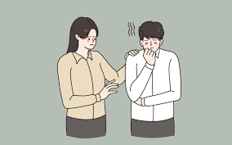
Empathic Listening – Continue
You show that you’re listening with empathy when you make it clear that you’re trying to understand; when you maintain eye contact, an attentive posture, and when you focus on the other person rather than yourself (Murphy, 2017).
Generally recommended is to maintain physical closeness to focus your concentration and to express involvement through facial expressions.
https://ortoday.com/skills-of-empathetic-listening/

Slide 20
Empathic Listening – Continue
Also helpful is checking the accuracy of your perceptions to show your commitment to understanding the speaker and reflecting back to the speaker the feelings that you think are being expressed.
Offering tentative statements about what you think the person is feeling: “You seem really angry with your father” or “I hear some doubt in your voice.”
At the same time that you want to communicate these positive responses, you’ll also want to avoid negative responses such as accusations or blame (“You should have stayed with your old job and not listened to your brother’s advice”), negative evaluation (“That outfit just doesn’t look professional”).

Slide 21
Polite Listening
Here are a few suggestions for demonstrating that you are, in fact, listening politely.
Avoid interrupting the speaker
Give supportive listening cues (I see; Yes, it’s true; or you may move closer to speaker.
Show empathy with the speaker. Demonstrate that you understand and feel the speaker’s thoughts and feelings by giving responses that show this level of understanding— smiling, or echoing the feelings of the speaker. If you echo the speaker’s nonverbal expressions, your behavior is likely to be seen as empathic.

Slide 22
Polite Listening – Continue
Maintain eye contact.
Give positive feedback. Throughout the listening encounter and perhaps especially after the speaker’s turn (when you continue the conversation as you respond to what the speaker has said), positive feedback will be seen as polite and negative feedback as impolite.
If you must give negative feedback, then do so in a way that does not attack the person’s negative face; for example, first mention areas of agreement or what you liked about what the person said and stress your good intentions. And, most important, do it in private. Public criticism is especially threatening and will surely be seen as a personal attack

Slide 23
Critical Listening
In many listening situations, you’ll need to exercise critical evaluation or judgment.
When you listen critically, you don’t just accept what you hear — you analyze and evaluate it carefully.
You try to think logically and calmly (dispassionately) about what the speaker says. For example:When a friend tells you a story, you think: “Is this realistic?”

Slide 24
Critical Listening – Continue
In listening critically, focus on the following guidelines:
Keep an open mind. Avoid prejudging. Delay your judgments until you fully understand both the content and the intention the speaker is communicating.
Avoid filtering out unpleasant messages. Don’t ignore or block out information just because it’s unpleasant or uncomfortable to hear. If you only listen to what feels good or what supports your own ideas, you won’t truly understand or think critically.
Recognize your own biases. Because they can change how you understand what you hear. When you listen, your beliefs, expectations, or prejudices might make you “hear” what you want to hear. This mental process is called assimilation — it means you “fit” new information into what you already believe, even if it doesn’t really match. So, your bias can make you distort the message without realizing it.

Slide 25
Critical Listening – Continue
Combat the tendency to sharpen, highlight, emphasize, or embellish (süsleme) one or two aspects of a message.
Don’t focus on or exaggerate just one part of a message while ignoring the rest.
This can make you misjudge the real meaning—for example, noticing only the words “I had a nice time” but missing the nonverbal signs that say otherwise.
Focus on both verbal and nonverbal messages

Slide 26

Critical Listening – Continue
Watch out for language fallacies. Language is often used to serve less than noble purposes, to convince or persuade you without giving you any reasons, and sometimes to fool you.
https://cropink.com/fallacies-in-advertising

Slide 27
Active Listening
One of the most important communication skills you can learn is that of active listening (Gordon, 1975; Grohol, 2019; Cuncic, 2019).
Problem: You’re disappointed that you have to redo your entire budget report. You say, “I can’t believe I have to redo this entire report. I really worked hard on this project, and now I have to do it all over again.”
Diana: You have to rewrite that report you’ve worked on for the past three weeks? You sound really angry and frustrated. Diana uses active listening.

Slide 28
Active Listening- Continue
Active listening owes its development to Thomas Gordon (1975), who made it a cornerstone of his P-E-T (Parent Effectiveness Training) technique; it is a process of sending back to the speaker what you as a listener think the speaker meant—both in content and in feelings.
Active listening, then, is not merely repeating the speaker’s exact words but rather putting together into some meaningful whole your understanding of the speaker’s total message.

Slide 29
Active Listening – Continue
Functions of Active Listening Active listening serves several important functions.
1st Function: Active listening helps you as a listener check your understanding of what the speaker said and, more important, what they meant. Reflecting back perceived meanings to the speaker gives the speaker an opportunity to offer clarification and correct any misunderstandings.
2nd Function: Second function is to let speakers know that you acknowledge and accept their feelings.
Diana, the active listener who reflected back to you what she thought you meant, accepted what you were feeling. In addition, she also explicitly identified your emotions; she commented that you sounded “angry and frustrated,” allowing you an opportunity to correct her interpretation if necessary.

Slide 30
Active Listening – Continue
Be careful to avoid sending “solution messages.”
Solution messages tell people how they should feel or what they should do.
The four types of messages that send solutions and that you’ll want to avoid in your active listening are as follows:
-Ordering messages—Do this . . . , Don’t touch that . . . ;
-Warning and threatening messages—If you don’t do this, you’ll . . . , If you do this, you’ll . . .
-Preaching and moralizing messages—People should all . . . , We all have responsibilities . . . ; and
-Advising messages—Why don’t you . . . , What I think you should do is . . . .

Slide 31
Active Listening – Continue
3rd Function is to encourage speakers to explore their feelings and thoughts.
For example, Diana’s response encourages you to elaborate on your feelings. This opportunity to elaborate also helps you deal with your feelings by talking them through.

Slide 32
Active Listening – Continue
Techniques of Active Listening (How we listen actively)
Paraphrase the speaker’s meaning: Stating in your own words what you think the speaker means and feels can help ensure understanding and also shows interest in the speaker.
Express understanding of the speaker’s feelings. Paraphrase the content and echo the feelings the speaker expressed
“You must have felt horrible”
This expression of feelings will help you further check your perception of the speaker’s feelings. This also will allow speakers to see their feelings more objectively—especially helpful when they’re feelings of anger, hurt, or depression—and to elaborate on these feelings.

Slide 33
Active Listening – Continue
Ask questions. Asking questions strengthens your own understanding of the speaker’s thoughts and feelings, and elicits additional information
“How did you feel when you read your job appraisal report?”
Ask questions to provide just enough stimulation and support so the speakers will feel they can elaborate on these thoughts and feelings.
These questions should further confirm your interest and concern for the speakers but not pry into unrelated areas or challenge them in any way.

Slide 34
Table 6.7 Listening Styles

