Slide 1
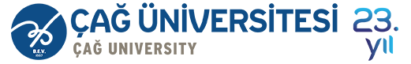

Course Title
Financial Literacy
Course Coordinator
Assist.Prof.Dr. Ayşegül Kurtulgan

Slide 2
Learning Objectives
After studying this chapter;
You will be able to know deposit institutions and other financial institutions.
You will be able to define savings.
You will be able to explain the reasons for savings.
You will be able to know how to create a savings plan.
You will be able to explain savings alternatives.
You will be able to identify the factors used to evaluate savings plans.

Slide 3
Financial Services for Financial Planning
  In recent years, banking activities have moved:
  From standing in line for a teller... To using a smartphone app.
  From writing a check... To transmitting money with a mobile payment system.
  From sending in a deposit by mail... To clicking a picture for a remote check deposit.
  From obtaining a loan from a bank... To borrowing from a peer-to-peer lender.

Slide 4
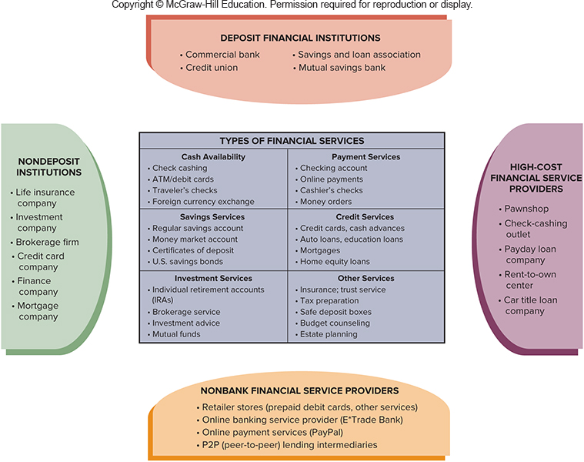
Financial Institutions and Banking Services
  While many alternative service providers are available, banks, savings and loan associations, credit unions and other financial institutions process most payment, savings and credit transactions.

Slide 5
Financial Institutions
DEPOSIT INSTITUTIONS
Commercial Banks Offers a full range of services including checking, savings, lending, and other services Organized as corporations
Savings and loan associations Traditionally, specialized in savings accounts and home mortgages Today, offer services comparable to banks
Mutual Savings Banks Specialize in savings and mortgages They are owned by their depositors Mainly located in northeastern United States
Credit Unions Are user-owned, nonprofit, cooperative financial institutions Annual banking studies report lower fees and lower loan rates with higher satisfaction levels compared to other financial institutions

Slide 6
Financial Institutions
Other Financial Institutions
Life Insurance Companies Provides financial security for dependents Offers insurance plus savings and investment features; recently expanded to offer investment and retirement planning
Investment Companies Are also referred to as Mutual Funds Offer a money market fund, which is a combination savings-investment plan, on which you can write a limited number of checks Accounts are not covered by federal deposit insurance
Brokerage Firms Employ investment advisors and financial planners which serve as agents between the buyer and seller for stocks and bonds
Finance Companies Make short- and intermediate-term loans to consumers and small businesses but at higher rates

Slide 7
Financial Institutions
Other Financial Institutions
Credit Card Companies Fund short-term retail lending
Mortgage Companies Provide loans to customers to purchase homes
Other Financial Service Providers Includes retailers, Internet banks

Slide 8
In Jane Bryant Quinn’s words,
“Savings is not to make you rich, but it is to keep you from being poor”

Slide 9
What is saving?
  Savings = Disposable income – Consumption.
  It is protection of money from loss.
  It helps you meet short-term goals and needs.
  It helps you prepare for the unexpected.

Slide 10
Reasons for Saving
To build an emergency fund
To cover budget shortfalls
To meet future needs
To achieve personal and financial goals
To keep funds secure while
increasing them

Slide 11
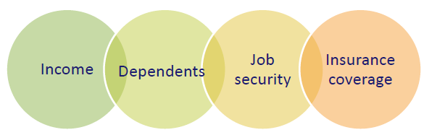
How much money should be saved?
At least six months worth of expenses in emergency savings
x =
Depends on:
$2,000 monthly expenses
6 months
$12,000

Slide 12
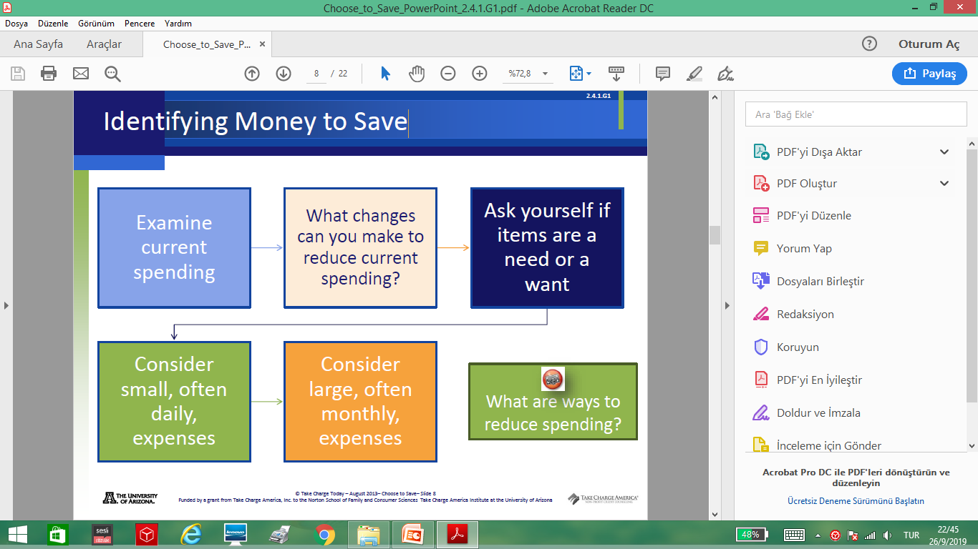
Identifying Money to Save

Slide 13
SAVINGS PLANS
Pay yourself first—put money into savings before you consider other expenses.
If you plan what you want to spend first, you may have no money left for savings.
Enter an amount that you would like to save. After entering expenses, you may need to adjust this amount.
You might not be able to save as much as you want and still pay for all expenses.

Slide 14
SAVINGS PLANS
Plan to save some money, however, if at all possible.
Savings allow you to plan for the future. You can identify items you would like to purchase at a future time with savings.
Savings can also be used to pay for unexpected expenses that you may have in the future.

Slide 15

SAVINGS PLANS
Assess the costs and benefits of various savings plans.
REGULAR SAVINGS ACCOUNTS
Usually involve a low or no minimum balance
Credit unions call them share accounts

Slide 16
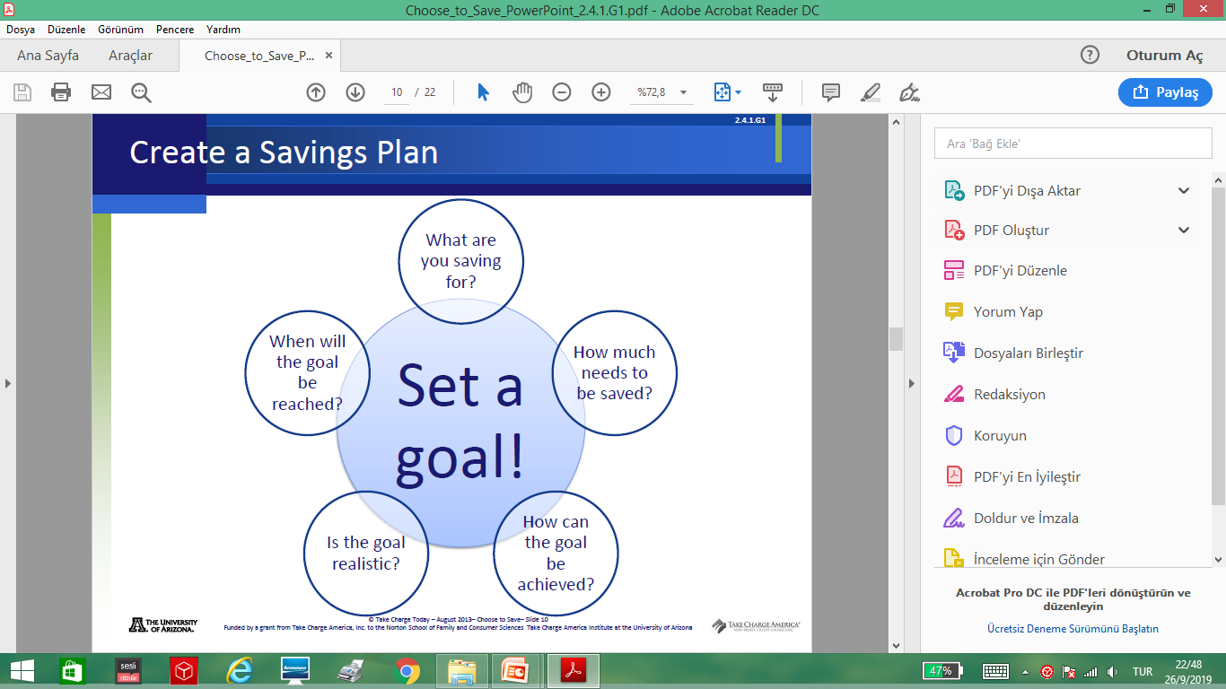
Create a Savings Plan

Slide 17
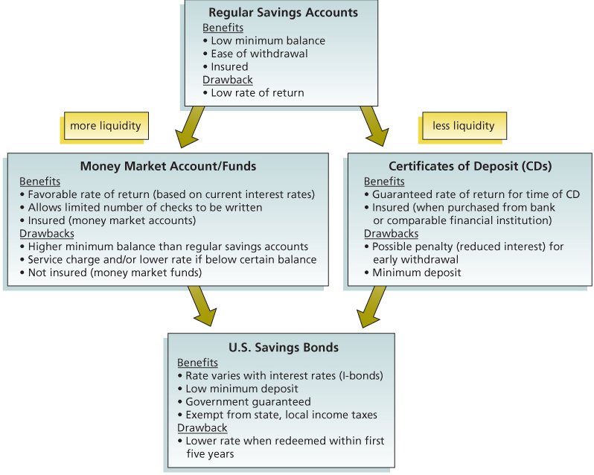
Savings Alternatives

Slide 18
Regular Savings Accounts
A regular savings account usually allows you to withdraw money as needed.
Banks, savings and loan associations and other financial institutions offer regular savings accounts.
At a credit union, these savings plans are called share accounts.

Slide 19
Certificates of Deposit
A CD is a savings plan that requires you to leave your money on deposit for a set time period, otherwise you incur early withdrawal penalties
  Several types to chose from
  Consider all the earnings and all the costs before saving with a CD or rolling over a CD (automatically buying a new one at maturity)
  Consider creating a CD portfolio with CDs maturing at different times (3-month, 6-month, 1-year, 2-year)
  Review current information about CD rates at various institutions at Bankrate

Slide 20
Types of CDs
While traditional certificates of deposit are most popular, other types of CDs are available:
Rising-rate or bump-up CDs
Rising-rate or bump-up CDs may have higher rates at set intervals, such as every six months.
Liquid CDs
Liquid CDs offer an opportunity to withdraw money without a penalty.
A zero-cupon CD
A zero-cupon CD is purchased at a deep discount with no interest payments.
Callable CDs start with higher rates and usually have long maturities. With this savings option, if interest rates drop, the bank may “call” (close) the account after a set period, such as one or two years.
Indexed CDs have earnings based on the stock market. In times of strong stock performance, your earnings can be higher than those on other CDs.
Indexed CDs
Callable CDs

Slide 21
Money Market Accounts and Funds
A money market account is a savings account that requires a minimum balance and has earnings based on market interest rates.
Money market accounts at banks and credit unions are covered by federal deposit insurance
  This is not true of money market funds, which are a product of investment companies.

Slide 22
Savings Bonds
U.S. savings bonds are a low-risk savings program guaranteed by the federal government and that may be used to achieve financial goals
The Treasury Department offers several programs for buying savings bonds:
  EE Bonds: EE Bonds are bought and managed online and may be purchased for any amount.
  I Bonds: I bond has an interest rate based on two components: (1) a fixed rate for the life of the bond and (2) an inflation rate that changes twice a year.

Slide 23
Savings Tools Characteristics
Each savings tool has different characteristics
Goal: Determine the savings tool most appropriate for reaching a financial goal

Slide 24
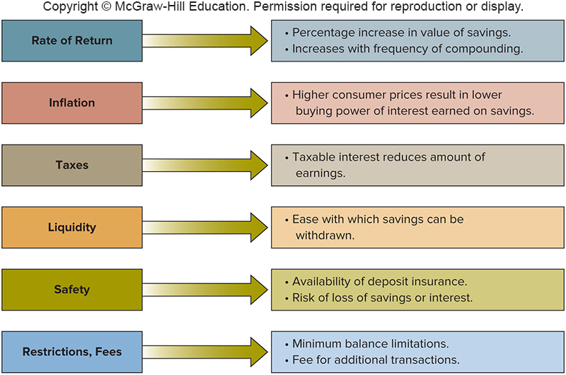
Evaluating Savings Plans
Identify the factors used to evaluate different savings plans.

Slide 25
Rate of Return
Percentage or yield is the increase in value of your savings from earned interest
Example: a $100 savings account that earned $3 has a yield of 3 percent ($3/$100)
Compounding refers to interest that is earned on “previously earned interest”
  More frequent compounding means the higher your rate of return

Slide 26
Example 1
$100 savings account that earned $3 interest for the year would have a rate of return of 3 percent.
$3 / $100 = 0.3 or 3 percent

Slide 27
Inflation and Tax Considerations
INFLATION
  Compare your savings rate with inflation rate
  If inflation rate is higher than savings rate, then savers will experience loss in buying power
TAX CONSIDERATIONS
  Taxes reduce interest earned on savings
  Taxes are not withheld from savings and investments; you may owe additional taxes at year-end as a result of earnings on saving

Slide 28
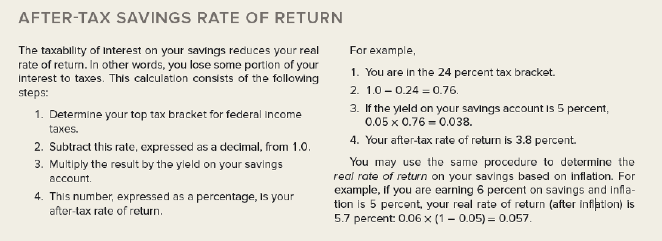
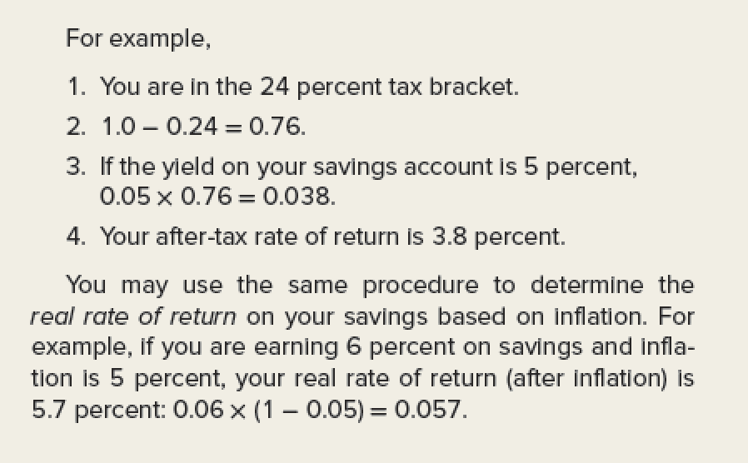
After-Tax Savings Rate of Return

Slide 29
Liquidity and Safety
LIQUIDITY
  Allows you to withdraw your money on short notice without a loss of principal or fees
  With certain types of savings accounts, early withdrawal penalty may be loss of interest or lower earnings rate
SAFETY: Most savings plans at banks, savings and loan associations nad credit unions are insured by federal government agencies.
  FDIC (Federal Deposit Insurance Corporation) coverage prevents a loss of money due to the failure of the insured institution up to $250,000 per depositor per insured financial institution
  NCUA (National Credit Union Administration) provides similar insurance for credit unions

Slide 30
Restrictions and Fees
Banks may charge additional fees such as:
  a monthly maintenance fee for low-balance accounts
  an inactivity fee if no deposits or withdrawals occur for 6 to 24 months, depending on the bank
  a transaction fee for more than six withdrawals during a month
  a transfer fee by online banks for outgoing payments
  a wire-transfer fee

Slide 31
Questions
What are the deposit institutions and other financial institutions? Explain.
What is saving?
Explain the reasons for savings.
What is liquidity?
When creating a savings plan, what do you need to know?
What are the savings alternatives?
Which factors used to evaluate savings plans?

Slide 32
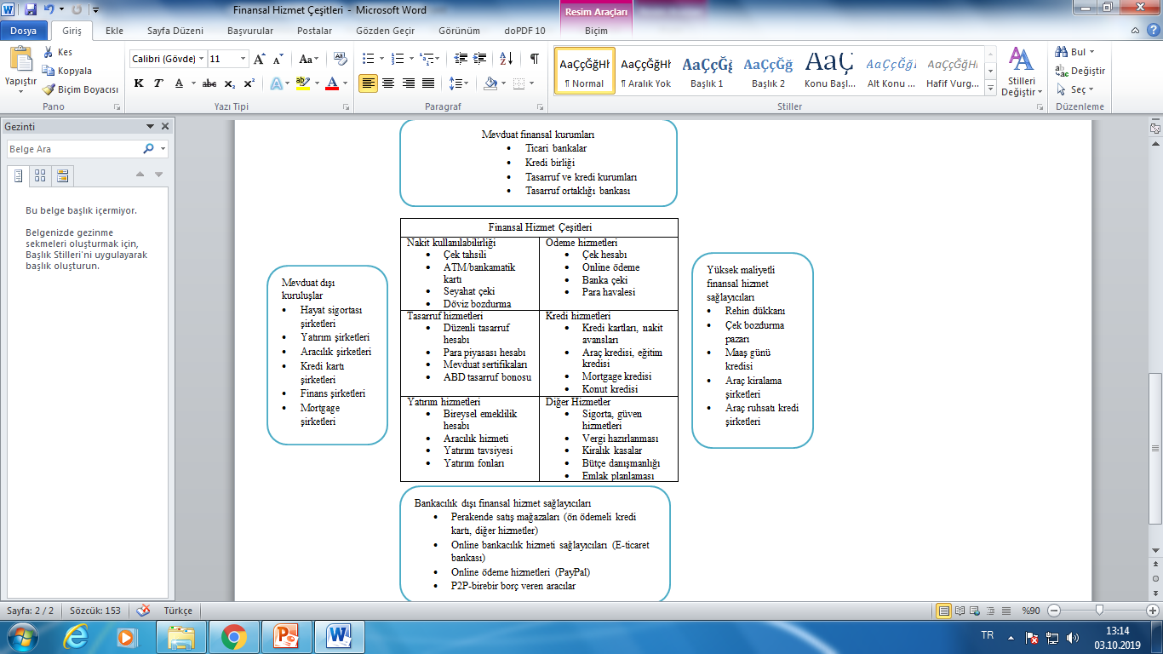
Appendix: Financial Institutions and Banking Services in Turkish

