Slide 1
Chapter Two
Determinants of Interest Rates

Slide 2
Interest Rate Fundamentals
Nominal interest rates: the interest rates actually observed in financial markets
  Used to determine fair present value and prices of securities
  Two components:
    Opportunity cost
    Adjustments for individual security characteristics
Notes:
Opportunity cost: All securities’ rates are dependent on rates available on competing investments. These rates will be a function of the underlying supply and demand of funds available.
As indicated later, adjustments for individual security characteristics would include default risk, maturity, liquidity risk and payment terms. Because these characteristics are different for different securities, we have different interest rates on each.

Slide 3
Real Riskless Interest Rates
    Additional purchasing power required to forego current consumption
  What causes differences in nominal and real interest rates?
  If you wish to earn a 3% real return and prices are expected to increase by 2%, what rate must you charge?
  Irving Fisher first postulated that interest rates contain a premium for expected inflation.
Notes:
The answers are inflation and about 5% respectively.

Slide 4
Loanable Funds Theory
Loanable funds theory explains interest rates and interest rate movements
Views level of interest rates as resulting from factors that affect the supply of and demand for loanable funds
Categorizes financial market participants – e.g., consumers, businesses, governments, and foreign participants – as net suppliers or demanders of funds

Slide 5
Supply and Demand for Loanable Funds
Demand
Supply
Interest
Rate
Quantity of Loanable Funds
Supplied and Demanded

Slide 6
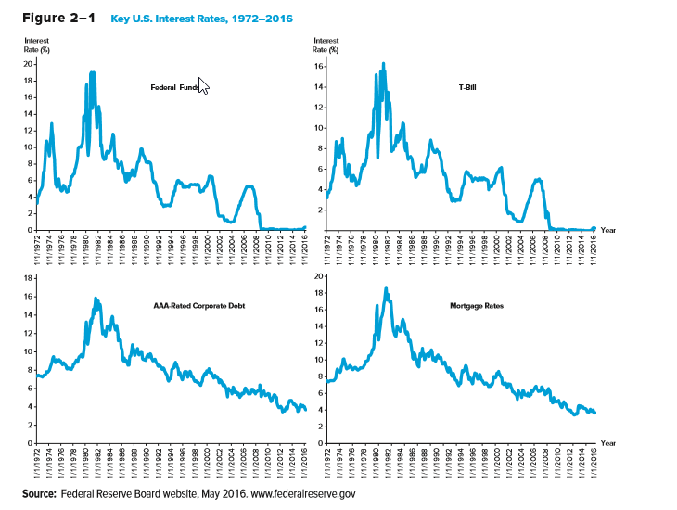
Key Interest Rates Over Time

Slide 7
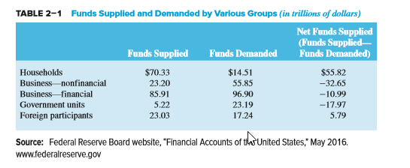
Net Supply & Demand of Funds in U.S. in 2016
Notes:
A negative number in the last column represents a net demand for funds.
The household (consumer) sector is one of the largest suppliers or loanable funds, while (financial) businesses demanded the most funds.

Slide 8
Determinants of Household Savings
Interest rates and tax policy
Income and wealth: the greater the wealth or income, the greater the amount saved
Attitudes about saving versus borrowing
Credit availability: the greater the amount of easily obtainable consumer credit the lower the need to save
Job security and belief in soundness of entitlements

Slide 9
Determinants of Foreign Funds Invested in the U.S.
Relative interest rates and returns on global investments
Expected exchange rate changes
Safe haven status of U.S. investments
Foreign central bank investments in the U.S.
Notes:
Foreign funds suppliers examine the same factors as U.S. suppliers except that they must also factor in expected changes in currency values, global interest rates, different tax rates and sovereign risk. There is typically some built in demand for U.S. investments however because the U.S. is considered a safe haven, i.e., a country with relatively low political and economic risk and a stable currency.
High levels of reserves are indicative of foreign central bank activity to limit the growth in the value of their currencies against the dollar. This may be done to stimulate their export sectors. The dollars are often reinvested in the U.S., typically in Treasuries. This provides an additional source of financing to the U.S. and helps remove a market discipline from U.S. borrowers.

Slide 10
Federal Government Demand for Funds Concluded
Governments borrow heavily in the markets for loanable funds
  $23.19 trillion in 2016
United States
  National debt was $19.21 trillion in 2016
    National debt (and interest payments on the national debt) have to be financed in large part by additional borrowing

Slide 11
Business Demand for Funds
Level of interest rates:
  When the cost of loanable funds is high (i.e., interest rates are high), businesses finance internally
Expected future profitability vs. risk:
  The greater the number of profitable projects available to businesses, the greater the demand for loanable funds
Expected economic growth

Slide 12
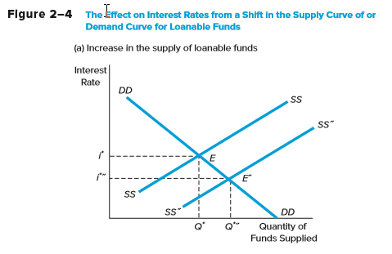
Effect on Interest Rates from a Shift in the Supply Curve for Loanable Funds

Slide 13
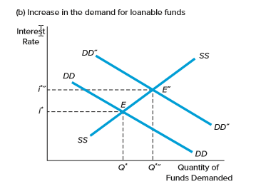
Effect on Interest Rates from a Shift in the Demand Curve for Loanable Funds

Slide 14
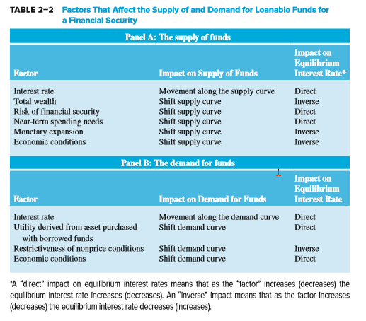
Factors that Affect the Supply of and Demand for Loanable Funds for a Financial Security

Slide 15
Determinants of Interest Rates for Individual Securities
i_{j}* = f(IP, RFR, DRP_{j}, LRP_{j}, SCP_{j}, MP_{j})
Inflation (IP)
  IP = [(CPI_{t+1} – CPI_{t})/CPI_{t}] x 100
Real risk-free interest rate (RFR) and the Fisher effect
  RFR = i – Expected (IP)
Notes:
Define CPI as the consumer price index.
i_{j}* = equilibrium nominal interest rate for a given security
Note: the first two factors (IP and RFR) are common to all financial securities, while the others can be unique to each individual security.

Slide 16
Determinants of Interest Rates for Individual Securities Continued
Default risk premium (DRP)
  DRP_{j} = i_{jt} – i_{Tt}
    i_{jt} = interest rate on security issued by a non-Treasury issuer (issuer j) of maturity m at time t
    i_{Tt} = interest rate on security issued by the U.S. Treasury of maturity m at time t
Liquidity risk (LRP)
Special provisions (SCP)
Term to maturity (MP)

Slide 17
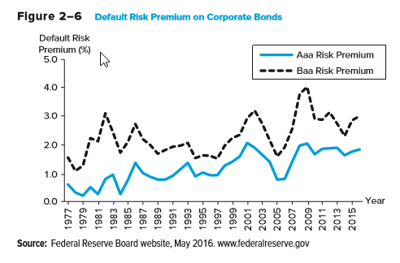
DRPs Over Time

Slide 18
Term Structure of Interest Rates: the Yield Curve
(a) Upward sloping
(b) Inverted or downward
sloping
(c) Flat
Yield to
Maturity
(a)
(c)
(b)
Time to Maturity

Slide 19
Unbiased Expectations Theory
Current long-term interest rates (₁R_{N}) are geometric averages of current and expected future, E(_{N}r₁), short-term interest rates
  ₁R_{N} = actual N-period rate today
  N = term to maturity, N = 1, 2, …, 4, …
  ₁R₁ = actual current one-year rate today
  E(_{i}r₁) = expected one-year rates for years, i = 1 to N
Notes:
Assumes no interest rate volatility, note these rates should be zero coupon rates called ‘spot’ rates.

Slide 20
Liquidity Premium Theory
Long-term interest rates are geometric averages of current and expected future short-term interest rates plus liquidity risk premiums that increase with maturity
  L_{t} = liquidity premium for period t
  L₂ < L₃ < …L_{N}
Notes:
Positive liquidity premia assume that investors prefer short term holdings to long term holdings.

Slide 21
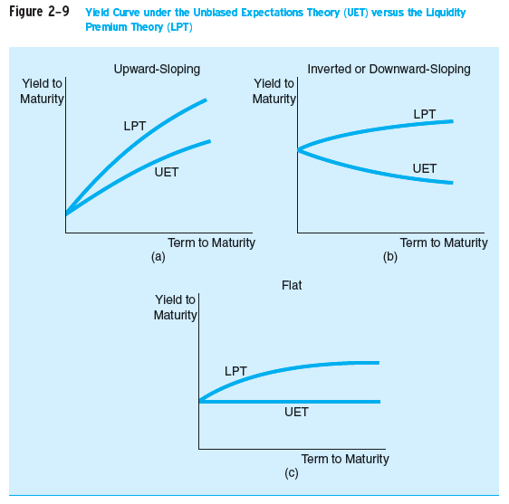
UET vs. LPT

Slide 22
Market Segmentation Theory
Individual investors and FIs have specific maturity preferences
Interest rates are determined by distinct supply and demand conditions within many maturity segments
Investors and borrowers deviate from their preferred maturity segment only when adequately compensated to do so

Slide 23
Implied Forward Rates
A forward rate (f) is an expected rate on a short-term security that is to be originated at some point in the future
The one-year forward rate for any year, N years into the future is:

Slide 24
Time Value of Money and Interest Rates
The time value of money is based on the notion that a dollar received today is worth more than a dollar received at some future date
  Simple interest: interest earned on an investment is not reinvested
  Compound interest: interest earned on an investment is reinvested, most common
Notes:
The formulas that follow are for compound interest.

Slide 25
Present Value of a Lump Sum
Discount future payments using current interest rates to find the present value (PV)
PV = FV_{t}/(1 + r)^{t}
  PV = present value of cash flow
  FV_{t} = future value of cash flow (lump sum) received in t periods
  r = interest rate earned per period on investment
  t = number of compounding periods in investment horizon

Slide 26
Future Value of a Lump Sum
The future value (FV) of a lump sum received at the beginning of the investment horizon
FV_{t} = PV (1 + r)^{t}

Slide 27
Relation between Interest Rates and Present and Future Values
Present
Value
(PV)
Future
Value
(FV)
Interest Rate
Interest Rate

Slide 28


Present Value of an Annuity
The present value of a finite series of equal cash flows received on the last day of equal intervals throughout the investment horizon
  PMT = periodic annuity payment

Slide 29


Future Value of an Annuity
The future value of a series of equal cash flows received at equal intervals throughout the investment horizon

Slide 30
Financial Calculators
Setting up a financial calculator
  Number of digits shown after decimal point
  Number of compounding periods per year
Key inputs/outputs (solve for one of five)
  N = number of compounding periods
  I/Y = annual interest rate
  PV = present value (i.e., current price)
  PMT = a constant payment every period
  FV = future value (i.e., future price)

