Slide 1
Course Name:
INTRODUCTION TO TOURISM (THM101)
T.C. ÇAĞ UNIVERSITY
FACULTY OF ECONOMICS & ADMINISTRATIVE SCIENCES
DEPARTMENT OF TOURISM MANAGEMENT
1
INSTRUCTOR:
Ceyda Melek CESEROĞLU
ceydamelek@windowslive.com
Mersin
2014

Slide 2
-Content-
An introduction to tourism
Introduction to hospitality industry
Defining the hospitality
The activities of the hospitality industry
Hospitality is part of tourism industry: tourism industry
The institutionalization of tourism
The professionalization of the tourism industry
What are the benefits of a standardized curriculum in tourism education?
Different perspectives to tourism
Defining tourism
Importance of Tourism
The tourism system
The successful destination
Defining a tourist
Problems defining a tourist
The purpose of visits
Tourist services
Four key characteristics of the tourism product

Slide 3
An introduction to tourism
Holloway, Humphreys and Davidson,
The Business of Tourism,
8th Edition,
© Pearson Education Limited
2009

Slide 4
Introduction to Hospitality Industry
The Nature of the Hospitality Industry
What is the meaning of HOSPITALITY? There have been different definitions of Hospitality.
A contemporary explanation of Hospitality refers to the relationship process between a guest and a host.
When we talk about the “Hospitality Industry”, we are referring to the companies or organisations which provide food and/or drink and/or accommodation to people who are away from home. However, this definition of the “Hospitality Industry” only satisfies most situations.
  Can you think of any circumstances where the phrase “away from home” would not be accurate?

Slide 5
Defining the hospitality
The Nature of the Hospitality Industry
The hospitality field, by definition, is a service industry. Its task is to create shareholder wealth by servicing and satisfying guests.
  Industry segments include, among others: hotels, restaurants, private clubs, managed food service, event planning, tourism related businesses, and travel providers.

Slide 6
Defining the hospitality
Langhorn (2004) noted that in hospitality, the service provider is “part of the product itself”.
For guests to be satisfied, they not only must believe that they have received a valuable service for their dollar, but also feel valued and respected by the workers providing the service (Kernbach & Schutte, 2005; Langhorn, 2004; Varca,2004; Winsted, 2000).

Slide 7
Defining the hospitality
Hospitality is:
- the act of kindness in welcoming and looking after the basic needs of guests or strangers, mainly in relation to food, drink and accommodation;
- refers to the relationship process between a guest and a host;
- the reception and entertainment of guests, visitors, or strangers with liberality and goodwill (Oxford English Dictionary);
- derived from the Latin word hospitare meaning to “receive as a guest”

Slide 8
THE ACTIVITIES OF THE HOSPITALITY INDUSTRY
Main business sectors in the hospitality industry:
- Accommodation – To provide accommodation (and usually food and drink) to people who for whatever reason are away from home
Food and beverage – To provide food and beverage to local, commuting, transient customers and tourists

Slide 9
Hospitality is Part of Tourism Industry:
Tourism Industry
Tourism Industry
Retail (Shopping) Stores
Transportation Services
Destination (Activity) Sites
Hospitality
Lodging (Accommodation)
F&B Operations
Figure: Segments in the Tourism Industry
    The Hospitality Industry include the companies or organizations which provide food and/or drink and/or accommodation to people who are away from home.
Notes:
Tourism industry is all businesses that cater to the needs of the traveling public.

Slide 10
The institutionalization of tourism
The tourism industry has become more commercialized
This has led to greater integration within and across sectors
Companies have increased in size, leading to greater centralization of control
As a result, companies have become more organized and efficient
Products have become more standardized, with better quality control
Marketing has become more professional

Slide 11
The professionalization of the tourism industry
Professionalization implies a more educated and trained body of staff
But,
On balance, employees in the tourism
industry are less well trained and educated
than their counterparts elsewhere
Many employers continue to prefer
training 'on the job' rather than recruiting
college-trained staff without experience

Slide 12
What are the benefits of a standardized curriculum in tourism education?
Each element of the core curriculum is
geared to the needs of the industry
It enhances opportunities for progression
within the industry
It enables employers to understand what
their employees should already know
It allows employees to transfer more easily
between companies, and between sectors of the industry

Slide 13
Different perspectives to tourism
Four different perspectives of tourism can be identified:
The tourist
The business providing tourist goods and services
The government of the host community
The host community

Slide 14
Defining tourism
Tourism may be defined as the processes, activities, and outcomes, arising from the relationships and the interactions among tourists, tourism suppliers, host governments, host communities, and surrounding environments that are involved in the attracting and hosting of visitors.
Sum of the phenomena and relationships arising from the travel and stay of nonresidents, in so far as they do not lead to permanent residence and are not connected to any earning activity. (Prof. Hunziker)

Slide 15
Defining tourism (2)
Tourism may be defined in terms of particular activities selected by choice and undertaken outside the home environment. Tourism may or may not involve overnight stays away from home'
AIEST/Tourism Society conference, 1981
Tourism comprises the activities of persons travelling to and staying in places outside their usual environment for not more than one consecutive year for leisure, business or other purposes'
UNWTO/UN Statistical Commission 1993

Slide 16
Importance of Tourism
1. Contribution to the balance of payments.
2. Dispersion of development.
3. Effect on the general economic development.
4. Employment opportunities.
5. Social benefits
6. Cultural enrichment
7. Educational significance
8. A vital force for peace
Imagine What Tourism Can Do

Slide 17
The tourism system
The generating region
The destination region
The transit zone
Based on Leiper, N (1979), The Framework of Tourism,
Annals of Tourism Research, 6 (4) 390-407

Slide 18
The successful destination
A successful destination must comprise three elements:
- Attractions
• Beaches, museums or galleries, places of
historical and cultural interest and events
- Amenities
• Infrastructure - airports, roads, parking, utilities,
etc.; and superstructure - hotels, restaurants, etc.
- Accessibility
• Ease of access, both real and perceived
Sometimes Ancillary Services (such as guiding, marketing, etc) are considered alongside the above three elements

Slide 19
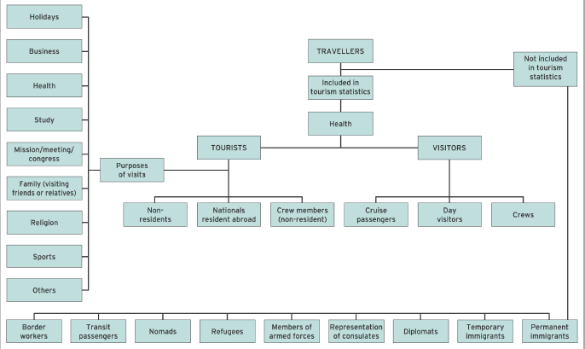
Defining a tourist
(Courtesy of the UN
World Tourism Organization)

Slide 20
Problems defining a tourist
Are the following defined as tourists in official statistics?
Local shoppers visiting a neighbourhood town
Second home owners
Tourists staying at a resort and making a day
excursion across the border into another
country
'Snowbirds' coming down from Canada and
Northern US states to spend their winters in
warmer southern states

Slide 21
The purpose of visits
Tourists embark on a trip for one of these three reasons:
Holidays (including visits to friends and
relatives - VFR)
Business (including meetings and conferences)
Other miscellaneous (including religion, health
and study)

Slide 22
Tourist services
1. Passenger transport
2. Accommodation, food & beverage, and entertainment
3. Consists of those provided by the travel agent and the tour operator

Slide 23
Four key characteristics of the tourism product
Intangibility
Complexity
Heterogeneity
Perishability

Slide 24
Four key characteristics of the tourism product
Intangibility
- The consumer buys the product on trust, being unable to inspect it
before committing themselves to the purchase
Complexity
- The tourism product is seldom a single component. It invariably includes one or more forms of transport, accommodation, the customer service associated with each of these and the overall 'experience' of the stay. Tourism experience is as much a
psychological as a physical one
Heterogeneity.
- Each element of a complex tourism product is subject to variations. Examples include:
    Flight turbulence
    Inclement weather
    The personality and mood of service personnel encountered by the tourist
Perishability
- Unsold capacity (flights, hotel rooms, coach excursions, etc.) cannot be stored and sold at a later date.

