Slide 1
Course Title
Financial Literacy
Course Coordinator
Assist.Prof.Dr. Gökhan Sökmen

Slide 2
Learning Objectives
After studying this chapter;
You will be able to explain deposit accounts.
You will be able to know types of loans.
You will be able to identify e-savings account.
You wil be able to know the features and benefits of e-savings account, TL time deposit account and foreign currency time deposit account.
You wil be able to explain the types of bank risks.

Slide 3
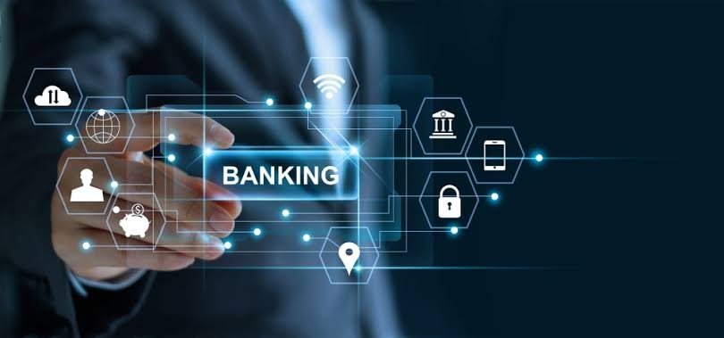
When choosing a bank, make sure to ask questions.
What are the fees?
How easily can I reach a person?
How is the customer service?

Slide 4
Deposit Accounts
e-Savings Account
TL Time Deposit Account
Foreign Currency Time Deposit Account

Slide 5
e-Savings Account
You can easily open a time deposit account through Internet Banking and earn more with the advantageous interest rates exclusive to Internet Banking.
Features and Benefits:
An additional interest rate of 5,75% for all TL accounts and 0,90% for USD and 0,85% for Euro accounts opened via Internet Banking is in effect
The minimum limit to open an account is TL 1.000, USD 1.000 and Euro 1.000.
The interest rate is gross rate.
The special interest rates exclusive to Internet Banking are available for all terms including broken maturity dates from 28 days to 365 days.
Your time deposit account opened via Internet Banking is extended with the interest rate exclusive to Internet Banking.

Slide 6
e-SavingsAccount

Slide 7
TL Time Deposit Account
To avoid getting affected by potential interest rate fluctuations in the long-run, you can open a TL Time Deposit Account and select the term that suits you the best.
With the TL Time Deposit Account, you obtain a risk-free return from your investment.
Features and Benefits:
Does not get affected by the interest rate fluctuations in the market, provides constant returns.
In addition to 1-month, 3-month, 6-month and 12-month terms, you can open a time deposit account with broken maturity dates from 32 days to 365 days.
Interest rates are gross rates.
The lower limit to open an account is TL 1.000.
Accounts terminated before maturity do not accrue interest.

Slide 8
TL TimeDeposit Account

Slide 9
Foreign Currency Time Deposit Account
With the FX (Foreign Currency) Time Deposit Account, obtain risk-free returns without getting affected by potential interest rate fluctuations in the long-term.
For this, all you have to do is to select the term that best suits you for investing your foreign currency.
Features and Benefits:
Does not get affected by the interest rate fluctuations in the market, provides constant returns.
In addition to 1-month, 3-month, 6-month and 12-month terms, you can open a FX (Foreign Currency) Time Deposit Account with broken maturity dates from 32 days to 365 days.
You can open a FX (Foreign Currency) Time Deposit Account in USD, Euro, JPY, CHF and GBP.
Interest rates are gross rates.

Slide 10
Foreign Currency Time Deposit Account

Slide 11
LOANS
Loans are the primary assets of modern commercial banks, accounting for well over one-half of assets.
Loans can be divided into five categories:
Business loans called commercial and industrial (C&I) loans;
Real estate loans, including both home and commercial mortgages and home equity loans;
Consumer loans, like auto and credit card loans;
Interbank loans; and
Other types, including loans for the purchase of other securities.

Slide 12
LOANS
Personal loan
Land Loan
Education Loan
Overdraft account
House loan
Car loan

Slide 13
LOANS
Personal Loan: | Whatever is on your wishlist, the personal loans can help you get it. A mobile phone, a computer or a holiday with your loved one… All you need is to decide.
Land Loan: | Purchasing a land by turning your savings into investment or creating your apple garden is easier than ever with Land Loan.
Education Loan: | Education expenses of your child increase day by day… Paying education expenses at once is a burden for the family budget. Now there is a loan to cover all education expenses of your child: “Education Loan”. Education loan can be used in financing education expenses of your children such as private school, university and training center…

Slide 14
LOANS
Overdraft account | You can withdraw money and make automatic payments even if you do not have money in your account. “Overdraft Account” is a lifesaver when your draw account balance is insufficent….
House Loan | Housing Loan with long maturity term and small amount installment options, and own your dream home or workplace, enjoying the advantage of repaying your loan as if you are paying rent.
Car Loan | While purchasing a new or used car, light commercial vehicle, you can use vehicle loan. You don’t need to have a surety for a vehicle loan to purchase a new car, car pledge is enough.

Slide 15
CARDS
Total Credit Limit: It indicates the maximum amount that you can use on cash draw and shopping transactions. In case the limit is not sufficient for your usage, you can apply to your branch for limit increase.
Available Credit Limit: It indicates the amount remaining from the limit assigned to your credit card after deducting your debt and receivable transactions reaching to the Bank until the credit card statement date and running record.
Debt for the Period: It is the total of your debt and receivable transactions reaching to our Bank until the credit card statement date and your running record.
Previous Balance: It indicates previous period debt status.

Slide 16
CARDS
Minimum Amount Due: It indicates the minimum amount due to be paid until the last payment date. This amount includes your overdue debts from the previous period.
Account Closing Date: It indicates the date when your credit card statement is arranged. This date is determined to be the same day for each month. But in case the day following the determined date is holiday (weekend or official holiday), the credit card statements are arranged at the last day of holiday.
Final Payment Date: It is the last payment date of your debt specified on the credit card statement.

Slide 17
Bank Card
Bank card is cash in its most secure state. It gives you the opportunity to shop and use the money in your account 365 days 24 hours without the risk of carrying cash with you.
Through the ATM's of the Bank, you may learn your account balance, withdraw money, transfer between your accounts, transfer to another account.
You may withdraw money from ATM’s bearing VISA, MasterCard or TROY signs.
You may shop in millions of establishments in Turkey and throughout the world.

Slide 18
Virtual Card
With Virtual Card, you can set your card’s limit and shop safely on the internet.
Features and Advantages:
The Virtual Card is a card number that can only be used for Internet shopping. It does not exist in physical card form for security reasons.
For maximum security, you can set your card’s limit based on the purchase you intend to do, and reset it after you have finished shopping.

Slide 19
Online and Mobile Banking
Benefits of convenience and saving time along with instant information access
Concerns of privacy, security of data, ease of overspending, costly fees, and online scams must also be considered
Traditional Electronic Banking
Automatic teller machine (ATM; also called a cash machine) offers various transactions
Debit card (or cash card) used to make purchases with your own funds

Slide 20
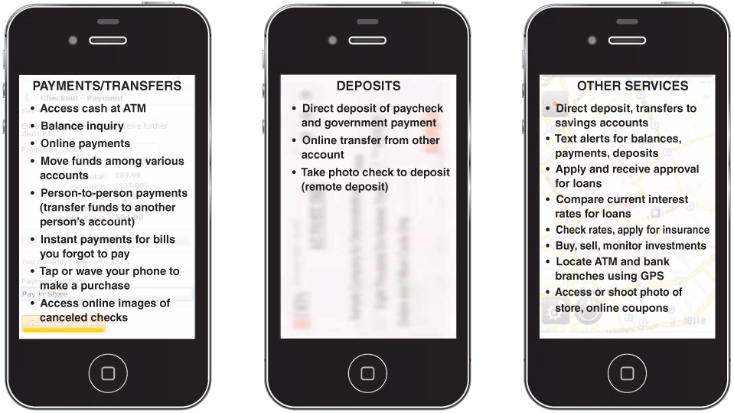
Online and Mobile Banking
Banking using text messages, mobile web banking, or banking apps

Slide 21
Bank Risks
The bank’s goal is to make a profit in each of its lines of business.
They want to pay less for the deposits they receive than for the loans they make and the securities they buy.
In the process of doing this, the bank is exposed to a host of risks:
Liquidity risk
Credit risk
Interest-rate risk
Trading risk

Slide 22
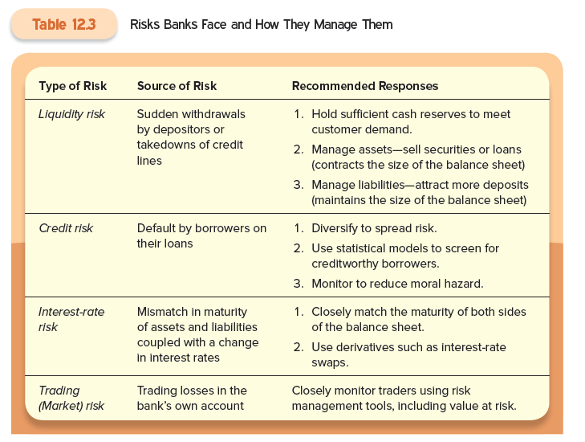
Bank Risks

Slide 23
Questions
What are the deposit accounts?
What are the features and benefits of e-savings account?
What are the features and benefits of TL time deposit account?
What are the features and benefits of foreign currency time deposit account?
Explain the types of loans.
What are the types of bank risks?

