Slide 1
PSY104- STATISTICS IN SOCIAL SCIENCES
General Revision
&
Classification of Variables on Psychological Research

Slide 2
To review…
1. Bir veri setinde mean = 72, median = 65, mode = 60.
a) Bu dağılım sağa mı sola mı çarpıktır? Neden?
2. İki grubun sınav ortalaması aynıdır (X̄ = 75).
Grup A’nın standart sapması 3, Grup B’nin standart sapması 15’tir.
a) Hangi grup daha homojendir?
b) Standart sapma farkı sonuçların yorumunu nasıl etkiler?
3. Bir araştırmada aynı öğrencilerin sınav öncesi ve sınav sonrası kaygı puanları karşılaştırılıyor.
a) Hangi t-testi kullanılmalıdır?
b) Neden diğer t-testleri uygun değildir?

Slide 3

To start…
What are the main ways to classify research in psychology?
How does quantitative research differ from qualitative research?
What distinguishes descriptive, correlational, and experimental research?
How would you ensure representativeness? – in terms of sample/population
Can a study be both correlational and experimental? Why or why not?

Slide 4
RESEARCH HYPOTHESIS
It is the concrete, analyzable-testable form of a research problem.
It is the expression of predictions about the possible outcome of a research, scientific propositions.
We form our hypotheses in the light of theories and based on the results of studies in the literature.
Writing a hypothesis;
The variables of the research and the levels (different conditions) of the variables are clear.
Our research method and design
It guides the researcher about the statistical analyzes we will use.

Slide 5
RESEARCH HYPOTHESIS
A good hypothesis;
Theoretical foundation,
Not contradicting what is known,
The relationship between variables should be well defined,
It should be testable,
It should be testable with the time and means available,
Clear, simple, understandable and useful…

Slide 6
RESEARCH HYPOTHESIS
Types of hypothesis:
Null Hypothesis (H0): There is no difference between the groups or indicates that there is no relationship between the variables.
Research Hypothesis (H1): A significant difference between groups or that there is a significant relationship between variables. The research hypothesis is established in two ways;
        Two way- There is a significant difference or a significant relationship.... are available.
    One-way - indicates the direction of the relationship or difference (if an experimental study is not being conducted or the result is uncertain, two-way hypotheses should be preferred)

Slide 7
RESEARCH VARIABLES
Variables included in the study are;
  Dependent Variable
  Independent Variable
  Confounding Variable
  Control Variable

Slide 8
RESEARCH VARIABLES
Dependent Variable: The outcome variable (Y) is the variable whose change is of interest and whose change with respect to other variables is examined (referred to as the predictor variable in correlational research).
The word “dependent”
Example - Anxiety in social interaction impact on
Independent Variable: An effect on the dependent variable that is thought to provide an effect on the dependent variable included in the study as having an effect (Relational referred to as predictor in research). – YORDAYICI
What affects the dependent variable?
Example - Anxiety in social interaction impact on

Slide 9
EXAMPLE
Are students' attitudes towards the course, the teaching method applied, and their gender related to their school achievement scores?
Independent Variable(s): Attitudes towards the course, the teaching method applied, and their gender
Dependent Variable: School achievement scores
Hypothesis?

Slide 10
CLASSIFICATION OF VARIABLES
Variables in Measurement and Statistics
In order to use variables correctly in measurement and statistics, we need to understand their nature.
Measurement is the numerical expression of the variable examined in the research.
Each participant in the study is assigned a score related to the relevant characteristic.
Everything in nature can be measured in four different ways.

Slide 11
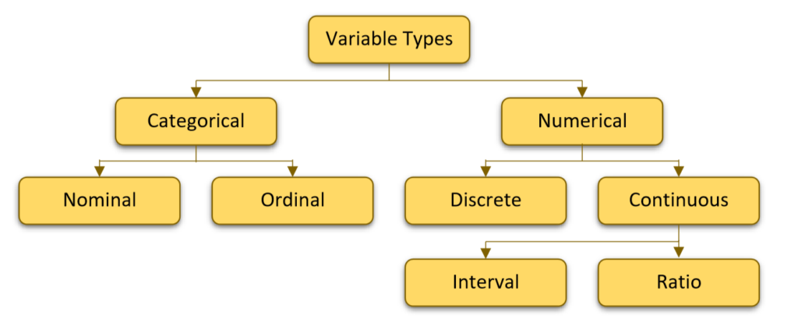
CLASSIFICATION OF VARIABLES

Slide 12
CLASSIFICATION OF VARIABLES
A discrete variable is a variable that can only take specific, countable values.
  It is typically expressed in whole numbers, and there are no intermediate values between two given points.
Examples:
Number of students (A class can have 20, 21, or 22 students, but not 20.5)
Number of siblings a person has, number of correct answers on a test, number of participants in a study.
In contrast, continuous variables can take an infinite number of values within a given range (e.g., height, weight, temperature).

Slide 13
CLASSIFICATION OF VARIABLES
A continuous variable is a variable that can take an infinite number of values between two specific points.
It typically represents measurable quantities and can include fractional or decimal values.
Examples:
Height (A person could be 170 cm, 170.2 cm, or 170.25 cm tall.)
Weight (An object could weigh 50 kg, 50.3 kg, or 50.35 kg.)
Temperature (The temperature could be 25°C, 25.1°C, or 25.15°C.)
Time (A runner might finish a race in 10 seconds, 10.2 seconds, or 10.25 seconds)
In contrast to continuous variables, discrete variables can only take specific, countable values…

Slide 14
CLASSIFICATION OF VARIABLES

Slide 15
CLASSIFICATION OF VARIABLES
Interval Variable: (Eşit aralıklı düzeyde ölçme)
An interval variable is a type of quantitative variable where the difference between values is meaningful and consistent, but there is NO true zero point (i.e., zero does not indicate the absence of the measured characteristic).
Examples:
Temperature in Celsius or Fahrenheit (The difference between 10°C and 20°C is the same as between 20°C and 30°C, but 0°C does not mean "no temperature.")
IQ scores (An IQ of 120 is higher than 100, but an IQ of 0 does not mean the absence of intelligence.)
Calendar years (The year 2000 is 100 years after 1900, but the year 0 does not represent the absence of time.)

Slide 16
CLASSIFICATION OF VARIABLES
Ratio Variable:
A ratio variable is a type of quantitative variable that has all the properties of an interval variable, but WITH A TRUE ZERO POINT, meaning that zero represents the complete absence of the characteristic being measured.
Examples:
Weight (50 kg is half of 100 kg, and 0 kg means no weight at all.)
Age (A 40-year-old is twice as old as a 20-year-old, and 0 years means no age.)
Income (Earning $0 means having no income, and $100 is twice as much as $50.)

Slide 17
CLASSIFICATION OF VARIABLES

Slide 18
CLASSIFICATION OF VARIABLES
Nominal Variable:
A nominal variable is a type of categorical variable that represents different groups or categories without any inherent order or numerical meaning.
These variables cannot be ranked and the differences between them cannot be measured.
Examples:
Gender (Male, Female, Other)
Eye color (Blue, Green, Brown)
Blood type (A, B, AB, O)
Birthplace (New York, London, Tokyo, Türkiye)
Occupation (Doctor, Teacher, Engineer)

Slide 19
CLASSIFICATION OF VARIABLES
Ordinal Variable: (Sıralama)
An ordinal variable is a type of categorical variable that has a specific order or ranking, but the differences between the categories cannot be measured precisely. In other words, there is a hierarchical relationship between the values, but the distance between them may not be equal.
Examples:
Education level (Elementary school < Middle school < High school < University)
Satisfaction level (Not satisfied < Slightly satisfied < Very satisfied)
Social status (Low income < Middle income < High income)

Slide 20
Why Levels of Measurement Matter?
  What kind of measurement of the variables you choose you decide that it is appropriate for their level.
  Research problem and hypotheses a measurement level appropriate to the measurement levels of the variables build with language
  Selecting appropriate statistical analyses
  Making correct inferences

Slide 21
  Operational Definition
An **operational definition** is a definition that describes how a concept or variable will be measured or observed in research or practical applications. It provides a clear, measurable expression of an abstract concept, specifying what it means and how it will be evaluated.
Happiness (A person's happiness might be defined by their score on a specific happiness survey.)
Success (A student's success might be measured by their score on an exam.)
Stress (Stress level can be determined by the result of a specific psychological test.)
SOYUT ---- SOMUT

Slide 22
  Operational Definition
A concept can have more than one operational definition. The important thing is which operations you use to define the variables in your research.
E.g.: What are the working definitions of anxiety?
State-Trait Anxiety Scale scores
May be an avoidance reaction… ☺
Movement in the sympathetic nervous system - heart rate, sweating, etc.

Slide 23
Any questions?

