Slide 1
Quantıtatıve research: QUESTIONS, PROBLEMS, HYPOTHESES
Prof. Dr. Şehnaz Şahinkarakaş

Slide 2
Research Problem
Empirical studies begin with research questions.
To address these questions, problem is formulated.
The research problem
is the issue, controversy, or concern that initiates the study
is included in the introduction section of a research report or article
consists of several sentences or a few paragraphs that show how the problem is formulated
provides the foundation for the meaningfulness of the study.

Slide 4
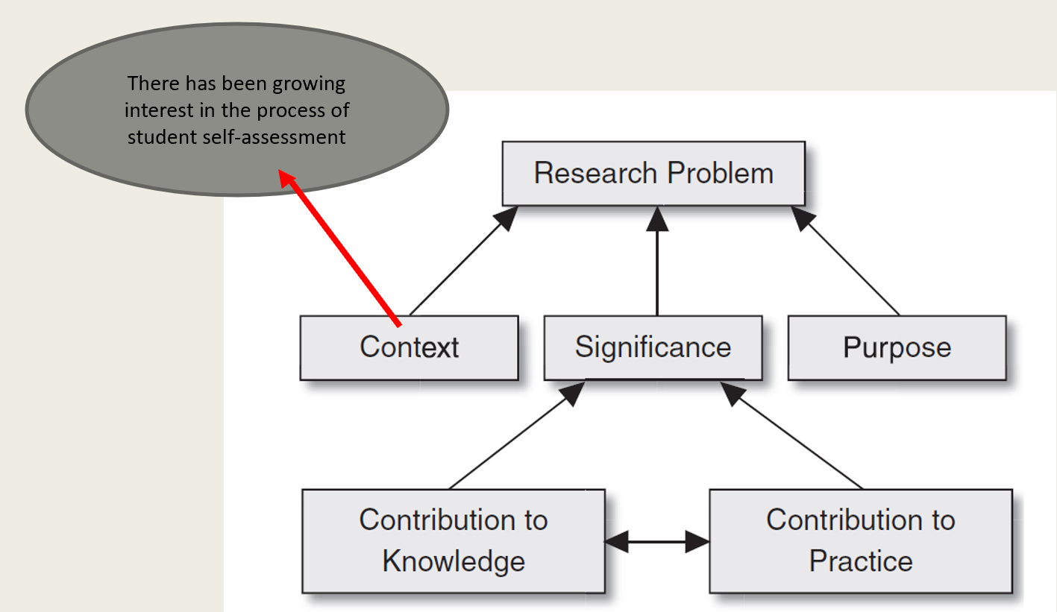

Slide 5
An Example Script to Context in Research Problem
In recent years there has been a growing concern regarding the current state of the educational system in the United States. For example, in comparison to other countries, high school students in the United States are falling behind students in other countries on various measures of academic achievement . . . given these concerns, one goal of this research was to examine the relative contributions of cognitive abilities to students’ science achievement.
(O’Reilly, & McNamara, 2007, cited in McMillan & Schumacher, 2013, p. 58)

Slide 6
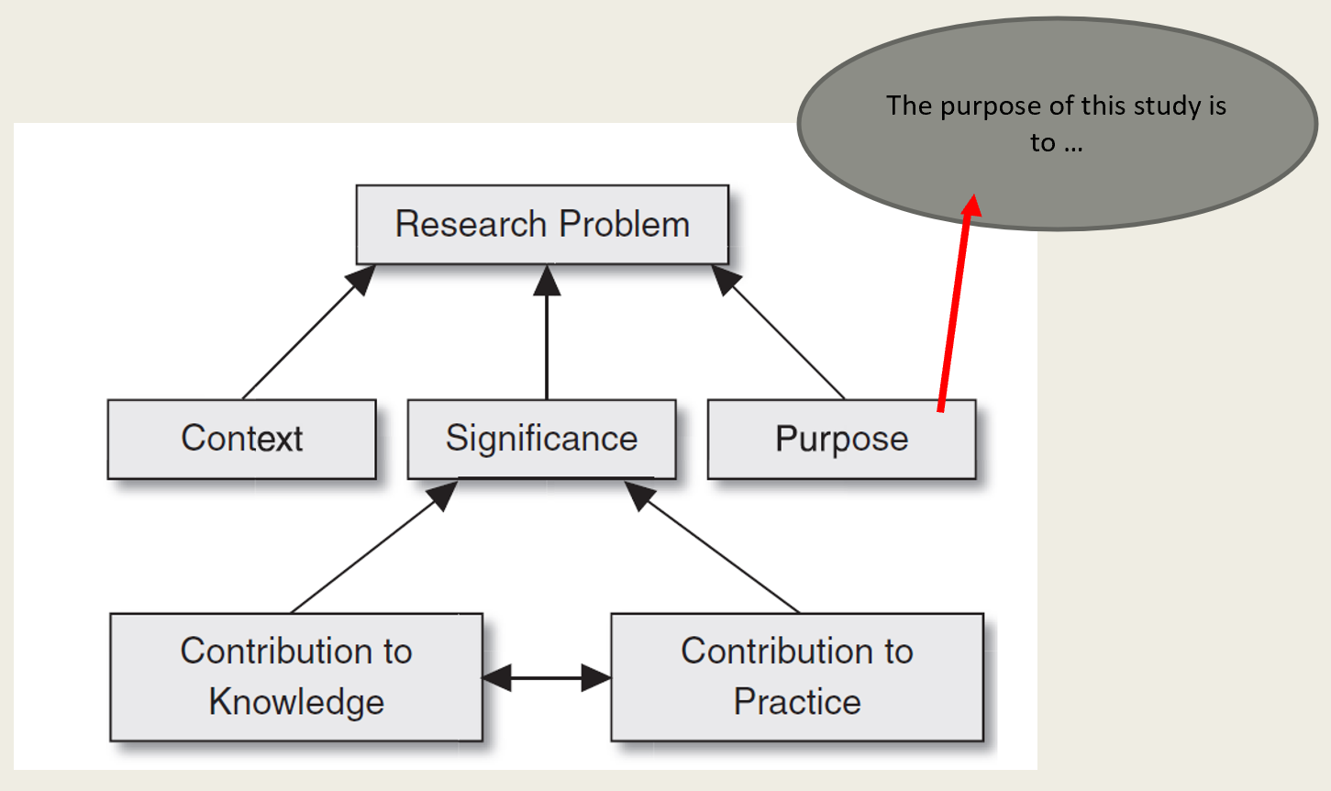

Slide 7
Purpose Statement Examples
Broad purpose statements:
The purpose of this study is to investigate effective approaches to mainstreaming exceptional students.
The purpose of this study is to determine the dropout rate.
The purpose of this study is to identify factors predicting teacher satisfaction.
The purpose of this study is to provide empirical evidence of students’ views of performance assessment.
More specific ones:
The purpose of this study is to investigate the relationship between teachers’ experience and student disruptions in the classroom.
The purpose of this investigation was to relate student knowledge of test-taking strategies to student performance on high-stakes tests.
Our goal was to examine which of three learning styles were best suited to differentiated instruction for elementary students.

Slide 8
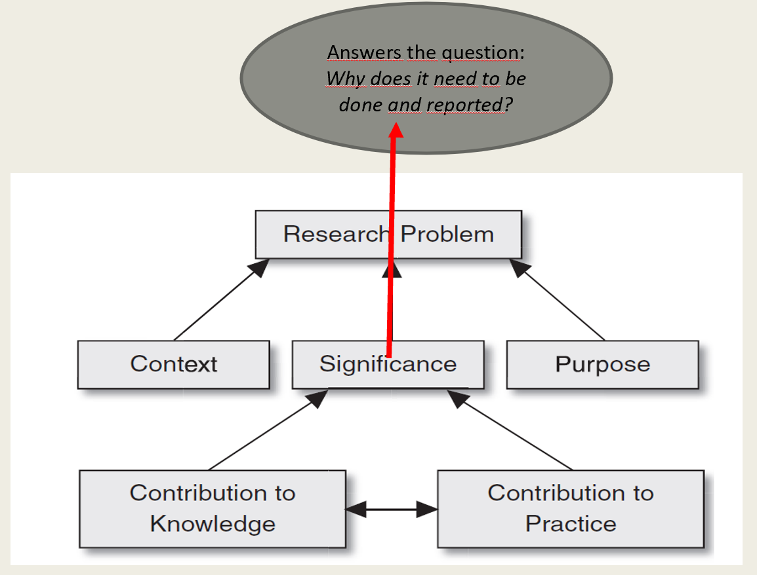

Slide 9
An example that indicates the significance of a study:
This work attempts to move this larger body of research on school accountability policies forward by examining the influence of accountability policies on teacher motivation . . . this empirical investigation of motivational theories in the CPS accountability context provides important insights into the motivation response of teachers to school accountability policies . . . understanding the factors that imp[rove] teacher motivation in low-performing schools . . . Contributes to a broader knowledge base around improving teacher performance and, as a result, student performance.

Slide 10
Some Well-Written Problem Statements
1. Effects of Explicit Vocabulary Instruction on Reading Comprehension in EFL Learners
Many English as a Foreign Language (EFL) learners struggle with reading comprehension due to limited vocabulary knowledge. While explicit vocabulary instruction has been suggested as a means to enhance comprehension skills, there is limited empirical research on its effectiveness in non-native English-speaking contexts. This study seeks to examine the impact of explicit vocabulary instruction on the reading comprehension skills of intermediate EFL learners.

Slide 11
2. Impact of Online vs. Face-to-Face Feedback on ESL Writing Development
Providing feedback is an essential component of language learning, but there is ongoing debate on whether online written feedback is as effective as face-to-face feedback in improving writing proficiency. Despite the increasing use of technology in education, little research has compared the effectiveness of these two feedback modes in ESL writing classrooms. This study aims to investigate the impact of online versus face-to-face feedback on ESL students’ writing performance and revision behaviors.

Slide 12
3. The Relationship Between Teacher Classroom Management Strategies and Student Motivation in ELT
Student motivation plays a crucial role in language learning success. However, there is insufficient research on how different classroom management strategies used by English language teachers influence student motivation. This study aims to explore the relationship between specific classroom management techniques and student motivation levels in EFL classrooms.

Slide 13
Practice Time
Let’s go to Workout Rooms

Slide 14
RESEARCH QUESTION FORMULATION

Slide 15
Construct
Abstract concept
expresses the idea behind a set of particulars.
E.g. Motivation, intelligence, achievement, anxiety, etc.

Slide 16
Variable
A name or label that represents
a concept (a class of objects; e.g. School, teacher, curriculum, etc). or
characteristic (a trait; e.g. Achievement, attitude, gender, etc)
Quantitative studies use variable rather than noun or characteristic
Thus, a variable
is a noun or characteristic that represents numerical or categorical variation.
E.g. characteristics such as speed, height, intelligence, and artistic ability

Slide 17
TYPES OF VARIABLES
A characteristic/attribute that is dependent on or influenced by the independent variable (i.e., outcome, effect, consequence variables)-- Multiple dependent variables can be investigated
Can be continuous or categorical
Examples of dependent variables:
achievement scores
Thoughts/beliefs/attitudes, etc
Study skills…
Ask this question: What is the OUTCOME of this study?
Dependent Variables

Slide 18
Independent Variables
A characteristic/attribute that influences or affects an outcome/dependent variable
May be called factors, treatments, predictors, determinants, or antecedents
Aim is to see what effect or influence they have on the outcome

Slide 19
Extraneous / Confounding Variables (may be responsible for differences observed between treatment groups)
Extraneous variables: any variable that you're not investigating that can potentially affect the dependent variable of your research study
E.g. Unplanned or unexpected events during the study
Confounding variable: type of extraneous variable that not only affects the dependent variable but is also related to the independent variable.

Slide 20
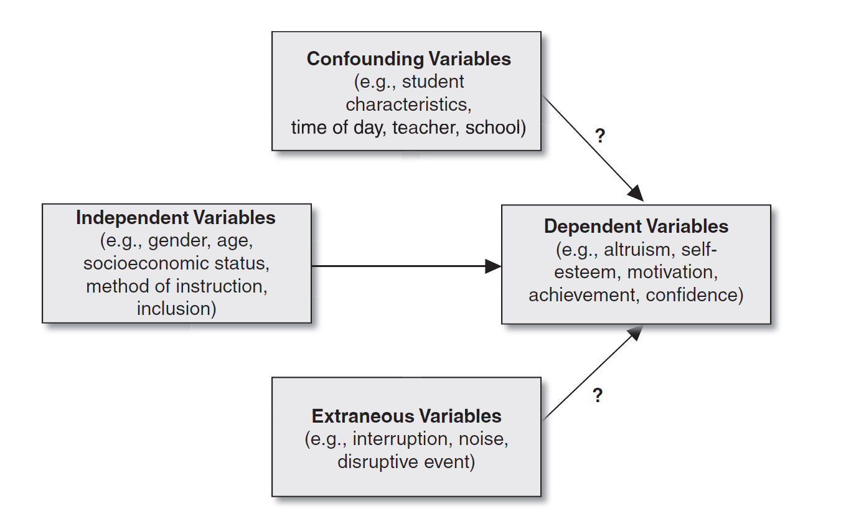

Slide 21
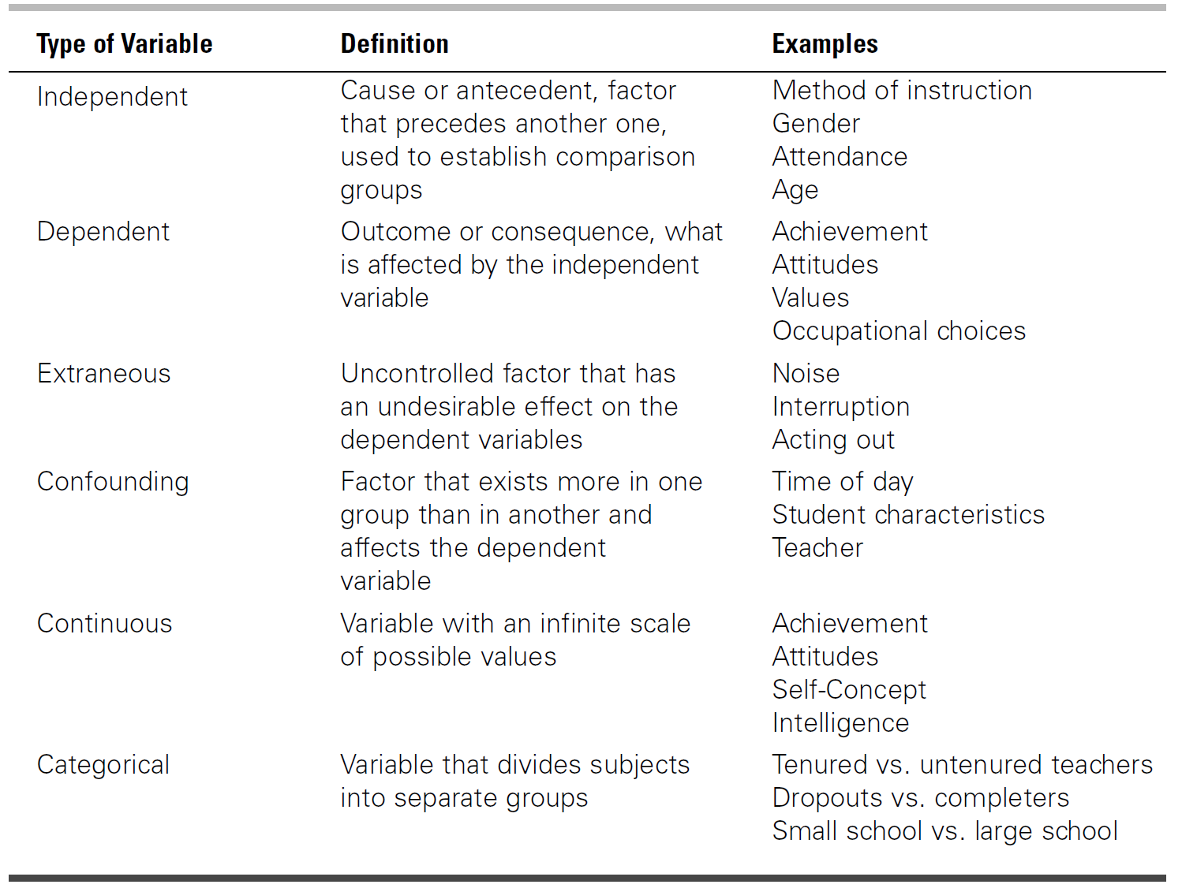

Slide 22
Quantitative Research Questions
Research questions describe
the participants’ reactions to a single variable
compare groups on an outcome
relate to variables
Some Guidelines
Begin with How, What, Why, To what extent,…
Specify the independent, dependent and mediating/control variables
Use the words describe, compare, relate, cause, effect,…
Indicate the participants and the research site

Slide 23
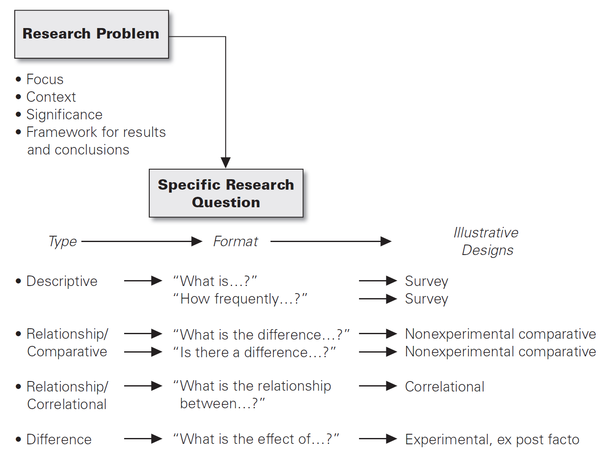

Slide 24
Descriptive Research Questions
Descriptive research questions are generally used for
frequencies, percentages, averages, total scores, graphs, and other indicators of how much or how frequently something has occurred.
no comparisons or correlations and independent variables.
Some examples:
What is the achievement level of fourth-grade students on the state accountability test?
What are parents’ beliefs about the best way to redraw school boundaries?
What do teachers perceive to be the area in which they would like training for Professional Development?

Slide 25
Non-experimental Relationship Questions
Can be considered under two types: differences (comparative) and correlations
Differences/Comparisons: analyzes differences or comparisons between groups of subjects.
E.g. Do sixth-grade students have stronger motivation than fifth-grade students?
What differences exist in the motivation of students across grade level?
Correlational: typically done with two continuous variables to measure the relationship with a correlation coefficient.
E.g. To what extent do preservice ratings during student teaching predict teaching effectiveness?
What is the relationship between first-semester grades of college students and retention?

Slide 26
Experimental Difference Questions
Groups of participants are compared to determine the effect of the intervention.
The differences between the groups are analyzed to investigate whether one group scores higher on the dependent variable than another group.
E.g. “Are there significant differences in achievement between traditional and computer-assisted learning groups?”

Slide 27
Writing Hypotheses
Like research questions, hypotheses narrow the purpose of the research, but they advance a prediction about what the research expects to find
Predictions are based on the literature
Hypotheses are not used
To describe a single variable as in research questions
As frequently as research questions in social sciences

Slide 28
Null Hypotheses (H₀)
TYPES OF HYPOTHESES
Basically two types: Null Hypotheses and Alternative Hypotheses
Null Hypotheses: Makes prediction that there is no relationship between independent and dependent variables or no difference between groups
E.g.
There is no difference between at-risk and non-at-risk students in terms of student achievement on English test scores for third-grade students in Southern part of Turkey.

Slide 29
Alternative Hypotheses H_{1,2}: Directional & Non-directional
This type shows your prediction about the difference.
Two types of alternative hypo: directional and non-directional
Directional hypotheses: The researcher predicts the direction of a change, difference, relationship, etc
E.g.
Students who participate in direct learning in elementary schools will have higher achievement scores than those who participate in whole-language learning
Non-directional hypotheses: There is a prediction about the difference but the direction of this prediction (negative or positive, greater or less, etc) is not indicated
E.g.
There is a difference between high-achievers and low-achievers in terms of their attitude towards learning English.

Slide 30
Guidelines to Write Hypotheses
The hypothesis generally state the direction of the difference or relationship
Use «Students of teachers who use specific comments as feedback score higher than students who receive brief praise»
The hypothesis should be testable.
The more specific the research hypothesis, the better
The hypothesis should have a clear rationale.
Ground the hypothesis in theory or previous research
The hypothesis should be clearly stated.

Slide 31
Some well-structured Research Questions & Hypotheses

Slide 32
1
Research Question: How does vocabulary size influence the reading comprehension performance of intermediate EFL learners?
Hypothesis: H₀ (Null Hypothesis): There is no significant relationship between vocabulary size and reading comprehension performance in intermediate EFL learners.
H₁ (Alternative Hypothesis): There is a significant positive relationship between vocabulary size and reading comprehension performance in intermediate EFL learners.

Slide 33
2
2. The Effect of Task-Based Language Teaching (TBLT) on Speaking Fluency
Research Question: What is the effect of task-based language teaching (TBLT) on the speaking fluency of adult ESL learners?
Hypothesis: H₀: Task-based language teaching does not significantly improve the speaking fluency of adult ESL learners. H₁: Task-based language teaching significantly improves the speaking fluency of adult ESL learners.

Slide 34
3
3. The Impact of Gamified Learning on Student Motivation in an Online EFL Course
Research Question: Does gamified learning increase student motivation in an online EFL course?
Hypothesis: H₀: Gamified learning has no significant impact on student motivation in an online EFL course. H₁: Gamified learning significantly increases student motivation in an online EFL course.

Slide 35
4
4. The Effect of Formative Feedback on Writing Accuracy in EFL Students
Research Question: What is the effect of formative teacher feedback on the writing accuracy of intermediate EFL students?
Hypothesis: H₀: Formative teacher feedback does not significantly improve writing accuracy in intermediate EFL students. H₁: Formative teacher feedback significantly improves writing accuracy in intermediate EFL students.

Slide 36
Practice Time
Let’s go to Workout Rooms

