Slide 1
Sources of the English Vocabulary Historical Development from 450 to Present

Slide 2
We will explore:
The major historical stages of English Vocabulary changes across periods
Key linguistic transformations
Growth of borrowings
Emergence of global English📌
And, the horizontal timeline
(Old → Middle → Early Modern → Modern)

Slide 3
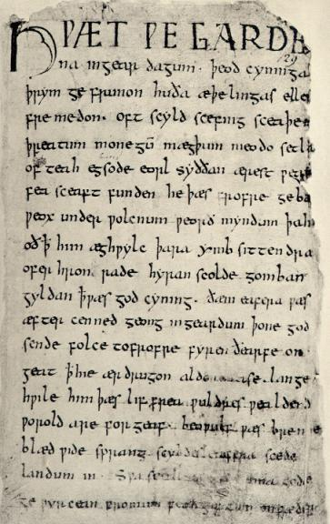
I. Old English Period (450–1066)

Slide 4
Historical Background
Old English (OE)
Spoken after Anglo-Saxon settlement (5th century)
Strongly Germanic
Limited literary corpus
Christianization (597) introduces Latin influence
Key manuscript: Beowulf

Slide 5
Linguistic Characteristics of OE
1. Strong Germanic Vocabulary
24,000 words
85% later disappeared
2. Kennings (figurative compounds)
hronrad = “whale-road” (sea)
banhus = “bone-house” (body)
3. Highly Inflected Grammar
Meaning expressed via endings
Word order less important

Slide 6
Vocabulary Profile of OE
Only 3% loanwords
Mainly Latin (religion, trade)
Examples:
Cheese
Bishop
Wine
Candle
Academic Insight: OE relied on internal word formation rather than borrowing.

Slide 7
II. Middle English Period (1066–1500)
Historical Turning Point
The Norman Conquest (1066)
French-speaking ruling class
Massive lexical borrowing
French becomes language of:
Government
Law
Military
Aristocracy

Slide 8
Vocabulary Transformation
Before 1066:
90% Anglo-Saxon vocabulary
After Middle English period:
Native stock reduced to 75%
French Loanwords:
government
court
judge
army
beauty
fashion

Slide 9
Linguistic Changes in ME
Spelling variation (no standardization)
Loss of many inflections
Greater reliance on word order
Expanded word-formation processes
📌 Important authors:
Geoffrey Chaucer
John Gower
William Langland

Slide 10
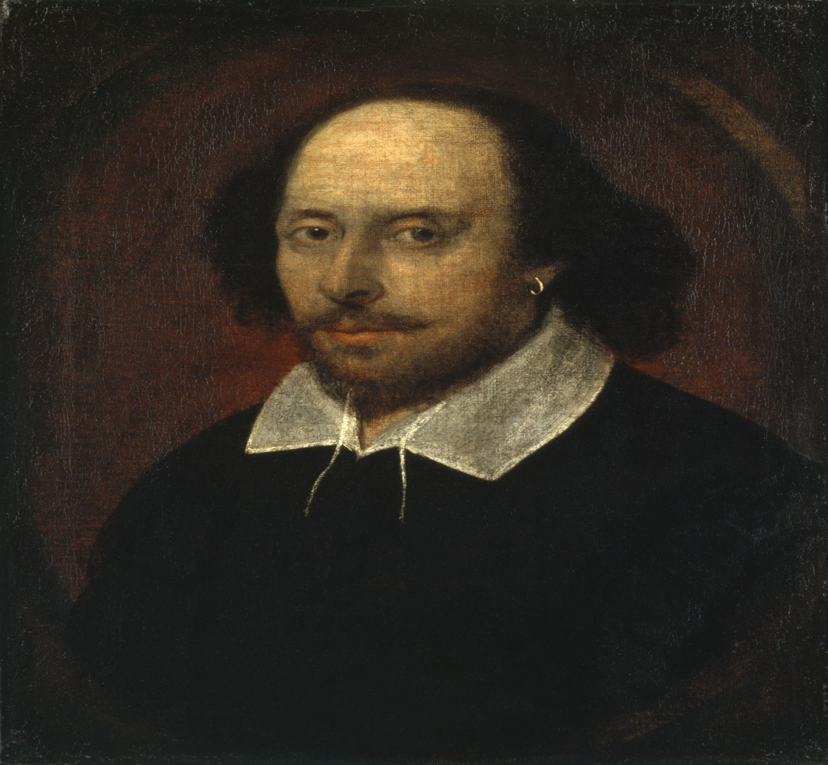
III. Early Modern English (1500–1800)

Slide 11
Two Major Influences
William Shakespeare
Thousands of new words introduced
Creative word formation
King James Bible (1611)
Preserved older forms
Influenced idiomatic English
Examples:
“a wolf in sheep’s clothing”
“an eye for an eye”
“fight the good fight”

Slide 12
Renaissance Influence
Massive borrowing from:
Latin
Greek
French
Italian
Spanish
Fields affected:
Science
Medicine
Philosophy
Arts
Examples: education; commemorate; thermometer; philosophy

Slide 13
Printing Revolution
1476 – William Caxton introduces printing
Consequences
Spelling begins to standardize
Wider circulation of texts
Increased literacy

Slide 14
IV. Modern English (1800–Present)
Scientific Expansion
Industrial Revolution → Explosion of terminology
New vocabulary in:
Technology
Engineering
Chemistry
Telecommunications
“English of science” emerges.

Slide 15
Rise of American English
USA becomes major economic power
4× more native speakers than UK
Global media influence
Americanisms enter British English and other languages.

Slide 16
Emergence of “New Englishes”
English adapts globally:
India
Singapore
Nigeria
Ghana
Philippines
Vocabulary reflects local cultural realities.
English becomes a global, adaptable system.

Slide 17
Comparative Overview
Period | Main Feature | Vocabulary Character
Old English | Germanic core | Few borrowings
Middle English | Norman Conquest | Massive French loans
Early Modern | Renaissance | Classical expansion
Modern English | Globalization | Scientific + global variety

