Slide 1
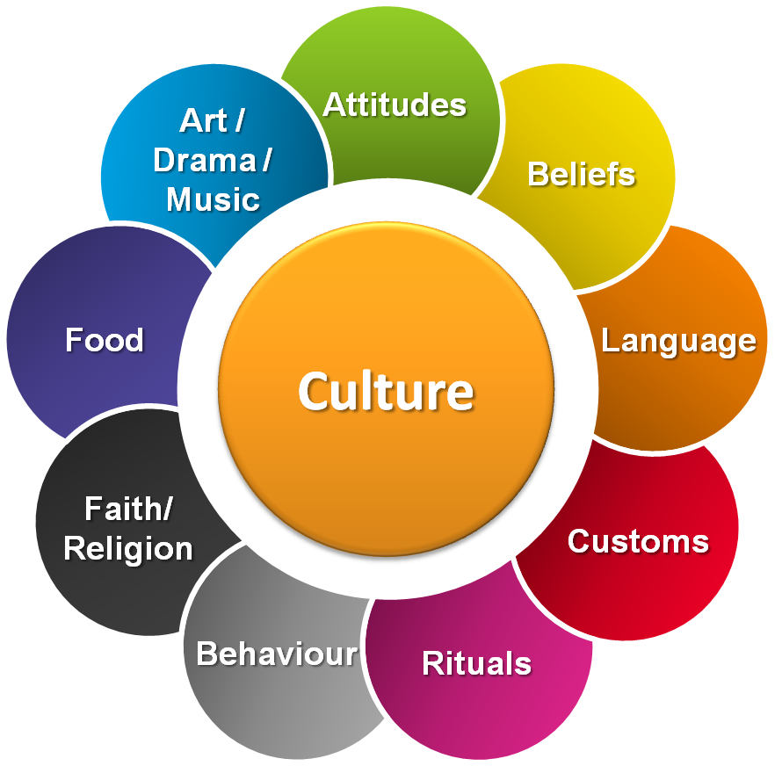
What exactly is
Culture?

Slide 2
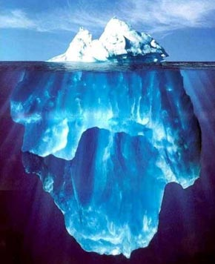
“Culture is like an iceberg…” (E. Hall 1976)
…Where some parts are visible while others are not. Still, not visible elements are the basis of the whole iceberg/culture…

Slide 3
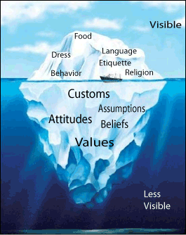
“Culture is like an iceberg…” (E. Hall 1976)

Slide 4
How is culture defined?
There are a lot of different definitions of culture, e.g.:
“That complex whole which includes knowledge, beliefs, art, morals, laws, customs, and any other capabilities and habits acquired by man as a member of society.” (Tylor, 1871)
“The collective programming of the mind which distinguishes the members of one human group from another” (Hofstede, 1997)
“Culture is a learned meaning system that consists of patterns of traditions, beliefs, values, norms, and symbols that are passed from one generation to the next and are shared to a varying degree by interacting members of a community.” (Ting-Toomey, 1999)

Slide 5
To sum up definitions
You can derive that defining culture is not that easy because culture has lots of dimensions!
All the definitions about culture are just limited directions to define culture. Culture is even more than all the definitions put together. In fact, everyone that you are going to meet abroad is an individual and you should treat him/her without prejudices – or at least: be aware of your stereotypes and try to encounter everyone unbiased!

Slide 6
Cultural Dimensions: Hofstede
Hofstede's cultural dimensions theory is a framework for cross-cultural communication. He shows that regional and national cultures do have a considerably impact on people´s behavior.
After conducting a large survey study 1967-1973 he came up with five dimensions.

Slide 7
Cultural Dimensions: Hofstede

Slide 8
Country Examples
PDI: Power Distance Index
IDV: Individualism
MAS: Masculinity
UAI: Uncertainty Avoidance
LTO: Long Term Orientation/ Time Perspective
For other countries, you can find a lot in the internet.

Slide 9
Ask yourself
How would you describe your own culture to others?
From which obvious features do you derive that?
If you consider the Iceberg-model, which values and beliefs shape your culture?
Do you know how the culture is described in the country you are going to visit?

Slide 10
Take Action!
Goal of this part is only to provide you with some ideas about cultural differences.
For more detailed information about the country you are going to it´s important to prepare yourself for your stay abroad. Therefore: Inform yourself about the country and search for information regarding religion, policy, art, environment, family values and working conditions for example.
You can also refer to the information you get after your match from iSOS.

Slide 11
Last Message
„Value the differences, but also discover the similarities and then learn from one another, start to understand each other and start to change perspectives.“ (Steffi Biester)

