Slide 1
Chapter Four
The Federal Reserve System, Monetary Policy, and Interest Rates
©McGraw-Hill LLC. All rights reserved. No reproduction or distribution without the prior written consent of McGraw-Hill.

Slide 2
Major Duties and Responsibilities of the Federal Reserve System: Chapter Overview
Central banks determine, implement, and control the monetary policy in their home countries
The Federal Reserve (the Fed) is the central bank of the United States
  Founded by Congress under Federal Reserve Act of 1913
  Independent central bank
  Duties incorporate four major functions:
    Conducting monetary policy
    Supervising and regulating depository institutions
    Maintaining the stability of the financial system
    Providing payment and other financial services to the U.S. government, the public, financial institutions, and foreign official institutions

Slide 3
Structure of the Federal Reserve System (FRS)
12 Federal Reserve Banks in cities throughout the U.S.
  Each acts as a depository institution for the banks in its district
  Operate under general supervision of the Board of Governors
  Each has its own 9-member board of directors
  Nationally chartered banks are required to become members of the FRS
7-member Board of Governors in Washington, D.C.
  Each member appointed by the president of the U.S. and must be confirmed by the Senate
  Members serve a nonrenewable, 14-year term
  Primary responsibilities are the formulation and conduct of monetary policy and the supervision and regulation of banks
Notes:
In terms of total assets, the three largest Federal Reserve Banks are the New York, San Francisco, and Richmond banks.

Slide 4
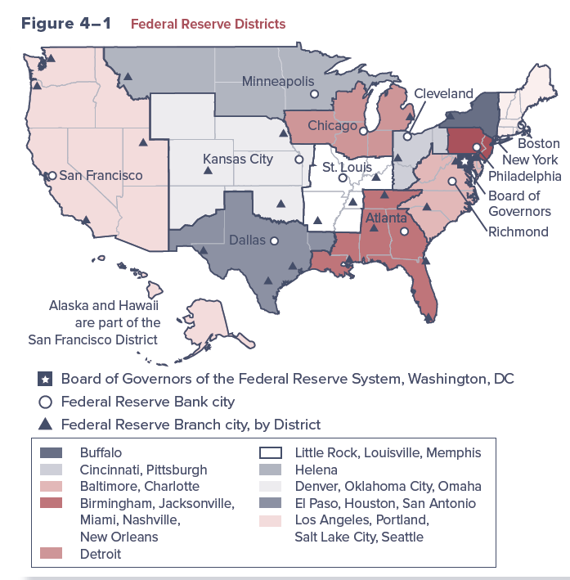
Federal Reserve Districts
4-4

Slide 5
Federal Open Market Committee (FOMC)
FOMC is the major monetary policy-making body of the Federal Reserve System
  Required to meet at least four times each year in Washington, D.C., but typically meet more often
  Main responsibilities are to formulate policies to promote full employment, economic growth, price stability, an da sustainable pattern of international trade
  Set guidelines regarding open market operations, the purchase and sale of U.S. government and federal agency securities, as the main policy tool to achieve monetary targets
  Beige Book summarizes information on current economic conditions by Federal Reserve district

Slide 6
Functions Performed by Federal Reserve Banks (FRBs)
Assistance in the conduct of monetary policy
  Set and change the discount rate
  Loans transacted through each FRBs discount window
Supervision and regulation
  Each FRB has supervisory and regulatory authority over the activities of state-chartered member banks and bank holding companies located in their districts
Consumer protection and community affairs
  Possess authority to implement federal laws intended to protect consumers in credit and other financial transactions
Government services
  Serves as the commercial bank for the U.S. Treasury

Slide 7
Functions Performed by Federal Reserve Banks (FRBs) (Continued)
New currency issue
  Responsible for the collection and replacement of currency (paper and coin) from circulation
Check clearing
  Operates a central check clearing system for U.S. banks, routing interbank checks to DIs on which they are written and transferring the appropriate funds from one bank to another
Wire transfer services
  FRBs and member banks are linked electronically through the Federal Reserve Communications System
Research services
  Each FRB uses professional economics to conduct research

Slide 8
Balance Sheet of the Federal Reserve
Liabilities
  Major liabilities on the Fed’s balance sheet are currency in circulation and reserves, the sum of which is referred to as the Fed’s monetary base or money base
  Total reserves can be classified into two categories:
    Required reserves are those the Fed requires banks to hold by law
    Excess reserves are additional over and above required reserves
Assets
  Major assets are Treasury and government agency (i.e., Fannie Mae, Freddie Mac) securities, Treasury currency, and gold and foreign exchange
  Interbank loans are a small portion of total assets, but they plan an important role in implementing monetary policy
Notes:
The Federal Reserve’s balance sheet has expanded and contracted over time.
During the 2007–2008 financial crisis and subsequent recession, total assets increased significantly from $951 billion in 2007 to $4.5 trillion in 2016, representing 377 percent growth.
Then, reflecting the FOMC’s balance sheet normalization program that took place between October 2017 and August 2019, total assets declined to $3.7 trillion in August 2019.
Beginning in September 2019, total assets started to increase.
By the end of 2021 Federal reserve’s total assets reached 8.91 trillion, more than double the level in late 2019.

Slide 9
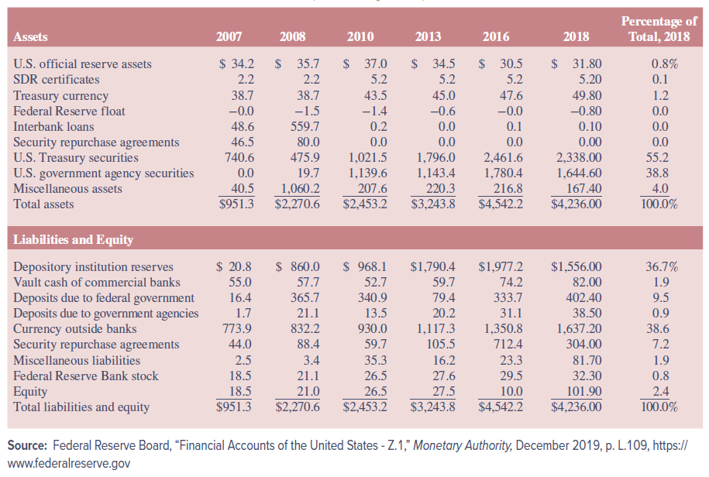
Balance Sheet of the Federal Reserve (Continued)

Slide 10
Monetary Policy Tools
Federal Reserve uses the following to implement monetary policy:
  Open market operations
  Discount rate
  Reserve requirements
Major link by which monetary policy impacts the macroeconomy occurs through the Federal Reserve influencing the market for bank reserves
Federal Reserve’s monetary policy seeks to influence either the demand for, or supply of, excess reserves at depository institutions and in turn the money supply and the level of interest rates

Slide 11
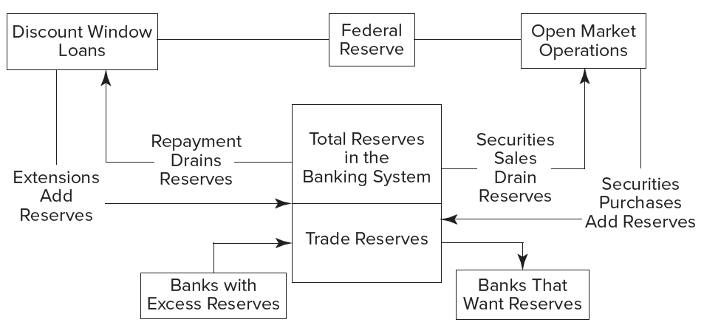
Federal Reserve Monetary Policy Activities

Slide 12
Monetary Policy Tools (Continued)
Depository institutions trade excess reserves held at their local Federal Reserve Banks among themselves
  Rate of interest (or price) on these interbank transactions is a benchmark interest rate, called the fed funds rate
Financial Services Regulatory Relief Act of 2006 authorized the Federal Reserve to pay interest on reserve balances
  Interest on excess reserves (IOER) and required reserves (IORR)
Federal Reserve can take one of two basic approaches to affect the market for banks’ excess reserves
  Target the quantity of reserves in the market
  Target the interest rate on those reserves (the fed funds rate)

Slide 13
Monetary Policy Tools:
Open Market Operations
Open market operations
  When a targeted monetary aggregate or interest rate level is determined by the FOMC, it is forwarded to the Federal Reserve Board Trading Desk at the Federal Reserve Bank of New York (FRBNY) through a statement called the policy directive
  Manager of Trading Desk uses policy directive to instruct traders on daily amount of open market purchases or sales to transact
Open market operations are the primary determinant of changes in bank excess reserves in the banking system
  Directly impact the size of the money supply and/or the level of interest rates (e.g., the fed funds rate)
Open market operations are primarily conducted using Treasury securities, but others can be used as well

Slide 14
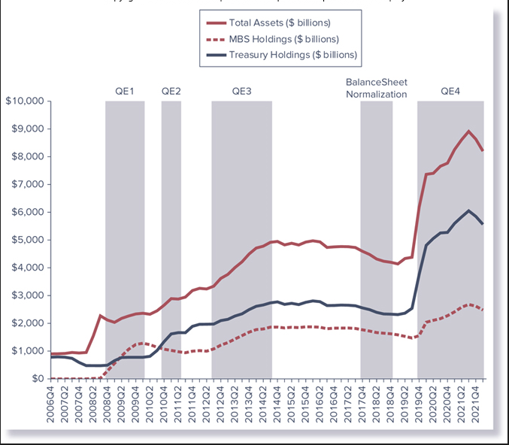
Federal Reserve’s Balance Sheet and Large-Scale Asset Purchases

Slide 15
Monetary Policy Tools:
Discount Rate
Recall, the discount rate is the rate of interest Federal Reserve Banks charge on loans to FIs in their district
  Raising the discount rate signals a desire to see a tightening of monetary conditions and higher interest rates in general
  Lowering the discount rate signals a desire to see more expansionary monetary conditions and lower interest rates in general
Federal Reserve has rarely used the discount rate as a monetary policy tool for the following reasons:
  It is difficult for the Fed to predict changes in bank discount window borrowing when the discount rate changes
  Because of its “signaling” importance, a discount rate change often has great effects on the financial markets
Notes:
For example, the unexpected decrease in the Fed’s discount rate (to 0.50 percent) on December 16, 2008, resulted in a 359.61 point increase in the Dow Jones Industrial Average, one of the largest one-day point gains in the history of the Dow and one of a handful of up days during the height of the financial crisis.

Slide 16
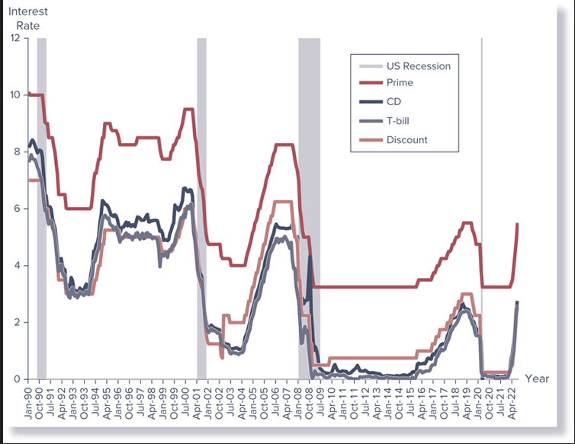
Various U.S. Interest Rates
Notes:
Figure 4–4 shows the correlation in four major U.S. interest rates (discount rate, prime rate [the rate banks charge to large corporations for short-term loans], three-month CD rate, and three-month T-bill rate) from January 1999 through August 2022.

Slide 17
Monetary Policy Tools:
Discount Rate (Continued)
Historically, discount window lending was limited to depository institutions (DIs) with severe liquidity needs
  Fed made changes to discount window lending that increased the cost of borrowing but eased the terms in January 2003
  Three lending programs are now offered through the Fed’s discount window:
    Primary credit is available to generally sound DIs on a very short-term basis, typically overnight, at a rate above the Federal Open Market Committee’s target rate for federal funds
    Secondary credit is available to meet backup liquidity needs when its use is consistent with a timely return to a reliance on market sources of funding or the orderly resolution of a troubled institution
    Seasonal credit is available to DIs that can demonstrate a clear pattern of recurring intrayearly swings in funding needs

Slide 18
Reserve Requirements
(Reserve Ratios)
Reserve requirements determine the minimum amount of reserve assets that DIs must maintain by law to back transaction deposit accounts held as liabilities on their balance sheets
  Requirement is usually set as a ratio of transaction accounts
  Very rarely used by the Federal Reserve as a monetary policy tool
A(n) decrease (increase) in the reserve requirement ratio means that DIs may hold fewer (must hold more) reserves against their transaction accounts, allowing them to lend out a greater (smaller) percentage of their deposits and increasing (decreasing) credit availability in the economy

Slide 19
Reserve Requirements
(Reserve Ratios) (Continued)
Decrease in the reserve requirement results in a multiplier increase in the supply of bank deposits and thus the money supply
  Multiplier effect:
Increase in the reserve requirement results in a multiple contraction in deposits and a decrease in the money supply
  Multiplier effect:

Slide 20
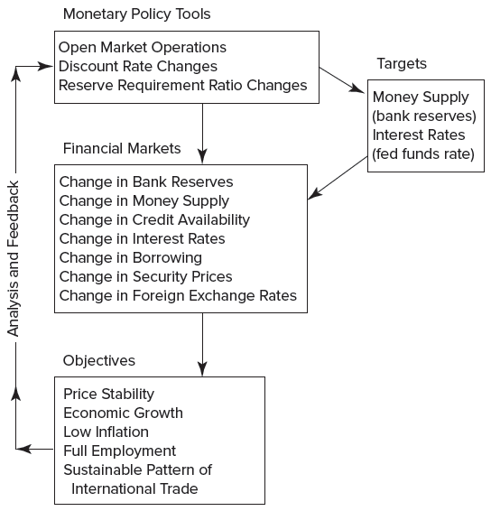
The Process of Monetary Policy Implementation
Notes:
The Federal Reserve takes steps to influence monetary conditions—the money supply, credit availability, interest rates, and ultimately security prices—so it can promote price stability (low inflation) and other macroeconomic objectives.

Slide 21
Effects of Monetary Tools on Various Economic Variables
Expansionary Activities
Contractionary Activities
Open market purchases of securities
  All else constant, reserve accounts of banks increase
Discount rate decreases
  All else constant, interest rates in the economy decrease
Reserve requirement ratio decreases
  All else constant, bank reserves increase
Open market sales of securities
  All else constant, reserve accounts of banks decrease
Discount rate increases
  All else constant, interest rates in the open market increase
Reserve requirement ratio increases
  All else constant, bank reserves decrease
4-21

Slide 22
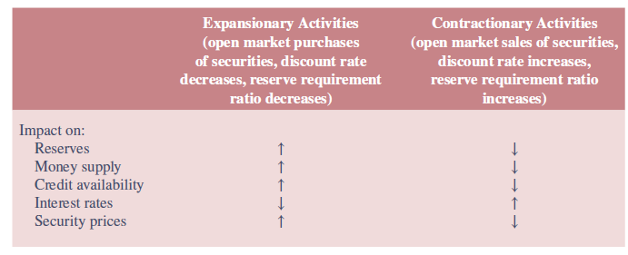
The Impact of Monetary Policy on Various Economic Variables
4-22

Slide 23
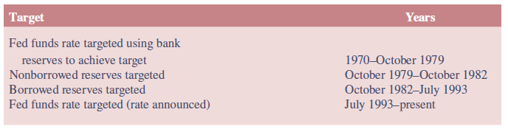
Money Supply versus Interest Rate Targeting
Federal Reserve can successfully target only one of these two variables (money supply or interest rates) at any one moment
  If the money supply is the target variable used to implement monetary policy, interest rates must be allowed to fluctuate relatively freely
  If an interest rate (e.g., fed funds rate) is the target, bank reserves and the money supply must be allowed to fluctuate relatively freely
Notes:
Table 4–8 shows how the Federal Reserve has varied between its use of the money supply and interest rates as the target variable used to control economic activity in the United States.

Slide 24
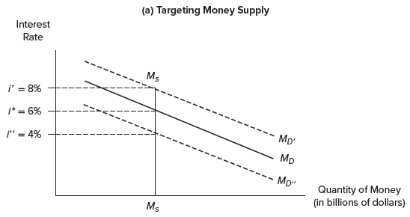
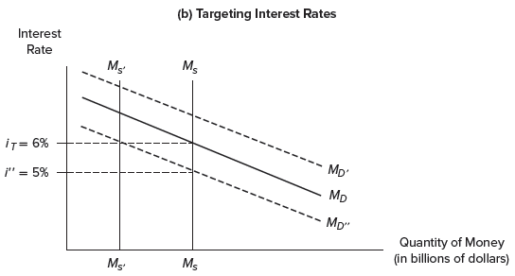
Federal Reserve Monetary Policy Targets
4-24
Notes:
Panel a of Figure 4–7 illustrates the targeting of money supply, while Panel b of Figure 4–7 shows the targeting of interest rates.

Slide 25
Money Supply versus Interest Rate Targeting (Continued)
Fed announced that it would use interest rates—the federal funds rate—as the main target variable to conduct monetary policy in 1993
  Guiding principle used by the Fed to set short-term interest rates is the Taylor rule, which states short-term interest rates should be determined by three conditions:
    Where actual inflation is relative to the Fed’s targeted level
    The extent to which the economy is above or below its full employment level
    What short-term interest rates should be to achieve full employment
  Under the current regime, the Fed simply announces whether the federal funds rate target has been increased, decreased, or left unchanged after every monthly FOMC meeting
Notes:
Although the Fed does not follow the Taylor rule unequivocally in conducting monetary policy, the rule closely describes how monetary policy actually has been conducted since 1993.

Slide 26
International Monetary Policies and Strategies
Central banks guide the monetary policy in virtually all countries
Independence of a central bank generally means that the bank is free from pressure from politicians who may attempt to enhance economic activity in the short term at the expense of long-term economic growth
  Other independent central banks, like the Federal Reserve:
    European Central Bank (ECB) is the central bank for the EU
    Bank of England is the central bank of the UK
  Banks with less independence:
    People’s Bank of China
    Reserve Bank of India
    Central Bank of Brazil

Slide 27
Systemwide Rescue Programs Employed during the Financial Crisis
Expansion of retail deposit insurance was widely used during the crisis to ensure continued access to deposit funding
Capital injections by central governments were the main mechanism used to directly support bank balance sheets
Debt guarantees allowed banks to maintain access to reasonably priced, medium-term funding.
  They also reduced liquidity risk and lowered overall borrowing costs for banks
Asset purchases/guarantees removed distressed assets from bank balance sheets
Notes:
At the heart of the efforts were 11 countries, which accounted for the bulk of the rescue programs: Australia, Canada, France, Germany, Italy, Japan, the Netherlands, Spain, Switzerland, the United Kingdom, and the United States.

Slide 28
Challenges following the Global Financial Crisis
While the worst of the financial crisis subsided in the U.S. in the last half of 2009, throughout the spring of 2010 Greece struggled with a severe debt crisis
  Problems in the Greek bond market then spread to other European nations with fiscal problems, such as Portugal, Spain, and Italy
  In August 2018, Greece exited the third bailout program
  In total, Greece now owes the EU and IMF roughly $330 billion, part of a public debt that has climbed to 180 percent of GDP

Slide 29
Challenges following the Global Financial Crisis (Continued)
Challenges to central banks became even bigger in June 2016 when the people of the United Kingdom voted to leave the EU after 43 years (i.e., Brexit)
  The pound fell more than 11 percent to its lowest point since 1985
  The DJIA dropped 610.32 points, or 3.4 percent
  The Stoxx Europe 600 index fell 7 percent, its steepest drop since 2008
  Japan’s Nikkei Stock Average declined 7.9 percent
Bank of England (BoE) unveiled a four-point plan to prevent a post-Brexit recession
  In August 2016, the BoE cut interest rates for the first time in more than seven years to a new record low of 0.25 percent

