Slide 1
CHAPTER1 : AN OVERVİEW OF HEALTHCARE MANAGEMENT
Jon M. Thompson, Sharon Buchbinder, and Nancy Shanks

Slide 2
Learning objectives
Define healthcare management and the role of the healthcare managers
Differentiate among the functions,roles and responsibilities of healthcare managers.
Compare and contrast the key competencies of healthcare managers
Identify current areas ıf research in healthcare management.

Slide 3
Care settings;
Direct : those organizations that provide care directly to a patient, client, residence who seeks services from the organization.
Non-direct: are not directly involved in providing care to persons needing health services, but rather support the care of individuals through products and services made availabe to direct care settings.

Slide 4
Health care Management;
is the profession that provides leadership and direction to organizations that deliver personal health services to divisions, departments units or services within those organization. HCM provides significant rewards and personal satisfaction for those who want to make a difference in the lives of others.

Slide 5
Healthcare organizations
Are complex and dynamic
The nature of organization requires that managers provide leadership, as well as the supervision and coordination of employees.
In healthcare organizations (HCO) the scope and complexity of tasks carried out in provision of services are so great that individual staff operating on their own could not get the job done.
The necessary task in producing services, in HCO requires the coordination of many highly specialized disciplines that must work together seamlessly.

Slide 6
Healthcare managers;
Are appointed to positions of authority, where they shape the organization by making important decisions.
recruitment and development of the staff,
Acquisition of the technology,
Service additions and reductions
Allocation and spending of financial resources.
Decisions made by an individual manager impact the organization’s overall performance.

Slide 7
Managers must contain two domain;
External domain: refers to the influences, resources, and activities that exist outside the boundary of organization but that significantly affect the organization.
Internal domain: refers to those areas of focus that managers need to address on a daily basis, such as ensuring the appropriate number and types of staff, financial performance and quality of care.

Slide 8
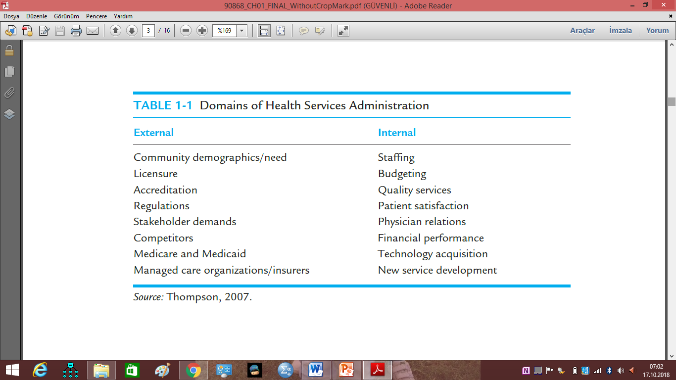
Domains of Health Services

Slide 9
Management: definions, functions, and competencies
Management: the process, comprised of social and technical functions and activities, occurring within organizations for the purpose of accomplishing predetermined objectives through human and other resources.
Managers work through desired objectives of the organization.
Manager is anyone in the organization who supports and is responsible for the work performance of one or more other persons.

Slide 10
The 8 key attributes of a great healthcare manager?
They know the details of the job, but do not get too bogged down in them. The healthcare business has a great deal of details that must be followed to be successful. These details are processes, technical requirements, payer relationships, customer relationships, and workflow. At any given time have a lot of balls in the air. Knowing how to quickly problem solve and delegate is an important aspect of middle management.
They have an excellent work ethic – they are consistently at work on time, and work steadily throughout the day at meaningful tasks. (This may sound obvious……sadly, it is not)
They are good listeners–less focused on imposing their own will than on hearing what others had to say. The ability to listen, actively listen and participate in employee concerns will bring loyalty and attention.

Slide 11
They are perceptive – able to understand the sometimes subtle issues their direct reports are daily encountering. Being able to know the jobs others are performing helps them to not only set realistic expectations, but also anticipate when they may need additional help or resources.
They are open communicators – approachable, candid, easy to talk to and available when needed. This skill cannot be over-estimated. The single complaint most often heard from employees is their managers is too busy to listen.
They possess a calm demeanor – Whether it is a patient or a volume issue, or the provider is behind…or any other number of routine daily stresses, a practice is a stressful place. A really good manager remains calm and knows how to calm others in stressful situations.

Slide 12
https://www.medmgtservices.com/8-qualities-healthcare-manager/
They are genuinely concerned about their direct reports’ well-being -men and women of integrity who care about their employees and can be trusted to keep their word. Integrity is not an old-fashioned word or concept. It is the essence of success.
They communicate a bold, specific and consistent vision. The vision may come from upper management, but they understand it, totally buy into it and can communicate it by word and deed to employees

Slide 13
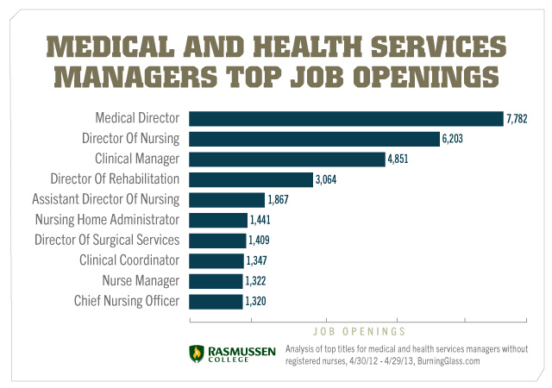

Slide 14
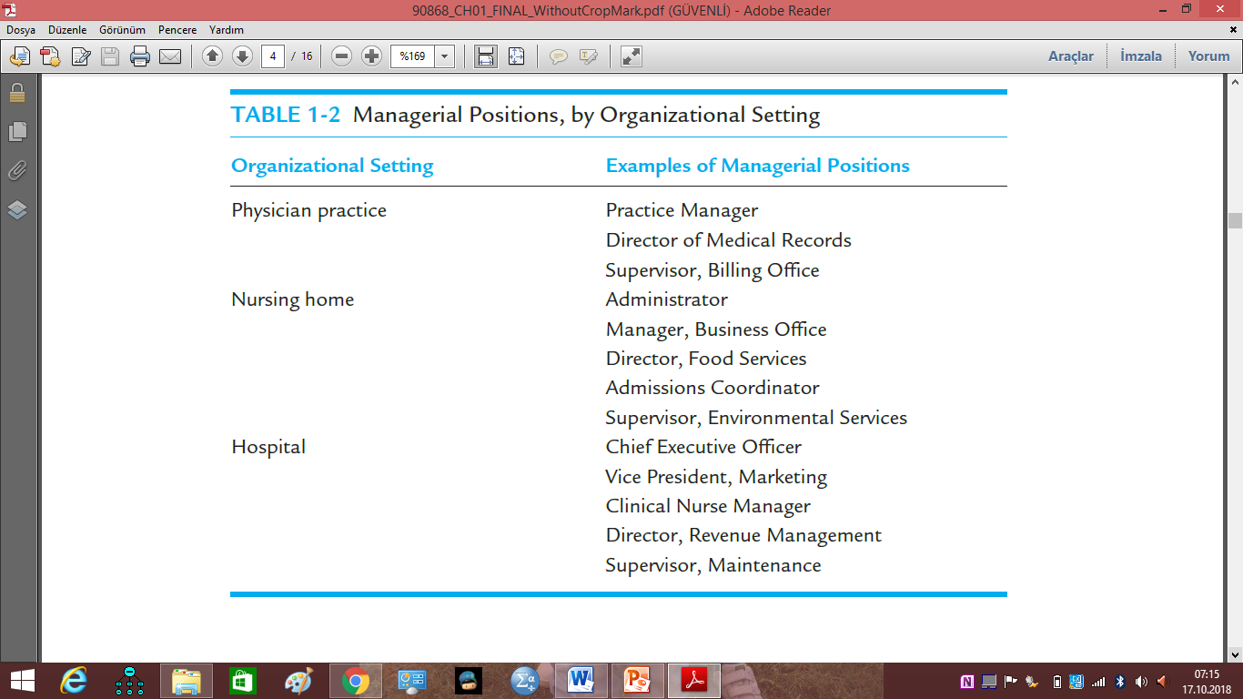
Managerial positions in healthcare

Slide 15
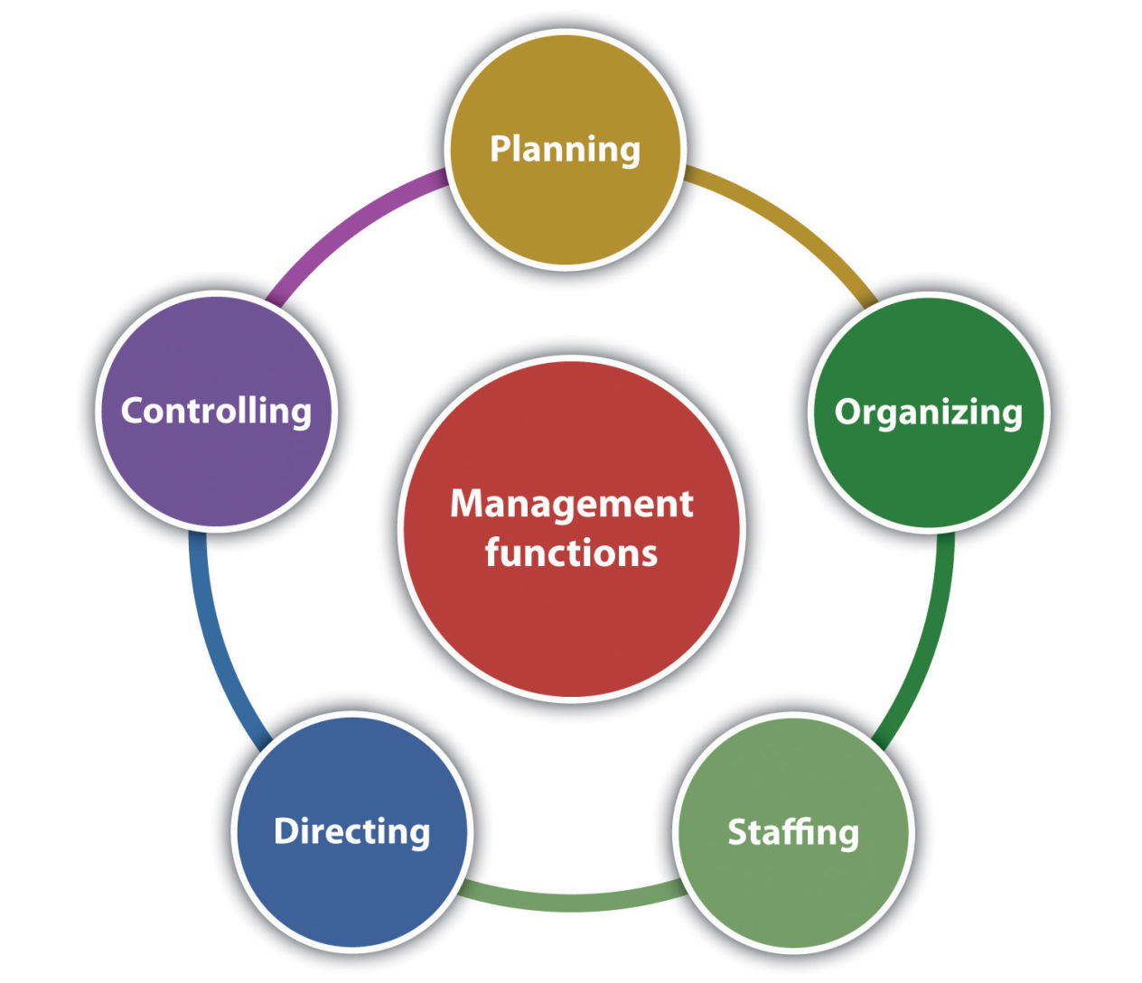
Management functions

Slide 16
Functions..
Planning: requires the manager to set a direction and determine what needs to be accomplished. İt means setting priorities and determining performance targets.
Organizing: refers the overall design of the organization or the specific divison,unit.

Slide 17
Functions..
Staffing: refers to acquiring and retainnig human resources.
Controlling: refers to monitoring staff activities and performance , making the appropriate actions for corrective action to increase performance
Directing: the focus is on initiating action in the organization through effective leadership and motivation of, and communication with, subordinates.
Decision making: is critical to all of the aforementioned management functions and means making effective decisions based on consideration of benefits and the drawbacks of alternatives.

Slide 18
Katz (1974) identifies key competencies for managers:
Conceptual skills: the ability to critically analyze and solve complex problems. For instance, a manager conducts an analysis of the best way to provide a service or determines a strategy to reduce patient complaints, regarding food service.
Technical Skills: that reflect expertise or ability to perform a specific work task. Example: a manager develops and implements a new incentive compensation program for staff or designs and implements modifications to a computer based staffing model.
Interpersonal skills: that enable a manager to communicate with and work well with other individuals, regardless of whether they ae peers, supervisors, or subordinates.

Slide 19
Hierarchy and Control
Management positions exist at lower levels, middle-management levels, and upper levels, i.e., senior management.
Hierarchy of management means that authority, or power, is delegated downward in the organization, and that lower-level managers have less authority than higher-level managers whose scope of responsibility is much greater.

Slide 20
Vertical Structure
Size and complexity of the specific health services organization will dictate the particular structure.
Larger organizations—such as large community hospitals, hospital systems, and academic medical centers—will likely have deep vertical structures reflecting varying levels of administrative control for the organization.

Slide 21
Matrix Structure
These include team-based models and service line management models.
The matrix model recognizes:
  that a strict functional structure may limit the organization’s flexibility to carry out the work, and
  that the expertise of other disciplines is needed on a continuous basis.

Slide 22
Matrix Examples
Team: functional staff, such as nursing and rehabilitation personnel, are assigned to a specific program such as geriatrics and report for programmatic purposes to the program director of geriatrics.
Service Line: manager heads a specific clinical service line (e.g., cardiology) with accountability for staffing, resource acquisition, budget, and financial control.

Slide 23
Focus of Management
Self Management: the individual manager must be able to effectively manage himself or herself, as well as time, information, space, and materials; being responsive and following through with peers, supervisors, and clients.
Maintaining a positive attitude and high motivation; developing and applying appropriate skills and competencies.

Slide 24
Unit/Team Management
The expertise of the manager at this level involves managing others in terms of effectively completing the work through task interdependence.
Includes assigning work tasks, review and modification of assignments, monitoring and review of individual performance, and carrying out the management functions described previously.

Slide 25
Organizational Management
Managers must work together as part of the larger organization to ensure organization-wide performance and organizational viability.
Success of the organization depends upon the success of its individual parts, and effective collaboration is needed to ensure that this occurs.

Slide 26
Talent Management
Recruitment, retention, training, and development of highly skilled employees is critical to health care organizations.
Health care organizations compete with each other for the brightest and the best talent.
Managers look for and keep the talent!

Slide 27
Organizational Culture, Values, Mission, and Vision
Organizational culture: the beliefs, attitudes, and behaviors that are shared among organizational members.
Values: principles the organization believes in that guide activities.
Mission: the organization’s purpose.
Vision: a desired future state describing what the HSO will be recognized and known for.

Slide 28
Ensuring High Performance
High-performance organizations are results oriented.
One framework has pillars of excellence for the specific goals of the organization: people (employees, patients and physicians), service, quality, finance, and growth (Studer, 2003).

Slide 29
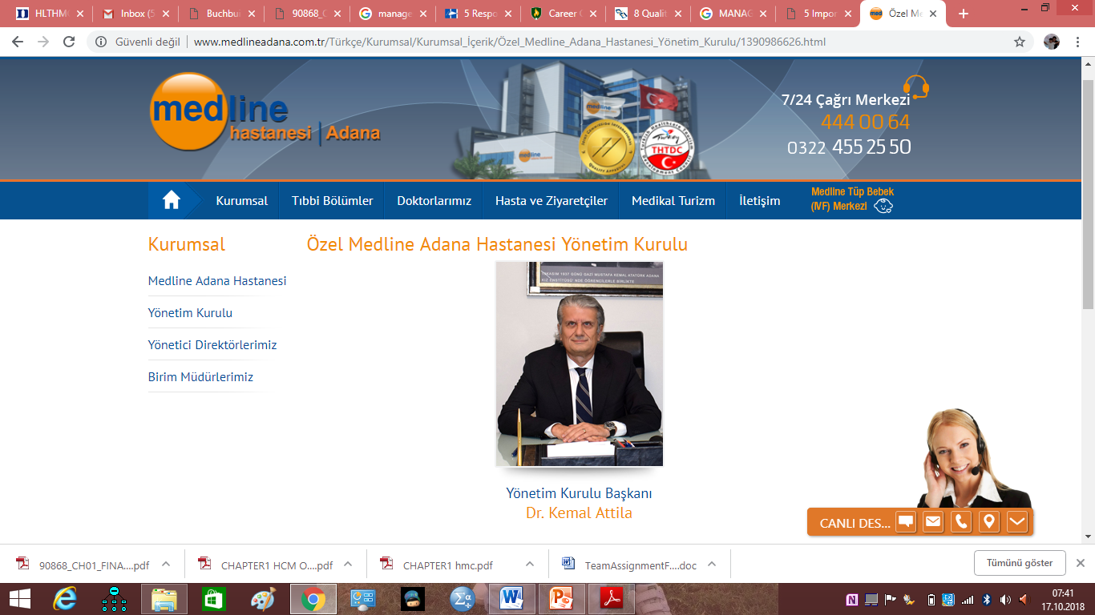
http://www.medlineadana.com.tr/T%C3%BCrk%C3%A7e/Kurumsal/Kurumsal_%C4%B0%C3%A7erik/%C3%96zel_Medline_Adana_Hastanesi_Y%C3%B6netim_Kurulu/1390986626.html

Slide 30
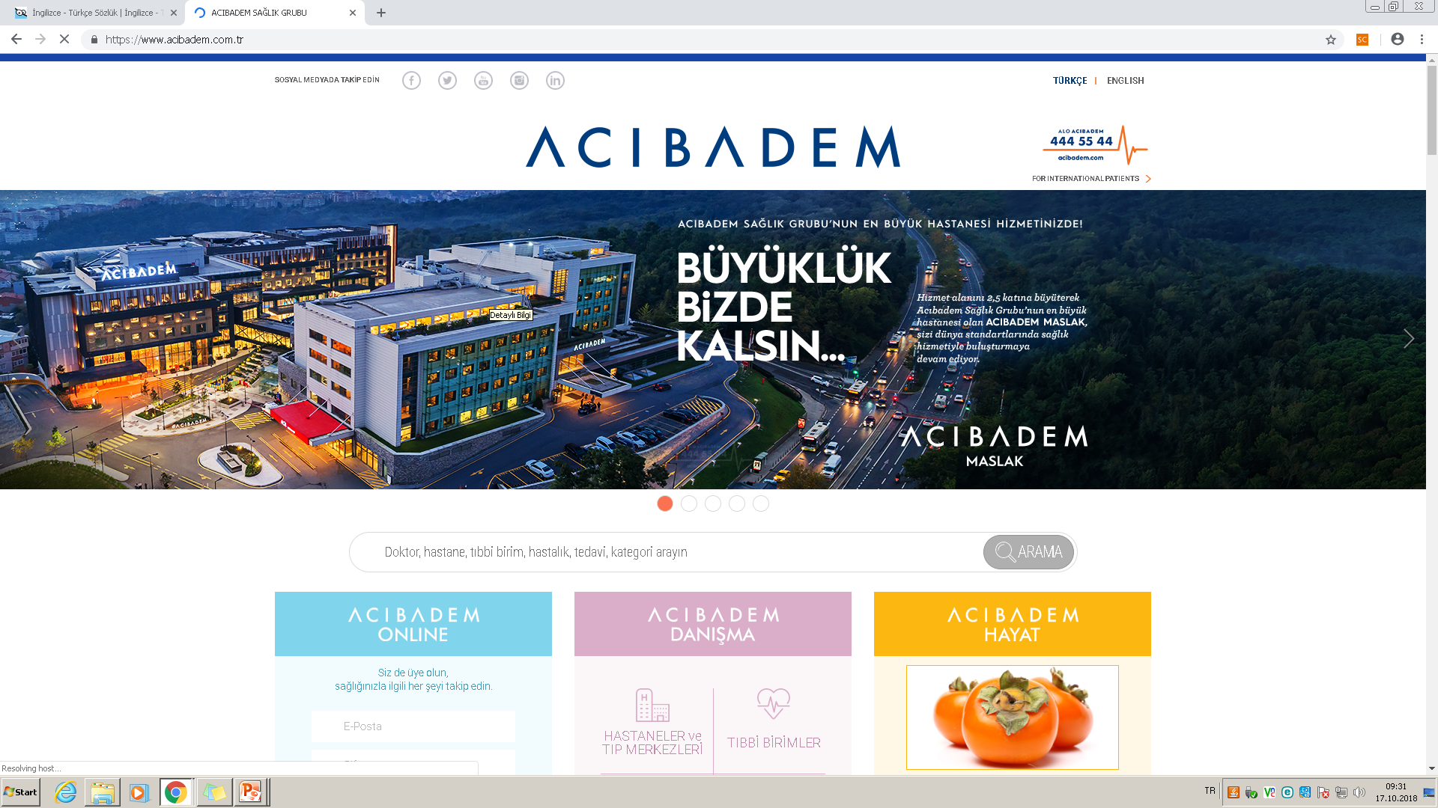

Slide 31
