Slide 1
Depository Institutions: Banks and Bank Management

Slide 2
Learning Objectives
Describe a commercial bank’s assets and liabilities.
Define bank capital and key measures of bank profits and returns.
Identify the type and sources of bank risk and explain how to control them.

Slide 3
Introduction
Most people use the word bank to describe a depository institution.
There are depository and non-depository institutions that differ by their primary source of funds - the liability side of their balance sheet.
Depository institutions include
  Commercial banks, savings and loans, and credit unions.

Slide 4
The Balance Sheet of Commercial Banks
Commercials banks are institutions established to provide banking services to businesses, allowing them to deposit funds safely and to borrow them when necessary.
Total bank assets equal total bank liabilities plus bank capital.
Banks obtain funds from individual depositors and businesses, as well as by borrowing from other financial institutions in financial markets.

Slide 5
The Balance Sheet of Commercial Banks
The difference between a bank’s assets and liabilities is the bank’s capital, or net worth.
  Net worth is the value of the bank to its owners.
A bank’s profits come from both service fees and from the difference between what it pays for its liabilities and the return it receives on its assets.

Slide 6
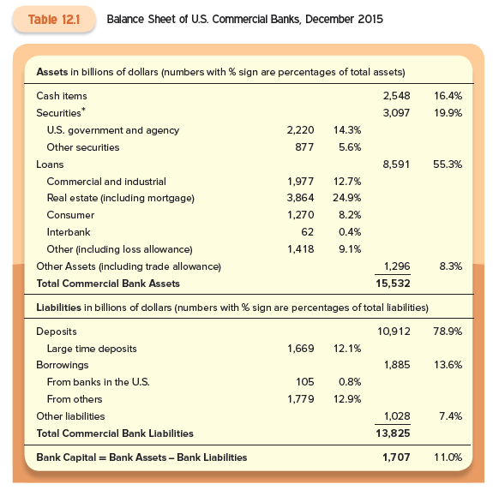

Slide 7
Assets: Uses of Funds
The asset side of the balance sheet shows what banks do with the funds they raise.
Assets are divided into four broad categories:
  Cash
  Securities
  Loans
  All other assets

Slide 8
Cash Items
Cash asset are of three types:
Reserves - the most important.
  Regulations require a certain percent of cash held in reserves.
  Include the cash in the bank’s vault, vault cash, and bank’s deposits at the Federal Reserve System.
  Cash is the most liquid of the bank’s assets.
Cash items in process of collection.
  The uncollected funds from checks.

Slide 9
Cash Items
Balances of the accounts that banks hold at other banks.
  Small banks have accounts at large banks - correspondent bank deposits.
In December 2015, banks held more than 16% of their assets in cash.
Up until the financial crisis of 2007-2009, banks held about 3%.
Banks want to minimize cash holdings because they earn less on cash.

Slide 10
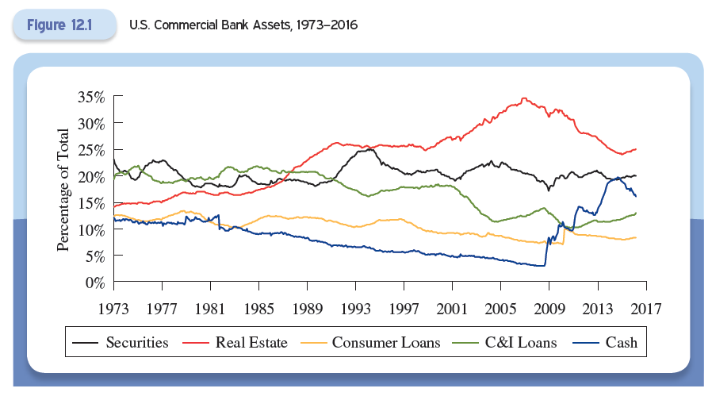
U.S. Commercial Bank Assets

Slide 11
Securities
Securities are the second largest component of bank assets.
Banks cannot hold stocks, so these are only bonds.
They are split between:
  U.S. government and agency securities (14.3% of assets), and
  Other securities (state and local government bonds) (5.6% of assets).

Slide 12
Securities
About half of all securities are mortgage-backed.
A sizeable portion are very liquid - can be sold quickly if the bank needs cash.
  Securities are therefore sometimes referred to as secondary reserves.
The share of securities in banks assets has varied around 20% from 1973 to 2016.

Slide 13
Loans
Loans are the primary assets of modern commercial banks, accounting for well over one-half of assets.
Loans can be divided into five categories:
  Business loans called commercial and industrial (C&I) loans;
  Real estate loans, including both home and commercial mortgages and home equity loans;
  Consumer loans, like auto and credit card loans;
  Interbank loans; and
  Other types, including loans for the purchase of other securities.

Slide 14
Loans
The different loan types differ in their liquidity.
The primary difference in various kinds of depository institutions is their composition of loan portfolios.
  Commercial banks make loans primarily to businesses.
  Savings and loans provide mortgages to individuals.
  Credit unions specialize in consumer loans.

Slide 15
Loans
Prior to the financial crisis, commercial banks became more involved in the real estate.
  The rise of the commercial paper market made securities debt finance more convenient for large firms.
  The creation of mortgage-backed securities (MBS) meant that banks could sell the mortgage loans they made, which reduced the risk of illiquid assets.
Since the financial crisis, banks seem to have reduced their real estate exposure.

Slide 16
Liabilities: Sources of Funds
Banks get funds from savers and from borrowing in the financial markets.
There are two types of deposit accounts:
  Transaction accounts (checkable deposits)
  Nontransaction accounts.

Slide 17
Checkable Deposits
Demand deposits make up the largest component of checkable deposits.
Financial innovation has reduced the importance of checkable deposits in the day-to-day business of banking.
  Checkable deposits plummeted from 40% of total liabilities in the 1970s to about 17 percent at the end of 2015.
  They have a low return for consumers
  Traditional checking accounts are no longer the principal source of bank funds

Slide 18

When choosing a bank, make sure to ask questions.
  What are the fees?
  How easily can I reach a person?
  How is the customer service?
And if choosing an internet bank, make sure they are a U.S. bank and are FDIC insured.

Slide 19
Nontransaction Deposits
In December 2015 nontransaction deposits accounted for more than half of fall commercial bank liabilities.
  Savings deposits were popular for may decades, but less so today.
  Time deposits are certificates of deposit (CDs) with a fixed maturity.
    Large CDs are greater than $100,000 in face value and are negotiable - they can be bought and sold in financial markets.
    Large CDs have an important role in bank financing

Slide 20
Borrowings
Borrowing is the second most important source of bank funds.
  Accounts for somewhat less than 15% of bank liabilities.
Banks can borrow by:
  Borrowing from the Federal Reserve, which is rare
  Borrowing from other banks

Slide 21
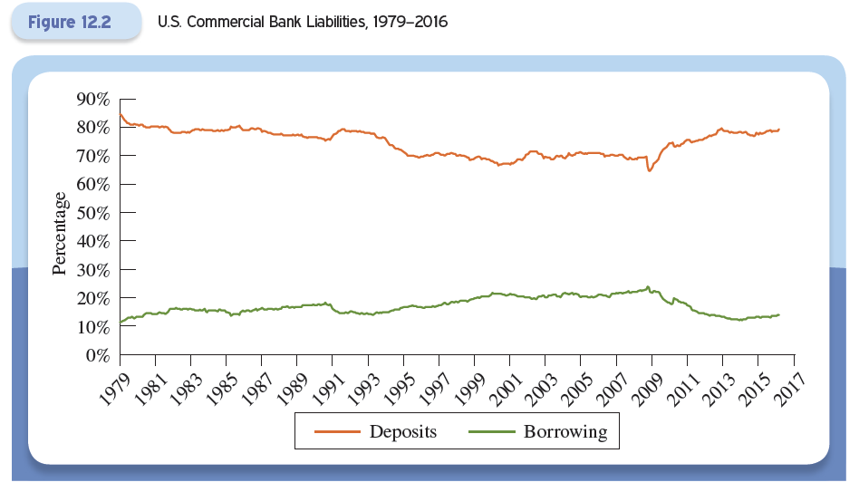
U.S. Commercial Bank Liabilities

Slide 22
Borrowings
Banks with excess reserves will lend their surplus funds to banks that need them though an interbank market called the federal funds market.
  The lending bank must trust the borrowing bank as these loans are unsecured.
Commercial banks also borrow from foreign banks and government-sponsored enterprises.

Slide 23
Borrowings
Banks finally can borrow using an instrument called a repurchase agreement, or repo.
  A short-term collateralized loan in which a security is exchanged for cash.
  The parties agree to reverse the transaction on a specific future date, typicaly the next day.

Slide 24
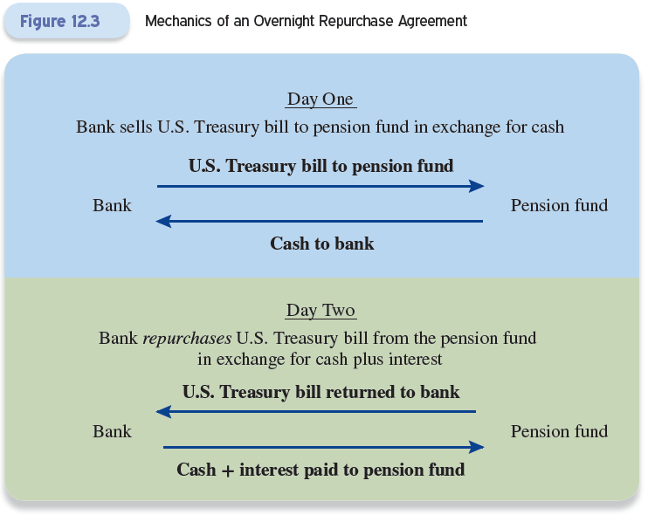
© 2017 McGraw-Hill Education. All Rights Reserved.

Slide 25
Bank Capital and Profitability
Net worth is referred to as bank capital, or equity capital.
We can think of capital as the owners’ stake in the bank.
Capital is the cushion banks have against a sudden drop in the value of their assets or an unexpected withdrawal of liabilities.
  It provides some insurance against insolvency.

Slide 26
Bank Capital and Profitability
An important component of bank capital is loan loss reserves:
  Loan loss reserves are an amount the bank sets aside to cover potential losses from defaulted loans.
At some point the bank gives up hope a loan will be repaid and it is written off, or erased from the bank’s balance sheet.
At this point, the loan loss reserve is reduced by the amount of the loan that has defaulted.

Slide 27

Bank Capital and Profitability
There are several measures of bank profitability.
Return on assets (ROA)
  ROA is the bank’s net profit left after taxes divided by the bank’s total assets.
  It is a measure of how efficiently a particular banks uses its assets.
  This is less important to bank owners than the return on their own investment.

Slide 28
Bank Capital and Profitability
The bank’s return to its owners is measured by the return on equity (ROE).
  This is the bank’s net profit after taxes divided by the bank’s capital.
ROA and ROE are related to leverage.
One measure of leverage is the ratio of banks assets to bank capital.
Multiplying ROA by this ratio yields ROE.

Slide 29
Bank Capital and Profitability

Slide 30
Bank Capital and Profitability
Prior to the financial crisis of 2007-2009, the typical U.S. bank has a ROA of about 1.3%.
For large banks, the ROE tends to be higher than for small banks, suggesting greater leverage, a riskier mix of assets, or the existence of significant economies to scale in banking.
  The poor performance during the crisis and moderate returns after, suggests their high returns were at least partly due to more leverage or a riskier mix of assets.

Slide 31
Bank Capital and Profitability
The final measure of bank profitability is net interest income.
  This is related to the fact that banks pay interest on their liabilities and receive interest on their assets.
    Deposits and bank borrowing rate interest expenses; securities and loans generate interest income.
  The difference between the two is net interest income.

Slide 32
Bank Capital and Profitability
Net interest income can also be expressed as a percentage of total assets to yield: net interest margin.
  This is the bank’s interest rate spread - the weighted average difference between the interest rate received on assets and the interest rate paid for liabilities.
Well-run banks have a high net interest income and a high net interest margin.
  If a bank’s net interest margin is currently improving, its profitability is likely to improve in the future.

Slide 33

It is safe to assume that depository institutions will be with us for some time.
There are three basic types of depository institutions: commercial banks, savings institutions, and credit unions.
Not all these depository institutions are likely to survive the financial innovations and economic upheaval of the coming decades.

Slide 34

In 2008, as the global economy tanked, China sought to boost domestic demand by relaxing the supply of credit (shadow banking)
  To fund the credit expansion, regulators allowed banks to offer new products that were like short-term deposits but with higher interest rates—often in excess of 10 percent
The rise of shadow banking constituted backdoor financial liberation

Slide 35
Off-Balance-Sheet Activities
To generate fees, banks engage in numerous off-balance-sheet activities.
Lines of credit - similar to limits on credit cards.
  The firm pays a bank a fee in return for the ability to borrow whenever necessary.
  The payment is made when the agreement is signed and firm receives a loan commitment.
  When the firm has drawn down the line of credit, the transaction appears on the bank’s balance sheet.

Slide 36
Off-Balance-Sheet Activities
Letters of credit
  These guarantee that a customer of the bank will be able to make a promised payment.
  Customer might request that the bank send a commercial letter of credit to an exporter in another country guaranteeing payment for the goods on receipt.
  In return for taking this risk, the bank receives a fee.

Slide 37
Off-Balance-Sheet Activities
Standby letter of credit
  Standby letters of credit are letters issued to firms and governments that wish to borrow in the financial markets
  They act as a form of insurance.
These activities expose a bank to risk that is not readily apparent on their balance sheet.
By allowing for the transfer of risk, modern financial instruments enable individual institutions to concentrate risk in ways that are very difficult for outsiders to discern.

Slide 38

Small stores act as financial intermediaries to provide loans to people who cannot borrow from mainstream financial institutions.
The most common type of loan is a payday loan.
They are very expensive and appeal only to those who cannot get credit elsewhere.
Laws are changing to rein in payday lending practices

Slide 39
Bank Risk: Where It Comes from and What to Do about It
The bank’s goal is to make a profit in each of its lines of business.
  They want to pay less for the deposits they receive than for the loans they make and the securities they buy.
In the process of doing this, the bank is exposed to a host of risks:
  Liquidity risk
  Credit risk
  Interest-rate risk
  Trading risk

Slide 40
Liquidity Risk
Liquidity risk is the risk of a sudden demand for liquid funds.
Banks face liquidity risk on both sides of their balance sheets.
  Deposit withdrawal is a liability-side risk.
  Things like lines of credit are an asset-side risk.
Even if a bank has a positive net worth, illiquidity can still drive it out of business.

Slide 41
Liquidity Risk
In the past, the common way to manage liquidity risk was to hold excess reserves.
  This is a passive way to manage liquidity risk.
  Holding excess reserves is expensive, because it means forgoing higher rates of interest than can be earned with loans or securities.
There are two other ways to manage liquidity risk.
  The bank can adjust its assets or its liabilities.

Slide 42
Liquidity Risk
On the asset side a bank has several options.
The easiest option is to sell a portion of its securities portfolio.
  Most are U.S. treasuries and can be sold quickly at relatively low cost.
  Banks that are particularly concerned about liquidity risk can structure their securities holdings to facilitate such sales.

Slide 43
Liquidity Risk
A second possibility is for the bank to sell some of its loans to another banks.
  Banks generally make sure that a portion of the loans they hold are marketable for this purpose.
Another way is to refuse to renew a customer loan that has come due.
  However this is bad for business.
    The bank can lose a good customer.
    Reducing assets lowers profitability.

Slide 44
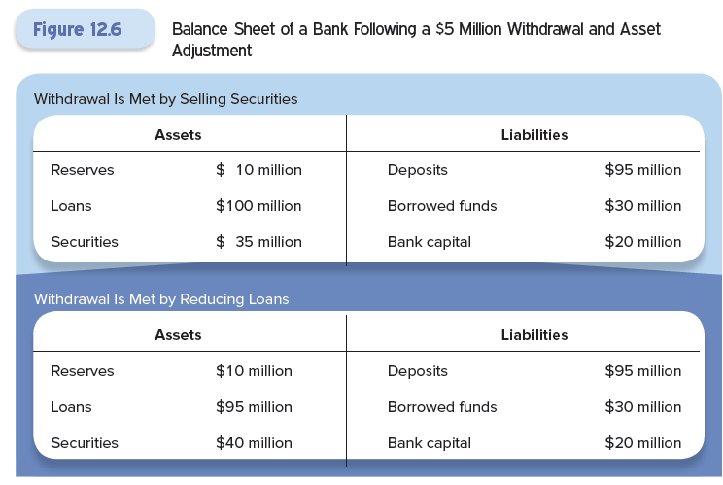

Slide 45
Liquidity Risk
Bankers prefer to use liability management to address liquidity risk.
Banks can borrow to meet any shortfall either from the Fed or from another bank.
The bank can attract additional deposits.
  This is where large certificates of deposits are valuable:
    They allow banks to manage their liquidity risk without changing the asset side of their balance sheet.

Slide 46
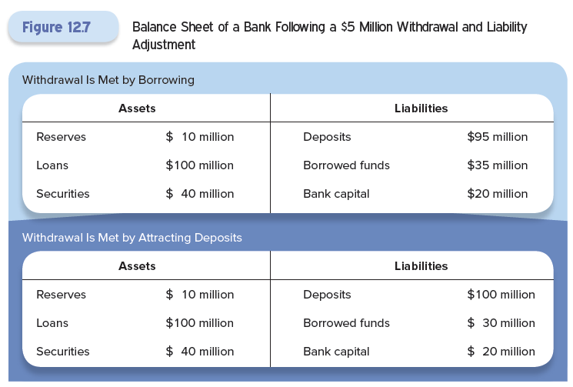

Slide 47
Liquidity Risk
In the financial crisis of 2007-2009, banks could neither sell their illiquid assets nor obtain funding at a reasonable cost to hold those assets.
When the interbank lending and wholesale money markets dried up, many banks faced a threat to their survival.

Slide 48
Credit Risk
Credit risk is the risk that a bank’s loans will not be repaid.
Banks use a variety of tools to manage credit risk:
Diversification, where banks make a variety of different loans to spread the risk.
Credit risk analysis, where the bank examines the borrower’s credit history to determine the appropriate interest rate to change.

Slide 49
Credit Risk
Diversification can be difficult for banks, especially if they focus on a certain type of lending.
  If a bank lends in only one geographic area or one industry, it is exposed to economic downturns that are local or industry-specific.
  It is important that banks find a way to hedge these risks.

Slide 50
Credit Risk
Credit risk analysis uses a combination of statistical models and information that is specific to the loan applicant
  The result is an assessment of the likelihood that a particular borrower will default.
In the financial crisis of 2007-2009, banks underestimated the risks associated with mortgage and other household credit.

Slide 51
Interest-Rate Risk
A bank’s liabilities tend to be short-term, while assets tend to be long term.
  The mismatch between the two sides of the balance sheet create interest-rate risk.
When interest rates rise, banks face the risk that the value of their assets will fall more than the value of their liabilities, reducing the bank’s capital.
  Rising interest rates reduce revenues relative to expenses, directly lowering a bank’s profits.

Slide 52
Interest-Rate Risk
The term interest-rate sensitive means that a change in interest rates will change the revenue produced by an asset.
For a bank to make a profit, the interest rate on its liabilities must be lower than the interest rate on its assets.
  The difference in the two rates is the bank’s net interest margin.
When a bank’s liabilities are more interest-rate sensitive than its assets, an increase in interest rates will cut into the bank’s profits.

Slide 53
Interest-Rate Risk
The first step in managing interest-rate risk is to determine how sensitive the bank’s balance sheet is to a change in interest rates.
Managers must compute an estimate of the change in the bank’s profit for each one-percentage-point change in the interest rate.
This procedure is called gap analysis.
  This can be refined to take account of differences in the maturity of assets and liabilities, but it gets complicated.

Slide 54
Interest-Rate Risk
Bank managers can use a number of tools to manage interest-rate risk.
They can match the interest-rate sensitivity of assets with that of liabilities.
  Although this decreases interest-rate risk, it increases credit risk.
Alternatives include the use of derivatives, specifically interest-rate swaps.

Slide 55

A bank’s capital is its net worth - a cushion against many risks, including market risk.
  Market risk is the decline in the market value of assets.
The larger a bank’s capital cushion, the less likely it will be made insolvent by an adverse surprise.
In the financial crisis of 2007-2009, banks were too leveraged - they had too many assets for each unit of capital.

Slide 56
Mark-to-market accounting rules require banks to adjust the recorded value of the assets on their balance sheets when the market value changes.
  When the price falls, the value is “written down” and writedowns reduce a bank’s capital.
Banks don’t like to hold a large capital cushion because capital is costly.
The more leverage the greater the possible reward for each unit of capital and the greater the risk.

Slide 57
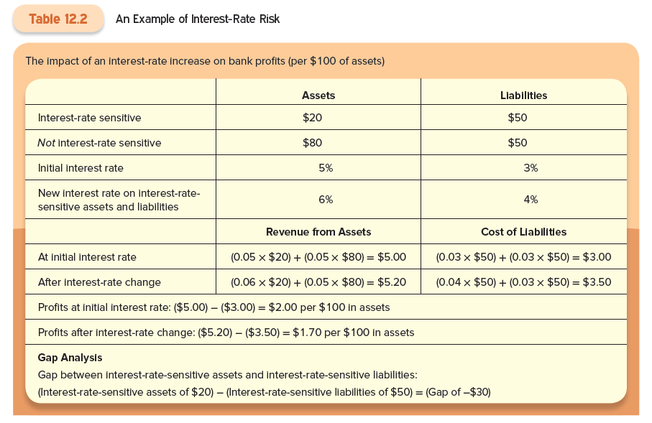

Slide 58
Trading Risk
Today banks hire traders to actively buy and sell securities, loans, and derivatives using a portion of the bank’s capital.
Risk that the instrument may go down in value rather than up is called trading risk, or market risk.
Traders normally share in the profits from good investments, but the bank pays for the losses.
  This creates moral hazard - traders take more risk than the banks would like.

Slide 59
Trading Risk
The solution to the moral hazard problem is to compute the risk the traders generate.
  Use standard deviation and value at risk.
The bank’s risk manager limits the amount of risk any individual trader is allowed to assume and monitors closely.
However, large banks find it difficult to monitor their traders and the managers who are supposed to be monitoring.

Slide 60
Trading Risk
Because of this, multi-million dollar losses from trading are common at large banks, even those that are well managed.
The higher the inherent risk in the bank’s portfolio, the more capital the bank will need to hold.

Slide 61

Peer-to-peer (P2P) lending: individuals can bypass traditional financial intermediaries and borrow directly from investors at lower cost
Financial intermediaries address information asymmetries in lending
  Banks screen potential borrowers and monitor them after a loan has been made

Slide 62
Other Risks
Foreign exchange risk comes from holding assets denominated in one currency and liabilities denominated in another.
Banks manage this in two ways:
  They work to attract deposits that are denominated in the same currency as their loans, matching assets to liabilities.
  They use foreign exchange futures and swaps to hedge the risk.
Both approaches can introduce other risks that must be managed.

Slide 63
Other Risks
Sovereign risk arises from the fact that some foreign borrowers may not repay their loans because their government prohibits them from doing so.
  If a foreign country is experiencing a financial crisis, the government may decide to restrict dollar-denominated payments.
Banks have three options:
  Diversification,
  Refuse loans to certain countries, or
  Use derivatives to hedge the risk.

Slide 64
Other Risks
Operational risk is when computer systems fail or buildings burn down.
  This was an issue for some banks when the World Trade Center was destroyed.
The banks must make sure their computer systems and buildings are sufficiently robust to withstand potential disasters.
  This means anticipating what might happen and testing to ensure a system’s readiness.

Slide 65
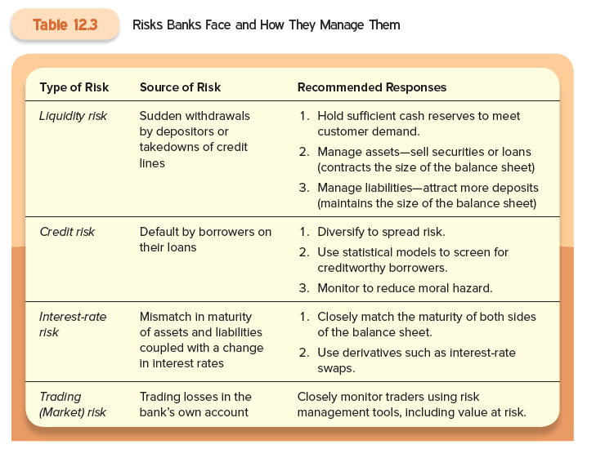
Summary of Sources and Management of Bank Risk

Slide 66

Repurchase agreements (repos) are a key form of short term finance for many intermediaries.
In 2007, the volume of outstanding repos was nearly half the overall liabilities in commercial banking system.
But in 2008, the repo market shrunk significantly, further affecting the financial crisis.

Slide 67
Policymakers have pushed for reforms in the repo market to synchronize the creation of new repo loans and the settlement of expiring loans.
This would significantly reduce the risk the clearing banks currently take on during the interday lending period.

