Slide 1
Chapter Fifteen
Insurance Companies
©McGraw Hill LLC. All rights reserved. No reproduction or distribution without the prior written consent of McGraw Hill.

Slide 2
Insurance Companies (ICs)
Primary function of insurance companies is to compensate policyholders if a prespecified event occurs, in exchange for premiums paid to the insurer by the policyholder
Insurance provider can act in one of two roles:
  Insurance underwriter assess risk of an applicant for coverage
  Insurance brokers sell insurance contracts
Insurance is broadly classified into two groups
  Life insurance policies provide protection against untimely death, illness, and retirement
  Property-casualty insurance protects against personal injury and liability due to accidents, theft, fire, and other catastrophes
Insurance companies also sell a variety of investment products, similar to other financial service firms
Notes:
2

Slide 3
Life Insurance Companies
740 life insurance companies existed in the U.S. in 2021
  In 1988, there were more than 2,300 life insurers
Industry has experienced major mergers in recent years to take advantage of economies of scale and scope and other synergies
  Anthem and Signa, Harford Life and Mass Mutual, and Metlife and American Life Insurance serve as examples of recent mergers
Aggregate industry assets were $8.7 trillion in 2021
  In 1988, aggregate assets of life insurers were $1.12 trillion
Ten largest life insurers represented 43.7% of the industry’s assets in 2021
Notes:
3

Slide 4
Largest Life Insurers
Notes:
4
Table 15-1 lists the largest life insurers in terms of total assets.

Slide 5
Distribution of Premiums Written on Various Life Insurance Lines
Notes:
5
Figure 15–1 shows the distribution of premiums written for the various lines of insurance in 2021.

Slide 6
Life Insurance Companies (Continued)
Life insurers pool the risks of individuals to diversify away some of the customer-specific risk
  Because of this, they can offer insurance services at a cost (premium) lower than any individual could achieve on his or her own
  Life insurers transfer income-related uncertainties, such as those due to retirement, from the individual to the group
Other activities of life insurance companies:
  Sell annuity contracts, which are savings contracts that involve the liquidation of those funds saved over a period of time
  Manage pension plans (tax-deferred savings plans)
  Provide accident and health insurance
Notes:
6

Slide 7
Life Insurance Companies (Concluded)
Insurance companies accept or underwrite risk that a prespecified event will occur in return for insurance premiums
  Major part of underwriting process is determining which risks should be accepted and which should be rejected
  For accepted risks, underwriters must determine how much to charge (in the form of premiums)
    E.g., a smoker would likely be charged a higher premium than a non-smoker and an increased probability of a major pandemic might cause insurers to increase life and health insurance premiums to all insured groups
Adverse selection problem exists because customers who apply for insurance policies are more likely to be those most in need of coverage
  E.g., someone with chronic health problems is more likely to purchase a life insurance policy than someone in perfect health
Notes:
7

Slide 8
The Role of Actuaries
Actuaries have traditionally worked in life insurance to reduce the risks of underwriting and selling life insurance
  With traditional life insurance, actuaries analyze mortality, produce life tables, and apply time value of money concepts to produce life insurance, annuities, and endowment policies
  With health insurance, actuaries analyze rates of disability, morbidity, mortality, fertility, and other contingencies
Notes:
8

Slide 9
Life Insurance
Four basis classes (or lines) of life insurance are distinguished by the way they are sold or marketed to purchasers:
  Ordinary life
  Group life
  Credit life
  Other activities
Of the $21.2 trillion life insurance policies in force in the U.S. at year-end 2021, ordinary life accounts for 64.2%, group life for 35.4%, and credit life for less than 1%
Notes:
9

Slide 10
The Four Types of Life Insurance
Ordinary life policies are marketed on an individual basis, usually in units of $1,000; policyholders make periodic premium payments in exchange for coverage
  Term life is the closest to pure life insurance; has no savings element attached and beneficiary receives payout at the time of the individual’s death during the coverage period
  Whole life protects the individual over an entire lifetime rather than for a specified coverage period
  Endowment life combines a pure (term) insurance element with a savings element
  Variable life invests fixed premium payments in mutual funds of stocks, bonds, and money market instruments
  Universal life and variable universal life
Notes:
10
Despite the enormous variety of contractual forms, there are essentially five basic contractual types. The first three are traditional forms of ordinary life insurance, and the last two are newer contracts that originated in the 1970s and 1980s when competition for savings from other segments of the financial services industry, such as mutual funds, increased.

Slide 11
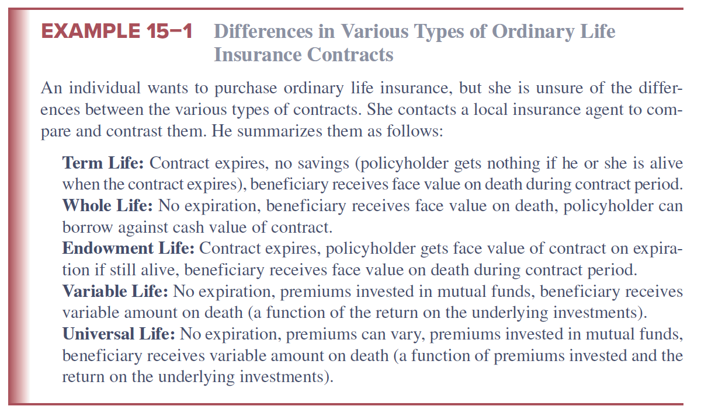
Differences in Various Types of Ordinary Life Insurance Contracts
Notes:
11

Slide 12
The Four Types of Life Insurance (Continued)
Group life insurance covers a large number of insured persons under a single policy
  Usually issued to corporate employers, these policies may be contributory or noncontributory
    Contributory requires both the employer and employee cover a share of the employee’s cost of insurance
    Noncontributory means the cost of the employee’s insurance is paid entirely by the employer; employee does not contribute to the cost of the insurance
Credit life insurance protects lenders against a borrower’s death prior to the repayment of a debt contract, such as a mortgage or car loan
  Usually, face amount of policy reflects outstanding principal and interest on the loan
Notes:
12

Slide 13
The Four Types of Life Insurance (Concluded)
Other activities of life insurers include the sale of annuities, private pension plans, and accident and health insurance
  Annuities represent the reverse of life insurance principals
    Life insurance involves building up a fund and eventually paying out a lump sum, while annuities involve different methods of liquidating a fund over a long period of time
    Popular mechanism for retirement savings because, unlike IRAs, annual annuity contributions are not capped and are not affected by the policyholder’s income level
    Annuity sales in 2021 topped $315.9b, compared to $26.1b in 1996
  Insurance companies offer many alternative pension plans to private employers
  More than $192 billion in accident and health premiums were written by life and health companies in 2021
Notes:
13

Slide 14
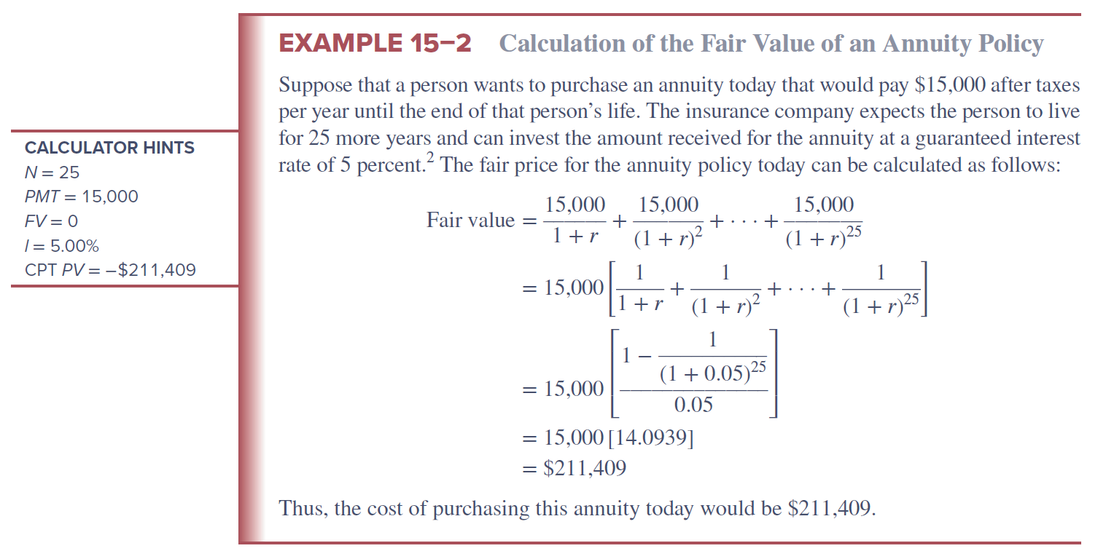
Calculation of the Fair Value of an Annuity Policy
Notes:
14

Slide 15
Balance Sheets
Assets
  Life insurers concentrate their asset investments at the longer end of the maturity spectrum (e.g., corporate bonds, equities, and government securities)
    In 2021, 6.0% of assets were invested in government securities, 65.7% in corporate bonds and stocks, and 8.0% in mortgages
Liabilities
  Net policy reserves made up $6.4 trillion, or 73.7% of total liabilities and capital, in 2021
  To meet unexpected future losses, life insurers hold a capital and surplus reserve fund with which to meet such losses
    Capital and surplus reserves for life insurers in 2021 totaled $497.1 billion, or 5.7% of their total liabilities and capital
Notes:
15

Slide 16
Life Insurance Industry Balance Sheet (in billions of dollars), 2021
Notes:
16
The aggregate balance sheet for the life insurance industry at the end of 2021 is presented in Table 15–3.

Slide 17
Recent Trends
Insurers earn profits by taking in more premium and interest income than they pay out in policy payments
Firms can increase their spread between premium income and policy payouts in two ways:
  Decrease future required payouts for any given level of premium payments
    Accomplished by reducing the risk of the insured pool
  Increase the profitability of interest income on net policy reserves
Industry was very profitable in the early and mid-2000s
2008-2009 financial crisis took a toll on this industry
  Treasury Department extended bailout funds to several struggling life insurers (e.g., AIG, Allstate, Lincoln National, etc.) in late 2008/early 2009
Late 2009 saw improvements in the industry, and premiums continued to recover in 2010 through 2021
Notes:
17

Slide 18
Recent Trends
Net income increased to $28.0 billion in 2010, and $48.7 billion in 2018, it dropped to $39.6 billion in 2020
Life insurers paid out a record $90.4 billion in death benefit payments in 2020, a 15.4% increase from the payments in 2019
  Greatest year-to-year increase since 1917-1918 influenza pandemic
In 2021, net income recovered to $54.1 billion
Notes:
18

Slide 19
Regulation
McCarren-Ferguson Act of 1945 confirmed primacy of states over federal regulation of insurance companies
  State insurance commissions charter, supervise and examine ICs using a coordinated examination system develop by the National Association of Insurance Commissioners (NAIC)
    Regulations cover areas such as insurance premiums, insurer licensing, sales practices, commission charges, and the types of assets in which insurers may invest
States promote life insurance guarantee funds
  Run and administered by the private insurers themselves
  Contributions are paid only when an IC fails (except in NY)
  Size of required contributions that surviving insurers make to protect policyholders in failed ICs differs widely from state to state
  Delay usually occurs before small policyholders receive payments from the guarantee fund
Notes:
19
Unlike the depository institutions discussed in Chapters 11 through 13, which can be chartered at either the federal or state levels, a life insurer is chartered entirely at the state level.
An insurance guarantee fund is a fund of required contributions from within-state insurance companies, used to compensate insurance company policyholders in the event of failure.

Slide 20
Regulation (Continued)
In 2009, Congress considered establishing an optional federal insurance charter
Wall Street Reform and Consumer Protection Act of 2010 created the Federal Insurance Office (FIO), called for the establishment of the Financial Stability Oversight Council (FSOC), and resulted in the Fed becoming a major supervisor of insurance firms
  FIO has authority to monitor insurance industry, identify regulatory gaps or systemic risk, deal with international insurance matters, and monitor the extent to which underserved communities have access to affordable insurance products
  FSOC is charged with identifying any financial institution (including insurance companies) that presents a systemic risk to the economy and subjecting such institutions to greater regulation
Notes:
20
Support for such an optional federal insurance charter increased when the existing state-by-state regulatory system failed to prevent insurance giant AIG’s problems from becoming a systemic risk to the national economy.

Slide 21
Property-Casualty (P&C)
Insurance Companies
Currently, close to 2,600 companies sell property-casualty (P&C) insurance, and approximately half of those firms write P&C business in all or most of the U.S.
  Top 10 firms have a 51.4% market share
  Top 200 firms make up 96.2% market share
  In 2018, State Farm was the top firm, writing 9.7% of all P&C insurance premiums
Distinctions between the two broad areas of property and liability insurance are becoming increasingly blurred
  Property insurance involves insurance coverages related to the loss of real and personal property
  Casualty (or, liability) insurance offers protection against legal liability exposures
Notes:
21
P&C insurers tend to offer multiple activity line coverages combining features of property and liability insurance into single policy packages—for example, homeowners multiple peril insurance.

Slide 22
Main P&C Lines
Fire insurance and allied lines protects against the perils of fire, lightning, and removal of property damaged in a fire
  5.4% of net premiums earned in 2021
Homeowners multiple peril (MP) insurance protects against multiple perils of damage to a personal dwelling and personal property, as well as liability coverage against the financial consequences of legal liability resulting from injury to others
  14.4% of net premiums earned in 2021
Commercial multiple peril (MP) insurance protects commercial firms against perils similar to homeowners MP insurance
  6.1% of net premiums earned in 2021
  Automobile liability and physical damage (PD) insurance provides protection against losses resulting from legal liability due to the ownership/use of the vehicle and theft or damage to vehicles
  36.1% of net premiums earned in 2021
Liability insurance (other than auto)
  11.2% of net premiums earned in 2021
Notes:
22

Slide 23
Balance Sheets of P&C Companies
Assets
  P&C insurers invest most of their assets in long-term securities, although the proportion held in common stock is lower than that of life insurance companies
  Bonds, preferred stock, and common stock represented 72.4% of total assets in 2019
Liabilities
  Loss reserves and loss adjustment expenses are a major component (31.3% of total liabilities and capital)
    Loss reserves are funds set aside to meet expected losses from underwriting the P&C lines
    Loss adjustment expenses are the expected administrative and related costs of adjusting (settling) claims
  Unearned premiums are 13.0% of total liabilities and capital
Notes:
23
Unearned premiums are set-aside reserves that contain the portion of a premium that has been paid at the start of the coverage period and therefore before insurance coverage has been provided.

Slide 24
Property-Casualty Industry Balance Sheet (in billions of dollars), 2019
Notes:
24
The balance sheet of P&C firms in 2019 is shown in Table 15–5.

Slide 25
Underwriting Risk
Underwriting risk results when premiums generated on a given insurance line are insufficient to cover claims (losses) and administrative expenses, after considering investment income generated
Underwriting risk may result from the following:
  Unexpected increases in loss rates (or loss risk)
  Unexpected increases in expenses (or expense risk)
  Unexpected decreases in investment yields or returns (investment yield/return risk)
Notes:
25

Slide 26
Loss Risk
Key feature of claims loss risk is the actuarial predictability of losses relative to premiums earned, which are premiums received and earned on insurance contracts because time has passed without a claim being filed
  In general, the following is true:
    Maximum levels of losses are more predictable for property lines than for liability lines
    Loss rates are more predictable on low-severity, high-frequency lines than on high-severity, low-frequency lines
    Long-tail risk exposure makes estimation of expected losses difficult
    Loss rates on all P&C property policies are adversely affected by unexpected increases in inflation, while liability lines may be subject to social inflation, as reflected by juries’ willingness to award punitive and other damages at rates far above the underlying rate of inflation
Reinsurance, essentially insurance for insurance companies, is an alternative to managing risk on a P&C insurer’s balance sheet
Notes:
26

Slide 27
Loss Ratio and Expense Ratio
Loss ratio measures actual losses incurred on a specific policy line; calculated as ratio of losses incurred to premiums earned
  Loss ratio of less than 100 percent means that premiums earned were sufficient to cover losses incurred on that line
  Loss ratio, net of loss adjustment expenses (LAE), in 2021 was 62.2%, down from 63.6% in 2012
Expense ratio is calculated as expenses incurred (before federal income taxes) divided by premiums written
Two major sources of expense risk to P&C insurers are:
  Loss adjustment expenses (LAE), which relate to the costs surrounding the loss settlement process
  Commissions and other expenses
Notes:
27

Slide 28
Property-Casualty (P&C) Key Ratios
Combined ratio is a measure of overall profitability of a line
  Calculated as the loss ratio plus the ratios of loss-adjusted expenses to premium earned as well as commission and other acquisition costs to premiums written plus any dividends paid to policyholders as a proportion of premiums earned
    If the combined ratio is less than 100 percent, premiums alone are sufficient to cover both losses and expenses related to the line
  In 2018, the combined ratio was 99.3%
Investment yield is calculated as net investment income divided by premiums earned
  In 2018, the investment yield was 11.4%
Operating ratio is also a measure of overall profitability; calculated as the combined ratio minus the investment yield
  In 2018, the operating ratio was 88.5%
Notes:
28

Slide 29
Property-Casualty Industry Underwriting Ratios
Notes:
29

Slide 30
Property-Casualty Industry Underwriting Ratios (Continued)
Notes:
30

Slide 31
P&C Recent Trends
Underwriting cycle is a pattern that the profits in the P&C industry tend to follow
Much of 1985-2021 period was not profitable for the P&C industry
  Combined ratio after dividends was 116.2 in 1985, 115.7 in 1992
  Major reason for poor performance was a succession of catastrophes
  Estimates of 2001 terrorist attacks on the World Trade Center and the Pentagon were as high as $19 billion for insurers
  Losses rose significantly in 2008 through 2012 due to jump in catastrophe losses and losses associated with financial crisis
  Profitability surged to its highest level in the post-crisis era in 2013-2016, but insured losses due to natural disasters in 2017 were more than triple the amount for 2016
  The combined ratio after dividends worsened in 2020 and 2021 due to the Covid-19 pandemic, but sustained premium growth, prior-year reserve releases, and lower loss costs in auto market offset the losses
Notes:
31

Slide 32
Property-Casualty (P&C)
Insurance Regulation
P&C insurers are chartered at the state level and regulated by state commissions
State guarantee funds provide (some) protection to policyholders, similar to the manner described for life insurance companies, should a P&C insurer fail
Additional burden faced by P&C insurers in some activity lines – especially auto insurance and workers’ compensation insurance – is rate regulation
  Given the social welfare importance of these lines, state commissioners often set ceilings on the premiums and premium increases in these lines
P&C industry has come under attack in recent years for the way it handled claims from homeowners associated with Hurricane Katrina
Notes:
32

Slide 33
Global Issues
Insurance sector is becoming increasingly global
  While the U.S., Japan, and western Europe dominate the global market, all regions are engaged in the insurance business and many insurers are engaged internationally
2017 was the costliest year for the worldwide insurance industry
  Natural disasters cost insurers a record $138 billion in losses, though losses in North America accounted for 83% of the total
  Key driver of losses in 2017 were the hurricanes Harvey, Irma, and Maria, which struck the USA and Caribbean in the space of a few weeks
2021 had overall economic losses from natural disasters of $259 billion, which is up 20% from the previous year’s total and also higher than the previous 10-year average of $229 million
Notes:
33

Slide 34
The World’s Top 10 Countries in Terms of Insurance Premiums Written, 2021
Notes:
34

