Slide 1


Slide 2
This book contains two parts
1^{th :} covering the nature of knowledge and the reasons for research,
2^{nd:} the specific methods used to carry out effective research.
The topics cover;
structuring and planning a research project
the ethical issues involved in research
different types of data and how they are measured
collecting and analyzing data in order to draw sound conclusions
devising a research proposal and writing up the research

Slide 3
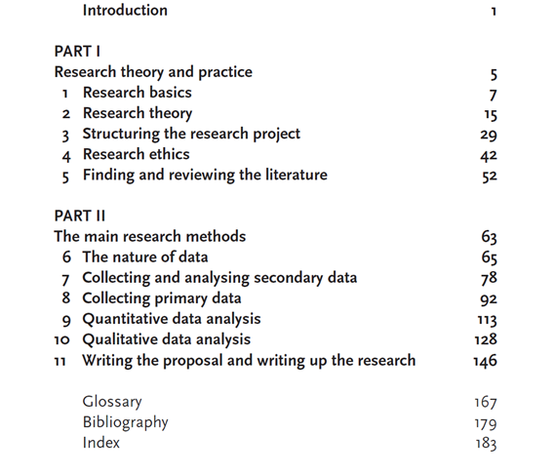

Slide 4
Why university students should take this course
Just about every university course includes an element of research that students must carry out independently, in the form of projects, dissertations and theses, and
The more advanced the degree, the greater the research content.
In the workplace there is frequently a need to do research in order to develop or improve the business or service,
While some types of businesses rely on doing research projects for their very existence.

Slide 5
Syllabus
https://www.cag.edu.tr/tr/akademik-kadro/26/dosyalar

Slide 6
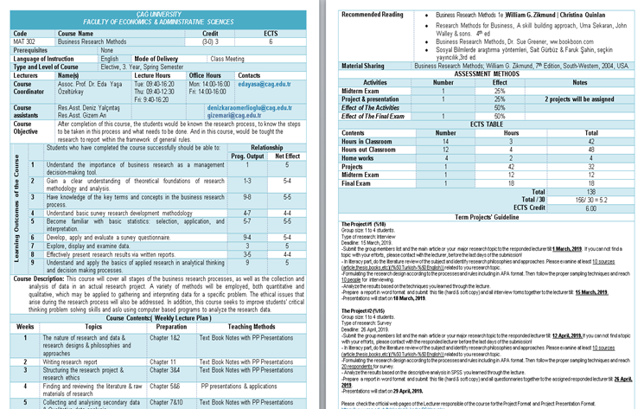

Slide 7
Term Projects (2)
ASSESSMENT METHODS
Activities | Number |  | Effect | Notes
Midterm Exam | 1 |  | 25%
Project & presentation | 2 |  | 25% | 2 projects will be assigned
Effect of The Activities |  |  | 50%
Effect of The Final Exam | 1 |  | 50%
ECTS TABLE
Contents |  | Number | Hours |  | Total
Hours in Classroom |  | 14 | 3 |  | 42
Hours out Classroom |  | 12 | 4 |  | 48
Home works |  | 4 | 2 |  | 4
Projects |  | 1 | 42 |  | 32
Midterm Exam |  | 1 | 12 |  | 12
Final Exam |  | 1 | 18 |  | 18
Total Total / 30 ECTS Credit |  |  |  |  | 138
 |  |  |  |  | 156/ 30 = 5.2
 |  |  |  |  | 6.00

Slide 9
BUSINESS RESEARCH METHODS
CHAPTER 1 & 2

Slide 10
What is Research?
Research is a very general term for an activity that involves finding out, in a more or less systematic way, things you did not know. A more academic interpretation is that research involves finding out about things that no-one else knew either.
Therefore the basic characteristics:
Data are collected systematically.
Data are interpreted systematically.
There is a clear purpose: to find things out.

Slide 11
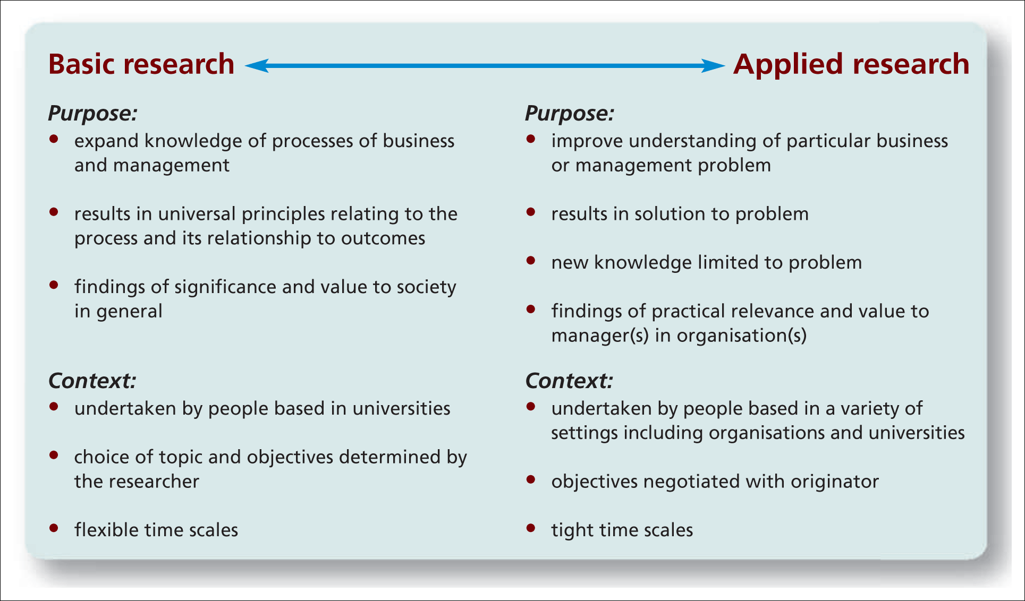
Types of Business Research:
Applied And Basic
Figure 1.1 Basic and applied research
Source: Authors’ experience; Easterby-Smith et al. (2012); Hedrick et al. (1993).

Slide 12

Methods vs Methodology
Methods to refer to techniques and procedures used to obtain and analyse data. This, includes questionnaires, observation and interviews as well as both quantitative (statistical) and qualitative (nonstatistical) analysis techniques and, as you have probably gathered from the title.
In contrast, the term methodology refers to the theory of how research should be undertaken. We believe that it is important that you have some understanding of this so that you can make an informed choice about your research.

Slide 13


Slide 14
Research Methods
Research methods are the techniques you use to do research.
They represent and provide you with ways to collect, sort and analyse information so that you can come to some conclusions.
If you use the right sort of methods for your particular type of research, then you should be able to convince other people that your conclusions have some validity, and that the new knowledge you have created is soundly based.

Slide 15
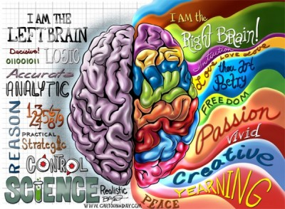
Generating research ideas..
Providing an initial research idea there are a lot of techniques.
The unique technique that you choose to use and the order in which you should use them are entirely up to you.
It is better to use a variety of techniques.

Slide 16
Before starting to your research
You need to have at least some idea of what you want to do.
This is probably
The most difficult
The most important, part of your research project.
Without being clear about what you are going to research it is difficult to plan how you are going to research it.

Slide 17

Rational thinking | Creative thinking
Examining your own strengths and interests | Keeping a notebook of your ideas
Examining staff research interests | Exploring personal preferences using past projects
Looking at past project titles | Exploring relevance to business using the literature
Discussion | Relevance trees
Searching existing literature | Brainstorming
Scanning the media
Table 2.1 More frequently used techniques for generating and refining research ideas

Slide 18
WHAT YOU CAN DO WITH RESEARCH
Categorise | This involves forming a typology of objects, events or concepts, i.e. a set of names or ‘boxes’ into which these can be sorted.
Describe | Descriptive research relies on observation as a means of collecting data. It attempts to examine situations in order to establish what is the norm, i.e. what can be predicted to happen again under the same circumstances.
Explain | This is a descriptive type of research specifically designed to deal with complex issues. It aims to in order to make sense of the myriad other elements involved, such as human, political, social, cultural and contextual.
Evaluate | This involves making judgements about the quality of objects or events. Quality can be measured either in an absolute sense or on a comparative basis.
Compare | Two or more contrasting cases can be examined to highlight differences and similarities between them, leading to a better understanding of phenomena.
Correlate | The relationships between two phenomena are investigated to see whether and how they influence each other.
Predict | Predictions of possible future behaviour or events are made on the basis that if there has been a strong relationship between two or more characteristics or events in the past, then these should exist in similar circumstances in the future, leading to predictable outcomes.
Control | Once you understand an event or situation, you may be able to find ways to control it. For this you need to know what the cause and effect relationships are and that you are capable of exerting control over the vital ingredients.

Slide 19
RESEARCH DESIGNS
There are numerous types of research design that are appropriate for the different types of research projects.
The choice of which design to apply depends on the nature of the problems posed by the research aims.
Each type of research design has a range of research methods that are commonly used to collect and analyze the type of data that is generated by the investigations.
Types of research
Historical
Descriptive
Correlation
Comparative
Experiemental
Ethnological
Cultural

Slide 20

HISTORICAL
This aims at a systematic and objective evaluation and synthesis of evidence in order to establish facts and draw conclusions about past events.
It uses primary historical data and documentary sources of the past

Slide 21
DESCRIPTIVE
This design relies on observation as a means of collecting data. ‘Observation’ can take many forms.
Depending on the type of information sought, people can be interviewed, questionnaires distributed, visual records made, even sounds and smells recorded.
Important is that the observations are written down or recorded in some way, in order that they can be subsequently analysed.

Slide 22
CORRELATION
This design is used to examine a relationship between two concepts. The correlation between two concepts can either be;
none (no correlation),
positive (where an increase in one results in the increase in the other, decrease results in a decrease),
negative (where the increase in one results in the decrease in the other or vice versa).

Slide 23

COMPARATIVE
This design is used to compare past and present or different parallel situations, particularly when the researcher has no control over events. It can look at situations at different scales, macro (international, national) or micro (community, individual)

Slide 24

EXPERIMENTAL
Experimental research attempts to isolate and control every relevant condition which determines the events investigated and then observes the effects when the conditions are manipulated.
They usually require a hypothesis (prediction) to be formulated first in order to determine what variables are to be tested and how they can be controlled and measured.

Slide 25
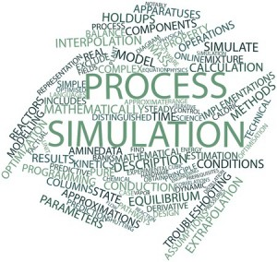
SIMULATION
Simulation involves devising a representation in a small and simplified form (model) of a system, which can be manipulated to gauge effects. It is similar to experimental design in the respect of this manipulation, but it provides a more artificial environment in that it does work with original materials at the same scale.

Slide 26

EVALUATION
This descriptive type of research is specifically designed to deal with complex social issues. It aims to move beyond ‘just getting the facts’, by trying to make sense of the myriad human, political, social, cultural and contextual elements involved. The results are generally used to prescribe changes to improve and develop the situation.

Slide 27
ETHNOLOGICAL
Ethnological research focuses on people. In this approach, the researcher is interested in how the subjects of the research interpret their own behaviour rather than imposing a theory from outside. It takes place in the undisturbed natural settings of the subjects’ environment.

Slide 28
CULTURAL
Many of the prevailing theoretical debates (e.g. postmodernism, poststructuralism etc.) are concerned with the subjects of language and cultural interpretation. Cultural research provides methodologies that allow a consistent analysis of cultural texts so that they can be compared, replicated, disproved and generalized.

Slide 29
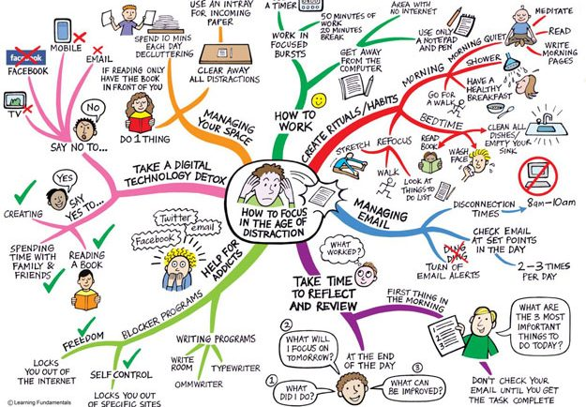

Slide 30
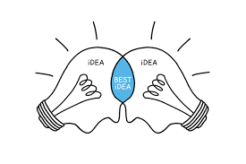
Deciding on The Research Type
It is your research interest that decides the nature of your research problem, and this will indicate the appropriate type of research to follow.
Once the objectives of a research project have been established, the issue of how these objectives can be met leads to a consideration of which research design should be chosen.

Slide 31
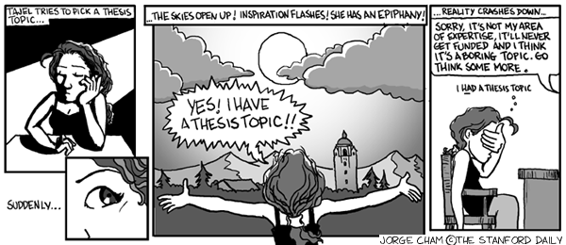
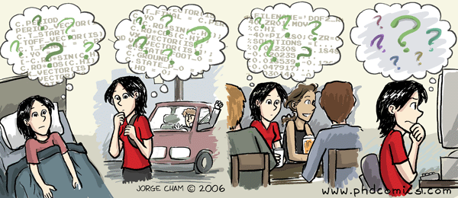
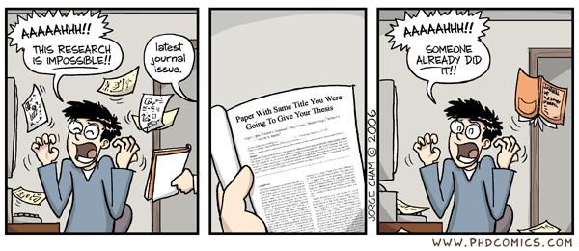
Deciding on Your Type of Research

Slide 32
INDUCTIVE REASONING – THE EMPIRICIST’S APPROACH
Inductive reasoning starts from specific observations or sensory experiences and then develops a general conclusion from them. This simple example gives and indication of the line of reasoning:
All the giraffes that I have seen have very long necks.(Repeated observations)
Therefore I conclude that all giraffes have long necks.(Conclusion)

Slide 33
? ? ?
There are problems with induction:
1- How many observations must be made before we can reasonably draw a conclusion that is reliable enough to generalize from?
2- How many situations and under which conditions should the observations be made so that true conclusions can be reached?

Slide 34
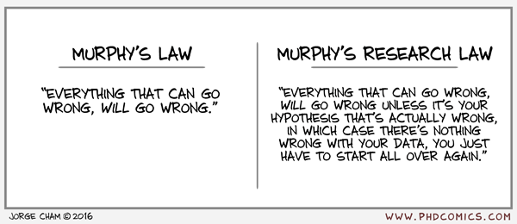
Therefore, in order to be able to rely on the conclusions we come to by using inductive reasoning, we should ensure that we make a large number of observations, we repeat them under a large range of circumstances and conditions and that no observations contradict the generalization we have made from the repeated observations.

Slide 35
DEDUCTIVE REASONING – THE RATIONALIST’S APPROACH
Deductive reasoning begins with general statements (premises) and, through logical argument, comes to a specific conclusion. Again, a simple example will provide a guide to how this works:
All living things will eventually die.(General statement – first premise)
Animals is a living things. (Inference – second premise)
Therefore, animals will eventually die.(Conclusion)

Slide 36
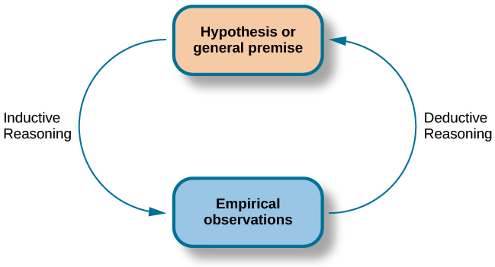

Slide 37
RESEARCH THEORY
All philosophical positions and their attendant methodologies, explicitly or implicitly, hold a view about reality. This view, in turn, will determine what can be regarded as legitimate knowledge. Philosophy works by making arguments explicit.
You need to develop sensitivity towards philosophical issues so that you can evaluate research critically. It will help you to discern the underlying, and perhaps contentious.

Slide 38
Theories
are speculative answers to perceived problems, and are tested by observation and experiment. Science is seen to proceed by trial and error: when one theory is rejected, another is proposed and tested, and thus the fittest theory survives.
In order for a theory to be tested, it must be expressed as a statement called a hypothesis. The essential nature of a hypothesis is that it must be falsifiable.

Slide 39
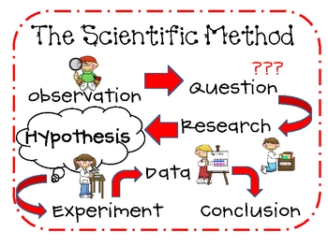
SCIENTIFIC METHOD
identification or clarification of a problem;
developing a hypothesis (testable theory) inductively from observations;
charting their implications by deduction;
practical or theoretical testing of the hypothesis;
rejecting or refining it in the light of the results.
It is this combination of experience with deductive and inductive reasoning which is the foundation of modern scientific research, and is commonly referred to as scientific method.

Slide 40
Aspects of philosophy
Positivism - the stance of the natural scientist
Realism - direct and critical realism
Interpretivism - researchers as ‘social actors’
Axiology - studies judgements about value

Slide 41
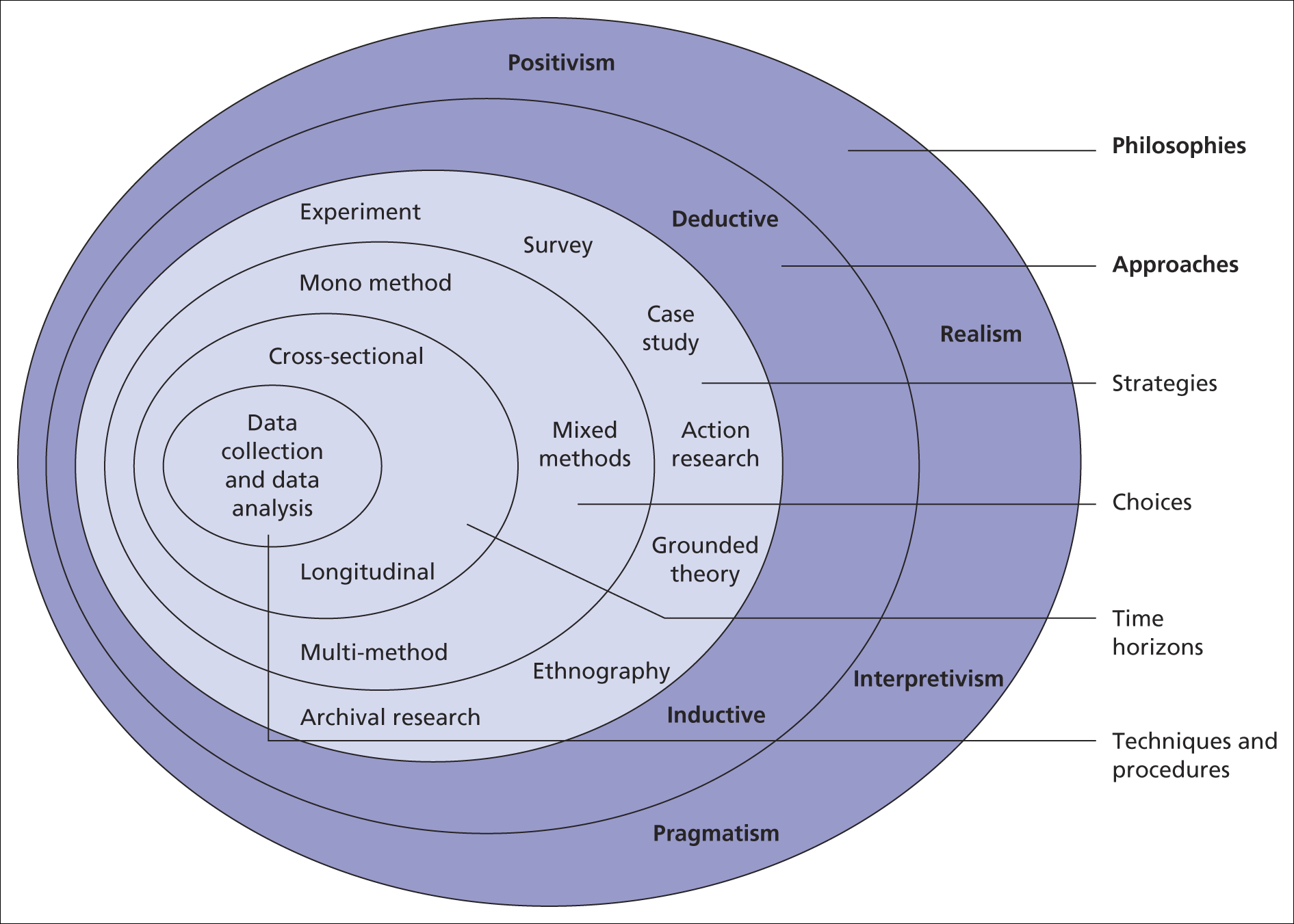
The research ‘onion’
Saunders et al, (2008)

Slide 42
Aspects of approaches
The two main research approaches are
Deduction;
Theory and hypothesis are developed and tested
Induction;
Data are collected and a theory developed from the data analysis

Slide 43
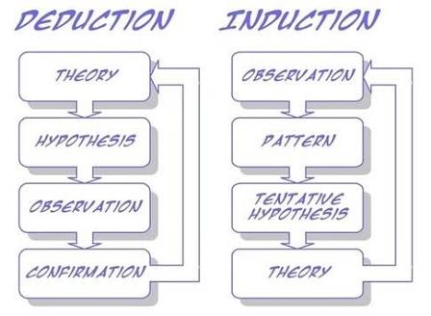
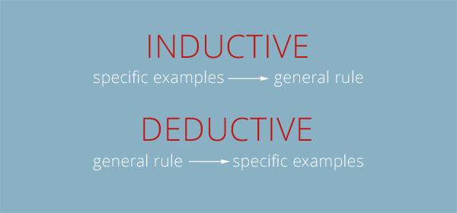

Slide 44
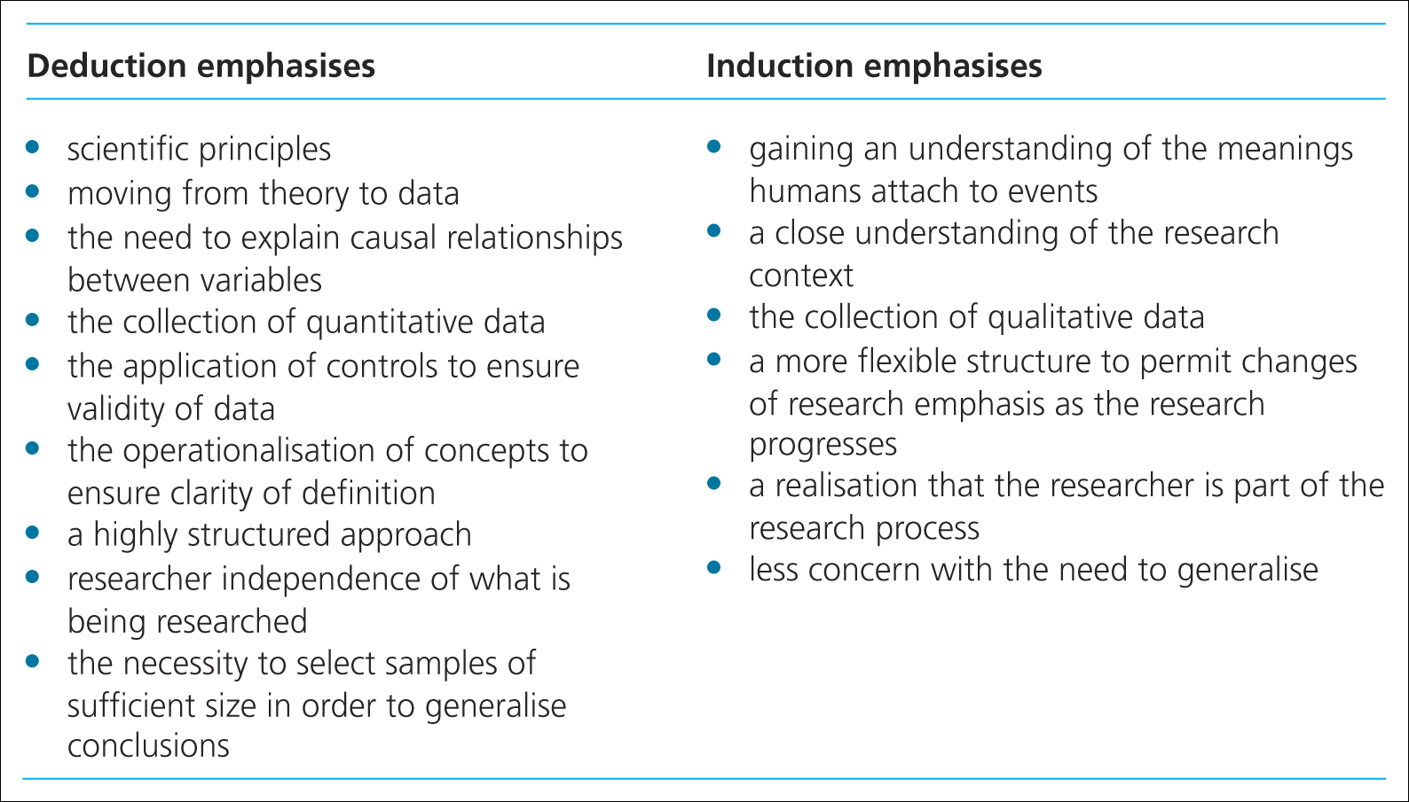
Major differences between these approaches
Saunders et al, (2009)
Table 4.2 Major differences between deductive and

Slide 45
Thinking about research philosophy
Ontology: nature of reality
Epistemology: what is acceptable knowledge in a particular field of study.
Axiology: value research

Slide 46
Aspects of Epistemology:
As for the methods of acquiring knowledge, there are two basic approaches:
empiricism – knowledge gained by sensory experience (using inductive reasoning);
rationalism – knowledge gained by reasoning (using deductive reasoning).

Slide 47
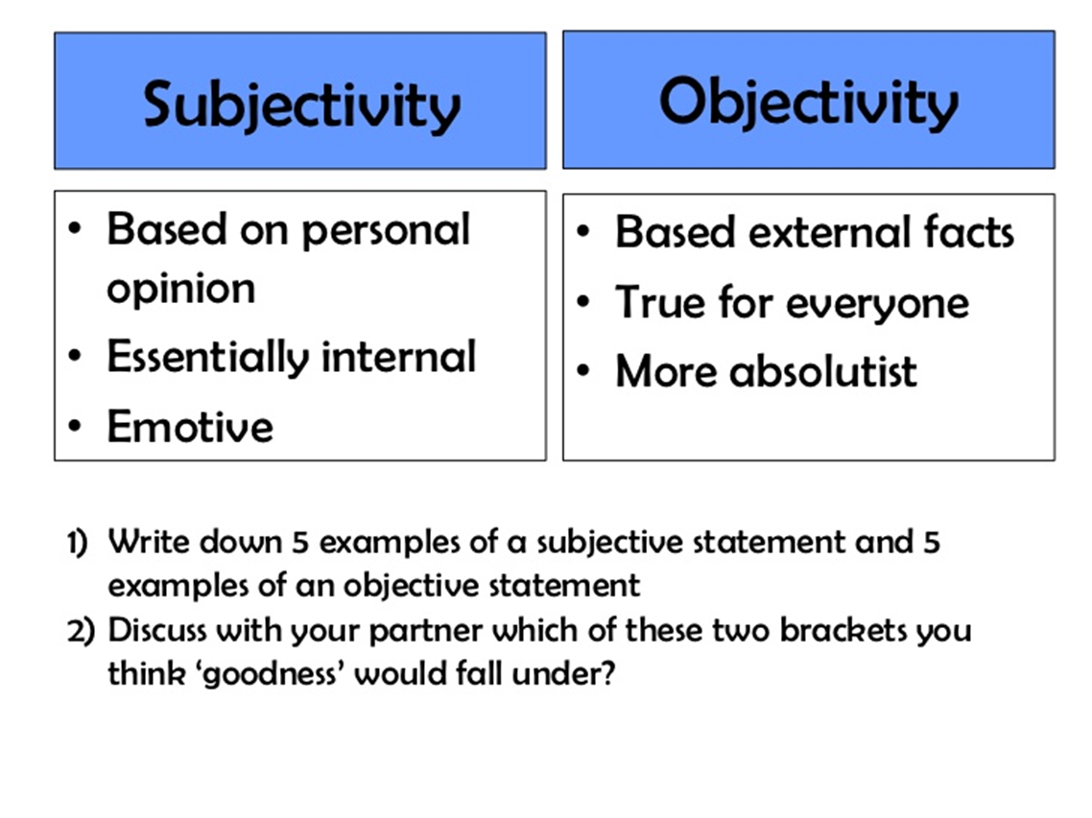
Aspects of Ontology
Objectivism: The position that social entities exist in reality external to social actors concerned with their existence.
Subjectivism: Social phenomena are created from the perceptions and consequent actions .

Slide 48
Research Paradigms
Paradigsm: is a term frequently used in the soical sciences, but one can lead to confusion because it tends to have multiple meanings.
Is a way of examining social phenomena from which particular understandings of these phenomena can be gained and explanations attemped.

