Slide 1
Chapter 1 The nature of business and management research and structure of this book

Slide 2
In this chapter
Be able to outline the purpose and distinct focus of management research;
• Be able to place your research project on a basic-applied research
Continuum according to its purpose and context;
Understand the stages you will need to complete (and revisit) as part of your research process;
Be aware of some of the ways you can use this book.

Slide 3
Methods vs methodology
methods to refer to techniques and procedures used to obtain and analyse data. This, includes questionnaires, observation and interviews as well as both quantitative (statistical) and qualitative (nonstatistical) analysis techniques and, as you have probably gathered from the title.
In contrast, the term methodology refers to the theory of how research should be undertaken. We believe that it is important that you have some understanding of this so that you can make an informed choice about your research.
we also discuss a range of philosophical assumptions upon which research can be based and the implications of these for the method or methods adopted.

Slide 4
The nature of research
The results of researches are all aorund
İt is difficult to avoid the term of research...
Bogus Survey & real research (Read box 1.1.)
BS are created just for publicity however, the real one has the objective of yielding the information.

Slide 5
Research
as something that people undertake in order to find out things in a systematic way, thereby increasing their knowledge. Two phrases are important in this definition: ‘systematic way’ and ‘to find out things’. ‘Systematic’ suggests that research is based on logical relationships and not just beliefs
Therefore the basic characteristics:
Data are collected systematically.
Data are interpreted systematically.
There is a clear purpose: to find things out.

Slide 6
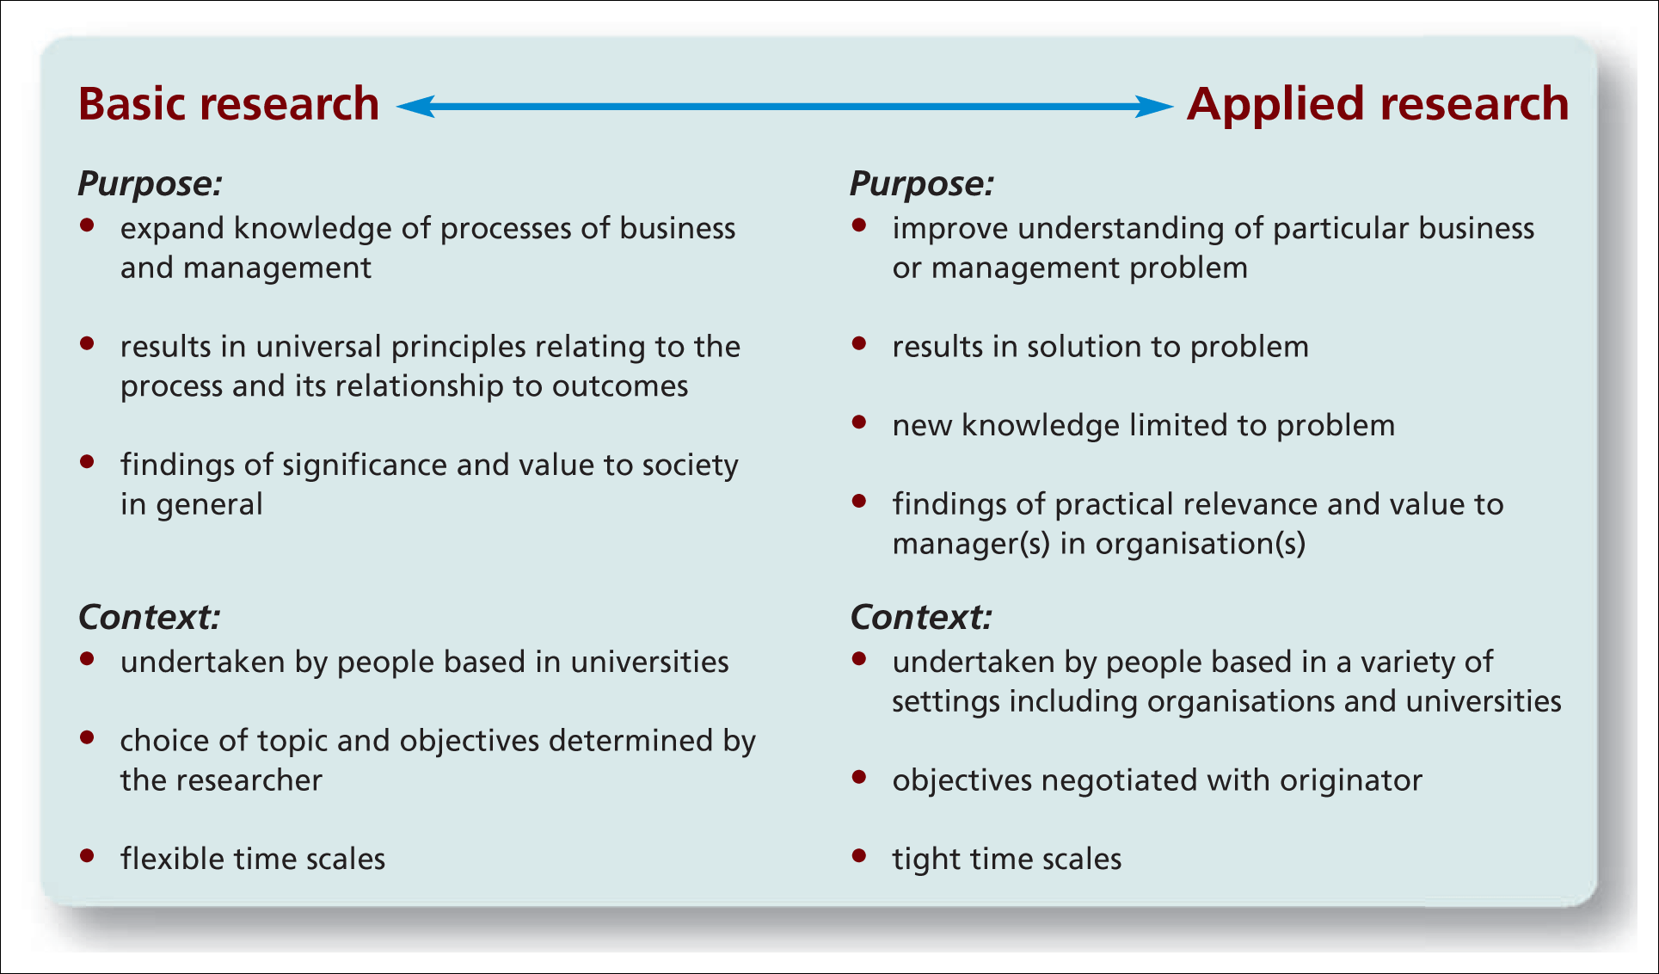
Figure 1.1 Basic and applied research
Source: Authors’ experience; Easterby-Smith et al. (2012); Hedrick et al. (1993)

Slide 7
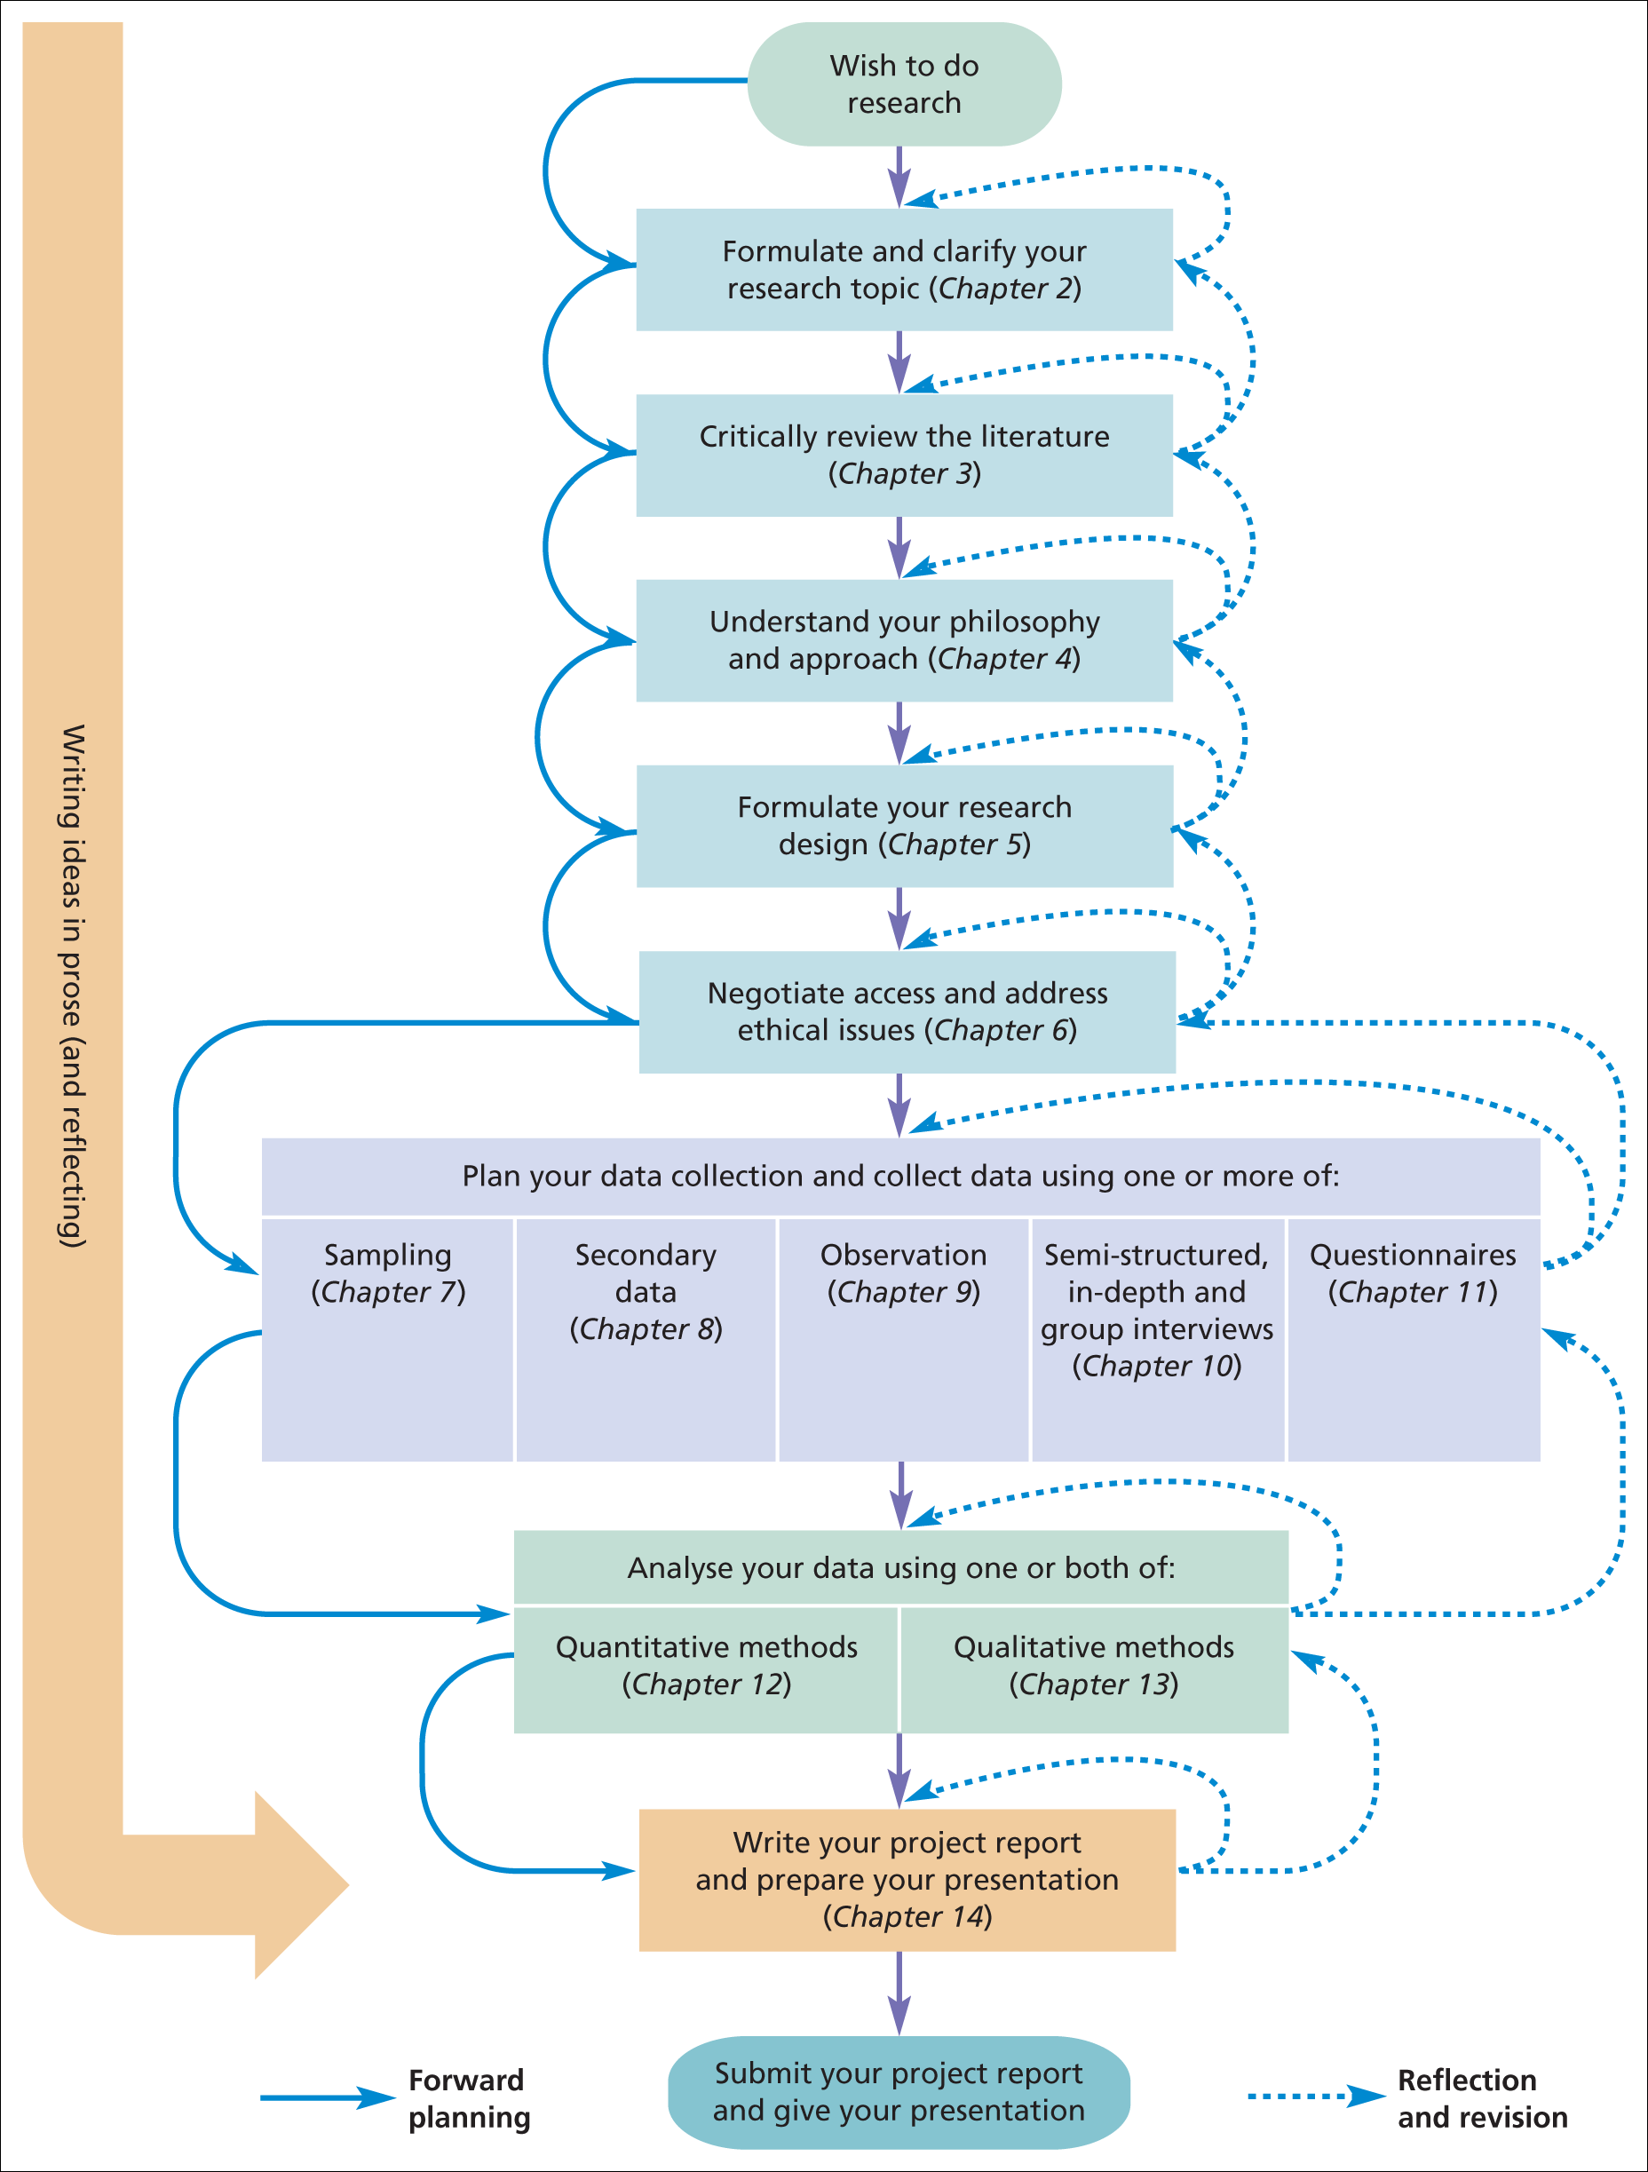
Figure 1.2 The research process
Source: © Mark Saunders, Philip Lewis and Adrian Thornhill 2015

Slide 8
Review questions (homework»1)
Read a quality newspaper. Make a note of at least
5 articles in your newspaper that mention the word ‘research’. Now examine the articles one at a time. As you examine each article, does the reference to research . . .
• . . . refer to the collection of facts or information with no clear purpose?
• . . . refer to the reassembling and reordering of facts or information without interpretation?
• . . . provide a means of getting the reader to respect what is being written?
• . . . refer to the systematic collection and interpretation of data with a clear purpose?

Slide 9
HW :2 case study
Isabella’s research dilemma p.17-18 read, sum up, and answer the questions.

Slide 10
Chapter 2.
generate ideas that will help in the choice of a suitable research topic;
identify the attributes of a good research topic;
turn research ideas into a research project that has clear research question(s) and objectives;
draft a research proposal.

Slide 11
How to decide...
clarfying. The research topic is the most exciting part.
it is important to choose something that will sustain your interest throughout the months that you will need to complete it.
You may even decide to do some research that is something that forms part of your leisure activities!

Slide 12
Capability: is it feasible?
Is the topic something with which you are really fascinated?
Do you have, or can you develop within the project time frame, the necessary research skills to undertake the topic?
Is the research topic achievable within the available time?
Will the topic still be current when you finish your project?
Is the topic achievable within the financial resources that are likely to be available?
Are you reasonably certain of being able to gain access to data you are likely to require for this topic?
Box 2.2 Attributes of a good research topic

Slide 13
Appropriateness: is it worthwhile?
Does the topic fit the specifications and meet the standards set by the examining institution?
Does your topic contain issues that have a clear link to theory?
Are you able to state your research question(s), aim and objectives clearly?
Will your proposed research be able to provide fresh insights into this topic?
Does your topic relate clearly to the idea you have been given (perhaps by an organisation)?
Are the findings for this topic likely to be symmetrical: that is, of similar value whatever the outcome?
Does the topic match your career goals?
Box 2.2 Attributes of a good research topic (Continued)

Slide 14
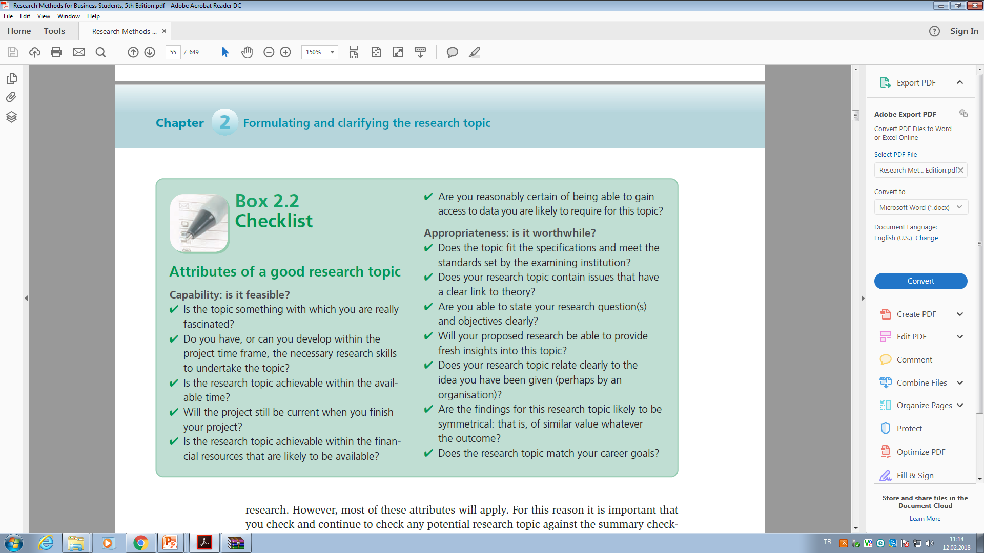

Slide 15
Before starting to your research
You need to have at least some idea of what you want to do.
This is probably
the most difficult
the most important, part of your research project.
This chapter is concerned with how to formulate and clarify your research topic and your research question.
Without being clear about what you are going to research it is difficult to plan how you are going to research it.

Slide 16
Alice’s Adventures in Wonderland
a favorite quote, is part of Alice’s conversation with the Cheshire Cat.
Alice asks the Cat (Carroll 1989:63–4):
‘Would you tell me, please, which way I ought to walk from here?’
‘That depends a good deal on where you want to get to’, said the Cat.
‘I don’t much care where’, said Alice.
‘Then it doesn’t matter which way you walk’, said the Cat.

