Slide 2
Topics Covered
20.1 Working Capital
20.2 Accounts Receivable and Credit Policy
20.3 Inventory Management
20.4 Cash Management
20.5 Investing Idle Cash: The Money Market
20.6 Managing Current Liabilities: Short-Term Debt
Notes:
2

Slide 3
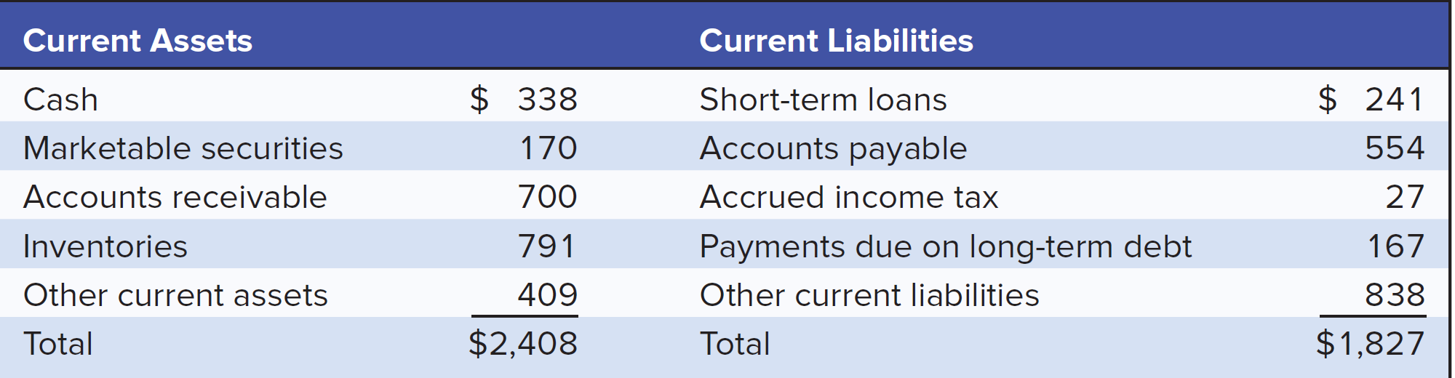
Working Capital (1 of 11)
Current assets and liabilities, U.S. manufacturing corporations, first quarter 2016 (figures in $ billions)

Slide 4
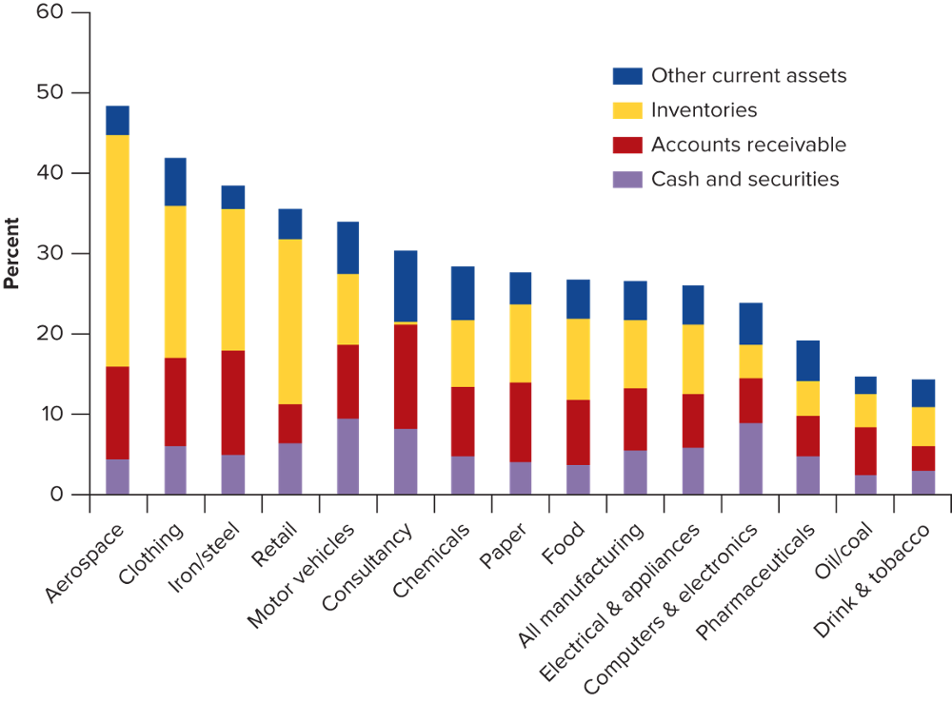
Working Capital (2 of 11)
Current assets as a percentage of total assets in different industries

Slide 5
Working Capital (3 of 11)
Net Working Capital
  Current assets minus current liabilities
  Often called working capital
Cash Conversion Cycle
  Period between firm’s payment for materials and collection on its sales
Notes:
3

Slide 6
Working Capital (4 of 11)
Simple Cycle of Operations
Cash
Receivables
Raw materials
inventory
Finished goods
inventory
Notes:
8

Slide 7
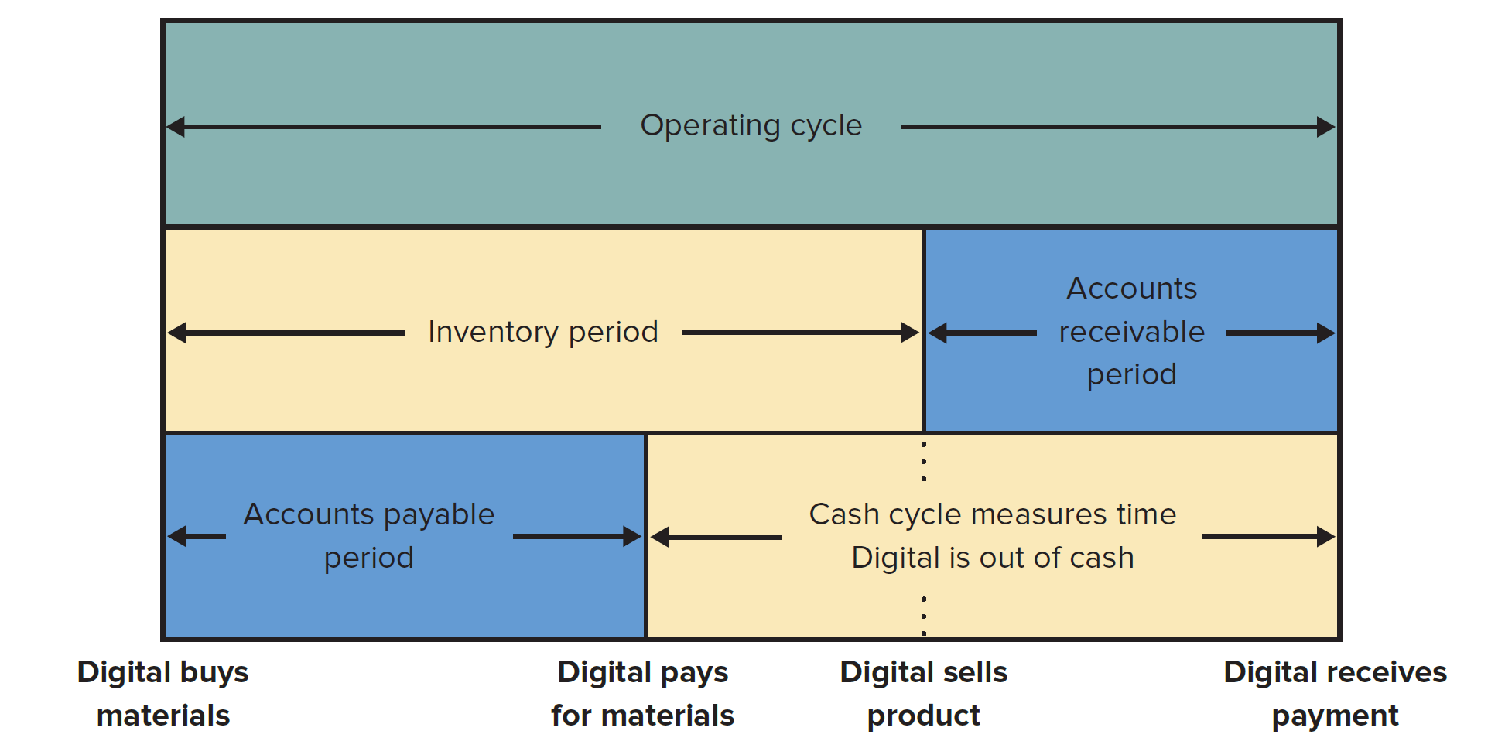
Working Capital (5 of 11)
Cash Conversion Cycle

Slide 8
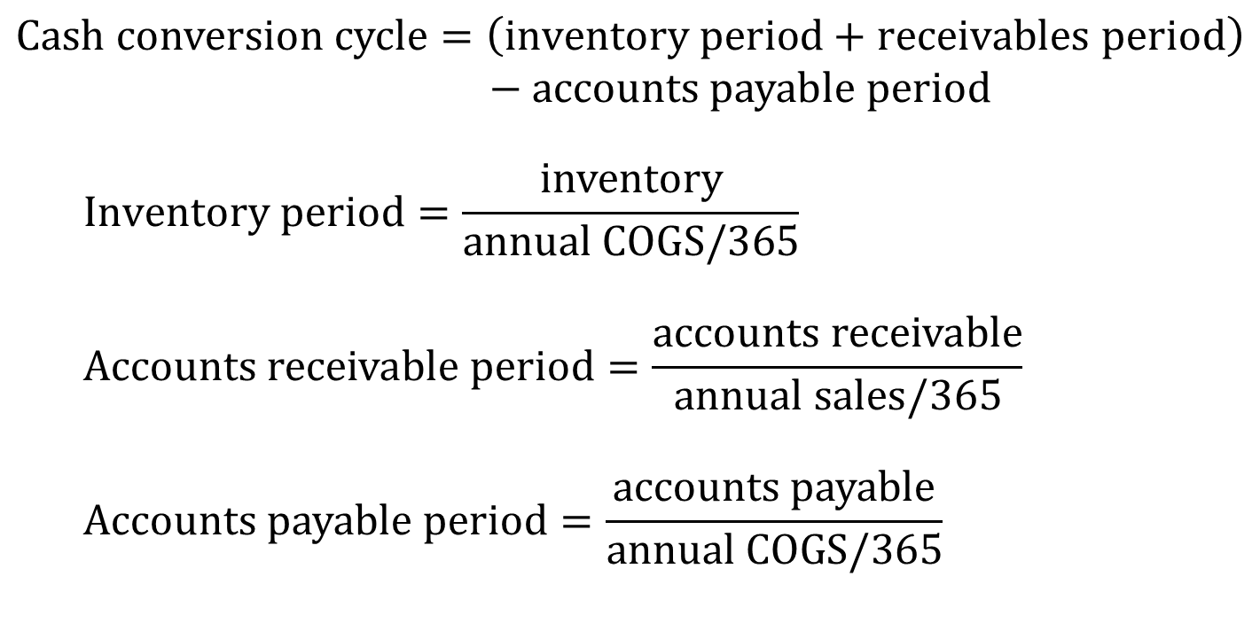
Working Capital (6 of 11)
$$Cash conversion cycle=\left(inventory period+receivables period\right)$$
$$− accounts payable period$$
$$Inventory period=\frac{inventory}{annual COGS/365}$$
$$Accounts receivable period=\frac{accounts receivable}{annual sales/365}$$
$$Accounts payable period=\frac{accounts payable}{annual COGS/365}$$
Notes:
14

Slide 9
Working Capital (7 of 11)
Example — Cash Conversion Cycle
  Given the aggregate balance sheet and income statement for U.S. Manufacturing firms, calculate the cash conversion cycle.
Income Statement |  | Balance Sheet
 | 2015 |  | 2015
Sales | 6,435 | Inventory | 787
Costs | 5,731 | A/R | 705
 |  | A/P | 566
Notes:
15

Slide 10
Working Capital (8 of 11)
Example (continued)
  Given the aggregate balance sheet and income statement for U.S. Manufacturing firms, calculate the cash conversion cycle.
Notes:
17

Slide 11
Working Capital (9 of 11)
Example (continued)
  Given the aggregate balance sheet and income statement for U.S. Manufacturing firms, calculate the cash conversion cycle.
Notes:
18

Slide 12
Working Capital (10 of 11)
Example (continued)
  Given the aggregate balance sheet and income statement for U.S. Manufacturing firms, calculate the cash conversion cycle.
Notes:
19

Slide 13
Working Capital (11 of 11)
Example (continued)
  Given the aggregate balance sheet and income statement for U.S. Manufacturing firms, calculate the cash conversion cycle.
Inventory period = 50.1 days
Receivables period = 40.0 days
Payable period = 36.0 days
Cash conversion cycle = (50.1+40.0) - 36.0 = 54.1 days
Notes:
20

Slide 14
Accounts Receivable and Credit Policy (1 of 2)
Credit Management Steps
  Establish terms of sale
  What form of IOU will you require
  Perform a credit analysis
  Create a credit policy
  Develop a collection policy

Slide 15
Accounts Receivable and Credit Policy (2 of 2)
Trade Credit
  Bills awaiting payment from one company to another
Consumer Credit
  Bills awaiting payment from final customer to a company
Terms of Sale
  Credit, discount, and payment terms offered on a sale

Slide 16
Terms of Sale (1 of 3)
Example — 5/10 net 30
5 — percent discount for early payment
10 — number of days that the discount is available
net 30 — number of days before payment is due
Notes:
3

Slide 17
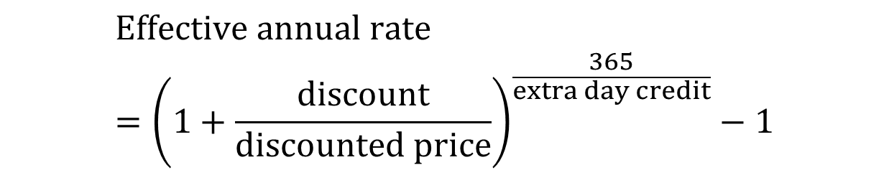
Terms of Sale (2 of 3)
A firm that buys on credit is in effect borrowing from its supplier
  It saves cash today, but will have to pay later
  This, of course, is an implicit loan from the supplier
We can calculate the implicit cost of this loan
$$Effective annual rate={\left(1+\frac{discount}{discounted price}\right)}^{\frac{365}{extra day credit}}−1$$
Notes:
5

Slide 18

Terms of Sale (3 of 3)
Example
  On a $100 sale, with terms 5/10 net 60, what is the implied interest rate on the credit given?
$$Effective annual rate={\left(1+\frac{discount}{discounted price}\right)}^{\frac{365}{extra day credit}}−1$$
$$= {\left(1+\frac{5}{95}\right)}^{365/50}−1=.454 or 45.4\%$$
Notes:
7

Slide 19
Credit Agreements
Terminology
  Open account
  Notes
  Commercial draft
  Sight draft
  Time draft
  Trade acceptance
  Banker’s acceptance
Notes:
8

Slide 20
Credit Analysis (1 of 7)
Open Account
  Agreement whereby sales are made with no formal debt contract
Credit Analysis
  Procedure to determine the likelihood customers will pay their bills
    Credit agencies, such as Dun & Bradstreet provide reports on the credit worthiness of a potential customer
    Financial ratios can be calculated to help determine a customer’s ability to pay its bills
Notes:
9

Slide 21
Credit Analysis (2 of 7)
Numerical credit scoring categories
  The customer’s character
  The customer’s capacity to pay
  The customer’s capital
  The collateral provided by the customer
  The condition of the customer’s business
Notes:
10

Slide 22
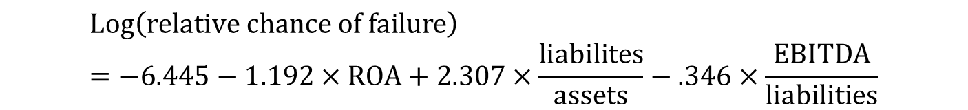
Credit Analysis (3 of 7)
William Beaver, Maureen McNichols, and Jung-Wu Rhie determined that the chance of failing during the next year, relative to the odds of not failing, is best determined by this equation:
$$Log\left(relative chance of failure\right)=−6.445−1.192×ROA+2.307×\frac{liabilites}{assets}−.346×\frac{EBITDA}{liabilities}$$
Notes:
12

Slide 23
Credit Analysis (4 of 7)
Credit analysis is only worthwhile if the expected savings exceed the cost
  Don’t undertake a full credit analysis unless the order is big enough to justify it
  Undertake a full credit analysis for the doubtful orders only
Notes:
16

Slide 24
Credit Analysis (5 of 7)
Non-failing firms
Return on Assets (%)
Failing firms
Years Before Bankruptcy

Slide 25
Credit Analysis (6 of 7)
Total Liabilities as a Percentage of Assets
Years Before Bankruptcy

Slide 26
Credit Analysis (7 of 7)
Non-failing firms
EBITDA as a Percentage of Total Liabilities
Failing firms
Years Before Bankruptcy

Slide 27
The Credit Decision (1 of 4)
Credit Policy
  Standards set to determine the amount and nature of credit to extend to customers
Credit Scoring
  What your lender won’t tell you
Extending credit gives you the probability of making a profit, not the guarantee
  There is still a chance of default
Denying credit guarantees neither profit or loss
Notes:
17

Slide 28
The Credit Decision (2 of 4)
The credit decision and its probable payoffs
Payoff = Rev − cost
Customer pays = p
Offer credit
Customer defaults = 1 - p
Payoff = − Cost
Refuse credit
Payoff = 0
Notes:
20

Slide 29


The Credit Decision (3 of 4)
Based on the probability of payoffs, the expected profit can be expressed as:
$$p×PV\left(rev −cost\right)−(1−p)×(PV×cost)$$
The break even probability of collection is:
$$p=\frac{PV(cost)}{PV(rev)}$$
Notes:
23

Slide 30
The Credit Decision (4 of 4)
Things to Remember in the Credit Decision
  Maximize profit
  Concentrate on the dangerous accounts
  Look beyond the immediate order
Notes:
23

Slide 31
Collection Policy (1 of 2)
Collection Policy
  Procedures to collect and monitor receivables
Aging Schedule
  Classification of accounts receivable by time outstanding
Notes:
24

Slide 32
Collection Policy (2 of 2)
Sample aging schedule for accounts receivable
Customer’s Name | Less than 1 Month | 1-2 Months | 2-3 Months | More than 3 Months | Total Owed
A | $10,000 | $0 | $0 | $0 | $10,000
B | 8,000 | 3,000 | 0 | 0 | 11,000
* | * | * | * | * | *
* | * | * | * | * | *
* | * | * | * | * | *
Z | 5,000 | 4,000 | 6,000 | 15,000 | 30,000
Total | $200,000 | $40,000 | $15,000 | $43,000 | $298,000
Notes:
25

Slide 33
Inventory Management (1 of 5)
Components of inventory
  Raw materials
  Work in process
  Finished goods
Carrying Costs
  Costs of maintaining current assets, including opportunity cost of capital
Tools used to minimize inventory
  Just-in-time
  Lean manufacturing

Slide 34
Inventory Management (2 of 5)
Goal = Minimize amount of cash tied up in inventory
As the firm increases its order size, the number of orders falls and therefore the order costs decline
However, an increase in order size also increases the average amount in inventory, so that the carrying cost of inventory rises
The trick is to strike a balance between these two costs
Notes:
22

Slide 35
Inventory Management (3 of 5)
Inventory
60
30
Inventory, thousands of units
Average Inventory
0 3 6 9 12
Weeks

Slide 36
Inventory Management (4 of 5)
Determination of optimal order size
Total costs
Carrying costs
Inventory costs, dollars
Total order costs
Optimal
order size
Order size
Notes:
24

Slide 37
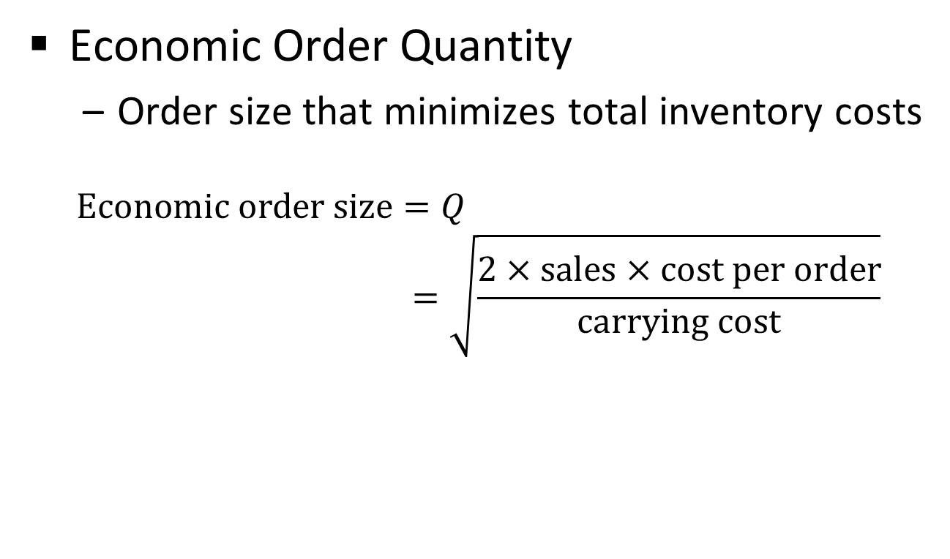
Inventory Management (5 of 5)
Economic Order Quantity
  Order size that minimizes total inventory costs
  $$Economic order size=Q$$
  $$=\sqrt{\frac{2×sales×cost per order}{carrying cost}}$$
Notes:
23

Slide 38
Cash Management
Cash does not pay interest
  Move money from cash accounts into short term securities
  “Sweep programs”
  MMDAs
  Concentration banking
  Lock-box system

Slide 39
Float
Time exists between the moment a check is written and the moment the funds are deposited in the recipient’s account
This time spread is called float
Notes:
3

Slide 40
Managing Float
Payers attempt to create delays in the check clearing process
Recipients attempt to remove delays in the check clearing process
Sources of delay
  Time it takes to mail check
  Time for recipient to process check
  Time for bank to clear check
Notes:
16

Slide 41
Concentration Banking (1 of 3)
Concentration Account
  Customers make payments to a regional collection center, which then transfers funds to an account at a principal bank
Lock-box System
  System whereby customers send payments to a post office box, and a local bank collects and processes checks
Notes:
13

Slide 42
Concentration Banking (2 of 3)
Example — Lock-box
  A lock box receives 150 payments per day, with an average size of $1,200. The daily interest rate is .02% and the lock box saves 1.2 days in mailing time and .8 days in processing time.
Notes:
13

Slide 43
Concentration Banking (3 of 3)
Example (continued)
  A lock box receives 150 payments per day, with an average size of $1,200. The daily interest rate is .02% and the lock box saves 1.2 days in mailing time and .8 days in processing time.
Reduced collection float
150 × $1,200 × (1.2 + .8) = $360,000
Perpetuity value of extra float earnings
$360,000 per day × .0002 = $72/day
($72/day) × 365 days = $26,280
$26,280/.073 = $360,000
Notes:
13

Slide 44
Cash (1 of 2)
Electronic Funds Transfer (EFT)
Automated Clearinghouse (ACH)
Fedwire
CHIPS (Clearing House Interbank Payments System)
CHIPS / Fedwire transaction volume = $1,300 trillion
International cash management
Compensating balances

Slide 45
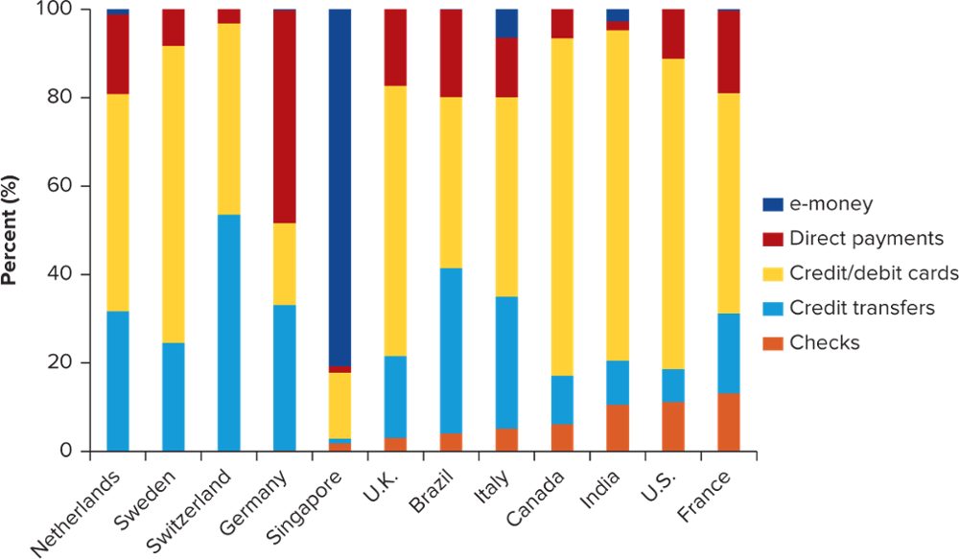
Cash (2 of 2)
Payment methods by country, 2014
(percentage of total non-cash transactions)

Slide 46
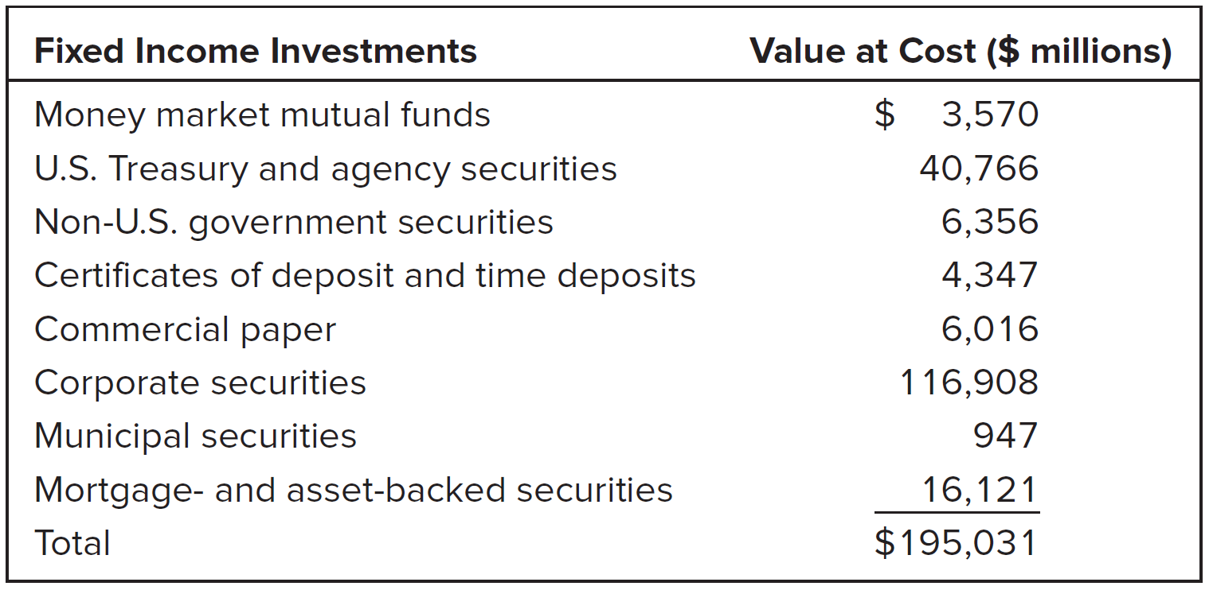
Investing Idle Cash
September 2016 Apple Invested Cash

Slide 47
Cash Balances
Money Market
  Market for short term financial assets
    Treasury bills
    Commercial paper
    Certificates of deposit
    Repurchase agreements
LIBOR
Notes:
26

Slide 48
Managing Current Liabilities
Bank Loans
  Secured loans
  Accounts receivable financing
  Inventory financing
Commercial paper
Notes:
26

