Slide 1
Balance of Payments
Notes:
This chapter serves to introduce the student to the balance of payments. How it is constructed and how balance of payments data may be interpreted.

Slide 2
Chapter Outline
Balance of Payments Accounting
Balance of Payments Accounts
  The Current Account
  The Capital Account
  Statistical Discrepancy
  Official Reserves Account
The Balance of Payments Identity
Balance of Payments Trends in Major Countries
3-2

Slide 3
Balance of Payments Accounting
The balance of payments is the statistical record of a country’s international transactions over a certain period of time presented in the form of double-entry bookkeeping.
Note: When we say “a country’s balance of payments” we are referring to the transactions of its citizens and government.
3-3

Slide 4
Balance of Payments Example
Suppose that Maplewood Bicycle in Maplewood, Missouri, USA imports $100,000 worth of bicycle frames from Mercian Bicycles in Darby, England.
There will exist a $100,000 credit recorded by Mercian that offsets a $100,000 debit at Maplewood’s bank account.
This will lead to a rise in the supply of dollars and the demand for British pounds.
3-4

Slide 5
Balance of Payments Accounts
The balance of payments accounts are those that record all transactions between the residents of a country and residents of all foreign nations.
They are composed of the following:
  The Current Account
  The Capital Account
  The Official Reserves Account
  Statistical Discrepancy
3-5

Slide 6
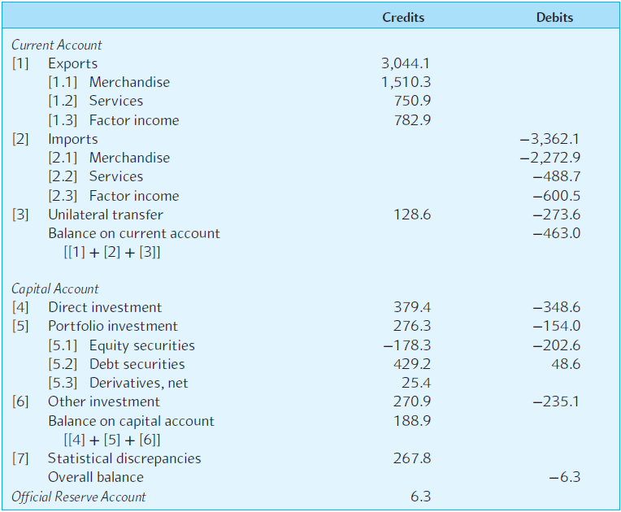
EXHIBIT 3.1 A Summary of the U.S. Balance of Payments for 2015 (in $ billion)
3-6

Slide 7
The Current Account
Includes all imports and exports of goods and services.
Includes unilateral transfers of foreign aid.
If the debits exceed the credits, then a country is running a trade deficit.
If the credits exceed the debits, then a country is running a trade surplus.
3-7

Slide 8
The Capital Account
The capital account measures the difference between U.S. sales of assets to foreigners and U.S. purchases of foreign assets.
In 2015, the U.S. enjoyed a $188.9 billion capital account surplus—absent of U.S. borrowing from foreigners, this finances the U.S. trade deficit.
The capital account is composed of Foreign Direct Investment (FDI), portfolio investments, and other investments.
3-8

Slide 9
Statistical Discrepancy
There are going to be some omissions and misrecorded transactions—so we use a “plug” figure to get things to balance.
Exhibit 3.1 shows a discrepancy of $267.8 billion in 2015.
Credits
Debits
Current Account
1
Exports
$3,044.1
2
Imports
($3,362.1)
3
Unilateral Transfers
$128.6
($273.6)
Balance on Current Account
($463.0)
Capital Account
4
Direct Investment
$379.4
($348.6)
5
Portfolio Investment
$276.3
($154)
6
Other Investments
$270.9
$235.1
Balance on Capital Account
$188.9
7
Statistical Discrepancies
$267.8
Overall Balance
$6.3
Official Reserve Account
($6.3)
3-9

Slide 10
The Official Reserves Account
Official reserves assets include gold, foreign currencies, SDRs, and reserve positions in the IMF.
3-10

Slide 11
The Balance of Payments Identity
BCA + BKA + BRA = 0
  where
  BCA = balance on current account
  BKA = balance on capital account
  BRA = balance on the reserves account
Under a pure flexible exchange rate regime,
BCA + BKA = 0
3-11

Slide 12
U.S. Balance of Payments Data 2015
Credits
Debits
Current Account
1
Exports
$3,044.1
2
Imports
($3,362.1)
3
Unilateral Transfers
$128.6
($273.6)
Balance on Current Account
($463.0)
Capital Account
4
Direct Investment
$379.4
($348.6)
5
Portfolio Investment
$276.3
($154)
6
Other Investments
$270.9
$235.1
Balance on Capital Account
$188.9
7
Statistical Discrepancies
$267.8
Overall Balance
$6.3
Official Reserve Account
($6.3)
Copyright © 2018 by the McGraw-Hill Companies, Inc. All rights reserved.
3-12

Slide 13
Balance of Payments: Balance on Current Account
Credits
Debits
Current Account
In 2015, the U.S. imported more than it exported, thus running a current account deficit of $463.0 billion.
1
Exports
$3,044.1
2
Imports
($3,362.1)
3
Unilateral Transfers
$128.6
($273.6)
Balance on Current Account
($463.0)
Capital Account
4
Direct Investment
$379.4
($348.6)
5
Portfolio Investment
$276.3
($154)
6
Other Investments
$270.9
$235.1
Balance on Capital Account
$188.9
7
Statistical Discrepancies
$267.8
Overall Balance
$6.3
Official Reserve Account
($6.3)
Copyright © 2018 by the McGraw-Hill Companies, Inc. All rights reserved.
3-13

Slide 14
Balance of Payments: Balance on Capital Account
Credits
Debits
Current Account
During the same year, the U.S. attracted net investment of $188.9 billion—clearly the rest of the world found the U.S. to be a good place to invest.
1
Exports
$3,044.1
2
Imports
($3,362.1)
3
Unilateral Transfers
$128.6
($273.6)
Balance on Current Account
($463.0)
Capital Account
4
Direct Investment
$379.4
($348.6)
5
Portfolio Investment
$276.3
($154)
6
Other Investments
$270.9
$235.1
Balance on Capital Account
$188.9
7
Statistical Discrepancies
$267.8
Overall Balance
$6.3
Official Reserve Account
($6.3)
Copyright © 2018 by the McGraw-Hill Companies, Inc. All rights reserved.
3-14

Slide 15
U.S. Balance of Payments “Balance”
Credits
Debits
Current Account
Under a pure flexible exchange rate regime, these numbers would balance each other out.
1
Exports
$3,044.1
2
Imports
($3,362.1)
3
Unilateral Transfers
$128.6
($273.6)
Balance on Current Account
($463.0)
Capital Account
4
Direct Investment
$379.4
($348.6)
5
Portfolio Investment
$276.3
($154)
6
Other Investments
$270.9
$235.1
Balance on Capital Account
$188.9
7
Statistical Discrepancies
$267.8
Overall Balance
$6.3
Official Reserve Account
($6.3)
Copyright © 2018 by the McGraw-Hill Companies, Inc. All rights reserved.
3-15

Slide 16
Balance of Payments Statistical Discrepancy
Credits
Debits
Current Account
1
Exports
$3,044.1
In the real world, there is a statistical discrepancy.
2
Imports
($3,362.1)
3
Unilateral Transfers
$128.6
($273.6)
Balance on Current Account
($463.0)
Capital Account
4
Direct Investment
$379.4
($348.6)
5
Portfolio Investment
$276.3
($154)
6
Other Investments
$270.9
$235.1
Balance on Capital Account
$188.9
7
Statistical Discrepancies
$267.8
Overall Balance
$6.3
Official Reserve Account
($6.3)
Copyright © 2018 by the McGraw-Hill Companies, Inc. All rights reserved.
3-16

Slide 17
U.S. Balance of Payments Identity
Credits
Debits
Current Account
1
Exports
$3,044.1
2
Imports
($3,362.1)
Including that, the balance of payments identity should hold:
BCA + BKA + SD = – BRA
3
Unilateral Transfers
$128.6
($273.6)
Balance on Current Account
($463.0)
Capital Account
4
Direct Investment
$379.4
($348.6)
5
Portfolio Investment
$276.3
($154)
6
Other Investments
$270.9
$235.1
($463.0) + $188.9 + $267.8
= ($6.3)
Balance on Capital Account
$188.9
7
Statistical Discrepancies
$267.8
Overall Balance
$6.3
Official Reserve Account
($6.3)
Copyright © 2018 by the McGraw-Hill Companies, Inc. All rights reserved.
3-17

Slide 18

Balance of Payments and the Exchange Rate
Exchange rate $
Credits
Debits
Current Account
1
Exports
$3,044.1
P
S
2
Imports
($3,362.1)
3
Unilateral Transfers
$128.6
($273.6)
Balance on Current Account
($463.0)
Capital Account
4
Direct Investment
$379.4
($348.6)
5
Portfolio Investment
$276.3
($154)
6
Other Investments
$270.9
$235.1
D
Balance on Capital Account
$188.9
7
Statistical Discrepancies
$267.8
Q
Overall Balance
$6.3
Official Reserve Account
($6.3)
Copyright © 2018 by the McGraw-Hill Companies, Inc. All rights reserved.
3-18

Slide 19
Balance of Payments and the Exchange Rate
Exchange rate $
Credits
Debits
Current Account
1
Exports
$3,044.1
P
S
2
Imports
($3,362.1)
3
Unilateral Transfers
$128.6
($273.6)
Balance on Current Account
($463.0)
Capital Account
4
Direct Investment
$379.4
($348.6)
5
Portfolio Investment
$276.3
($154)
6
Other Investments
$270.9
$235.1
D
Balance on Capital Account
$188.9
7
Statistical Discrepancies
$267.8
Q
Overall Balance
$6.3
Official Reserve Account
($6.3)
As U.S. citizens import, they supply dollars to the FOREX market.
Copyright © 2018 by the McGraw-Hill Companies, Inc. All rights reserved.
3-19

Slide 20
Balance of Payments and the Exchange Rate (continued)
Exchange rate $
Credits
Debits
Current Account
1
Exports
$3,044.1
P
S
2
Imports
($3,362.1)
3
Unilateral Transfers
$128.6
($273.6)
Balance on Current Account
($463.0)
Capital Account
4
Direct Investment
$379.4
($348.6)
5
Portfolio Investment
$276.3
($154)
6
Other Investments
$270.9
$235.1
D
Balance on Capital Account
$188.9
7
Statistical Discrepancies
$267.8
Q
Overall Balance
$6.3
Official Reserve Account
($6.3)
As U.S. citizens export, others demand dollars at the FOREX market.
Copyright © 2018 by the McGraw-Hill Companies, Inc. All rights reserved.
3-20

Slide 21
Balance of Payments and the Exchange Rate
(concluded)
Exchange rate $
Credits
Debits
Current Account
1
Exports
$3,044.1
P
S
S₁
2
Imports
($3,362.1)
3
Unilateral Transfers
$128.6
($273.6)
Balance on Current Account
($463.0)
Capital Account
4
Direct Investment
$379.4
($348.6)
5
Portfolio Investment
$276.3
($154)
6
Other Investments
$270.9
$235.1
D
Balance on Capital Account
$188.9
7
Statistical Discrepancies
$267.8
Q
Overall Balance
$6.3
Official Reserve Account
($6.3)
As the U.S. government sells dollars, the supply of dollars increases.
Copyright © 2018 by the McGraw-Hill Companies, Inc. All rights reserved.
3-21

Slide 22
Sovereign Wealth Funds
Government-controlled investment funds are playing an increasingly visible role in international investments.
SWFs are mostly domiciled in Asian and Mid-East countries and usually are responsible for recycling foreign exchange reserves of these countries swelled by trade surpluses and oil revenues.
3-22

Slide 23
Exhibit 3.2: The J-Curve Effect
Following a currency depreciation, the trade balance may at first deteriorate before it improves.
The shape depends on the elasticity of the imports and exports.
Change in the Trade Balance
Time
As an example, consider an imported good for which there is no domestic producer. If demand is price inelastic, then following a depreciation the trade balance gets worse (until domestic production begins).
3-23

Slide 24
Balance of Payments Trends
Since 1982 the U.S. has experienced continuous deficits on the current account and continuous surpluses on the capital account.
During the same period, Japan has experienced the opposite.
3-24

Slide 25
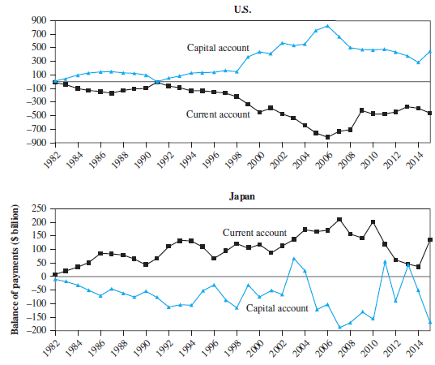
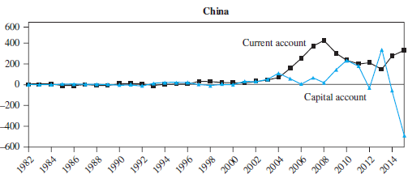
Exhibit 3.7: Balance-of-Payments Trends: 1982-2015
3-25

Slide 26
Balance of Payments Trends
The U.S. and the U.K. tend to realize current account deficits, whereas China, Japan, and Germany tend to realize current account surpluses.
This “global imbalance” implies that the U.S. and U.K. generally use up more outputs than they produce, while the opposite holds for China, Japan, and Germany.
3-26

Slide 27
Mercantilism and the Balance of Payments
Mercantilism holds that a country should avoid trade deficits at all costs, even to imposing various restrictions on imports.
Mercantilist ideas were criticized in the 18th century by such British thinkers as Adam Smith, David Ricardo, and David Hume.
They argued that the main source of wealth in a country is its productive capacity not its trade surpluses.
3-27

Slide 28
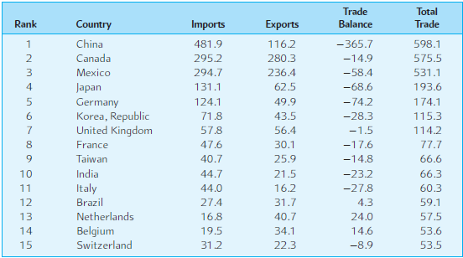
Exhibit 3.8: Top U.S. Trading Partners 2015
(in billions of dollars)
3-28

Slide 29
Summary
The balance of payments is the statistical record of a country’s international transactions over a certain period of time presented in the form of double-entry bookkeeping.
Any transaction resulting in a receipt from foreigners is a credit, any transaction resulting in a payment to foreigners is a debit.
A country’s international transactions can be grouped into three categories: the current account, the capital account and the official reserves account.
3-29

Slide 30
Summary (continued)
The current account is divided into four subcategories: merchandise trade, services, factor income, and unilateral transfers.
The capital account is divided into three subcategories: direct investment, portfolio investment, and other investment.
When we compute the cumulative balance of payments including the current account, capital account, and the statistical discrepancies, we obtain the overall balance.
3-30

Slide 31
Summary (concluded)
A country can run a balance-of-payments surplus or deficit by increasing or decreasing its official reserves.
  Under the fixed exchange rate regime, the combined balance on the current and capital accounts will be equal in size, but opposite in sign, to the change in the official reserves.
  Under the pure flexible exchange rate regime where the central bank does not maintain any official reserves, a current account surplus or deficit must be matched by a capital account deficit or surplus
3-31

Slide 32
The following slides cover the Appendix to Chapter 3.
3-32

Slide 33
Relationship between Balance of Payments and National Income Accounting
National income (Y), or gross domestic product (GDP), is equal to the sum of the nominal consumption of goods and services (C), private investment (I), government spending (G), and the difference between exports (X) and imports (M):
Y ≡ GDP ≡ C + I + G + (X – M)
3-33

Slide 34
Relationship between Balance of Payments and National Income Accounting
Private savings is defined as the amount left from national income after consumption and taxes (T) are paid:
S ≡ Y – C – T or
S ≡ C + I + G + (X – M) – C – T
Note that BCA ≡ X – M; we can rearrange the last equation as
(S – I) + (T – G) ≡ X – M ≡ BCA
3-34

Slide 35
Relationship between Balance of Payments and National Income Accounting
(S – I) + (T – G) ≡ X – M ≡ BCA
This shows that there is an intimate relationship between a country’s BCA and how it finances its domestic investment and pays for government spending.
If (S – I) < 0, then a country’s domestic savings is insufficient to finance domestic investment.
Similarly, if (T – G) < 0, then tax revenue is insufficient to cover government spending and a government budget deficit exists.
3-35

Slide 36
Relationship between Balance of Payments and National Income Accounting
(S – I) + (T – G) ≡ X – M ≡ BCA
When BCA < 0, government budget deficits and/or part of domestic investment are being financed by foreign-controlled capital.
To reduce a BCA deficit, one of the following must occur:
  For a given level of S and I, the government budget deficit (T – G) must be reduced.
  For a given level of I and (T – G), S must be increased.
  For a given level S and (T – G), I must fall.
3-36

