Slide 1
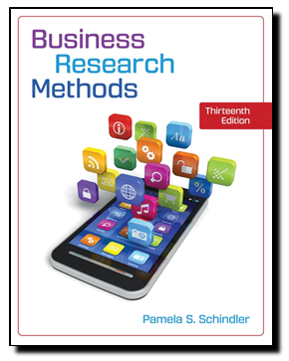
Business Research Methods
Thirteenth Edition
Pamela S. Schindler
Chapter 3
STAGE 1: CLARIFY THE RESEARCH QUESTION
explains the use of secondary data sources to develop and formulate research questions
©2019 McGraw-Hill Education. All rights reserved. Authorized only for instructor use in the classroom. No reproduction or further distribution permitted without the prior written consent of McGraw-Hill Education.
Notes:
This chapter explains the use of secondary data sources to develop and formulate research questions.

Slide 2
Research Thought Leader
“A beautiful question is an ambitious yet actionable question that can begin to shift the way we perceive or think about something—and that might serve as a catalyst to bring about change.”
Warren Berger,
consultant and author,
A More Beautiful Question

Slide 3
Learning Objectives
Understand . . .
The question hierarchy.
The purposes and process of exploration.
How internal and external exploration differ.
The process and goal of research valuation.
The process and justification needed to budget for research.
Ethical issues at this stage of the process.

Slide 4
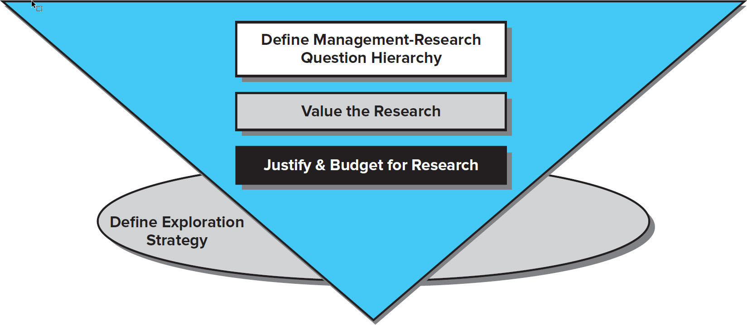
Tasks Associated with Stage 1
has four primary tasks that lead to a clarified research question.
Notes:
Exhibit 3-1 has four primary tasks that lead to a clarified research question.

Slide 5
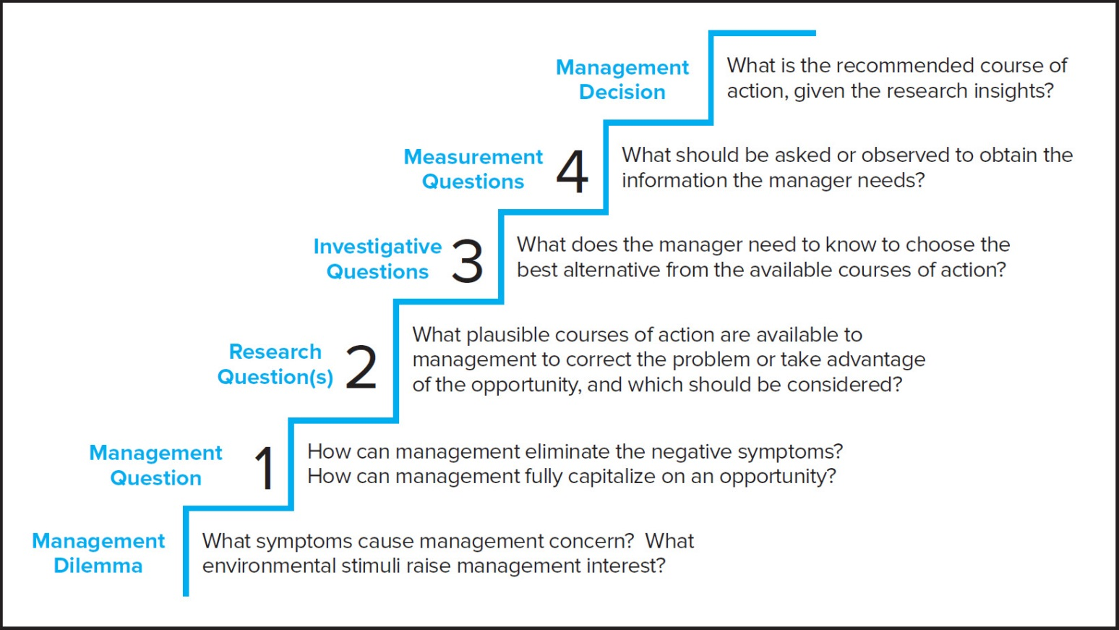
The Management-Research Question Hierarchy
Jump to long description
Notes:
Exhibit 3-2
Exhibit 3-2 illustrates a first task within stage 1 of the research process: Clarify the Research Question.
A useful way to approach the research process is to state the basic dilemma that prompts the research and then try to develop other questions by progressively breaking down the original question into more specific ones. This process can be thought of as the management-research question hierarchy.
The process begins at the most general level with the management dilemma, a symptom of an actual problem, such as rising costs, declining sales, or a large number of defects, or emerging behaviors, attitudes, etc. that signal an opportunity.
A management question is a restatement of the manager’s dilemma in question form.
A research question is the hypothesis that best states the objective of the research; the question that focuses the researcher’s attention.
An investigative question is the question the researcher must answer to satisfactorily answer the research question.
A measurement question is the question asked of the participant or the observations that must be recorded.
This is a good time to discuss the Snapshot: The Art of Asking the Right Question

Slide 6
A useful way to approach the research process is to state the basic dilemma that prompts the research and then try to develop other questions by progressively breaking down the original question into more specific ones. This process can be thought of as the management-research question hierarchy.
The process begins at the most general level with the management dilemma, a symptom of an actual problem, such as rising costs, declining sales, or a large number of defects, or emerging behaviors, attitudes, etc. that signal an opportunity.
A management question is a restatement of the manager’s dilemma in question form.
A research question is the hypothesis that best states the objective of the research; the question that focuses the researcher’s attention.
An investigative question is the question the researcher must answer to satisfactorily answer the research question.
A measurement question is the question asked of the participant or the observations that must be recorded.

Slide 7
Management Questions
Types
Evaluation of Solutions
Control
Choice of purpose or objectives
Troubleshooting
Notes:
These are the categories represented in Exhibit 3-5. Use this slide to ask students to give you a description and an example. Then use the next slide to review each type and correct any errors.

Slide 8
Types of Management Questions
Categories | General Question | Sample Management Questions
Evaluation of solutions (choices between concrete actions to solve problems or take advantage of opportunities) | How can we achieve the objectives we have set? | Should we reposition brand X as a therapeutic product from its current cosmetic positioning? How can we improve our program for product repairs and servicing?
Choice of purpose (choice of objectives) | What do we want to achieve? | What goals should XYZ try to achieve in its next round of union negotiations? What goals should we set for sales and profits in the next 5 years? What goals should XYZ set for its return on its investment portfolio?
Troubleshooting (diagnosing ways an organization is failing to meet its goals) | Why is our (blank) program not meeting its goals? | Why does our department have the lowest sales-to-web page visit ratio? Why does our recruiting program generate the lowest hire-to-offer ratio in the industry?
Control (monitoring or diagnosing ways an organization is failing to meet its goals) | How well is our (blank) program meeting its goals? | What is our product line’s sales-to-promotion cost ratio?
Notes:
This Exhibit 3-5 shows examples of management questions that might flow from management dilemmas.

Slide 9
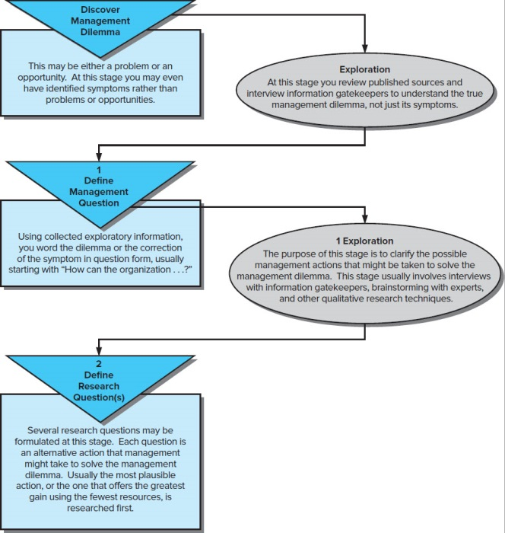
Formulating the Research Question
Notes:
Exhibit 3-4
This slide depicts how exploration leads back into the formulation of management questions and research questions.

Slide 10

Tasks of Exploration (1 of 2)
Understand management dilemma, management problem and research question.
Discover how others have addressed or solved similar problems.
Establish priorities for addressing management dilemmas or management problems.
Identify action options and develop hypotheses.
Gather background information to refine research question.
Notes:
This slide details five of the ten tasks of exploration. The remainder are on the next slide.
Photo Credit
Image Source/Getty Images.

Slide 11

Tasks of Exploration (2 of 2)
Identify information to formulate investigative questions.
Develop operational definitions for concepts, constructs, variables.
Provide evidence for justifying and budgeting research.
Set foundation for final research design.
Identify sources for sample frames & measurement questions..
Notes:
Photo credit
© Image Source, all rights reserved.

Slide 12

Desired Outcomes of Exploration (1 of 2)
Establish range and scope of possible management decisions.
Establish major dimensions of research task.
Define a set of subsidiary questions that can guide research design.
Notes:
An exploratory study is finished when the researchers have achieved the objectives listed in this and the next slide.
Photo credit
© Tony Tallec / Alamy Stock Photo

Slide 13

Desired Outcomes of Exploration (2 of 2)
Develop hypotheses about possible causes of management dilemma.
Learn which hypotheses can be safely ignored.
Conclude additional research is not needed or not feasible.
Notes:
Photo credit
Shutterstock / Andrey_Popov.

Slide 14
Exploration Strategy
What information sources should be used?
What methods will be used to extract information from these sources?
+

Slide 15
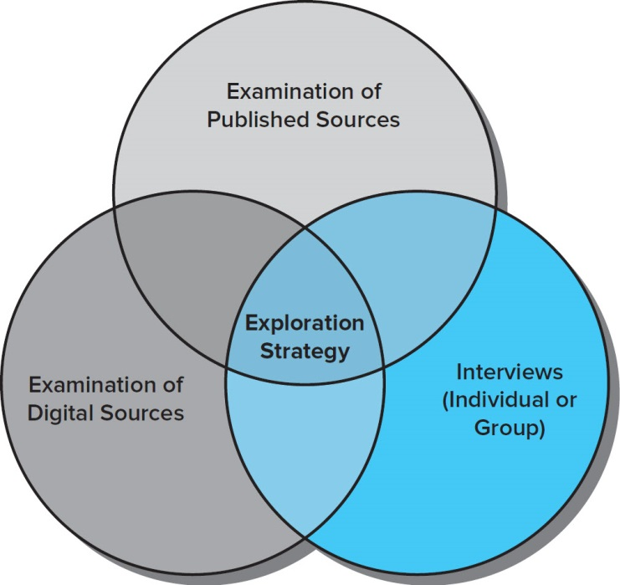
Exploration Strategy Methods
Notes:
Exhibit 3-6 reveals the various aspects of the exploration strategy.

Slide 16

Four Groups of People Sources
Institutional memory guardians or company historians.
Industry or problem experts.
Company employees involved directly in the problem.
Company employees likely to be affected by any considered solution.
People in these four groups often bring unique perspectives to the management dilemma and possible solutions.
Notes:
People in these four groups often bring unique perspectives to the management dilemma and possible solutions.
Photo credit
Shutterstock / nd3000.

Slide 17
Questions to Ask of People Sources
What is being done?
What has been tried in the past with or without success?
How have things changed?
Who is involved in the decisions?
What problem areas can be seen?
Whom can we count on to assist or participate in research on this issue/topic?
Notes:
Broad questions guide the discussion when we use people as sources during exploration. Several questions that could be used are listed in the slide. Some examples of groups who might be identified for an experience survey include potential car buyers, dealer sales representatives, advertising columnists, and automotive industry analysts.

Slide 18
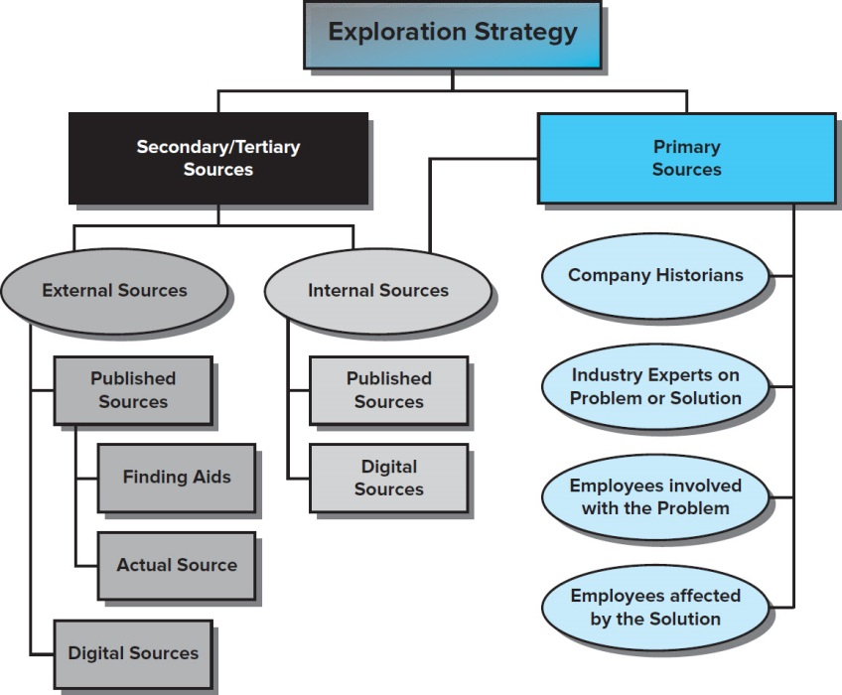
Exploration Strategy Sources
Jump to long description
Notes:
Exhibit 3-7 reveals the primary exploration strategy sources.

Slide 19
Levels of Published & Digital Sources
Primary Sources:
Memos
Letters Interviews Speeches Laws
Internal records
Secondary Sources:
Encyclopedias Textbooks Handbooks Magazines Newspapers Newscasts
Tertiary Sources:
Indexes Bibliographies Internet search engines
Primary sources are original works of research or raw data without interpretation or pronouncements that represent an official opinion or position.
Tertiary sources are aids to discover primary or secondary sources or an interpretation of a secondary source.
Notes:
Information sources are categorized into three levels.
Primary sources are original works of research or raw data without interpretation or pronouncements that represent an official opinion or position.
Secondary sources are interpretations of primary data. A firm searching for secondary sources can search either internally or externally, as depicted in Exhibit 3-7 (slide 18).
Tertiary sources are aids to discover primary or secondary sources or an interpretation of a secondary source.

Slide 20

Primary Internal Sources
Many company reward programs collect transaction data made via store-owned credit programs.
Data can reveal the likely success of a promotion or the sales lift effect of a price incentive.
Notes:
Numerous companies build large consumer purchase behavior databases by collecting transaction data made via store-owned credit programs or frequent purchase loyalty identification programs not linked directly with payment plans. Studying such data can reveal the likely success of a new product introduction or the sales lift effect of a price incentive.
PHOTO CREDIT
stocknshares/Getty Images.

Slide 21


Conduct a Literature Search
Define management dilemma.
Consult books for relevant terms.
Use terms to search.
Locate/review secondary sources.
Evaluate value of each source and content.
The result of a literature search could be a solution to the management dilemma. If so, no further research is necessary. Otherwise, a research proposal is generated.
Notes:
Generally, the exploration phase will begin with a literature search. A literature search is a review of books, journal articles, and professional literature that relate to the management dilemma. This may also include Web-published material. This slide details the five steps of a literature search.
The result of a literature search could be a solution to the management dilemma. If so, no further research is necessary. Otherwise, a research proposal is generated.
Photo credit
Shutterstock / Rawpixel.com

Slide 22
Types of Secondary Sources
TYPES
An index is a secondary data source that helps to identify and locate a single book, journal article, author, etc. from a larger set.
A bibliography is an information source that helps locate a single book, article, photograph, etc.
Dictionaries are secondary sources that define words, terms, and jargon.
Encyclopedias are secondary sources that provide background or historical information about a topic.
A handbook is a secondary source used to identify key terms, people, or events relevant to the management dilemma or management question.
Directories are reference sources used to identify contact information
Notes:
These are the five types of information sources used most by researchers at this phase of a project.
Indexes and bibliographies help one to identify books and journal articles.
An index is a secondary data source that helps to identify and locate a single book, journal article, author, etc. from a larger set.
A bibliography is an information source that helps locate a single book, article, photograph, etc.
Dictionaries are secondary sources that define words, terms, and jargon.
Encyclopedias are secondary sources that provide background or historical information about a topic.
A handbook is a secondary source used to identify key terms, people, or events relevant to the management dilemma or management question.
Directories are reference sources used to identify contact information.

Slide 23

A dictionary…

Slide 24
Evaluate Published & Digital Sources
Evaluation Factors
  Purpose is the explicit or hidden agenda of the information source.
  Scope is the breadth or depth of topic coverage, including time period, geographic limitations, and the criteria for information inclusion.
  Authority is the level of the data (primary, secondary, tertiary) and the credentials of the source author.
  Audience refers to the characteristics and background of the people or groups for whom the source was created.
  Format refers to how the information is presented and the degree of ease in locating specific information within the source.
Notes:
A researcher using secondary sources will want to conduct a source evaluation on five factors; Exhibit 3-8 examines these in detail. If you prefer, you can use the next two slides (hidden) which show the actual table from the text.
Purpose is the explicit or hidden agenda of the information source.
Scope is the breadth or depth of topic coverage, including time period, geographic limitations, and the criteria for information inclusion.
Authority is the level of the data (primary, secondary, tertiary) and the credentials of the source author.
Audience refers to the characteristics and background of the people or groups for whom the source was created.
Format refers to how the information is presented and the degree of ease in locating specific information within the source.
Students often accept web-delivered information as of the same quality as electronic databases. One exercise is to have them view a web-site and present an analysis of it using the five factors. Students are often active participants in blogging, so having them use such a site for analysis might open their eyes.
Exhibit 3-8 offers several questions to answer when evaluating web sites on the five factors.

Slide 25
Evaluating Internal Sources
The quality and appropriateness of internal sources should not be assumed.
Compatibility with the current management dilemma, problem, and research question (the more compatible the data, the more valuable the data).
Timelessness (the more the data hasn’t been affected by time, the more valuable the data).
Recentness (the more current the data, the more valuable the data.)
Quality of original research process (the more that standards of good research were applied in collecting the original data, the more valuable the data).
Author(s) experience of the individual(s) compiling the source (the more experienced the individuals, the more valuable the data).
Notes:
The quality and appropriateness of internal sources should not be assumed.
Compatibility with the current management dilemma, problem, and research question (the more compatible the data, the more valuable the data).
Timelessness (the more the data hasn’t been affected by time, the more valuable the data).
Recentness (the more current the data, the more valuable the data.)
Quality of original research process (the more that standards of good research were applied in collecting the original data, the more valuable the data).
Author(s) experience of the individual(s) compiling the source (the more experienced the individuals, the more valuable the data).

Slide 26
Fine-Tuning the Research Question
In addition to fine-tuning the original question, other research question-related activities should be addressed in this phase to enhance the direction of the project.
  Examine variables to be studied and assess whether they are operationally defined.
  Review the research questions to break them down into second and third-level questions.
  Evaluate hypotheses to be sure they meet the criteria for strong hypotheses.
  Determine what evidence must be collected to answer the various questions and hypotheses.
  Set the scope of the study by stating what is not a part of the research question.
.
Notes:
A research question best states the objective of the marketing research study. Incorrectly defining the research question is the fundamental weakness in the marketing research process.
After the exploration process is complete, the researcher must fine-tune the research question. At this point, the research question will have evolved in some fashion. It will have better focus.
In addition to fine-tuning the original question, other research question-related activities should be addressed in this phase to enhance the direction of the project.
Examine variables to be studied and assess whether they are operationally defined.
Review the research questions to break them down into second and third-level questions.
Evaluate hypotheses to be sure they meet the criteria for strong hypotheses.
Determine what evidence must be collected to answer the various questions and hypotheses.
Set the scope of the study by stating what is not a part of the research question.

Slide 27

Value the Research (1 of 3)
Research value is the “difference between the result of decisions made with [new] information and the result that would be made without it.”
Notes:
Photo credit
©Ariel Skelley/Blend Images

Slide 28
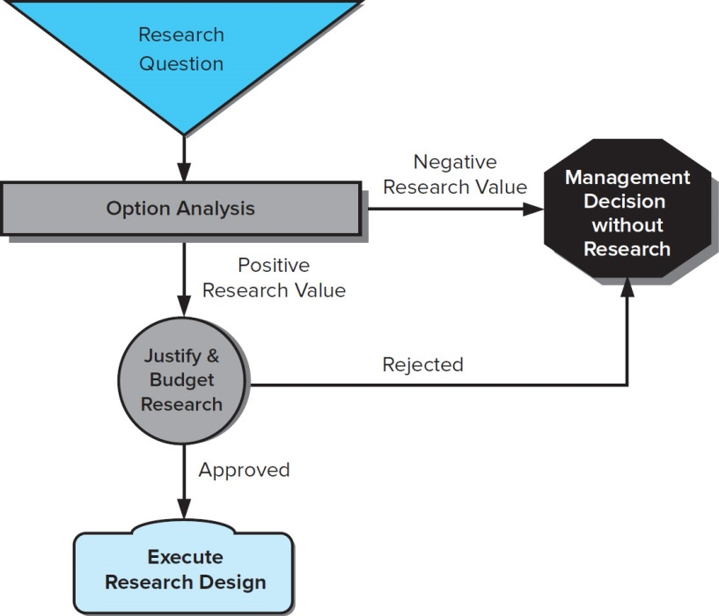
Value the Research (2 of 3)
Notes:
Exhibit 3-9 summarizes the process for valuing research.

Slide 29

Value the Research (3 of 3)
Option analysis: Managers conduct formal analysis of each alternative research project judged in terms of estimated costs and associated benefits and with managerial judgment playing a major role.
Decision theory: The focus is on trying to assess the outcomes of each action. The manager chooses the action that affords the best outcome – the action criteria that meets or exceeds whatever criteria are established. Each criterion is a combination of a decision rule and a decision variable. The decision rule is a criterion for judging the attractiveness of two or more alternatives when using a decision variable. The decision variable is a quantifiable characteristic, attribute, or outcome on which a choice decision will be made. The evaluation of alternatives requires that
    each alternative is explicitly stated,
    a decision variable is defined by an outcome that may be measured, and
    a decision rule is determined by which outcomes may be compared.
Most research is valued after it is conducted (by determining how much money was saved or gained, how many employees were retained vs lost, etc.). But over time, a savvy manager can estimate value of research based on prior experience.
Notes:
Managers are increasingly asked to prove that research meets ROI objectives. Conceptually, the value of research is not difficult to determine. It may be judged in terms of the difference between the result of decisions made with the information and the result that would be made without it. This application cannot be measured, though.
Option analysis: Managers conduct formal analysis of each alternative research project judged in terms of estimated costs and associated benefits and with managerial judgment playing a major role.
Decision theory: The focus is on trying to assess the outcomes of each action. The manager chooses the action that affords the best outcome – the action criteria that meets or exceeds whatever criteria are established. Each criterion is a combination of a decision rule and a decision variable. The decision rule is a criterion for judging the attractiveness of two or more alternatives when using a decision variable. The decision variable is a quantifiable characteristic, attribute, or outcome on which a choice decision will be made. The evaluation of alternatives requires that
each alternative is explicitly stated,
a decision variable is defined by an outcome that may be measured, and
a decision rule is determined by which outcomes may be compared.
Most research is valued after it is conducted (by determining how much money was saved or gained, how many employees were retained vs lost, etc.). But over time, a savvy manager can estimate value of research based on prior experience.
Photo Credit
Purestock/Superstock.

Slide 30
Budget the Research
Task budget. Dollars are drawn from the discretionary reserves of an organization or the budget of an in-house research operation to fund a research project. A discretionary reserve might be based on a fixed percentage of projected or prior year’s sales.
Functional area budget. Dollars drawn from a portion of the manager’s business unit’s operational funds and allocated to research activities. The manager has the authority to spend budget dollars as he or she desires. This process is also competitive because, internally, the manager has numerous goals and priorities. Government agencies, not-for-profits, and businesses alike frequently manage research budgeting this way.
Notes:
Task budget. Dollars are drawn from the discretionary reserves of an organization or the budget of an in-house research operation to fund a research project. A discretionary reserve might be based on a fixed percentage of projected or prior year’s sales.
Functional area budget. Dollars drawn from a portion of the manager’s business unit’s operational funds and allocated to research activities. The manager has the authority to spend budget dollars as he or she desires. This process is also competitive because, internally, the manager has numerous goals and priorities. Government agencies, not-for-profits, and businesses alike frequently manage research budgeting this way.

Slide 31
Key Terms
Bibliography
Data warehouse
Decision rule
Decision variable
Dictionary
Directory
Encyclopedia
Expert interview
Exploration
Exploration Strategy
Handbook
Index
Investigative questions
Literature search
Management dilemma
Management question
Management-research question hierarchy
Measurement questions
Option Analysis
Primary sources
Research questions
Secondary sources
Source evaluation
Purpose
Scope
Authority
Audience
Format
Tertiary sources

