Slide 1



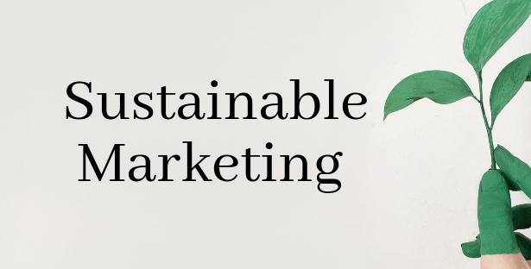

Slide 2
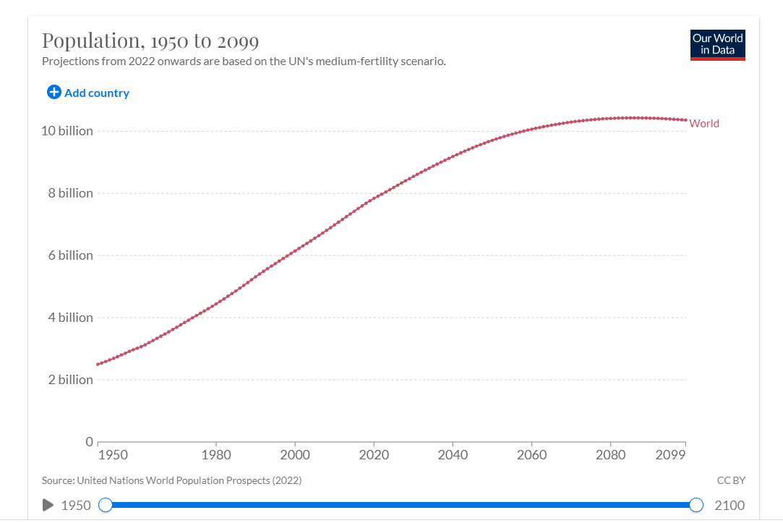
The next global population milestone—nine billion—will likely be hit sometime in the 2030s.

Slide 3
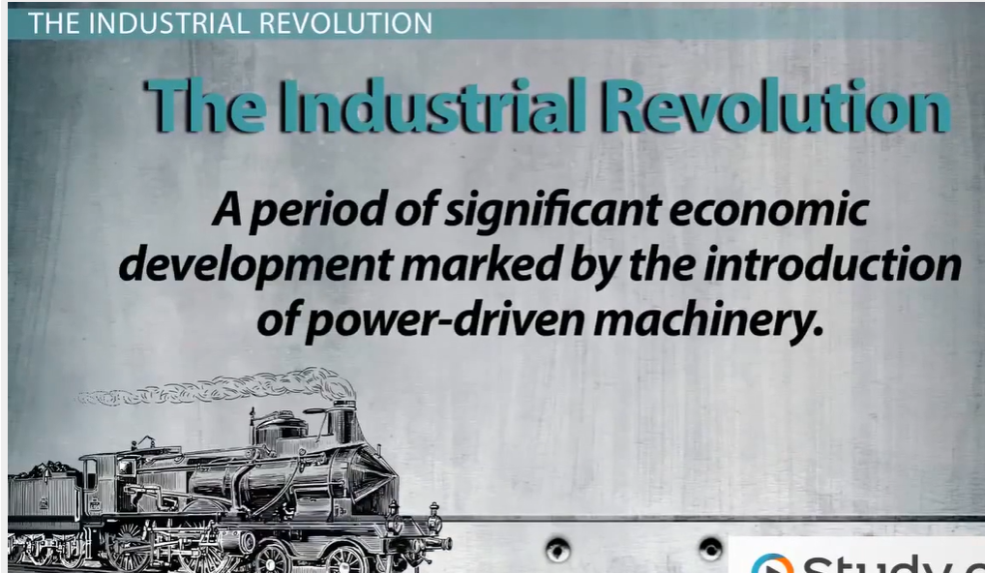



Slide 4
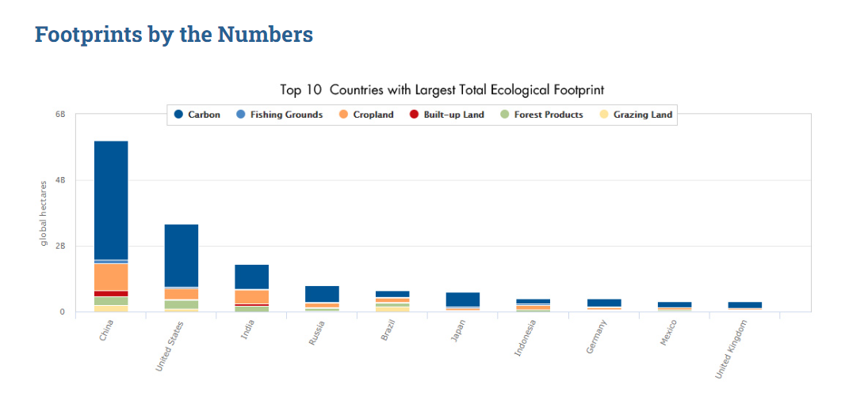
For more than 40 years, humanity’s demand on nature has exceeded what our planet can replenish. We would need the regenerative capacity of 1.6 Earths to provide the natural resources and ecological services we currently use.
Biocapacity and Ecological Footprint accounts document the supply and demand of natural resources and services based on historical datasets. It includes:
the biologically productive area (or biocapacity) needed for crops, grazing land, built-up areas, fishing grounds and forest products
the area of forest needed to absorb carbon dioxide emissions that cannot be absorbed by the ocean.
Carbon from burning fossil fuels

Slide 5
Environmental Problems
Global Warming From Fossil Fuels
Poor Governance
Food Waste
Biodiversity Loss
Plastic Pollution
Deforestation
Air Pollution
Melting Ice Caps and Sea Level Rise
Ocean Acidification
Agriculture / release of green house gases
Food and Water Insecurity
Overfishing
https://earth.org/the-biggest-environmental-problems-of-our-lifetime/

Slide 6
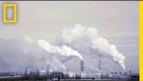

Slide 7
Some other facts…
It's estimated that approximately 700 million people still live on less than US$1.90 per day, a total of 1.3 billion people are multi-dimensionally poor, including a disproportionate number of women and people with disabilities and 80 percent of humanity lives on less than US$10 per day. Increasingly, middle-income countries account for a large part of this trend.
Around 258 million people live outside their countries of origin and 68.5 million are displaced. Disasters and the effects of climate change have displaced more people than ever before – on average 14 million people annually.
840 million people worldwide have no access to electricity, and 2.9 billion people use solid fuels to cook or heat their homes, exposing their families to grave health hazards and contributing to vast deforestation worldwide
Women and girls make up a disproportionate share of people in poverty, and are more likely to face hunger, violence, and the impacts of disaster and climate change. They are also more likely to be denied access to legal rights and basic services.

Slide 8

Sustainable Development
Sustainable development is development that meets the needs of the present without compromising the ability of future generations to meet their own needs
The key concepts of are needs (quality of life) and limitations.
The world is experiencing a great gap between rich and poor countries and unequal distribution of wealth. Sustainable development means to cover at least the basic needs of all people; all other living standards have to be sustainable.
The “ability of future generations to meet their own needs” refers more to the environment. With humanity’s current Ecological Footprint the planet’s environmental capacity is already exceeded and essentially resources are borrowed from future generations, thus limiting their ability to meet their own needs.

Slide 9
Sustainable Development
The concept was globally introduced at the Brundlandt Report in 1987 (World Environment and Development Commision)
With the goal of producing a new blueprint for global action on the environment, at the Earth summit in 1992 its concluded that "integrating and balancing economic, social, and environmental concerns in meeting our needs is vital for sustaining human life on the planet."
Agenda 2030 (UNDP) conceived the 17 Sustainable Development Goals (SDGs) with their 169 targets as balancing "the three dimensions of sustainable development, the economic, social and environmental.

Slide 10
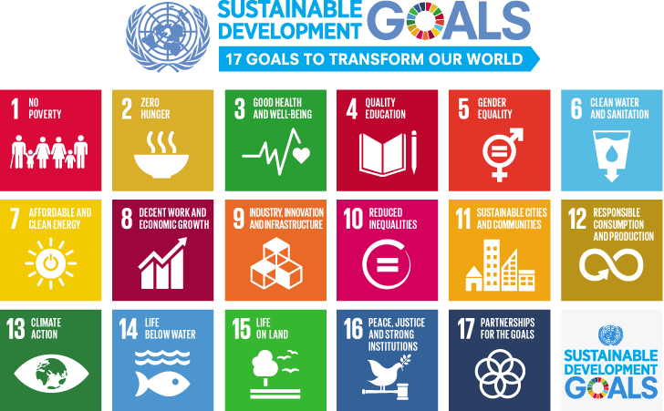

Slide 11
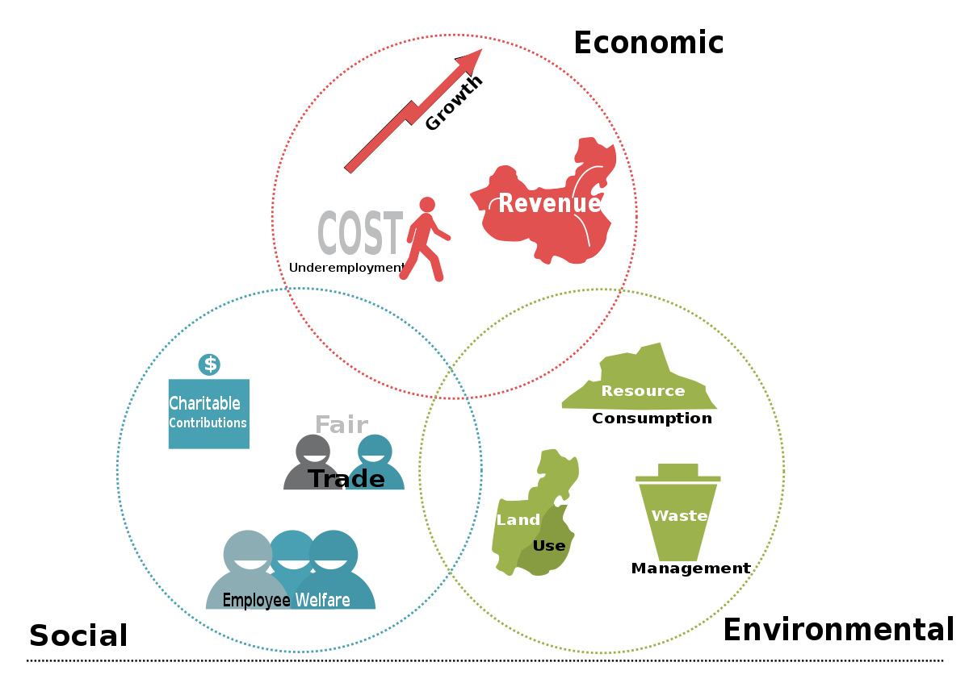
Three Pillars of Sustainability

Slide 12
How to apply these pillars within your company?
Social pillar: ensure the well-being of your employees
  Well-being of employees, take ethical action
Economic pillar: optimise your budget
  More responsible approach by encouraging recycling, limiting waste, usin renewable raw materials, integrate waste into a second line of production or sales channel
Environmental pillar: improve your CSR strategy
  Have an essential corporate social responsibility perspective
  Revise your brand image in an eco-friendly wat

Slide 13
Sustainable Marketing
Sustainability vs. Marketing

Slide 14
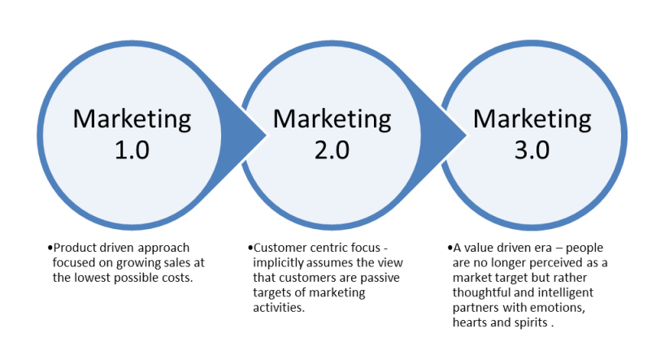
The Eras of Marketing
Source: Developed according to Kotler’s concept of Marketing

Slide 15

Evolution of Sustainability in Marketing
Social and Societal Marketing
Ecological Marketing
Green Marketing

Slide 16
Social and Societal Marketing
Social marketing has consumer orientation, which can be effective at winning people over, engaging them, motivation them and empowering them as individuals or within communities” (Gordon, 2011)
It is well known for using in public health campaigns, like drink-driving, antismoking and drug abuse, etc. Social marketers know that they have the responsibility to try to change behaviors

Slide 17
Ecological Marketing
Ecological marketing is concerned with all marketing activities (a) that have served to help cause environmental problems and (b) that may serve to provide a remedy for environmental problems” (Peattie, 2001)
Ecological marketing deals with factors affecting ecology and pollution. Ecological issues mainly concentrated on producer’s will to become environmental friendly and these were not considering consumer demand at all

Slide 18

Green Marketing
Less priority was given to environmental issues in terms of marketing strategy from 1970 to 1985, but after that these issues really picked the pace.
Green Marketing is about companies applying sustainable thinking holistically, from production to post-purchasing service, aiming to balance the company’s need for profit with the wider need to protect the environment
“Green marketing focuses on market pull and legislative push towards improved, environmentally friendly corporate performance» (Dam and Apeldoorn, 1996)
Green marketing facilitates the development and marketing of more sustainable products and services while introducing sustainability efforts into the core of the marketing process and business practice

Slide 19
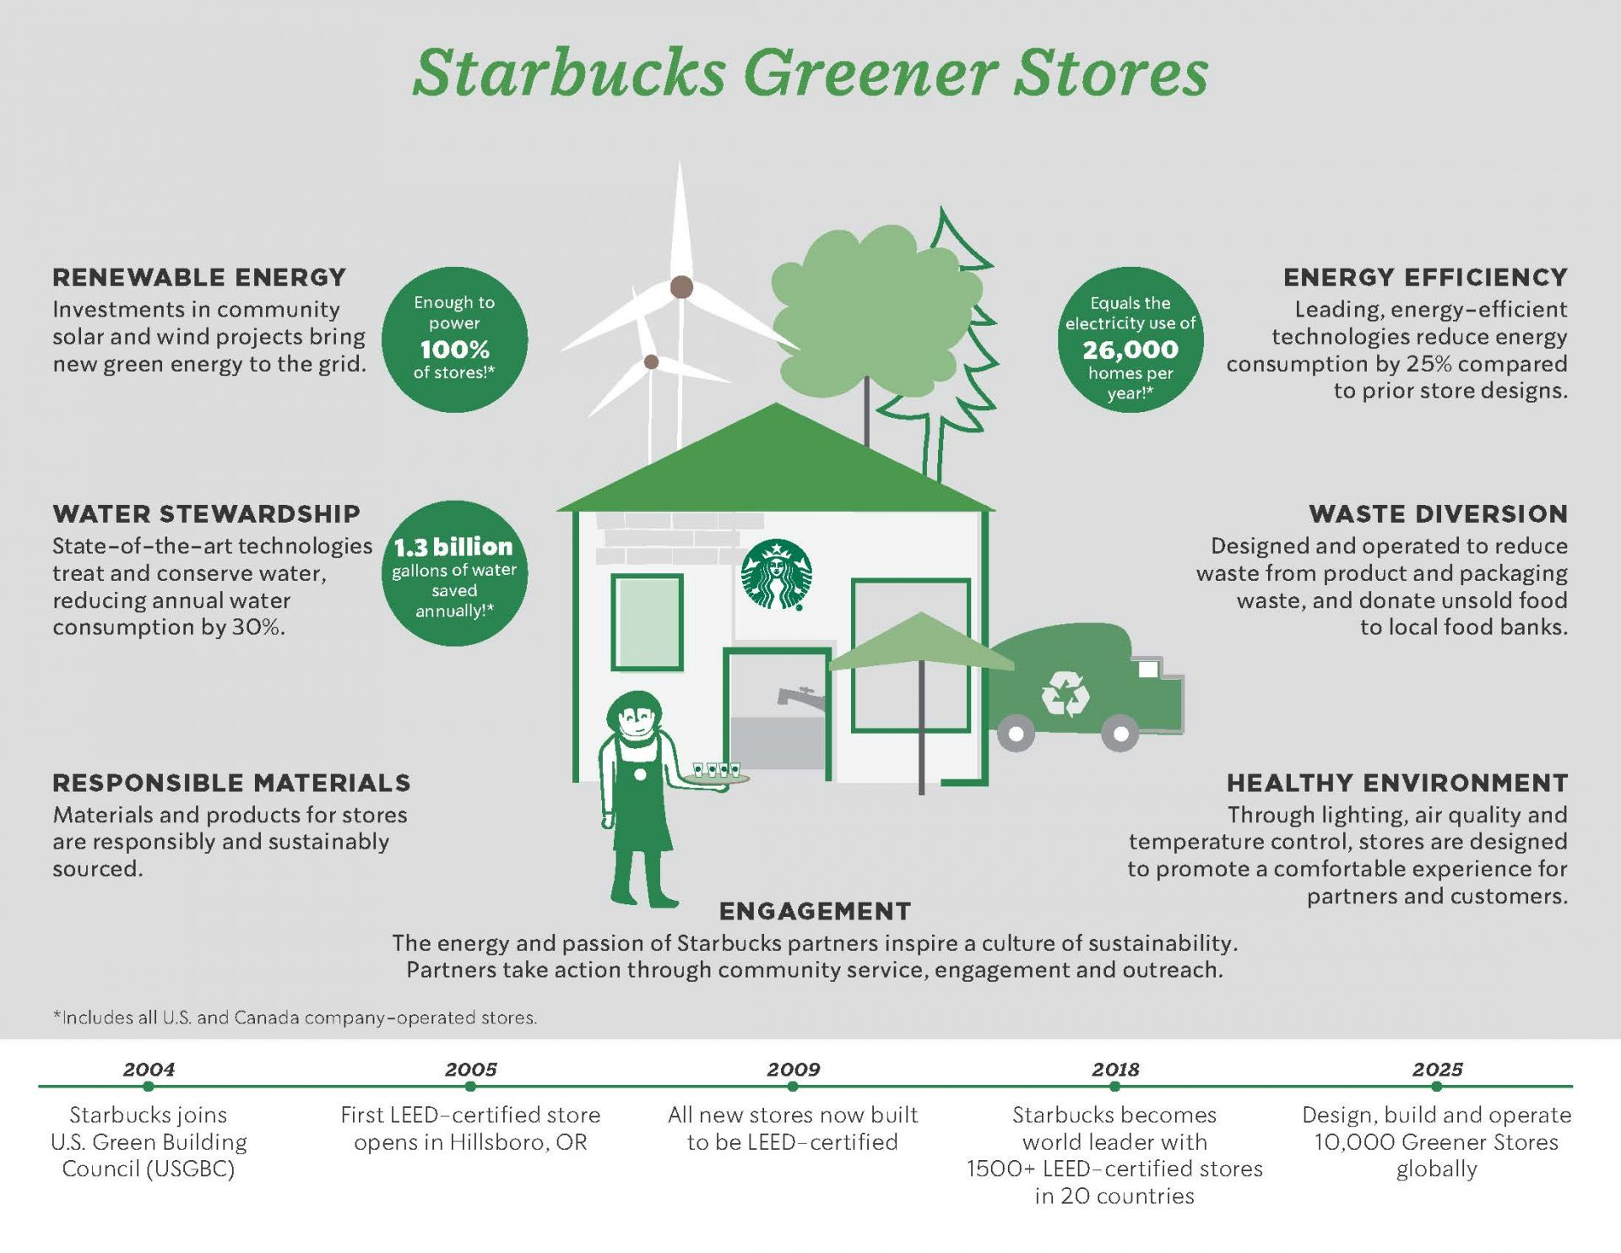

Slide 20
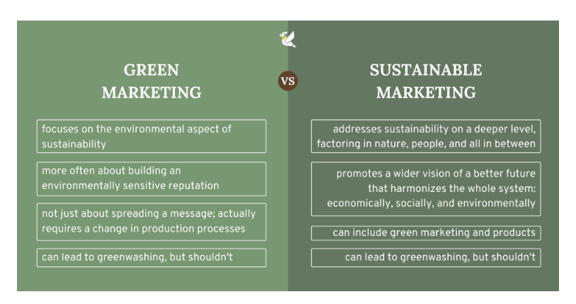
Dressing up in a disguise of eco-friendliness in order to dupe people who’re concerned about the environment into buying is known as greenwashing

Slide 21
Sustainable Marketing
The underlying philosophy of Sustainable Marketing, which Kotler calls Marketing 3.0, seems to be a business model that could meet the people’s needs, increase the efficiency of the development of global society, create new jobs and raise the level and quality of life for today and tomorrow.
“Sustainable Marketing recognizes that all human activity is dependent on the existence of the natural capital provided by the planet and acknowledges that long-term, sustainable economic viability only results both environmental stability and societal equity. The sustainable marketing paradigm aims to address these challenges (Seretny & Seretny, 2015)
Based on three pillars - economic, social and environmental - responsible consumption involves the use of the goods in a more efficient and responsible manner, suggesting an equitable distribution of resources between rich and poor societies

Slide 22
Sustainable Marketing is…
Not just about producing better and cheaper, and refrain from cutting down trees.
The value of doing business, which influences efficiency, inspires creativity, promotes and preserves cooperation.
An aim to influence customer behavior and utilise consumer social evolution in order to create positive social change and thus to achieve a new long-term profit.
A way to influence what the customer receives - create brands that are part of the commercial and social future.
Supposed to provide goods and services, through managing in a responsible manner, being open to fair cooperation in marketing communication.

Slide 23
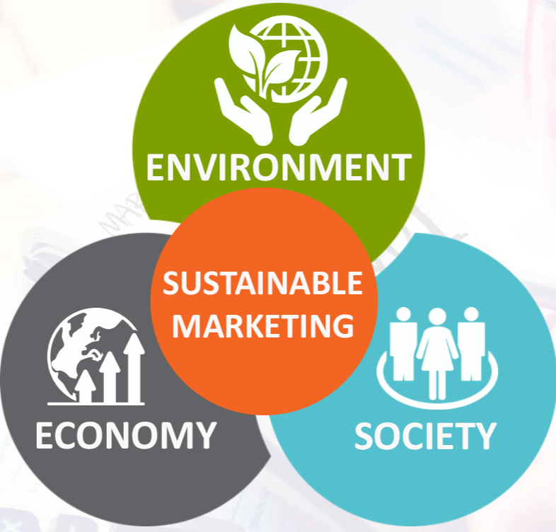
Sustainable marketing is a holistic approach
A company’s mission and vision has to support sustainable marketing, which can be found in the core values of a company.
Designing, producing and delivering a sustainable product is not only the responsibility of the marketing department but requires the collaboration between all departments in a company

Slide 24
Does Consumer Value Sustainability?
“Sustainability communications are no longer a hygiene factor, but a priority factor. Many customers now look for sustainability as one of the priority filters to purchase, often over price.”
With 79% of consumers changing purchase preference based on products’ social or environmental impact, marketers are racing to capitalise with sustainability messaging.
“Sustainability is unforgiving. More so than price, delivery and quality. If you get your sustainability messages wrong or your promises are lies, then it’s a long road to try and claw that back.”

Slide 25
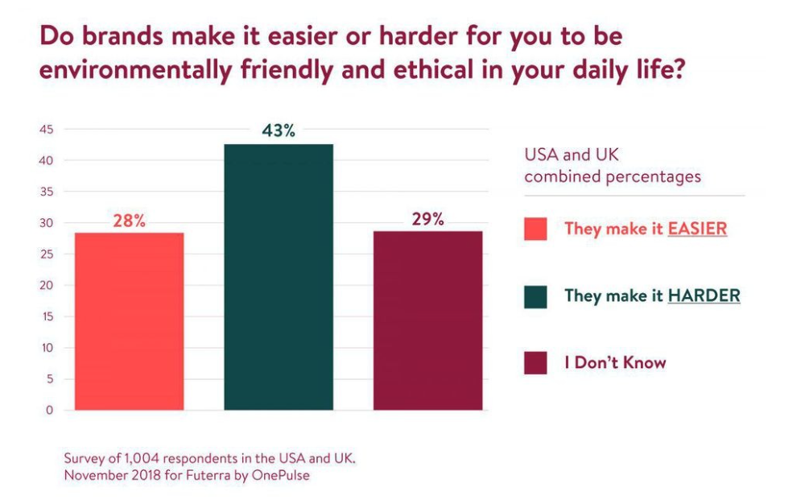

Slide 26

Consumers are realizing how ethical spending can bring serious solutions
Between 2013 and 2019, 50% of growth in consumer packaged goods came from sustainability-marketed products, and consumers are increasingly likely to spend more money on eco-friendly brands.
In a 2019 study, 96% of consumers surveyed felt that their actions could make a difference, but nearly half complained that company practices got in their way.

Slide 27
Sustainable Marketing Mix

Slide 28
Sustainable Products
Sustainable product and/or service is defined as an offer serving customer needs while fostering the implementation of environmental and social objectives, in the whole of the product life cycle.
Enable to satisfy customer needs.
Durability of the product - sustainable product should enable meeting the needs of the customer in the long term,
the dual nature of sustainable offers, i.e. the implementation of social and environmental aspects. Unlike the organic, sustainable products should focus on social and environmental aspects,
Broad understanding of the product life cycle - from raw material acquisition stage, through transport and manufacturing to use and post - use,
Continuous improvement of products
Taking into account the significant improvements - sustainable products have to make a worthwhile contribution to tackling socio-ecological problems for both: the target group and the society,
Transparency, not only in terms of the level of the service quality or product performance assessment, but also the manufacturing process (including the type of sources and their origin)
Belz, 2012

Slide 29
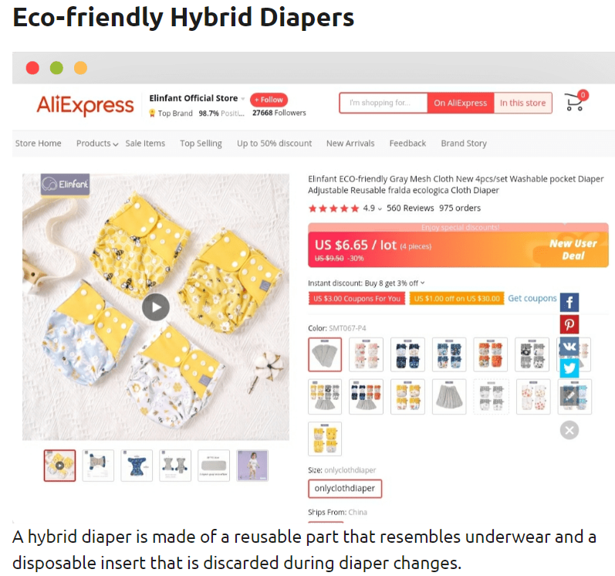
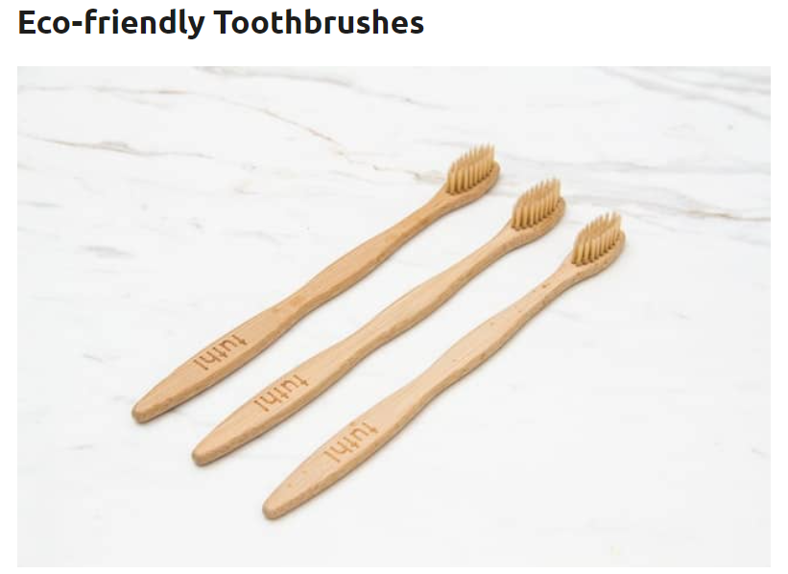


Slide 30
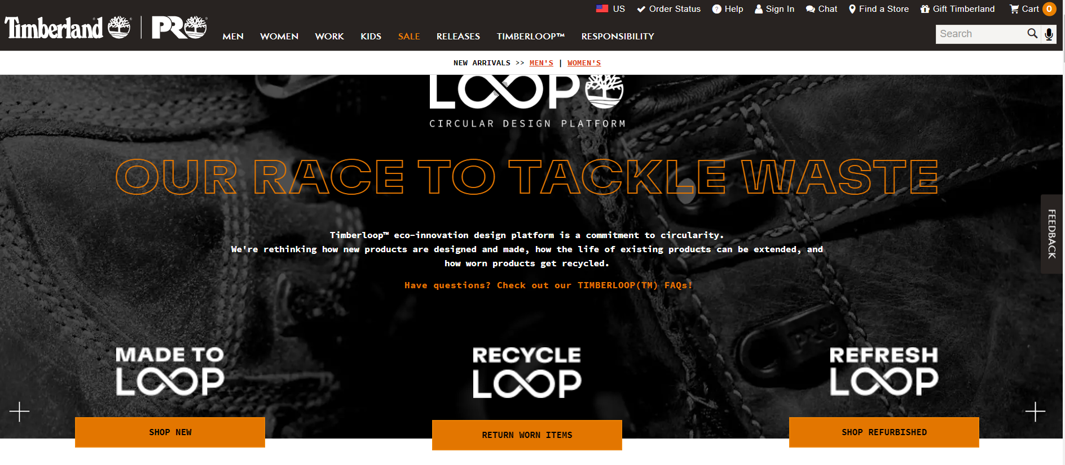

Slide 31

Ikea Sustainability

Slide 32
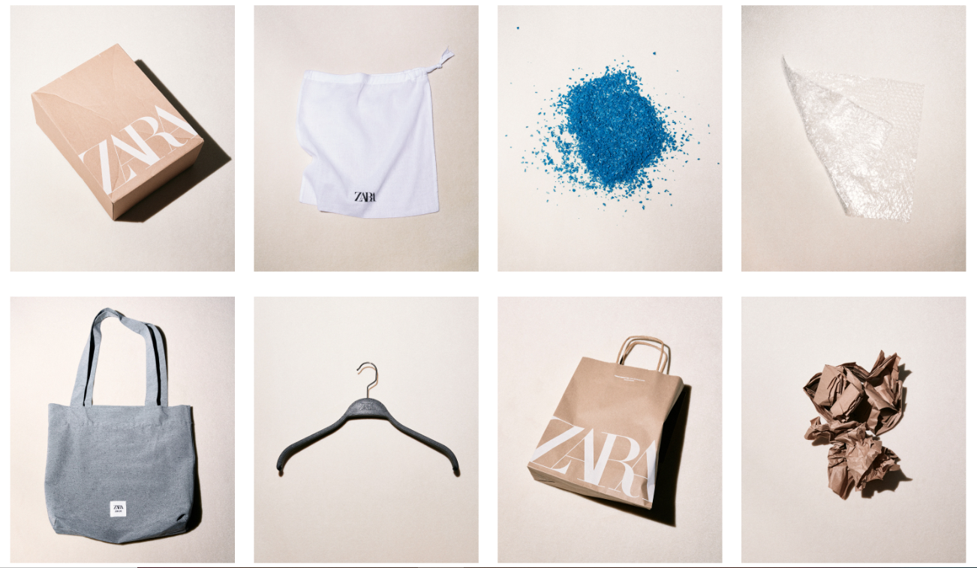
https://www.zara.com/us/en/sustainability-products-mkt1455.html?v1=1471219
https://www.inditex.com/itxcomweb/en/sustainability

Slide 33
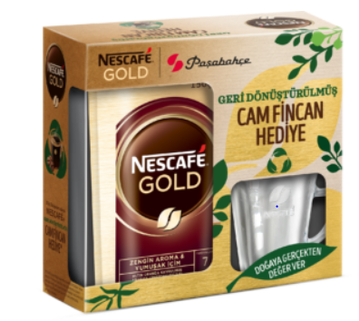
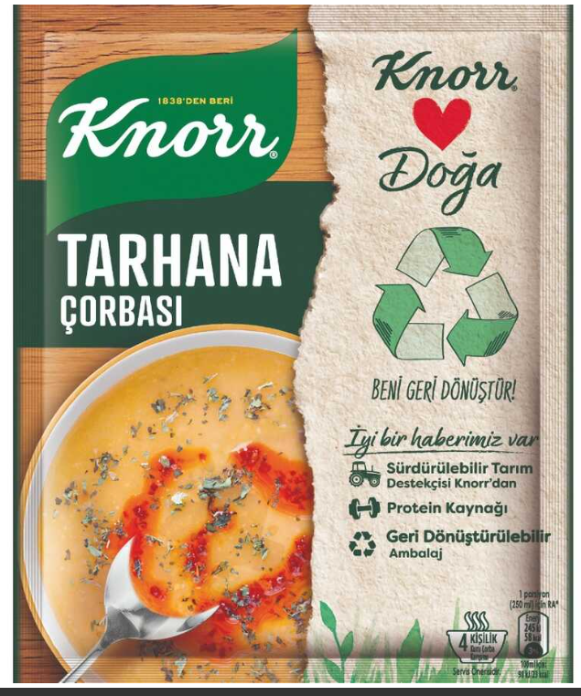
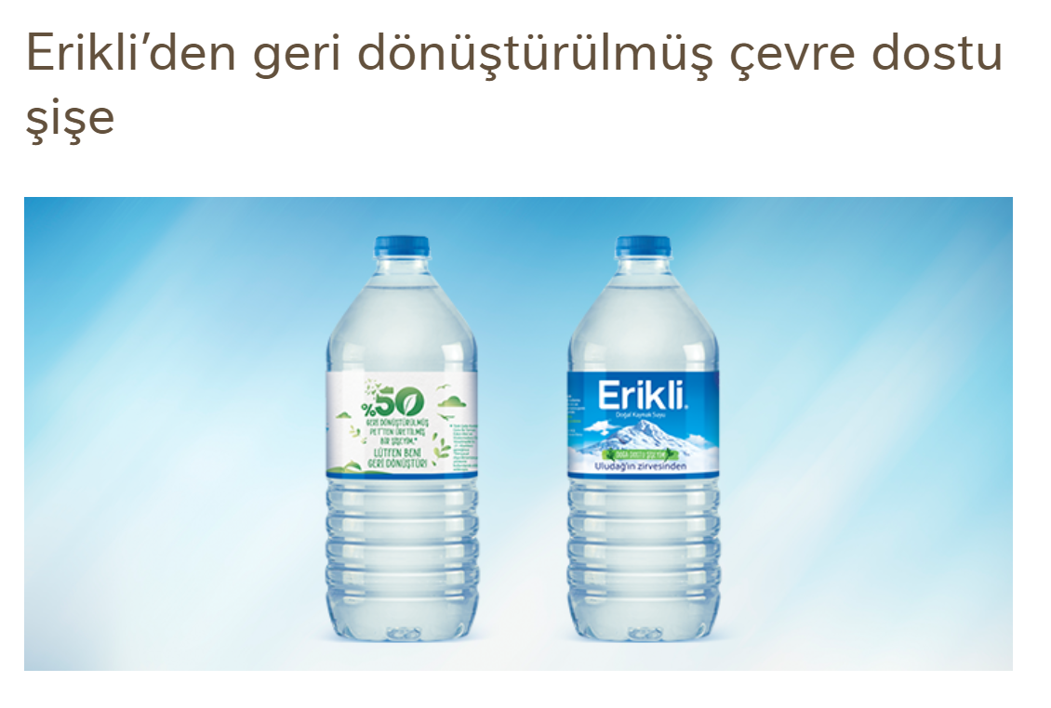

Slide 34
Sustainable Prices
Research the possibility of connecting prices with important social or environmental issue,
Identify opportunities for growth in margins and/or increasing the competitiveness of the prices combining them with ecological impacts,
Identify the price level, which will be accepted by customers thanks to the features possessed by the product,
Include overall social and environmental costs in the price while providing benefits for the buyer and a fair profit level for the seller
Sustainable products have higher prices than other offers, which is an important barrier on the demand side
Sustainable marketing concept is not confined to calculating the economic costs, but also takes into account the social and environmental costs
Martin, Schouten 2012

Slide 35
Distribution Policy of Sustainable Products
Physical distribution of goods and services has both direct and indirect impact on the environment
How to reach consumers through new/modified distribution channels allowing minimizing the negative impact on the socio-ecological environment?
Green Supply Chain Management
Maximizing customer service levels while minimizing costs and minimizing negative impacts on the environment
The control of the selection of suppliers, integration of the supply processes, manufacturing, delivery, returns handling, recycling processes, and waste management for fulfilling social and environmental standards,
Ciesielski, 2011

Slide 36
Promotion / Responsible communication
Products or services provided by companies operating in a sustainable way have a higher price, thus the image of luxury products. Meanwhile, their purchase should not be judged as snobbish, but conscious and responsible behaviour of the buyer.
Communication in sustainable marketing is the inclusion of a company in a dialogue with various stakeholders.
Sustainable marketing concept is based on an interactive dialogue, following the actual needs and expectations of the customer
Encourage consumers to purchase their offers, but at the same time underline the products and brands features, which meet the socio-ecological requirements
Rudawska, Frackiewicz, & Wiscicka, 2016

Slide 37
Sustainable marketing activities in relation to employees
Employees, are one of the key stakeholder groups, in addition to customers and shareholders.
Employees are an integral part of the sustainable marketing strategy, because they directly implement its foundationand effectiveness to reach goals.
Integration, internal communication and social dialogue, which considers the needs of employees
Include safety in the workplace and health care and employees' rights
The creation of company friendly to parents and ensuring the harmony between work and private live (work-life-balance), i.e. offering a flexible/reduced working time, individual setting of schedule or telecommuting opportunities,
Company engagement in the socio-ecological initiatives as well as informing and educating employees in this area as well as encouraging employees to engage in them

Slide 38
Sustainable Marketing Strategies
Have a larger purpose.
Place value ahead of profit.
Be consumer-oriented.
Reflect sustainability in every aspect of your brand

Slide 39
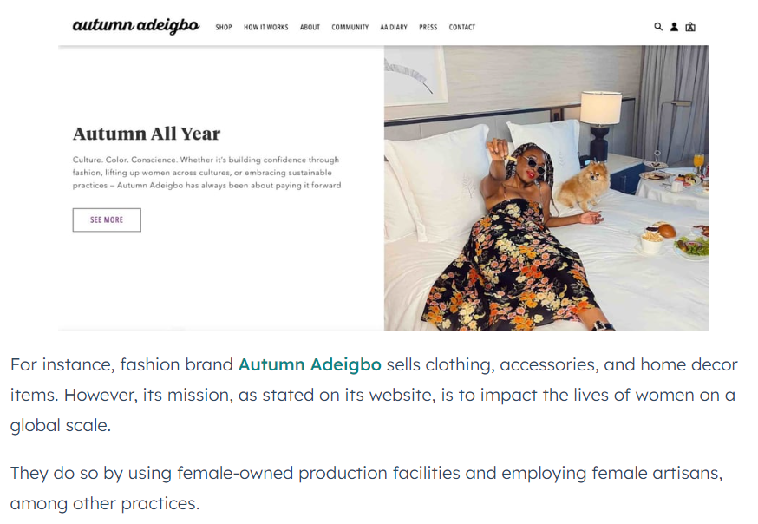
Have a larger purpose
As a brand, you have to promote something that’s bigger than your products and services and transcends any particular industry.

Slide 40
Think ahead
Sustainable marketing looks at ways to nurture consumers during the entire buyer’s journey.
Education is one way to build loyalty with your audience early on. From when they first discover you on social media to after they’ve made a purpose.
For instance, a food brand could educate its audience on the importance of ethical farming on social media and continue this process post-purchase with package recycling tips.

Slide 41
Be consumer oriented
In traditional marketing, a brand will often try to push a product or service to a customer. With consumer-oriented marketing, it’s more about understanding your customers’ needs and tailoring your marketing to that.
For instance, say your audience is craving more transparency in your sourcing practices or wants you to be more vocal on social issues. You could use that information for your next campaign.

Slide 42
Reflect sustainability in every aspect of your brand
Sustainability marketing doesn’t work if it’s not authentic.
Make sure your brand is looking at sustainability from a holistic lens.
Are you preaching about sustainability but using unsustainable resources to build your product? Are you collaborating with brands that conflict with your mission? Is your team representative of the future you want to promote?
Audiences don’t expect perfection, they do, however, value transparency. It’s ok to share where you currently fall short and how you plan to remedy these issues.

Slide 43

Pangaia

Slide 44


Global Trends in Sustainable Marketing

Slide 45
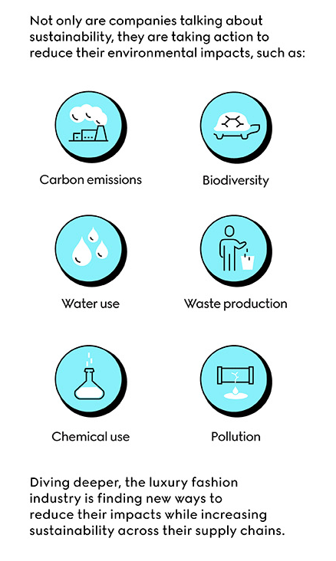
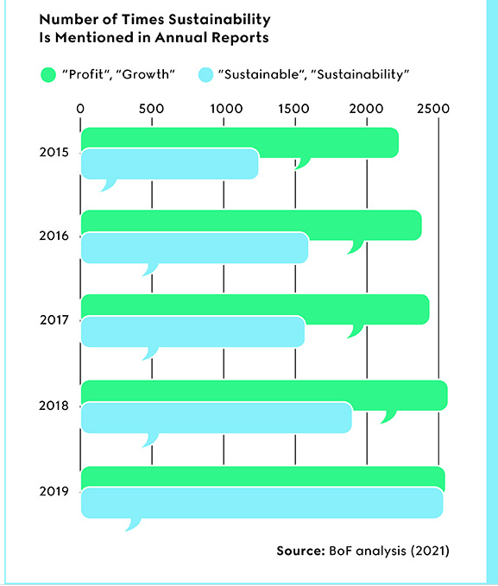
Leaders in Luxury fashion are putting sustainability at the forefront of supply chain transformation to all departments to address the global climate and biodiversity crises.

Slide 46
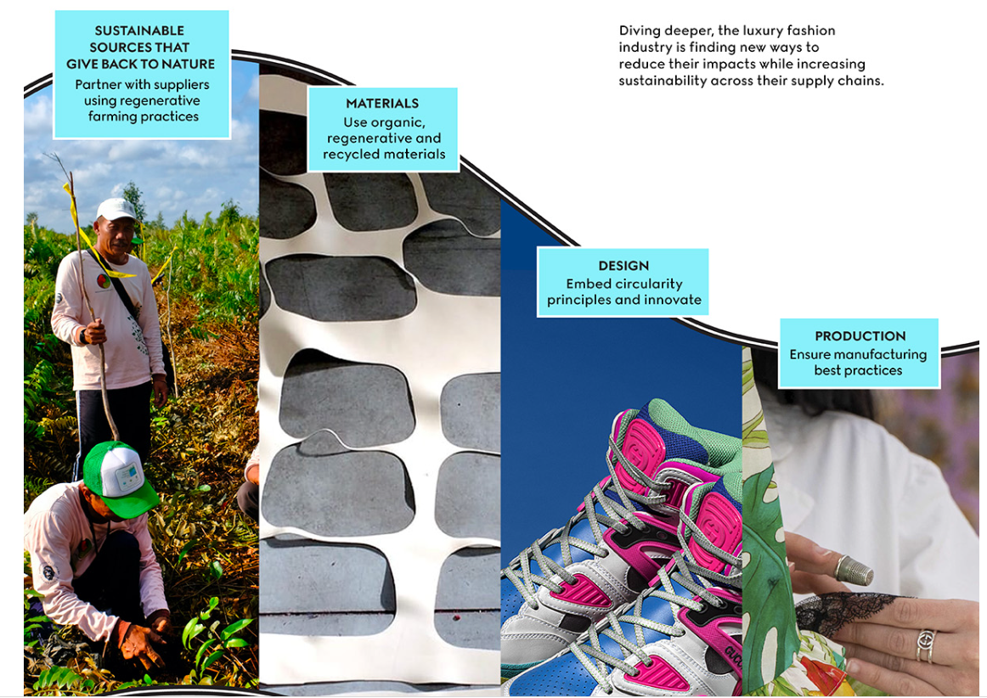

Slide 47
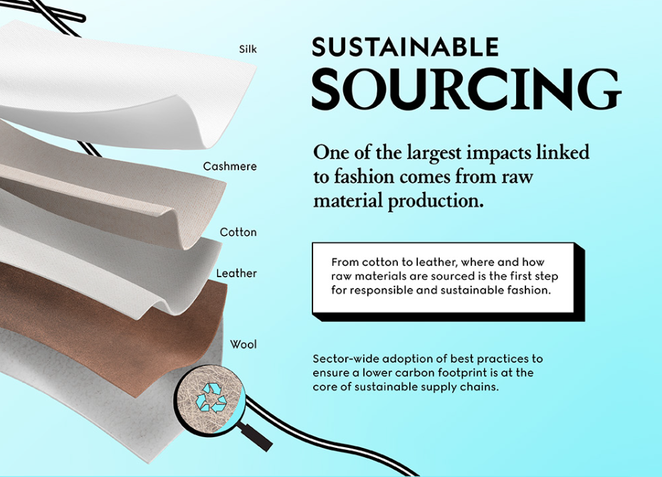
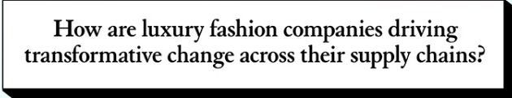
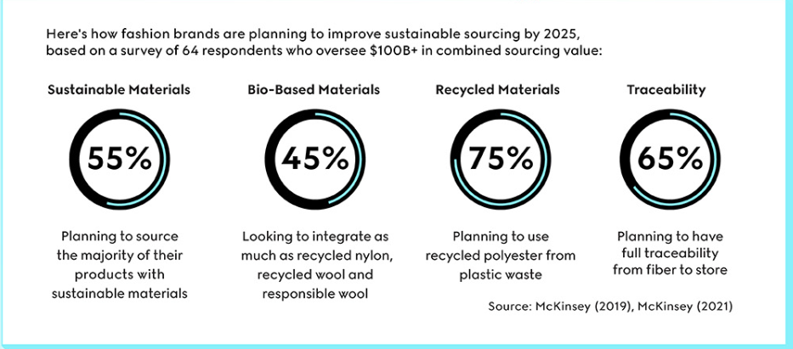

Slide 48
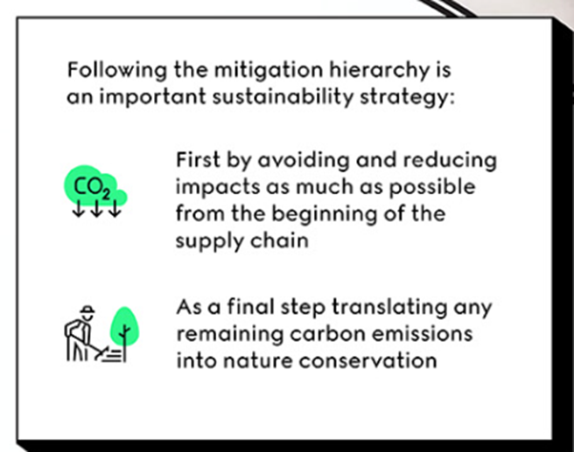
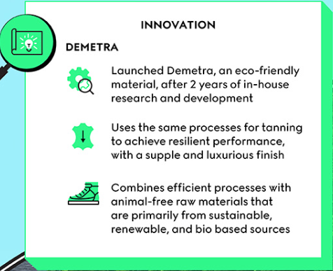

Slide 49
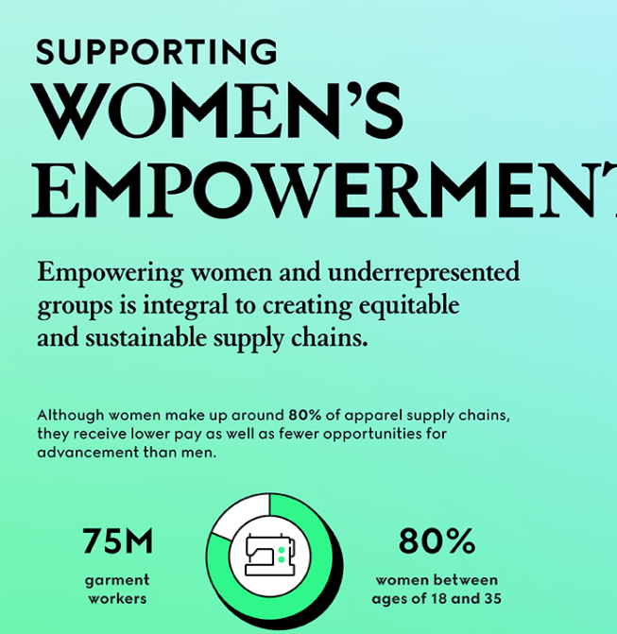
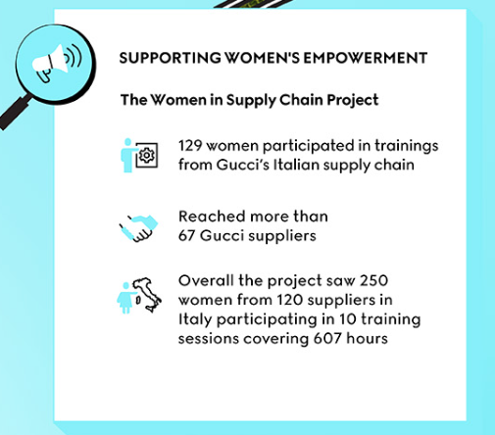

Slide 50
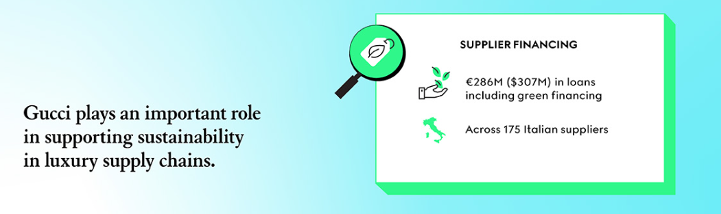
Supplier Financing: Provided $307 million in loans including green financing across 175 Italian suppliers.
https://equilibrium.gucci.com/impactreport-2021/?utm_source=VisualCapitalist-Web&utm_medium=sponsored-piece-VC&utm_campaign=VisCap-GucciEquilibrium

Slide 51

The Better M Program
McDonald’s five priority areas in the 2018 re-launch of its sustainability platform :packaging and recycling; climate action; beef sustainability; youth opportunity; and commitment to families.
The McDonald’s campaign aims to reduce and remove plastic from its restaurants, and increase the recyclability of its globally-recognised product packaging.
The goal is for all customer packaging to be either recyclable or certified sustainable by 2025, and every one of the 37,000 global restaurants is to actively recycle by 2025.

Slide 52
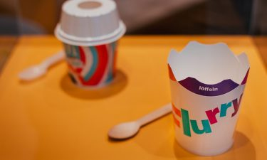
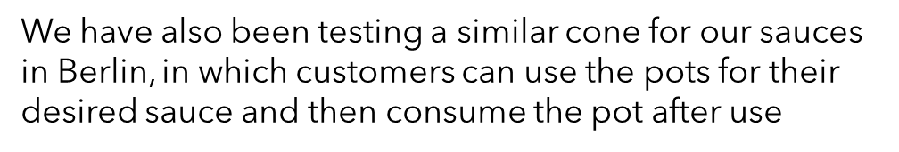
The Better M Program
The new design has eliminated the need for a plastic lid, saving more than 1,200 tonnes of plastic per year across its European restaurants
Trials are also being conducted for plastic-free McFlurry spoons. Wooden and paper alternatives are being tested in a bid to find the material that best meets customer preferences, operational functionality and sustainability.
Edible Packaging

Slide 53
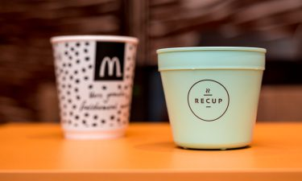
The ReCup programme
McDonald’s has been sponsoring The Next Generation Cup Consortium for about 18 months, alongside Starbucks.
The aim is not only to stimulate innovation around the next generation of cups that will be sustainable and widely-accepted, but also to provide a significant amount of funding so that innovations can be tested in real-life studies and across large reaching scales.
The key to partnerships
An example of the need for partnerships is the recent rollout of paper straws in the UK – there was simply not enough production capacity globally to supply the nation, so our suppliers bought some production facilities online that now produce paper straws not only for the UK McDonald’s market, but for the European McDonald’s markets, as well as for other customers around the world
https://youtu.be/wrIjvo_xrrk

Slide 54

Change a little, change a lot

Slide 55
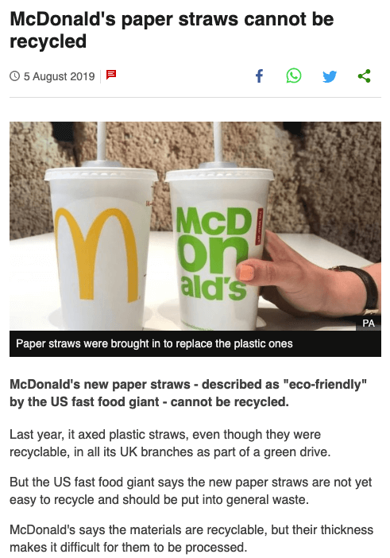
But your plan needs to be consistent…

Slide 56

Key takeaway
The essence of sustainable marketing is that you position your brand as an active figure in an environmental or societal issue.
It can humanize your brand messages and create another reason why customers should choose you over your competition.
But do not underestimate the commitment needed to participate in sustainable initiatives. These aren't simple 'buzzwords' or 'hot topics' – they are programs dedicated to reducing carbon emissions, increasing recyclable materials, and improving prospects for the next generation.

