Slide 1


The Marketing Concept: Its Evolution and Value
Explaining the Definition and Evolution of Marketing

Slide 2


The Marketing Concept

Slide 3
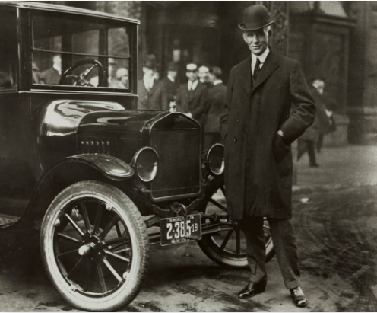
What is Marketing?
Marketing is the set of activities involved in creating, offering, and exchanging products, services, or ideas that hold value to satisfy societal needs and wants.
Marketing constitutes the most outward-facing set of business operations by organizing activities and communicating with the external environment, not just internally.
Viewing marketing solely as sales or promotional activities lowers efficiency and is one of the primary issues that reduces business profitability.
Figure 1.1 Misconceptions of Marketing Among Laypeople

Slide 4
From the perspective of consumers, marketing creates form, time, place, and possession utility. From this viewpoint, marketing: (i) is directed towards satisfying human wants and needs, (ii) deals with goods, services, and ideas, (iii) facilitates and executes exchange, (iv) is a system of diverse actions, (v) is carried out by actions, organizations, and people, (vi) is conducted under changing environmental conditions, and (vii) must be planned, executed, and controlled.
The common characteristic of businesses viewing marketing with an exchange or relationship orientation is their effort to provide an exchange to meet consumer wants and needs. For exchange to occur in marketing, the following conditions must be present (Kotler, 1972:47):
• At least two parties must be involved in the exchange,
• Communication must exist between the parties,
• Each party must possess something of value desired by the other,
• The exchange must provide mutual benefit to both parties,
• Each party must engage in the exchange voluntarily.

Slide 5


Exchange-Oriented Perspective (Marketing Management)
"The American Marketing Association (AMA, 1985) defined marketing as 'the process of planning and executing the conception, pricing, promotion, and distribution of goods, services, and ideas to create exchanges that satisfy individual and organizational objectives.'"
Value-Creating Perspective (Relationship Marketing)
"Defined as 'an applied synthetic social science that aims to establish, maintain, enhance, and, when necessary, terminate networks of value-creating exchange relationships with stakeholders.'"

Slide 6
Core Concepts Related to Marketing

Slide 7


The Concept of Exchange in Marketing
Utilitarian Exchange
Symbolic Exchange
Mixed Exchange
Refers to expected utility and functional (visible) benefit related to concrete objects. Products and services are exchanged for money or goods, driven primarily by functional utility. Also called economic exchange (Bagozzi, 1975).
Discovered when utilitarian exchange became insufficient to explain consumer behavior. Refers to the mutual exchange of psychological, social, and intangible entities. Levy (1959) noted that products are purchased for the symbols they express rather than just utility.
Combines utilitarian and symbolic exchange. Changes in marketing occur along a spectrum between pure utility and pure symbolism. Marketing individuals are rational yet driven by psychological and sociological factors (Bagozzi, 1975).

Slide 8

The Concept of Utility in Marketing
Marketing enables consumers to access goods, services, or ideas wherever, whenever, and however they desire.
Form Utility
Time Utility
Consumer demands are conveyed to production via research. This bridge determines the physical size, color, shape, and packaging of goods.
Ensuring products are available exactly when consumers want them (e.g., sunscreen availability during summer peak demand).
Place Utility
Possession Utility
Delivering goods so consumers do not have to travel to original manufacturing plants to acquire them.
Providing title, ownership, and purchasing rights over goods and services to the end buyer.

Slide 9
Needs and Wants
A need can be defined as an unsatisfied drive. Human needs fall under basic headings such as food, air, water, clothing, education, shelter, and entertainment.
Wants are defined as the specific form human needs take as they are shaped by culture, personality, and environment.
For example, thirst is a basic human need. While we can satisfy this need simply by drinking water, we may want to quench it with soda, cola, juice, or sparkling water.

Slide 10




Maslow's Hierarchy of Needs

Slide 11
Needs Should Be Examined in Five Groups:
1.
Stated Needs: (Consumers want an inexpensive car.)
2.
Real Needs: (Consumers prefer a car whose operating and maintenance costs are low, rather than just initial sticker price.)
3.
Unstated Needs: (Consumers expect attentive service when visiting a dealership.)
4.
Delight Needs: (Consumers are delighted when the dealer includes a complimentary navigation system.)
5.
Secret Needs: (Consumers want to be seen by peers as savvy, intelligent buyers.)

Slide 12

Consumer, Customer, Demand
In marketing, a consumer is defined as any person or organizational unit that uses or consumes a product. Thus, the term consumer encompasses both individual end-users and legal business entities.
A customer refers to the entity actually making the purchasing decision. For example, anyone using a mobile phone is a consumer, whereas someone purchasing an Apple iPhone is a customer of that specific brand.
Demand is defined as a consumer want backed by purchasing power.

Slide 13

Product, Value, Satisfaction
Product
In marketing terms, a product is anything of commercial value offered to a market to satisfy a consumer need or want.
Therefore, the term product extends beyond physical tangible goods to include services, experiences, persons, places, organizations, and ideas.

Slide 14

Product, Value, Satisfaction
Value
Refers to the perceived benefit derived from a product.
The value a product provides is the difference between total expected benefits and total costs (money, time, effort) paid to acquire it.
When this gap widens, perceived value increases. Customer value consists of quality, service, and price—known as the Customer Value Triad.

Slide 15
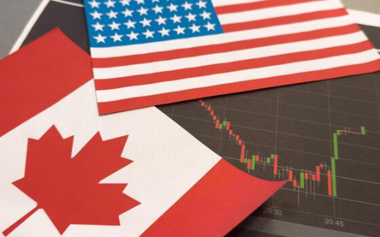
Importance of Value
Importance of the Concept of Value
Value lies at the heart of all marketing activities. It directly impacts consumer purchasing decisions by balancing product benefits against costs.
Understanding and delivering superior value builds long-term customer loyalty, enhances brand reputation, and secures sustainable competitive advantage.

Slide 16

Value Creation Strategies
1. Enhancing Product & Service Quality
4. Integrated Marketing Communication
Delivering superior products tailored to customer expectations to maximize overall satisfaction.
Delivering clear, consistent brand messages to build brand equity and audience resonance.
2. Strategic Pricing
5. Customer Relationship Management (CRM)
Setting prices that reflect true customer value to gain a strong competitive edge.
Managing ongoing customer relationships to foster satisfaction and sustainable loyalty.
3. Effective Channel Distribution
Ensuring products reach the right people at the right place and time.

Slide 17

Product, Value, Satisfaction
Satisfaction
Customer satisfaction is defined as the degree to which a product's perceived performance matches buyer expectations.
If performance falls short of expectations, the customer is dissatisfied. If performance matches or exceeds expectations, the customer is satisfied.

Slide 18

Evolution of Marketing

Slide 19
History of the Marketing Concept
Development and Historical Background
Emerging alongside the Industrial Revolution in the early 20th century, the marketing concept has continually evolved in response to technological innovation, changing customer needs, and shifting market competition.

Slide 20
Evolution of Marketing Thought
• Production Orientation
• Product Orientation
• Sales Orientation
• Marketing Orientation
• Societal Marketing Orientation
• Relationship Marketing Orientation

Slide 21
Development of Marketing
Category | Orientation / Era | Focus | Primary Goals
Traditional Marketing Concept | Production (1880–1950) | Production Capacity | Increase production efficiency, lower costs & maximize profits.
Product (1930–1950) | Product Quality | Improve product quality & features to maximize profits.
Sales (1950–1980) | Sales Volume | Maximize sales through aggressive promotion & advertising.
Modern Marketing Concept | Marketing Management (1970–Present) | Customer Needs | Integrated marketing focused on long-term profitable exchange.
Societal Marketing (1970–Present) | Society & Welfare | Balance marketing orientation with long-term societal well-being.
Relationship Marketing (1990–Present) | Stakeholder Networks | Build long-term value-creating stakeholder networks.

Slide 22
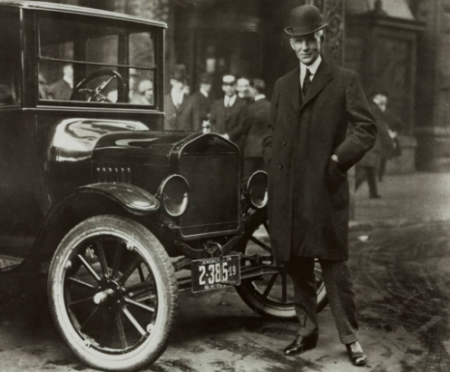
Production Orientation
Predominant when demand exceeded supply. Companies focused on mass production at minimal costs because finding customers was effortless.
The philosophy was summarized as "I sell whatever I produce" because managers believed good products sell themselves.
Henry Ford's famous 1910s statement regarding the Model T epitomizes this era: "Any customer can have a car painted any color that he wants so long as it is black."

Slide 23


Sales, Marketing & Societal Orientations
Sales Orientation
Marketing Orientation
Societal Marketing
Selling became the primary business challenge. Management relied heavily on aggressive advertising and salesmanship to overcome consumer resistance.
Emerged in the 1950s. Focus shifted toward achieving profit by satisfying customer needs better than competitors.
Extends customer satisfaction to include societal welfare, balancing company profits, consumer wants, and long-term public interest.

Slide 24
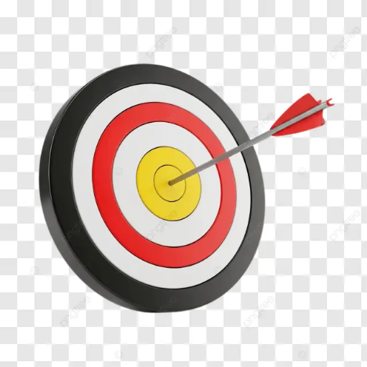
Elements of the Marketing Mix
The marketing mix represents the foundation of business marketing activities, popularised as the 4Ps (Product, Price, Place, Promotion).
Product
A product encompasses tangible or intangible features, design, branding, and services offered to fulfill target consumer demands.

Slide 25
Price
Narrowly, price is the amount of money charged for a product. Broadly, it represents the sum of all values consumers exchange for the benefits of having or using a product.
Pricing strategies must align with customer value, competitive positioning, and profit objectives. Price is the most flexible element in the marketing mix.

Slide 26
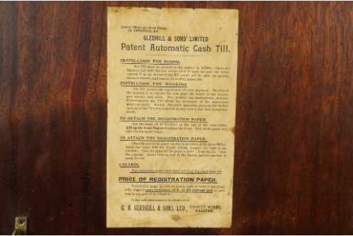
Place (Distribution)
Refers to the channels and logistics through which products flow from producer to target consumer.
Effective distribution acts as a strategic bridge, physically and digitally moving and storing goods to ensure availability and customer satisfaction.

Slide 27
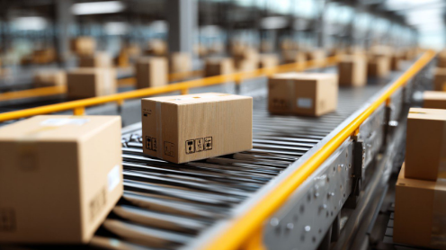
Marketing Communication (Promotion)
Consists of persuasive communication activities aimed at informing, reminding, and convincing consumers regarding product benefits.
• Advertising
• Sales Promotion
• Personal Selling
• Public Relations

Slide 28

Evolution of the Marketing Mix – 7Ps
People: Refers to employees and customers. Competencies, customer relationships, and service quality are vital parts of modern strategy.
Processes: Procedures, workflows, and systems required to deliver the service or product effectively to consumers.
Physical Evidence: Tangible cues (store design, packaging, branding) that build trust and validate service quality.

Slide 29








7Ps Marketing Mix
7P
Marketing Mix

Slide 30






Image Sources
https://png.pngtree.com/thumb_back/fw800/background/20260123/pngtree-organized-workspace-flat-lay-with-laptop-notebook-pen-coffee-cup-and-image_21093737.webp
Source: pngtree.com
https://mcfaddin-ward.org/wp-content/uploads/2025/04/Henry-Ford-with-Ford-Model-T-Buffalo-New-York-1921-courtesy-of-The-Henry-Ford-1024x846.jpg
Source: mcfaddin-ward.org
https://img.magnific.com/premium-photo/hand-screen-person-office-smartphone-display-ui-update-user-interface-project-sign-ux-design-online-with-tech-event-planner-info-app-digital-connection_590464-490791.jpg
Source: www.magnific.com
https://www.extermpro.com/wp-content/uploads/2022/09/assorted-cleaning-products-stockpack-adobe-stock-540x540.jpg
Source: www.extermpro.com
https://png.pngtree.com/background/20250105/original/pngtree-glowing-light-bulb-on-bright-yellow-background-creative-idea-concept-with-picture-image_15934001.jpg
Source: pngtree.com
https://static.vecteezy.com/system/resources/thumbnails/055/896/221/small/flag-of-the-united-states-of-america-and-canada-and-dollar-banknotes-photo.jpg
Source: www.vecteezy.com

Slide 31






Image Sources
https://media.istockphoto.com/id/2204500718/photo/smiling-young-man-with-curly-hair-showing-thumbs-up-gesture-against-blue-background.jpg?s=612x612&w=0&k=20&c=EWWeruSMrByoZnFA58df5w4nV-SbPvjMq1zMYG1K_jk=
Source: www.istockphoto.com
https://images.stockcake.com/public/7/f/6/7f661923-a93f-4e60-ba56-3e6812f89e70_large/illuminated-bulb-handheld-stockcake.jpg
Source: stockcake.com
https://png.pngtree.com/png-vector/20260403/ourlarge/pngtree-red-dart-hitting-bullseye-on-target-board-with-arrow-close-up-png-image_19044379.webp
Source: pngtree.com
https://www.harpgallery.com/photos/cd/cash35185reg10.jpg?v=1637622088
Source: www.harpgallery.com
https://images.presentationgo.com/2025/05/cardboard-boxes-conveyor-belt.jpg
Source: www.presentationgo.com
https://png.pngtree.com/png-vector/20260529/ourlarge/pngtree-d-red-and-white-megaphone-loudspeaker-speaker-vector-illustration-for-digital-png-image_19400092.webp
Source: pngtree.com

