Slide 1
SPSS
Gettıng sums & means for sub-scales

Slide 2
Manipulating Data: Getting the Sum
Use ELT_Descriptive_Statistics_With_Motivation_Items
You want to get the SUM of the Sub-Scale «Intrinsic Motivation» (Items 1, 2)
From the menu at the top of the screen, click on Transform, then click on Compute Variable.
In the Target Variable box, type in the new name you wish to give to the total scale scores (IntMot).
Select Statistical under Function Group. Then select Sum under Functions and Special Variables.
From the list of variables on the left-hand side, double click on the items you want to add in the sub-scale (Q1, Q2). Make sure there is a comma between each item.
Click OK
This will create a new variable at the end of your data set called «IntMot».

Slide 3
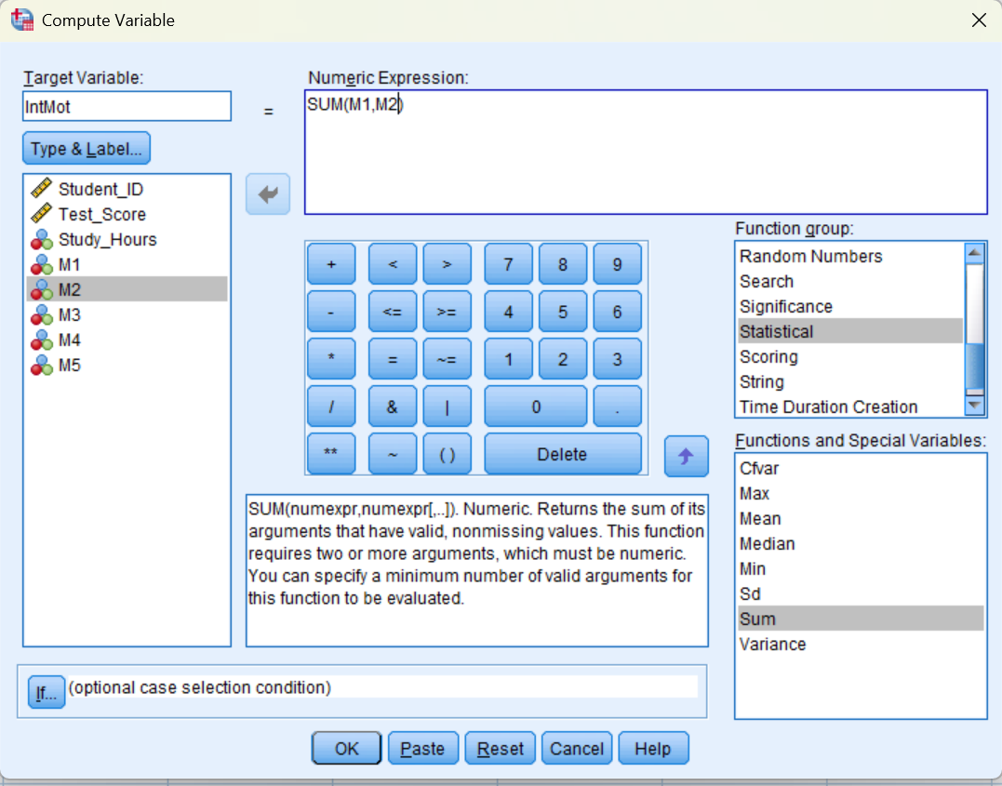

Slide 4
Manipulating Data: Getting the Mean
You want to get the MEAN of the Sub-Scale « Extrinsic Motivation» (Items 3, 4, 5)
Follow the same procedure as you did for SUM. But select Mean under Functions and Special Variables.
In the Target Variable box, type in the new name you wish to give to the total scale scores (ExtMot).
BUT, this will not round the mean scores, so you will have fractional numbers. If you want to have rounded scores (no fractions), type in the following:
  rnd(MEAN(Q1, Q5, Q11, Q13, Q16),1)
This will create a new variable at the end of your data set called «ExtMot».

Slide 5
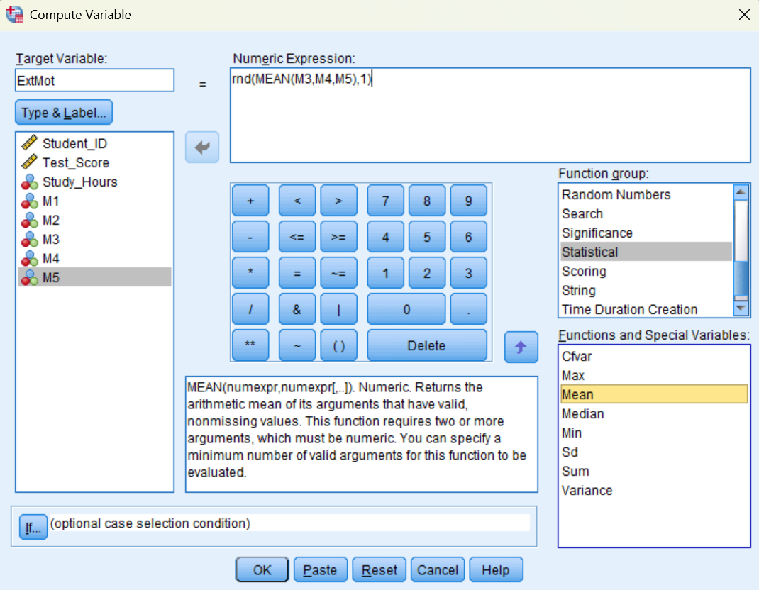

Slide 6
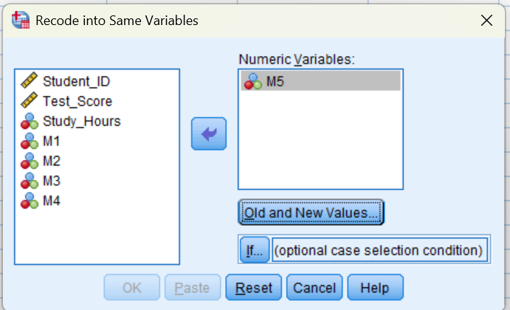
(Manipulating Data: Reversing Items)
As we know, Items 3, 4, 5(R) are related to activities that illustrate extrinsic motivation
Imagine Item 5 is a reverse item—We need to rescore this item on SPSS
From the menu at the top of the screen, click on Transform, then click on Recode Into Same Variables. -Select the items you want to reverse (M5). Move this into the Variable box.

Slide 8
(Manipulating Data: Reversing Items)
Click on the Old and New Values button. In the Old Value section, type 1 in the Value box. In the New Value section, type 5 in the Value box (this will change all scores that were originally scored as 1 to 5).
Click on Add. This will place the instruction (1 → 5) in the box labelled Old > New.
Repeat the same procedure for the remaining scores. For example:
Old Value—type in 2 New Value—type in 4 Add
Old Value—type in 3 New Value—type in 3 Add
Old Value—type in 3 New Value—type in 2 Add
Old Value—type in 5 New Value—type in 1 Add
Click on Continue and then OK.

Slide 9
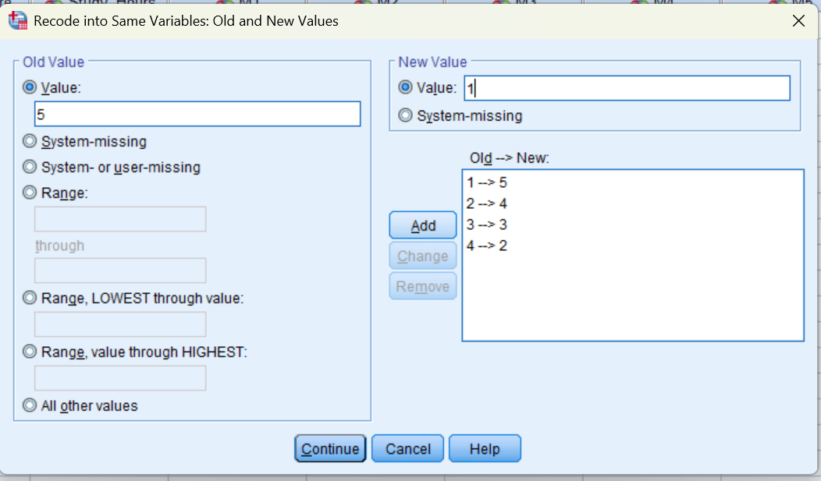

Slide 10
ACTIVITIES
You will be given an excel data set—Culture Teaching Activities together with the questionnaire that show the items for each subscale and the reverse items.
Do the following activities using this data.
  Reverse items when needed
  Get the mean of the subscales
  Run descriptive statistics for the related sub-scale
  Present the results in a table (APA)
  Interpret the analysis

Slide 11
Activity 1
Descriptive Results of the Sub-Scale
Do the descriptive analysis of the sub-scale «Illustrate» and present the findings in a table. Following table presents only the first item. Be careful; Item 16 is a reverse item.
Do the rest of the sub-scale

Slide 13
Activity 2
Now do all the step for another sub-scale: «Sharing Experiences»
Select Q2, Q3, Q7(R), Q8, Q9, Q10, Q17
Work on the reverse item
Create a new variable for this sub-scale; Use mean (not sum)
Develop a table to present the results
Interpret the results

Slide 14
Activity 6
Now do all the step for another sub-scale: «Helping Students Experience Foreign Culture»
Select Q4, Q6(R), Q12, Q14, Q15
Work on the reverse item
Create a new variable for this sub-scale; Use mean (not sum)
Develop a table to present the results
Interpret the results

