Slide 1
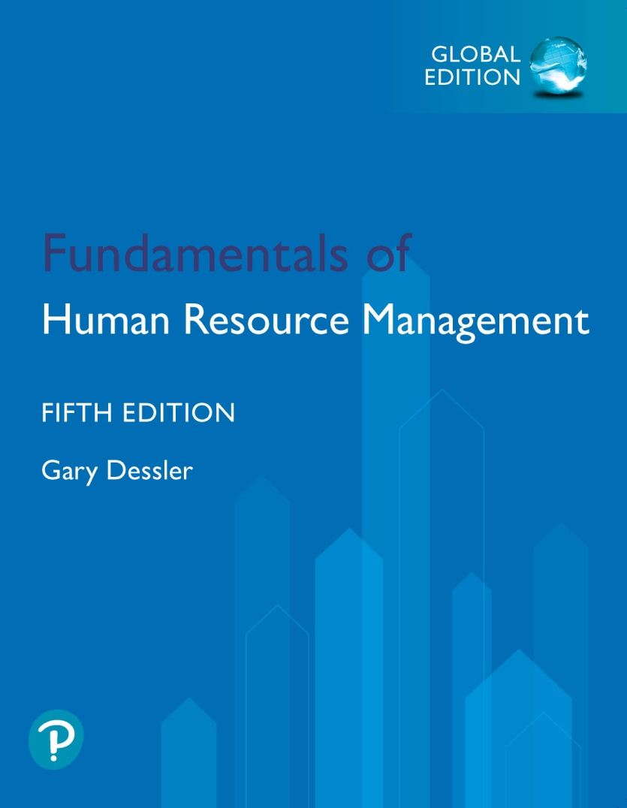
Fundamentals of Human Resource Management
Fifth Edition, Global Edition
Chapter 1
Managing Human Resources Today
Copyright © 2020 Pearson Education, Ltd. All Rights Reserved
Notes:
In Chapter 1, we will cover…
The meaning of Human Resource Management
The trends shaping human resource management
Consequences for today’s human resource managers
The plan of this book

Slide 2
Learning Objectives (1 of 2)
Answer the questions, “What is human resource management?” and “Why is knowing HR management concepts and techniques important to any supervisor or manager?”
Describe with examples what trends are influencing human resource management.
Notes:
At the conclusion of this chapter, you will be able to:
Understand the meaning of human resources management.
Understand why knowing HR management concepts and techniques are important to any supervisor or manager.
Describe with examples what trends are influencing human resources management.

Slide 3
Learning Objectives (2 of 2)
Discuss at least five consequences such trends have for human resource management today.
Explain what sorts of competencies, knowledge, and skills characterize today’s new human resource manager.
Outline the plan of this book.
Notes:
Additionally, you should be able to…
Discuss at least five consequences such trends have for human resource management today.
Explain what sorts of competencies, knowledge, and skills characterize today’s new human resource manager.
Outline the plan of this book.

Slide 4
Managing: Five Basic Functions
Management Process:
Planning
Organizing
Staffing
Leading
Controlling
Notes:
To understand human resources management, we should first review what managers do.
Managers: People who are responsible for accomplishing the organization’s goals through directing the efforts of people within an organization.
Organization: An entity that consists of people with formally assigned roles who work together to achieve organizational goals.
Managers help organizations achieve its goals through performing the five basic functions of management:
Planning: Establishing goals and standards; developing rules and procedures; developing plans and forecasts.
Organizing: Giving each subordinate a specific task; establishing departments; delegating authority to subordinates; establishing channels of authority and communication; coordinating the work of subordinates.
Staffing: Determining what types of people should be hired; recruiting prospective employees; selecting employees; setting performance standards; compensating employees; evaluating performance; counseling employees; training and developing employees.
Leading: Getting others to get the job done; maintaining morale; motivating subordinates.
Controlling: Setting standards such as sales quotas, quality standards, or production levels; checking to see how actual performance compares with these standards; taking corrective action as needed.

Slide 5
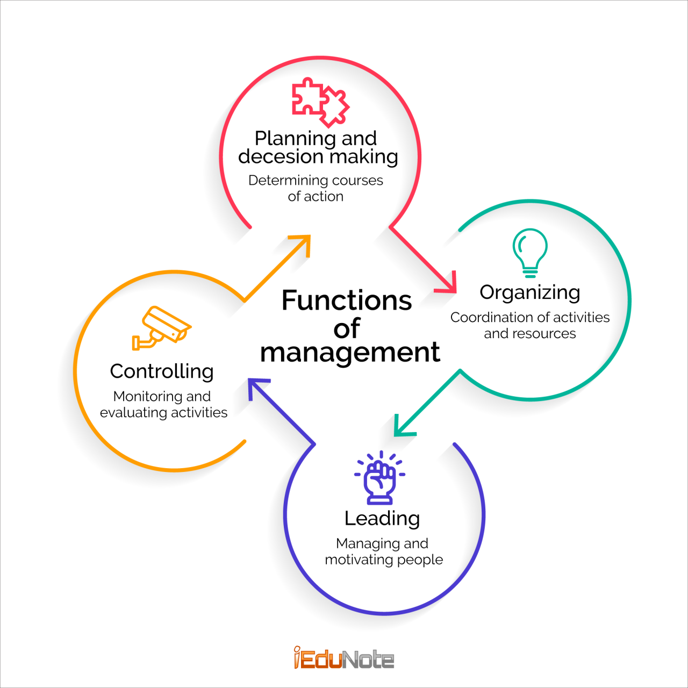
Functions of management
Giving each subordinate a specific task; establishing departments; delegating authority to subordinates; establishing channels of authority and communication; coordinating the work of subordinates
Establishing goals and standards; developing rules and procedures; developing plans and forecasts
Setting standards such as sales quotas, quality standards, or production levels; checking to see how actual performance compares with these standards; taking corrective action as needed.
Getting others to get the job done; maintaining morale; motivating subordinates

Slide 6
To understand human resources management, we should first review what managers do…
.
Managers: People who are responsible for accomplishing the organization’s goals through directing the efforts of people within an organization.
Organization: An entity that consists of people with formally assigned roles who work together to achieve organizational goals.
.
Staffing: Determining what types of people should be hired;
recruiting prospective employees;
selecting employees;
setting performance standards;
compensating employees;
evaluating performance;
counseling employees;
training and developing employees.

Slide 7

Managers

Slide 8
What is Human Resource Management?
Notes:
LO1: “What is human resource management?”

Slide 9
The «People» or Personnel Aspects of Management (1 of 2)
Conducting job analyses
Planning labor needs and recruiting job candidates
Selecting job candidates
Orienting and training new employees
Managing wages and salaries
Notes:
The topics we’ll discuss should provide you with the concepts and techniques you’ll need to perform the “people” or personnel aspects of management. These include…
Conducting job analyses
Planning labor needs and recruiting job candidates
Selecting job candidates
Orienting and training new employees
Managing wages and salaries

Slide 10
The Personnel Aspects of Management (2 of 2)
Providing incentives and benefits
Appraising performance
Communicating
Training employees and developing managers
Building employee relations and engagement
Notes:
Additional personnel aspects of management include…
Providing incentives and benefits
Appraising performance
Communicating
Training employees and developing managers
Building employee relations and engagement

Slide 11
Why is human resource management important to all managers?
Notes:
LO1 cont.: “Why is knowing HR concepts and techniques important to any supervisor or managers?” First, let’s take a look at “what not to do” (personnel mistakes) to understand what’s important.

Slide 12
Personnel Mistakes to Avoid
To have your employees not doing their best
To hire the wrong person for the job
To experience high turnover
To have your company in court due to your discriminatory actions
To have your company cited for unsafe practices
To let a lack of training undermine your department’s effectiveness
To commit any unfair labor practices
Notes:
An HR manager’s job is to ensure managers in the workplace avoid these costly mistakes:
To have your employees not doing their best
To hire the wrong person for the job
To experience high turnover
To have your company in court due to your discriminatory actions
To have your company cited for unsafe practices
To let a lack of training undermine your department’s effectiveness
To commit any unfair labor practices
Carefully studying human resource management can help you avoid mistakes like these.

Slide 13
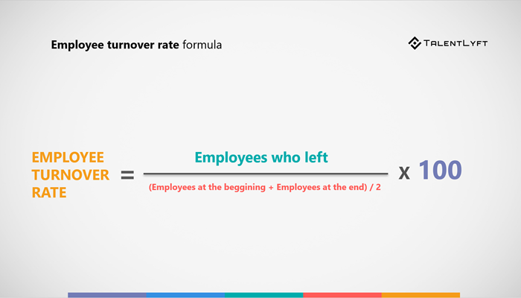
Employee Turn over ratio
Employee turnover (sometimes also called staff turnover) is a measurement of how many employees are leaving a company.
When employees leave, a company has to replace them with new employees.

Slide 14
Why is it so costly to replace employees?
The reason why replacing employees costs so much money becomes much clearer when you consider all the expenses associated with employee replacement.
First, you need to find and hire new employees. Then you have to onboard new hires and train them.
You should also count in the ramp up time. Inexperienced employees tend to be less productive. Not to mention the time wasted to find, hire and train new employees until they are fully productive.

Slide 15
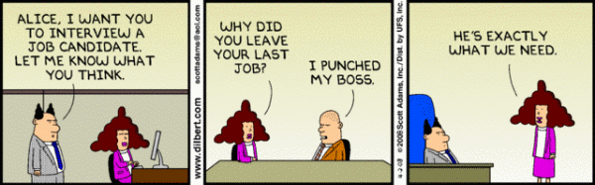
The right manager…

Slide 16
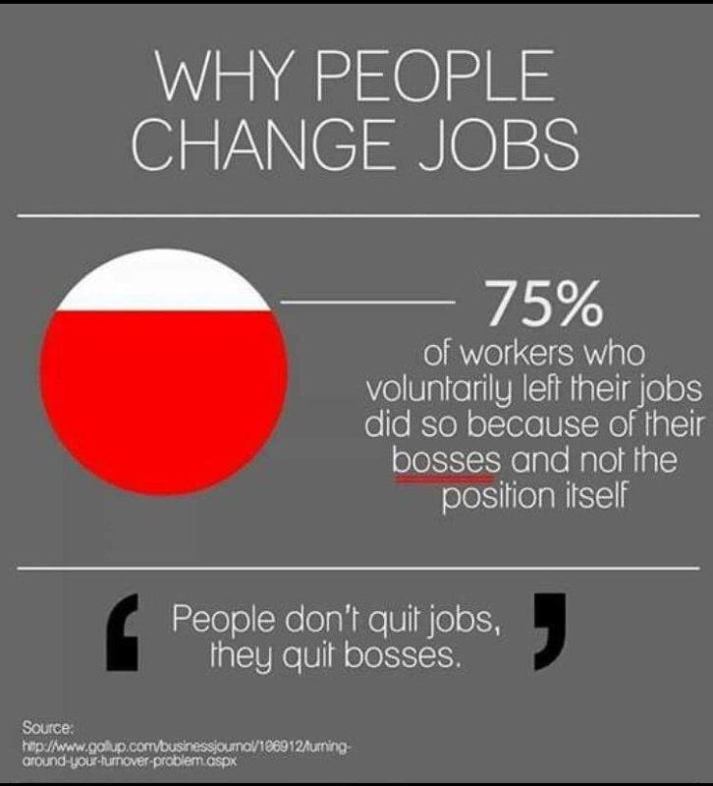

Slide 17
Why Study HRM?
You May Become an HR Manager
One third of U.S. businesses surveyed appointed non-HR managers to become their HR managers
One half of people working in the United States work for small firms where managers sometimes need to perform their own HR-related activities
Notes:
About 1/3 of large U.S. businesses surveyed, appointed non-HR managers to be their top human resources executives.
Why? Some think these people may be better equipped to integrate the firm’s human resources activities with the company’s strategic needs.
With about one half of people working in the United States for small firms, it is likely most of those people will work in some human resource management capacity.

Slide 18
Line and Staff Aspects of HRM
Recruiting
Interviewing
Selecting
Training
Notes:
All managers are in a sense, human resources managers because they all get involved in activities such as:
Recruiting
Interviewing
Selecting
Training
How do duties of the HR manager and his or her staff relate to line managers’ human resources duties? Let’s answer this by starting with a short definition of line versus staff authority.

Slide 19
Line versus Staff Authority
Authority: The right to make decisions, to direct the work of others, and to give orders.
Line authority: Gives managers the right to issue orders to other managers or employees.
Staff authority: Gives managers the right to advise other managers or employees.
Notes:
Authority: The right to make decisions, to direct the work of others, and to give orders.
Line authority: Gives managers the right to issue orders to other managers or employees.
In practice, HR and line managers share responsibility for most human resource activities. For example, human resource and line managers in about two-thirds of the firms in one survey shared responsibility for skills training.
Staff authority: Gives managers the right to advise other managers or employees.

Slide 20
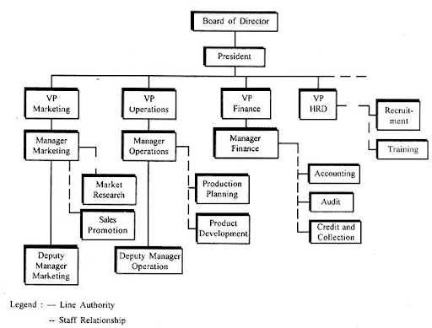

Slide 21
Line Managers’
HRM Responsibilities (1 of 2)
The direct handling of people always has been an integral part of every line manager’s responsibility, from president down to the first-line supervisor.
Thus, a line supervisor’s responsibilities for effective human resource management includes:
Placing the right person in the right job
Starting new employees in the organization
Training employees for new jobs
Improving job performance for each employee
Gaining cooperation and developing smooth relationships
Notes:
The direct handling of people always has been an integral part of every line manager’s responsibility, from president down to the first-line supervisor.
Thus, a line supervisor’s responsibilities for effective human resource management includes:
Placing the right person in the right job
Employee orientation
Training employees for new jobs
Improving job performance for each employee
Gaining cooperation and developing smooth relationships

Slide 22
Line Managers’
HRM Responsibilities (2 of 2)
Interpreting the company’s policies and procedures
Controlling labor costs
Developing the abilities of each person
Creating and maintaining departmental morale
Protecting employees’ health and physical conditions
In small organizations, line managers may carry out all of these personnel duties…
Notes:
Additionally, these are more of a line managers’ HRM responsibilities:
Interpreting the company’s policies and procedures
Controlling labor costs
Developing the abilities of each person
Creating and maintaining departmental morale
Protecting employees’ health and physical conditions
In small organizations, line managers may carry out all of these personnel duties.

Slide 23
The Human Resources Department
The human resource department provides many specialized assistance to organizations. Typical positions include:
Recruiters: Maintain contacts within the community and perhaps travel extensively to search for qualified job applicants.
Equal Employment Opportunity (EEO) Representatives/Affirmative Action Coordinators: Investigate and resolve EEO grievances, examine organizational practices for potential violations, and compile and submit EEO reports.
Job Analysts: Collect and examine detailed information about job duties to prepare job descriptions.
Compensation Managers: Develop compensation plans and handle the employee benefits program.
Training Specialists: Plan, organize, and direct training activities.
Labor Relations Specialists: Advise management on all aspects of union-management relations
Notes:
The human resource department provides many specialized assistance to organizations. Typical positions include:
Recruiters: Maintain contacts within the community and perhaps travel extensively to search for qualified job applicants.
Equal Employment Opportunity (EEO) Representatives/Affirmative Action Coordinators: Investigate and resolve EEO grievances, examine organizational practices for potential violations, and compile and submit EEO reports.
Job Analysts: Collect and examine detailed information about job duties to prepare job descriptions.
Compensation Managers: Develop compensation plans and handle the employee benefits program.
Training Specialists: Plan, organize, and direct training activities.
Labor Relations Specialists: Advise management on all aspects of union-management relations.

Slide 24
New Approaches to Organizing HR
Corporate HR Teams: Assist top management in top-level issues such as developing the personnel aspects of the company’s long-term strategic plan.
Embedded HR Teams: Have HR generalists assigned to functional departments like sales and production. They provide selection and other assistance the department needs.
Centers of Expertise: Are basically specialized HR consulting firms within the company. For example, they may provide advice about organizational change.
Notes:
Many employers are changing their human resource management organization structures, and planned to use technology to institute more shared services.
These shared services in a centralized HR unit will offer their services through Intranets and centralized call centers, aiming to provide managers and employees with specialized support with the day-to-day HR activities.
Corporate HR Teams: Assist top management in top-level issues such as developing the personnel aspects of the company’s long-term strategic plan.
Embedded HR Teams: Have HR generalists assigned to functional departments like sales and production. They provide selection and other assistance the department needs.
Centers of Expertise: Are basically specialized HR consulting firms within the company. For example, they may provide advice about organizational change.

Slide 25
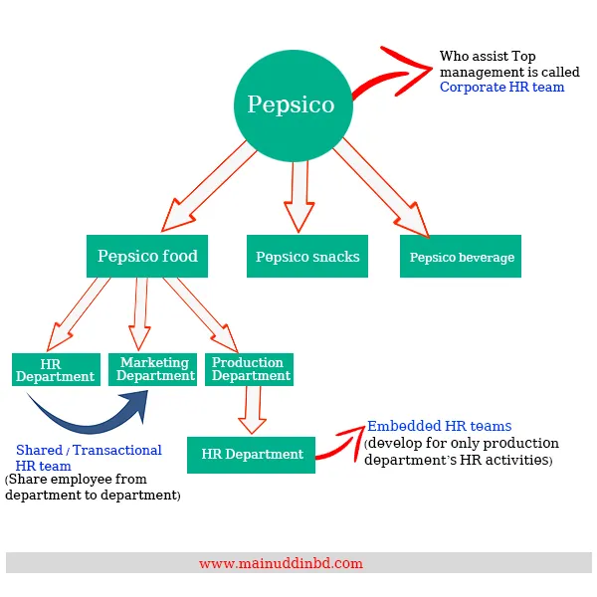

Slide 26
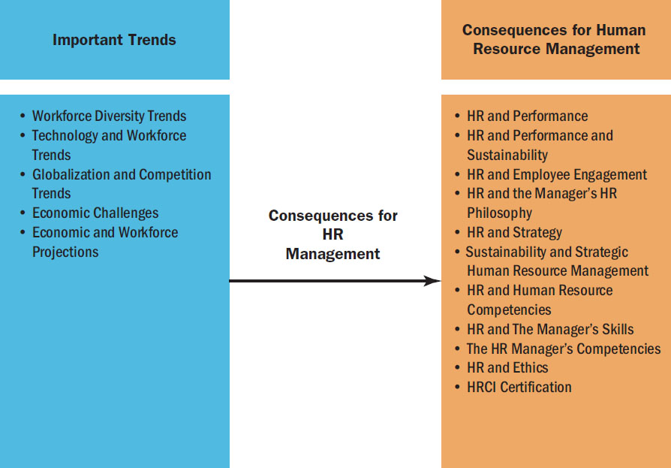
Trends Influencing HRM
Notes:
LO2 Describe with examples what trends are influencing human resource management.
Changes are occurring in the environment of human resources management that are requiring it to play a more central role in organizations. These trends include:
Workforce Diversity
Technological and Workforce Trends
Globalization and Competition
Economic Challenges
Economic and Workforce Projections
All of these trends impact the role that HR managers play within organizations. For example, these changes within the environment and trends result in the following consequences for HRM:
HR and Performance
HR and Performance and Sustainability
HR and Employee Engagement
HR and the Manager’s HR Philosophy
HR and Human Resource Competencies
HR and the Manager’s Skills
The HR Manager’s Competencies
HR and Ethics
HRCI Certification

Slide 27
Workforce Diversity Trends
it will continue to become more diverse with more women, minority group members, and older workers in the workforce
TABLE 1.1 Demographic Groups as a Percent of the Workforce, 1992–2024
Age, Race, and Ethnicity | 1992 | 2002 | 2012 | 2022
Age: 16–24 | 16.9% | 15.4% | 13.7% | 11.3%
25–54 | 71.4 | 70.2 | 65.3 | 63.9
55+ | 11.8 | 14.3 | 20.9 | 24.8
White | 85.0 | 82.8 | 79.8 | 77.0
Black | 11.1 | 11.4 | 11.9 | 12.7
Asian | 4.0 | 4.6 | 5.3 | 6.6
Hispanic origin | 8.9 | 12.4 | 15.7 | 19.8
Source: U.S. Bureau of Labor Statistics Economic News Release, www.bls.gov/news.release/ecopro.t01.htm, accessed December 19, 2013, and www.bls.gov/news.release/ecopro.t01.htm, accessed April 16, 2017
Notes:
The composition of the workforce will continue to change over the next few years; specifically, it will continue to become more diverse with more women, minority group members, and older workers in the workforce.
The projections from 1992 to 2022 are displayed above.
Demographic trends are also making finding and hiring of employees more challenging. In the United States, labor force growth is not expected to keep pace with job growth and the number of baby-boom era older workers who are retiring. Talent management will be a challenge. Thus, the hiring of foreign workers for U.S. jobs will continue.

Slide 28
Demographic trends are also making finding and hiring of employees more challenging.
In the United States, labor force growth is not expected to keep pace with job growth and the number of baby-boom era older workers who are retiring. Talent management will be a challenge. Thus, the hiring of foreign workers for U.S. jobs will continue.

Slide 29
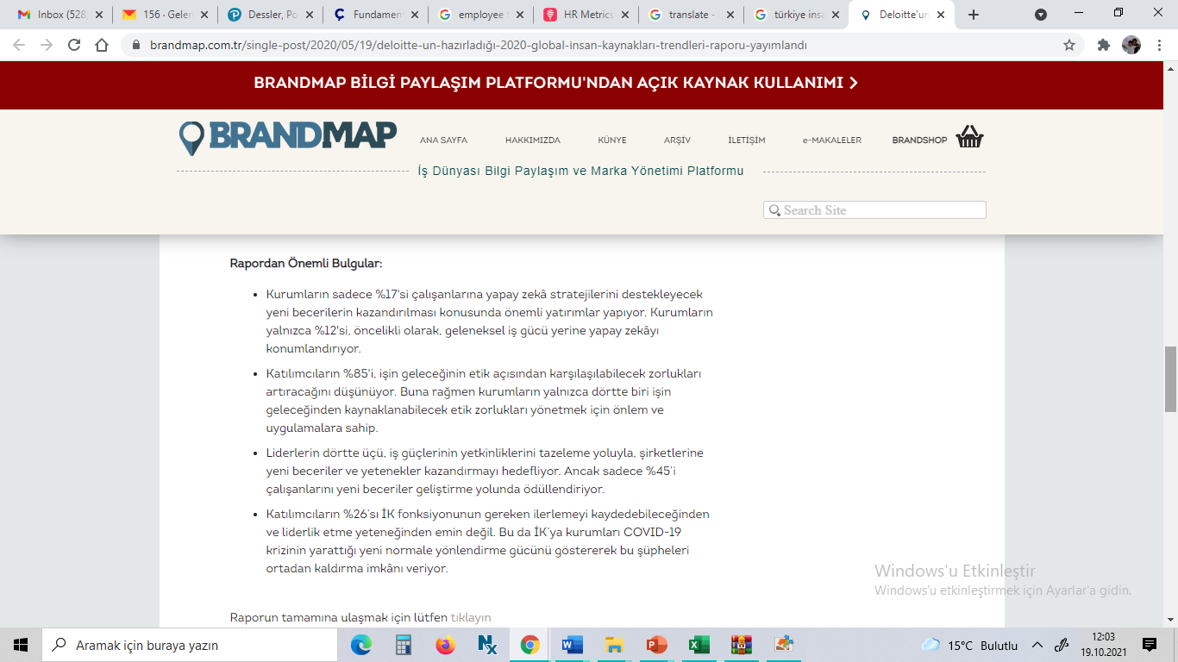
Deloitte 2020 insan kaynakları Trendleri raporu

Slide 30

Trends in How People Work
Service Jobs: Today, two-thirds of the U.S. workforce is employed in producing and delivering services, not products. By 2020, service-providing industries are expected to account for 131 million of our 150 million (87%) wage and salary jobs overall.
“Gig” Workers: Workers who are part of a vast workforce of contract, temp, freelance, or independent workers. Much of this work is “on-demand” (like Uber).
Notes:
Service Jobs: Today, two-thirds of the U.S. workforce is employed in producing and delivering services, not products. By 2020, service-providing industries are expected to account for 131 million of our 150 million (87%) wage and salary jobs overall.
“Gig” Workers: Workers who are part of a vast workforce of contract, temp, freelance, or independent workers. Much of this work is “on-demand” (like Uber).

Slide 31
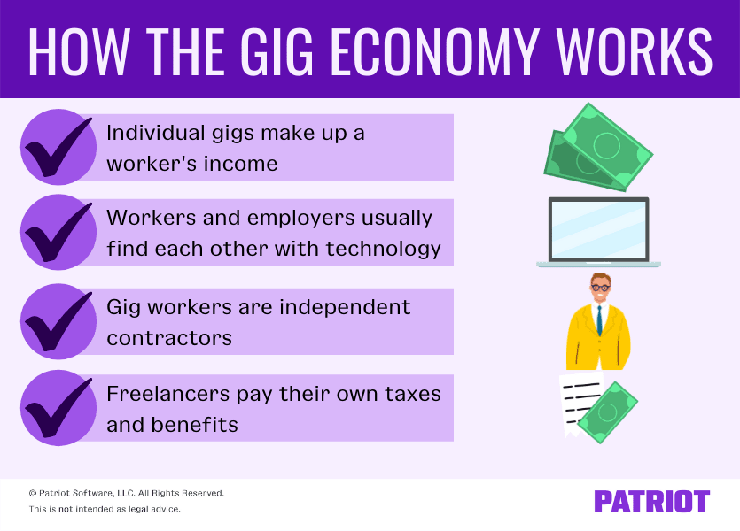

Slide 32
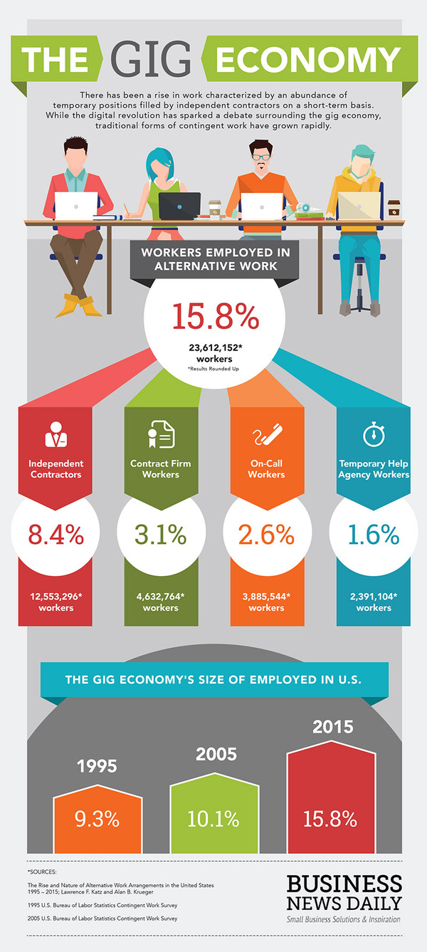

Slide 33

Service

Slide 34
Globalization and Competition Trade
Globalization: Refers to the tendency of organizations to extend their sales, ownership, and manufacturing to new markets abroad. Globalization of the world economy and other trends have triggered changes in how companies organize, manage, and utilize their HR units.
Globalization has boomed for the past 50 years. For example, the total sum of U.S. imports and exports rose from $47 billion in 1960 to $562 billion in 1980, to about $5 trillion today.
Managing the “people” aspects of globalization is a big task for any company that expands abroad and for its HR managers
Notes:
Globalization: Refers to the tendency of organizations to extend their sales, ownership, and manufacturing to new markets abroad. Globalization of the world economy and other trends have triggered changes in how companies organize, manage, and utilize their HR units.
Globalization has boomed for the past 50 years. For example, the total sum of U.S. imports and exports rose from $47 billion in 1960 to $562 billion in 1980, to about $5 trillion today.
Managing the “people” aspects of globalization is a big task for any company that expands abroad and for its HR managers.

Slide 35
Economic and Workforce Projections
Unemployment rate: For example, the unemployment rate had fallen from a high of more than 10% a few years ago to around 4.5% in 2017, and economic activity was also picking up.
Still, after the 2008 economic recession, companies were hesitant to spend money and expand factories and equipment.
Labor force: Complicating all of this is the fact that the labor force in America is growing more slowly than expected, which means employers cannot get enough workers to expand.
Aging population: The slower labor force growth is mainly because the baby boomer generation is aging and the population that wants to work, is declining.
Notes:
Today, economic trends are pointing upward.
Unemployment rate: For example, the unemployment rate had fallen from a high of more than 10% a few years ago to around 4.5% in 2017, and economic activity was also picking up.
Still, after the 2008 economic recession, companies were hesitant to spend money and expand factories and equipment.
Labor force: Complicating all of this is the fact that the labor force in America is growing more slowly than expected, which means employers cannot get enough workers to expand.
The Bureau of Labor Statistics projects the labor force to grow at 0.5% per year through 2012 to 2022, compared with an annual growth rate of 0.7% during the 2002–2012 decade.
Aging population: The slower labor force growth is mainly because the baby boomer generation is aging and the population that wants to work, is declining.
Almost half of employed U.S. college graduates are in jobs that generally require less than a four-year college education.
Many jobs that are increasing over the next 10 years do not require postsecondary education for entry.

Slide 36
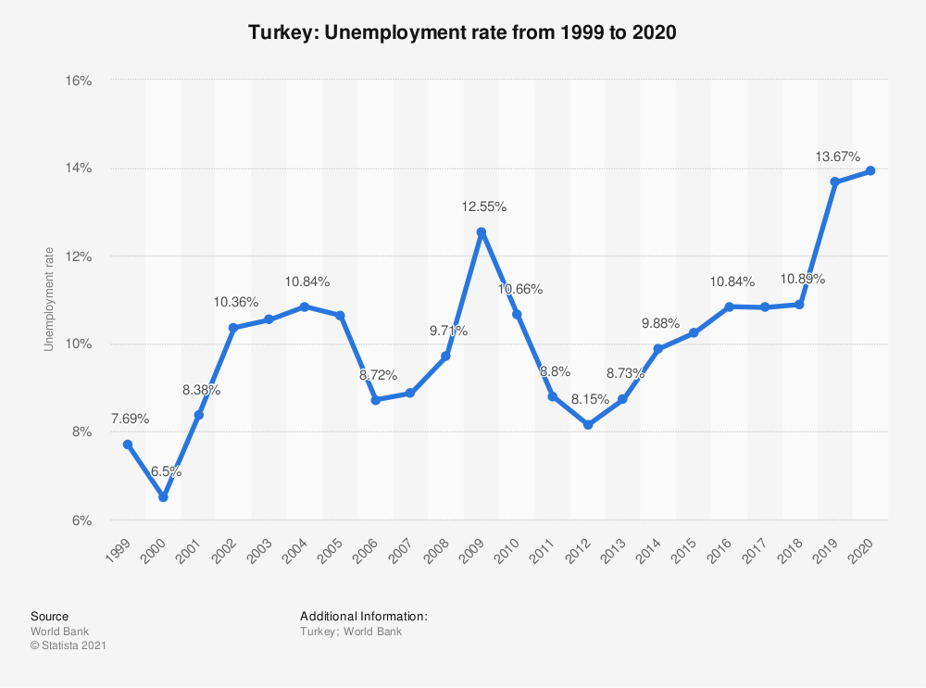
Turkey

Slide 37
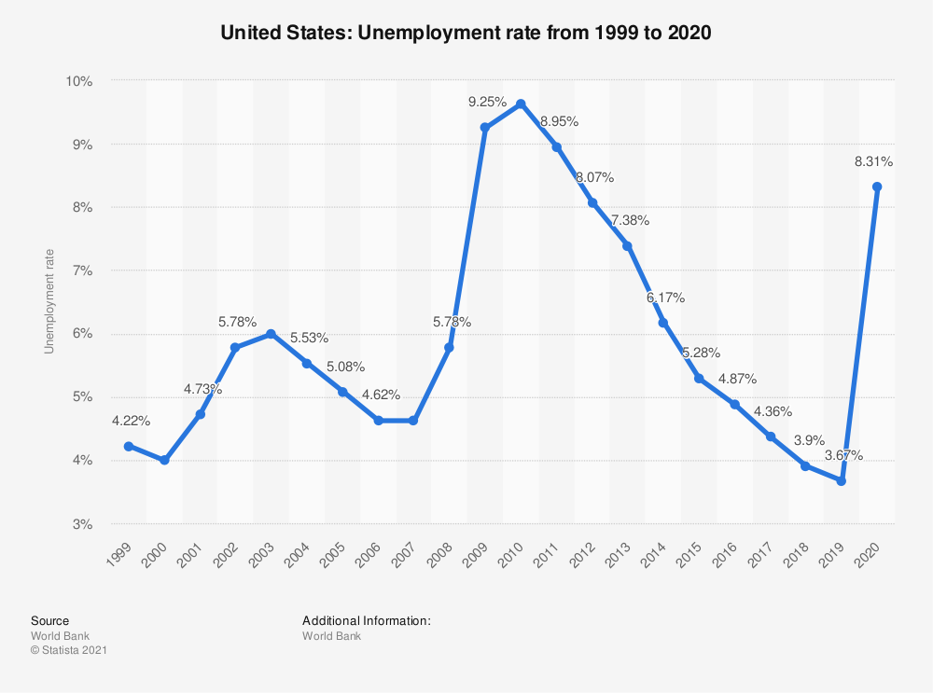

Slide 38
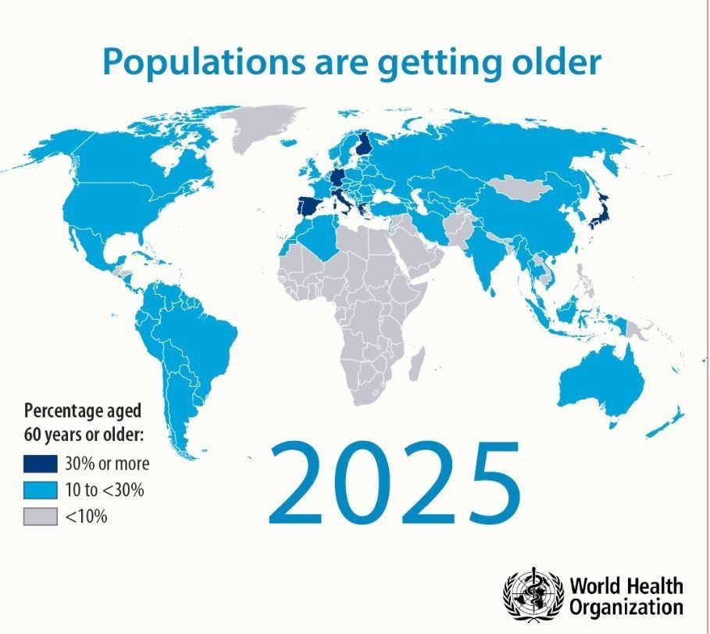

Slide 39
Technology Trends
Talent analytics: Many employers use talent analytics to sift through large amounts of employee data to identify the skills that excel on particular jobs.
Human capital: Because of the demographic and technological trends facing companies, “human capital” (workers’ knowledge, education, training, skills, and expertise) is growing in emphasis. Tomorrow’s employees will additionally need to have innovative characteristics for jobs, such as those found at Google.
Notes:
Talent analytics: Many employers use talent analytics to sift through large amounts of employee data to identify the skills that excel on particular jobs.
Human capital: Because of the demographic and technological trends facing companies, “human capital” (workers’ knowledge, education, training, skills, and expertise) is growing in emphasis. Tomorrow’s employees will additionally need to have innovative characteristics for jobs, such as those found at Google.

Slide 40
Consequences for Today’s HRM
Distributed HR
HR and Performance
HR and Employee Engagement
HR and Sustainability
HR and Ethics
Notes:
LO 3: Discuss at least five consequences such trends have for human resources management today.
For much of the 20th century, “personnel” managers focused mostly on day-to-day activities of payroll, benefits, hiring, and firing.
Today’s employers, however, face new challenges. With the environmental shifts and trends, employers expect HR managers to be experts in various areas and to deal with the challenges and trends.
Human Resource Managers are responding:
Distributed HR: More human resource tasks are being redistributed from a central HR department to the company’s employees and line managers.
HR and Performance: HR is involved with staffing, cost-effective employment, and strategic initiatives.
HR and Employee Engagement: Current research links engaged employees to performance.
HR and Sustainability: The environment and social performance are also important.
HR and Ethics: Many workplace ethical issues are human resource related.

Slide 41
For much of the 20th century, “personnel” managers focused mostly on day-to-day activities of payroll, benefits, hiring, and firing.
Today’s employers, however, face new challenges. With the environmental shifts and trends, employers expect HR managers to be experts in various areas and to deal with the challenges and trends.
Human Resource Managers are responding:
Distributed HR: More human resource tasks are being redistributed from a central HR department to the company’s employees and line managers.
HR and Performance: HR is involved with staffing, cost-effective employment, and strategic initiatives.
HR and Employee Engagement: Current research links engaged employees to performance.
HR and Sustainability: The environment and social performance are also important.
HR and Ethics: Many workplace ethical issues are human resource related

Slide 42
The New Human Resource Manager
HR and HR Competencies
HR and Manager’s Skills
HR Manager Certification
HR and Manager’s Human Resource Philosophy
Notes:
LO 4: Explain what sorts of competencies, knowledge, and skills characterize today’s new human resource manager.
HR and HR Competencies: HR managers today must possess a multitude of competencies.
HR and Manager’s Skills: Skills such as recruiting, selecting, training, appraising, providing safe environments, and incentivizing employees are just some of the skills needed.
HR and Manager’s Certification: This text will cover many areas in preparation of the HRCI certification.
HR and Manager’s Human Resource Philosophy: Everyone has a certain set of beliefs based on basic assumptions that they make about people. Every personnel decision reflects this basic philosophy.

Slide 43
LO 4: Explain what sorts of competencies, knowledge, and skills characterize today’s new human resource manager.
HR and HR Competencies: HR managers today must possess a multitude of competencies.
HR and Manager’s Skills: Skills such as recruiting, selecting, training, appraising, providing safe environments, and incentivizing employees are just some of the skills needed.
HR and Manager’s Certification: This text will cover many areas in preparation of the HRCI certification.
HR and Manager’s Human Resource Philosophy: Everyone has a certain set of beliefs based on basic assumptions that they make about people. Every personnel decision reflects this basic philosophy.

Slide 44
Plan of This Book
Introduction
Staffing: Workforce Planning and Employment
Training and HR Development
Compensation and Total Rewards
Employee and Labor Relations
Special Issues in HRM
Notes:
This book has two main aims: (1) to provide all future managers, not just HR managers, with practical human resource skills needed to produce an engaged and high-performing workforce; and (2) to cover the HRCI’s “A Body of Knowledge” in a relatively compact and economical 14-chapter soft cover format.
The parts of the book include:
Introduction
1. Managing Human Resources Today
2. Managing Equal Opportunity and Diversity
3. Human Resource Strategy and Analysis
Staffing: Workforce Planning and Employment
4. Job Analysis and Talent Management
5. Personnel Planning and Recruiting
6. Selecting Employees
Training and HR Development
7. Training and Developing Employees
8. Performance Management and Appraisal
9. Managing Careers
Compensation and Total Rewards
10. Developing Compensation Plans
11. Pay for Performance and Employee Benefits
V. Employee and Labor Relations
12. Maintaining Positive Employee Relations
13. Labor Relations and Collective Bargaining
14. Improving Occupational Safety, Health, and Risk Management
Special Issues in HRM
Module A: Managing HR Globally
Module B: Managing Human Resources in Small and Entrepreneurial Firms

Slide 45
Fundamentals of Human Resource Management
Fifth Edition, Global Edition
Chapter 3
Human Resource Strategy and Performance
Copyright © 2020 Pearson Education, Ltd. All Rights Reserved

Slide 46
Learning Objectives (1 of 2)
Explain, with examples, each of the steps in the strategic management process.
Define strategic human resource management, and give an example of strategic human resource management in practice.
Explain, with examples, why metrics are important for managing human resources.
Notes:
At the conclusion of this chapter, you will be able to:
Explain, with examples, each of the steps in the strategic management process.
Define strategic human resource management, and give an example of strategic human resource management in practice.
Explain, with examples, why metrics are important for managing human resources.

Slide 47
Learning Objectives (2 of 2)
Answer the question “What are high-performance work systems?” and give examples of how they differ from non-high-performance ones.
Answer the question (with examples) “Why is employee engagement important?”
Describe how you would execute a program to improve employee engagement.
Notes:
Additionally, at the conclusion of this chapter, you will be able to:
Answer the question “What are high-performance work systems?” and give examples of how they differ from non-high-performance ones.
Answer the question (with examples) “Why is employee engagement important?”
Describe how you would execute a program to improve employee engagement.

Slide 48
Explain, with examples, each of the steps in the strategic management process
Notes:
LO1: Explain, with examples, each of the steps in the strategic management process.
In this chapter, we will discover how managers formulate, implement, analyze, and evaluate results of human resources strategic management processes. However, we will first look at the basic management processes.

Slide 49
The Strategic Management Process (1 of 2)
Strategic Plan
The Basic Management Planning Process
  Goals
  Forecasts
  Plan
  Hierarchy of goals
Policies and Procedures
Notes:
L01: Explain, with examples, each of the steps in the strategic management process.
A strategic plan is the company’s plan for how it will match its internal strengths and weaknesses with its external opportunities and threats in order to maintain a competitive position. Based on this plan, the human resource manager formulates human resource policies and practices that aim to produce the employee competencies and skills the company needs to achieve its strategic goals.
The basic management planning process consists of five steps: setting goals, making basic planning forecasts, reviewing alternative courses of action, evaluating which options are best, and then choosing and implementing your plan.
A plan is a device that shows the course of action for getting from where you are to the goal.
It is traditional to view the goals from the top of the firm down to the front-line employees as a chain or hierarchy of goals.
Policies and procedures provide the day-to-day guidance employees need to do their jobs in a manner that is consistent with the company’s plans and goals.
Policies set broad guidelines delineating how employees should proceed.
Procedures spell out what to do if a specific situation arises.

Slide 50
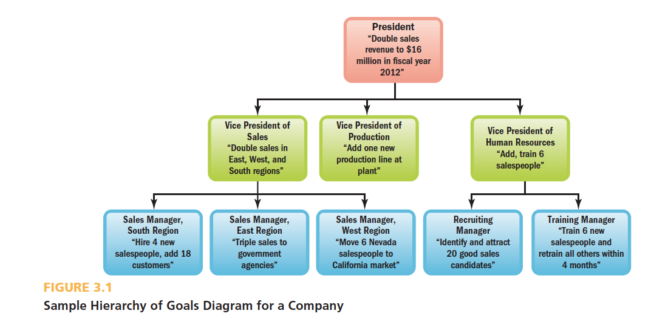
Hierarchy of Goals
Notes:
In this slide, we have a sample hierarchy of goals diagram for a company. Let’s view this and discuss.

Slide 51
Strategic Planning
Strategy
Strategic Management
Strategic Management Process
Vision and Mission Statement
Notes:
A strategy is a course of action the company can pursue to achieve its strategic aims.
Strategic management is the process of identifying and executing the organization’s strategic plan, by matching the company’s capabilities with the demands of its environment.
The strategic management process involves seven steps as shown on the next slide.
A vision statement is a general statement of the firm’s intended direction that shows, in broad terms, “what we want to become.”
A mission statement summarizes the answer to the question, “what business are we in?”

Slide 52
A strategy is a course of action the company can pursue to achieve its strategic aims.
Strategic management is the process of identifying and executing the organization’s strategic plan, by matching the company’s capabilities with the demands of its environment.
The strategic management process involves seven steps as shown on the next slide.
A vision statement is a general statement of the firm’s intended direction that shows, in broad terms, “what we want to become.”
A mission statement summarizes the answer to the question, “what business are we in?”

Slide 53
The Strategic Management Process involves seven steps. They are as follows:
Asking “where are we now?”
Evaluating the firm’s internal and external strengths, weaknesses, opportunities, and threats (SWOT analysis)
Formulating a new business direction
Translating the mission into strategic goals
Formulating strategies or courses of action
Implementing the plan
Evaluating the strategic plan by looking at performance

Slide 54
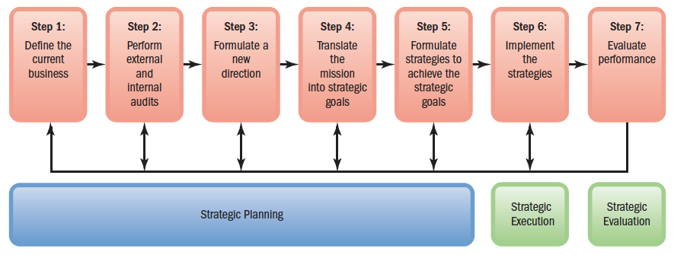
The Strategic Management Process
Notes:
The Strategic Management Process involves seven steps. They are as follows:
Asking “where are we now?”
Evaluating the firm’s internal and external strengths, weaknesses, opportunities, and threats (SWOT analysis)
Formulating a new business direction
Translating the mission into strategic goals
Formulating strategies or courses of action
Implementing the plan
Evaluating the strategic plan by looking at performance

Slide 55
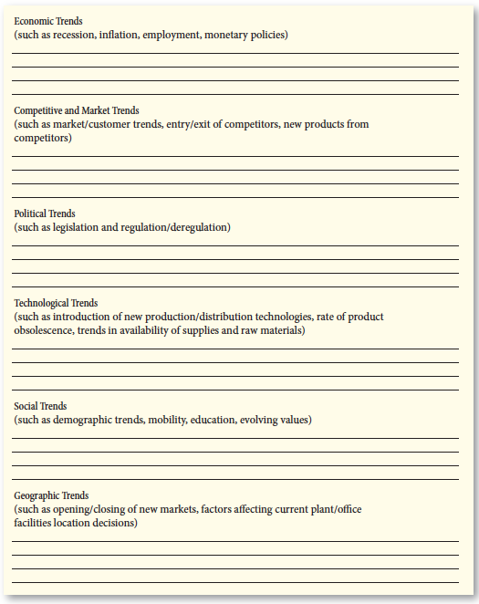
Worksheet for Environmental Scanning
competitive intelligence and general information concerning the firm’s industry should be gathered by what is called “environmental scanning.
Notes:
As a part of the SWOT analysis, competitive intelligence and general information concerning the firm’s industry should be gathered by what is called “environmental scanning.” Here is a sample worksheet for answering key items in conducting the SWOT analysis through environmental scanning.

Slide 56
SWOT Matrix, with Generic Example
Potential Strengths
Market leadership
Strong research and development
High-quality products
Cost advantages
Patents
Potential Weaknesses
Large inventories
Excess capacity for market
Management turnover
Weak market image
Lack of management depth
Potential Opportunities
New overseas markets
Failing trade barriers
Competitors failing
Diversification
Economy rebounding
Potential Threats
Market saturation
Threat of takeover
Low-cost foreign competition
Slower market growth
Growing government regulation
Notes:
The SWOT analysis matrix involves these items to investigate under each SWOT area.

Slide 57
Types of Strategies
Corporate-Level Strategy
Competitive Advantage
Competitive Strategy
  Cost leadership
  Differentiation
  Focus
Functional Strategy
Notes:
A corporate-level strategy is the type of strategy that identifies the portfolio of businesses that, in total, comprise the company and the ways in which these businesses relate to each other.
For example:
A concentration (single-business) corporate strategy offers one product/service in one market.
A diversification corporate strategy means the firm will expand by adding new product lines.
A vertical integration strategy means the firm expands by producing its own raw materials (for example).
A consolidation strategy is when the company reduces its size.
A geographic expansion means the company expands locations abroad.
A competitive advantage is any factor(s) that allow an organization to differentiate its product or service from those of its competitors to increase market share.
A competitive strategy is a strategy that identifies how to build and strengthen the business’s long-term competitive position in the marketplace.
The standard competitive strategies include: (1) Cost leadership (becoming the low-cost leader), or (2) Differentiation (firm is unique in the industry), or (3) Focus (where firm has carved out a niche and serves a smaller target-market).
A functional strategy is a department’s functional strategy, which identifies what the department must do in terms of specific departmental policies and practices to help the business accomplish its competitive goals.

Slide 58
Level of Strategy | Definition | Example
Corporate strategy | Market definition | Diversification into new product or geographic markets
Business strategy | Market navigation | Attempts to secure competitive advantage in existing product or geographic markets
Functional strategy | Support of corporate strategy and business strategy | Information systems, human resource practices, and production processes that facilitate achievement of corporate and business strategy
Level of Strategy | Definition | Example

Slide 59
A corporate-level strategy is the type of strategy that identifies the portfolio of businesses that, in total, comprise the company and the ways in which these businesses relate to each other.
For example:
A concentration (single-business) corporate strategy offers one product/service in one market.
A diversification corporate strategy means the firm will expand by adding new product lines.
A vertical integration strategy means the firm expands by producing its own raw materials (for example).
A consolidation strategy is when the company reduces its size.
A geographic expansion means the company expands locations abroad.

Slide 60
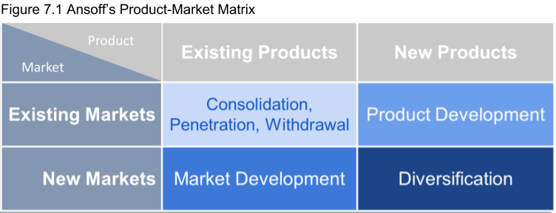

Slide 61
A competitive advantage is any factor(s) that allow an organization to differentiate its product or service from those of its competitors to increase market share.
A competitive strategy is a strategy that identifies how to build and strengthen the business’s long-term competitive position in the marketplace.
The standard competitive strategies include: (1) Cost leadership (becoming the low-cost leader), or (2) Differentiation (firm is unique in the industry), or (3) Focus (where firm has carved out a niche and serves a smaller target-market).
A functional strategy is a department’s functional strategy, which identifies what the department must do in terms of specific departmental policies and practices to help the business accomplish its competitive goals.

Slide 62
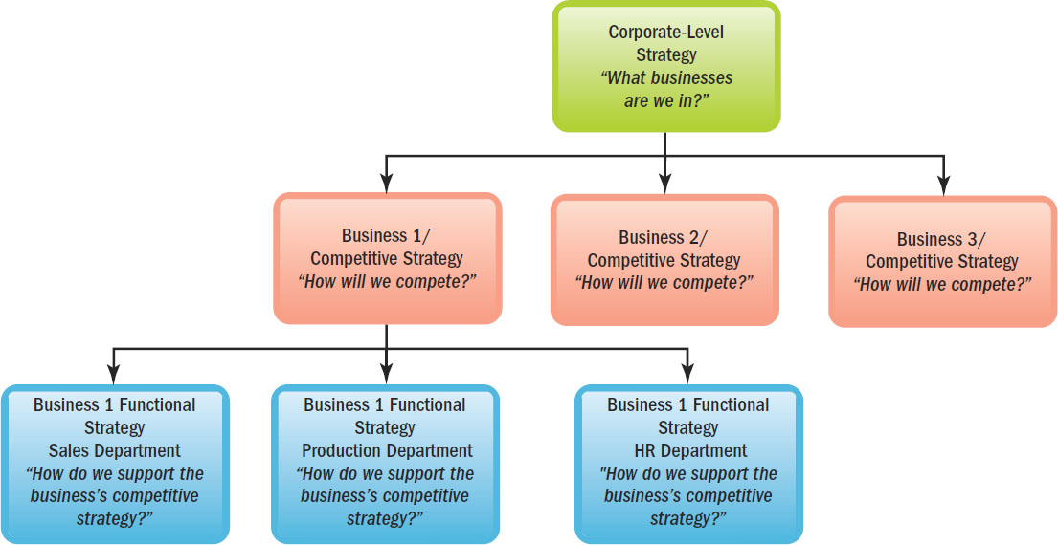
Type of Strategy at Each Company Level
Notes:
In this slide, we have pictured the graphic of the types of strategy at each company level.

Slide 63
Managers’ Role in Strategic Planning
Devise a Plan
Obtain Competitive Intelligence
Identify Strengths and Weaknesses
Participate in Communication
Notes:
Top executives rarely formulate strategic plans without the input of lower-level managers.
Managers must devise a plan in conjunction with corporate-wide plans. Managers also must understand their own firm’s competitive pressures, vendor capabilities, product and industry trends, and employee capabilities while devising plans.
Competitive intelligence (information) must be obtained regarding things like the competitor’s incentive plans, employee opinion surveys that elicit information regarding customer complaints and information about pending legislation such as labor laws. Human resource personnel generally provide a lot of this information.
Understanding the firm’s strengths and weaknesses is crucial for managers. Additionally, managers must understand their own department’s strengths and weaknesses. HR managers should be the masters of information about their own firms’ employees’ strengths and weaknesses.
In devising the firm’s overall strategic plan, managers must involve themselves in frequent meetings and discussion among and between top and lower-level managers.

Slide 64
Define strategic human resource management, and give an example of strategic human resource management in practice
Notes:
LO2: Define strategic human resource management, and give an example of strategic human resource management in practice.
Managers formulate corporate strategies, and then competitive strategies for each of their businesses. We will now look at the human resources side and their part in the competitive strategies of the firm.

Slide 65
What Is Strategic Human Resource Management?
Formulate strategic plans
Ensure employee competencies and behaviors
HR strategies, policies, and practices
Notes:
Strategic human resources management means formulating and executing human resource policies and practices that produce the employee competencies and behaviors the company needs to achieve its strategic aims. The aim of HR should be to produce the employee skills and behaviors that the company needs to achieve its strategic goals.
The next slide shows a graphic depiction of the HR Strategy Model.

Slide 66
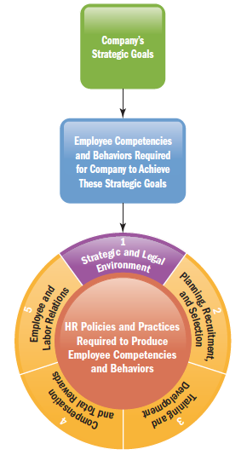
The HR Strategy Model
First, management formulates the strategic plans and goals.
In turn, executing these plans and achieving these goals depends on having the right mix of employee competencies and behaviors.
Finally, to produce these required employee competencies and behaviors, the human resource manager must put in place the right mix of recruitment, selection, training, and other HR strategies, policies, and practices
Notes:
This slide depicts a graphic model of the Human Resources Strategy.
First, management formulates the strategic plans and goals. In turn, executing these plans and achieving these goals depends on having the right mix of employee competencies and behaviors. Finally, to produce these required employee competencies and behaviors, the human resource manager must put in place the right mix of recruitment, selection, training, and other HR strategies, policies, and practices.

Slide 67
Three Important Strategic HR Tools
Strategy Map
  Graphical tool that summarizes the chain of activities that contribute to a company’s success, and so shows employees the “big picture” of how their performance contributes to achieving the company’s overall strategic goals.
HR Scorecard
  A process for assigning financial and nonfinancial goals or metrics to the human resource management–related chain of activities required for achieving the company’s strategic aims and for monitoring results.
Digital Dashboard
  Presents the manager with desktop graphs and charts, so he or she gets a picture of where the company has been and where it’s going, in terms of each activity in the strategy map.
Notes:
In this slide, we see the display of the three important strategic human resource tools used as a part of strategic planning.

Slide 68
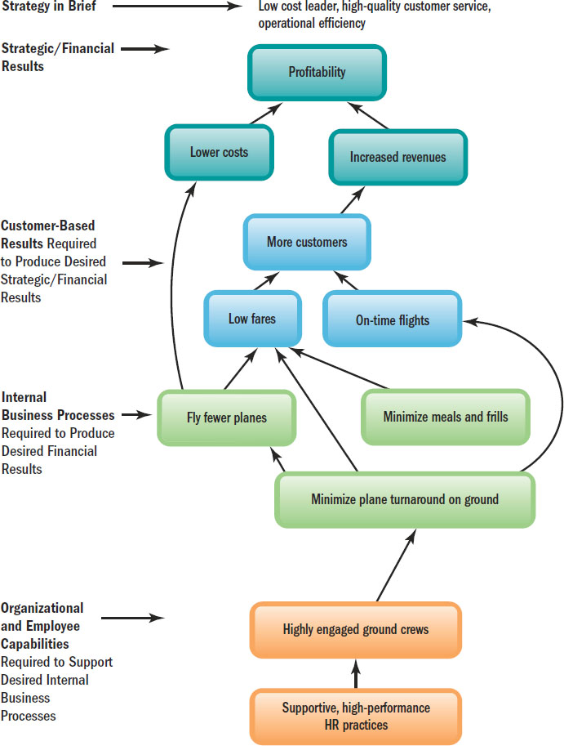
Strategic Human Resource Management Tools
Strategy Map
A strategy map is a strategic planning tool that shows the “big picture’ of how each department’s performance contributes to achieving the company’s overall strategic goals
Notes:
In this slide, we see an example of a Strategy Map. This is actually a strategy map for Southwest Airlines.
A strategy map is a strategic planning tool that shows the “big picture’ of how each department’s performance contributes to achieving the company’s overall strategic goals.

Slide 69
Strategic Human Resource Management Tools
The HR scorecard is a process for assigning financial and nonfinancial goals or metrics to the human resource management–related chain of activities required for achieving the company’s strategic aims and for monitoring results. The scorecard actually refers to a process of assigning financial and nonfinancial goals or metrics.
Metrics (for Southwest Airlines, for example) can include such things as airplane turnaround time, percent of on-time flights, and ground crew productivity.
Managers use special scorecard software to facilitate scoring. The scorecard software helps managers quantify the relationships between (1) HR activities, (2) the resulting employee behaviors, and (3) the resulting firm-wide strategic outcomes and performance.
A digital dashboard presents the manager with desk-top graphs and charts, and a computerized picture of where the company stands on all those metrics from the HR scorecard process.
Notes:
The HR scorecard is a process for assigning financial and nonfinancial goals or metrics to the human resource management–related chain of activities required for achieving the company’s strategic aims and for monitoring results. The scorecard actually refers to a process of assigning financial and nonfinancial goals or metrics.
Metrics (for Southwest Airlines, for example) can include such things as airplane turnaround time, percent of on-time flights, and ground crew productivity.
Managers use special scorecard software to facilitate scoring. The scorecard software helps managers quantify the relationships between (1) HR activities, (2) the resulting employee behaviors, and (3) the resulting firm-wide strategic outcomes and performance.
A digital dashboard presents the manager with desk-top graphs and charts, and a computerized picture of where the company stands on all those metrics from the HR scorecard process.

Slide 70
HR Metrics and Benchmarking
Types of Metrics
Benchmarking
Strategy-Based Metrics
Workforce/Talent Analytics and Data Mining
Notes:
LO3: Explain, with examples, why metrics are important for managing human resources.
Being able to measure what the company is doing is an integral part of human resources strategy process.
Human resource managers use many such measures or metrics. In the next slide, we’ll see examples (in detail) of metrics used in the various areas of the organization.
Benchmarking is measuring how one is doing against the best in that area. For example, a high-end retail clothing company might compare their data against the industry’s best company in order to effectively plan their corporate strategy.
Benchmarking provides only one perspective on how the company’s human resource management system is performing. Strategy-based metrics focus on measuring the activities that contribute to achieving a company’s strategic aims. This might mean something like the strategic HR metrics of 100% employee testing, 80% guest returns, and 40% incentive pay as a percent of total salaries.
Workforce, or talent, analytics means using special software applications to analyze human resources data and to draw conclusions from it.
Data mining shifts through huge amounts of employee data to identify correlations that employers then use to improve their employee selection and other practices. Data mining is the “set of activities used to find new, hidden, or unexpected patterns in data.”

Slide 71
Metrics/Benchmarking Report (1 of 2)
Organizational Data
Revenue
Revenue per FTE
Net Income Before Taxes
Net Income Before Taxes per FTE
Positions Included within the Organization’s Succession Plan
HR Department Data
Total HR Staff
HR-to-Employee Ratio
Percentage of HR Staff in Supervisory Roles
Percentage of HR Staff in Professional/Technical Roles
Percentage of HR Staff in Administrative Support Roles
Reporting Structure for the Head of HR
Types of HR Positions Organizations Expect to Hire in 2011
Employment Data
Number of Positions Filled
Time-to-Fill
Cost-Per-Hire
Employee Tenure
Annual Overall Turnover Rate
Annual Voluntary Turnover Rate
Annual Involuntary Turnover Rate
Expectations for Revenue and Organizational Hiring
Percentage of Organizations Expecting Changes in Revenue in 2011 compared to 2010
Percentage of Organizations Expecting Changes in Hiring in 2011 compared to 2010
Notes:
In this slide, we see an example of customized human capital benchmarking metrics used in a report. This information was obtained from the Society for Human Resource Management (SHRM) website.

Slide 72
Metrics/Benchmarking Report (2 of 2)
HR Expense Data
HR Expenses
HR Expense to Operating Expense Ratio
HR Expense to FTE
Compensation Data
Annual Salary Increase
Salaries as a Percentage of Operating Expense
Target Bonus for Non-Executives
Target Bonus for Executives
Tuition/Education Data
Maximum Reimbursement Allowed for Tuition/Education Expenses per Year
Percentage of Employees Participating in Tuition/Education Reimbursement Programs
Metrics for More Profitable Organizations
Total HR Staff
HR-to-Employee Ratio
HR Expenses
HR Expense to Operating Expense Ratio
HR Expense to FTE Ratio
Annual Salary Increase
Target Bonus for Non-Executives
Target Bonus for Executives
Maximum Reimbursement Allowed for Tuition/Education Expenses per Year
Percentage of Employees Participating in Tuition/Education Reimbursement Programs
Time-to-Fill
Cost-Per-Hire
Annual Overall Turnover Rate
Source: Reprinted with permission from the Society for Human Resource Management. All rights reserved.
Notes:
In this slide, we see an example of customized human capital benchmarking metrics used in a report. This information was obtained from the Society for Human Resource Management (SHRM) website.

Slide 73
HR as a Profit Center
Employers use talent analytics to answer several types of questions:
Analytical HR (answers which departments, units, or individuals need attention)
Human capital investment analysis (answers which actions have the greatest impact on business)
Talent value model (looks at why employees choose to stay or leave the company)
Talent supply chain (analytics that predict daily store volume)
Notes:
Talent analytics can produce striking profitable results. For example, Best Buy used talent analytics to determine that a 0.1% increase in employee engagement led to more than a $100,000 rise in the store’s annual operating income.
Employers use talent analytics to answer several types of questions:
Analytical HR (answers which departments, units, or individuals need attention)
Human capital investment analysis (answers which actions have the greatest impact on business)
Talent value model (looks at why employees choose to stay or leave the company)
Talent supply chain (analytics that predict daily store volume)

Slide 74
Evidence-Based HR
Objective
Experimentation
Predict
Notes:
Evidence-based human resource management means using data, facts, analytics, scientific rigor, critical evaluation, and critically evaluated research case studies to support human resource management proposals, decisions, practices, and conclusions.
In a way, management must think like a scientist and be objective when looking at the current status of the organization. This is also like being realistic as to what the data values reveal.
The manager must also experiment as a scientist would. This means that the manager must implement a plan on a much smaller scale (with a few employees) to make sure the plan will work, prior to the plan being implemented company-wide.
Taking these steps will help the manager predict outcomes. Metrics help with future predictions.
For managers in companies such as Sears and Home Depot, the point of being “scientific” is to make better decisions by forcing the managers to gather the facts. For example, “Is our employee sales incentive plan really boosting appliance sales?”

Slide 75
Building High-Performance Work Systems
High-Performance Work System
High Performance Work Practices
  Paid more
  Trained more
  Sophisticated recruitment
  More self-managed work teams
Human Resource Metrics
Notes:
LO4: Answer the question “What are high-performance work systems?” and give examples of how they differ from non-high performance ones.
High-performance work systems are sets of human resource management policies and practices that promote organizational effectiveness.
High Performance work practices involve looking at best practices of high-performance work systems (sort of like benchmarking).
The chosen “best practices” high-performance work system has paid their employees more, trained their employees more, and used more sophisticated recruitment and hiring practices than others, and uses more self-managed work teams.
Human resource metrics are the quantitative gauge of a human resource management activity such as hours of training per employee, or qualified applicants per position.

Slide 76
Comparison of High-Performance vs. Low-Performance (1 of 2)
TABLE 3.1 Examples Selected from Several Studies of How Recruitment, Selection, Training, Appraisal, Pay, and Other Practices Differ in High-Performance and Low-Performance Companies
blank | Lower-Performance Companies’ HR Practice Averages (e.g., company performance in terms of sales/employee, innovation, and employee retention)* | Higher-Performance Companies’ HR Practice Averages (e.g.,company performance in terms of sales/employee, innovation, and employee retention)*
Recruitment: Average number of qualified applicants per position | 8 | 37
Selection: Average percentage of employees hired based on a validated selection test | 4% | 30%
Training: Average number of hours of training for new employees | 35 Hours | 117 Hours
Appraisal: Average percentage of employees receiving a regular performance appraisal | 41% | 95%
Pay Practices: Average percentage of the workforce eligible for incentive pay | 28% | 84%
Use of Teams: Average percentage of the workforce routinely working in all teams, semiautonomous, cross functional, or project teams | 11% | 42%
Notes:
In this slide, we see a juxtaposition of comparison between high-performance company practices and low-performance company practices in the areas of recruitment, selection, training, appraisal, pay, and other practices.

Slide 77
Comparison of High-Performance vs. Low-Performance (2 of 2)
TABLE 3.1 Examples Selected from Several Studies of How Recruitment, Selection, Training, Appraisal, Pay, and Other Practices Differ in High-Performance and Low-Performance Companies
blank | Lower-Performance Companies’ HR Practice Averages (e.g.,company performance in terms of sales/employee, innovation, and employee retention)* | Higher-Performance Companies’ HR Practice Averages (e.g.,company performance in terms of sales/employee, innovation, and employee retention)*
Self-Directed Teams: Percent of companies with semiautonomous or autonomous work teams | 9% | 70%
Operational Information Sharing: Employees receive relevant operating performance information | 62% | 82%
Financial Information Sharing: Employees receive relevant financial performance information | 43% | 66%
*Findings rounded. Source: Based on “Comparison of HR Practices in High-Performance and Low-Performance Companies,” by B. E. Becker et al., from The HR Scorecard: Linking People, Strategy and Performance (Boston: Harvard Business School Press, 2001); Barry Macy, Gerard Farias, Jean-Francois Rosa, and Curt Moore, “Built to Change: High-Performance Work Systems and Self-Directed Work Teams—A Longitudinal Field Study,” Research in Organizational Change and Development, 16, pp. 339–418, 2007; James Gathrie, Wenchuan Liu, Patrick Flood, and Sarah MacCurtain, “High Performance Work Systems, Workforce Productivity, and Innovation: A Comparison of MNCs and Indigenous Firms,” The Learning, Innovation and Knowledge (LINK) Research Centre Working Paper Series, WP 04-08, 2008; Richard A. Posthuma, Michael C. Campion, and Malika Masimova, “A High Performance Work Practices Taxonomy: Integrating the Literature and Directing Future Research,” Journal of Management, 39, no. 5, July 2013, pp. 1184–1220.
Notes:
In this slide, we see a juxtaposition of comparison between high-performance company practices and low-performance company practices in the areas of recruitment, selection, training, appraisal, pay, and other practices.

Slide 78
Employee Engagement
Why is employee engagement important?
The employee engagement problem
What can managers do to improve employee engagement?
How to measure employee engagement
Notes:
LO5: Answer the question (with examples) “Why is employee engagement important?”
Employee engagement is important because it drives performance and productivity. In one Gallup survey, employees engaged have an 83% chance of performing above the company median; those with the lowest employee engagement have only a 17% chance.
The problem is that, depending on the study, only about 21 to 30% of employees nationally are engaged. Engaged employees means employees “who work with passion and feel a profound connection to their company.”
Managers can improve employee engagement by taking concrete steps to do so. They can have their employees (1) understand how their departments contribute to company success; (2) see how their own efforts contribute toward company goals; and (3) get a sense of accomplishment from working at the firm.
Employees who are engaged are involved.
Monitoring employee engagement does not have to be difficult. Organizations can find out why employees stay with the company and leave the company. They can also involve their employees more in the decision-making process and with the communication of company goals.

Slide 79
Employee engagement is important because it drives performance and productivity. In one Gallup survey, employees engaged have an 83% chance of performing above the company median; those with the lowest employee engagement have only a 17% chance.
The problem is that, depending on the study, only about 21 to 30% of employees nationally are engaged. Engaged employees means employees “who work with passion and feel a profound connection to their company.”
Managers can improve employee engagement by taking concrete steps to do so. They can have their employees (1) understand how their departments contribute to company success; (2) see how their own efforts contribute toward company goals; and (3) get a sense of accomplishment from working at the firm.
Employees who are engaged are involved.
Monitoring employee engagement does not have to be difficult. Organizations can find out why employees stay with the company and leave the company. They can also involve their employees more in the decision-making process and with the communication of company goals.

Slide 80
The New HRM Strategy for Kia
Kia’s newly appointed head of HR, Gary Tomlinson, believed that low employee engagement was the likely culprit of poor performance and turnover. He identified poor communication among employees and the poor morale that resulted. Tomlinson then implemented an employee engagement strategy through new HR policies and practices which changed poor performance and reduced turnover. Employee turnover fell from 31% to 15% in 2007 and to 5% in 2008. By the end of 2009, it was below 2%.
Executing Kia UK’s employee engagement HR strategy involved six steps. These were:
1. set measurable objectives for the program;
2. provide leadership development, for example, send all managers for training to improve their management skills;
3. institute new employee recognition programs, for instance, giving “Outstanding Awards” to selected employees quarterly;
4. develop improved internal communications, for instance, begin quarterly employee briefings;
5. institute a new employee development program, for instance, using the company’s appraisal process to identify employees’ training needs and to create training plans for each employee; and
6. change the compensation and other policies to ensure they are aligned with the new cultural values.
Notes:
Kia’s newly appointed head of HR, Gary Tomlinson, believed that low employee engagement was the likely culprit of poor performance and turnover. He identified poor communication among employees and the poor morale that resulted. Tomlinson then implemented an employee engagement strategy through new HR policies and practices which changed poor performance and reduced turnover. Employee turnover fell from 31% to 15% in 2007 and to 5% in 2008. By the end of 2009, it was below 2%.
Executing Kia UK’s employee engagement HR strategy involved six steps. These were:
1. set measurable objectives for the program;
2. provide leadership development, for example, send all managers for training to improve their management skills;
3. institute new employee recognition programs, for instance, giving “Outstanding Awards” to selected employees quarterly;
4. develop improved internal communications, for instance, begin quarterly employee briefings;
5. institute a new employee development program, for instance, using the company’s appraisal process to identify employees’ training needs and to create training plans for each employee; and
6. change the compensation and other policies to ensure they are aligned with the new cultural values.

Slide 81
Summary
Strategic planning is important to all managers
Each function or department needs its own functional strategy
The manager will want to gather and analyze data prior to making decisions
High-performance work system is a set of HRM policies
Employee engagement is important
HR Strategy involves six steps
Notes:
In this chapter, we have covered and discussed the following areas:
Strategic planning is important to all managers
Each function or department needs its own functional strategy
The manager will want to gather and analyze data prior to making decisions
High-performance work system is a set of HRM policies
Employee engagement is important
HR Strategy involves six steps

Slide 82

Copyright

