Slide 1


Course Title
Investment Analysis
Course Coordinator
Assist.Prof.Dr. Gökhan Sökmen
Research Assistant
Gözde Elbir

Slide 2
Learning Objectives
After studying this chapter;
You will be able to compute payback and discounted payback and understand their shortcomings
You will be able to compute the internal rate of return and profitability index, understanding the strengths and weaknesses of both approaches
You will be able to compute net present value and understand why it is the best decision criterion
Notes:
ROSS

Slide 3
INVESTMENT DECISIONS AND OWNERS’ WEALTH MAXIMIZATION
Managers must evaluate a number of factors in making investment decisions.
We already know that the value of the firm today is the present value of all its future cash flows. But we need to understand better where these future cash flows come from. They come from:
Assets that are already in place, which are the assets accumulated as a result of all past investment decisions, and Future investment opportunities
The value of the firm, is therefore,
  Value of firm = Present value of all future cash flows
  = Present value of cash flows from all assets in place
    + Present value of cash flows from future investment opportunities

Slide 4
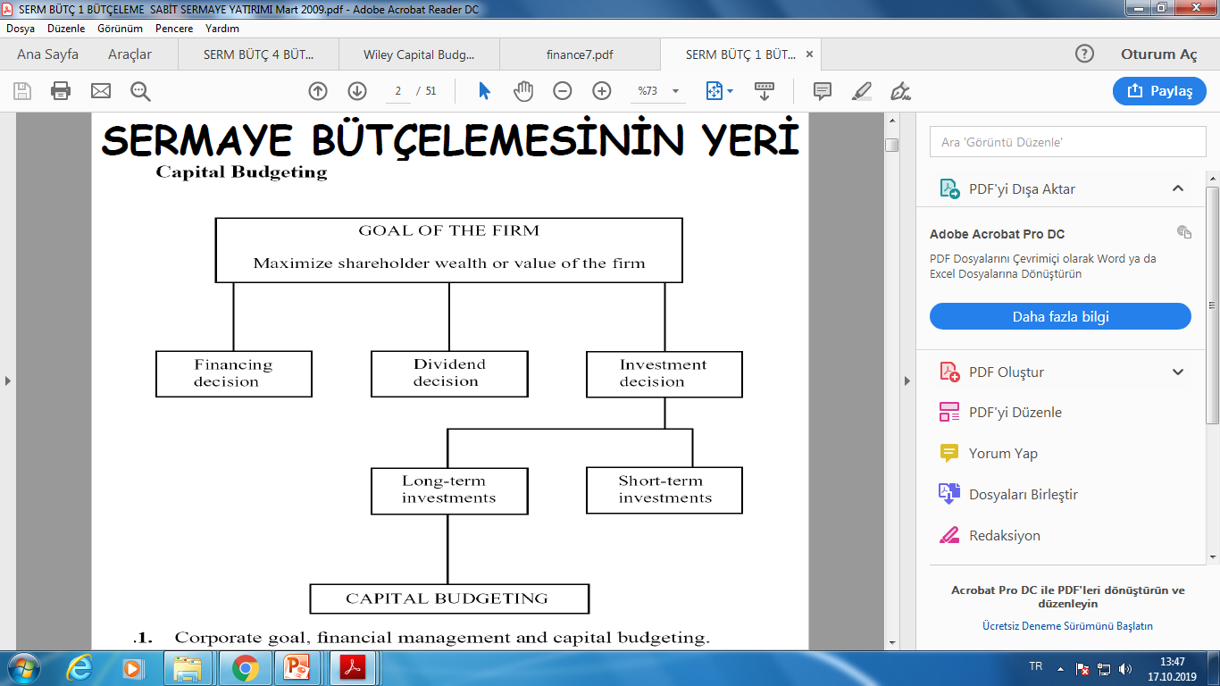
Capital Budgeting

Slide 5
Capital Budgeting
Firms continually invest funds in assets, and these assets produce income and cash flows that the firm can then either reinvest in more assets or pay to the owners.
These assets represent the firm’s capital. Capital is the firm’s total assets. It includes all tangible and intangible assets.
These assets include physical assets (such as land, buildings, equipment, and machinery), as well as assets that represent property rights (such as accounts receivable, securities, patents, and copyrights).
When we refer to capital investment, we are referring to the firm’s investment in its assets.
The term “capital” also has come to mean the funds used to finance the firm’s assets. In this sense, capital consists of notes, bonds, stock, and short-term financing. We use the term “capital structure” to refer to the mix of these different sources of capital used to finance a firm’s assets.

Slide 6
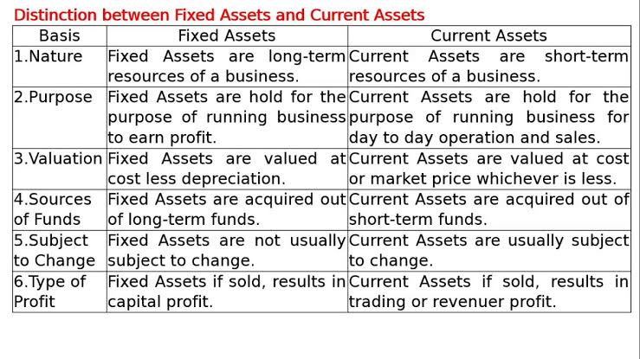

Slide 7
Required datas for making investment decisions
Investment amount
Net cash inflow
Economic life of the investment
Salvage value
Required rate of return

Slide 8
Capital Budgeting Techniques
Payback period
Discounted payback period
Net present value
Profitability index
Internal rate of return
Modified internal rate of return

Slide 9
Payback Period Method
Payback Period
  Time until cash flows recover the initial investment of the project
The payback rule specifies that a project be accepted if its payback period is less than a specified cutoff period.

Slide 10
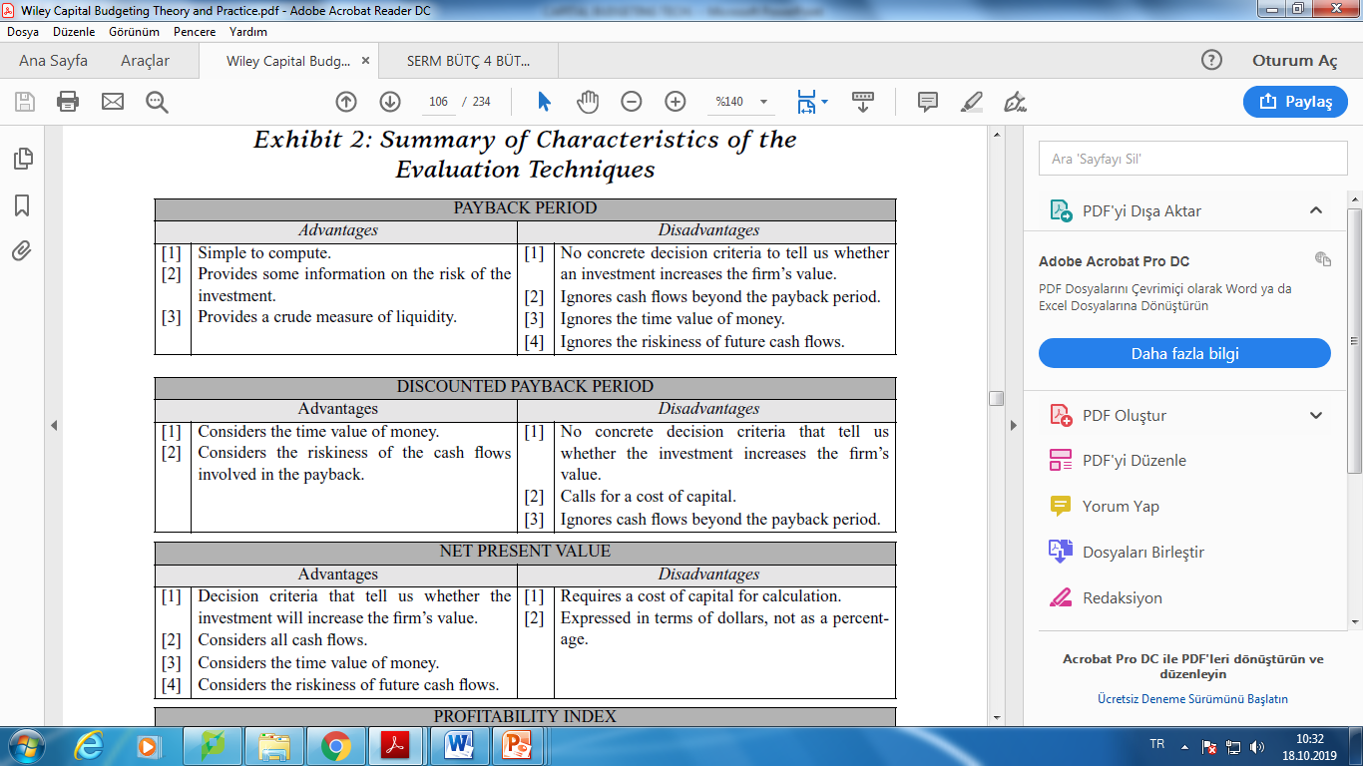
Payback Period Method

Slide 11

Payback Period Method
Example:
Investment cost $200,000
Expected useful life 8 years
Expected annual net cash flows (equal) $40,000
PaybackPeriod: $\frac{200,000}{40,000}=5$ years

Slide 12
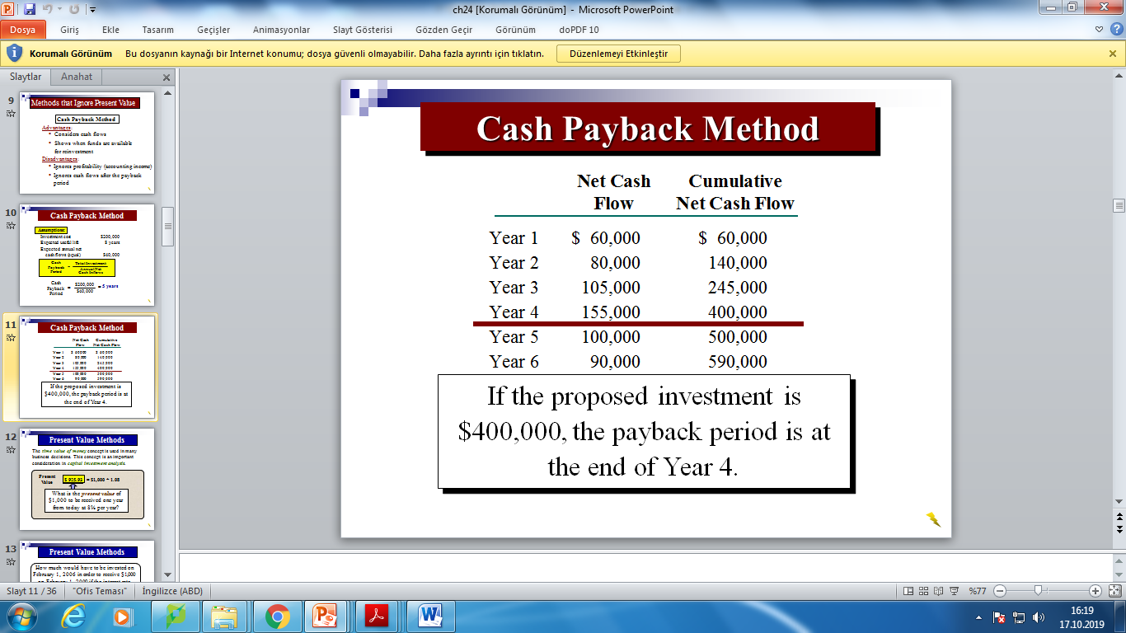
Payback Period Method

Slide 13
Payback Period Method
Example: Management at The Daily Grind wants to install an espresso bar in its restaurant that
  Costs $140,000 and has a 10-year life.
  Will generate annual net cash inflows of $35,000.
Management requires a payback period of 5 years or less on all investments.
What is the payback period for the espresso bar?

Slide 14
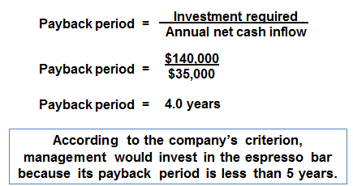
Payback Period Method
Example Solution:

Slide 15
Payback Period Method
Example : Consider the information provided for two investments. Which project has the shortest payback period?
Consider the following two investments:
Project X Project Y
Initial investment $100,000 $100,000
Year 1 cash inflow $60,000 $60,000
Year 2 cash inflow $40,000 $35,000
Year 14-10 cash inflows $0 $25,000
Which project has the shortest payback period?
  a. Project X
  b. Project Y
  c. Cannot be determined

Slide 16
Payback Period Method
Example Solution:
Consider the following two investments:
Project X Project Y
Initial investment $100,000 $100,000
Year 1 cash inflow $60,000 $60,000
Year 2 cash inflow $40,000 $35,000
Year 14-10 cash inflows $0 $25,000
Which project has the shortest payback period?
  a. Project X
  b. Project Y
  c. Cannot be determined

Slide 17
Discounted Payback Period Method
How long does it take the project to “pay back” its initial investment, taking the time value of money into account?
Decision rule: Accept the project if it pays back on a discounted basis within the specified time.
By the time you have discounted the cash flows, you might as well calculate the NPV.

Slide 18

Discounted Payback Period Method

Slide 19
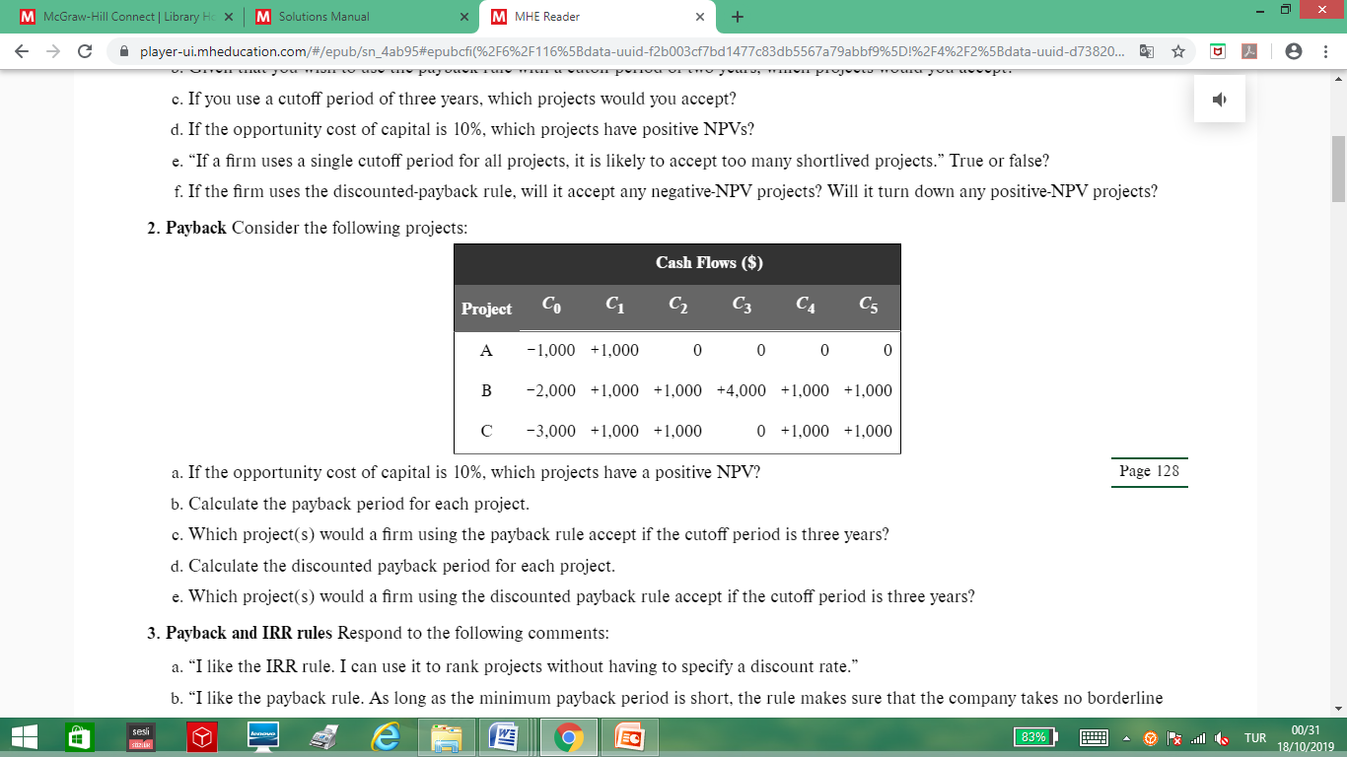
Payback Period Method
Example:

Slide 20

Payback Period Method
Example Solution:
a) NPV_{A} = –$1,000 + $1,000 / (1 + .10) = –$90.91
NPV_{B} = –$2,000 + $1,000 / (1 + .10) + $1,000 / (1 + .10)² + $4,000 / (1 + .10)³ + $1,000 / (1 + .10)⁴ + $1,000 / (1 + .10)⁵
NPV_{B}= $4,044.73
NPV_{C} = –$3,000 + $1,000 / (1 + .10) + $1,000 / (1 + .10)² + $1,000 / (1 + .10)⁴ + $1,000 / (1 + .10)⁵
NPV_{C} = $39.47
Projects B and C have positive NPVs.

Slide 21
Payback Period Method
Example Solution:
b) Payback _{A} = 1 year
Payback_{B} = 2 years
Payback_{C} = 4 years
c) Accept projects A and B
d) Project A:
PV = CF_{t} / (1 + r)^{t}
PV_{A} = $1,000 / (1 + .10)
PV_{A} = $909.09
The present value of the cash inflows for Project A is less than the initial outlay for the project, which means the project never pays back on a discounted basis. This is true for any negative NPV project.

Slide 22
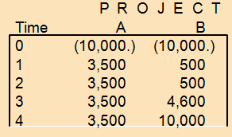
Payback Period Method
Example : Number of years needed to recover your initial outlay.

Slide 23
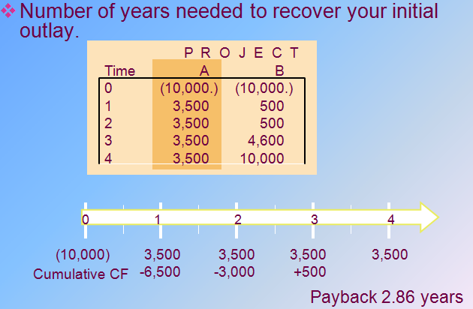
Payback Period Method
Example Solution:

Slide 24
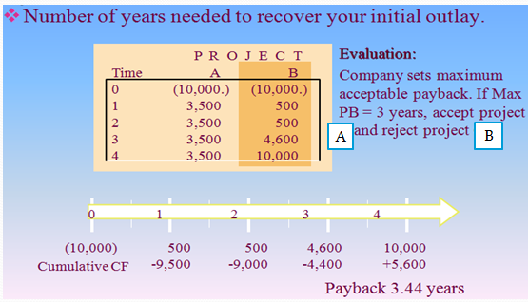
Payback Period Method
Example Solution:

Slide 25
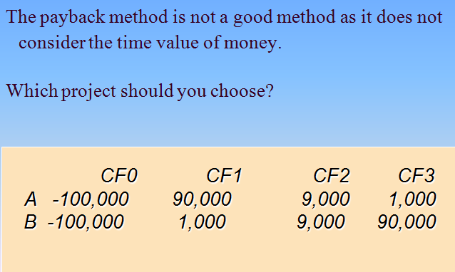
Payback Period Method
Example:

Slide 26

Net Present Value
Net Present Value
  Present value of cash flows minus initial investments
Opportunity Cost of Capital
  Expected rate of return given up by investing in a project

Slide 27

Net Present Value
Net Present Value Rule
  Managers increase shareholders’ wealth by accepting projects that are worth more than they cost
  Therefore, they should accept all projects with a positive net present value
Notes:
13

Slide 28
Net Present Value
NPV = PV - required investment
Notes:
11

Slide 29
Net Present Value
C₀ = Initial cash flow (often negative)
C₁ = Cash flow at time 1
C₂ = Cash flow at time 2
C_{t} = Cash flow at time t
t = Time period of the investment
r = Opportunity cost of capital
Notes:
11

Slide 30
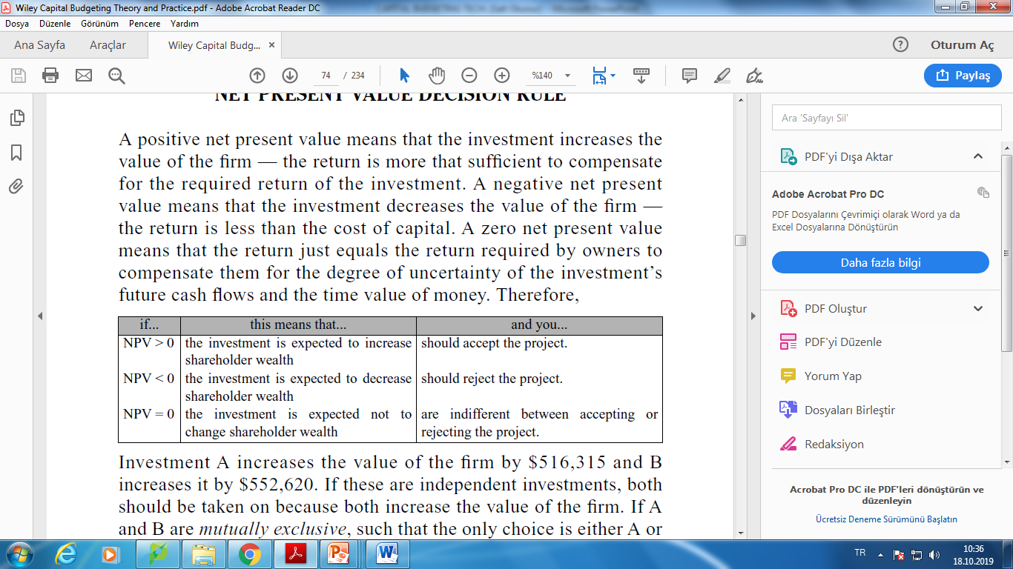
Net Present Value

Slide 31
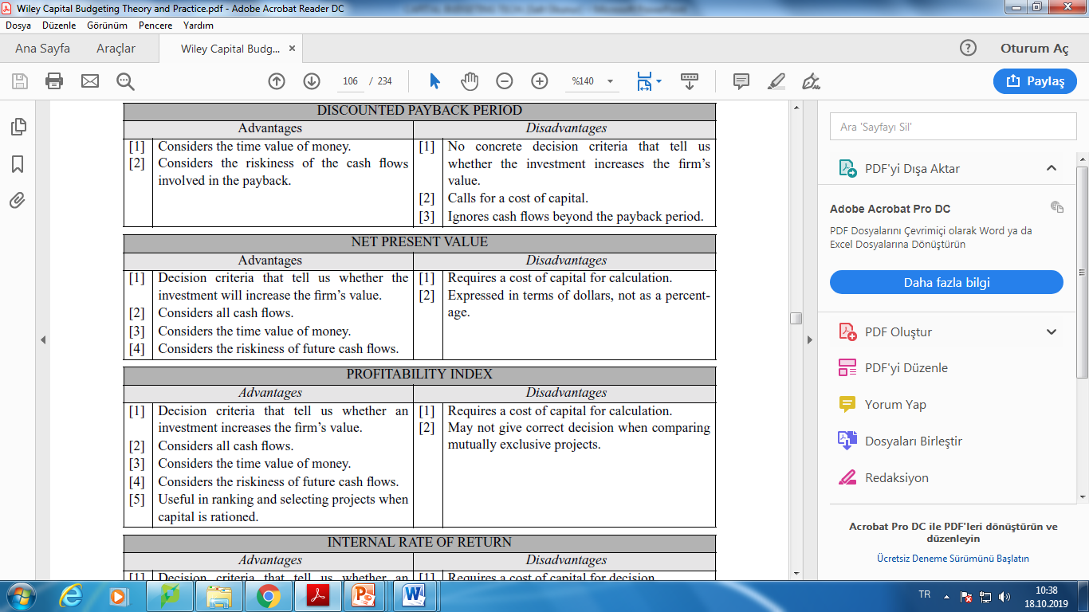
Net Present Value

Slide 32
Net Present Value
Example : Suppose we can invest $50 today & receive $60 later today. What is our increase in value?
A: Profit = −$50 + $60
= $10
$10
Added Value
$50
Initial Investment
Notes:
6

Slide 33
Net Present Value
Example : Suppose we can invest $50 today and receive $60 in one year. What is our increase in value given a 10% expected return?
$4.55
Added Value
$50
Initial Investment
This is the definition of NPV
Notes:
8

Slide 34
Net Present Value
Example: Valuing an Office Building
Step 1: Forecast cash flows
Cost of building = C₀ = 350,000
Sale price in Year 1 = C₁ = 400,000
Step 2: Estimate opportunity cost of capital
If equally risky investments in the capital market
offer a return of 7%, then
Cost of capital = r = 7%

Slide 35
Net Present Value
Step 3: Discount future cash flows
Step 4: Go ahead if PV of payoff exceeds investment

Slide 36
Net Present Value (Risk and Present Value )
Higher risk projects require a higher rate of return
Higher required rates of return cause lower PVs

Slide 37
Net Present Value (Risk and Present Value )

Slide 38
Net Present Value (Risk and Present Value )
New NPV = 357,143 − 350,000 = $7,143
Higher risk = Lower value

Slide 39

Net Present Value
Example:
Investment of $9000
  Net cash flows of $5090, $4500 and $4000 at the end of years 1, 2 and 3 respectively
  Assume required rate of return is 10%.
  What is the NPV of the project?
Notes:
13

Slide 40
Net Present Value
  Example Solution:
  Thus, using a discount rate of 10%, the project’s NPV = $2351 > 0, and is therefore acceptable.
Notes:
13

Slide 41
Net Present Value
Example: At the beginning of 2006, equipment with an expected life of five years can be purchased for $200,000. At the end of five years it is anticipated that the equipment will have no residual value.
A net cash flow of $70,000 is expected at the end of 2006. This net cash flow is expected to decline $10,000 each year (except 2010) until the machine is retired. The firm expects a minimum rate of return of 10%. Should the equipment be purchased?

Slide 42
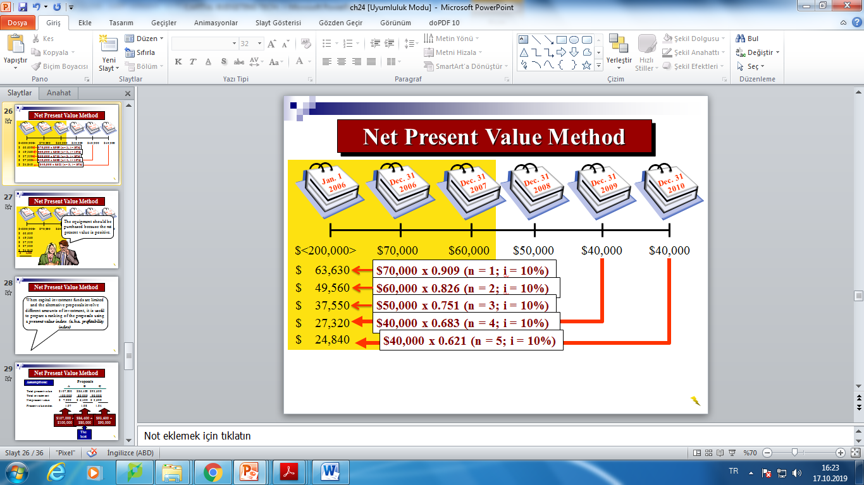
Net Present Value
Example Solution:
The equipment should be purchased because the net present value is positive.
$ 2,900

Slide 43
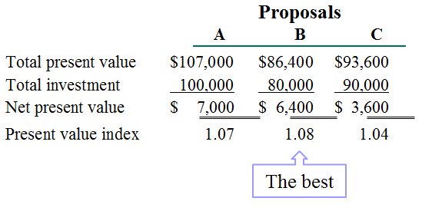
Net Present Value
Example:

Slide 44
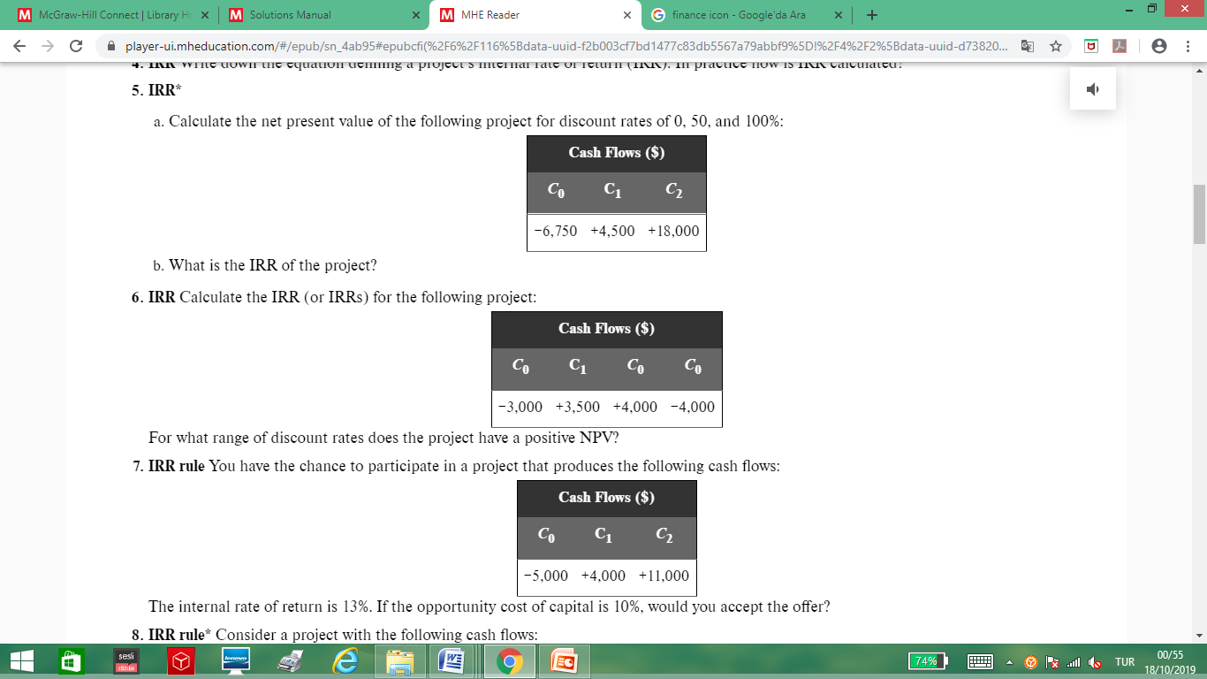

Net Present Value
Example:
NPV = –$6,750 + $4,500 / (1 + 0) + $4,500 / (1 + 0)²
= $15,750
NPV = –$6,750 + $4,500 / (1 + .50) + $4,500 / (1 + .50)²
= $4,250
NPV = –$6,750 + $4,500 / (1 + 1) + $4,500 / (1 + 1)² = $0

Slide 45
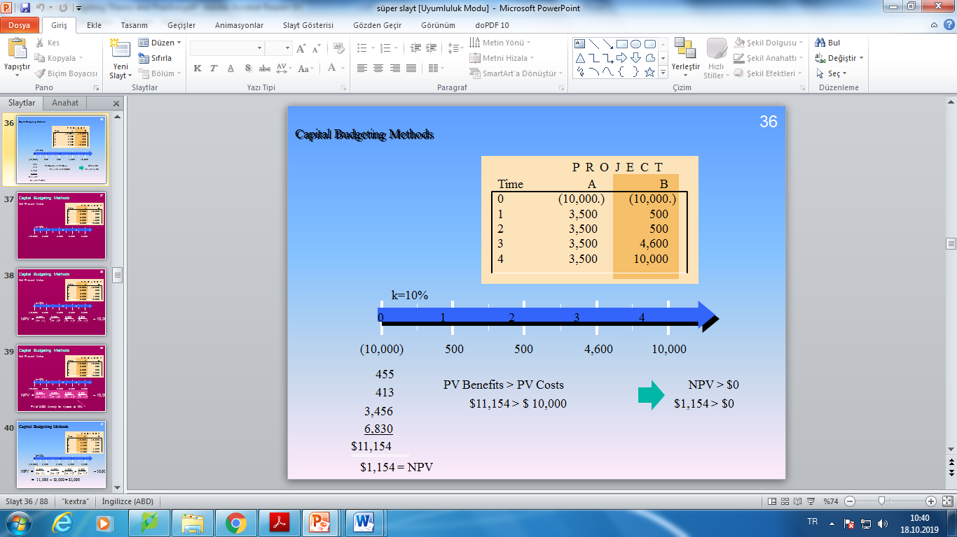
Net Present Value
Example:

Slide 46
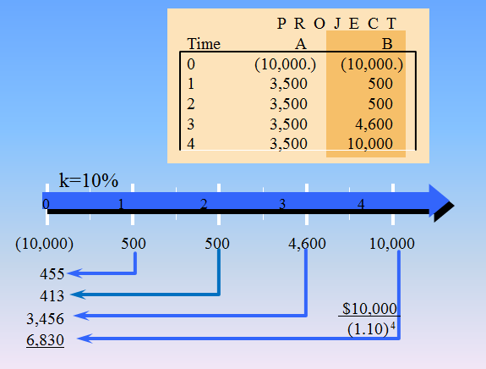
Net Present Value
Example:

Slide 47
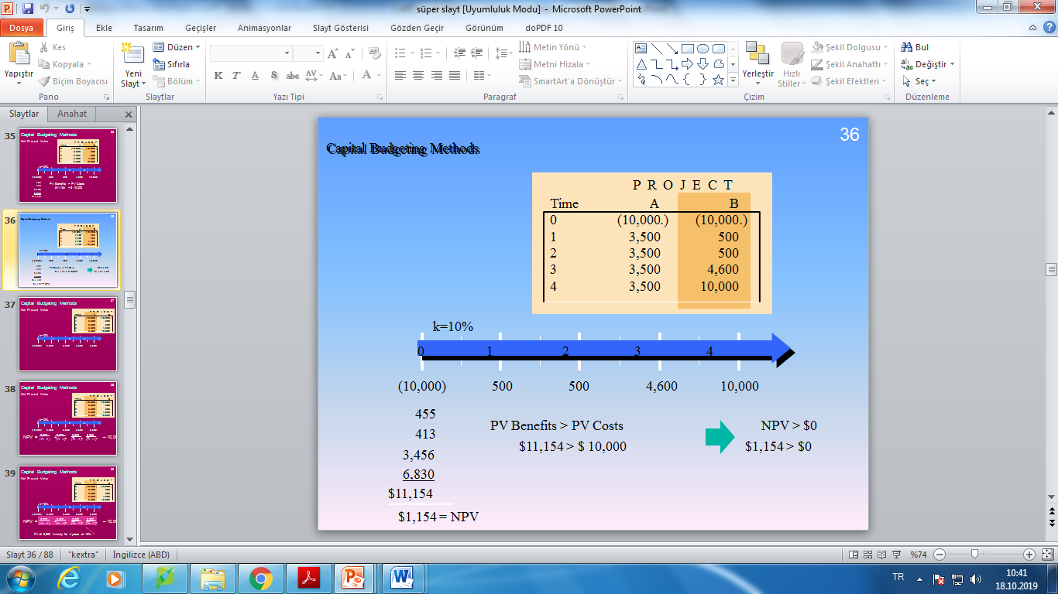
Net Present Value
Example:

Slide 48
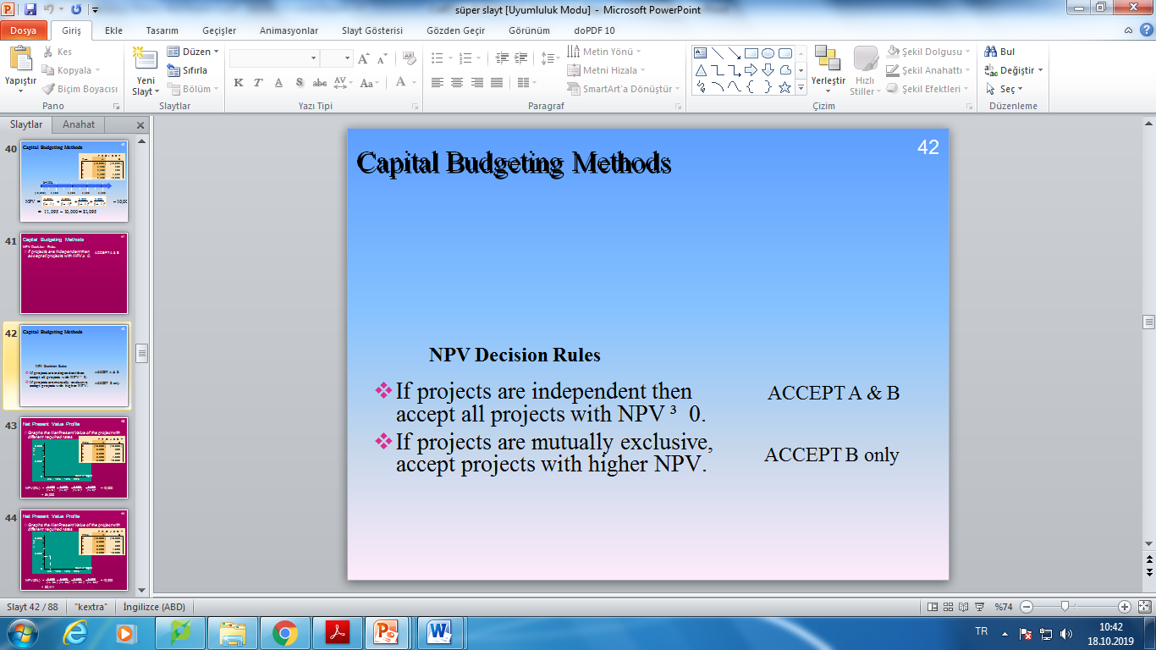
Net Present Value
Example:

Slide 49
Profitability Index
Profitability Index
  Ratio of net present value to initial investment
Minimum Acceptance Criteria:
  Accept if PI > 1
Ranking Criteria:
  Select alternative with highest PI

Slide 50

Profitability Index

Slide 51
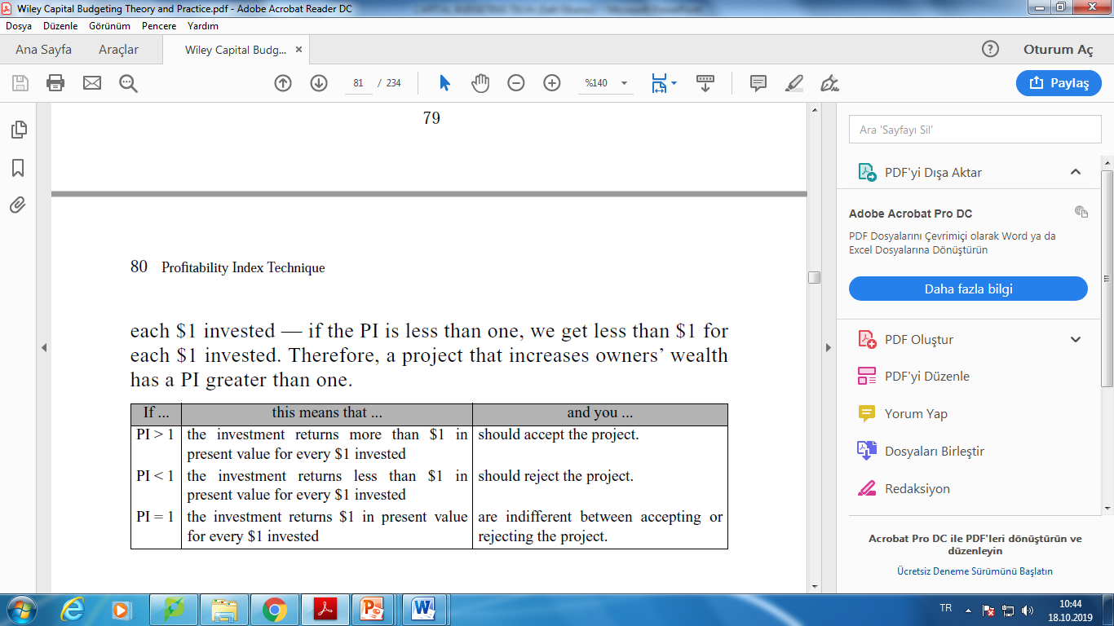
Profitability Index
If there is a limit on how much we can spend on capital projects, PI is useful. Limiting the capital budget is referred to as capital rationing.

Slide 52
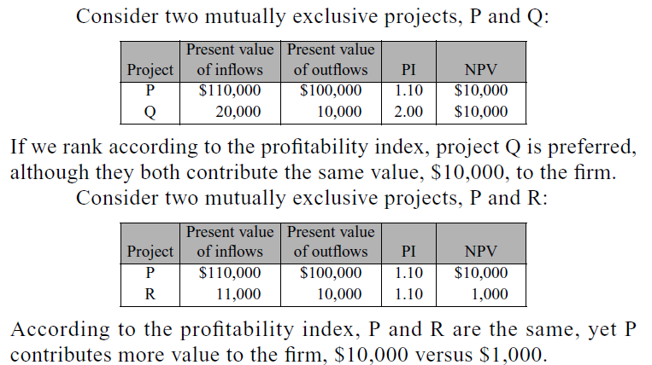
Profitability Index

Slide 53
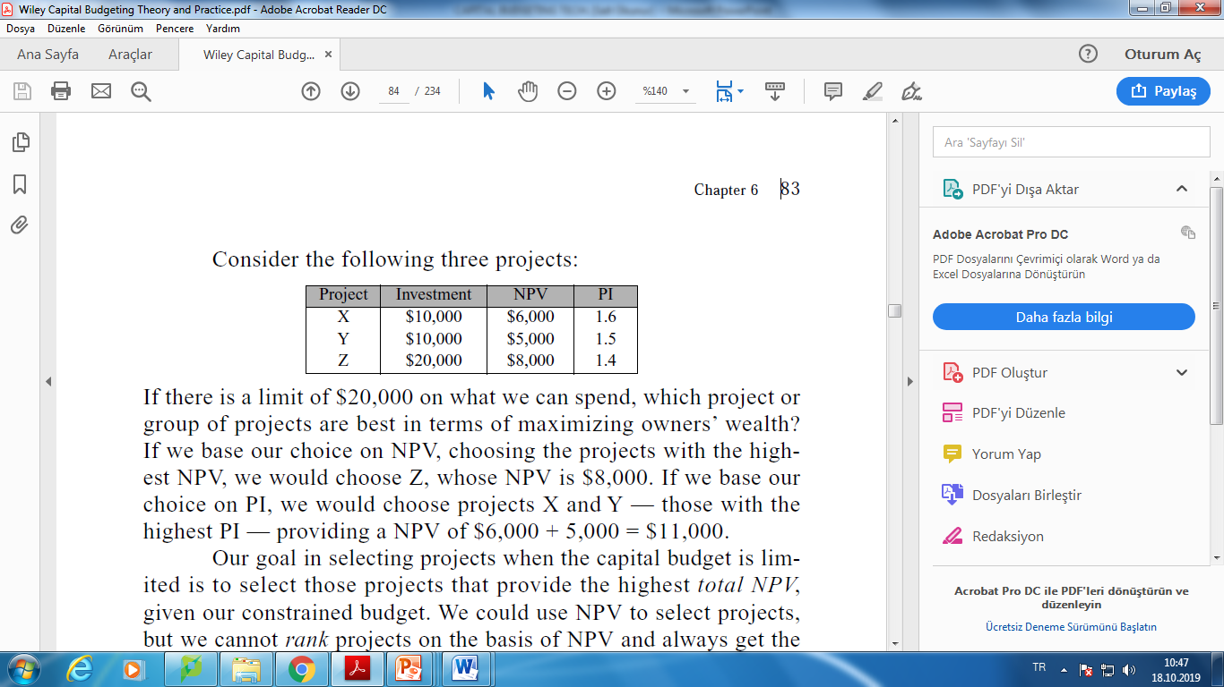
Profitability Index

Slide 54
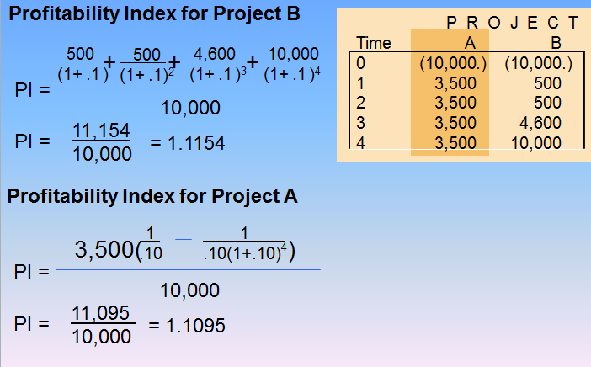
Profitability Index (Example)

Slide 55
Internal Rate of Return
Internal Rate of Return (IRR)
  Discount rate at which NPV = 0
Rate of Return Rule
  Invest in any project offering a rate of return that is higher than the opportunity cost of capital

Slide 56
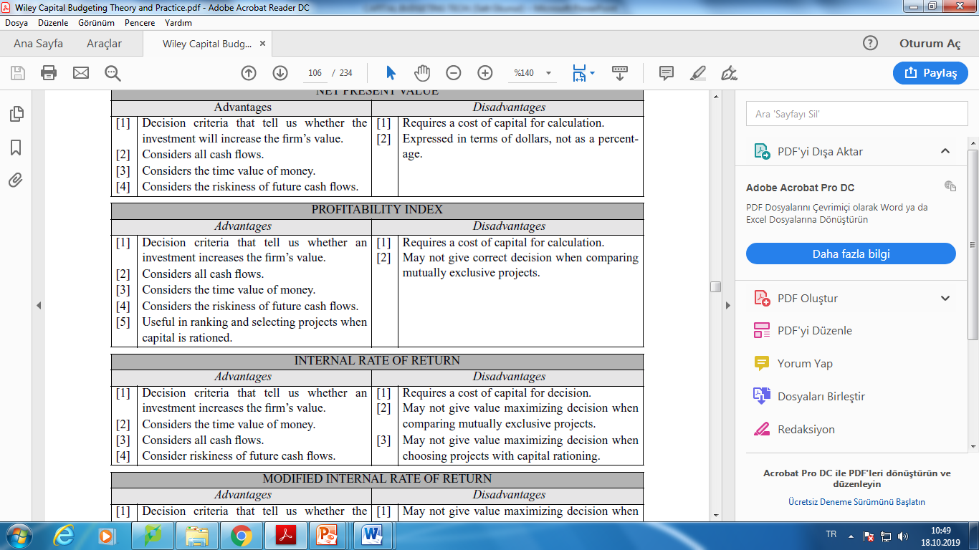
Internal Rate of Return

Slide 57
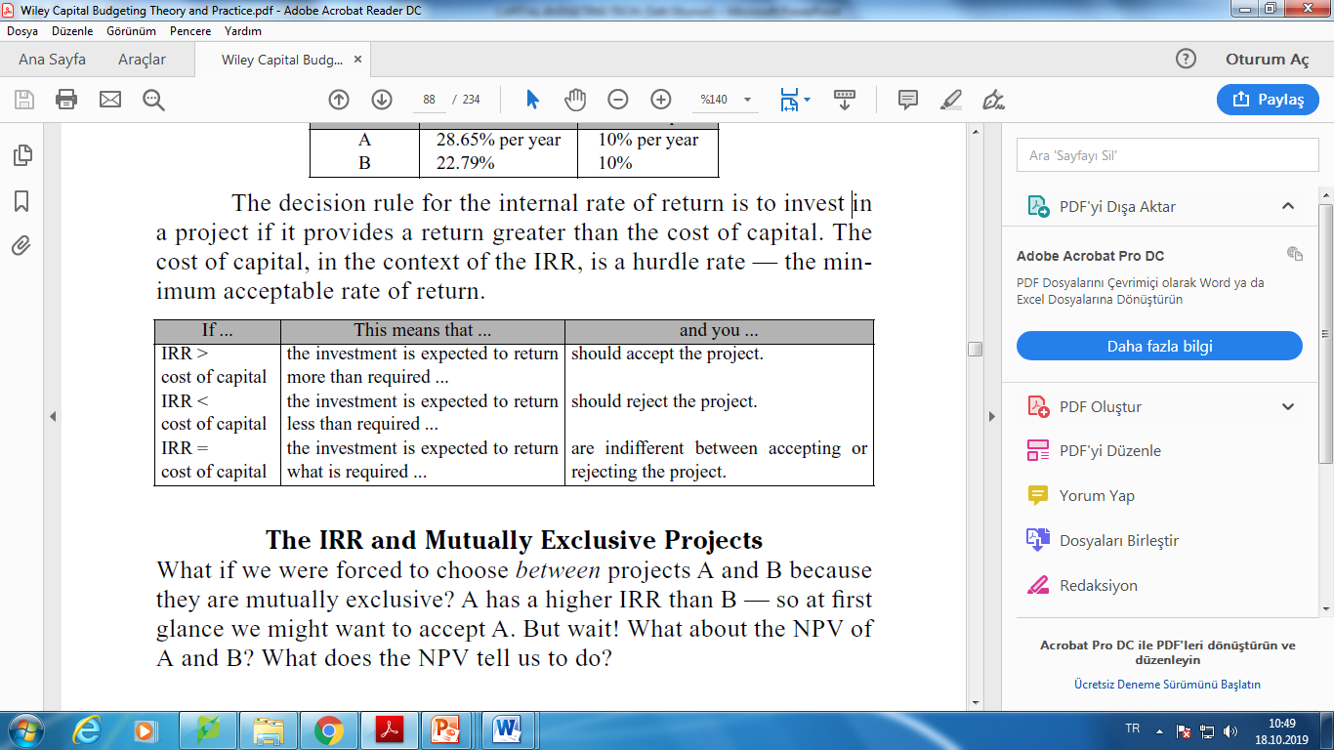
Internal Rate of Return

Slide 58
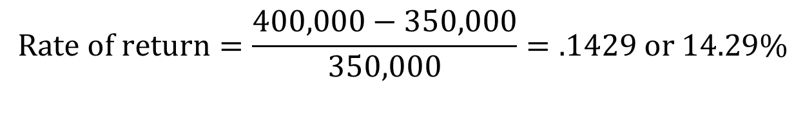
Internal Rate of Return
Example
  You can purchase a building for $350,000. At the end of the year you will sell the building for $400,000. What is the rate of return on this investment?
$$Rate of return=\frac{400,000−350,000}{350,000}=.1429 or 14.29\%$$
Notes:
21

Slide 59
Internal Rate of Return
Example
  You can purchase a building for $375,000. The investment will generate $25,000 in cash flows during the first three years. At the end of three years you will sell the building for $450,000. What is the IRR on this investment?
IRR = 12.56%
Notes:
23

Slide 60
Internal Rate of Return
Notes:
23

Slide 61
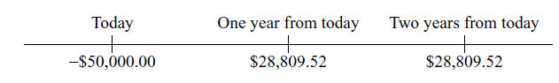
Internal Rate of Return
Example: Suppose you are offered an investment opportunity that requires you to put up $50,000 and has expected cash inflows of $28,809.52 after one year and $28,809.52 after two years. We can evaluate this opportunity using the following time line:

Slide 62
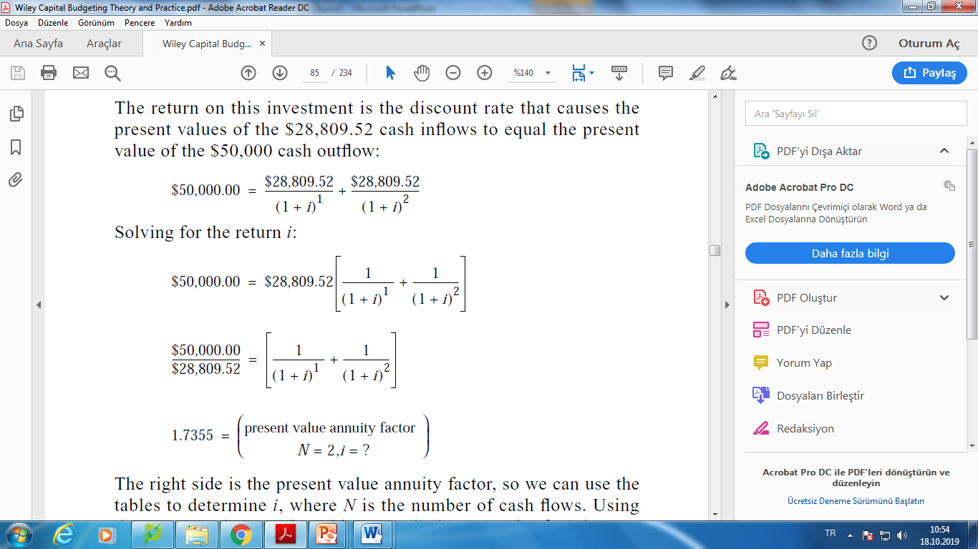
Internal Rate of Return
Example: The return on this investment is the discount rate that causes the present values of the $28,809.52 cash inflows to equal the present value of the $50,000 cash outflow:

Slide 63
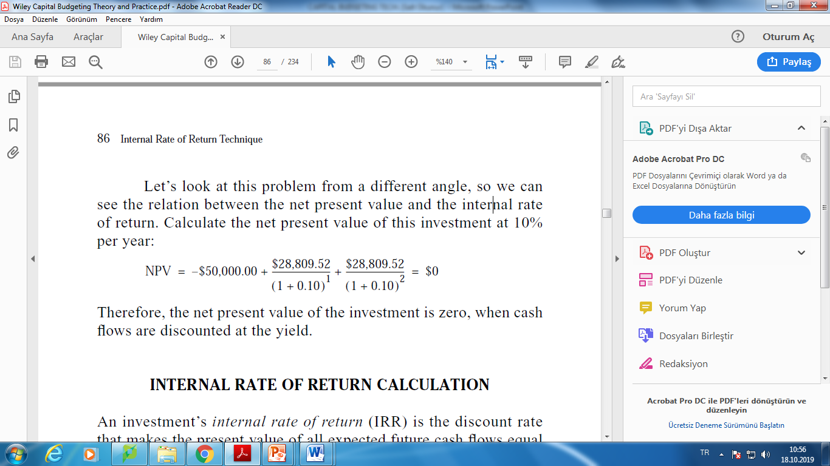
Internal Rate of Return
We can use the tables to determine i, where N is the number of cash flows. Using the present value annuity table or a calculator annuity function, i = 10%. The yield on this investment is therefore 10% per year.
Example:
Let’s look at this problem from a different angle, so we can see the relation between the net present value and the internal rate of return. Calculate the net present value of this investment at 10% per year:
Therefore, the net present value of the investment is zero, when cash flows are discounted at the yield.

Slide 64
Internal Rate of Return
Example:
NPV = –$6,750 + $4,500 / (1 + 0) + $4,500 / (1 + 0)²
= $15,750
NPV = –$6,750 + $4,500 / (1 + .50) + $4,500 / (1 + .50)²
= $4,250
NPV = –$6,750 + $4,500 / (1 + 1) + $4,500 / (1 + 1)² = $0
100%; NPV = 0 when the discount rate is 100 percent.

Slide 65
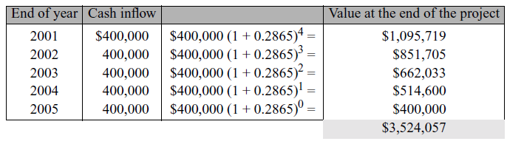
Modıfıed Internal Rate of Return Technıque
Let’s look again at A’s IRR of 28.65% per year. This means that, when the first $400,000 comes into the firm, it is reinvested at 28.65% per year for four more periods, when the second $400,000 comes into the firm, it is reinvested at 28.65% per year for three more periods, and so on. If you reinvested all of A’s cash inflows at the IRR of 28.65% (that is, you had other investments with the same 28.65% yield) you would have by the end of the project:

Slide 66
Modıfıed Internal Rate of Return Technıque
Investing $1,000,000 in A contributes $3,524,057 to the future value of the firm in the fifth year, providing a return on the investment of 28.65% per year. Let FV = $3,524,057, PV = $1,000,000, and n = 5. Using the basic valuation equation
FV = PV(1 + i)^{n}
and substituting the known values for FV, PV, and n, and the r, the IRR is,
$3,524,057 = $1,000,000(1 + i)⁵
i = 28.65% per year
Therefore, by using financial math to solve for the annual return, i, we have assumed that the cash inflows are reinvested at the IRR.

Slide 67
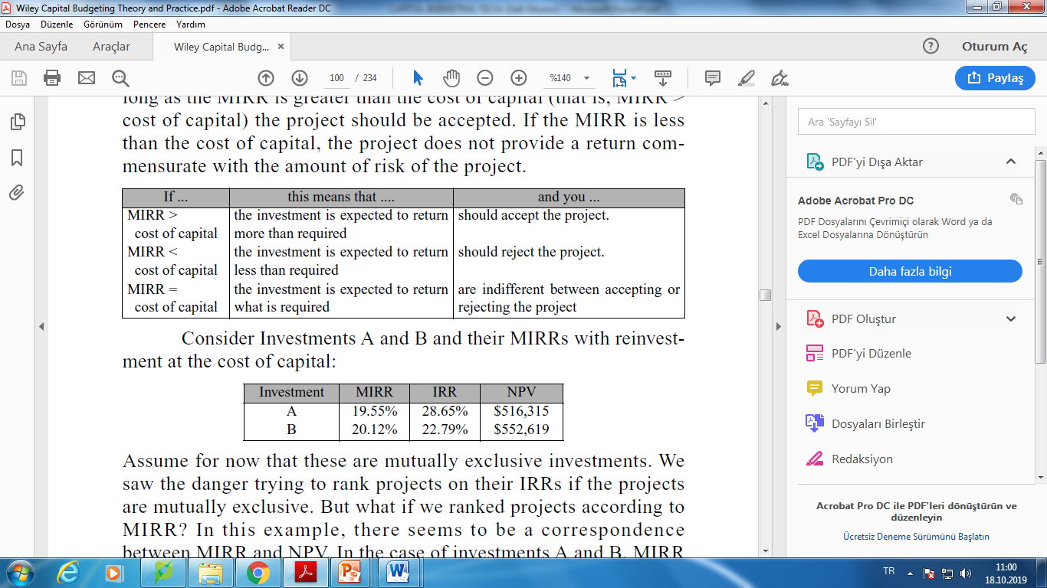
Modıfıed Internal Rate of Return Technıque

Slide 68
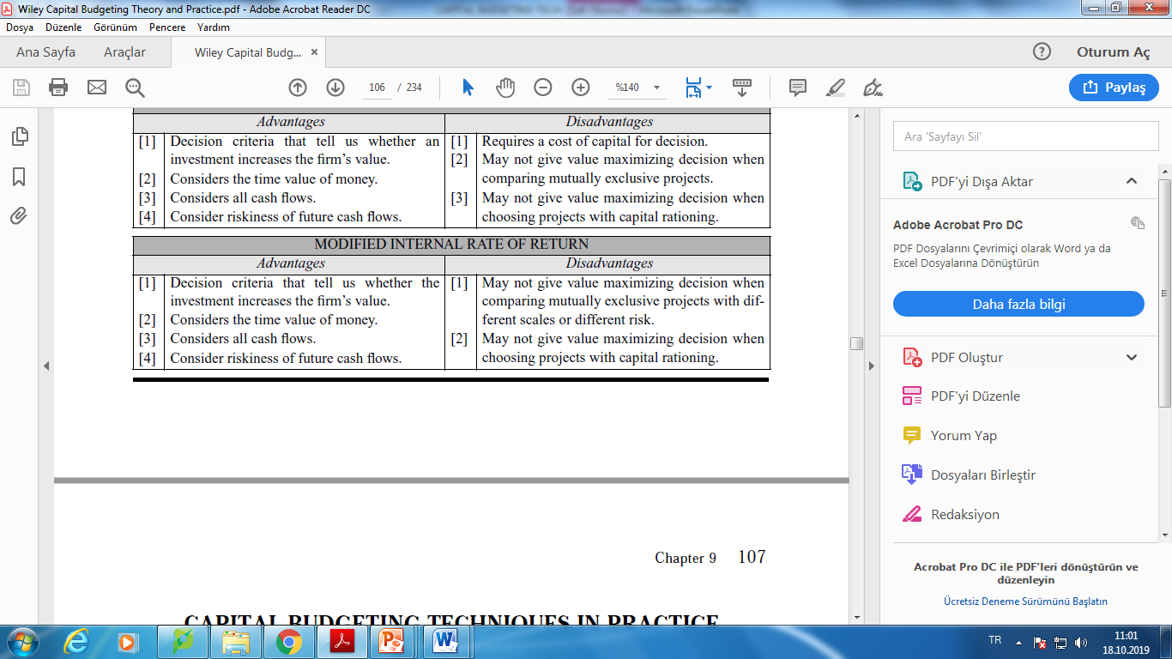
Modıfıed Internal Rate of Return Technıque

Slide 69
Summary
Net present value
  Difference between market value and cost
  Accept the project if the NPV is positive
  Has no serious problems
  Preferred decision criterion
Internal rate of return
  Discount rate that makes NPV = 0
  Take the project if the IRR is greater than the required return
  Same decision as NPV with conventional cash flows
  IRR is unreliable with nonconventional cash flows or mutually exclusive projects
Notes:
ROSS

Slide 70
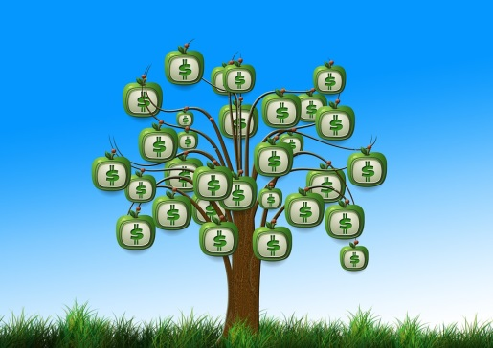
Summary
Profitability Index
  Benefit-cost ratio
  Take investment if PI > 1
  Cannot be used to rank mutually exclusive projects
  May be used to rank projects in the presence of capital rationing
Payback period
  Length of time until initial investment is recovered
  Take the project if it pays back in some specified period
  Does not account for time value of money, and there is an arbitrary cutoff period
Discounted payback period
  Length of time until initial investment is recovered on a discounted basis
  Take the project if it pays back in some specified period
  There is an arbitrary cutoff period

Slide 71
Capital Budgeting Techniques
Criterion | Definition | Investment Rule
Net present value (NPV) | Present value of cash flows minus investment | Accept project if NPV is positive. For mutually exclusive projects, choose the one with the highest (positive) NPV.
Internal rate of return (IRR) | The discount rate at which project NPR equals zero | Accept project if IRR is greater than opportunity cost of capital.
Profitability index | Ratio of net present value to initial investment | Accept project if profitability index is greater than 0. In case of capital rationing, accept projects with highest profitability index.
Payback period | Time until the sum of project cash flows equals the initial investment | Accept project if payback period is less than some specified number of years.

