Slide 1
Chapter Eight
Stock Markets
©2019 McGraw-Hill Education. All rights reserved. Authorized only for instructor use in the classroom. No reproduction or further distribution permitted without the prior written consent of McGraw-Hill Education.

Slide 2
Overview of Stock Markets
Primary stock markets allow suppliers of funds to raise equity capital.
Secondary stock markets are the most closely watched and reported of all financial markets.
Stockholders are the legal owners of a corporation.
Have a right to share in the firm’s profits (Example: through dividends).
Are residual claimants.
Have limited liability.
Have voting rights (Example: to elect board of directors).

Slide 3
Common Stock
Common stock is the fundamental ownership claim in a public or private corporation
Dividends are discretionary, and are thus not guaranteed
Common stockholders have the lowest priority claim in the event of bankruptcy (That is a residual claim)
Limited liability implies that common stockholders can lose no more than their original investment
Common stockholders control the firm’s activities indirectly by exercising their voting rights in the election of the board of directors

Slide 4
Common Stock Voting Rights
Dual-class firms have two classes of common shares outstanding, with different voting rights assigned to each class.
With cumulative voting, the number of votes assigned to each stockholder equals the number of shares held multiplied by the number of directors to be elected.
The number of shares needed to elect p directors, N_{p}, is:
N_{p} = [(p x # of votes available) / (# of directors to be elected + 1)] +1
A proxy vote allows stockholders to vote by absentee ballot (Example: by internet or by mail).

Slide 5
Stock Returns
The return on a stock over one period (R_{t}) can be divided into capital gains and dividend returns:
P_{t} = stock price at time t
D_{t} = dividends paid over time t – 1 to t
(P_{t} – P_{t – 1}) / P_{t – 1} = capital gain over time t – 1 to t
D_{t} / P_{t – 1} = return from dividends over time t – 1 to t

Slide 6
Stock Returns Example
Suppose an investor buys 10 shares of stock priced at $55.10 and sells the stock one year later for $56.30 after collecting a $0.30 dividend per share. What was the investor’s pre-tax holding period return?
If dividend income is taxed at a 28% rate and capital gains are taxed at 20%, what was the investor’s after-tax holding period return?

Slide 7
Bond Valuation
Preferred stock is a hybrid security that has characteristics of both bonds and common stock.
Similar to common stock in that it represents an ownership interest in the issuing firm, but like a bond it pays a fixed periodic (dividend) payment.
Generally has fixed dividends that are paid quarterly.
Generally does not have voting rights unless dividend payments are missed.
Nonparticipating versus participating.
Cumulative versus noncumulative.
Notes:
Under the government’s Capital Purchase Program (a part of TARP), the government injected capital into firms and received cumulative preferred stock in return paying a 5% cumulative dividend for five years then a 9% dividend afterwards.

Slide 8
Primary Stock Markets 1
Primary markets are markets in which corporations raise funds through new issues of securities, most of the time through investment banks.
Example: Morgan Stanley or Bank of America Merrill Lynch.
Investment banks act as distribution agents in best efforts underwriting.
Investment banks act as principals in firm commitment underwriting.
gross proceeds − net proceeds = underwriter’s spread
A syndicate is a group of investment banks working in concert to issue stock; the lead underwriter is the originating house.

Slide 9
Primary Stock Markets 2
An initial public offering (I P O) is the first public issue of financial instruments by a firm.
A seasoned offering is the sale of additional securities by a firm whose securities are already publicly traded.
Preemptive rights give existing stockholders the ability to maintain their proportional ownership.
A red herring prospectus is a preliminary version of the prospectus that describes a new security issue.
Shelf registration allows firms to offer multiple issues of stock over a two-year period with only one registration statement.

Slide 10
Secondary Stock Markets 1
Secondary stock markets are the markets in which stocks, once issued, are traded among investors.
The U.S. has several major stock markets.
New York Stock Exchange Euronext (N Y S E/Euronext).
The N Y S E/Euronext Exchange was purchased by I C E in 2013.
National Association of Securities Dealers Automated Quotation (N A S D A Q).
Bats/Direct Edge (former E C N s).

Slide 11
N Y S E Euronext 1
Trading occurs at a specific place on the floor of the exchange called a trading post.
Each stock has a special market maker called a specialist or Designated Market Maker (D M M) that maintains liquidity for the stock at all times.

Slide 12
N Y S E Euronext 2
Three types of transactions occur at trading posts.
A market order is an order to transact at the best price available when the order reaches the trading post.
A limit order is an order to transact at a specified price.
Specialists transact for their own account.
Program trading is the simultaneous buying and selling of a portfolio of at least 15 different stocks valued at more than $1 million using computer programs to initiate the trades.
Circuit breakers give investors time to make informed choices during periods of high market volatility.

Slide 13
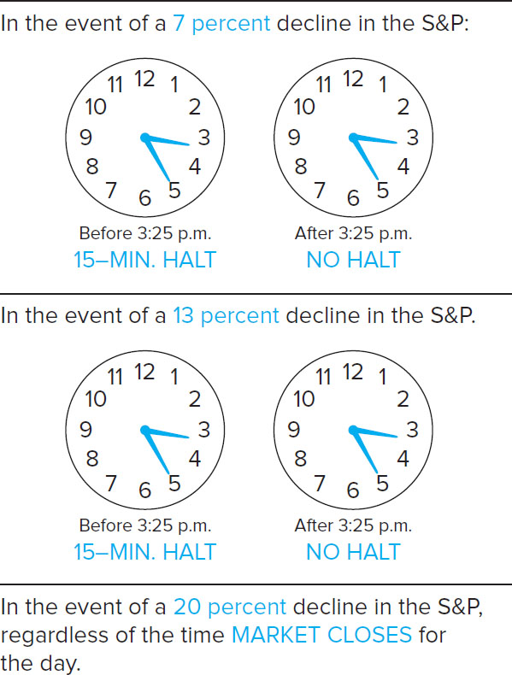
Circuit-Breaker Levels
Figure 8–11 Circuit-Breaker Levels for the Third Quarter of 2016
Source: New York Stock Exchange Euronext website. www.nyse.com
Access the long description slide.

Slide 14
Purchase of a Stock on the N Y S E
Access the long description slide.

Slide 15
Stock Market Quote
Name
Symbol
Open
High
Low
Close
Net Chg
% Chg
Volume
52 Wk High
52 Wk Low
Div
Yield
P/E
YTD % Chg

Slide 16
Stock Market Quote Example
Table 8-1 Stock Market Quote, July 7, 2016
Source: The Wall Street Journal Online, July 8, 2016. www.wsj.com
Access the long description slide.
Notes:
Note that if the security makes semiannual or monthly payments then the cash flow, the interest rate and the number of periods must be adjusted to reflect the payment frequency.

Slide 17
Exchange Traded Funds (E T F s)
Pioneered by the former A M E X (now N Y S E/A M E X).
E T F s are index funds that are listed on an exchange and can be traded intraday and shorted.
Prices may not exactly match an index.

Slide 18
N A S D A Q and O T C Markets
N A S D A Q was the world’s first electronic market and has no physical trading floor.
Provides continuous trading for the most active stocks traded over-the-counter (O T C).
Primarily a dealer market where many, often more than 20, dealers act as market makers.
A small order execution system (S O E S) provides automatic order execution for orders of less than or equal to 1,000 shares.
The N A S D maintains an electronic “O T C bulletin board” and “pink sheets” for small firms that are not part of the N A S D A Q.

Slide 19
Secondary Stock Markets 2
Choice of market listings.
N Y S E has extensive listing requirements (Example: firm market value and trading volume).
N A S D A Q requirements are cheaper and can be met by smaller firms with less active trading.
Electronic communication networks (E C N s).
Normal trading occurs between 9:30 a.m. and 4:00 p.m. eastern standard time.
Extended-hours trading occurs through computerized alternative trading systems (A T S s) a.k.a. E C N s.
B A T S (Better Alternative Trading System) has now become an exchange.
Online trading via the internet is becoming increasingly popular with both individual and professional investors.

Slide 20
Features of Duration
Flash trading.
For a fee, traders are allowed to see incoming buy or sell orders milliseconds earlier than general market traders.
Exchanges claim that the flash trading benefits all traders by creating more market liquidity and the opportunity for price improvement.
Critics contend that flash trading creates a market in which certain traders can unfairly exploit others.
Wash trades.
The illegal act of acting as both buyer and seller in the same transaction.

Slide 21
Flash Trading
In flash trading, traders are allowed to see incoming buy or sell orders milliseconds earlier than general market traders.
Flash traders then use computerized statistical analysis to generate high frequency trading strategies that are executed by computer as well.
Pro.
Flash trading creates more liquidity and the possibility of price improvement.
Cons.
Creates a disadvantage for regular traders and investors who are not allowed to view incoming orders.
High volume of trading generated by multiple computers can lead to events like the so called “flash crash”.

Slide 22
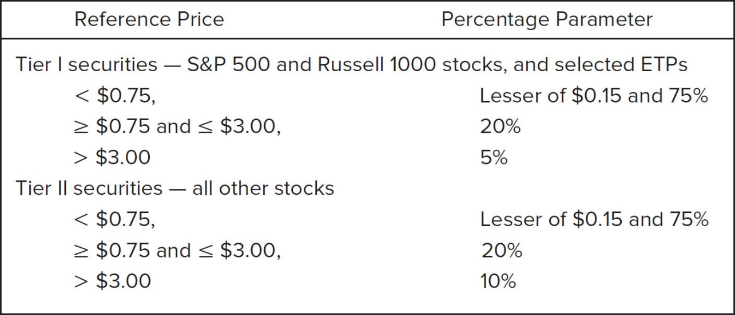
Flash Trading Concluded
As a result of the flash crash, the S E C imposed circuit breaker rules for individual stocks.
Trading is halted if the price breaks the price band.
Price band = (Reference Price) ± [(Reference price) × (Percentage parameter)].
Figure 8–12 Limit Up–Limit Down Structure in Place in 2016
Access the long description slide.

Slide 23
Naked Access and Dark Pools
Naked access occurs when brokers and exchanges allow some traders to engage in high frequency trades anonymously using the broker’s access code.
Dark pools of liquidity are trading networks that provide liquidity but that do not display trades on order books.
In 2008, 3% of daily stock trading was processed through dark pool trading. In 2016, this number climbed to 42%.
In 2013, the S E C approved a plan for new rules requiring dark pools to disclose and detail trading activity on their platforms.
New rules require such systems to file detailed information about their operations, including trading by broker dealer operators on the A T S, which could pose conflicts of interest.

Slide 24
Stock Market Indexes
A stock market index is the composite value of a group of secondary market-traded stocks.
Price-weighted index.
The Dow Jones Industrial Average (D J I A), composed of 30 large companies, is the most widely reported stock market index.
Value-weighted indexes.
N Y S E Composite.
Standard & Poor’s 500.
N A S D A Q Composite.
Wilshire 5000.

Slide 25
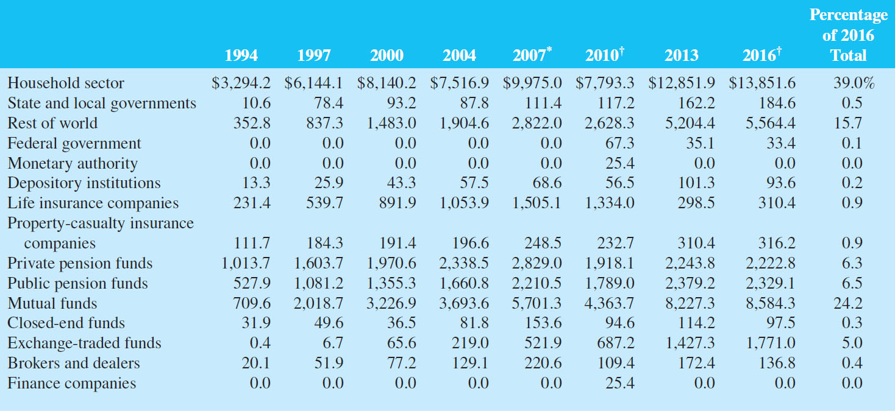
Holders of Corporate Stock
Table 8–4 Holders of Corporate Stock (in billions of dollars)
*As of the end of the third quarter.
†As of the end of the first quarter.
Sources: Federal Reserve Board website, various issues. www.federalreserve.gov
Access the long description slide.

Slide 26
Other Stock Market Issues 1
Economic indicators.
Stock market indexes might be used to forecast future economic activity.
An increase (decrease) in stock market indexes today potentially signals the market’s expectation of higher (lower) corporate dividends and profits and, in turn, higher (lower) economic growth.
Stock prices are one of the 10 variables included in the index of leading economic indicators used by the Federal Reserve as it formulates economic policy.

Slide 27
Other Stock Market Issues 2
Market efficiency refers to the speed with which financial security prices reflect unexpected news events.
Weak form market efficiency.
Concludes that investors cannot make more than the fair (required) return using information based on historical price movements.
Empirical research suggests that markets are weak form efficient.
Semistrong form market efficiency.
According to semistrong form market efficiency, investors cannot make more than the fair (required) return by trading on public news releases.
Note that if semistrong form market efficiency holds, weak form market efficiency must hold as well.

Slide 28
Other Stock Market Issues Concluded
Market efficiency refers to the speed with which financial security prices reflect unexpected news events.
Strong form market efficiency.
States that stock prices fully reflect all information about the firm, both public and private.
According to strong form efficiency, even learning private information about the firm is of not help in earning more than the required rate of return.
Limited empirical testing, but studies do suggest that corporate insiders earn abnormal returns from trading and the more informed the insider, the more often abnormal returns are earned.
For this reason, laws prohibit investors from trading on the basis of private information.

Slide 29
Stock Market Regulations 1
The Securities and Exchange Commission (S E C) is the primary regulator of stock markets.
Promote full and fair disclosure of information on securities and ensure fair treatment of investors.
Enforce Securities Act of 19 33/Securities Exchange Act of 19 34.
Prosecute inside trading.
Galleon Fund, Raj Rajaranam.
S A C Capital Advisors L P.
S E C failed to uncover Madoff fraud.
Significant turnover of personnel since.

Slide 30
Stock Market Regulations 2
The Financial Industry Regulatory Authority (F I N R A) is the regulator for all U.S. securities firms.
F I N R A oversees registering and educating brokers and dealers, examining securities firms, promulgating rules, enforcing federal securities laws, and conducting dispute arbitration.
Notes:
FINRA was created by the 2007 merger of the NASD and the regulatory arm of the NYSE.

Slide 31
International Aspects of Stock Markets
U.S. stock markets are the world’s largest.
European markets have increased their share of the global market with the advent of a common currency, the Euro, but hurt by the Euro area crisis.
Growth has strengthened China and Pacific Basin countries.
International stock markets allow investors to diversify by holding stocks issued by corporations in foreign countries.
International diversification can increase risk due to incomplete information about foreign stocks as well as foreign exchange and political risk.

Slide 32
American Depository Receipts (A D R s) 1
An A D R is a certificate that represents ownership of a foreign stock.
Created by a U.S. bank, after acquiring stock in foreign corporations in their domestic currencies.
The bank then issues dollar A D R s backed by the shares of the foreign stock, investors earn returns in U.S. dollars.
There are currently over 3,600 A D R s of foreign corporations available to U.S. investors representing asset values of over $3.1 trillion in 2015.

Slide 33
American Depository Receipts (A D R s) 2
There are 3 types of A D R s:
Level 1 A D R s trade O T C and are not required to meet U.S. G A A P nor issue annual reports.
Level 2 A D R s trade on the exchanges and must meet exchange requirements and adhere to U.S. reporting standards.
Level 3 A D R s meet the same reporting standards as Level 2 and must register with the S E C and file the equivalent of 10K forms. These firms are allowed to raise public capital in the U.S.
Notes:
Level 2 ADRs are much more liquid than Level 1 offerings.
ADRs provide low cost diversification, but may more directly expose investors to currency and sovereign risk.

Slide 34
Impact of Change in Foreign Currency Exchange Rates on Market Returns
Table 8-7 Impact of Change in Foreign Currency Exchange Rates on Market Returns
(U.S. dollars and local currencies in millions)
blank | blank | Value in Local Currency | in U.S. Dollars | Percentage Change since May 2015 | Percentage Change since May 2015
Exchange | Currency | May 2016 | May 2016 | (in U.S. dollars) | (in local currency)
Buenos Aires SE | Argentine peso | 816,261.2 | 58,654.2 | −12.2% | 36.0%
Colombia SE | Colombian peso | 296,356,386.0 | 98,048.8 | −21.3% | −6.4%
Mexican Exchange | Mexican peso | 7,204,606.5 | 389,948.3 | −17.6% | −0.6%
TMX Group | Canadian dollar | 2,454,982.9 | 1,879,628.6 | −11.1% | −6.9%
BSE India | Indian rupee | 99,286,781.7 | 1,479,132.7 | −8.3% | −3.6%
Japan Exchange Group—Tokyo | Japanese yen | 529,918,536.3 | 4,772,750.9 | −4.6% | −14.6%
National Stock Exchange India | Indian rupee | 97,405,511.5 | 1,451,106.3 | −7.6% | −2.8%
Johannesburg SE | South African rand | 3,074,158.0 | 3,419,911.0 | −2.2% | −4.0%
NYSE Euronext (Europe) | Euro | 15,496,523.3 | 982,527.6 | 3.3% | 34.8%
Oslo Børs | Norwegian Krone | 1,729,085.5 | 207,140.6 | −11.6% | −5.3%
Tel Aviv SE | Israeli new sheqel | 852,286.0 | 221,637.8 | −2.0% | −2.6%
Wiener Börse | Euro | 84,699.2 | 94,225.4 | −6.3% | −8.0%

Slide 35
Capital Asset Pricing Model
C A P M.
A model that predicts the relationship between the risk and equilibrium required returns on risky assets.
Built on the theory that the appropriate risk premium on an asset will be determined by its contribution to the risk of an investor’s overall portfolio.

Slide 36
Event Study Tests
Marked model.
Used by event studies to identify the normal relationship between a stock’s return and the market’s return using a period of time prior to a news release (Example: the year prior).
Represented as an ordinary least squares regression equation.

Slide 37
Circuit-Breaker Levels Long Description
In the event of a 7% decline in the S&P before 3:25 p.m. there is a 15-minute halt. After 3:25 p.m. there is no halt. In the event of a 13% decline in the S&P before 3:25 p.m. there is a 15-minute halt. After 3:25 p.m. there is no halt.
Return to slide containing original image.

Slide 38
Purchase of a Stock on the N Y S E Long Description
The investor submits a buy order for shares using cash through the broker (Wells Fargo), who gives cash to the commission or floor broker, who then exchanges with the market maker or other floor broker. The shares flow back through to the investor.
Return to slide containing original image.

Slide 39
Stock Market Quote Example Long Description
The information provided in the columns are the name, symbol, open, high, low, close, net change, percent change, volume, 52 week high, 52 week low, dividend, yield, P/E, and year to date percent change.
Return to slide containing original image.

Slide 40
Flash Trading Concluded Long Description
Table showing the reference prices and percentage parameters for Tier I and Tier II securities. Tier I securities - S&P 500, and Russell 1000 stocks, and selected ETPs. Less than $0.75 the percentage parameter is the lesser of $0.15 and 75%. Between $0.75 and $3, the percentage parameter is 20%. Greater than $3, the percentage parameter is 5%.
Tier II securities - all other stocks. Less than $0.75 the percentage parameter is the lesser of $0.15 and 75%. Between $0.75 and $3, the percentage parameter is 20%. Greater than $3, the percentage parameter is 10%.
Return to slide containing original image.

Slide 41
Holders of Corporate Stock Long Description
The row values are: house hold sector, state and local governments, rest of the world, federal government, monetary authority, depository institutions, life insurance companies, property-casualty insurance companies, private pension funds, public pension funds, mutual funds, closed-end funds, exchange-traded funds, brokers and dealers, and finance companies.
Return to slide containing original image.

