Slide 1
IRE … Turkish Foreign Policy
Assist. Prof. Saffet Akkaya
Course hours: ???
saffetakkaya@cag.edu.tr
Week 16: General Review

Slide 2

Main Source for the Course Türk Dış Politikası Vol 1, 2, 3 Ed. Baskın Oran
Türk Dış Politikası Vol 1, 2, 3

Slide 3
General Eview
Review the topics for all 1-16th weeks

Slide 4
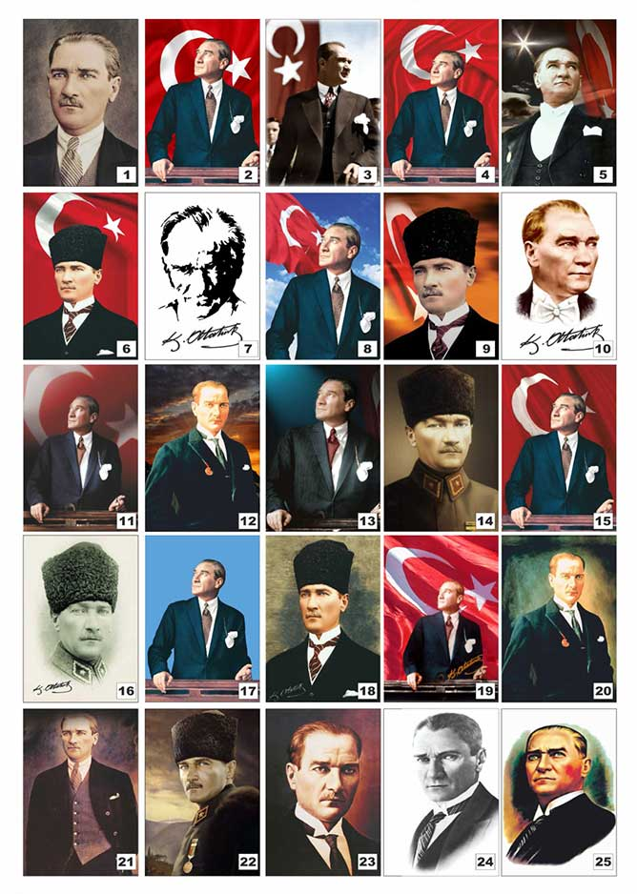
Questions?

