Slide 1
Note Taking Techniques for
Consecutive Translation
Dr. Beyza Şahin Yıldırım

Slide 2
CLAUSES
It has been said from the beginning that we should get the notes in SVO group, since the object is considered as the third or fourth element of the sentence.
The beautiful woman was standing in the garden.
S V O

Slide 3
Clauses
What if the third element is not just a noun or a phrase but a whole clause.
Reported Speech
Subordinate Clauses (Noun Clauses, Relative Clauses etc.)

Slide 4
Clauses
S V
David Cameron has pointed out that ‘Immigration brings many benefits to our country –economic, social and cultural’.
S V
I think [that] this greater cultural intermingling should be a cause for rejoicing rather than for concern.

Slide 5
Clauses
In clause itself, there is a Subject, a Verb and an Object.
... That ‘Immigration brings many benefits to our country –economic, social and cultural.’
.... [that] this greater cultural interminling should be a cause for jecoicing rather than for concern.

Slide 6
clauses
‘ ∩ ’ symbol can be used to represent that and to introduce the clauses.
∩ = that, which
Where, when, who are also introduce subordinate clauses.
∩ ◦ = Who, whose, whom (the ◦ denotes a person)

Slide 7
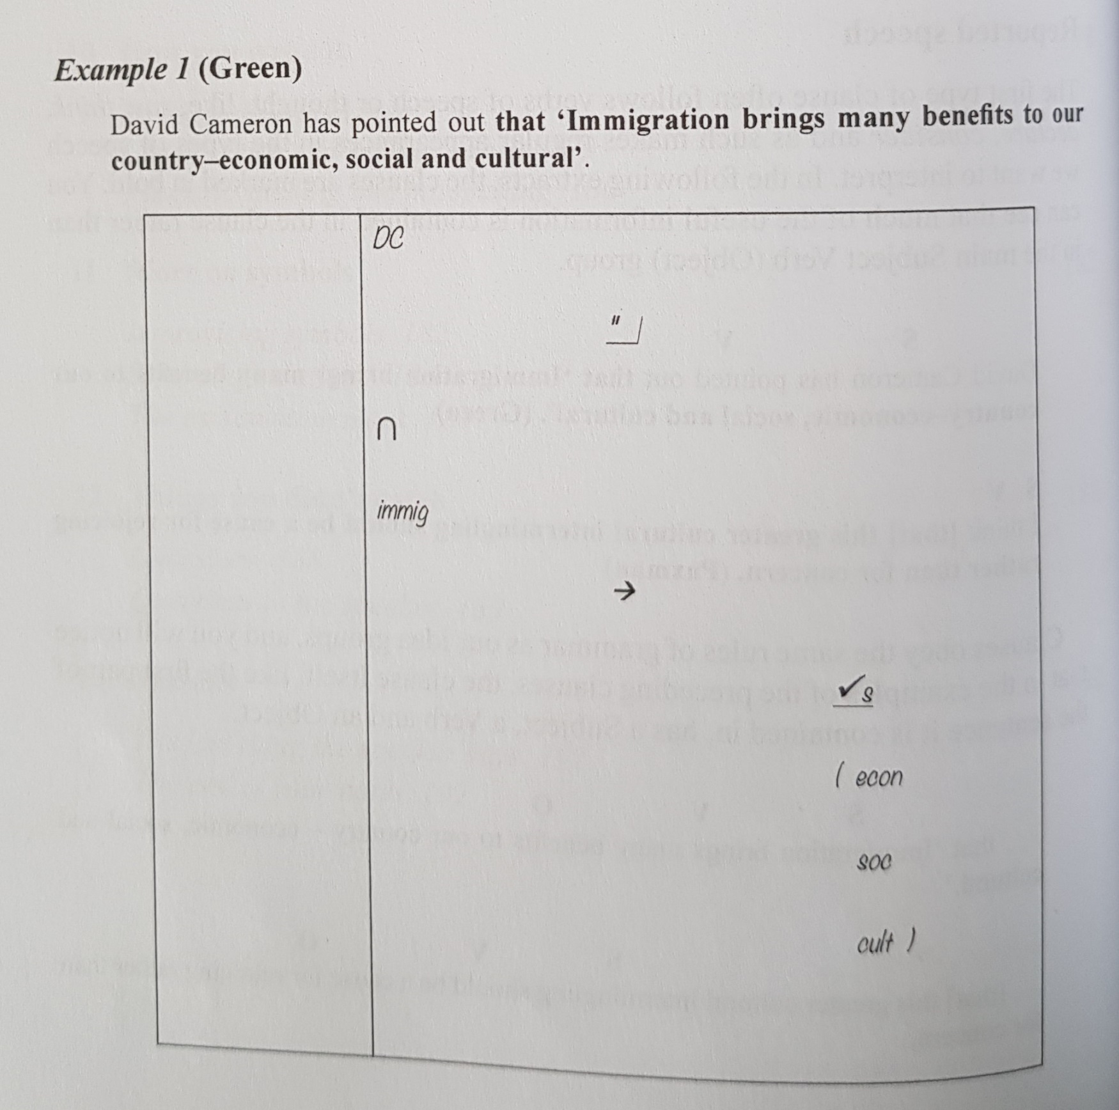

Slide 8
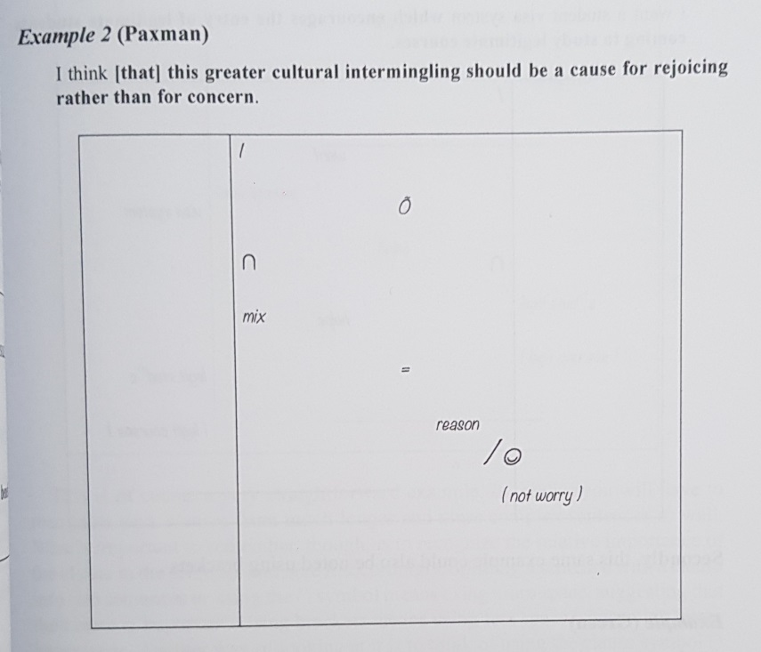

Slide 9
Clauses
We also see this situation in Subordinate Clauses.
We can note them in three ways:
Using the ∩ symbol
Using the brackets
Splitting the sentence into two

Slide 10
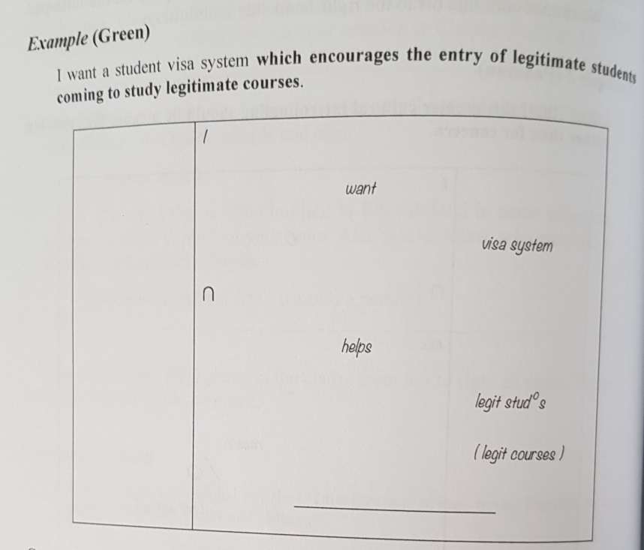

Slide 11
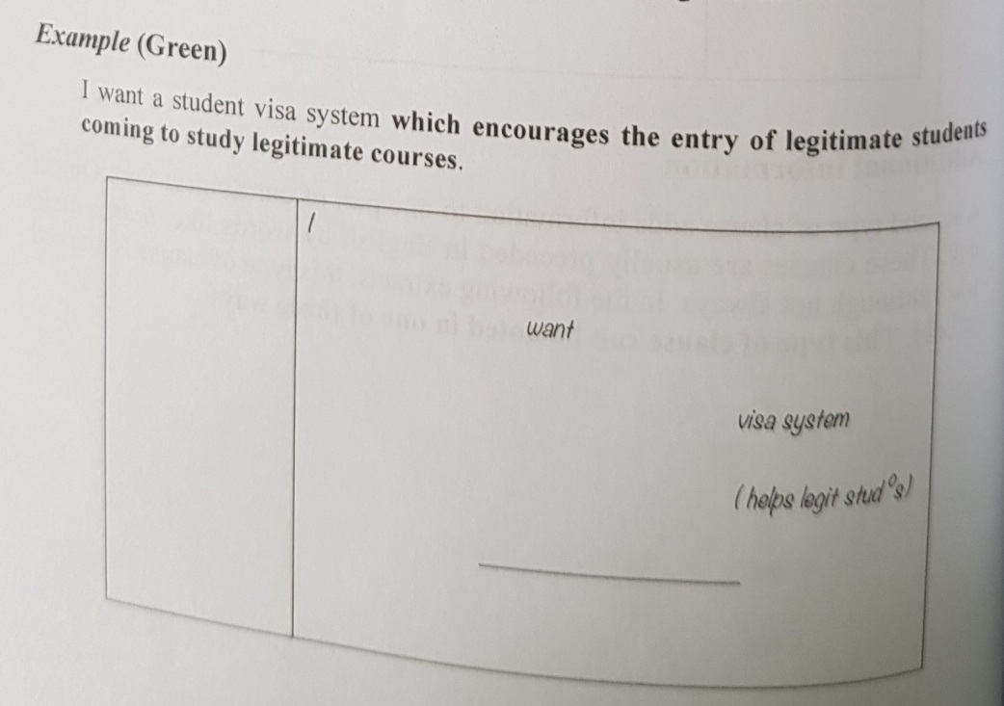

Slide 12
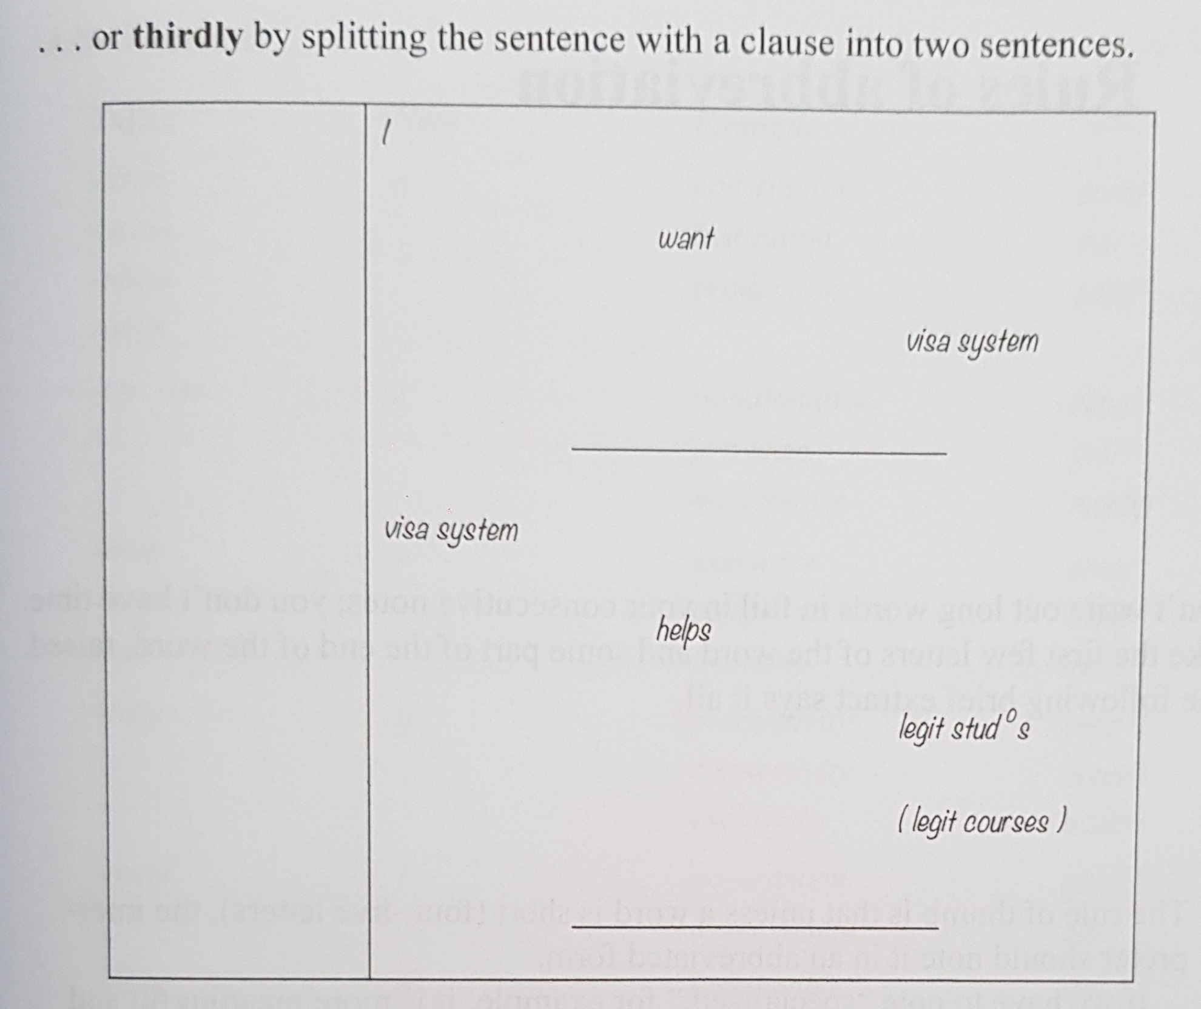

Slide 13
Rules of abbreviation
In your notes, don’t take down the long words in full.
The rule of thumb:
More than four-five letters?
Note the abbreviated form.

Slide 14
Rules of abbreviation
Specialized -> Sp ^{ed}
Stat. can be for ‘statute’ or ‘statistics’ -> St ^{ute} St ^{ics}
Prod. can be for ‘production’, ‘producer’, ‘product’ or ‘productivity’ -> Pr ^{on} Pr ^{er} Pr ^{ct} Pr ^{vity}
Com. can be for ‘commission’ or ‘committee’ -> C ^{on} C ^{tee}

Slide 15
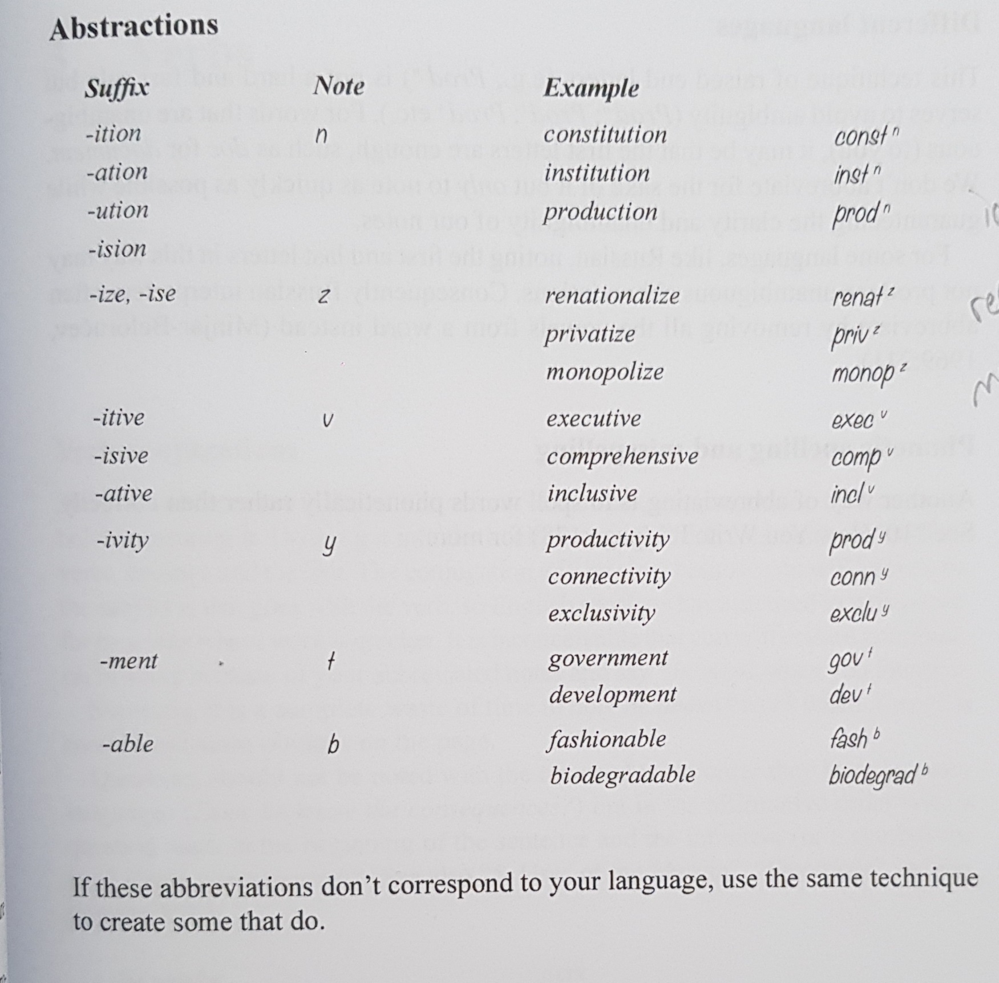

Slide 16
Rules of abbreviation
Plurals
Institution -> Inst ^{n}
Institutions -> Inst ^{n} s

Slide 17
verbs
Verb Conjugations
  He works work
  He doesn’t work X work
  Does he know the consequences ? Know consequences ?

Slide 18
verbs
Verb Tenses
  Work work
  Work ^{g} working
  Work| worked
  |work will work
  Work would work
  Work| would have worked

Slide 19
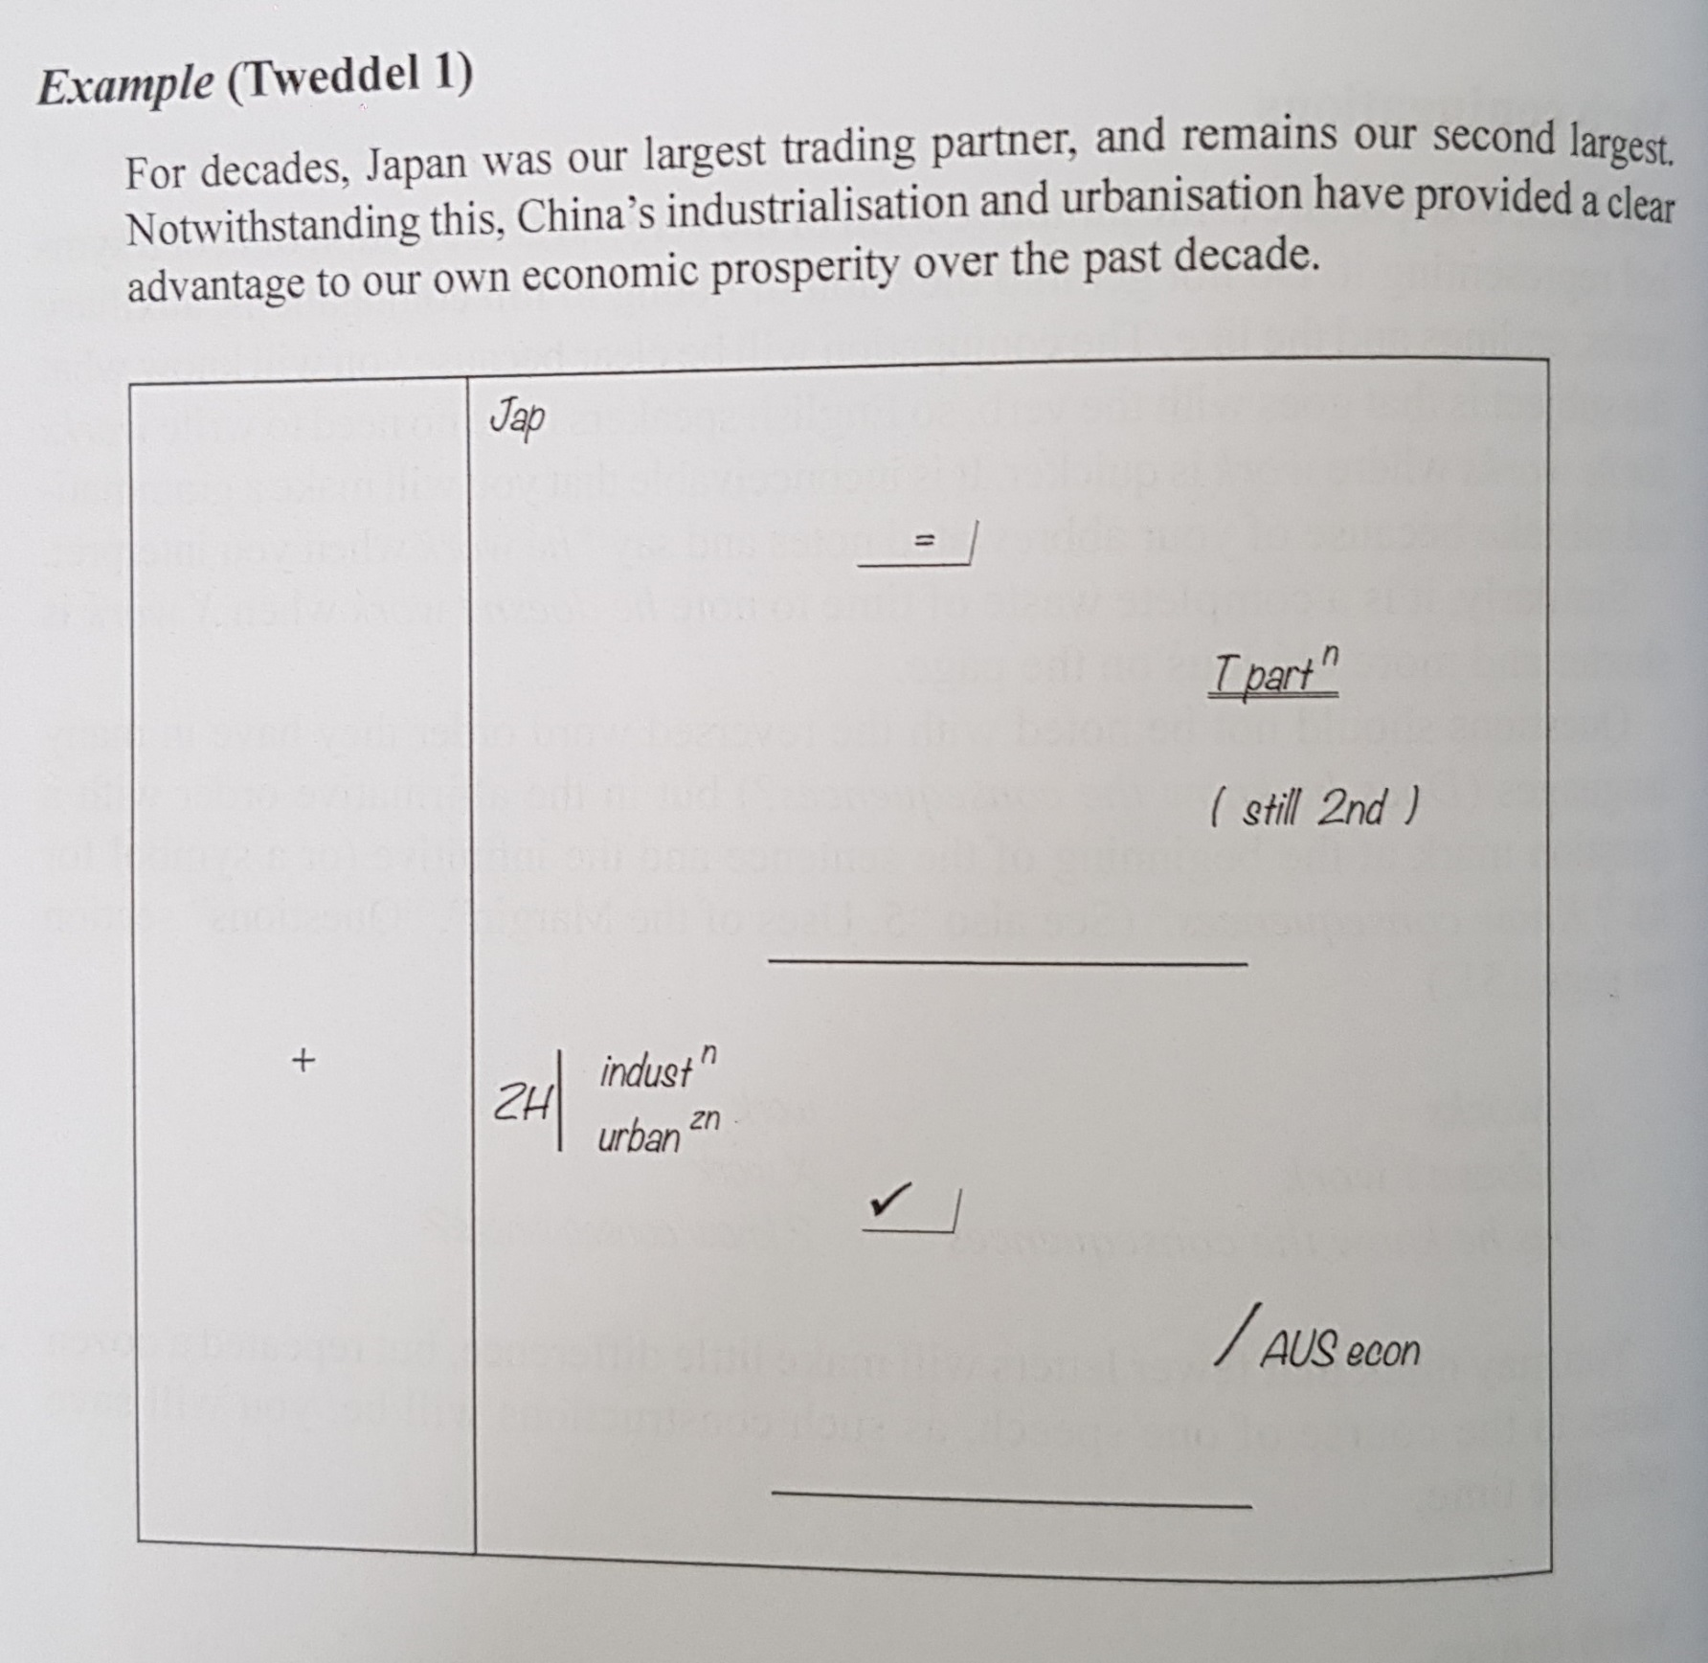

Slide 20
Verbs
Modal Verbs
    Should -> shd
    Could -> cd
    Would -> ^
    Must -> >
    May -> may
  HORIZONTALLY TO THE VERB

Slide 21
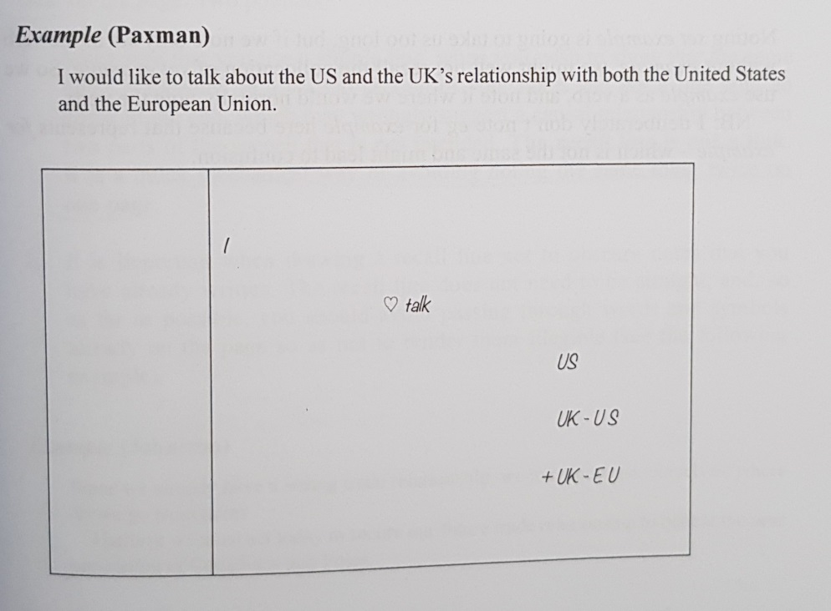

Slide 22
vERBS
Noun as Verbs
Since it would be quicker, If it’s suitable, nouns can
be used as if they are a verb.

Slide 23
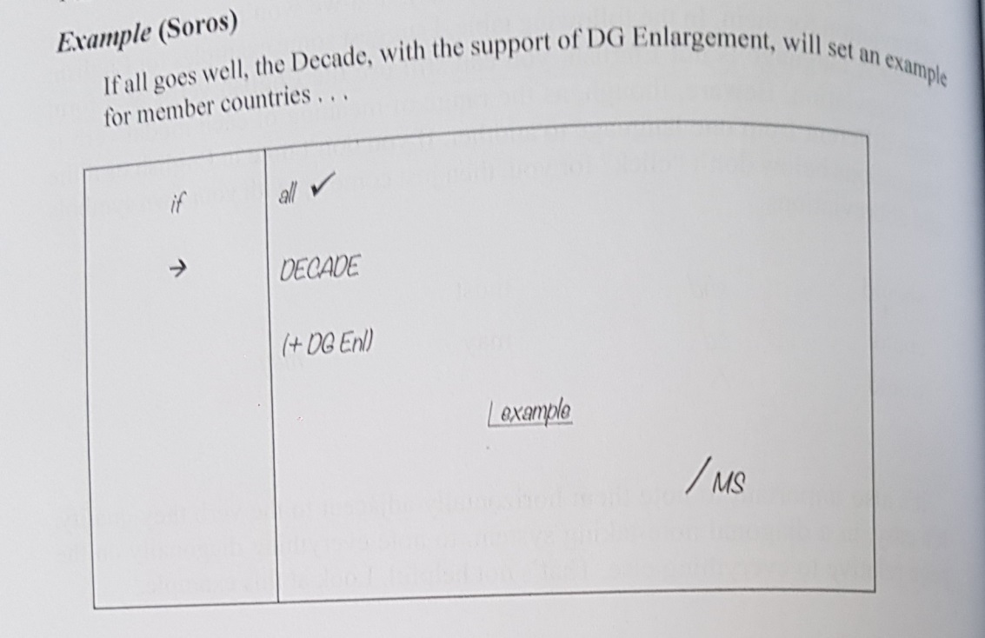

Slide 24
The recall line
The same symbol should not be noted twice on the same page.
Don’t use this technique for the linkers, as It should be clear on the page.
Two pointers for The Recall Line:

Slide 25
The recall line
Use a simple line
Not a line with an arrow at the end.
The recall line is not a link.
A quick way of avoiding noting the same thing twice on one page.
Do not go over the notes you’ve taken.
Not needed to be a straight line.
Avoid going over the symbols on the left column.

Slide 26
The recall line
Example:
Since we already have a strong trade relationship, we must now ask ourselves, where do we go from here?
I believe we must act today to secure our future trade relationship to benefit the next generation of Canadians and Poles.

Slide 27
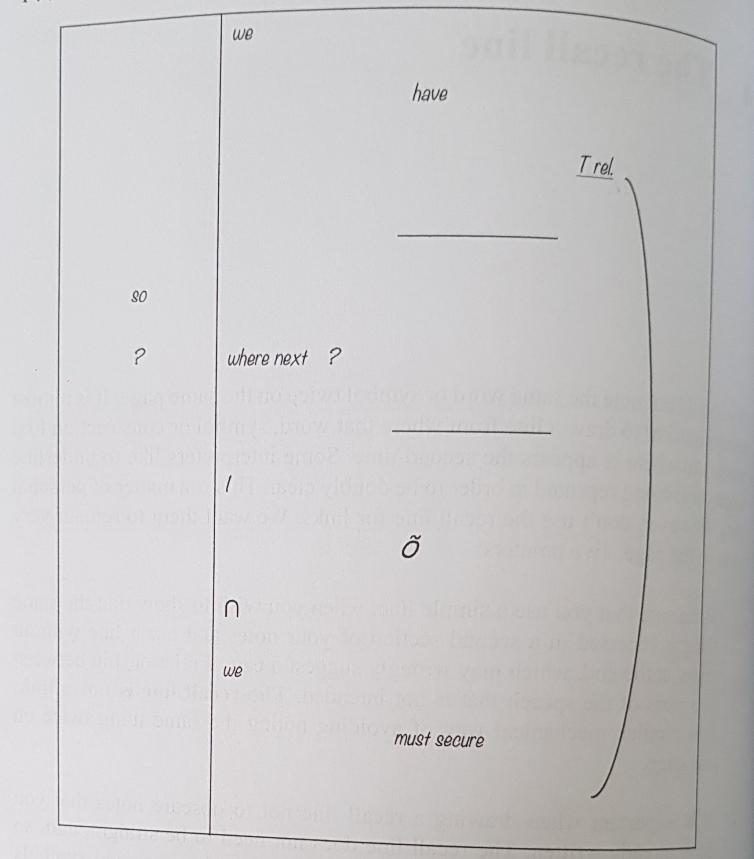

Slide 28
The recall line
So, can the recall line pass over to the next page? If can, how?
Can it be used for multiple repetitions?

Slide 29
The recall line
Example:
50 years ago many African countries attained indepence on the promise that they would feed their people. 50 years later Africa is still complaining. 50 years later there is no shortage of universities that describe themselves as universities of agriculture and technology. 50 years later there is no shortage of research institutes which are donor funded. 50 years later many Africans are dying younger than they were dying in 1963. 50 years later nutrition levels have gone down. 50 years later my rural village is worse off that it was when I was a young boy.

Slide 30
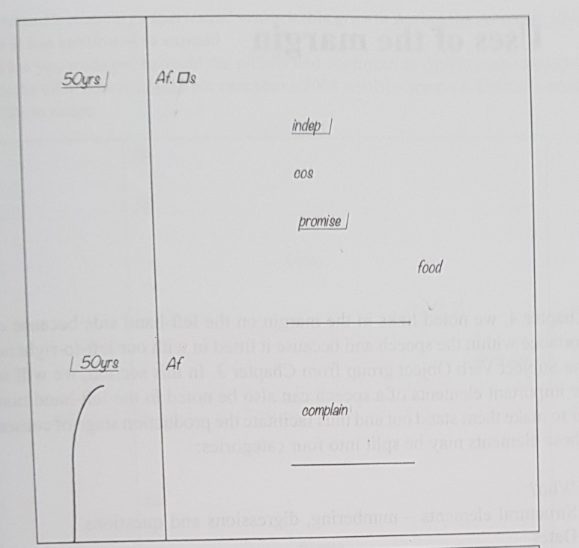

Slide 31
