Slide 1
ITL 301 Supply Chain Management
Inventory Management and Demand Forecasting in Supply Chain

Slide 2
Content
1. What is Inventory Management?
2. Challenges in Inventory Management
3. What Is Demand Forecasting?
4. The Connection Between Inventory and Demand
5. Forecasting Methods for Inventory Management:
Time Series Models
Econometric Models
Judgmental Forecasting
Scenario Planning

Slide 3
Introduction
Inventory Management is the practice of tracking and controlling stock levels to meet customer demand effectively.
Demand Forecasting predicts future customer needs based on data, trends, and analysis.
Both concepts are vital for:
Reducing costs associated with overstocking or stockouts.
Enhancing supply chain efficiency.
Maintaining high levels of customer satisfaction.

Slide 4
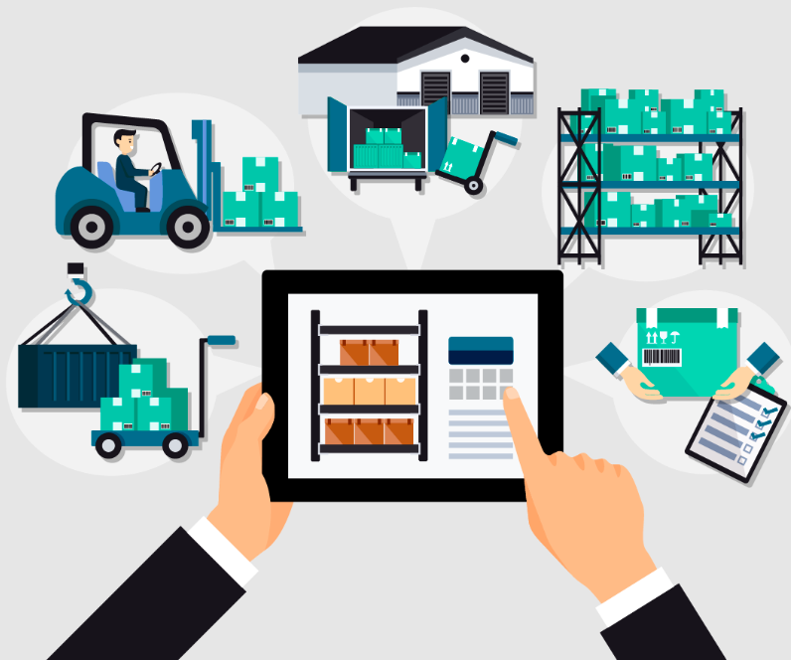
What is Inventory Management?
A systematic approach to sourcing, storing, and selling inventory —both raw materials and finished goods.
Key Functions:
Tracking stock levels, orders, and deliveries.
Ensuring stock availability to meet customer demand.
Reducing holding and operational costs.

Slide 5
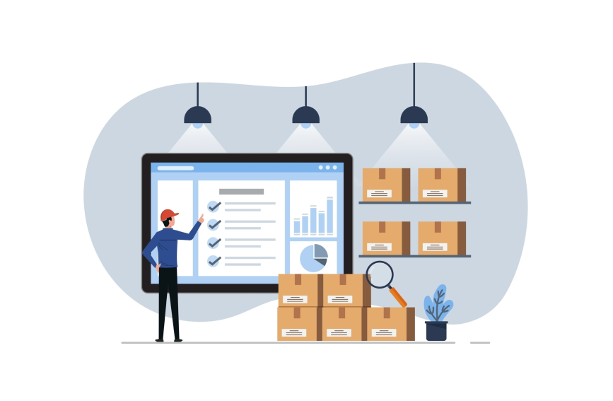
Inventory management is the backbone of efficient supply chain operations. It involves tracking, organizing, and controlling inventory to ensure businesses meet customer demand without incurring unnecessary costs.
Effective inventory management helps businesses maintain a balance between stock availability and operational costs.
Notes:
Inside Amazon's Smart Warehouse
https://www.youtube.com/watch?v=IMPbKVb8y8s

Slide 6
Why It Matters:
Poor inventory management leads to high costs, inefficiencies, and dissatisfied customers.
Effective systems enhance business performance and profitability.

Slide 7
Reduces stock-related inefficiencies like overstocking or stockouts.
Optimizes cash flow and minimizes waste.
Improves customer satisfaction by ensuring product availability.

Slide 8
Inventory Management vs. Stock Management
Are They the Same?
Inventory management and stock management are not the same, though they are closely related.
They differ in terms of scope, focus, and processes, but they work together to optimize business operations.

Slide 9
Inventory Management vs. Stock Management
Criteria | Inventory Management | Stock Management
Scope | Comprehensive (raw materials to finished goods) | Limited to products in a specific location
Focus | Strategic (forecasting, supply chain optimization) | Operational (stock levels and organization)
Tools/Techniques | Advanced tools like ERP, demand forecasting software | Barcode, RFID, and manual stock counts
Example | Optimizing inventory flow across the supply chain | Ensuring shelves in a retail store are stocked

Slide 10
Challenges in Inventory Management
Demand Uncertainty:
Predicting customer needs can be complex, especially in volatile markets.
Seasonal Peaks:
Businesses face fluctuating demand during certain periods (e.g., holidays).
Supply Chain Disruptions:
Delays or interruptions in supply chains can lead to shortages.
Cost Management:
Balancing storage costs, spoilage, and transportation expenses.
Inefficiencies in Data:
Outdated systems or errors in tracking inventory can lead to costly mistakes.

Slide 11
Solutions to Inventory Challenges
Real-Time Tracking Systems: Use software with real-time visibility to monitor inventory across locations.
Automated Replenishment: Implement reorder points based on data-driven forecasts.
Warehouse Optimization: Design layouts that reduce handling times and improve space utilization.
Technology Integration: Adopt barcode scanning or RFID systems to improve tracking accuracy.
Regular Audits: Periodic physical inventory checks reconcile records and actual stock.

Slide 12
Real-Time Inventory Management Systems
Automated Data Collection
Technologies like barcodes, RFID, and IoT sensors automate real-time inventory tracking, eliminating manual data entry and reducing errors.
Data Analysis and Reporting
Advanced analytics transform raw data into actionable insights, while user-friendly dashboards simplify trend analysis and decision-making.
Inventory Control Systems
Integrated systems centralize inventory data across platforms, offering a unified view for streamlined management.

Slide 13
Understanding Demand Forecasting
Demand forecasting predicts future customer demand using data such as historical sales, market trends, and seasonal factors. It provides businesses with actionable insights to prepare for demand fluctuations effectively.
The process of estimating future customer demand for products or services.
Helps businesses optimize inventory levels, reduce waste, and plan resources.

Slide 14
Categories of Forecasting
Quantitative Methods:
Use numerical data and statistical models.
Suitable for situations with sufficient historical data.
Qualitative Methods:
Based on expert insights and market observations.
Used when historical data is limited or unavailable.
Demand forecasting is the backbone of effective inventory management.

Slide 15
The Connection Between Inventory and Demand
Inventory management relies on accurate demand forecasts to:
Determine reorder points and optimal stock levels.
Plan for seasonal demand fluctuations.
Allocate resources efficiently across the supply chain.
Impact of Poor Forecasting:
Overstocking leads to increased storage costs and obsolescence.
Understocking results in lost sales and customer dissatisfaction.
Balancing inventory with forecasted demand ensures business stability and growth.

Slide 16
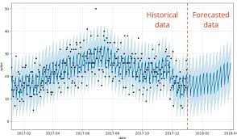
Time Series Models: Quantitative Forecasting
A forecasting method that analyzes historical data to identify patterns and trends over time.
Key Features:
Focuses on recurring cycles, seasonality, and long-term trends.
Best For:
Businesses with stable, recurring sales patterns.

Slide 17
Time Series Models: Quantitative Forecasting Example of Time Series Models
Scenario: A grocery store preparing for holiday sales.
Steps Taken:
Analyzes sales data from the past three holiday seasons.
Identifies patterns of increased demand for specific items like chocolates and gift packs.
Result:
Stocks popular products in higher quantities during the holiday season.
Avoids overstocking items with historically low demand.

Slide 18
Econometric Models: Using Economic Data for Forecasting
A forecasting method that incorporates economic variables (e.g., income, prices, interest rates) to predict demand.
Key Features:
Explains relationships between economic indicators and sales.
Models the impact of external factors on customer behavior.
Best For:
Markets influenced by broader economic conditions, such as real estate or automotive industries.

Slide 19
Econometric Models: Using Economic Data for Forecasting Example of Econometric Models
Scenario: A car dealership adjusting inventory for luxury cars.
Steps Taken:
Tracks interest rates and consumer confidence data.
Predicts reduced demand for high-end vehicles during an economic downturn.
Result:
Orders fewer luxury models and focuses on affordable options.
Minimizes financial risks from unsold inventory.

Slide 20
Judgmental Forecasting
A qualitative forecasting method that relies on expert opinions and experience.
Key Features:
Used when historical data is limited or unavailable.
Combines insights from industry experts, sales teams, and customer feedback.
Best For:
New product launches or highly uncertain events.

Slide 21
Judgmental Forecasting Example of Judgmental Forecasting
Scenario: A tech startup launching a new wearable device.
Steps Taken:
Gathers opinions from tech experts and surveys potential customers.
Combines insights to estimate initial demand.
Result:
Plans an optimal launch inventory, reducing risks of overproduction or shortages.

Slide 22
Scenario Planning: Preparing for Uncertainty
A creative approach to explore multiple possible futures.
Key Features:
Develops "what-if" scenarios for best, worst, and moderate cases.
Focuses on adaptability rather than precise predictions.
Best For:
Industries facing high volatility or complex external factors.

Slide 23
Scenario Planning: Preparing for Uncertainty Example of Scenario Planning
Scenario: A logistics company preparing for fuel price volatility.
Steps Taken:
Develops scenarios for fuel prices increasing by 10%, 20%, and 30%.
Plans inventory and transportation strategies for each case.
Result:
Maintains profitability by adapting quickly to changing costs.

Slide 24
Conclucion
Inventory management and demand forecasting are interconnected and vital for supply chain success.
Choosing the right forecasting method depends on the situation and available data.
A combination of methods often delivers the best results.
Investing in accurate forecasting tools and techniques reduces risks and boosts efficiency.

