Slide 1
Chapter 3-4
Contemporary Theoretical Perspectives

Slide 2
Contemporary Theoretical Perspectives
A theory is a set of logically interrelated statements that attempts to describe, explain, and predict social events.

Slide 3
1.Functionalist Perspective
Functionalist Perspectives are based on the assumption that society is a stable, orderly system.
The functionalist perspective sees society as a system.
All parts of society work together to keep society stable and organized.

Slide 4
1.Functionalist Perspective
These parts include institutions such as:
family
education
religion
government
economy
Each institution has a function, which means it has an important role in society.

Slide 5
Society as a Body (Functionalist)
Functionalists often compare society to the human body.
In the body:
the heart pumps blood
the lungs help us breathe
the brain controls the body
Each part has a job.
If one organ stops working, the body has problems.

Slide 6
Key Concepts of Functionalism
Social order
Society works best when there is stability and agreement on rules.
Social institutions
Structures that organize social life (family, education, religion).
Function
The role an institution plays in maintaining society.

Slide 7
Functionalists
Emile Durkheim
Herbert Spencer
Robert K. Merton
Talcott Parsons

Slide 8
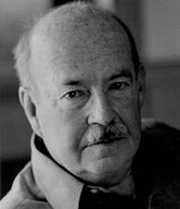
Talcott Parsons
Talcott Parsons (1902–1979) was an American sociologist and one of the most important figures of structural functionalism. He worked at Harvard University and developed theories explaining how social systems remain stable through shared values, institutions, and social roles.

Slide 9
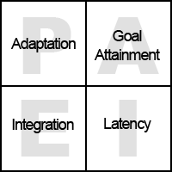

Slide 10
Talcott Parsons
Parsons’ AGIL Model
Parsons created a famous model called the AGIL model.
He said that every society must solve four important problems in order to survive.
AGIL stands for four functions.
A – Adaptation
Society must adapt to its environment and produce resources.
The economy helps society do this.
For example:
producing goods
creating jobs
distributing resources

Slide 11
G – Goal Attainment
Society must set goals and achieve them.
The government usually performs this function.
For example:
making laws
making political decisions
organizing society

Slide 12
I – Integration
Society must keep people united and manage conflicts.
The legal system and social norms help integrate society.
They make sure people follow rules.

Slide 13
L – Latency (Pattern Maintenance)
Society must maintain values, culture, and motivation.
Institutions like family, education, and religion help with this.
They teach people:
values
beliefs
cultural traditions

Slide 14
Robert K. Merton
  Manifest functions are intended and/or overtly recognized.
  Latent functions are unintended functions that are hidden and remain unacknowledged.
  Dysfunctions are the undesirable functions of any element of a society.

Slide 15
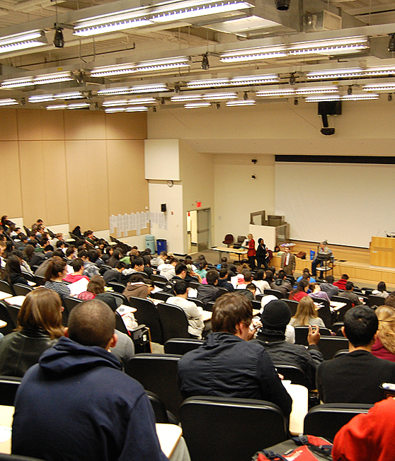
Example 1
University
Manifest:
education
training for careers
Latent:
friendships
networking
social life
Dysfunction: academic stress
social inequality

Slide 16
Example: Family Dinner
Manifest Function
(The intended purpose)
eating food
feeding family members
spending time together as a family
Latent Function
(Unintended effects)
strengthening family bonds
children learning social behavior
sharing daily experiences
building emotional support

Slide 17

Dysfunction
(Negative consequences)
family arguments
tension between parents and children
emotional pressure

Slide 18
“For each situation, what are the intended outcomes, hidden outcomes, and possible negative consequences?”

Slide 19
Examples
Watching a Football Match
Social Media
Religious Services
Going to a Shopping Mall
Going to the Gym
Eating at a Restaurant
Using a Smartphone
Attending a Wedding
Watching TV Series
Joining a Student Club

Slide 20
Conflict Perspective
Belief that groups in society are engaged in a continuous power struggle for control of scarce resources.
conflict perspective says that society is not always stable and harmonious.
Instead, society is full of conflicts between different groups.

Slide 21
Conflict Perspective
These conflicts usually happen because of:
power
money
status
resources
Different groups in society compete for these things.

Slide 22
Main Sociologist
The most important thinker behind conflict theory is Karl Marx.
Marx believed that society is divided into social classes.
Two main classes in capitalism are:
Bourgeoisie
the owners of factories, businesses, and wealth
Proletariat
the workers who sell their labor
Marx argued that the bourgeoisie often benefit from the work of the proletariat.

Slide 23
Key Idea
According to conflict theory:
Social institutions often serve the interests of powerful groups.
This means institutions such as:
education
government
law
economy
may help maintain existing inequalities.

Slide 24

Example: Education
Conflict theorists say education does not only teach knowledge.
It can also reproduce social inequality.
For example:
students from wealthy families often have better educational opportunities
elite schools provide advantages
social class affects academic success
So education may reinforce class differences.

Slide 25
Example: Workplace
In the workplace, conflict theory focuses on
power differences.
Employers want:
higher productivity
lower labor costs
Workers want:
higher wages
better working conditions
This creates conflict between labor and management.

Slide 26
Examples
Housing
Healthcare
Media
Sports
Technology
Education
Workplace
Social Media
Politics
Transportation

Slide 27
The feminist approach stresses the importance of gender as an element of social structure.
  Patriarchy is a system in which men dominate women.

Slide 28

Symbolic Interactionist Perspective
The symbolic interactionist perspective focuses on everyday interactions between people.
It studies how people create meaning through communication and social interaction.
According to this perspective, society is built through daily interactions and shared meanings.

Slide 29

Handshake example
Two people shake hands when they meet.
A handshake can symbolize:
respect
greeting
agreement
The meaning comes from social interaction.

Slide 30

Emojis in Messages
People use emojis when texting.
For example:
🙂 can mean friendliness
😂 can mean humor
❤️ can mean affection
These are symbols that carry meaning.

Slide 31

3. Wearing a Uniform
A uniform can communicate identity.
Examples:
police uniform → authority
doctor’s coat → medical professional
school uniform → student identity
People interpret these symbols socially.

Slide 32

Social Media Profiles
People carefully choose:
profile pictures
posts
captions
They are presenting an identity to others.

Slide 33
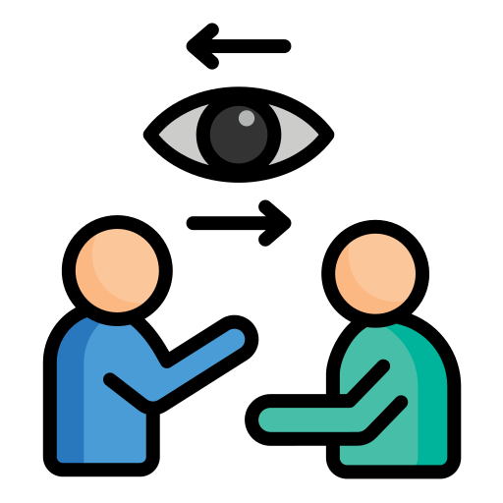
Eye Contact
Eye contact during conversation can signal:
confidence
attention
respect
However, the meaning of eye contact can vary across cultures and situations.

Slide 34
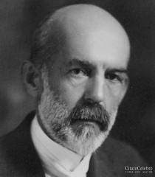
Charles Horton Cooley (1864-1929)
American sociologist
An important early thinker in symbolic interactionism.
University of Michigan
Looking-Glass Self

Slide 35
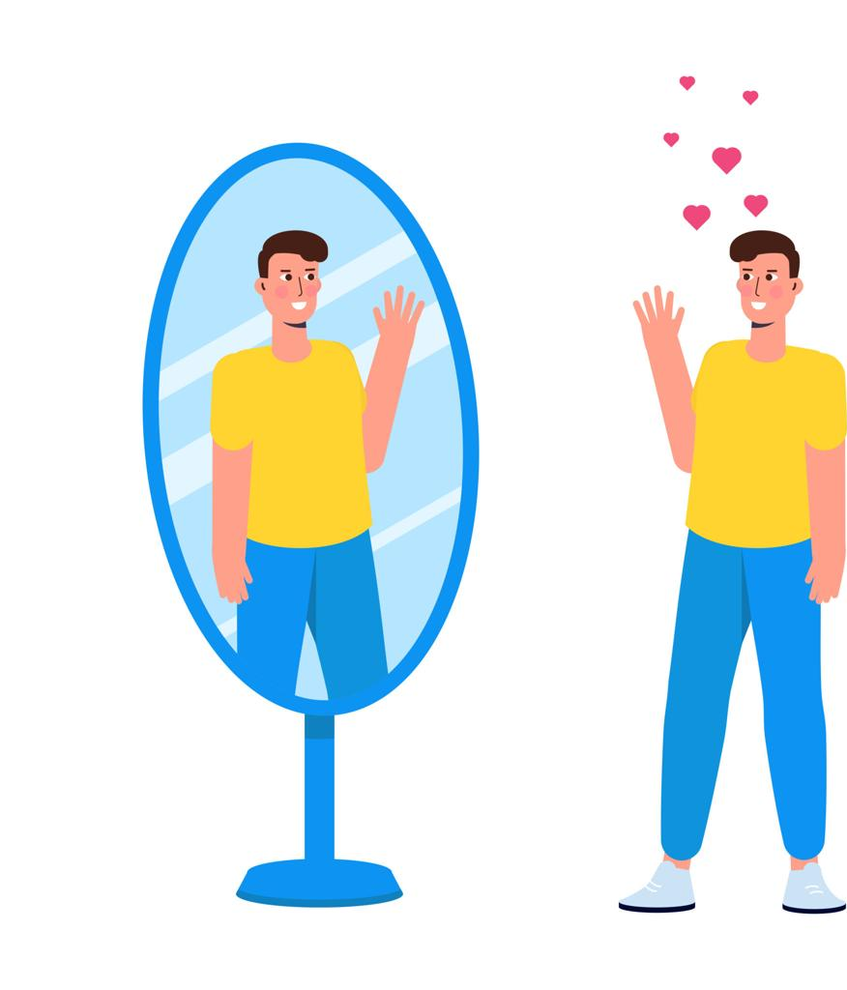
Looking-Glass Self
This idea explains that people develop their self-identity through social interaction and through how they believe others see them

Slide 36
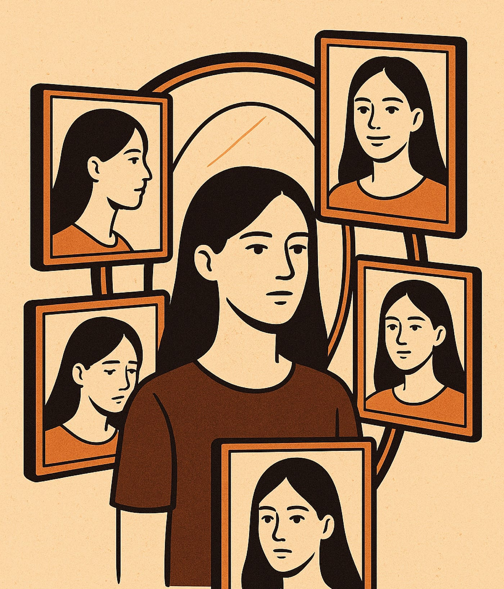
Three Simple Steps
1️⃣ We imagine how others see us
“Do they think I look confident?”
2️⃣ We imagine their judgment
“They probably think I did well.”
3️⃣ We develop feelings about ourselves
We may feel proud, confident, or embarrassed

Slide 37
Simple example (Looking Glass)
If classmates smile → the student feels confident.
If classmates laugh → the student may feel embarrassed.

Slide 38
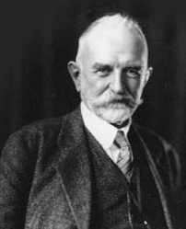
George Herbert Mead (1863 – 1931)
American Sociologist
People learn who they are by interacting with others.
Two Parts of the Self

Slide 39
Two Parts of the Self (G.Mead)
I
The I is the spontaneous and personal side of the self.
It represents:
Creativity, personal reactions, individual behavior
Example: Laughing loudly in class.
Me
The Me is the social side of the self.
It represents:
social rules
expectations of society
how others expect us to behave
Example:
Being quiet in a classroom.

Slide 40
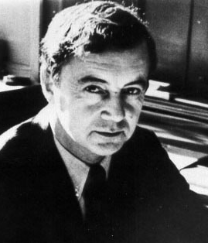
Erving Goffman (1922-1982)
Canadian sociologist
One of the key thinkers of symbolic interactionism
Dramaturgical Theory

Slide 41
Dramaturgical Theory
Goffman compared social life to a theatre performance.
He said that people behave like actors on a stage.
In social situations, people try to control the impression others have of them.

Slide 42
Dramaturgical Theory
Just like actors in a play:
people perform roles
they present themselves in certain ways
they try to influence how others see them

Slide 43

Front Stage
Front stage is when people behave according to social expectations.
Example:
a teacher in the classroom
a waiter serving customers
a student giving a presentation
People try to act professionally and appropriately.

Slide 44

Back Stage
Back stage is when people are more relaxed and natural.
Example:
a teacher relaxing at home
a worker complaining about their job
a student talking freely w

Slide 45
Discussion
How can each theory be applied to understanding shopping and consumption?
Which theoretical perspective do you find more compelling? Why?

