Slide 1
Consumer Behavior

Slide 2
Objectives
Define consumer behavior and its role in marketing decisions.
Describe the three interpersonal determinants/causations of consumer behavior.

Slide 3
Objectives
Explain the five personal determinants of consumer behavior.
Distinguish between high-involvement and low-involvement purchase decisions.

Slide 4
Objectives
Outline the six steps in the consumer decision process.
Differentiate/distinguish among routinized response behavior, limited problem solving, and extended problem solving by consumers.

Slide 5
Consumer Behavior
Process through which buyers make purchase decisions
Marketers borrow extensively from psychology and sociology to better understand consumer behavior
Consumer behavior is understood as a function of interpersonal influences and personal factors

Slide 6
Interpersonal Determinants Of Consumer Behavior
Cultural influences
Culture – Values, beliefs, preferences, and tastes handed down/conveyed from one generation to the next
It is the broadest environmental determinant of behavior (and accordingly buying behavior).

Slide 7
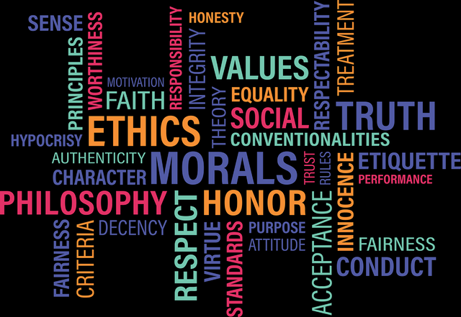
Values
Values are basic and fundamental beliefs that guide or motivate attitudes or actions. They help us to determine what is important to us. Values describe the personal qualities we choose to embody/ interiorize to guide our actions; the sort of person we want to be; the way we treat ourselves and others, and our interaction with the world around us. Provides general rules/ guidelines for conduct/ behavior.
Retrieved from: Steven Mintz, aka Ethics Sage, on August 1, 2018.

Slide 8
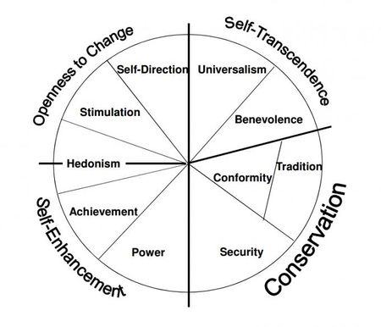
Beliefs
Personal Values are “broad desirable goals that motivate people’s actions and serve as guiding principles in their lives”
Schwartz in 1992 presented 10 motivationally distinct types of values
Retreived from: Sagiv L, Roccas S, Cieciuch J, Schwartz SH. Personal values in human life. Nature Human Behaviour. 2017 Sep;1(9):630

Slide 9
Beliefs
1. Self-direction e.g. freedom, creativity
2. Stimulation e.g. exciting life, daring/courage
3. Hedonism e.g. pleasure, self-indulgent/self-admiration
4. Achievement e.g. ambitious, successful
5. Power e.g. wealth, authority
6. Security e.g. social order, family security, cleanliness
7. Conformity/accordance e.g. politeness, self-discipline, respect
8. Tradition e.g. respect for traditions, modest, humble, devout/religious
9. Benevolence/kindness e.g. loyal, responsible, helpful, forgiving
10. Universalism e.g. equality, wisdom, world of peace, social justice, protecting the environment

Slide 10
Preferences
In psychology, preferences refer to an individual's attitude towards a set of objects, typically reflected in an explicit decision-making process (Lichtenstein & Slovic, 2006). The term is also used to mean evaluative judgment in the sense of liking or disliking an object (e.g., Scherer, 2005) which is the most typical definition employed in psychology. Consequently, preference can be affected by a person's surroundings and upbringing in terms of geographical location, cultural background, religious beliefs, and education ( https://en.wikip edia.org/wiki/Preference, Accessed. 10/
30/2020).

Slide 11
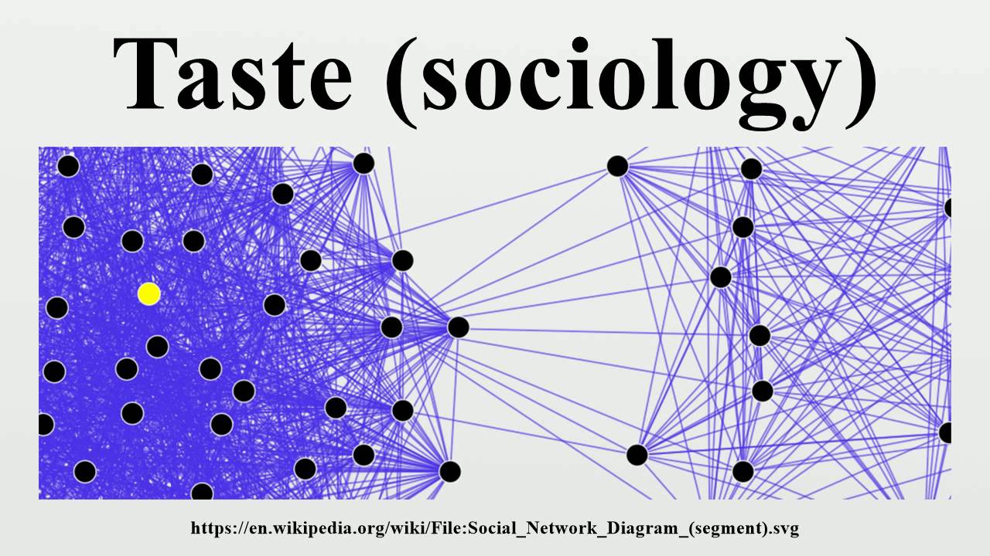
In sociology, taste is an individual's personal, cultural and aesthetic patterns of choice and preference. Taste is drawing distinctions between things such as styles, manners, consumer goods, and works of art and relating to these (https://en.wikipedia.org/wiki/Taste_(sociology)# , Acc.
10/30/2020).

Slide 12
Core Values in U.S. Culture
Work ethic
Desire to accumulate wealth
Importance of education, individualism, freedom, youth, health, volunteerism, and efficiency
Consumers are adopting new values
Communicating with anyone, anytime, anywhere in the world using new technologies.
Core Values for Turkey: Generosity/open-handedness, Hospitality, Community Networks (relatives, friends etc.), Nationalism, Honour, Kemalism, Loyalty
(https://culturalatlas.sbs.com.au/turkish-culture/turkish-culture-core-concepts Acc. 30/10/2020)

Slide 13
International Perspective on Cultural Influences
Successful strategies in one country may not extend to other international markets
Example: Domino’s allows local managers to run their own advertising campaigns tailored/ costomized to the preferences of their customers

Slide 14
Subcultures
Groups with their own distinct modes of behavior
Can differ by ethnicity, nationality, age, rural versus urban location, religion, and geographic distribution
Population mix in U.S. is changing as the Hispanic, African American, and Asian populations grow. i.e. Sryians in Turkey.

Slide 15
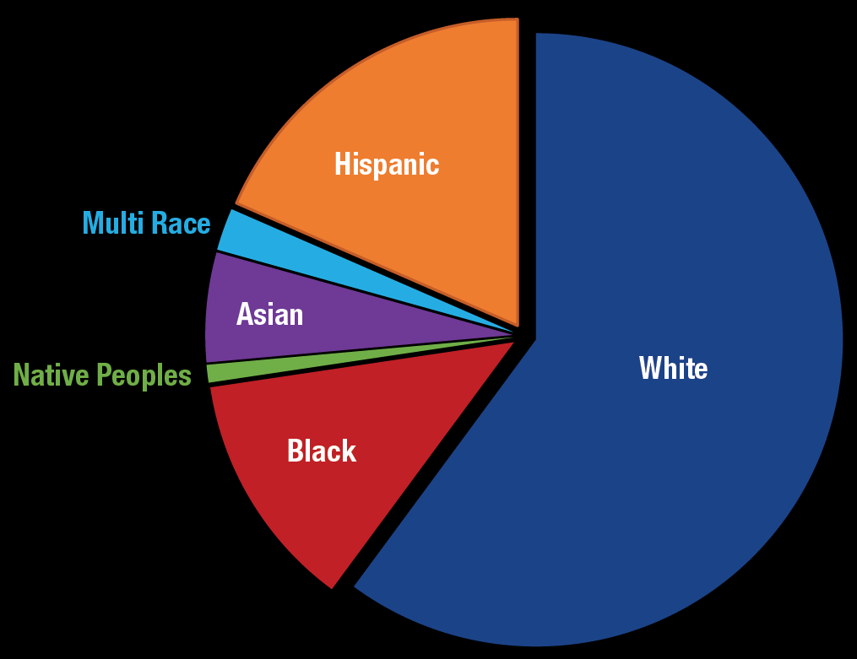
Figure 6.1 - Ethnic and Racial Minorities as a Percentage of the Total U.S. Population
Distribution (%): W 60.1, H&L (of any race): 18.5, B (or African american):13.4, A: 5.4,
Note: The Hispanic category includes Hispanics of any races.
Source: U.S. Census Bureau, Population Estimates, 2019.
Analysis: K.M. Johnson. Carsey School, University of New Hampshire
https://carsey.unh.edu/publication/US-population-growth-slows-diversity-grows , Acc. 10/30/2020)

Slide 16
Subcultures
Hispanic American consumers:
Not a homogenous group
Hispanic population fueled by (become strong) a sharp rise in births
Marketers should consider Hispanics control more disposable income than any other minority group

Slide 17
Subcultures
African American consumers
The African American population stands at more than 44.08 million people
71% (by 2014?) of them own a smart phone
They are members of every economic group
Marketers must avoid approaching all African American consumers in the same way

Slide 18
Subcultures
Asian American (19.5 million) consumers
Spread among culturally diverse groups
Retain their own languages
Each group brings its own language, religion, and value system to purchasing decisions

Slide 19
Social Influences
Everyone belongs to multiple social groups - Family, neighborhood, clubs, and sports teams
Group membership influences an individual consumer’s purchases and behavior in overt/ apparent and subtle/subtle (hard to comprehend or define) ways
Differences in group status and roles influence buying behavior
People make purchases designed to reflect their status within a particular group

Slide 20
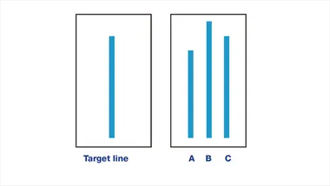
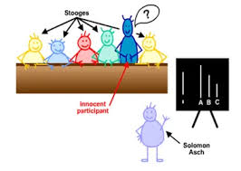
The Asch Phenomenon (Herd Mentality)
Theory of psychologist S. E. Asch - Individuals conform to majority rule, even if that majority rule goes against their beliefs
The Asch phenomenon can be a big factor in many purchase decisions
From major choices such as buying a car to deciding whether to buy a pair of shoes on sale

Slide 21
Reference Groups
People or institutions such as family, friends, or celebrities:
Whose opinions are valued
To whom a person looks for guidance in his or her own behavior, values, and conduct

Slide 22
Reference Groups
Influence of reference group depends on two conditions:
The purchased product must be one that others can see and identify
The purchased item must be a brand or product that not everyone owns

Slide 23
Social Classes
Six classes within the social structures of both small and large U.S. cities
Upper-upper
Lower-upper
Upper-middle
Lower-middle
Working class
Lower class

Slide 24
Social Classes
Class rankings determined by occupation, income, education, family background, and residence location
Income is not always a primary factor
Occupations and incomes of one or both parents are primary influences on social class
Individuals’ buying habits reflect the class to which they aspire/seek for

Slide 25
Opinion Leaders
Trendsetters who purchase new products before others in a group and then influence others in their purchases
Individuals tend to act as opinion leaders based on their knowledge of and interest in products
Information about goods and services flows from mass media to opinion leaders to consumers
Sometimes flows directly to consumers

Slide 26
Family Influences
Family structure has changed over the last century
Many couples are separated or divorced, so single heads of households are more common
Role of each spouse (husband/wife) in a household:
Autonomic role
Husband-dominant role
Wife-dominant role
Syncretic/mediating role. Syncratic Decision is
a purchase decision in which both husband and wife have equal influence (https://www.monash.edu/business/ marketing/marketing-dictionary/s/syncratic-decision, Accessed. 10/30/2020).

Slide 27
Children and Teenagers in Family Purchases
Children and teenagers represent a huge market, and they influence what their parents buy
They have significant influence over the goods and services their families purchase
Teens don’t necessarily shy away/avoid from practicality

Slide 28
Personal Determinants of Consumer Behavior
Consumer behavior is affected by several internal, personal factors also
Need – Imbalance/contrast between a consumer’s actual and desired states/situation
Motive/impeturs- Inner/spiritual state that directs a person toward the goal of satisfying a need

Slide 29
Maslow’s Hierarchy of Needs
Physiological needs - Needs concerning essential requirements for survival, such as food, water, shelter, and clothing
Safety needs - Financial or lifestyle security, protection from physical harm, and avoidance of the unexpected
Social/belongingness needs - The desire to be accepted by people and groups important to that individual

Slide 30
Maslow’s Hierarchy of Needs
Esteem needs - A universal desire for a sense of accomplishment and achievement
Actualization needs - Desire to realize potential and find fulfillment by expressing their unique talents and capabilities

Slide 31
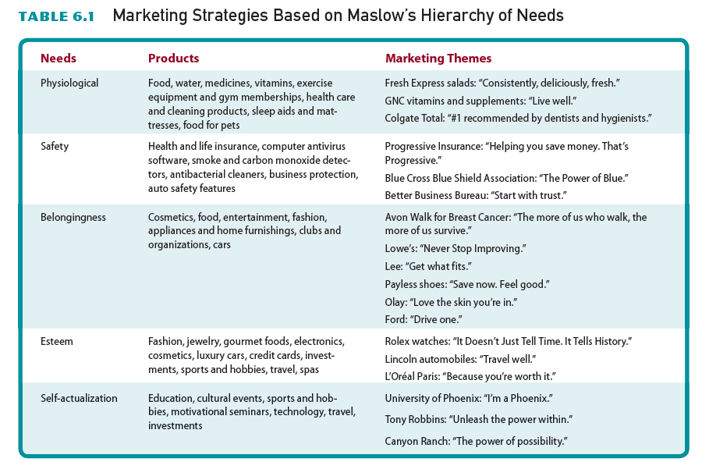
Table 6.1 - Marketing Strategies Based on Maslow’s Hierarchy of Needs

Slide 32
Perceptions
Meaning that a person attributes to incoming stimuli gathered through the five senses
Results from the interaction of two types of factors:
Stimulus (inner) factors
Individual factors

Slide 33
Perceptual/cognitive Screens/eliminations
The mental filtering processes through which all inputs must pass/go through
Techniques that marketers use to elicit/reveal a positive response from consumers:
Doubling the size of an ad
Using certain colors or graphics
Developing unique packaging
Word of mouth - The oldest and most effective marketing technique in existence

Slide 34
Subliminal Perception
Subconscious receipt of incoming information
Aimed at the subconscious level of awareness to circumvent/bypass the audience’s perceptual screens
Unlikely to induce purchasing except by people already inclined/minded to buy

Slide 35
Attitudes
Person’s enduring/continuos favorable or unfavorable evaluations, emotions, or action tendencies/leanings toward some object or idea
Attitude components:
Cognitive/mental
Affective/emotional
Behavioral

Slide 36
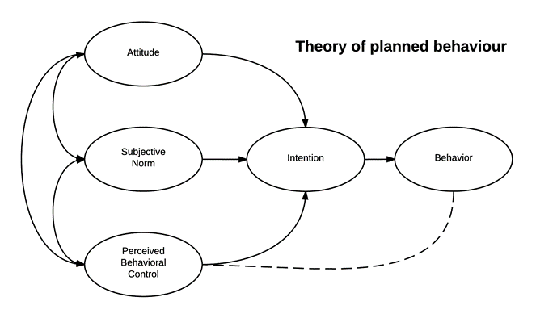
The Theory of Planned Behavior ICEK AJZEN (1991)
http://citeseerx.ist.psu.edu/viewdoc/download?doi=10.1.1.317.9673&rep=rep1&type=pdf , Accessed. 10/30/2020.

Slide 37
Changing Consumer Attitudes
Marketers have two choices for appealing/ addressing to consumer attitudes:
Attempt to produce consumer attitudes that will lead to the purchase of an existing product
Evaluate existing consumer attitudes and create or modify products to appeal to these attitudes

Slide 38
Modifying the Components of Attitude
Providing evidence of product benefits and correcting misconceptions/misunderstandings
Engaging/attracting buyers in new behavior
New technologies can also encourage consumers to change their attitudes

Slide 39
Learning
Knowledge or skill acquired as a result of experience, which changes consumer behavior
Most businesses underestimate how hard it is to change people’s behavior. There is an assumption built into most marketing and advertising campaigns that if a business can just get your attention, give you a crucial piece of information about their brand, tell you about new features, or associate their brand with warm and fuzzy (fluffy, warm) emotions, that they will be able to convince you to buy (…)
Your business will not succeed just by trying to change attitudes and preferences. You will succeed by helping people to develop goals, create plans, overcome temptations, manage their environment and engage with others. You will influence your customers only when you give them as much support as you would need to change your own behavior." (Markman, A. https://hbr.org/2014/02/dont-persuade-customers-just-change-their-behavior, Accessed. 10/30/2020).

Slide 40
Learning
Components of learning process:
Drive/impact - Fear, pride, greed, jealousy, hunger, thirst, comfort, and rivalry
Cue/clue - An object or signal in the environment that determines the nature of the consumer’s response to a drive
Response - Individual’s reaction to a set of cues and drives
Reinforcement/enhancement - Reduction in drive that results from a proper response

Slide 41
Applying Learning Theory to Marketing Decisions
Marketers use shaping/forming
Applying a series of rewards and reinforcements, to permit more complex behavior to evolve/change
Promotional strategy and the product itself play a role in the shaping process

Slide 42
The Shaping Process
Offer a free-sample package that includes a substantial discount for first purchase
Entice/temp the consumer to buy the item with little financial risk
Motivate the person to buy the item again at a moderate cost
Customer decides whether to buy the item at its true price without the discount coupon

Slide 43
Self-Concept Theory
Person’s multifaceted picture of himself or herself
Four components that influence purchasing decisions:
Real self
Self-image
Looking-glass self
Ideal self

Slide 44
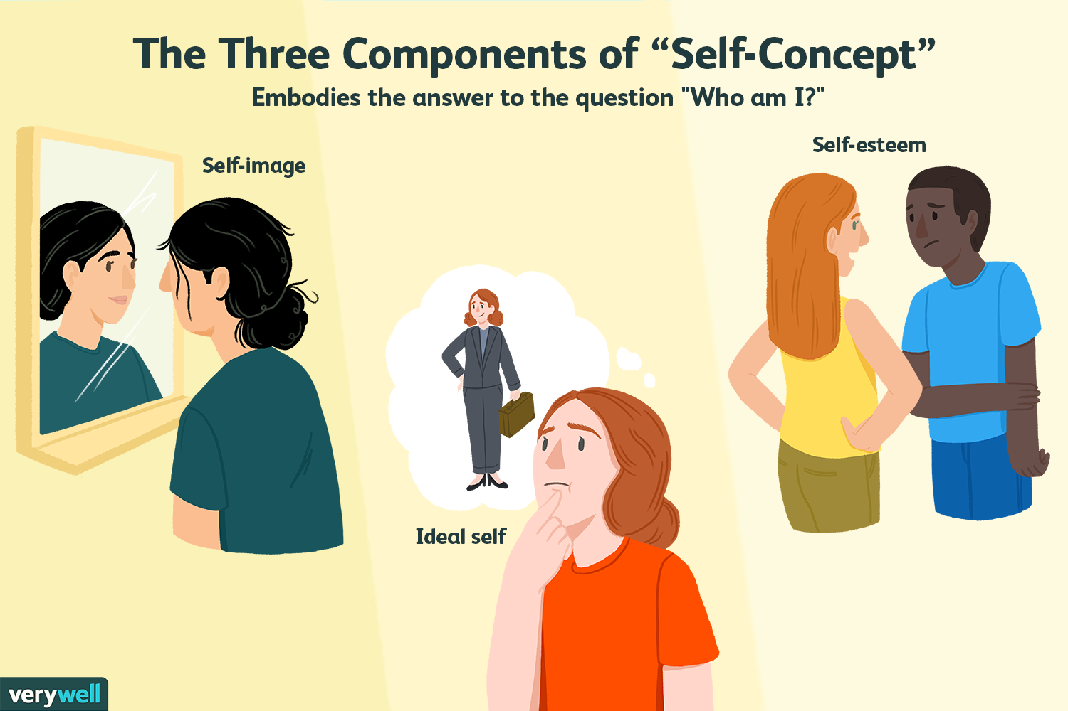
Self-concept Theory
"The individual's belief about himself or herself, including the person's attributes and who and what the self is" Baumeister (1999). Materialize!

Slide 45
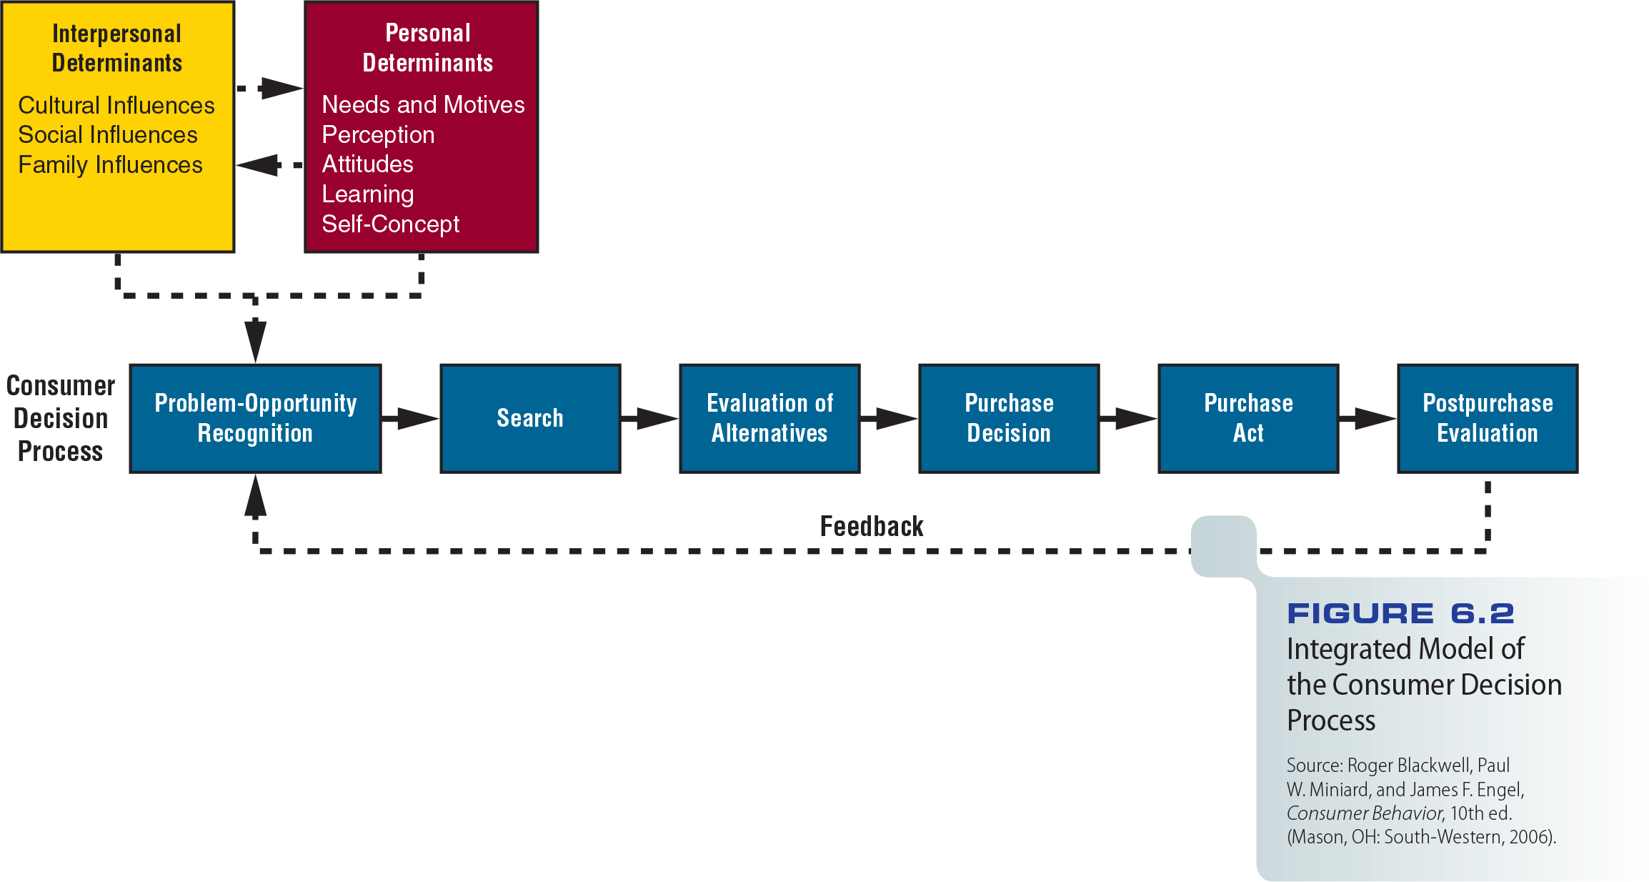
Figure 6.2 - Integrated Model of the Consumer Decision Process

Slide 46
The Consumer Decision Process
High-involvement purchase decisions
Purchases with high levels of potential social or economic consequences/outcomes. i.e. Car, TV, jewelry (bracelet, necklace, earring)
Low-involvement purchase decisions
Routine purchases that pose/bear little risk to the consumer. i.e. Chewing gum, bottled water, canned food etc.

Slide 47
Steps in the Consumer Decision Process
Consumer becomes aware of a gap/ absence between the existing situation and a desired situation
Consumer gathers information about the attainment/achieve of a desired state of affairs/situation.
Evoked/remind set - Number of alternatives that a consumer considers in making a purchase decision

Slide 48
Steps in the Consumer Decision Process
Consumer evaluates the evoked set of options and as the search progresses, the consumer accepts, distorts/misinterprets, or rejects
Evaluative criteria - Features that a consumer considers in choosing among alternatives
The consumer narrows the alternatives down to one
The consumer decides where or from whom to make the purchase

Slide 49
Steps in the Consumer Decision Process
Post-purchase evaluation – Buyer feels either:
Satisfaction at the removal/elimination of the discrepancy/gap between the existing and desired states
Dissatisfaction/dysphoria with the purchase
Cognitive dissonance - Imbalance among knowledge, beliefs, and attitudes that occurs after an action or decision, such as a purchase. Why seller persons in a shop say: "You have the best shoes in the shop." or "This shirt looks amazing on you sir." etc.???
Leon Festinger: (8 May 1919 – 11 February 1989) was an American social psychologist, perhaps best known for cognitive dissonance and social comparison theory.

Slide 50
Steps in the Consumer Decision Process
Dissonance is likely to increase:
As the dollar value of a purchase increases
When the rejected alternatives have desirable features that the chosen alternatives do not provide
When the purchase decision has a major effect on the buyer
Marketers can reduce cognitive dissonance by providing information that supports the chosen item

Slide 51
Classifying Consumer Problem-Solving Processes
Routinized response behavior
Consumer makes many purchases routinely by choosing a preferred brand or one of a limited group of acceptable brands
Limited problem solving
Consumer has previously set evaluative criteria for a particular kind of purchase but then encounters/faces a new, unknown brand

Slide 52
Classifying Consumer Problem-Solving Processes
Extended problem-solving results when brands are difficult to categorize or evaluate
Typical of high-involvement purchases

Slide 53
Strategic Implications of Marketing in the 21st Century
Cultural influences play a big role in marketers’ relationships with consumers
Family characteristics are changing
This forecasts a change in the way family units make purchasing decisions
What are the recent facts about changing family characteristics in Turkey???

Slide 54
Strategic Implications of Marketing in the 21st Century
Marketers:
Constantly work toward changing or modifying components of consumers’ attitudes to gain a favorable attitude and purchase decision
Refine/improve their understanding of the consumer decision process
Use their knowledge to design effective marketing strategies

Slide 55
Ski Butternut Video
http://www.cengage.com/marketing/book_content/boone_9781133628460/videos/ch06.html

