Slide 1
CHAPTER- 3 Structuring the Research Project

Slide 2
Structuring the Research Project
What information you collect and how you analyse it depends on the nature of the research problem, the central generating point of a research project.

Slide 3
THE RESEARCH PROCESS
The problem will generate the subject of the research, its aims and objectives,
and will indicate what sort of data need to be collected in order to investigate the issues raised,
and what kind of analysis is suitable to enable you to come to conclusions that provide answers to the questions raised in the problem.

Slide 4
The answers to four important questions underpin the framework of any research project:
What are you going to do?
The subject of your research.
Why are you going to do it?
The reason for this research being necessary or interesting.
How are you going to do it?
The research methods that you will use to carry out the project.
When are you going to do it?
The programme of the work.

Slide 5
THE RESEARCH PROBLEM
There is no shortage of problems throughout the world, but for a problem to be researchable, it needs to have several crucial features. It must be:
stated clearly and concisely;
significant i.e. not trivial or a repeat of previous work;
delineated, in order to limit its scope to practical investigation;
possible to obtain the information required to explore the problem;
possible to draw conclusions related to the problem, as the point of research is to find some answers.

Slide 6
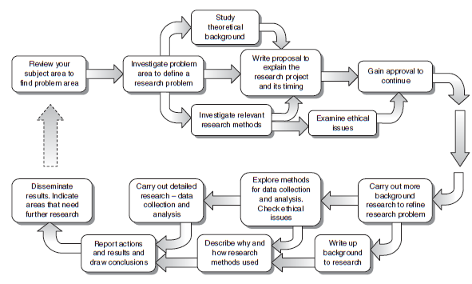
Structure of a typical research project, Walliman, 2011

Slide 7
A research problem
can be based on a question, an unresolved controversy, a gap in knowledge or an unrequited need within the chosen subject.

Slide 8
The different things you can do to split up the main question are to:
Split it down into different aspects that can be investigated separately, e.g. political, economic, cultural, technical.
Explore different personal or group perspectives, e.g. employers, employees.
Investigate different concepts used, e.g. health, wealth, confidence, sustainability.
Consider the question at different scales, e.g. The individual, group, organization.
Compare the outcomes of different aspects from the above ways of splitting down.

Slide 9
DEFINING THE RESEARCH PROBLEM
Question or Questions: Probably the simplest way to set up a research problem is to ask a question.
For example:
Main question: Are school exam results a true test of a student’s intelligence?

Slide 10
In this case the sub-questions could concentrate on:
What constitutes intelligence? (Investigating a concept, i.e. ‘intelligence’.)
What ways of testing intelligence are there? (Exploring different perspectives – i.e. other intelligence tests, and thus investigating the concept ‘test’.)
What sort of school exams are there and how are they marked? Investigating another concept – i.e. ‘exams’.)
How do school exam criteria match those of the criteria of other intelligence tests? (Split into aspects – in this case, criteria of exams and other intelligence tests.)

Slide 11
Note how all the sub-questions relate directly to the main question and break down the rather abstract question into practical questions that can be investigated individually and build up to an answer to the main question.

Slide 12
An example of this form of research definition is:
This study examines the problem of career development of women engineers in the automotive industry in Britain. It focuses on the identification of specific barriers (established conventions, prejudices, procedures, career paths) and explores the effectiveness of specific initiatives that have been aimed at breaking down these barriers.

Slide 13
HYPOTHESES
The research problem in research projects that use the hypothetico-deductive method is expressed in terms of the testing of a particular hypothesis.
Hypotheses are nothing unusual.
Reasonable guesses can be expressed in the form of statement. This is a hypothesis.
A good hypothesis is a very useful aid to organizing the research effort, but it must have certain qualities.
It must be a statement that can be put to the test.
It must specifically limit the enquiry to the interaction of certain factors.

Slide 14
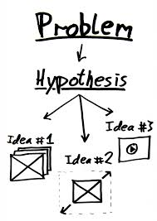
So, to express the above example of a research question in the form of a hypothesis it would need to be written simply like this as a statement:
School exam results are a true test of a student’s intelligence.

Slide 15
Operationalization
One of the fundamental criteria of a hypothesis that it is testable but formulated on a conceptual level cannot be directly tested; it is too abstract.
It is therefore necessary to convert it to an operational level. This is called operationalization.

Slide 16
PROPOSITIONS
Focusing a research study on a set of propositions, rather than on a hypothesis, allows the study to concentrate on particular relationships between events, without having to comply with the rigorous characteristics required of hypotheses.
The first proposition is a statement of a particular situation, which is then followed with further propositions that point out factors or events that are related to it and ending with one that indicates a conclusion that could be drawn from these interrelationships.

